Slide 1
CRA Annual Report Worksheet
A how-to Presented by the palmetto community redevelopment agency

Slide 2
Disclaimer
These materials, workbook, presentation, and walkthrough video, are made available by the Florida Redevelopment Association for educational purposes only, and are not meant to be relied on as legal advice. We make no guarantees as to the accuracy of the information provided. By using these materials, you confirm that there is no attorney-client relationship between you and the Florida Redevelopment Association. The materials should not be used as a substitute for competent legal advice from a licensed attorney.

Slide 3
Goals
The goals of this workbook include the following;
Discover & utilize existing data sources,
Easily incorporate the existing data,
Create a user friendly, consistent & uniform state-wide reporting tool, & finally,
Give each CRA the opportunity to produce a high-quality annual report that meets the new State requirements while minimizing the amount of necessary labor.

Slide 4
Background
Florida law related to the reporting requirements for Community Redevelopment Agencies was amended in 2019, within CS/HB 9, or Chapter No. 2019-163.
Among other things, this statutory change included a new section of law, Chapter 163. 371, which expanded the list of information which must be included in one of the many reports required of CRAs in Florida.
This report is sent to the local governing body and is posted for the public every March 31. There is no requirement to send it to any state agency, but in fact, includes information obtained from the state.
This CRA “local” annual report due each March 31 is not new.
Compliance with this NEW statutory section is still (post 2019) very open as to the format, style and information that a CRA chooses.
The statutory list is only a MINIMUM.
Many CRAs over recent years included this new information already, and they can be viewed here: https://redevelopment.net/cra-resources/reporting-requirements/.
In the meantime, this template is designed for all CRAs in Florida to use as a tool to summarize the statistics and numbers relevant to your CRA for the 2018-19 fiscal year. The statutory requirements under Chapter 163, Part III apply to the CRA fiscal year (OCT 1 - SEPT 30) prior to the March 31 report deadline.

Slide 5
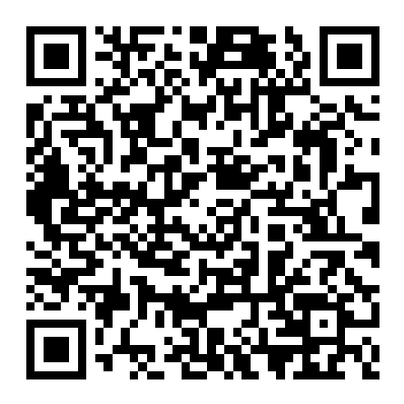
Locating & OPENING the workbook
PLEASE, DOWNLOAD OR SAVE A COPY BEFORE YOU START ENTERING INFORMATION.
Please, follow the link below or scan the QR code
https://1drv.ms/x/s!ApT1jvWt0Y9aiX6R7NLjyt7KiVXl?e=XGyqTo

Slide 6
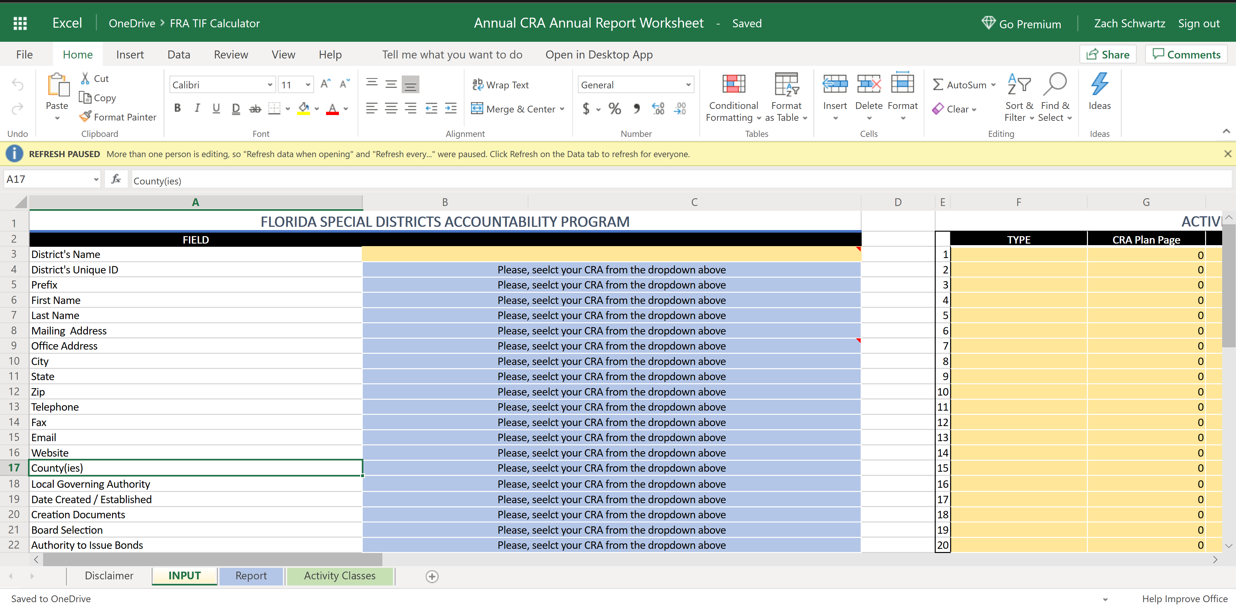
Saving the workbook
If you have Office on your computer, you can click here to open the workbook on your computer & save it as you would any other file.
Clicking on ‘File’ will lead you to the next slide

Slide 7
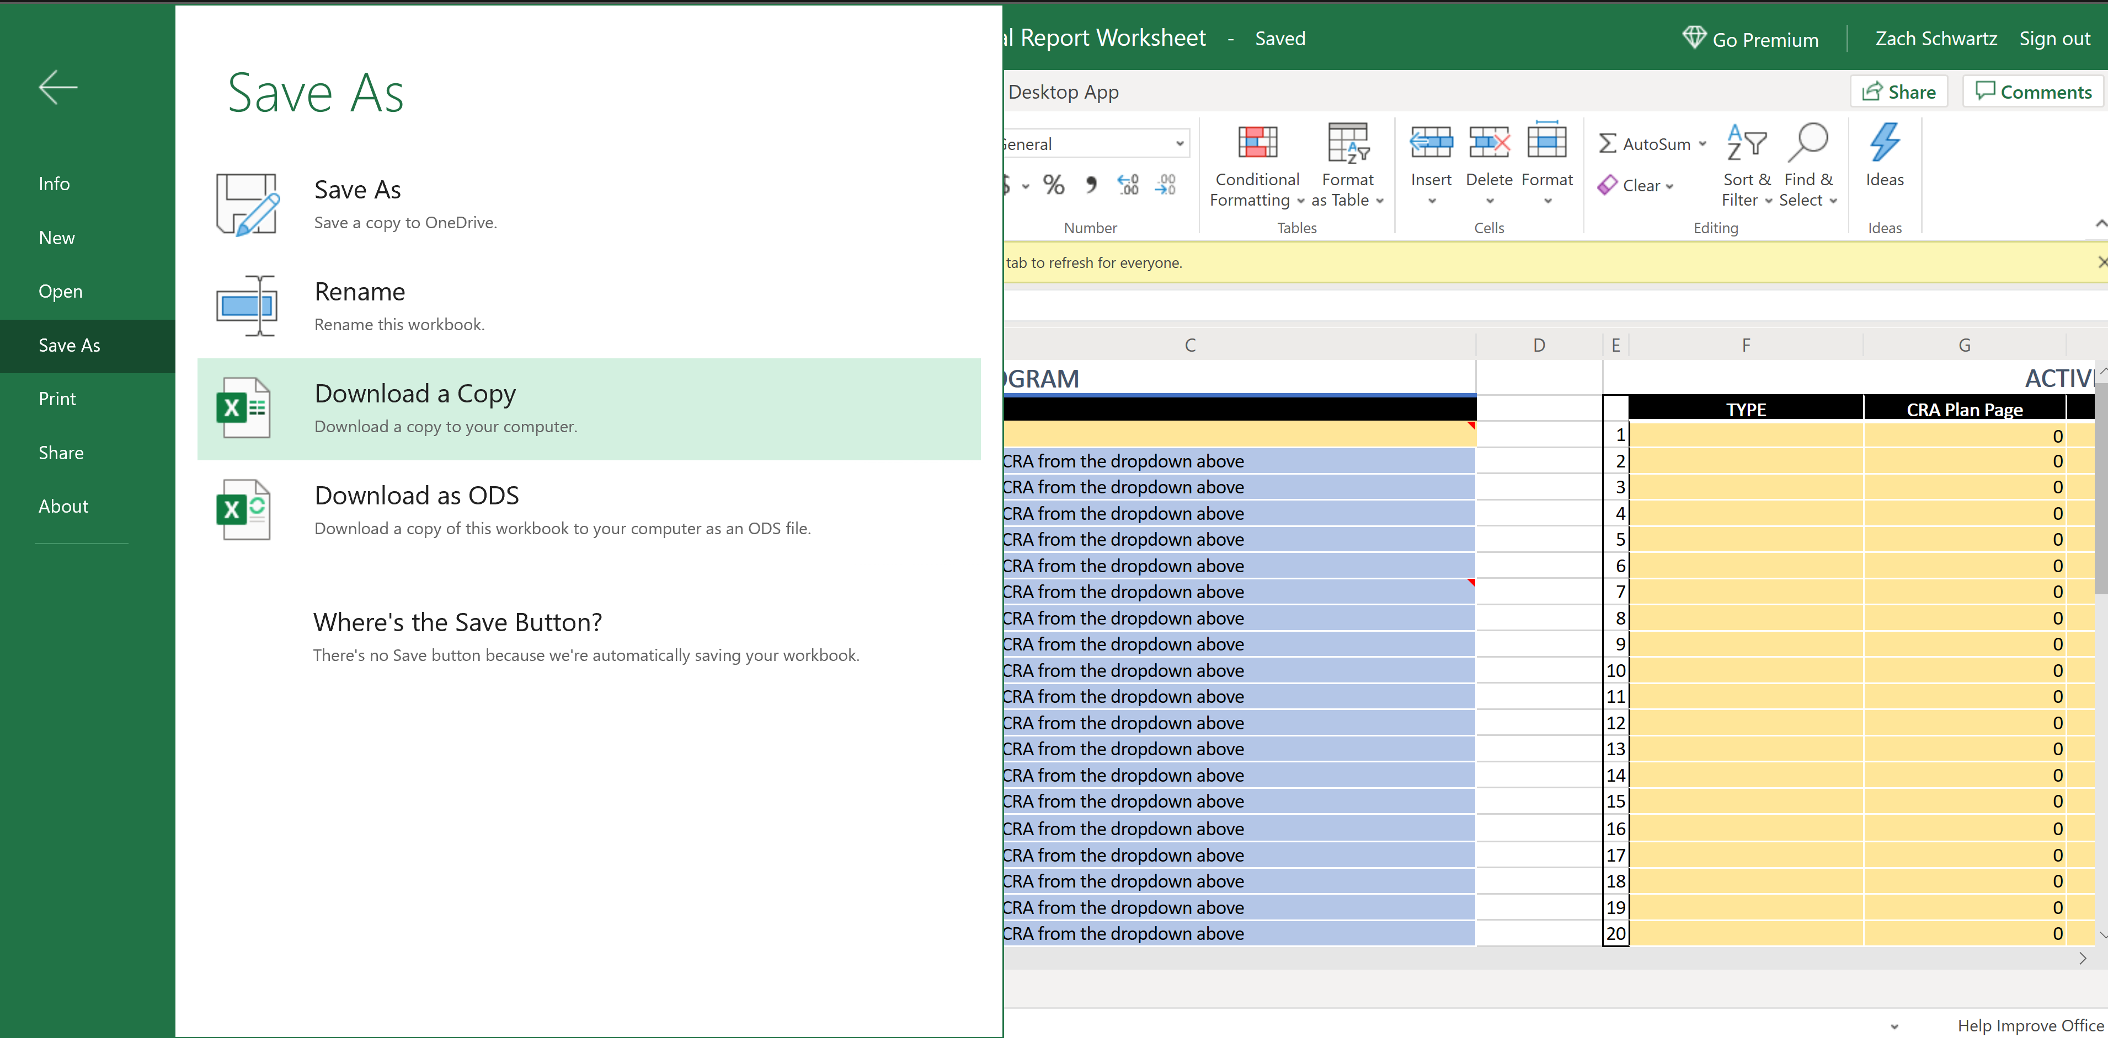
Saving the workbook
This is where you would save & rename a copy for yourself or download a copy to your computer.
PLEASE SAVE OR DOWNLOAD A COPY TO YOUR COMPUTER BEFORE MAKING ANY CHANGES!

Slide 8
FEATURES
FLORIDA SPECIAL DISTRICTS ACCOUNTABILITY PROGRAM
AKA District’s Information
Pulled from FDEO Special District data
FINANCIALS
Partial manual entry & partial calculation
ACTIVITIES
Manually entered
Combination of Projects & Programs
REPORT
Calculated from INPUT tab with charts automatically calculated from INPUT tab
Can be edited as desired in Excel or manually exported to PDF or HTML
HTML can then be opened in Microsoft Word for additional editing
Newer versions of Word can import/open PDFs

Slide 9
Exporting & printing
Methods will vary depending on which version of Microsoft Office you are running
Export to PDF (Office 365): File → Export → Create PDF / XPS
Export to HTML for import into Microsoft Word or preferred document editing software
While on Report tab → File → Save a Copy → File Type Dropdown → Web Page (*.htm, *.html)
Office 365 desktop Word application can import PDFs: Start Word → Open file → Navigate to PDF Report

Slide 10
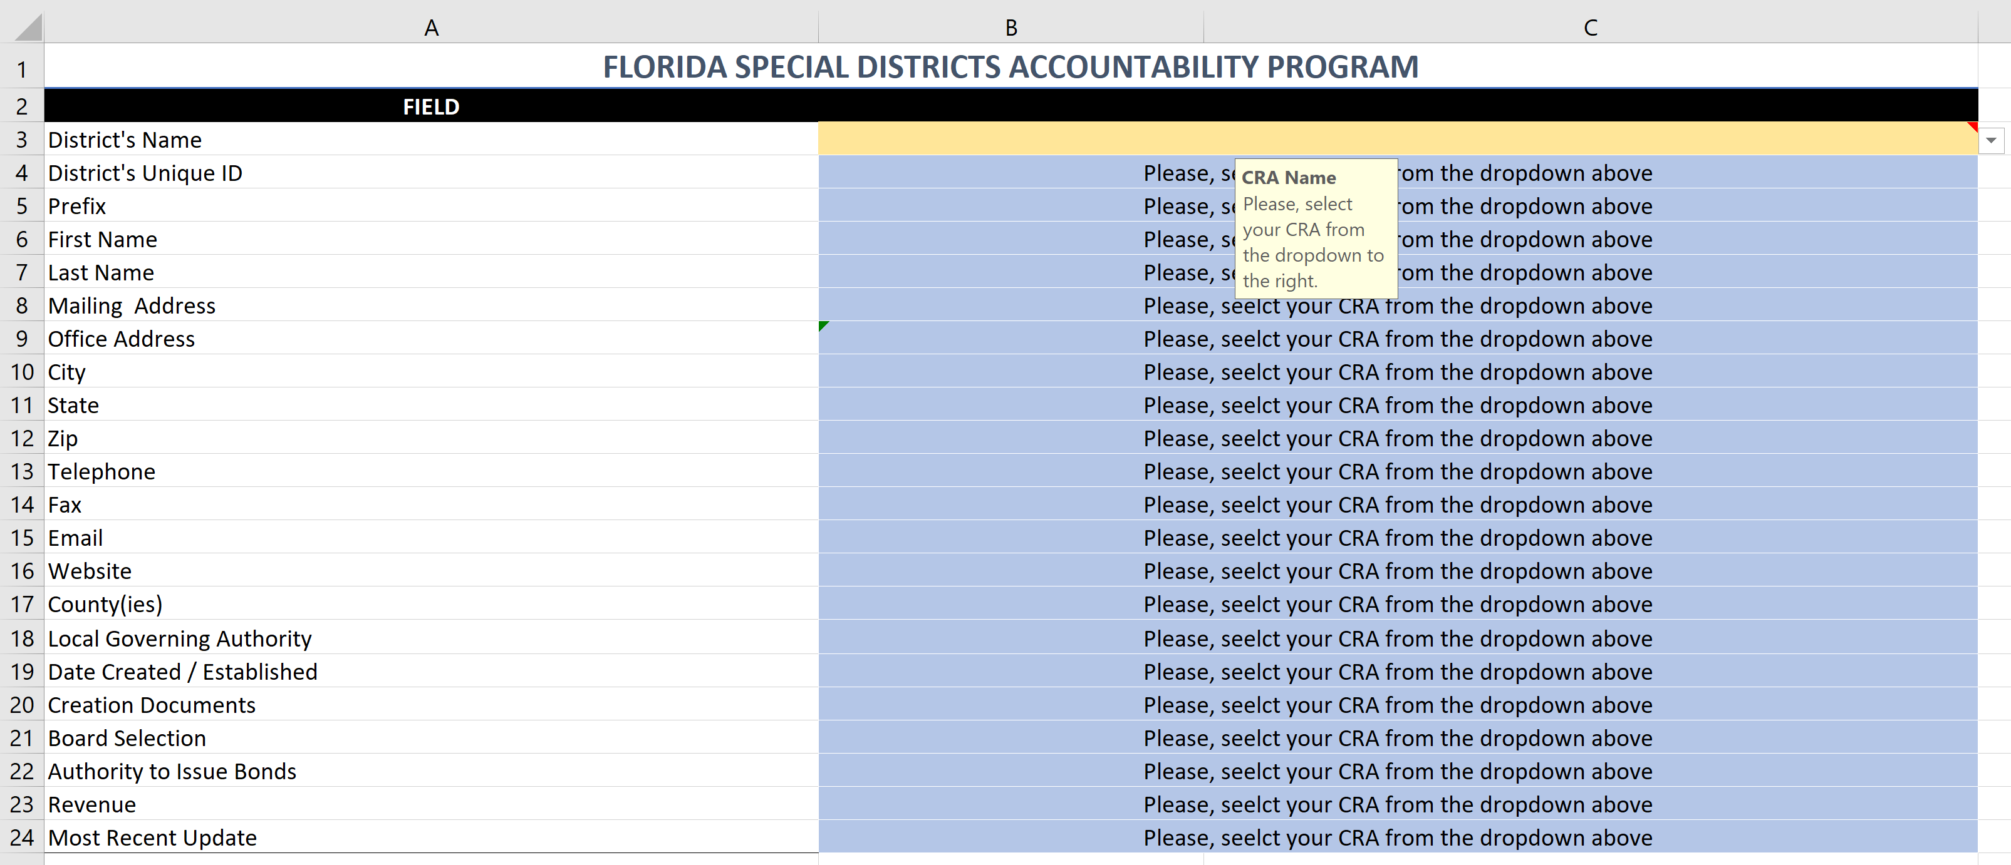
WALKTHROUGH (CRA info)
Field Note
Fillable
Dropdown
Calculated

Slide 11
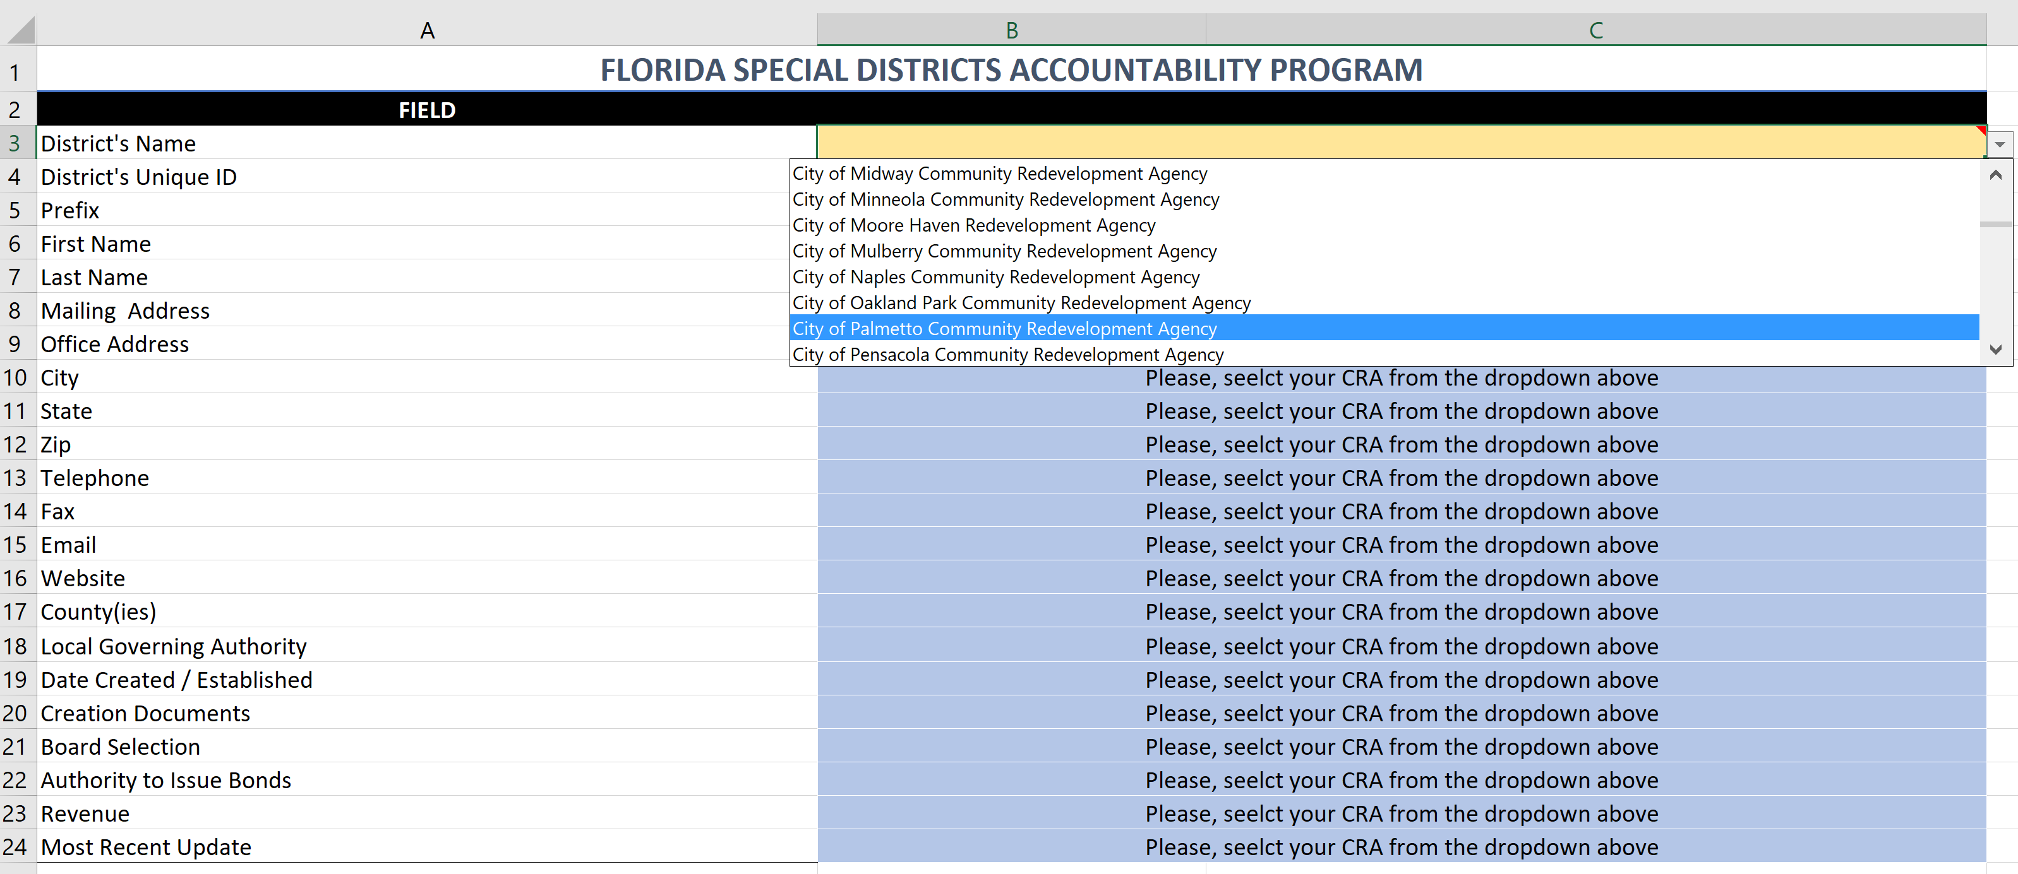
WALKTHROUGH (CRA info)

Slide 12
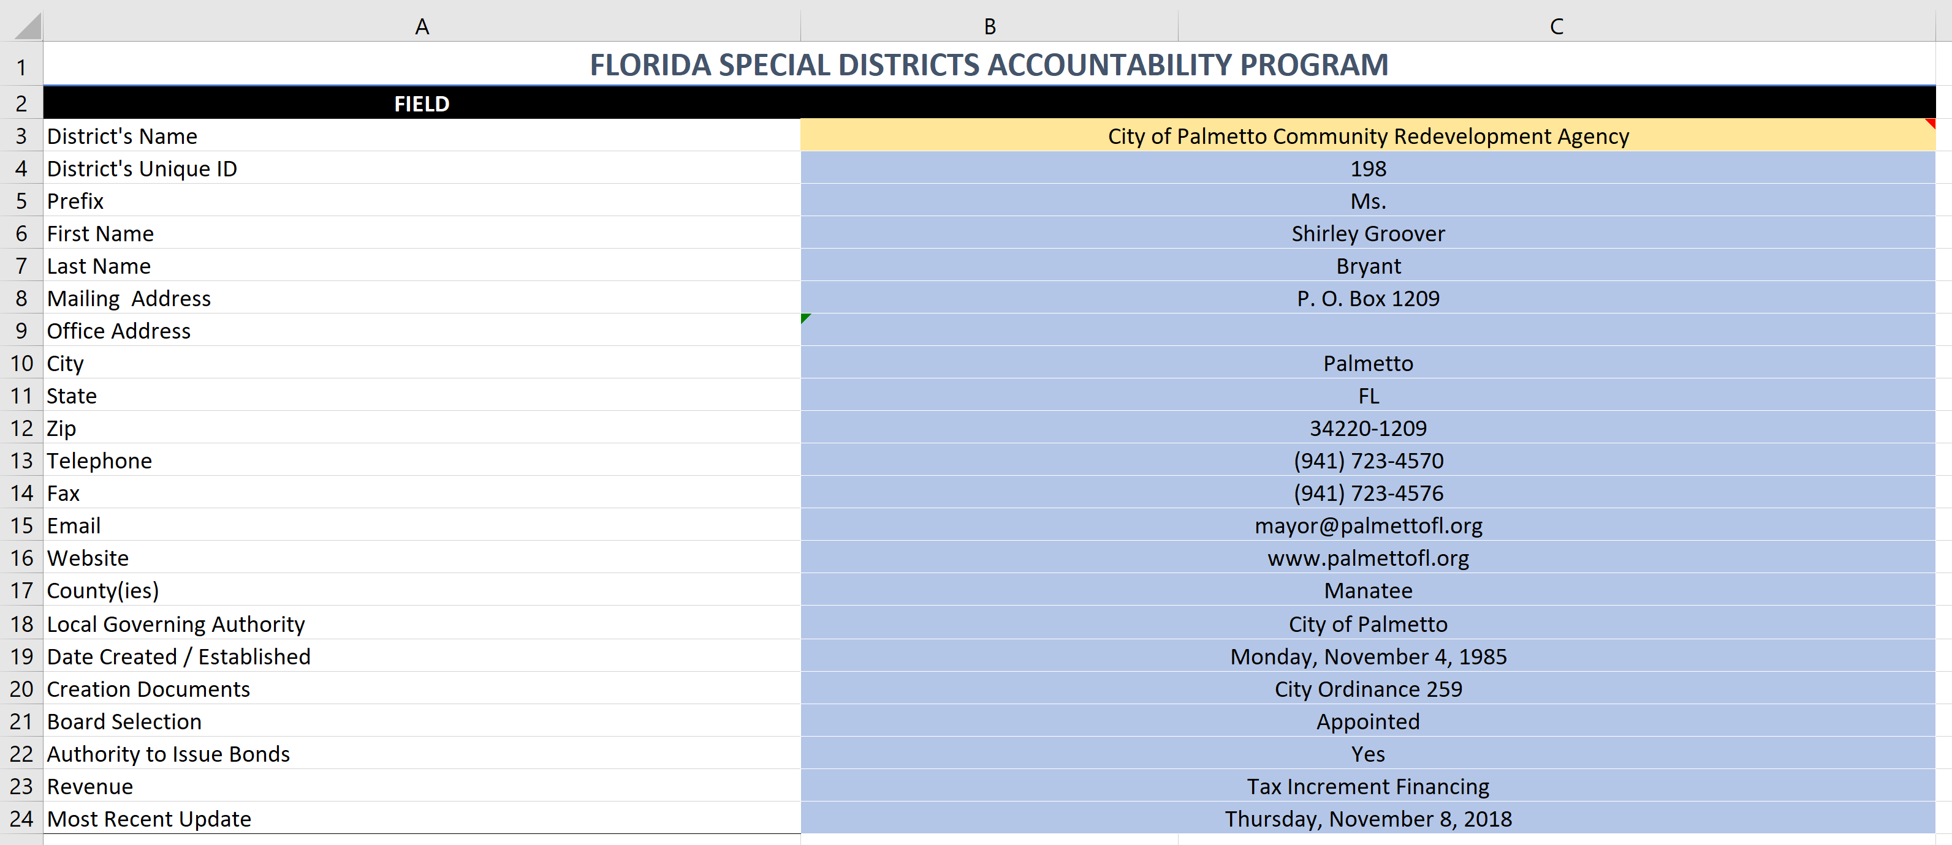
WALKTHROUGH (CRA info)

Slide 13
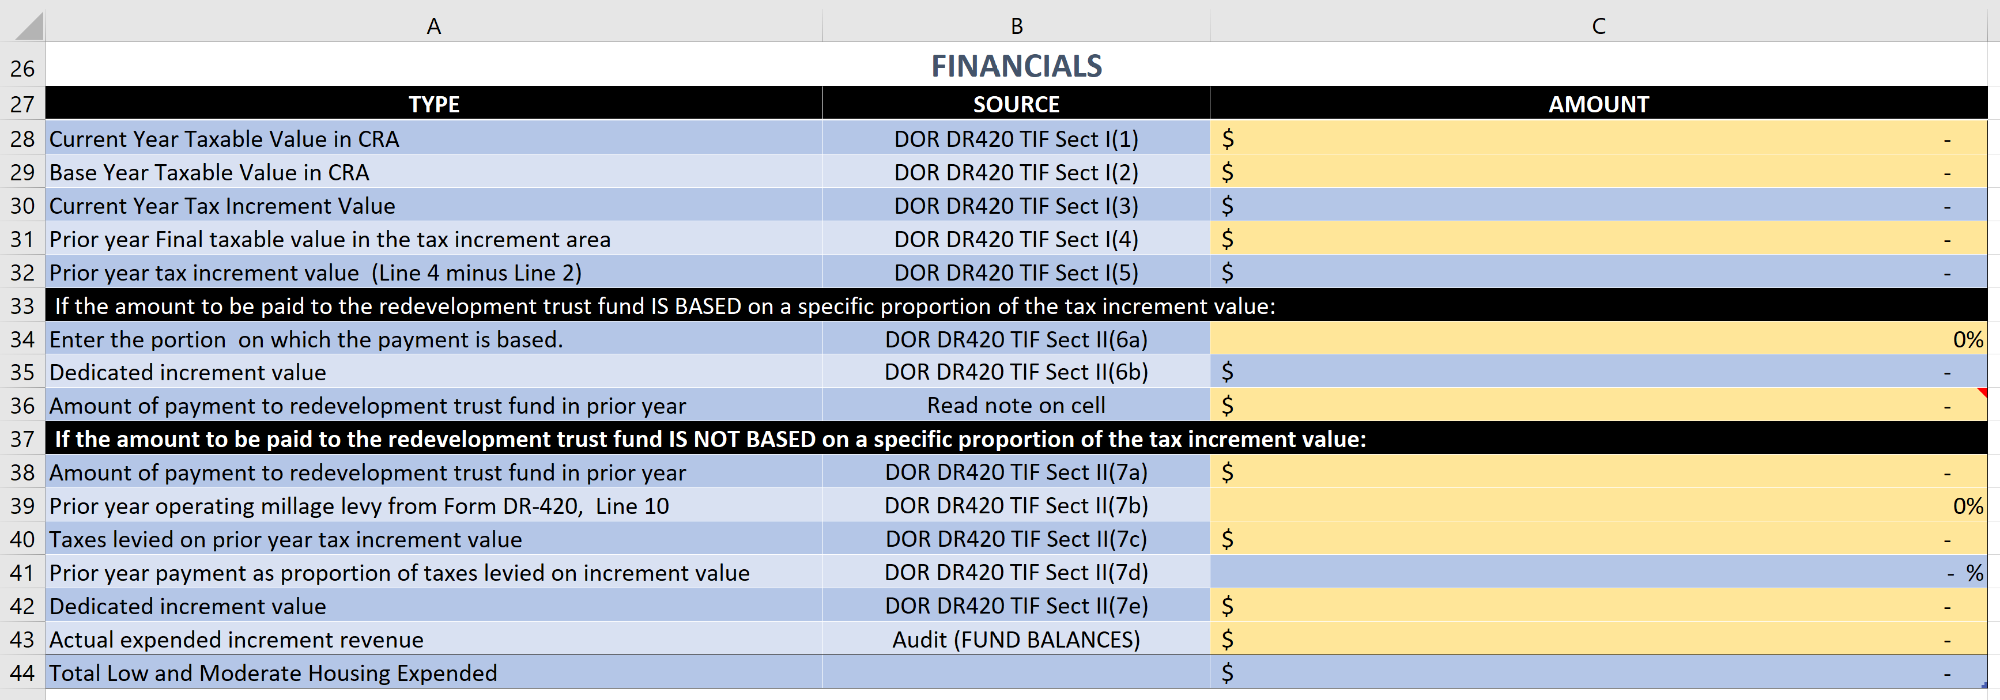
WALKTHROUGH (FINANCIALS)
Field Note
Description
Source
Document
Blue = Calculated, Yellow = Input

Slide 14
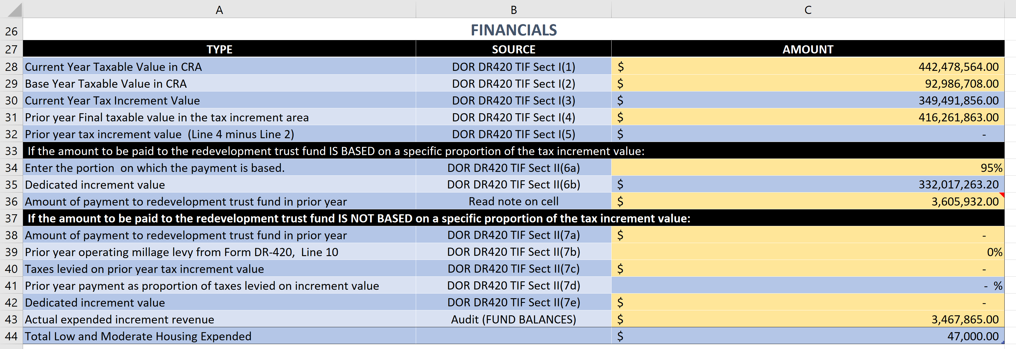
WALKTHROUGH (FINANCIALS)
Field Note
Pulled from ‘Activities’ table
Description
Source
Document
Blue = Calculated, Yellow = Input

Slide 15
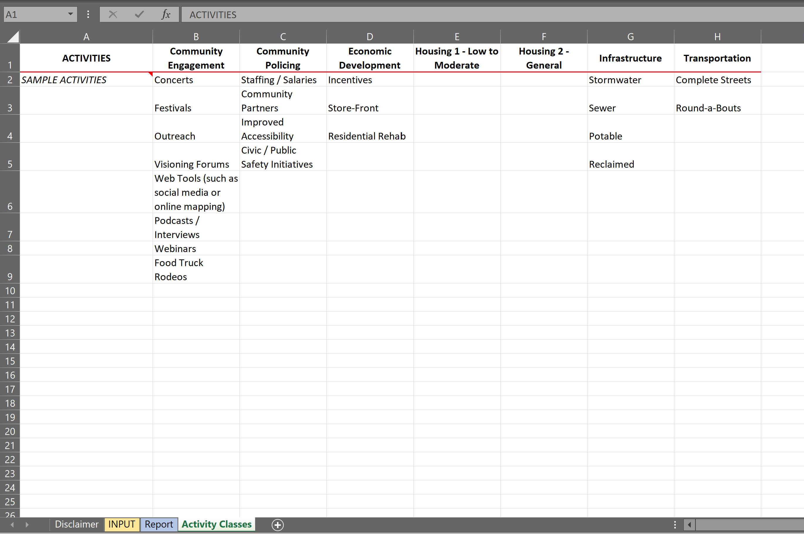
WALKTHROUGH (ACTIVITIES)
The Activity Classes tab serves to provide examples of typical CRA projects & programs. Each sample activity appears in the same column as the Activity category they would fall under. This list is a work in progress & is intended to serve as guide rather than a definitive listing.

Slide 16
Low to Moderate Housing definitions
A low-income person is someone whose total annual income is 50% or less of the AMI or average income for the community where they live. That means if the AMI is $60,000, you need to make less $30,000 a year to be considered low-income.
A moderate-income person is someone whose total annual income is above 50% but less than 80% of the AMI or average income for the community where they live. That means, if the AMI is $60,000, you would need to make between $30,001 and $48,000 a year to be considered moderate-income.
source
Notes:
Source: https://www.ecfr.gov/cgi-bin/text-idx?SID=d4ebf029aa7ade35dfb94a2ac306401b&mc=true&node=pt12.1.25&rgn=div5#se12.1.25_112

Slide 17
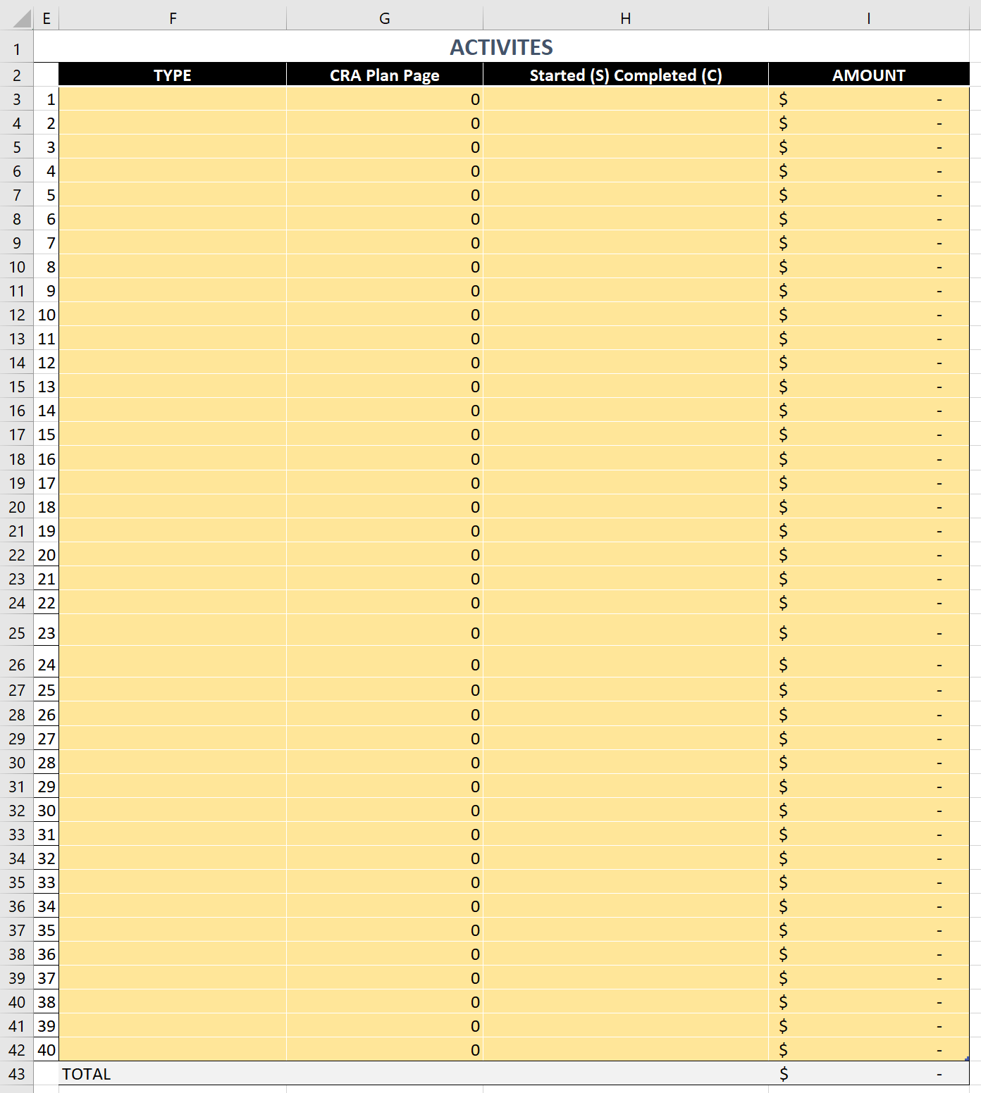
WALKTHROUGH (ACTIVITIES)
Activity Type*
Activity dollar ($) amount
CRA Plan Page
Started (S) or Completed (C)
Pulled from your CRA plan, the ‘Activities’ table serves to highlight your CRA’s achievements. This table is used to create the Achievements section of the report.
Activity Total – The Total for the Activity Table is automatically calculated with the dollar amount for ‘Housing - Low to Moderate’ pulled into the Financials table (cell C44). See slide 16 for definitions of Low to Moderate Housing
* See the ‘Activity Classes’ tab (slide 11 in presentation / green colored tab in workbook) for additional information regarding which types (classes) of activities fall into which Activity Type Categories

Slide 18
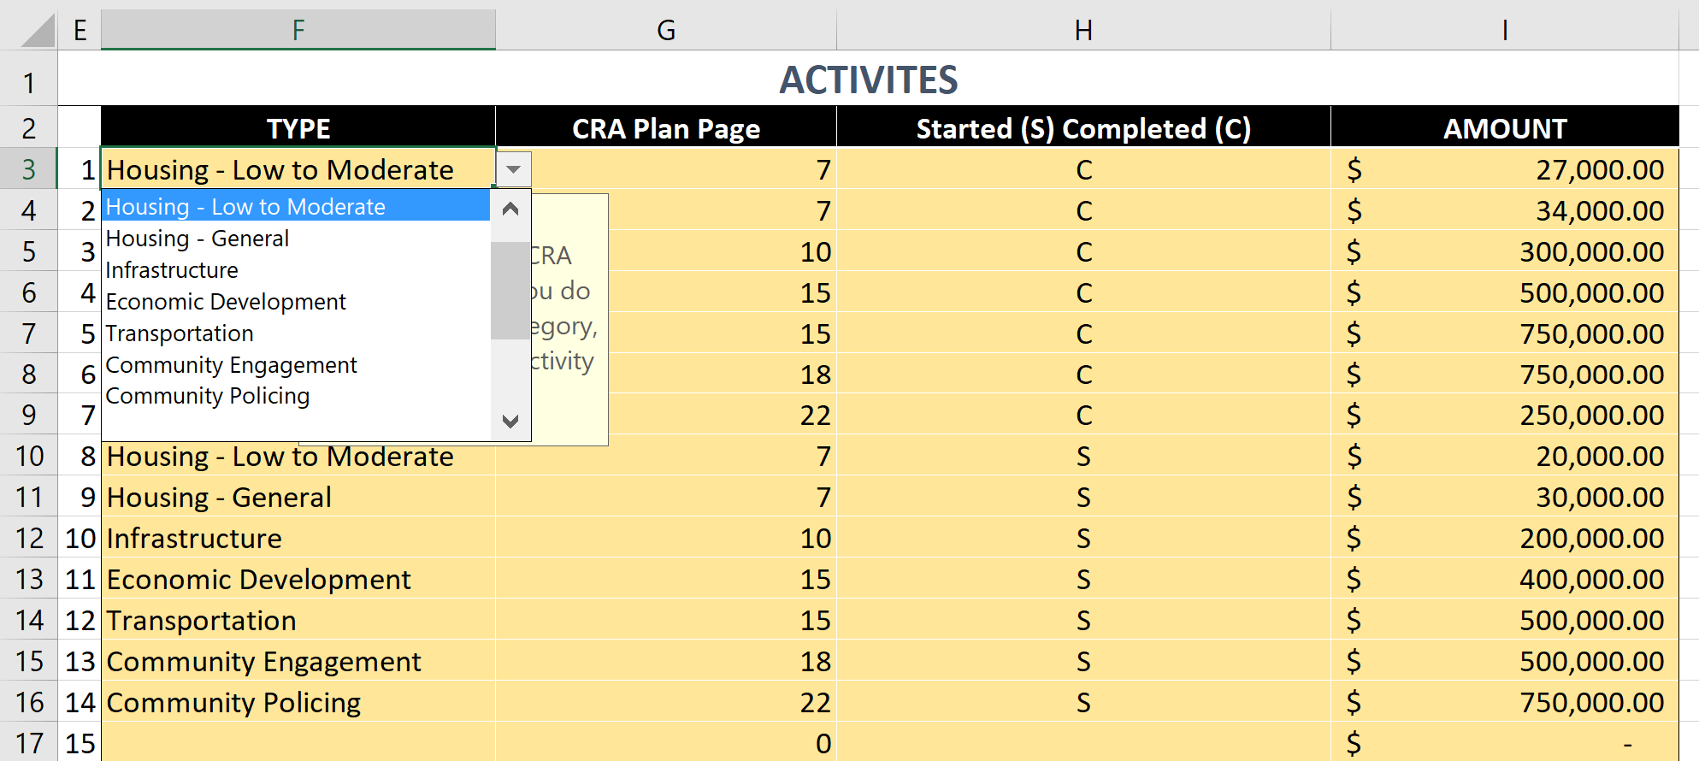
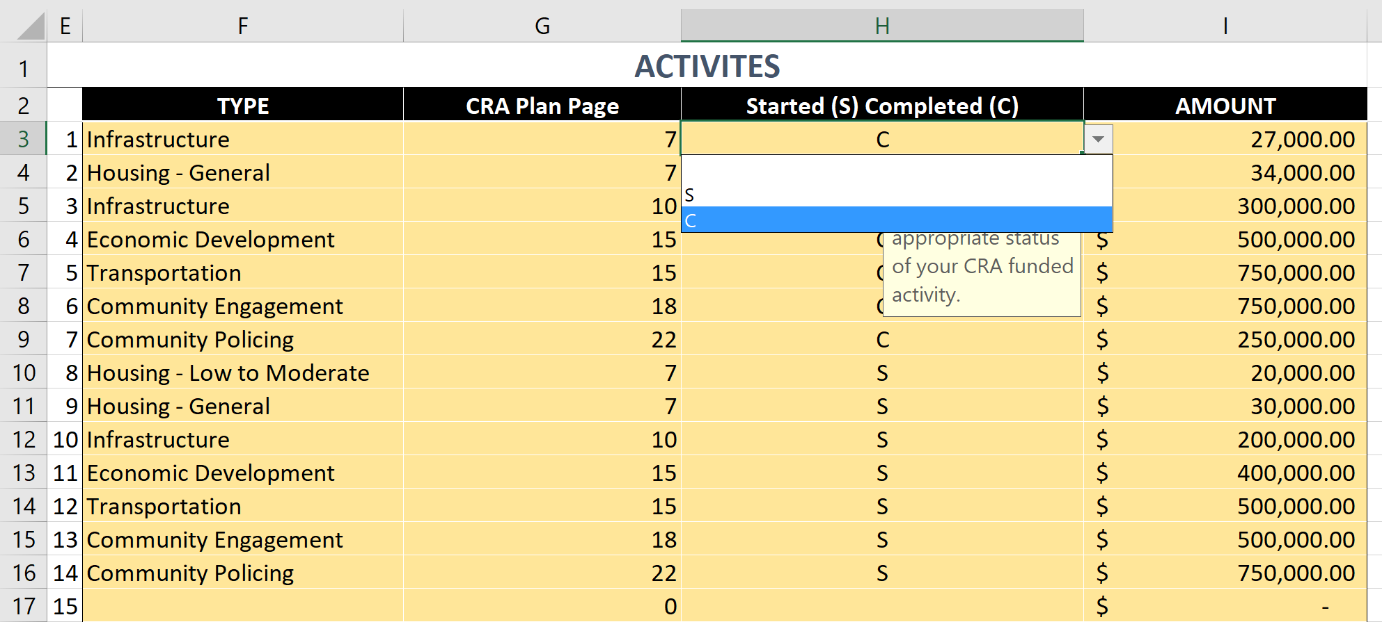
WALKTHROUGH (ACTIVITIES)
Dropdown – Activity Type
Dropdown – Started (S) or Completed (C)

Slide 19
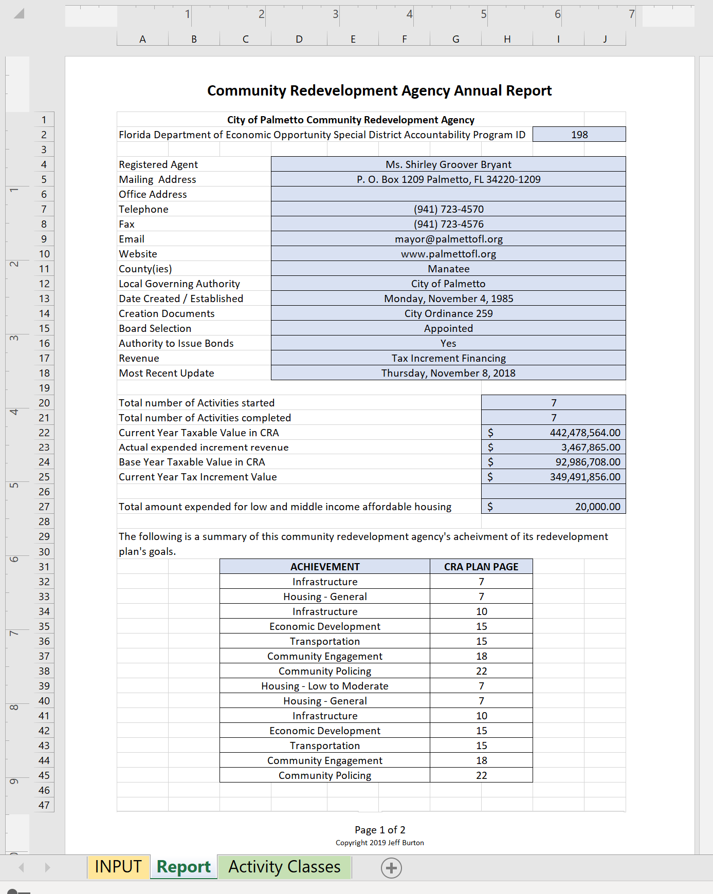
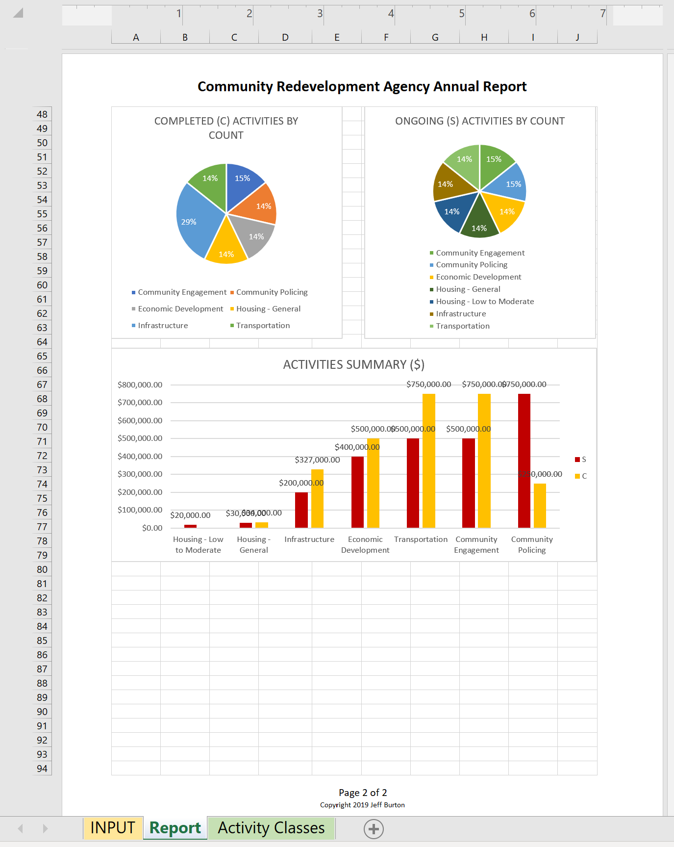
WALKTHROUGH (ACTIVITIES)
Once refreshed, the manually entered Activities from the INPUT tab are automatically used to create the pie & bar charts
The “Achievements’ section of the report pulls the manually entered Activities from the INPUT tab & counts the number of each Activity type

Slide 20
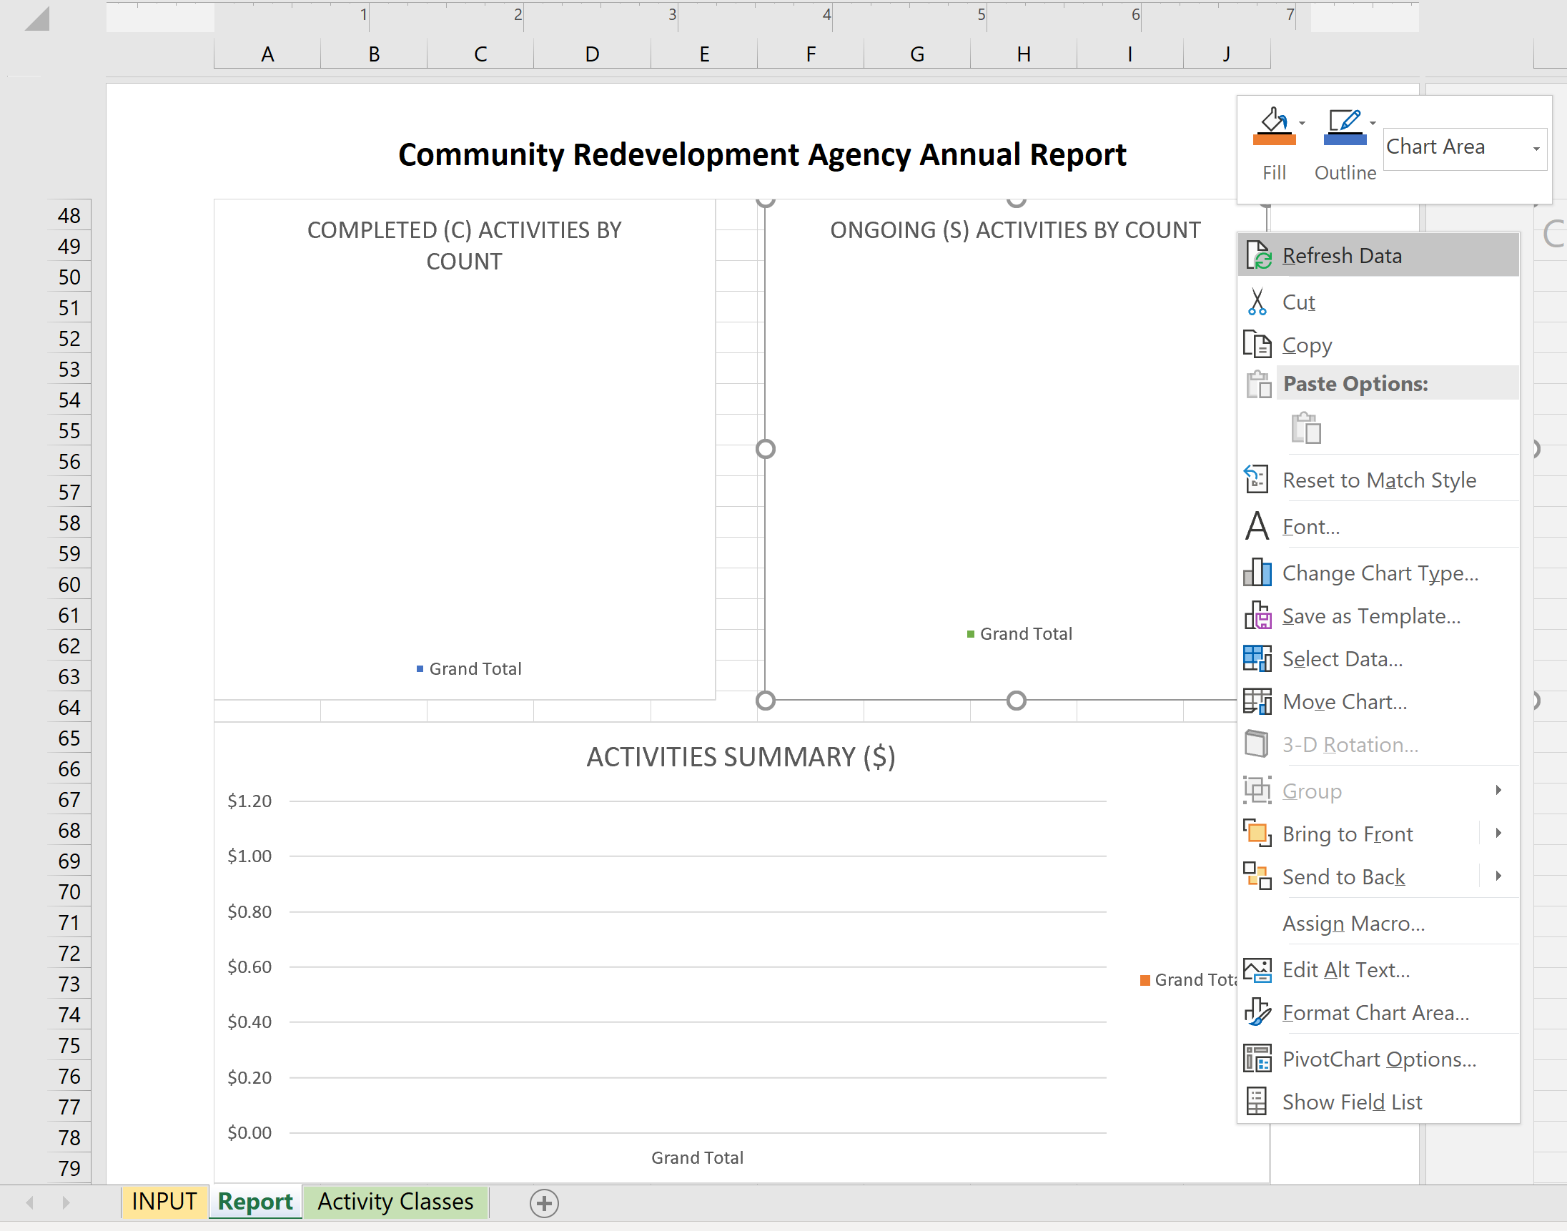
WALKTHROUGH (print/export)
Be sure to refresh each chart to reflect your manually entered data:
On the Report tab, right click in the chart → left click on ‘Refresh Data’
Tailoring charts can be done on the Report tab.
Chart troubleshooting can be done through the parent pivot tables on the Charts tab which is hidden by default.

Slide 21
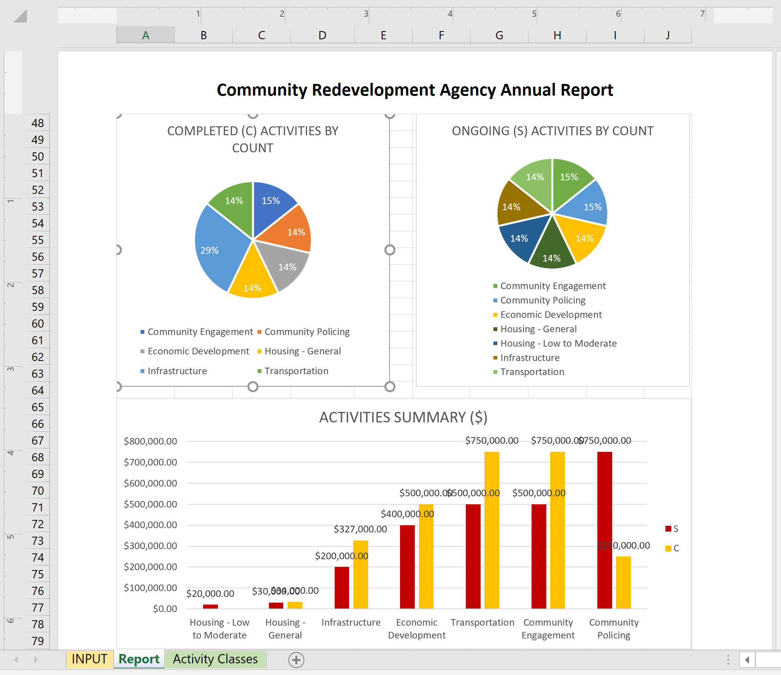
WALKTHROUGH (print/export)
Be sure to tailor each chart to reflect your personal preferences. This includes:
Plot Area location
Legend
Labels
Color palette
Tailoring each chart can be done by right-clicking in the chart element & selecting the desired settings from the sidebar on the right.

Slide 22
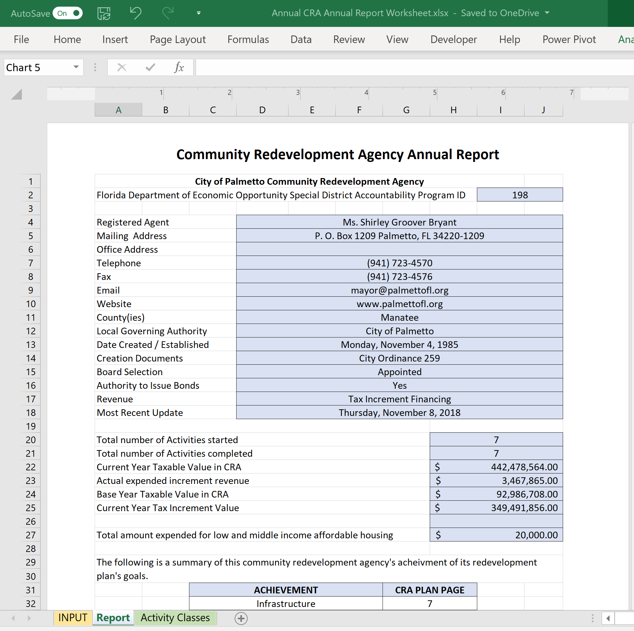
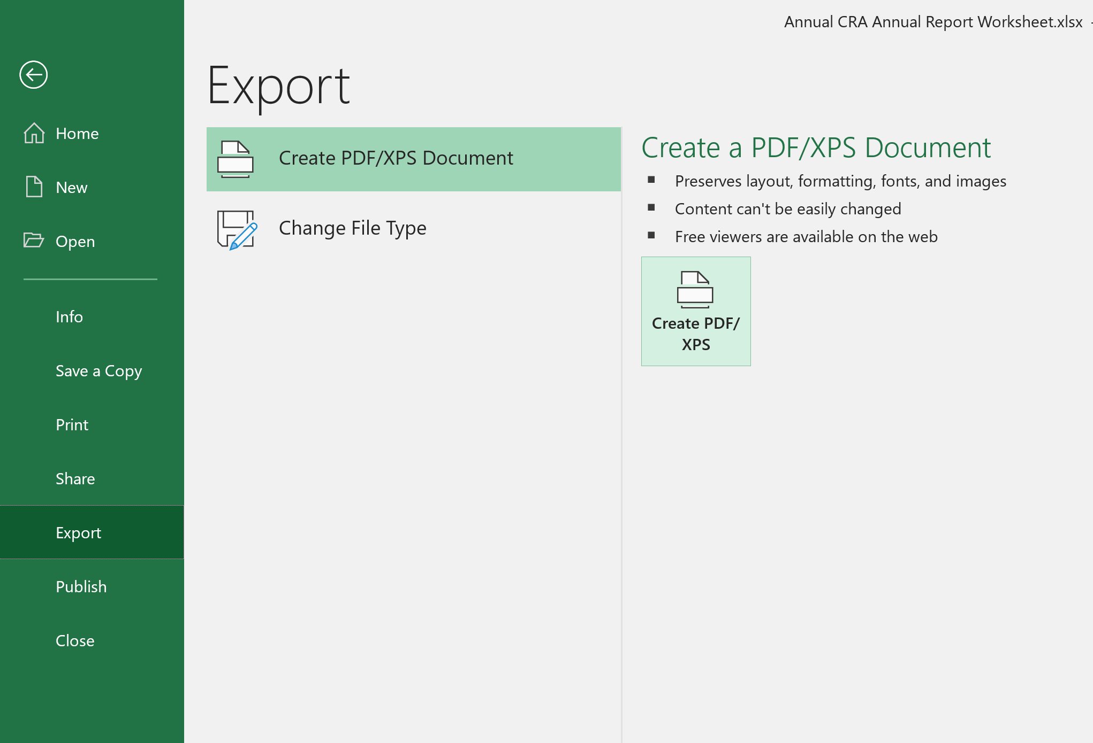
WALKTHROUGH (print/export)
Export to PDF (Office 365): File → Export → Create PDF / XPS

Slide 23
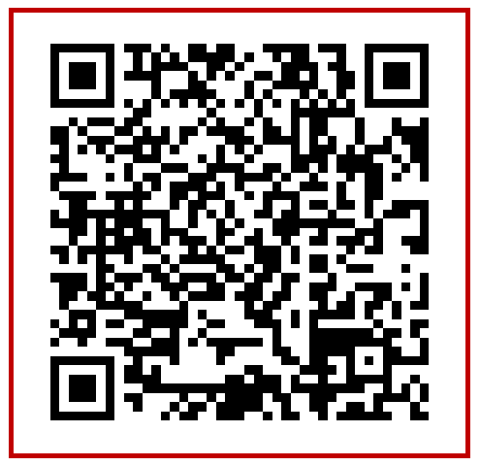
WALKTHROUGH (print/export)
Example Report:
Document
Link
https://1drv.ms/b/s!ApT1jvWt0Y9aihAZEVdE4ezg6nMg?e=HJ1gvt
QR code

Slide 24
WALKTHROUGH (video)
Notes:
Direct link - https://youtu.be/XwPN76U2bYw

Slide 25
Maintenance, customization, & updates
Updating CRA listing (hidden tab)
Annual update or as requested
To update your CRA contact information, see the Contact Info slide
Macro-enabled worksheet
Print to PDF button
Update CRA listing button
Feature Requests & Additions
Distributing INPUT tab tables, Contact Info, Financials, & Activities, across multiple separate tabs to accommodate larger counties with multiple CRAs or other special use cases.
Any other feature requests can be direct to the FRA contact on the Contact Info slide

Slide 26
Resources
FL Redevelopment Association (FRA) summary of CS/HB 9 https://my.redevelopment.net/2019-summary-of-cra-legislation-cs-hb-9/ bill analysis and text https://www.flsenate.gov/Session/Bill/2019/9
Florida Department of Economic Opportunity (FDEO)
FEDO Special District Accountability Program - http://floridajobs.org/community-planning-and-development/special-districts/special-district-accountability-program
Dept. Financial Services annual reports - https://apps.fldfs.com/LocalGov/Reports/
Special District Resources and Contacts - http://www.floridajobs.org/community-planning-and-development/special-districts/special-district-accountability-program/special-district-resources-and-contacts#afr
FDEO Special District Reports - http://specialdistrictreports.floridajobs.org/webreports/createspreadsheet.aspx
DR-420TIF - https://floridarevenue.com/property/Documents/dr420tif.pdf
Statewide CRA web map - https://arcg.is/0mbDWy

Slide 27
Contact info
For any questions, requests, or maintenance please contact Carol Westmoreland
CWestmoreland@flcities.com
To update your CRA’s contact information, please contact Jack Gaskins
Jack.Gaskins@deo.myflorida.com

