Slide 1
FRA Awards 2020
Discover Downtown – Reimagining Downtown Orlando Information Center
“Outstanding Renovation Project”
City of Orlando, Community Redevelopment Agency

Slide 2
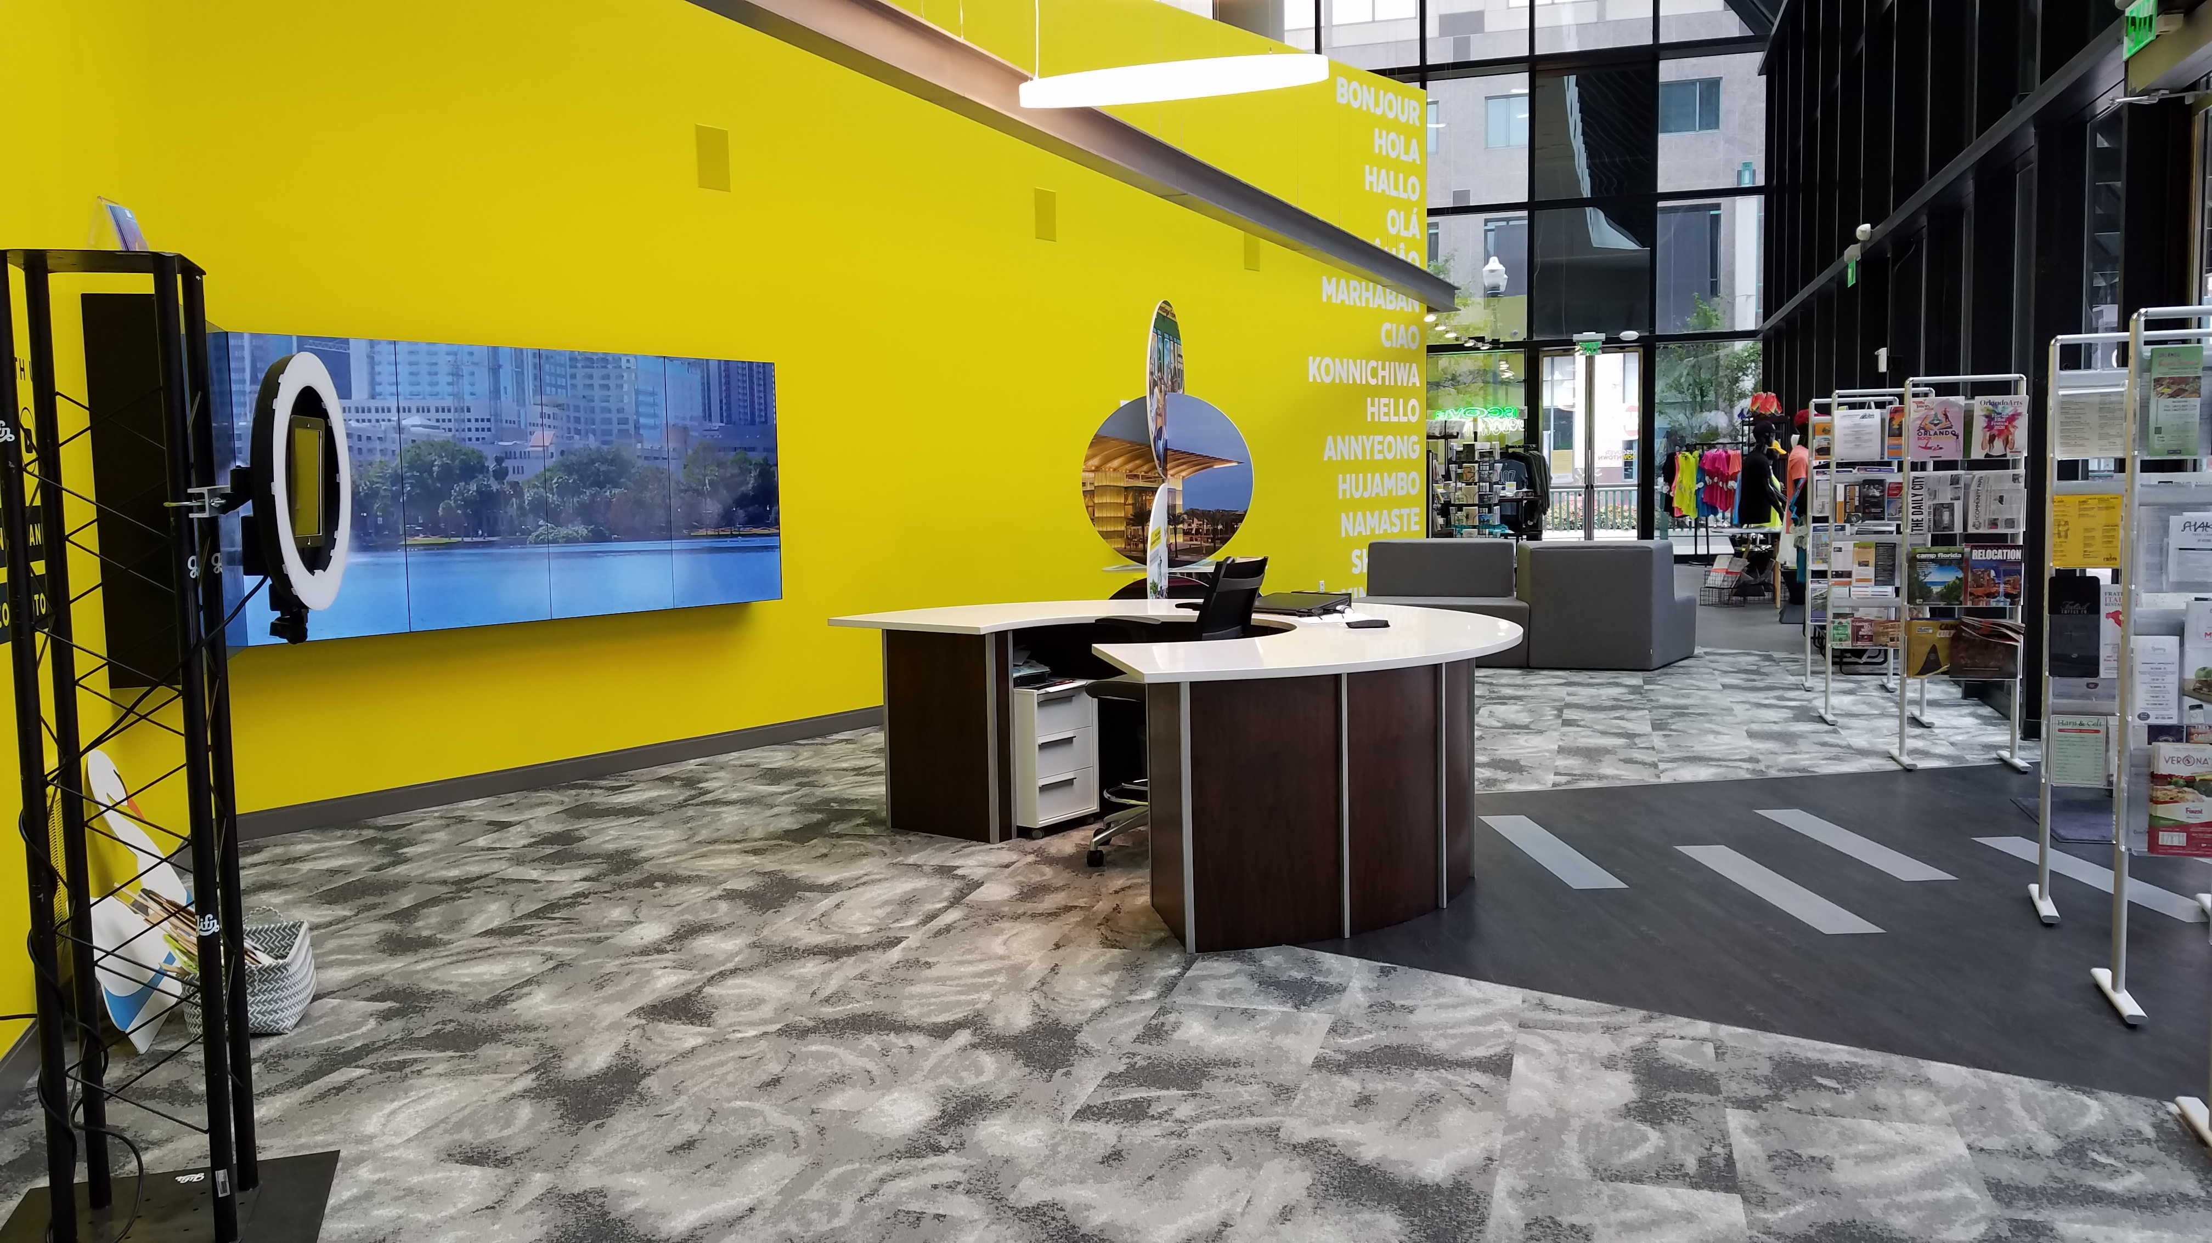
Discover Downtown
View of Welcome Area and Multimedia

Slide 3
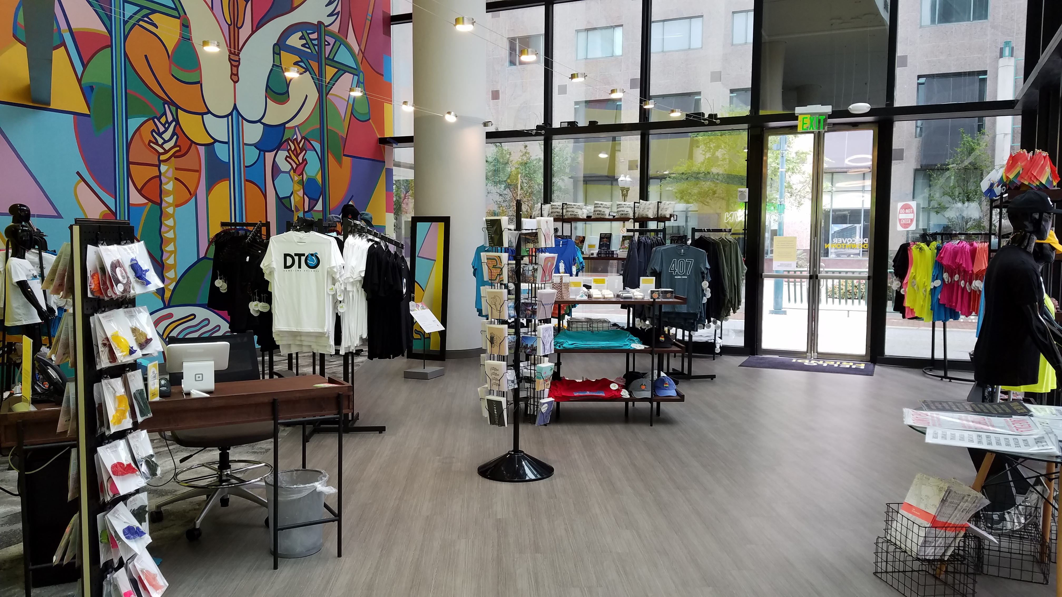
Discover Downtown
Retail Area and Virtual Reality Accessible Boy Kong Mural

Slide 4
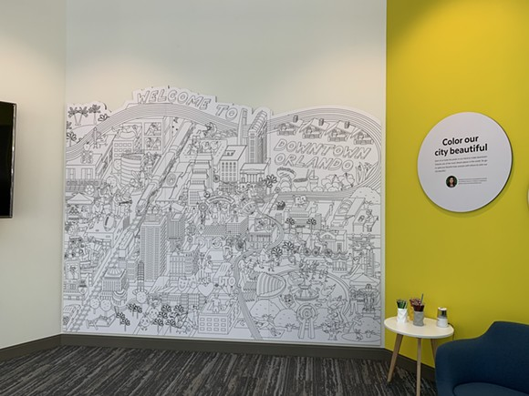
Discover Downtown

Slide 5
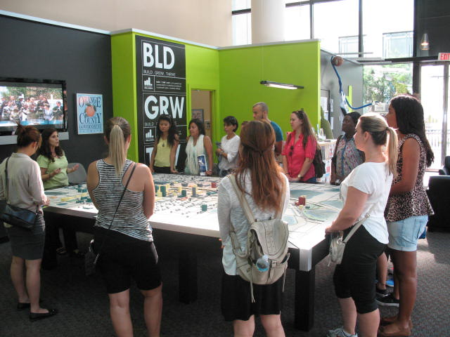
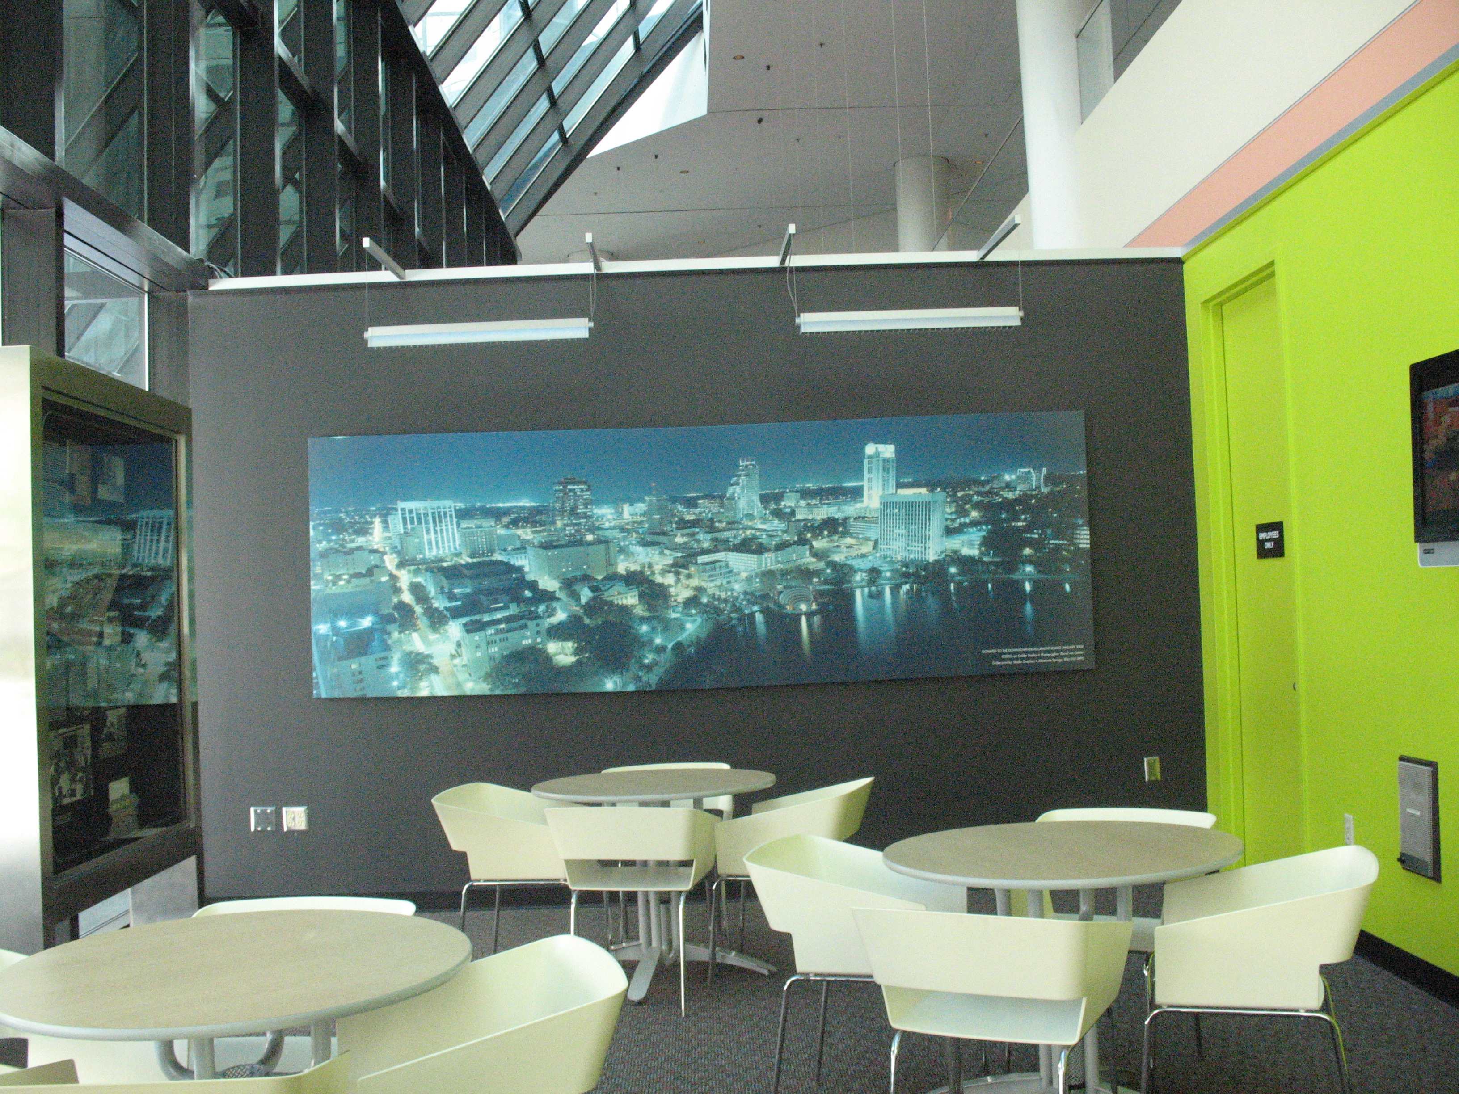
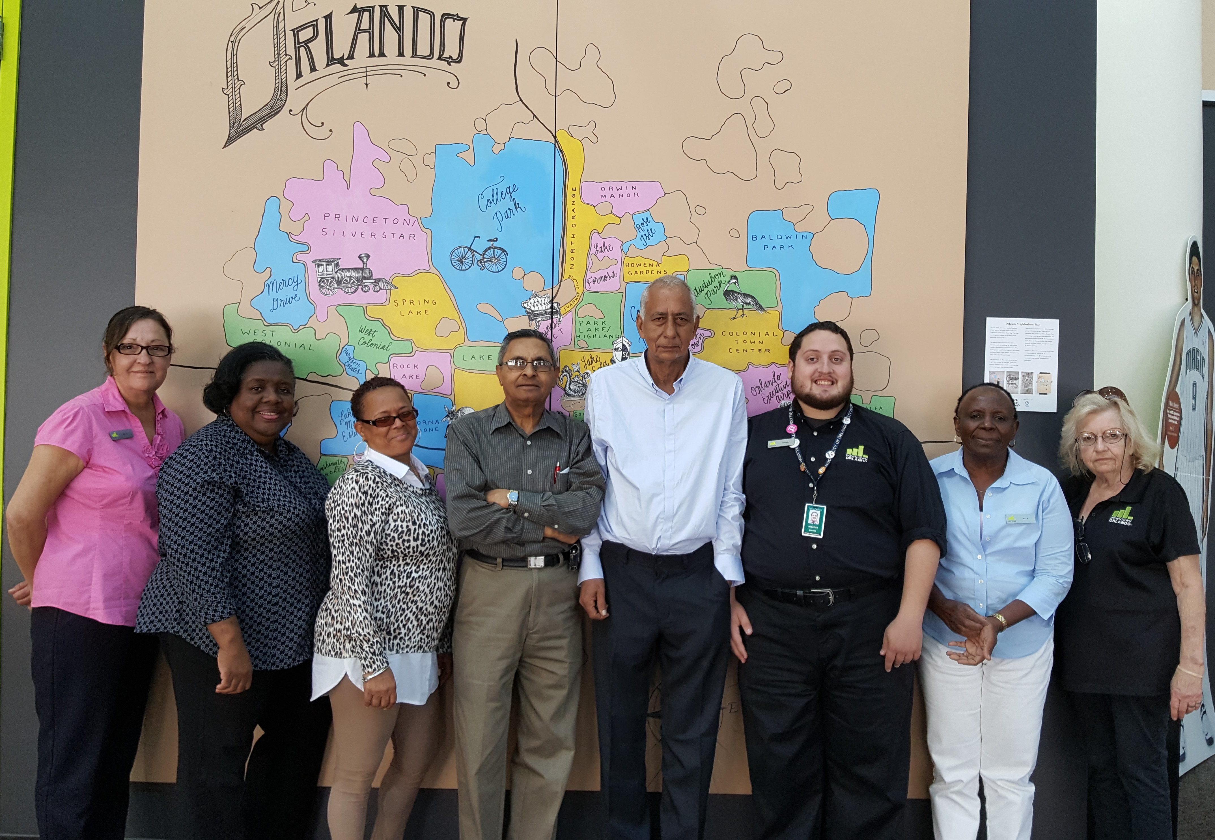
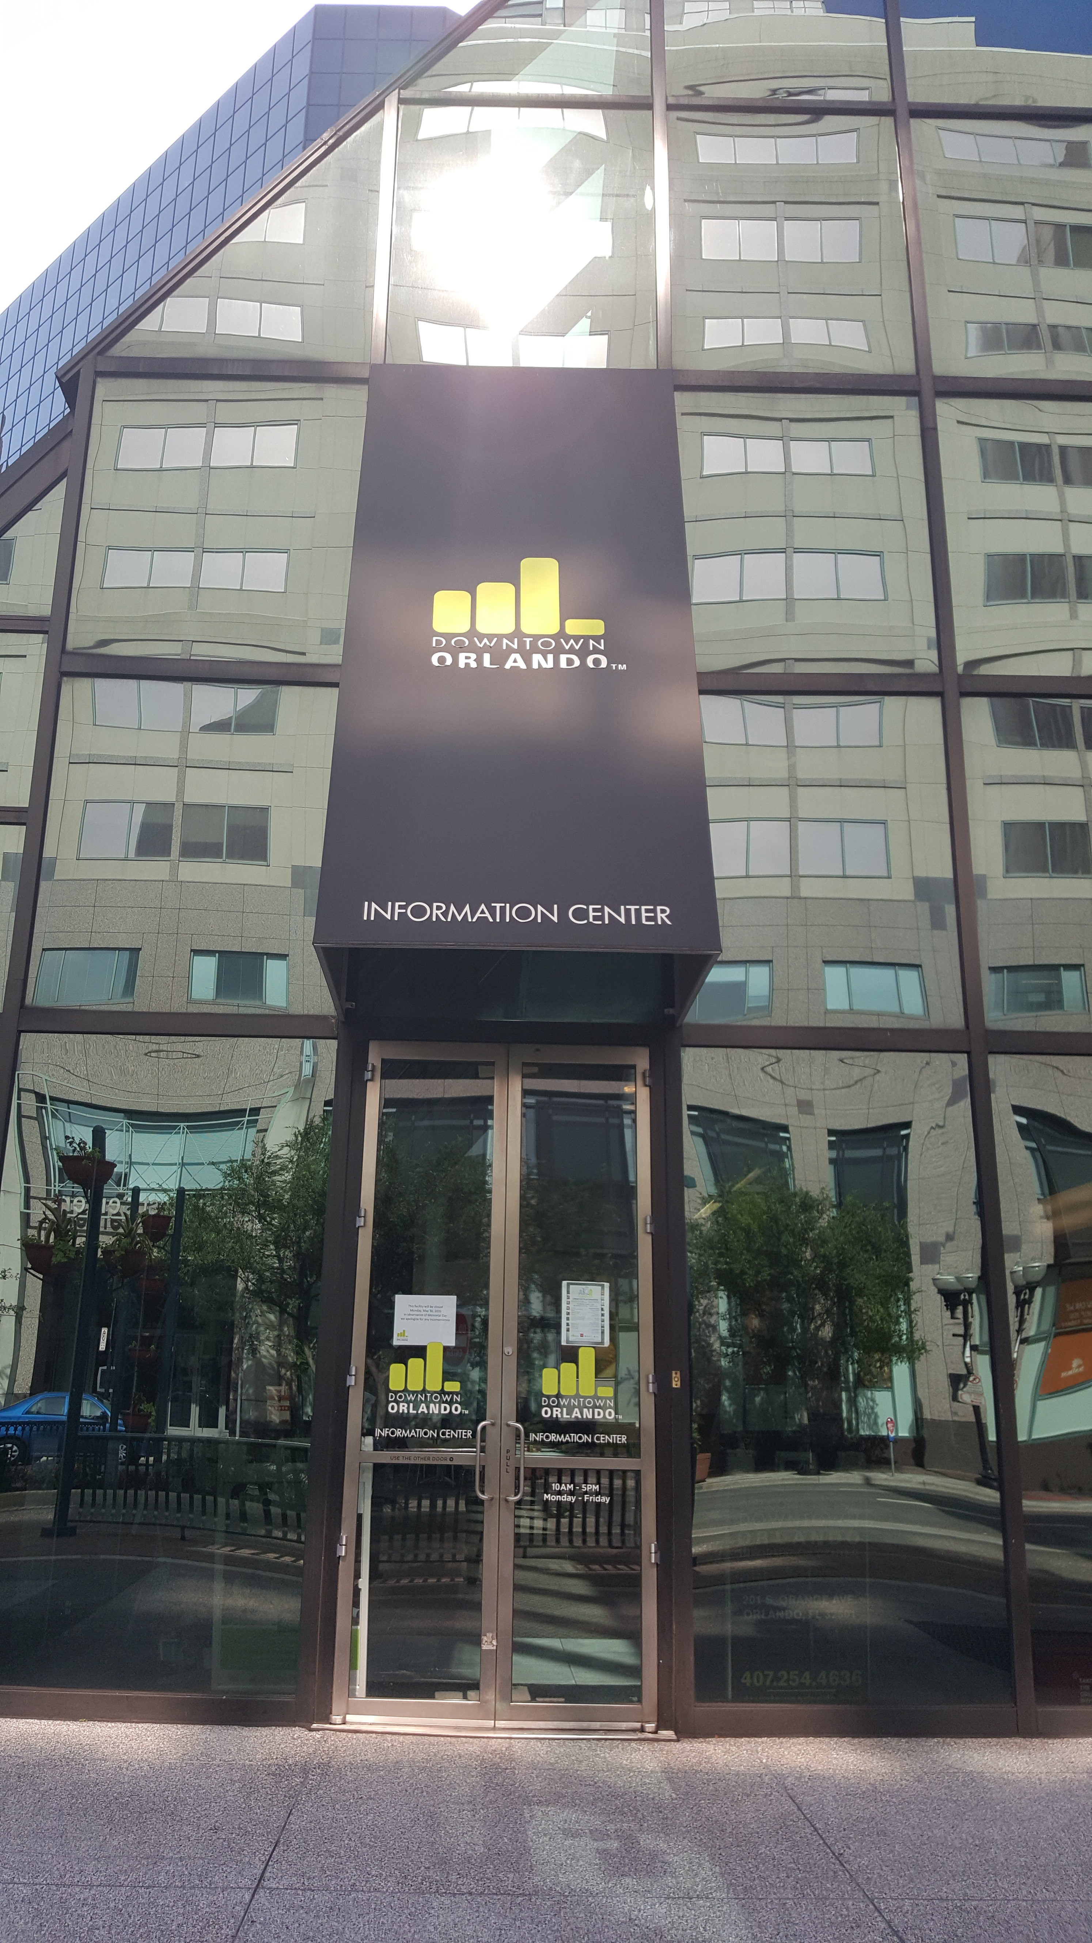
Discover Downtown
Original Welcome Center
Images taken prior
to the renovation

Slide 6
Discover Downtown
Innovation
The original 1,900 sq. ft. information center was located in a small, converted retail storefront, accessed through ill-defined entries and framed by a maze of unrelated objects, including an imposing, view-only, table-top area map, an array of brochure racks of varying heights and offerings, as well as cramped and dated seating areas without easy access to technology or retail offerings.
By expanding to 3,800 sq. ft., the Center was thoughtfully redesigned to enhance ease of access, improve site navigation and optimize experiential learning, thereby maximizing positive user experiences and encouraging repeat visits.
New offerings, in addition to regular services, include local Orlando branded creative merchandise, an interactive art and Downtown wall map, a GIFN photo booth, and a 30-foot-high virtual reality accessible mural by local artist, Boy Kong.
As part of the expansion, Discover Downtown is now home to the Downtown Ambassador program as well as the Church Street Main Street District offices; the daily presence of both groups further ensures a positive visitor experience.

Slide 7
Discover Downtown
Community Impact
Economic:
As the economic hub of Central Florida, Downtown Orlando has experienced almost continuous growth since the 1980s and has over $5.2 billion in investments. Recent significant projects include the Dr. Phillips Performing Arts Center (2014), Major League Soccer Exploria Stadium (2017) and the phased, mixed-use work, play and live 68 ac. Creative Village project (2019) with $625 million Downtown UCF and Valencia campuses
These projects and other Downtown destinations are promoted through the Center’s multimedia presentations, retail offerings and interactive educational sessions, which showcase Downtown’s resilient and sustainable quality of life
Social:
Thoughtfully designed to guide users through a series of meaningful experiences including interactive visual arts, experiential education and on-site local retail opportunities, the Center highlights Downtown’s unique social character, recreation and area open spaces, as well as popular eating and drinking places
These innovative experiences serve to “break the ice” and allow visitors to better understand their environment and interact, in comfort, with the Downtown community and its surroundings.

Slide 8
Discover Downtown
Community Impact
Design
With Downtown’s growing reputation as a quality international destination, it soon became apparent that the Downtown information center needed to be upgraded to reflect Downtown’s many unique and varied locales and offerings.
While typical welcome center designs tend to be heavily focused on improving host-centric operational efficiencies, the Discover Downtown’s design was primarily focused on creating a quality user experience. In particular, there was a focus on the strategic use of vibrant color, varied textures, and contemporary lighting to make the Center engaging, without overwhelming the guest.
Some key Center improvements include augmented reality art, commemorative image making, and relaxing, technology-friendly family areas.
Cultural Assets
In the heart of the City’s traditional Downtown, visitors can learn about the area’s historic and cultural offerings via the Center’s multi-media, viewing first hand historic Church St. through the Center’s vast glass walls, or stepping outside and within ten minute walk reach famous destinations such as Lake Eola Park and its swan boat rides, the Performing Arts Center or Gertrudes’ Walk, an area trail.

Slide 9
Discover Downtown
Funding
City of Orlando’s Downtown Development Board and Community Redevelopment Agency provided project monies, for a total renovation budget of $640,000
Due to local companies’ generosity, donating almost $26,000 in furnishings and equipment, Discover Downtown general appearance was significantly upgraded
Significant discounts or full donations were received from:
Common Sense: L-Shaped Desk and Chairs
Wilsonart: Reception Desk
StoneMax: Reception Desk
Gleman: Round Reception Desk
CI Group: Seating Groups
Ascend: Video Wall Displays

Slide 10
Discover Downtown
Problem Solving
“Discover Downtown”, was formerly known as the “Downtown Information Center”, and first opened its doors 12 years ago. The cramped 1,900 sq. ft. center had limited technology, no interactive activities, and few events.
Tourists, in particular, were frustrated by the lack of souvenirs and local retail offerings, which would commemorate their journey to Orlando and an otherwise, memorable downtown visit
Improved site design and data collection supports a positive visitor experience and the site has 36 local makers expanding merchandise offerings
Prior to the grand opening, Discover Downtown saw an average of 760 guests walk thru its doors in 2017. Today, about 965 people walk thru the doors monthly.
New events include civic meetings, local tours and “What’s Up Downtown”, a popular educational session that draws between 50-80 visitors including college students and area professionals to learn more about downtown Orlando.

Slide 11
Discover Downtown
Applicability to Other Communities
Many destinations have an official visitor’s center but fail to design it to serve the needs of visitors of varied interests, ages and abilities
The Destination Downtown experience concentrates on user needs and collaborative expert guidance with a focus on interactive activities as well as visual and retail creative offerings
Having well trained and motivated staff with local knowledge and providing concierge service is more important than expensive furnishings and technology
The site’s design and offerings can be easily replicated in other settings, particularly with the layering of other functions such as expanding the site’s area and including the Ambassadors and Main Street offices, which not only reduces overall operating costs for the CRA/DDB but also improves the visitors experience

Slide 12
Discover Downtown
Other Thing to Tell the Judges
The project size and complexity required that many parties were involved from the Downtown Development Board members to the City of Orlando’s multimedia team
The renovation took about a year to complete
DDB/CRA agency on record designed the coloring wall where guests could not only “leave their mark” on our wall, but purchase a small replica to take home and color.
Donated to Discover Downtown is the Gifn, a popular interactive technology, which functions as a freestanding photobooth that’s directly connected to social media. Visitors love it because, depending on the time of year, we can switch out the various photobooth props and photo templates, which help make unforgettable memories!

