Slide 1
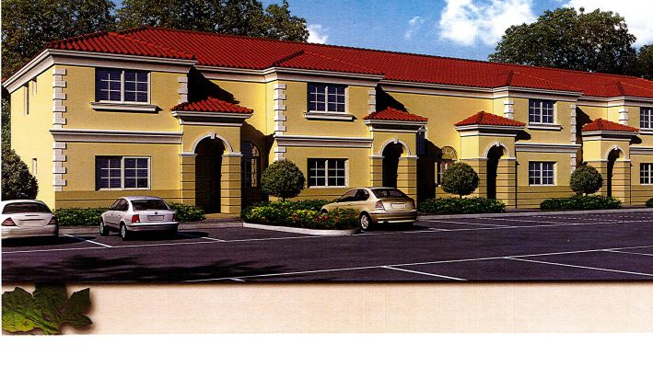
The Crossing at North Lauderdale
Developed by Urban Pointe Developers, (Schumer Capital & The Pointe Companies)

Slide 2
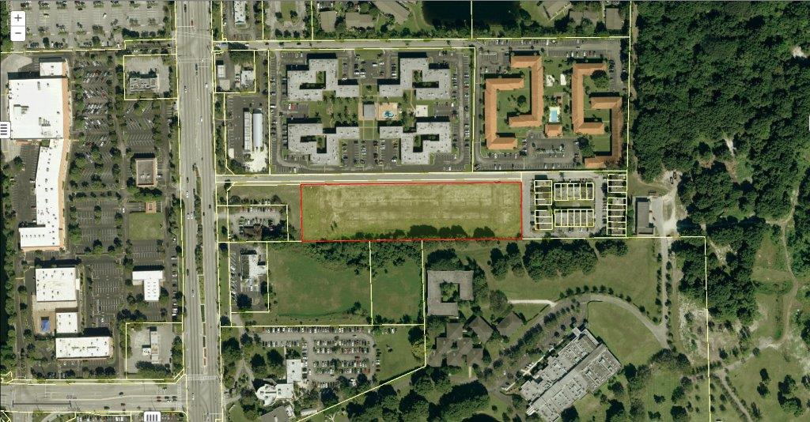
BEFORE
Future Home of The Crossing

Slide 3
AFTER

Slide 4
Site Plan

Slide 5
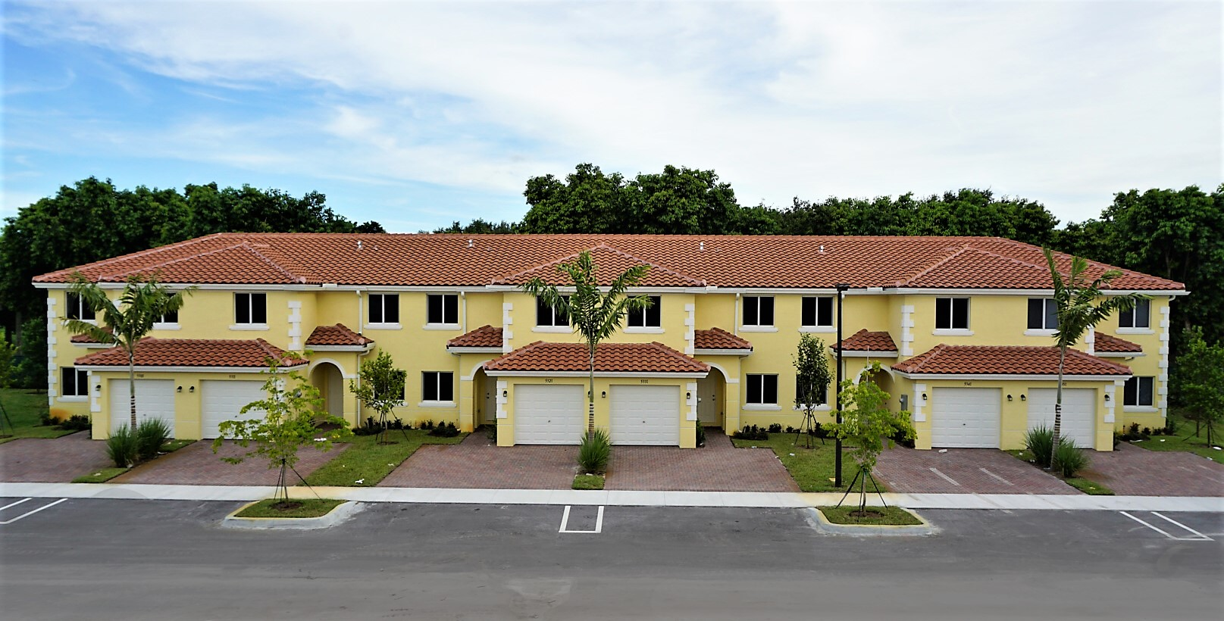
EXTERIOR FRONT

Slide 6
BOUGAINVILLEA MODEL
Comprised of 46 market-rate well-appointed work force townhomes, featuring open floor plans, Barrel tile roofs, stainless steel appliances and hurricane impact windows and doors.

Slide 7
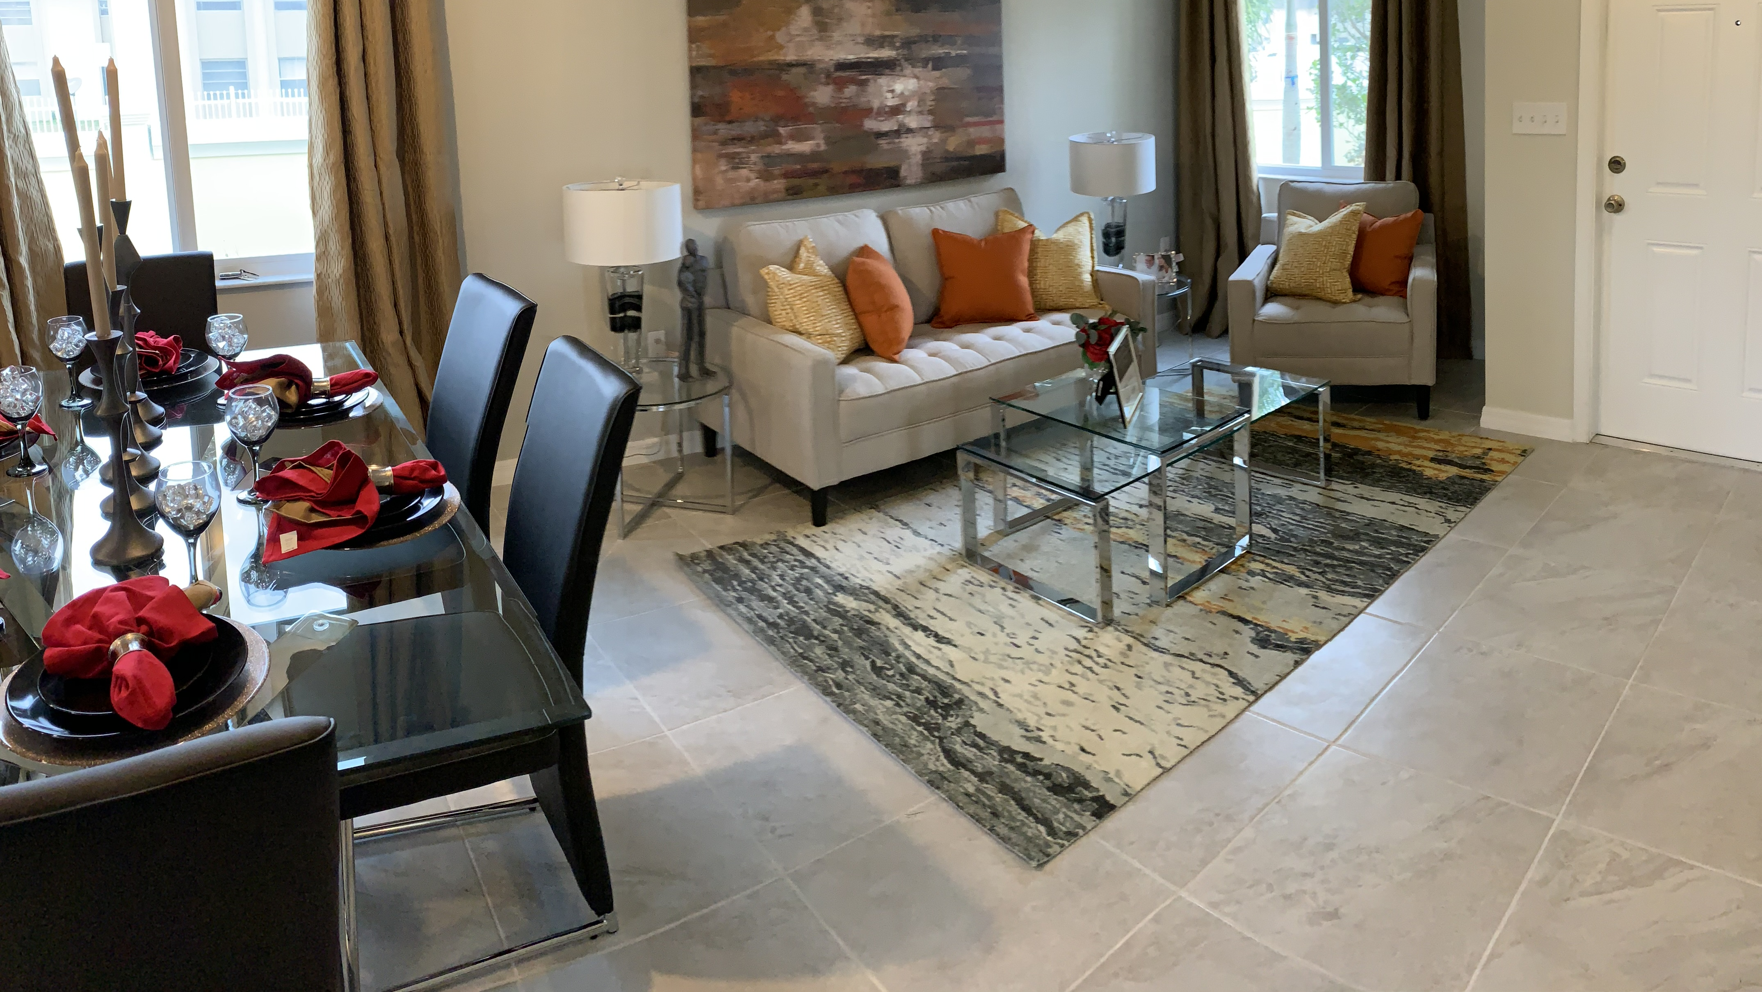
Living Flex Space

Slide 8
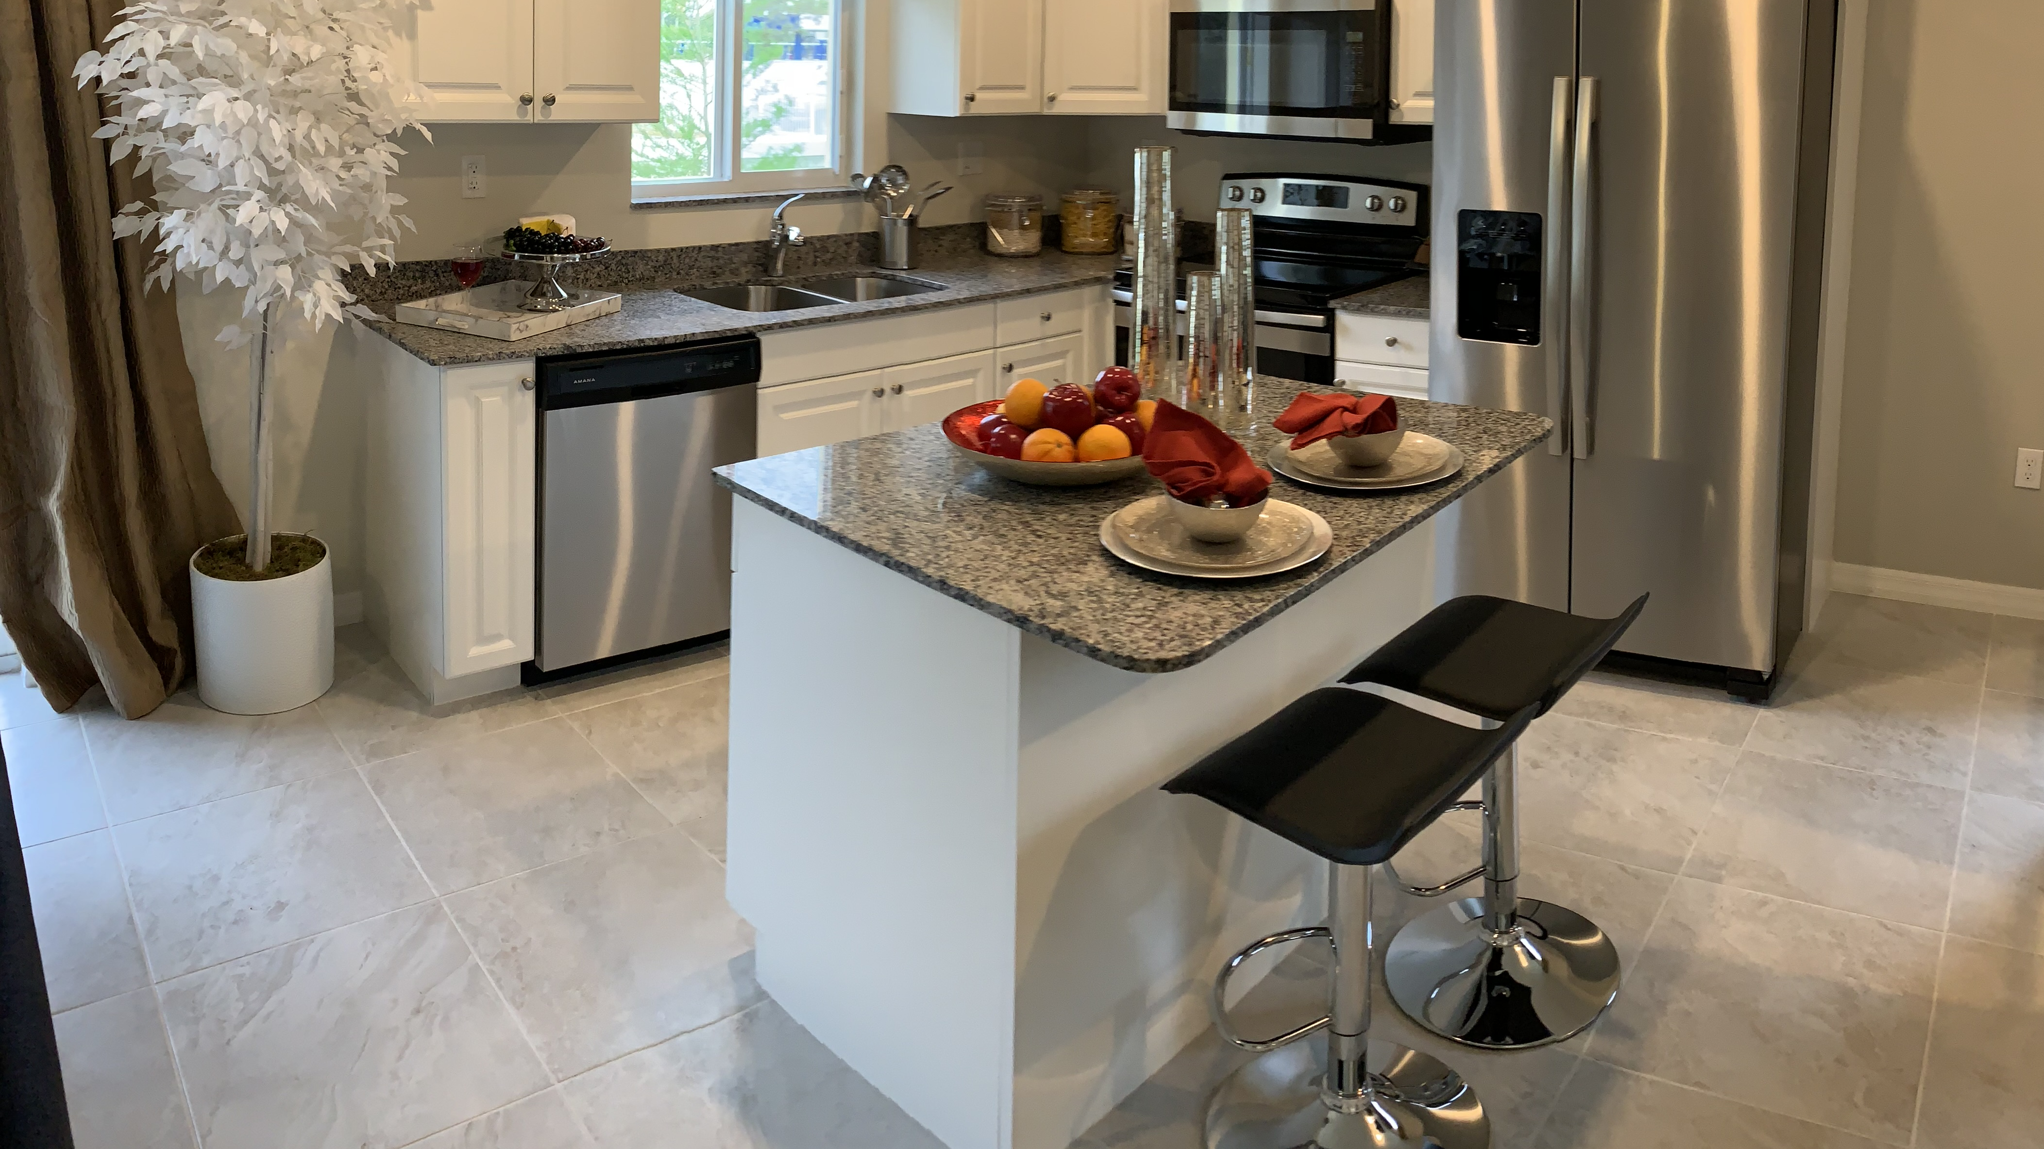
Kitchen

Slide 9
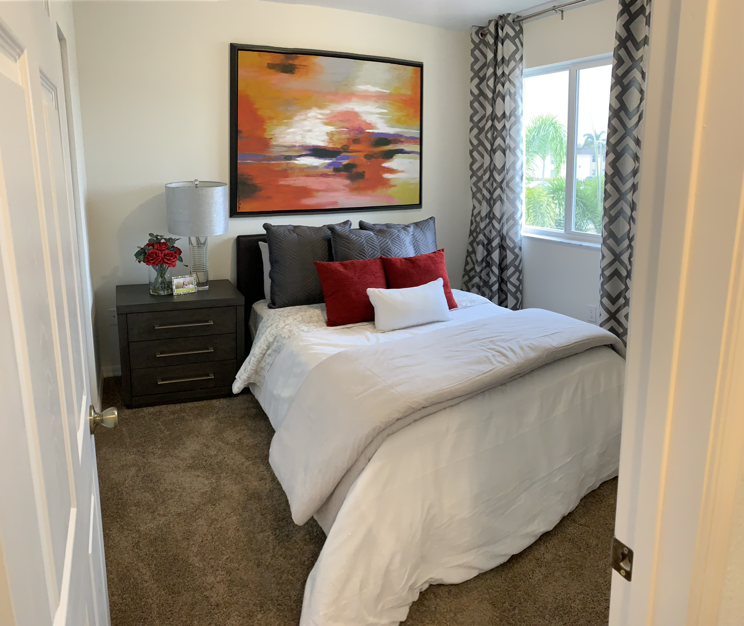
Bedroom

Slide 10
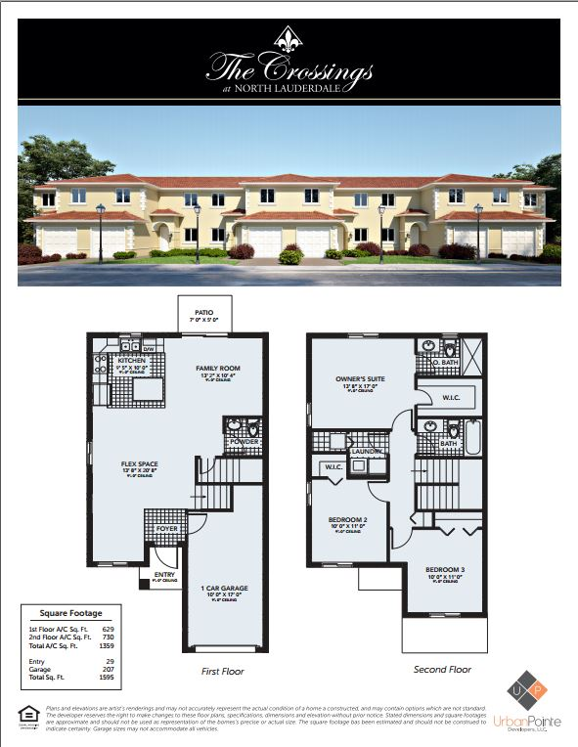
Floor Plan

