Slide 1
FRA Awards 2020
Parramore Oaks
“Outstanding Housing Project”
City of Orlando, Community Redevelopment Agency

Slide 2
Parramore Oaks
Innovation
Identified in the Parramore Comprehensive Neighborhood Plan, as a critical “catalyst site”, residents believed that its redevelopment would bring in much needed housing opportunities, complementing earlier affordable home building efforts led by the City. Within walking distance to the beloved Z.L. Riley children’s park and the popular Jackson Neighborhood Center, Parramore Oaks, is a multi-story, multi-phased contemporary residential complex;
The 4.21 ac. Phase I site is comprised of 104 apartment units, and 12 attached flats along both sides of Parramore Ave., just south of Conley St. The development’s Phase I completion is deemed a success with quality affordable housing and easy access to multi-modal transportation, employment opportunities and modern lifestyle amenities; and,
The development brings much needed quality urban residential development, allowing families of varying sizes and generations to collectively reside. Key to Parramore Oak’s success is financing. The development has 80% affordable units with 5% set aside for permanent supportive housing, or 96 affordable housing units.

Slide 3
Parramore Oaks
Community Impact
Economic
The $1.14 million dollar CRA investment also ensures that Phase I will have a 50 year affordability period. Rent for a one bedroom typically starts $627 to $825, two bedroom starts at $753 to $1,008, and three bedroom starts at $875 to $1,341. The lower-end affordable leases are for individuals who make 60% of median income. In addition, six of the units are for renters who were homeless and another six are for those making less than 40% of the area median income;
Social
A 4.21 acre beautiful property graced with large, stately oak trees, it is centrally located in the historic African American Holden Parramore neighborhood, which, due to community involvement and Orlando DDB/CRA leadership, supports the “residential resurgence”. The property also has amenities serving the tenants and neighborhood;

Slide 4
Parramore Oaks
Community Impact
Design
The site was rezoned to Planned Development, which allowed greater development flexibility and supported superior design. The spacious and unique floorplans at Parramore Oaks are modern and stylish and built with green design principles including long-wear, mold/mildew resistance, and energy efficiency; and,
Cultural Assets
Characterized by spacious layouts and modern amenities the property includes an exercise/fitness room, kids’ activity room, library/computer center, meeting space/community area for use by the residents and by service providers offering seminars and workshops to tenants. The space for workshops and seminars is anticipated to opening the door to new employment and educational opportunities.

Slide 5
Parramore Oaks
Funding
The $1.14 million dollar CRA investment also ensures that Phase I will have a 50 year affordability period. Rent for a one bedroom typically starts $627 to $825, two bedroom starts at $753 to $1,008, and three bedroom starts at $875 to $1,341.
The lower-end affordable leases are for individuals who make 60% of median income. In addition, six of the units are for renters who were homeless and another six are for those making less than 40% of the area median income.

Slide 6
Parramore Oaks
Problem Solving
“Original plans for Parramore Oaks called for a mix of apartments and 31 townhomes, but Paula Rhodes, president of InVictus Development, indicated that due to soaring development costs a new approach had to be pursued. Further challenges included added expenses in securing tax credits because of federal reforms, as well as tariffs on building materials and shortages in labor….” (Orlando cuts ribbon.., October 29, 2019)
The site was rezoned to Planned Development, which allowed greater development flexibility and supported superior design. To address Florida’s harsh climate, the spacious and unique floorplans at Parramore Oaks are modern and stylish and built with green design principles including long-wear, mold/mildew resistance, and energy efficiency.
To address its urban setting, Crime Prevention Through Environmental Design (CPTED) principles are integrated through-out the development from the front door to the rear parking lot as well as through the choice of landscaping plants and points of pedestrian access.

Slide 7
Parramore Oaks
Applicability to Other Communities
The overarching goal has been to develop housing that ensures that area residents have access to quality affordable housing all the while safeguarding historic development patterns and scale and collaboratively building an attractive, healthy and sustainable neighborhood;
Parramore Oaks with its iconic architecture, well placed amenities and strategic siting along multi-modal routes, is an excellent model on how affordable housing, can, and should, be executed. Key to success is comprehensive land-use planning, strong community partnerships and a development entity which has capacity to implement a complex project and ability to secure tax credits; and
The project’s success and potential for replication is evidenced by the proposed 2.04 ac. Phase II site, abutting the new apartment complex. It is already in the pre-construction planning phase, and is to be comprised of 91 multifamily units.

Slide 8
Parramore Oaks
Other Things to Tell the Judges
This project won a Golden Brick Award from the Downtown Orlando Partnership a prestigious local recognition that honors projects that have positively impacted downtown and contributed significantly to its quality of life, making downtown Orlando a more exciting place to live, work, and play;
Affordable rental housing of various sizes is essential in building affordable neighborhood housing that serves current residents and provides opportunities for new families;
Integrating local feedback with technical experience led to the strategic siting and design of the development; and,
Resident input has been key to the success of this project.

Slide 9
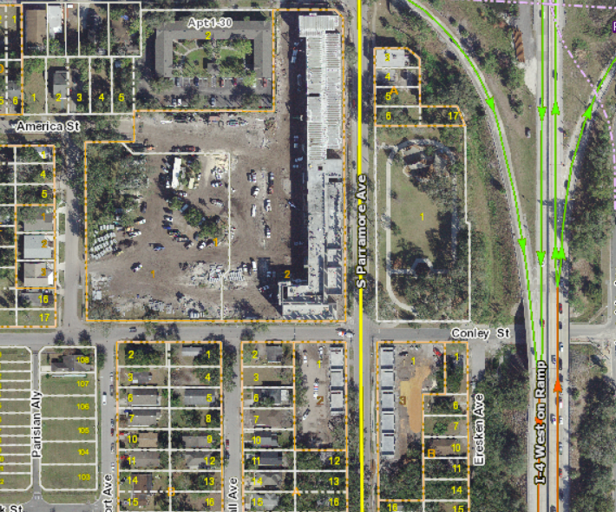
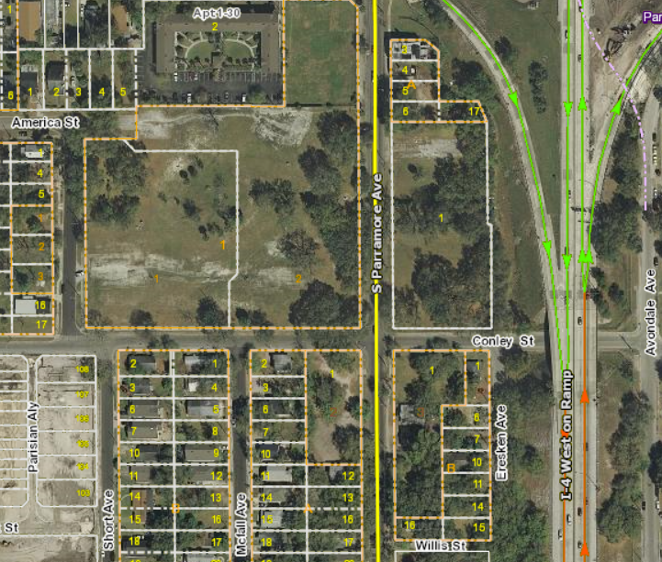
Parramore Oaks
o
o
Short Ave.
ZL Riley Park
2019 Aerial: Development Underway
2010 Aerial: Vacant Land

Slide 10
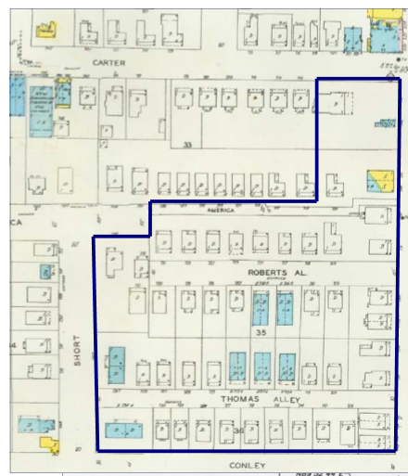
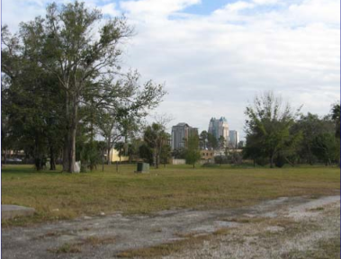
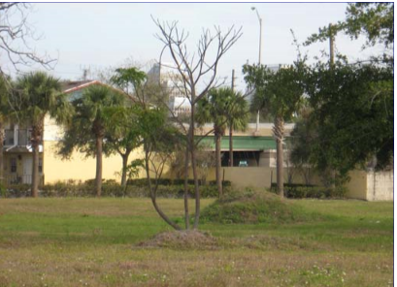
Before Photos
ZL Riley Park
Site Views Prior to Development
Early 1963 Sanborn Map
Showing Small Shotgun Homes on Substandard Lots

Slide 11
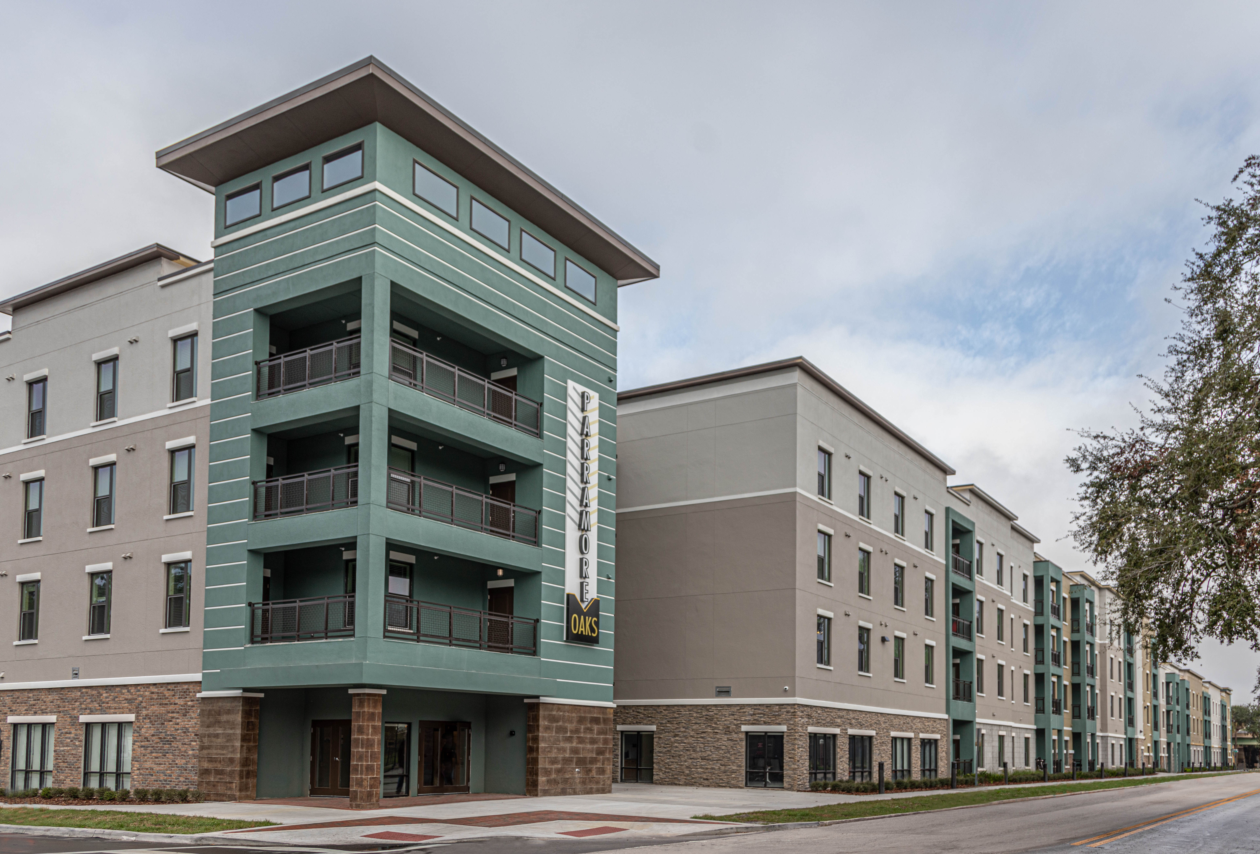
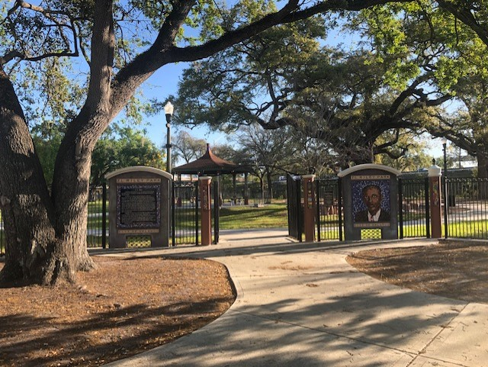
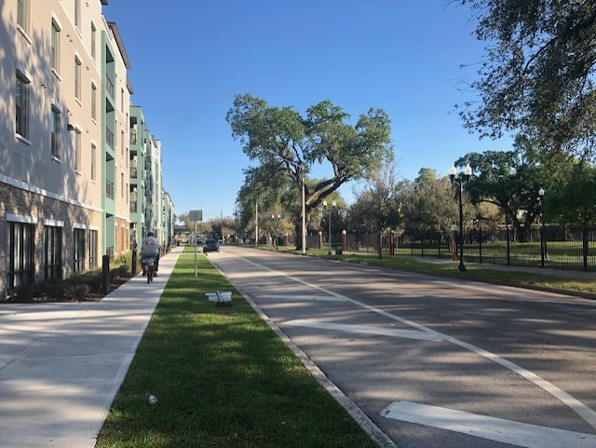
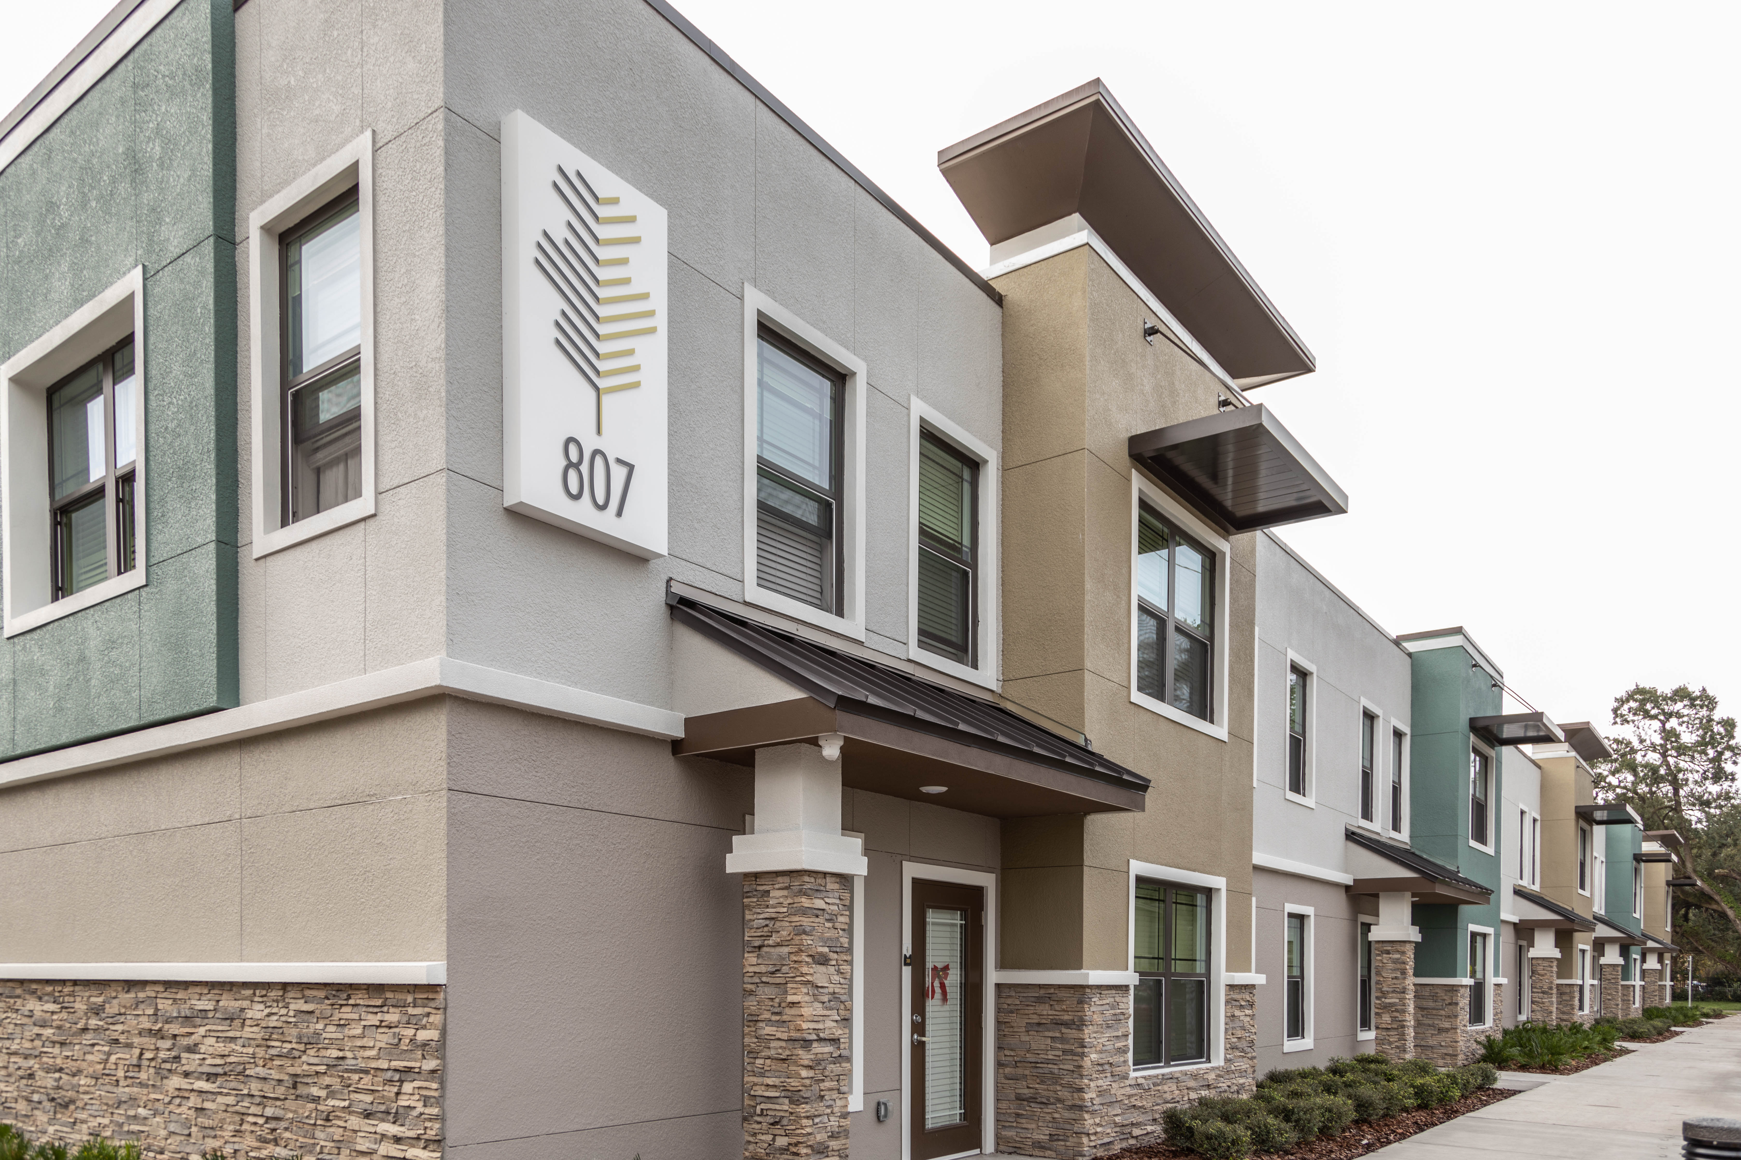
After Photos
ZL Riley Park
Exterior Views of Apartments and Flats

Slide 12
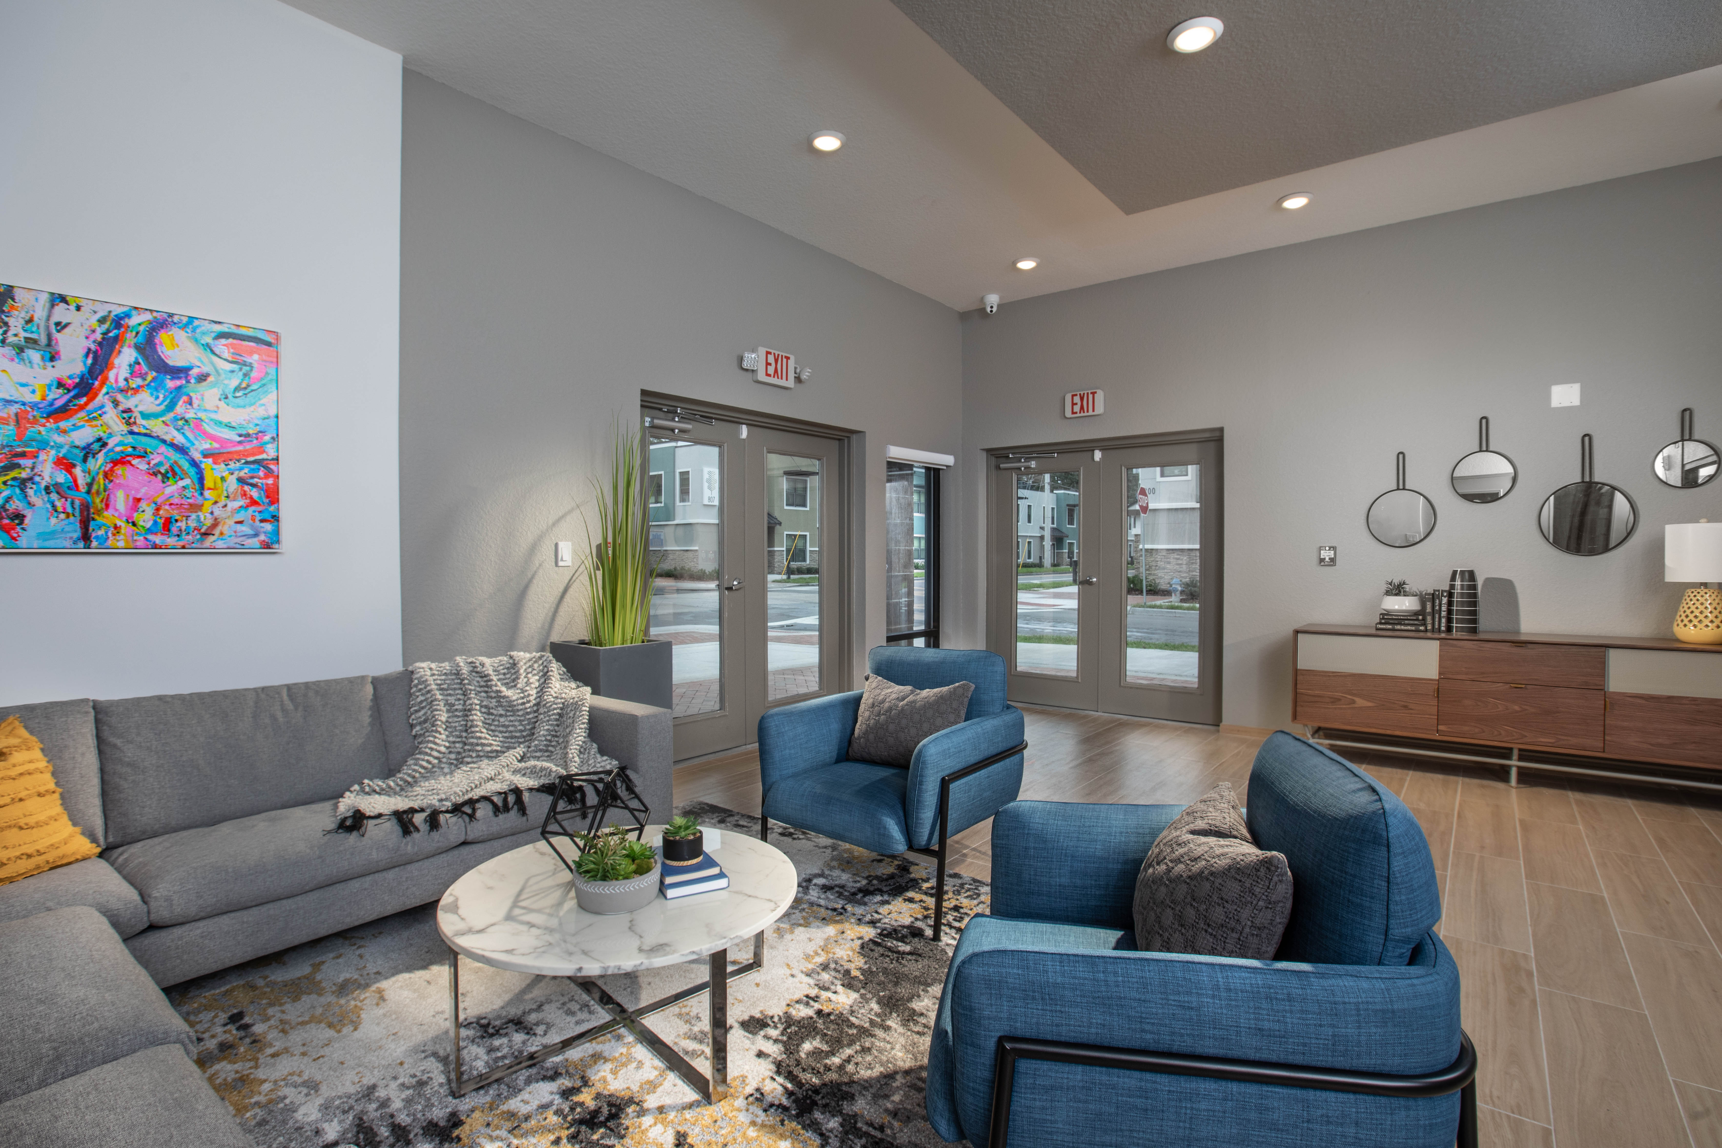
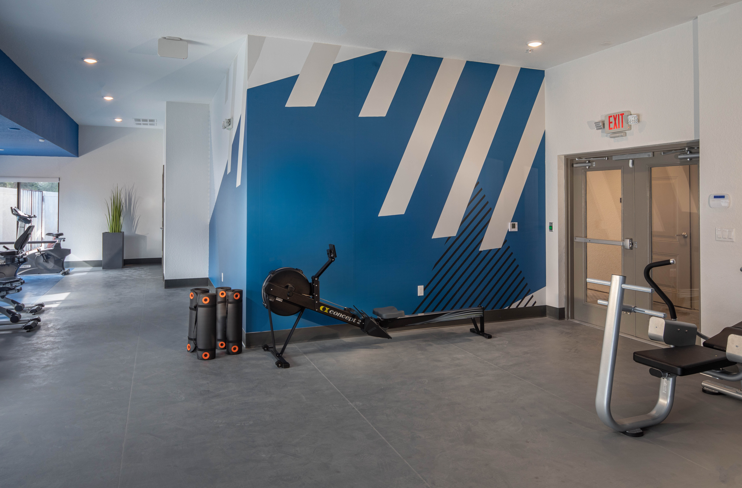
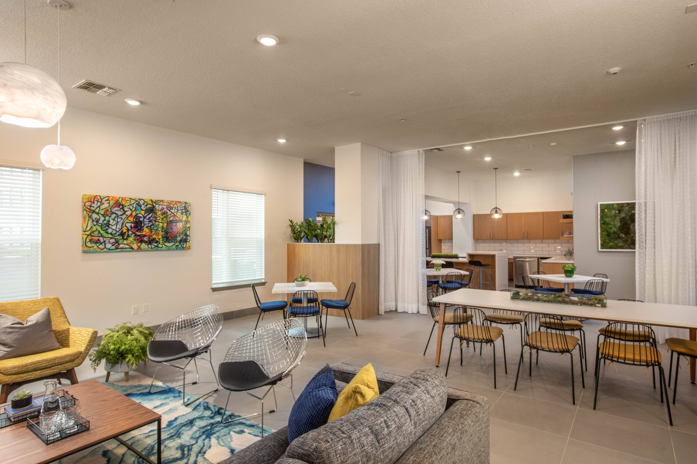
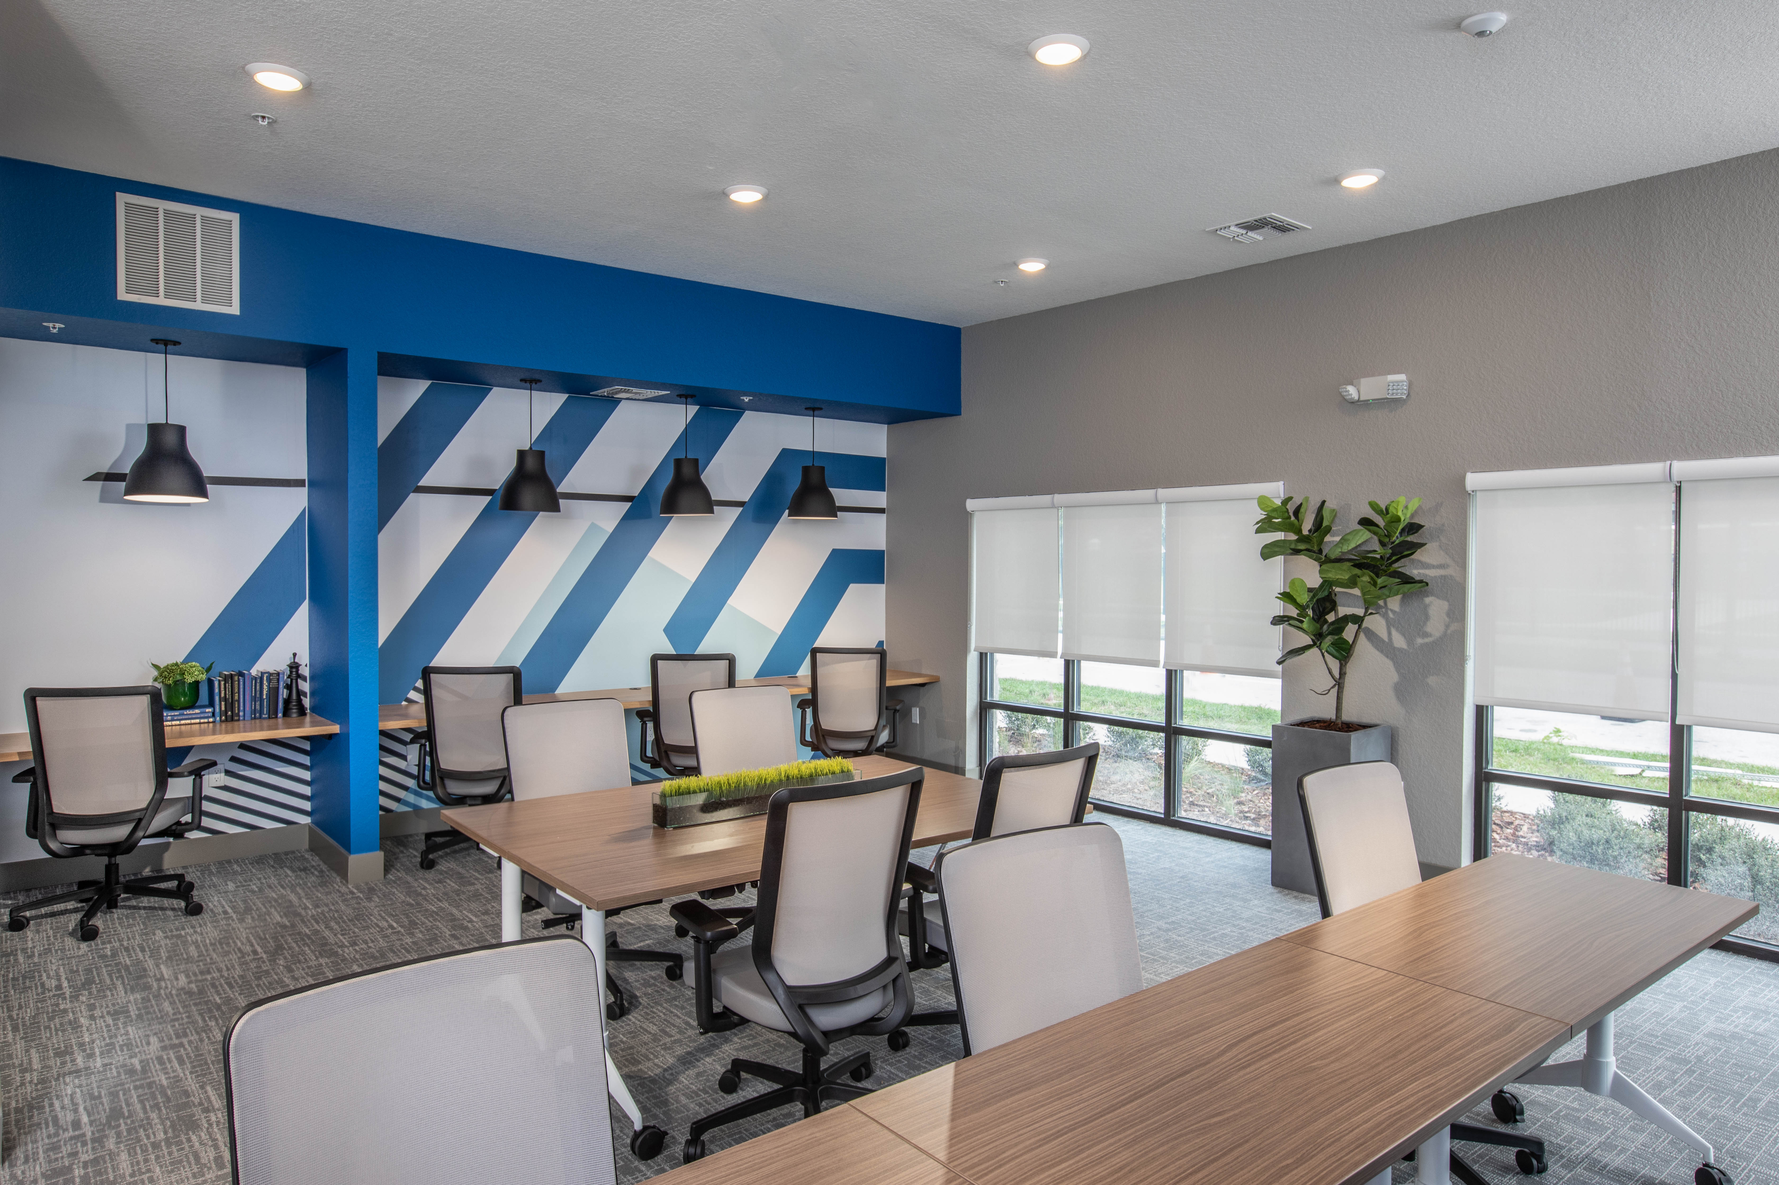
Parramore Oaks
Various Common Areas
Weight Room
Kitchen and Community Room
Computer and Library

Slide 13
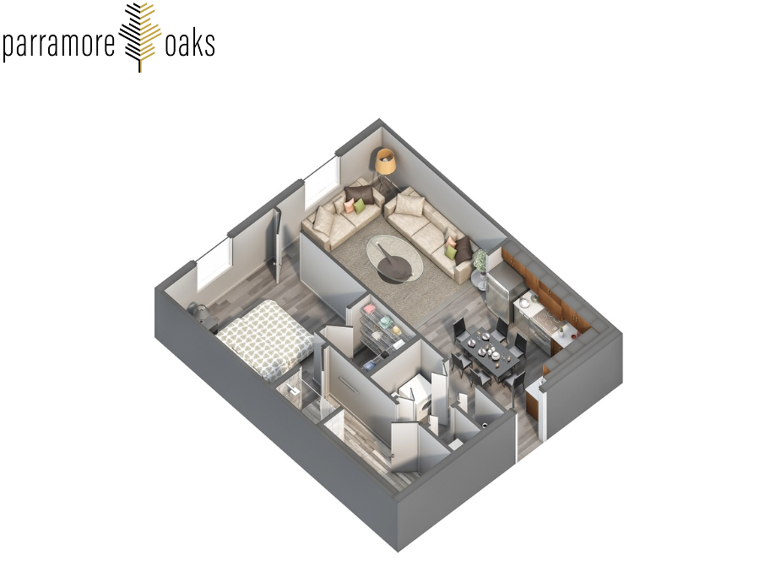
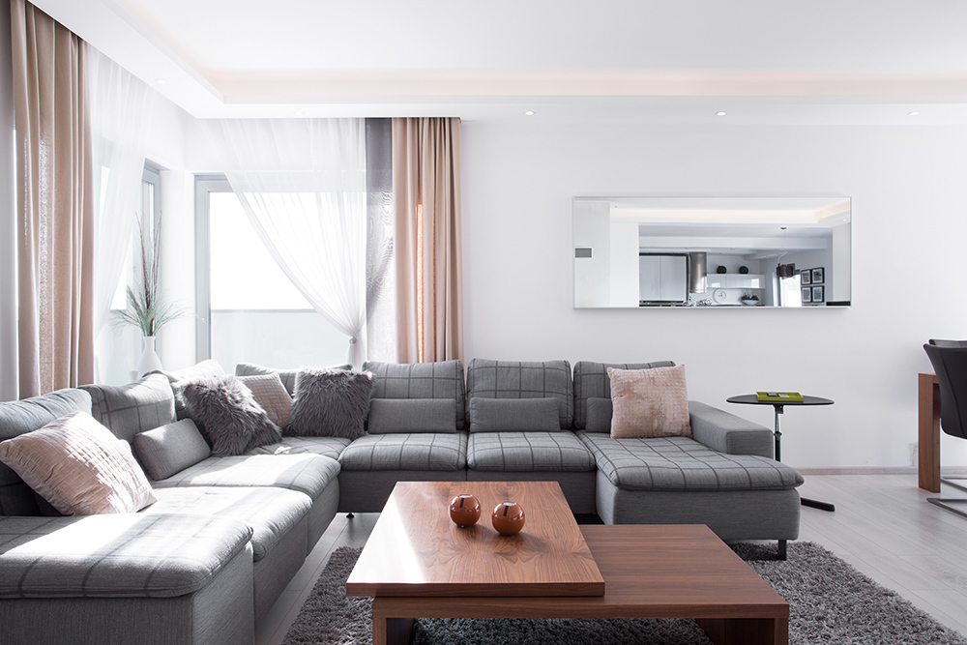
Parramore Oaks
Example of a one bedroom apartment starting at 725 sq.ft.

