Slide 1
Redeveloping Clyde Killens Hall… Embracing the spirit of
OVERTOWN
“Harlem of the South”

Slide 2
Clyde Killens hall redevelopment Business & design imperatives
A welcoming, fun and dynamic dining experience that is approachable, yet elevated, offering new energy, refinement and distinct flavor to the Overtown food scene
Bar, Restaurant, Supper club convergence offering impeccable service and the highest quality food provisions
Entertainment destination inspired by Overtown’s relevant past but nods to aspirations for Overtown’s future
Distinctive business model that merges visibility of celebrity chef with community inclusion and partnerships
Healthy Farm-to-Table approach driven by seasonality
Classic, bold world-class design elements that recall old Overtown, yet stretch forward for contemporary functional and feel

Slide 3
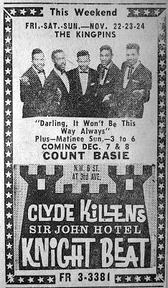
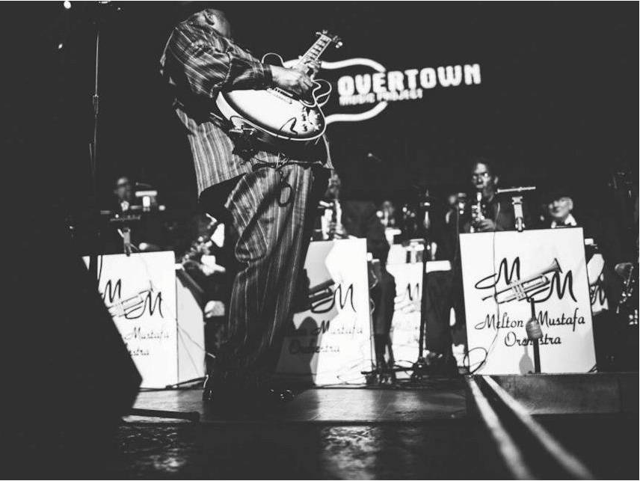
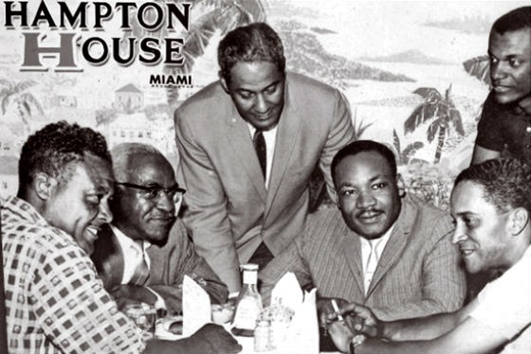
Clyde Killens Pool Hall Mood Board

Slide 4
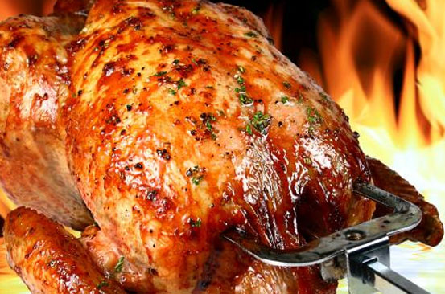
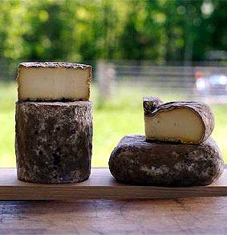
Clyde Killens Pool Hall Mood Board

Slide 5
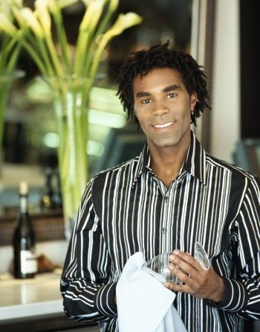
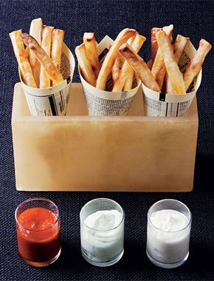
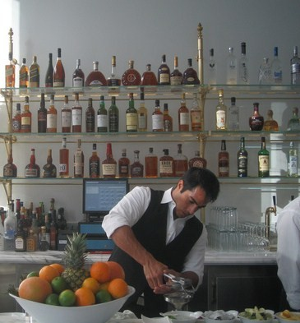
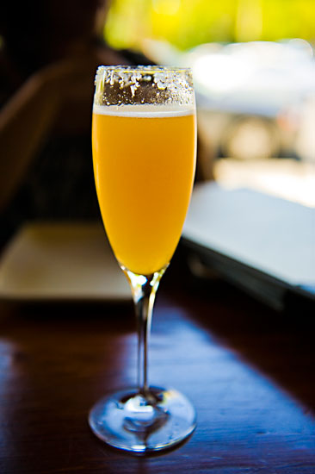
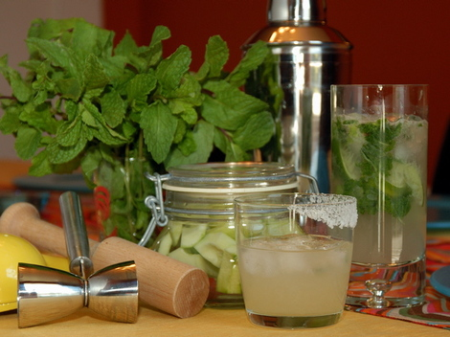
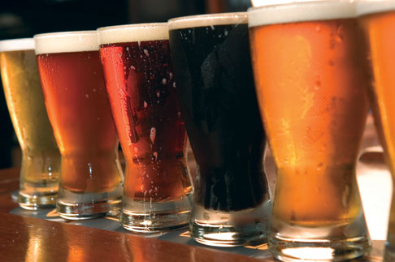
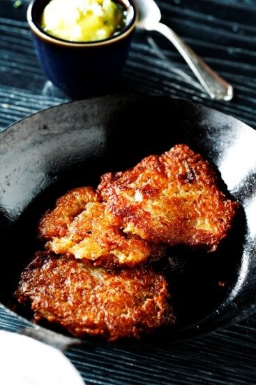
Clyde Killens Pool Hall Mood Board

Slide 6
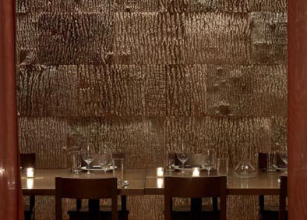
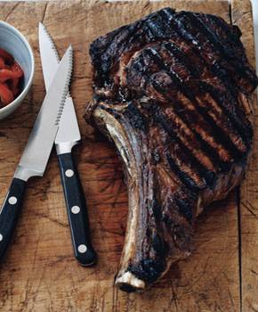
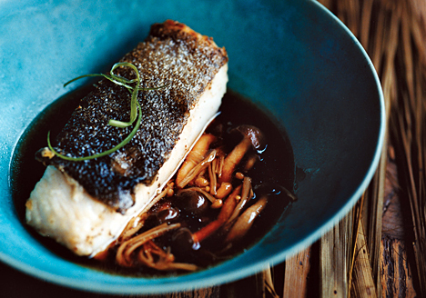
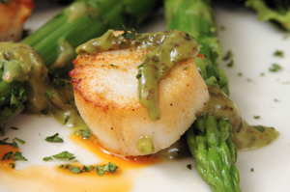
Clyde Killens Pool Hall Mood Board

Slide 7
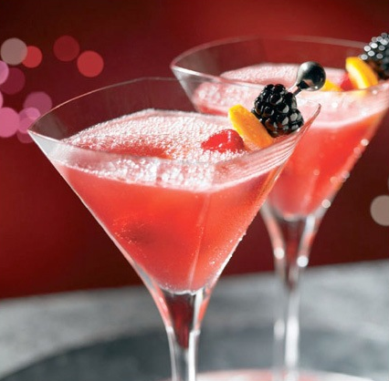
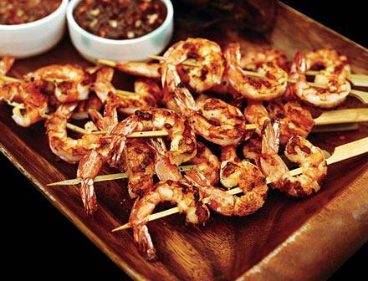
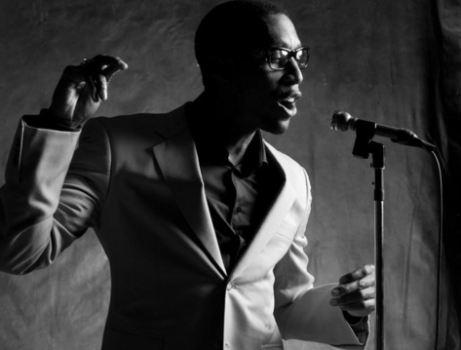
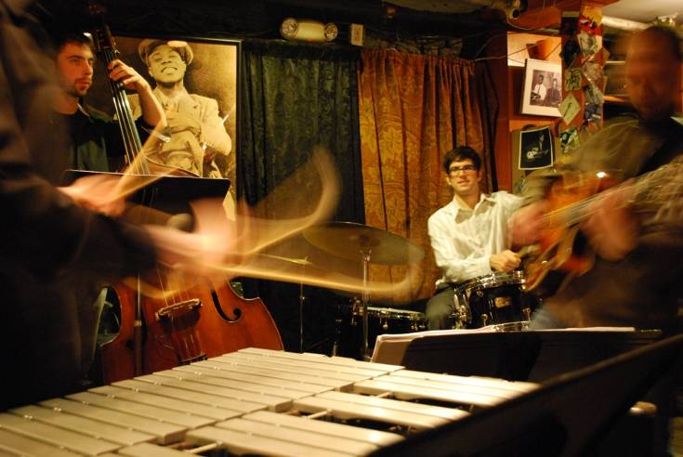
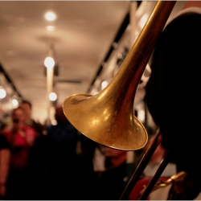
Clyde Killens Pool Hall Mood Board

Slide 8
Critical Success factors
Create Jobs for Overtown residents
Promote Overtown as food and entertainment destination
Provide new services and amenities for residents of
Overtown/Miami as well as regional tourist
Cooking /Business classes for residents –integrating
residents into the Overtown food movement
Adopt and partner with a local school (Booker T. Senior High School)
focused on responsible eating and urban gardening.
Strengthening and leveraging relationships with local partners
such as Miami Dade Culinary Institute, CRA, owner/stakeholders
Assist in Overtown Master Planning efforts

Slide 9
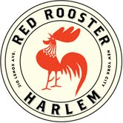
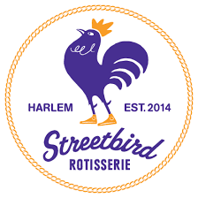
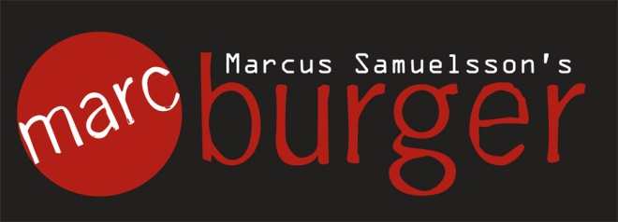
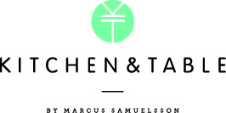
Current & Previous developments

Slide 10
Red Rooster Harlem
Red Rooster Harlem is inspired by the legendary Harlem speakeasy that was located at 138th Street and 7th Avenue, where neighborhood folk, jazz greats, authors, politicians and some of the most noteworthy figures of the 20th Century – such as Adam Clayton Powell Jr., Nat King Cole and James Baldwin – would converge to enjoy drinks and music in an inviting atmosphere. We have been honored to join Harlem’s vibrant community-based, legendary institutions such as The Apollo Theater, Studio Museum, Sylvia’s and the Schomburg Center for Research in Black Culture, who seek to serve as well as act as proud beacons of Harlem unique history, culture and international relevance.
At our Red Rooster, we want to embrace today’s Harlem with that same spirit of inclusiveness, community and outward pride. We strive within our mantra, to be MORE THAN A RESTAURANT, actively engaging in art, music, literature, community affairs and economic empowerment. At Rooster its about the experience that can only be captured within our offerings and embrace. The convergence of our culinary creativity, diverse clientele and talented/whimsical artistry is distinct and we work hard everyday to maintain its uniqueness. This has largely been the rationale for our international acclaim.
Central to our success is the committed team who are largely natives of our community. Our brand of hospitality extends through them each day as they not only represent the excellence we strive for, but also the profundity of the Harlem brand.
It is our goal to continue to have the opportunity to serve and forever create the magic of Rooster.

Slide 11
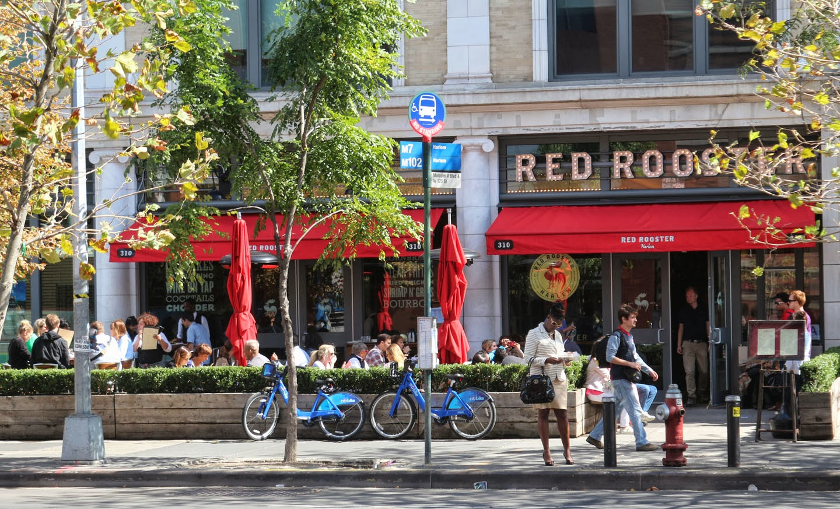
Red Rooster Harlem

Slide 12
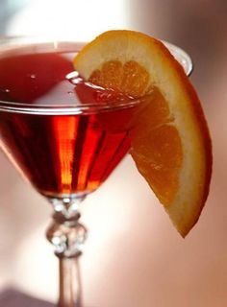
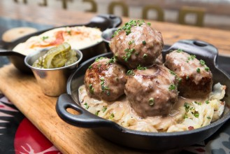
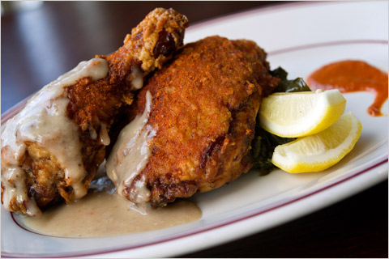
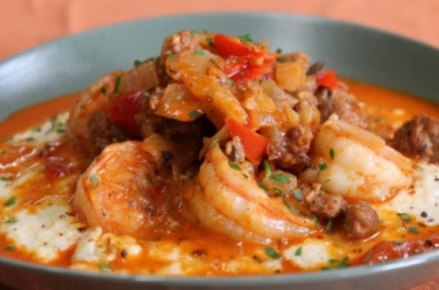
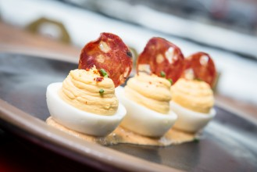
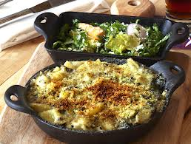
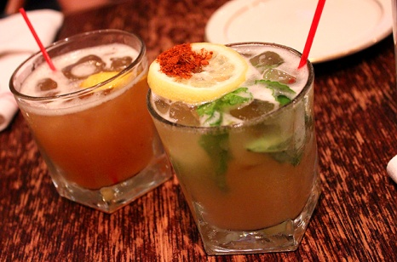
Red Rooster Harlem

Slide 13
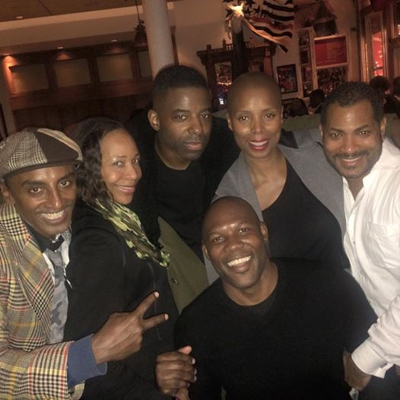
Red Rooster Harlem-community

Slide 14
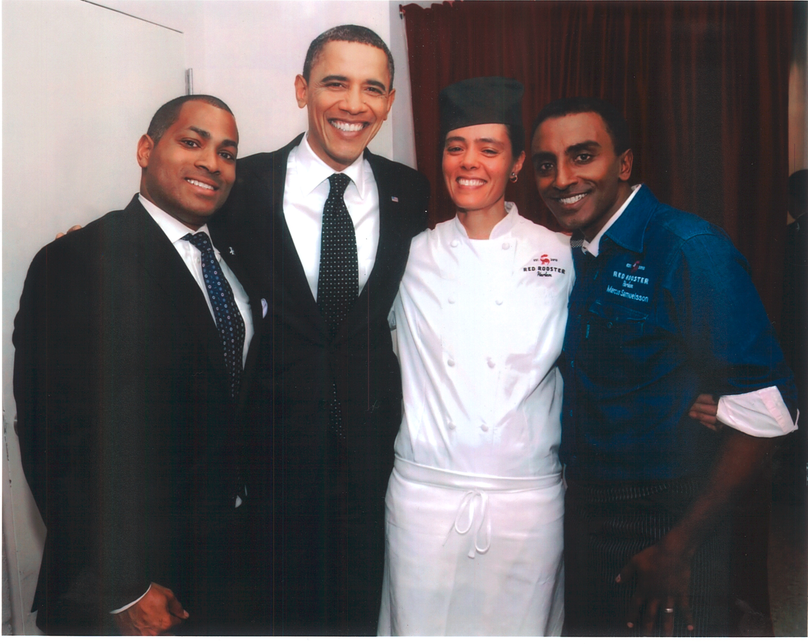
red Rooster Harlem –Host Dignitaries

Slide 15
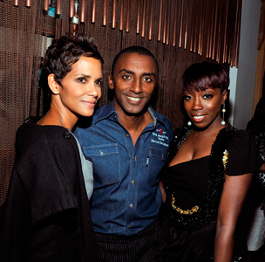
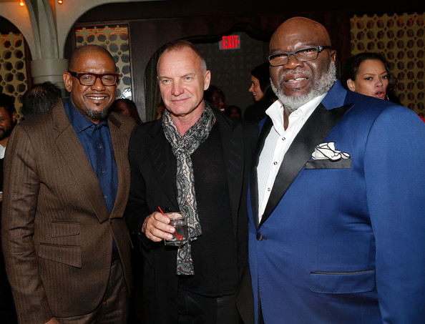
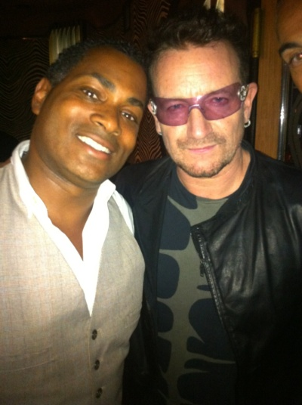
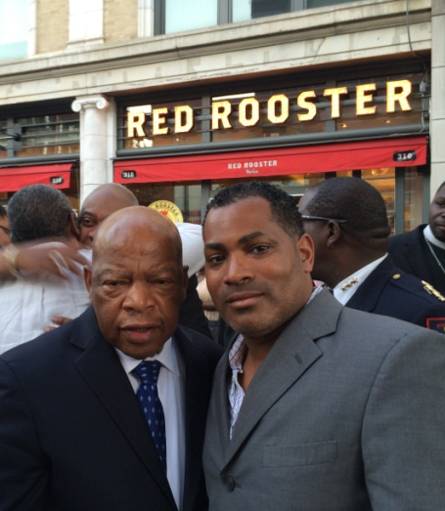
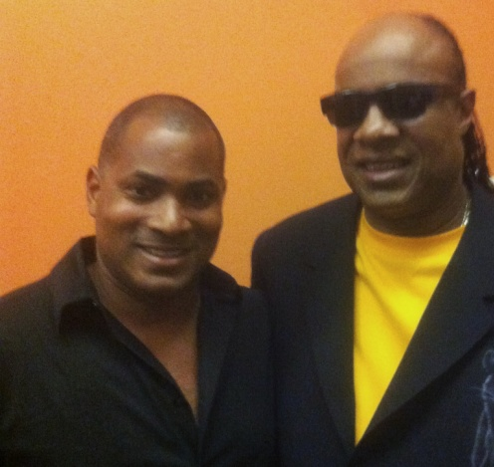
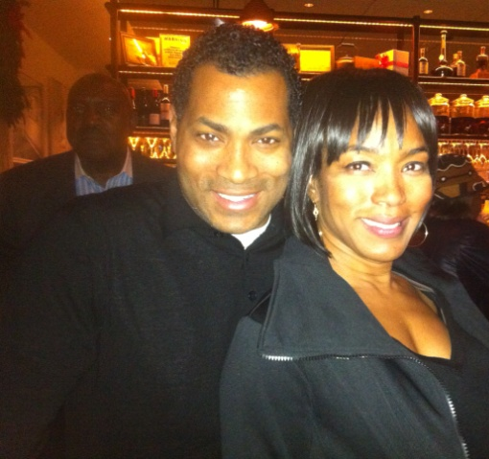
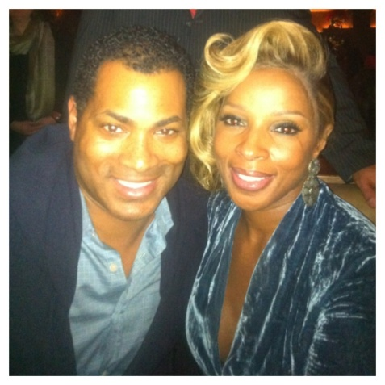
Red Rooster- VIP’s frequent our Harlem location

Slide 16
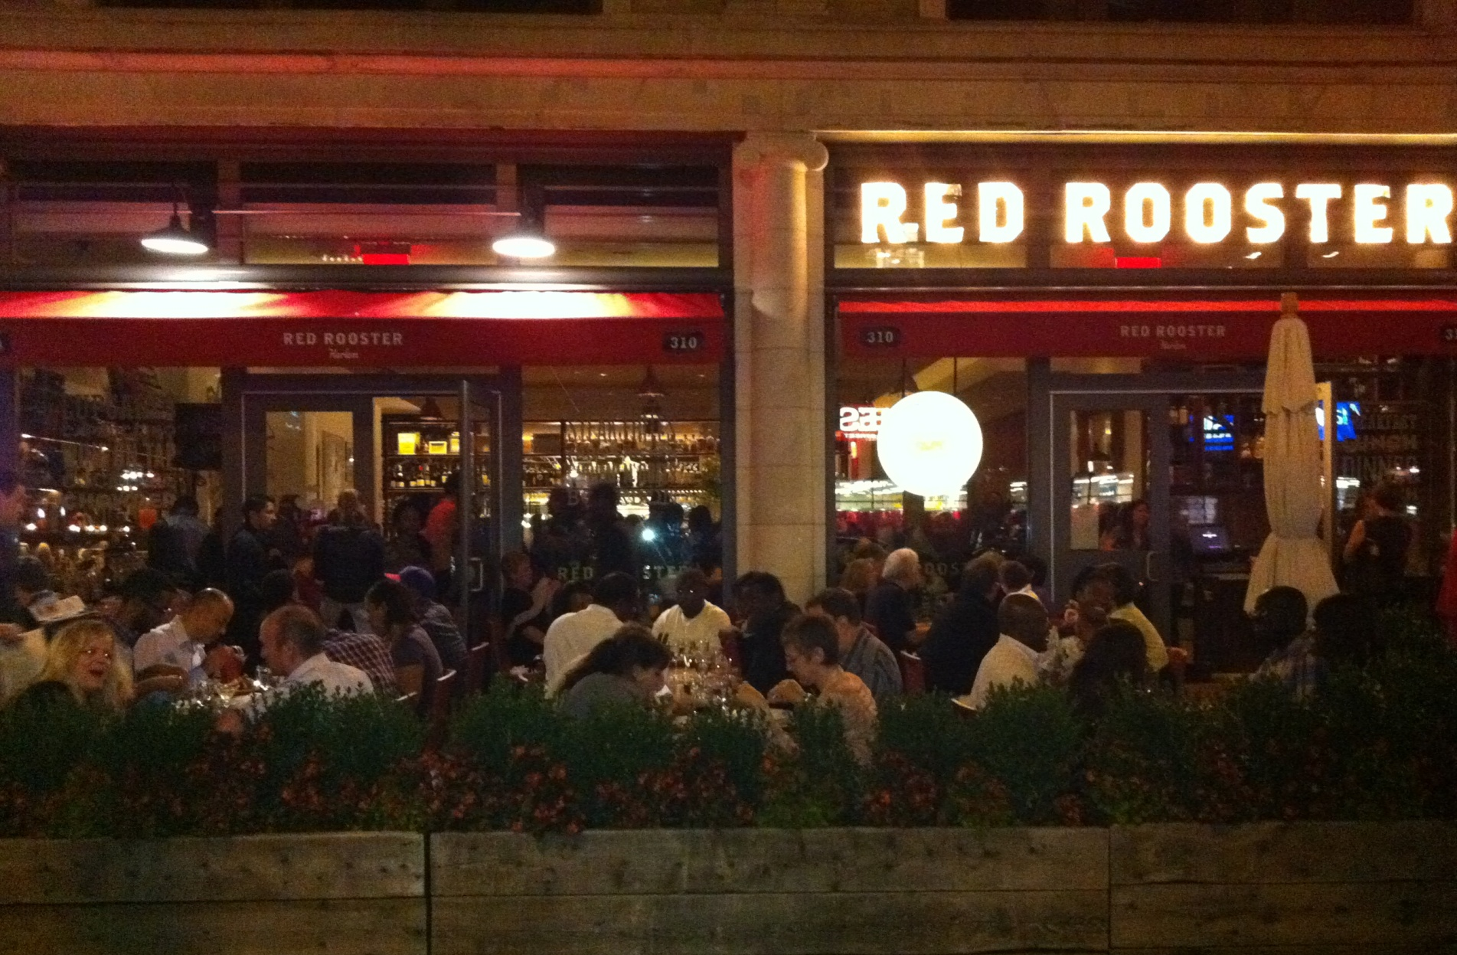
Red Rooster Harlem Nightlife

Slide 17
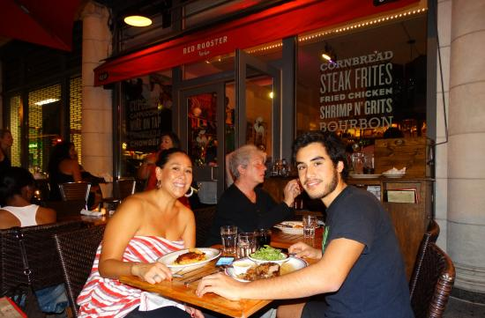
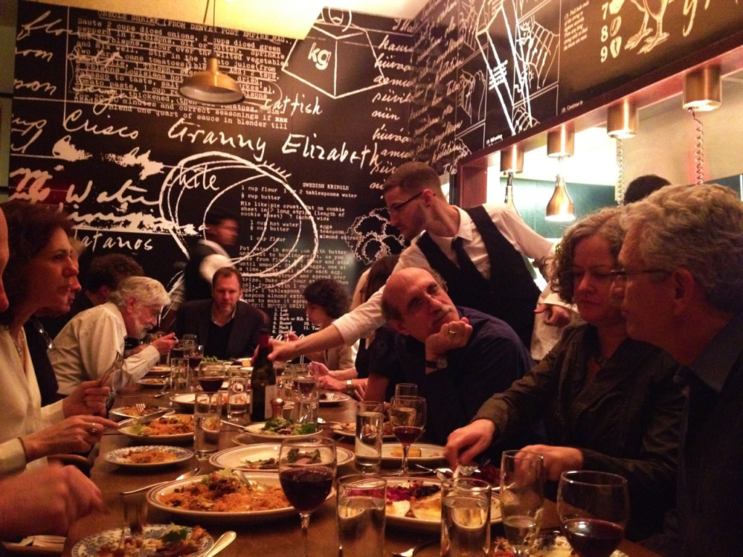
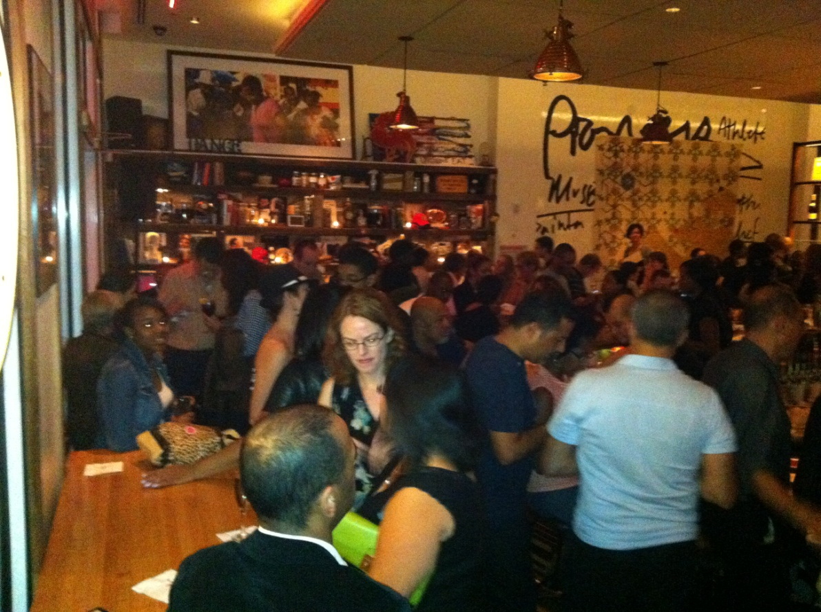
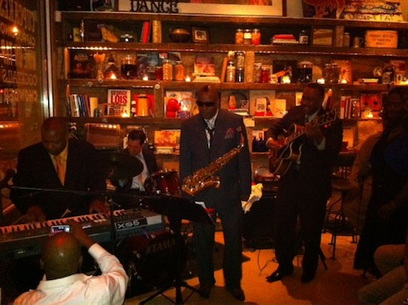
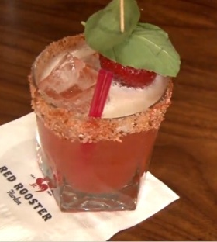
Red Rooster Harlem-Nightlife

Slide 18
Ginny’s Supper Club
Wander downstairs at the Red Rooster Harlem and you’ll soon pick up the trail of its spirited sister venue. With a hat tipped to Harlem’s Renaissance, Ginny’s Supper Club is a modern reincarnation of the glamorous speakeasies and Harlem nights of the Twenties – an intimate lounge with a warm bourbon glow and an even warmer welcome.
Ginny’s operates in multiple capacities throughout the week. Private receptions for corporate, civic and community groups, jazz performance theater, intimate dining setting and spirited late night lounge. Whatever your flavor, Ginny’s can likely provide the setting for a comfortable, elevated, memorable experience.
The mix of local and internationally acclaimed talent keeps maintains the essence of approachably elevated moments. A carefully managed booking and artist relations system assures the sustainability of this unique and addictive entertainment flow.
We are humbly proud to continue Harlem’s rich history of entertaining the world.

Slide 19
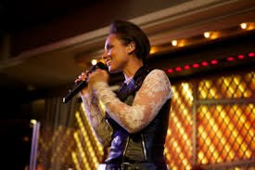
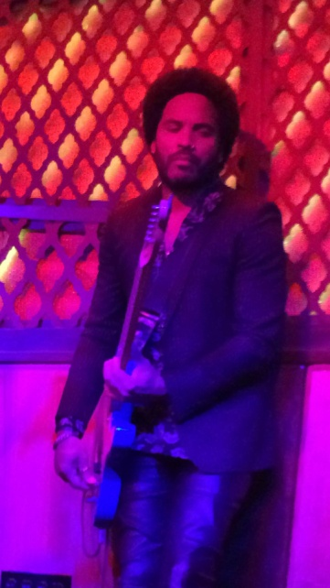
Ginny’s Supper Club – Premier Performances
Roberta Flack
Alicia Keys
John Legend
Wynton Marsalis
India Arie
Lenny Kravitz
Eric Benet

Slide 20
Ginny’s Supper Club - Lounge

Slide 21
Ginny’s Supper Club–Special Events & Private Dining

Slide 22
Ginny’s Supper Club–special Events
Artist Talks
David Dinkins Book signing Hosted by Alpha Phi Alpha Fraternity
Book Discussions
Holiday Parties
Cooking Demonstrations

Slide 23
Streetbird rotisserie
Streetbird is a rotisserie chicken restaurant that has its roots in street food from around the world. Inspired by Harlem Americana, we look to the birth of hip hop, as well as street culture for aesthetic inspiration and feel. Streetbird is fast, fun, fresh, and familiar. It's where you can pick up a rotisserie bird on your way home from work, have it delivered from our kitchen to yours in minutes, or kick back with friends and family in the restaurant to celebrate a birthday, or even just a Tuesday.
Streetbird, is perched on an iconic corner on one of Harlem’s high traffic corridors. It strives to be the classic diner with urban sensibility. Its approachable price point positions it as a local staple, provider a healthier, tastier, more enjoyable option on a frequent basis.
Like no other, Streetbird is urban America’s answer to the love of chicken and hip diners…

Slide 24
Streetbird Rotisserie

Slide 25
Streetbird Rotisserie

Slide 26
Marcus Bermuda
Marcus’ Bermuda was a first time expansion into the Caribbean marketplace. In partnership
with the Hamilton Princess, Marcus’ celebrates the best of Bermuda with vibrant flavors, warm
hospitality and the freshest seasonal ingredients. The colorful menu is executed by Executive Chef Leonardo Marino, which hailed from our very own Red Rooster Harlem in New York.
The restaurant offers breathtaking panoramic views of Hamilton Harbor from a spectacular outdoor terrace. Signature specialties are prepared on the wood-burning grill in the open kitchen, infusing the blend of local flavors with world class dining.
The Bermuda destination immediately became a hot-spot upon opening, hosting live music sessions and private events for corporate groups, taste-making tourists and local gatherers.

Slide 27
Marcus Bermuda

Slide 28
Eatery Social
Food prepared from scratch every day, Eatery Social in Malmo, Sweden takes the rich diversity of street food to create a sociable setting that suits all the manner of occasions. Eatery Social transports people from Malmo to the streets of Mexico, New York and L.A, both in vibe and culinary experiences. We offer a range of food, drinks, street culture and lifestyle inspired by some of the finest coasts and cities in the world.
The restaurant is an informal and lively space , centrally located by the canal at Clarion Hotel and Congress. Similar to customs in Mexico, where tacos are enjoyed both everyday and for special celebrations, Eatery Social becomes the perfect venue for any occasion. Guests join us throughout the week, winding down after work and turning it up a notch on the weekends, allowing the atmosphere and music to lead to a great night out. During the summer months, a large outdoor terrace allows guests to enjoy sun and fantastic views of the canal.

Slide 29
Eatery Social

Slide 30
Norda Bar & Grill
The Cornerstone of Norda Bar & Grill’s philosophy is to take and combine the best of two distinct cities that have shaped us, Gothenburg, Sweden and New York. Here in this eatery we are inspired by the local street classics, served in a unique way –with quality ingredients, careful preparation and great love. The menu features the most sophisticated seafood and meat dishes.
Steeped in the core of the Clarion Hotel Post, Norda is positioned as the anchor food and beverage experience in the superbly restored Postal Hall that host premier hospitality and culinary experiences. Our expertise has been woven into the design experience, contrasting modern Italian furniture with classic touches that warm the spaces throughout. An exciting fusion is created that is, at once, a unique, cultural blending. We manage the main dining room, room service, bars and coffee services. Altogether, Norda Bar & Grill becomes a rare coming together of American & European food and décor, setting the stage for many such culinary, hotel collaborations across Europe we’ve been able to execute. The success of this brand, not only helped to restore an historic site, but also has forged a path for many formidable spin-off eateries throughout Scandinavia.

Slide 31
Norda Bar & Grill

Slide 32
Kitchen & Table
The multi-cultural mix of people, lifestyles and food are what make Manhattan so incredible. Manhattan is definitely the root of broad range of unique flavors.
Our group, based in New York has brought Manhattan’s international flavors and cuisine to Scandinavia and combined them with local ingredients to bring an exciting mix of taste and indulges found in the greatly received, Kitchen & Table.
The Kitchen and Table concept represents over 20 independent locations between Norway and Sweden, each of which takes this ecletic, high caliber approach to culinary and dining. In partnership with Clarion Hotels, Kitchen and Table represents the highest level of brand scaling and execution in a dynamic, cosmopolitan marketplace.

Slide 33
KitChen & Table

Slide 34
Marc Burger
Marc Burger combines world flavors with American tradition, creating exciting and unique burgers in a casual, family friendly, moderately priced environment. We focus on a wide selection of high-quality char grilled burgers (including fish and chicken sandwiches), served with a range of flavorful toppings, freshly made sides and classic American drinks. Mahi- Mahi fish burgers, turkey burgers, shakes, salads and warm, fresh deserts round out the classic burger-joint menu.
In partnership with Macy’s Celebrity Culinary Court, MSG created Marc Burger in contribution to an American classic. Marc Burger collaborates with local American growers, producers and purveyors, while emphasizing care in food preparation, assuring delivery of some of America’s best sustainable homegrown products. The keen approach to seasoning along with higher quality products enables the eatery to offer a finer, healthier quick-service food alternative.
The partnership with a major national U.S. retail chain, represents the brands solid reputation within the mainstream American marketplace.

Slide 35
Marc Burger

Slide 36
Harlem Eat Up Food Festival
Our group founded & launched Harlem EatUP, validating Harlem as a viable food destination
President Clinton Announces Harlem EatUp

