Slide 1

North Miami Beach asked,
WHO ARE WE?
The Development of a Marketing & Brand Plan

Slide 2
Who Are We?
The Challenges
North
Miami Beach
Boundary
Recent achievements not associated with reputation
Irregular boundaries (like many cities)
Confusion – “Miami” included in several cities’ names
Lack of place positioning within the muddled Miami-Dade area
North Miami
North Miami
Miami Shores
Miami Beach
North Beach

Slide 3
City’s Goals
  Create Brand Identity
  Increase Community Engagement
  Attract Private Investment
  Promote Tourism
  Recruit Corporate, Industrial, and Retail Businesses

Slide 4
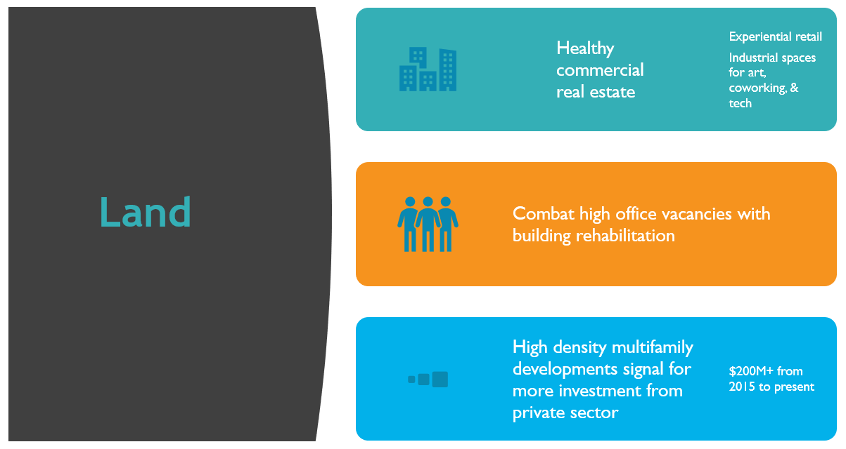
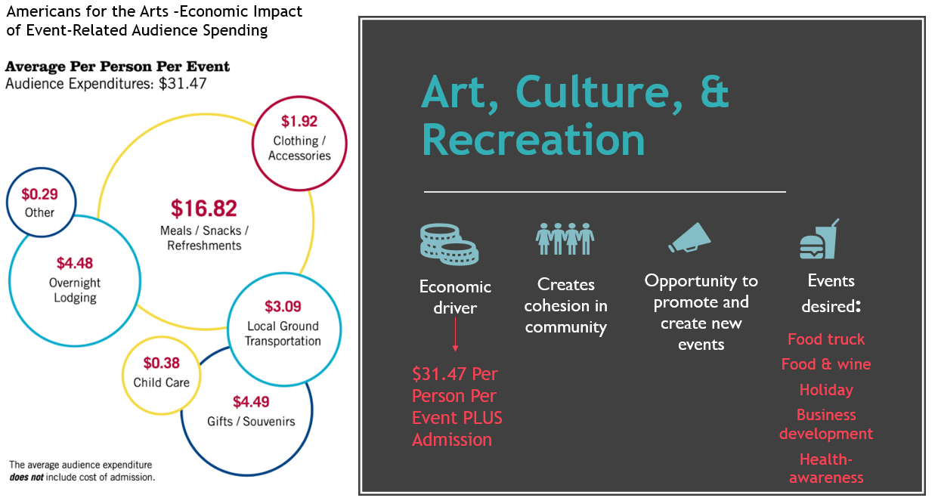
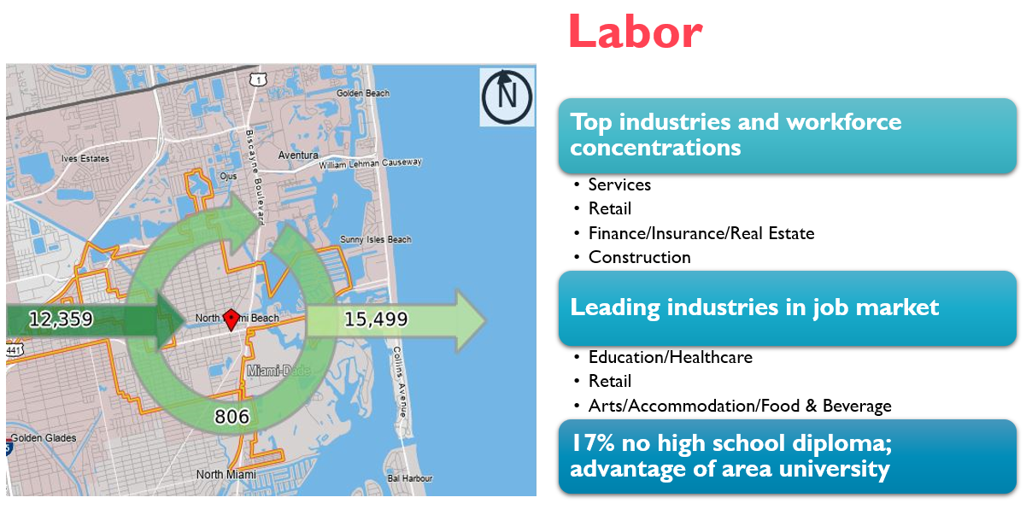
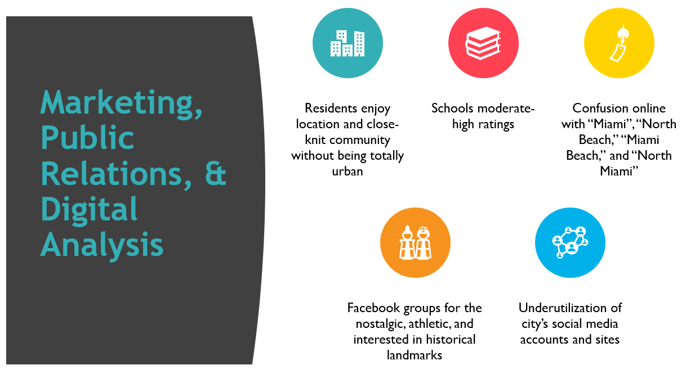
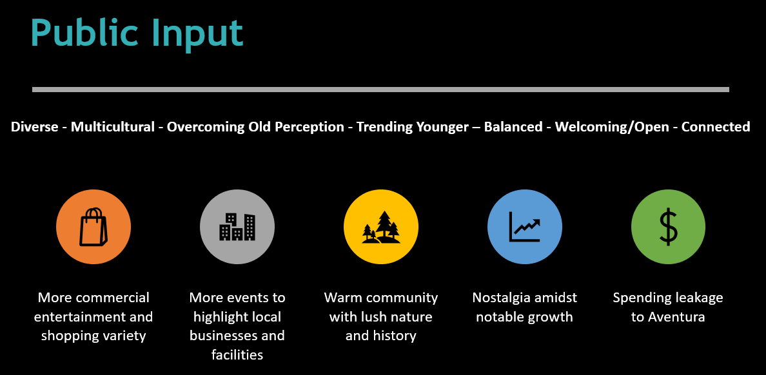
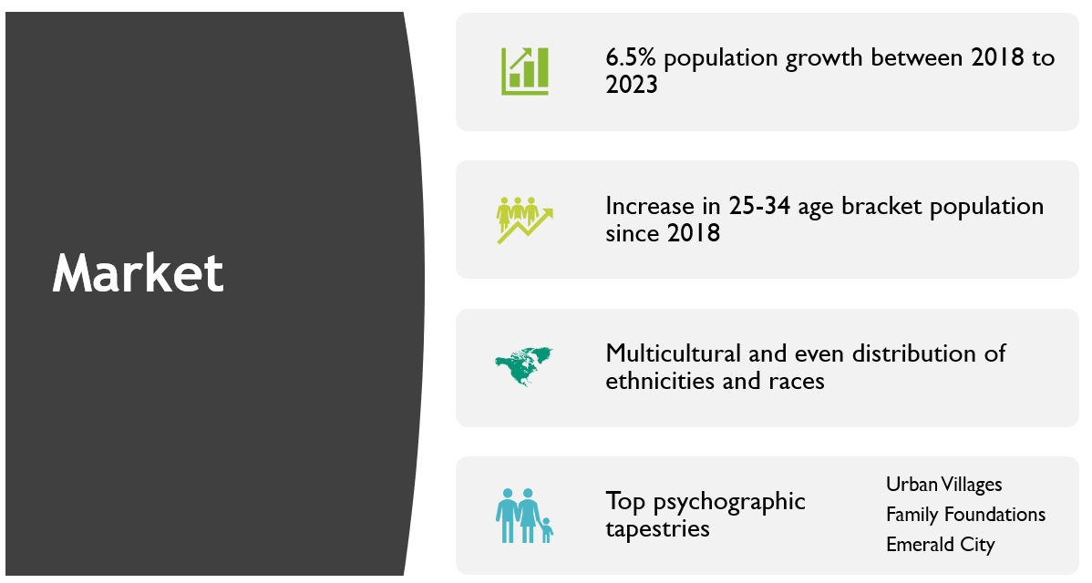
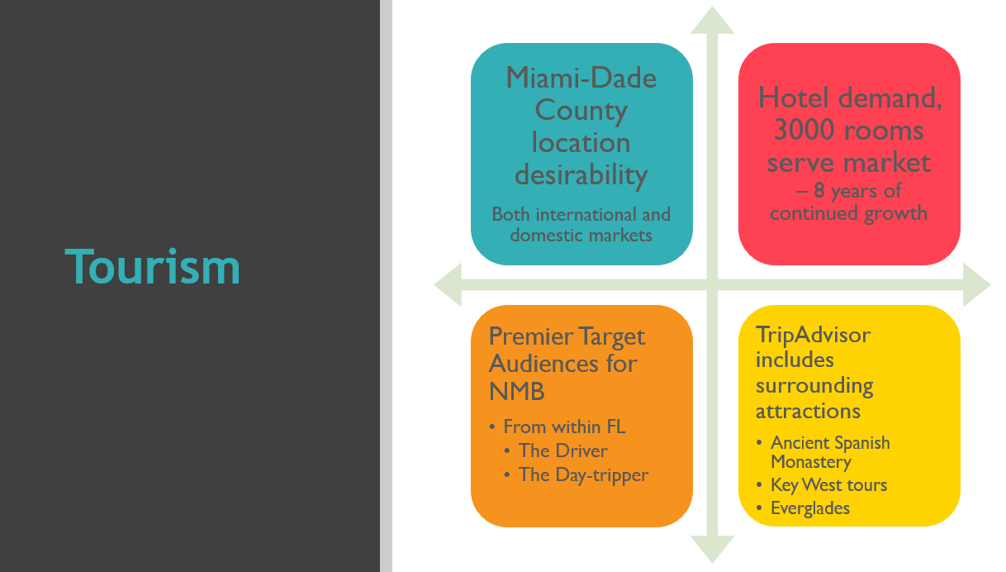
Who Are We?
The Approach
City addressed the question with openness - involved and actively listened to a variety of stakeholders
Analysis of land, labor, markets, social media/communications channels, online presence and reputation, arts and cultural offerings, tourism, and a local media snapshot
Business and community surveys in three languages
Focus-group meetings/public input meeting
One-on-one meetings with elected officials and stakeholders

Slide 5
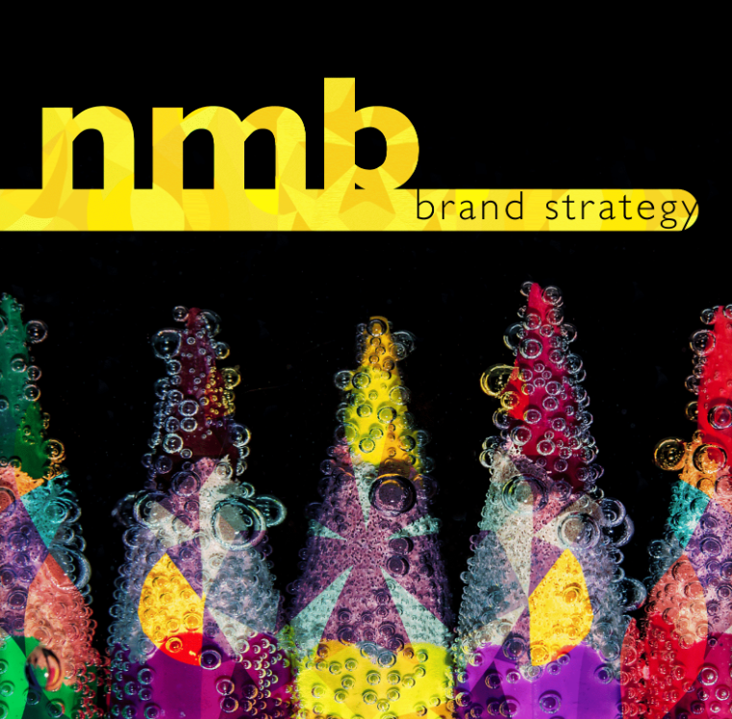
Who Are We?
The Data Drove:
Creative Process
The Strategic Plan

Slide 6

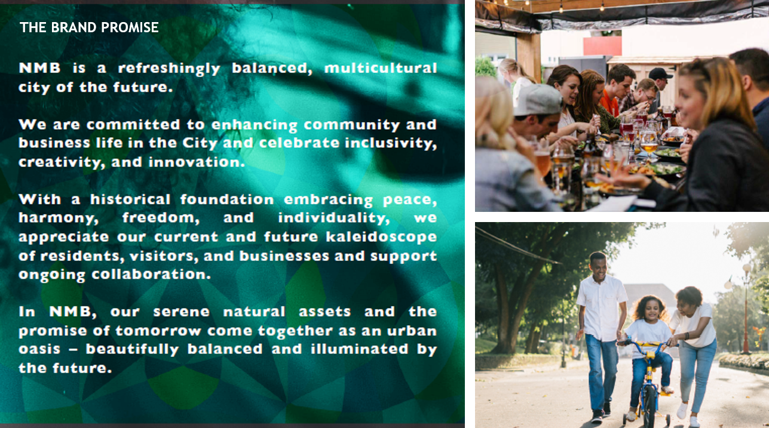
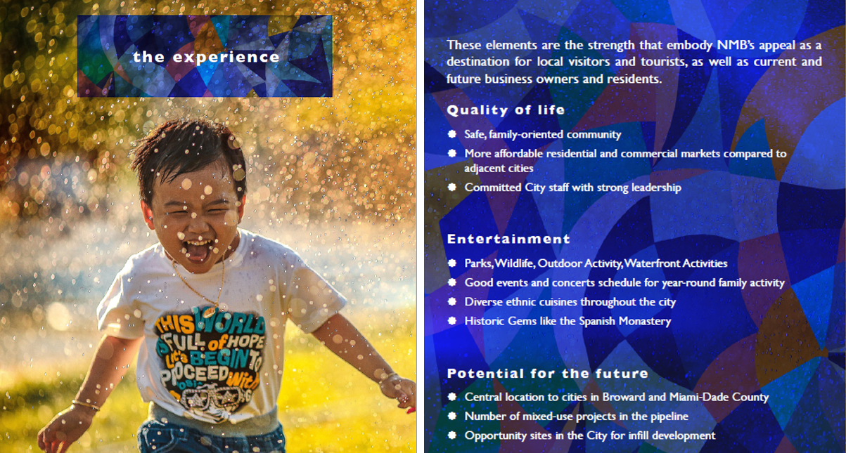

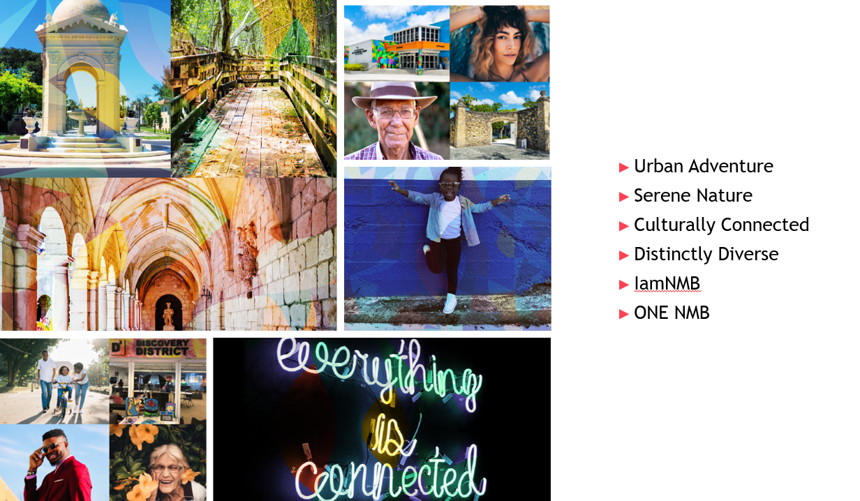
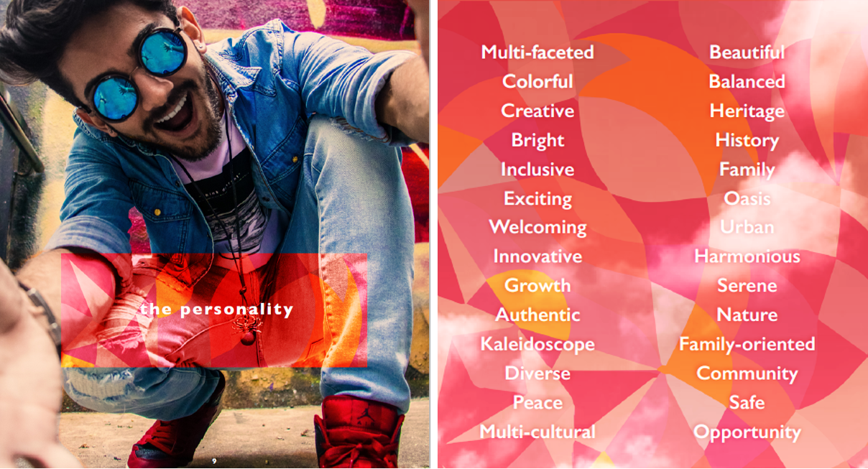

The Creative Process: The Brand Strategy & Guide
Analysis-based conclusion: it was difficult to decisively answer “Who are we?” was because North Miami Beach is truly balanced
Economically balanced: the city’s economy is sustained yet growing across different sectors
No ethnic group or socioeconomic group outweighed the next
Pinpointed the underlying problem. One staff member put it best: “No wonder we couldn’t figure out who we are! We really are everything and everyone.”

Slide 7
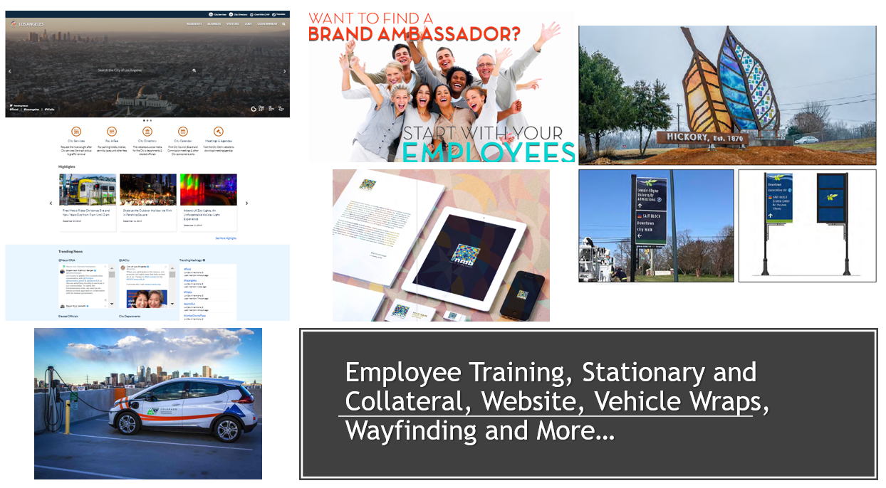
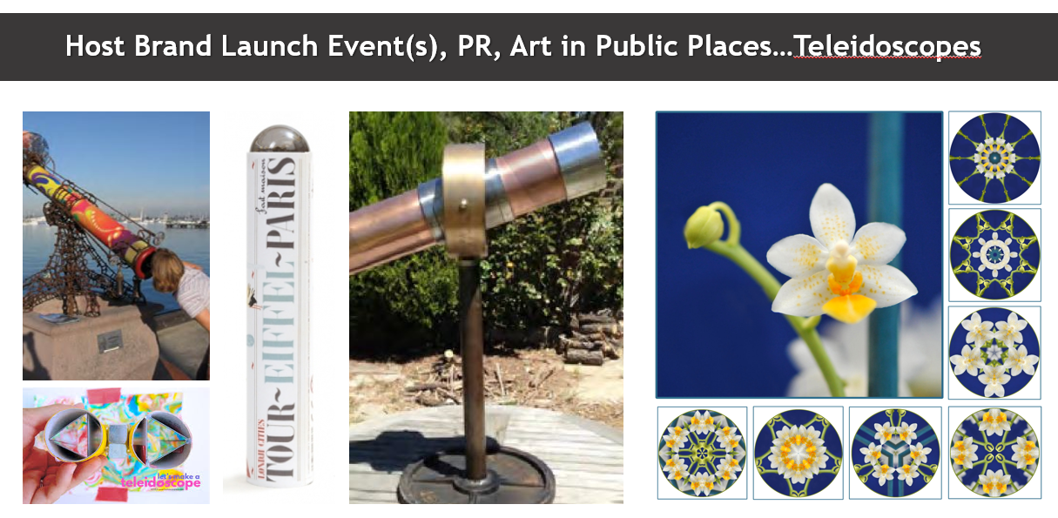
The Plan:
Goal 1. Creating a Brand Identity
Adopt Brand Promise
Adopt New Logo and Brand Standards Guide
Launch Brand – Campaign Messages

Slide 8
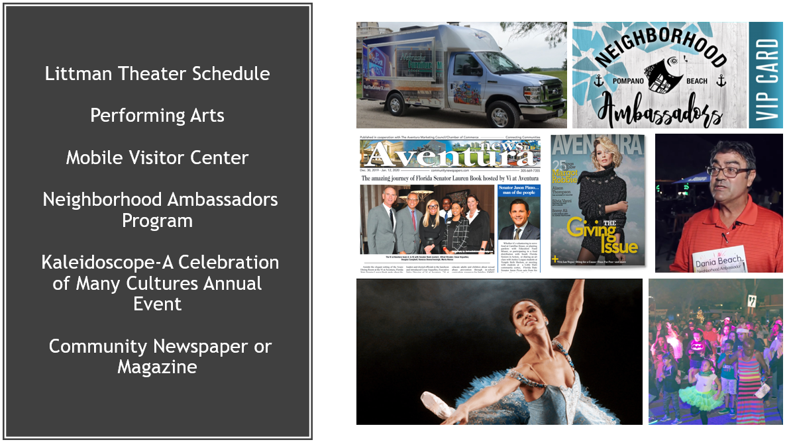
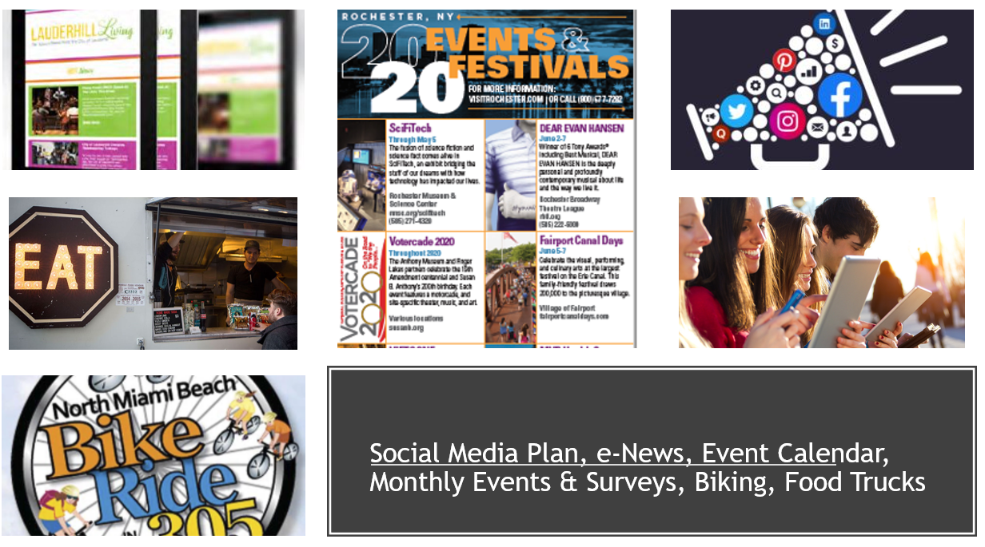
The Plan:
Goal 2. Increase Community Engagement
  Improve social media engagement
  Improve e-communications
  Launch comprehensive event/local assets marketing strategy
  Develop neighborhood-centric event program (extension of Town Hall initiative)

Slide 9
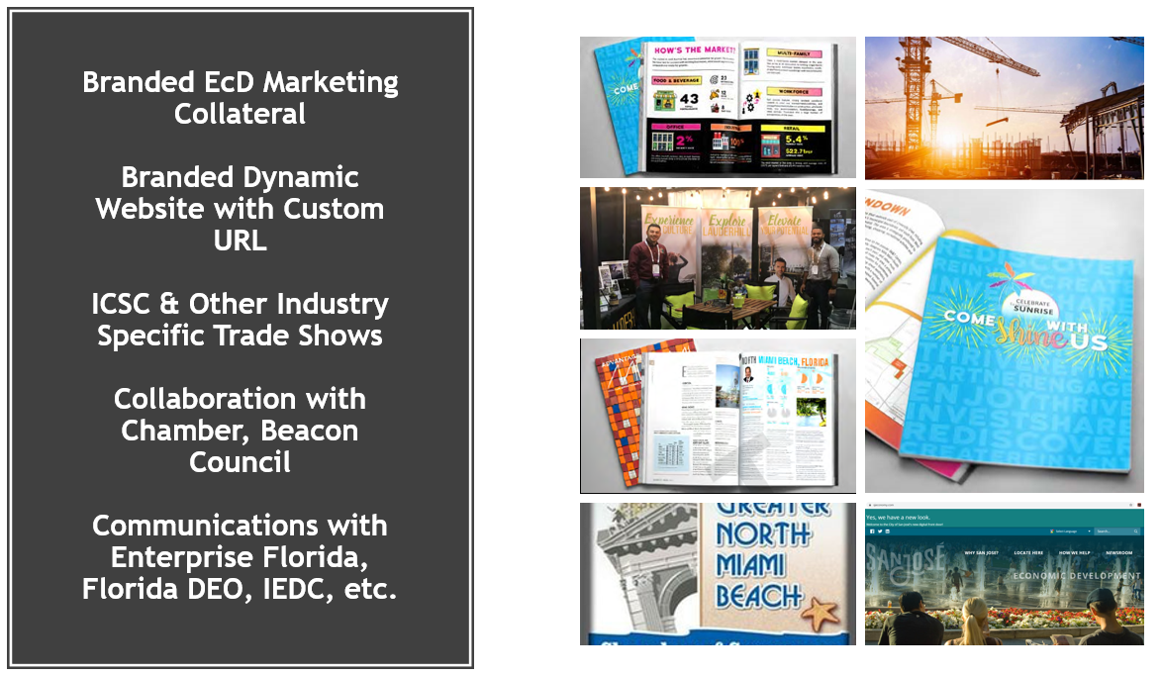
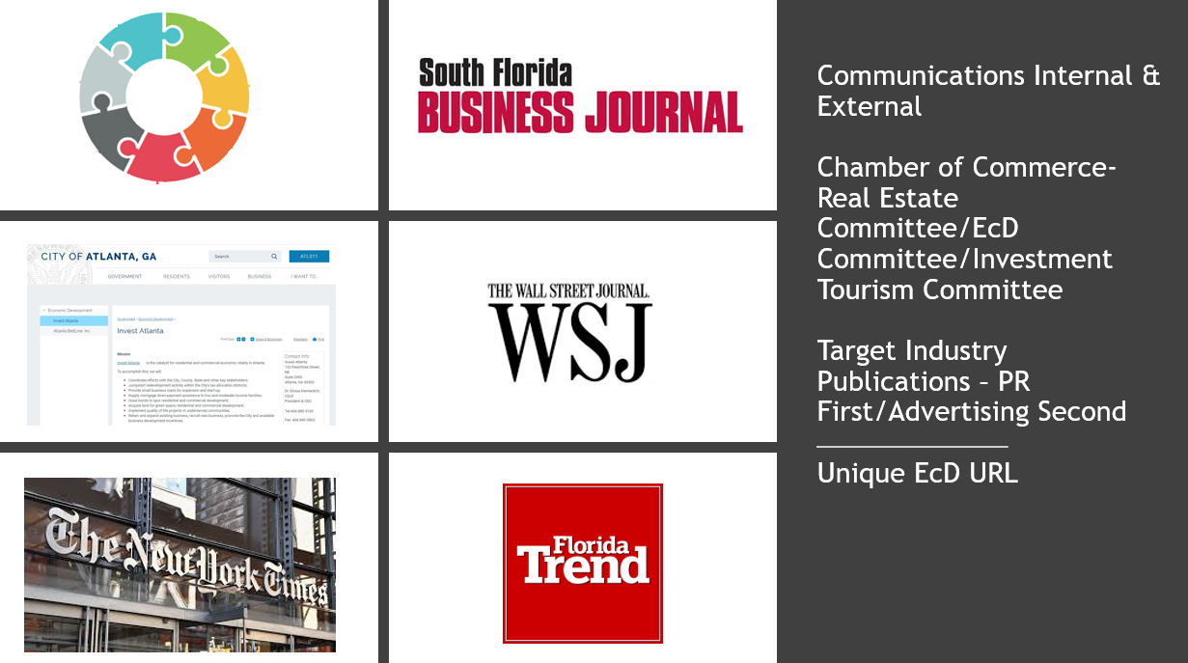
The Plan:
Goal 3. Attract Private Investment &
Goal 5. Recruiting Businesses
  Promote available opportunities for new development and redevelopment to target audiences
  Increase communications with County, Regional and State economic development organizations
  Increase communications with local commercial real estate community
  Launch strategic marketing campaign to target industries

Slide 10
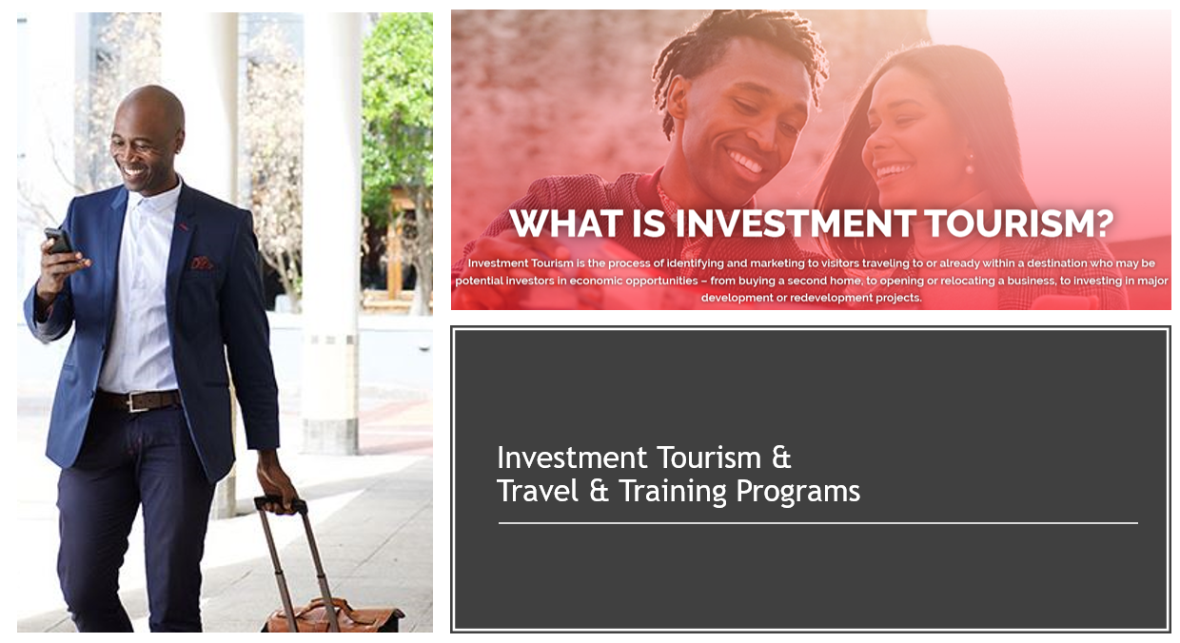
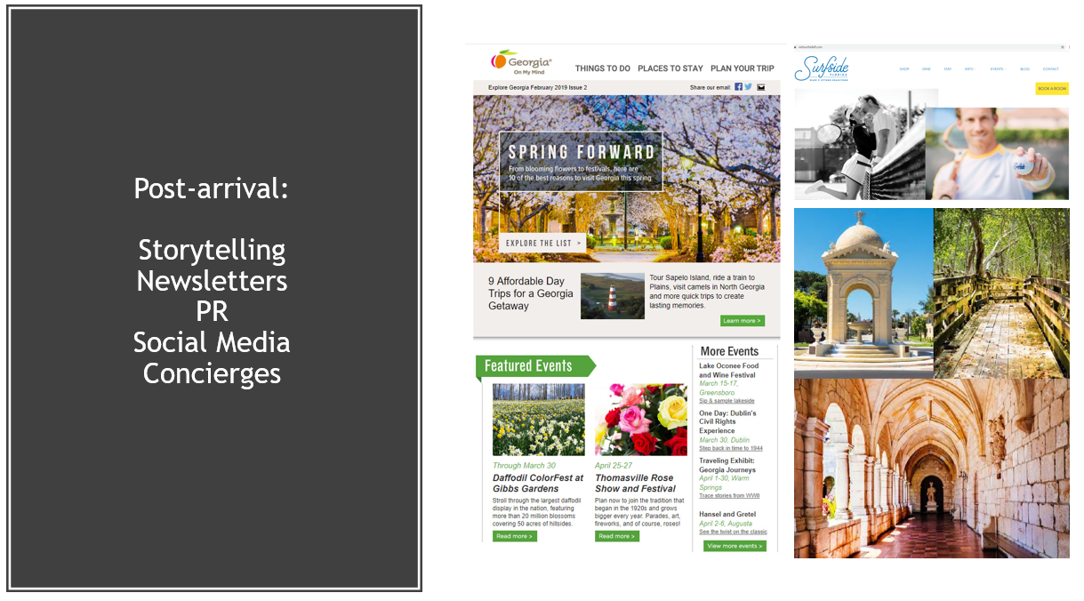
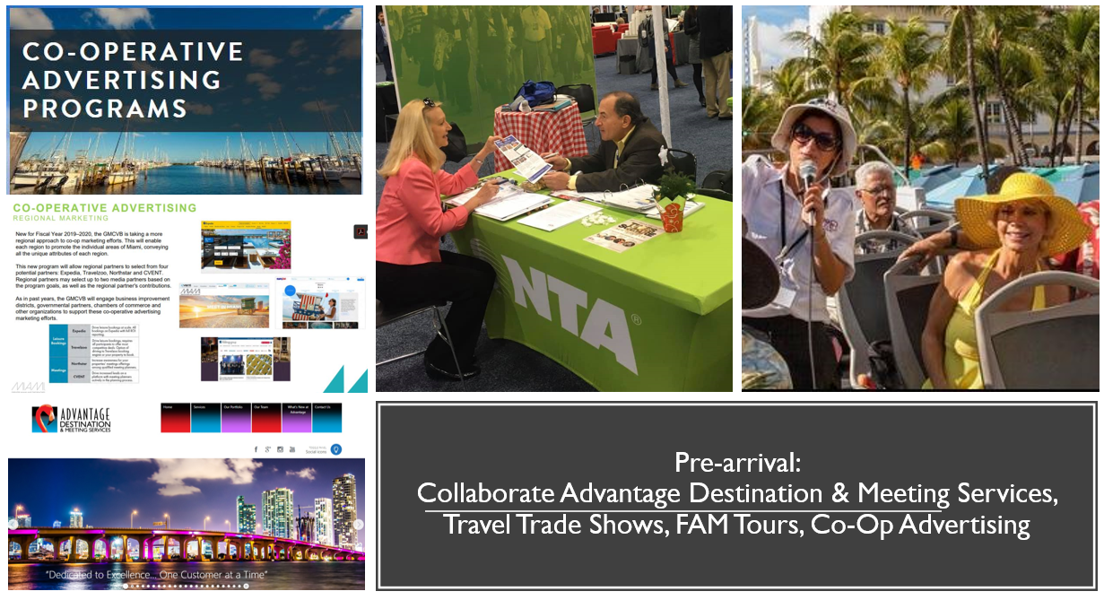
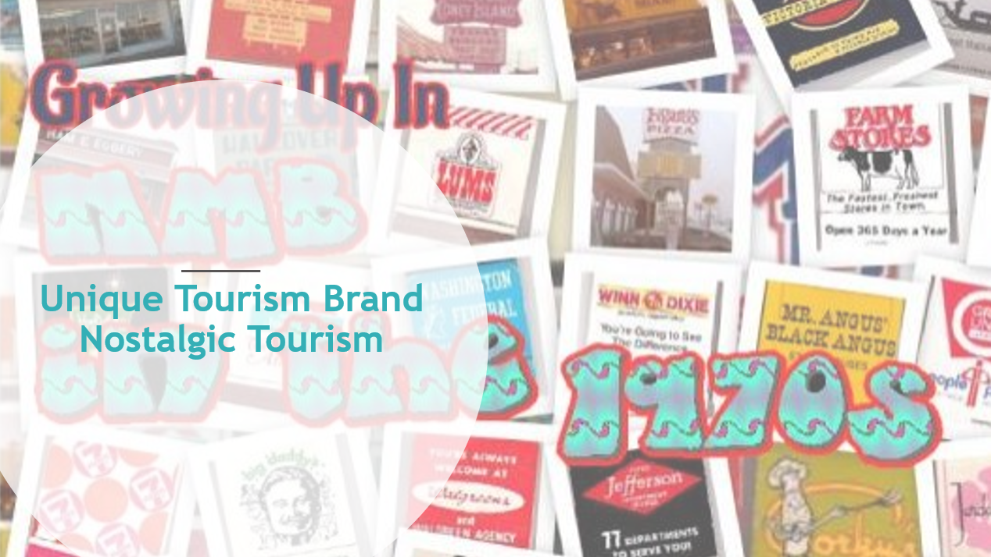
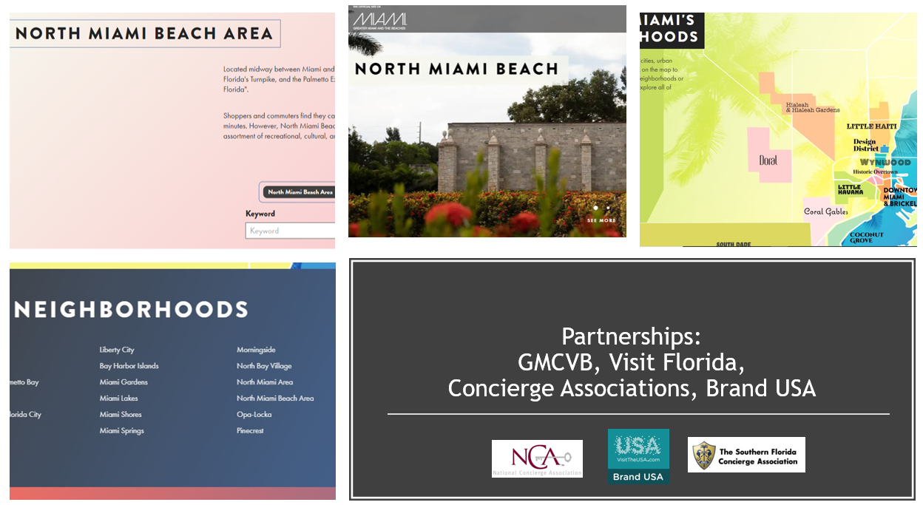
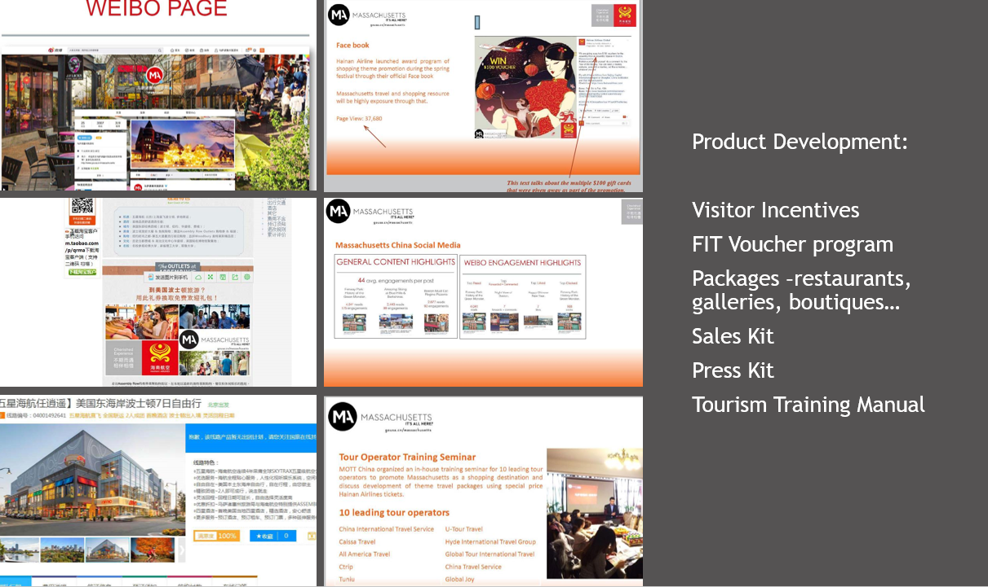
The Plan:
Goal 4. Promoting Tourism
Partnership Development to increase leveraging opportunities
Product Development for the travel trade
Pre-Arrival Initiatives for brand recognition prior to arrival
Communication – Post Arrival tactics to capitalize on the pre-arrival programs
Create a unique tourism brand for NMB – “Nostalgic Tourism”
Investment Tourism to increase revenue to the city
Training and Education Programs for the Stakeholders and Travel Trade

