Slide 1
Outstanding New Building Project
in historic downtown New Port Richey

Slide 2
Main Street Landing is a Mediterranean themed mix-use (commercial/office/apartment) redevelopment project with 80 residential units and 15 commercial units. The project is located on the Pithlachascottee River and Main Street. The apartments feature 10 and 11-foot-high ceilings, granite countertops, with concrete and steel construction.
The project was originally initiated in 2004 when Ken and Linda McGurn expanded their commitment to redevelopment by launching this mixed-use project in downtown New Port Richey. Intended as a catalyst for the revival of New Port Richey, the project was to feature a new block of retail with nearly 60 condominiums on the Pithlachascootie River which bisects the downtown. Initial excitement resulted in a near sellout of residential units and, with deposits in hand, construction of the project got underway.

Slide 3
Unfortunately, delays due to site engineering along with shortages of labor and materials due to a high demand in the construction industry as well as shortages caused by Hurricane Katrina, resulted in the shutdown of the project. Pre-sale deposits were returned to purchasers/investors.
The project remained in hiatus after a futile attempt to negotiate incentives with the City in subsequent years.

Slide 4
Finally, in 2017, an agreement was reached with The New Port Richey Community Redevelopment Agency offering $1.75 Million in incentives, including; abatement of permit fees, impact fees and a Tax Increment Financing payment, when the project completed.
Additionally, the CRA is offering new tenants Leasehold Improvement Grants offering 50% match of eligible expenses. New tenants may also qualify for 50% reimbursement of rent, up to $1,250 per month, for the first year with a 2 year lease.
The project was completed in 2019 and received Certificates of Occupancy for both the residential and commercial components.

Slide 5
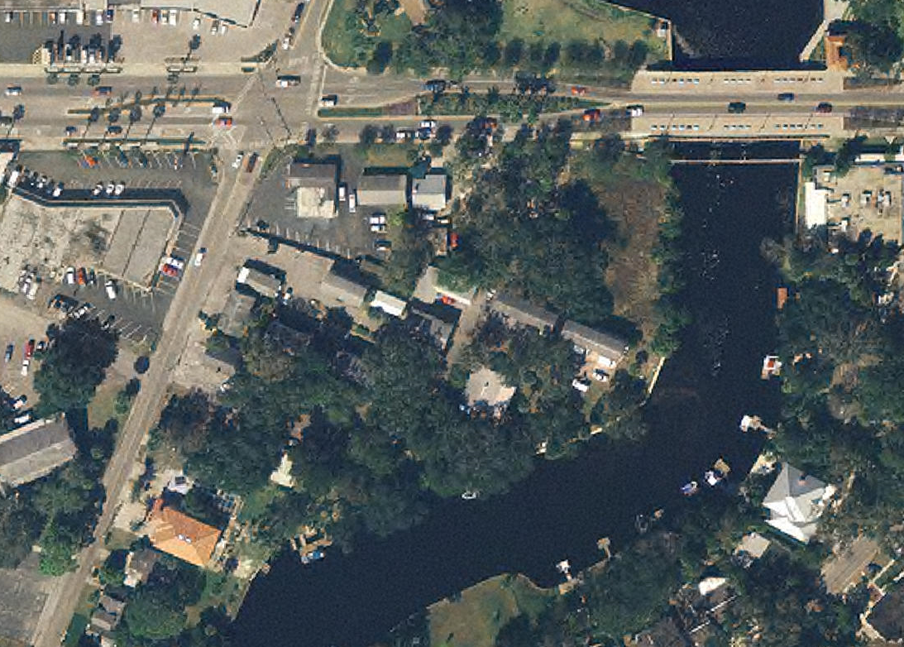
2004

Slide 6
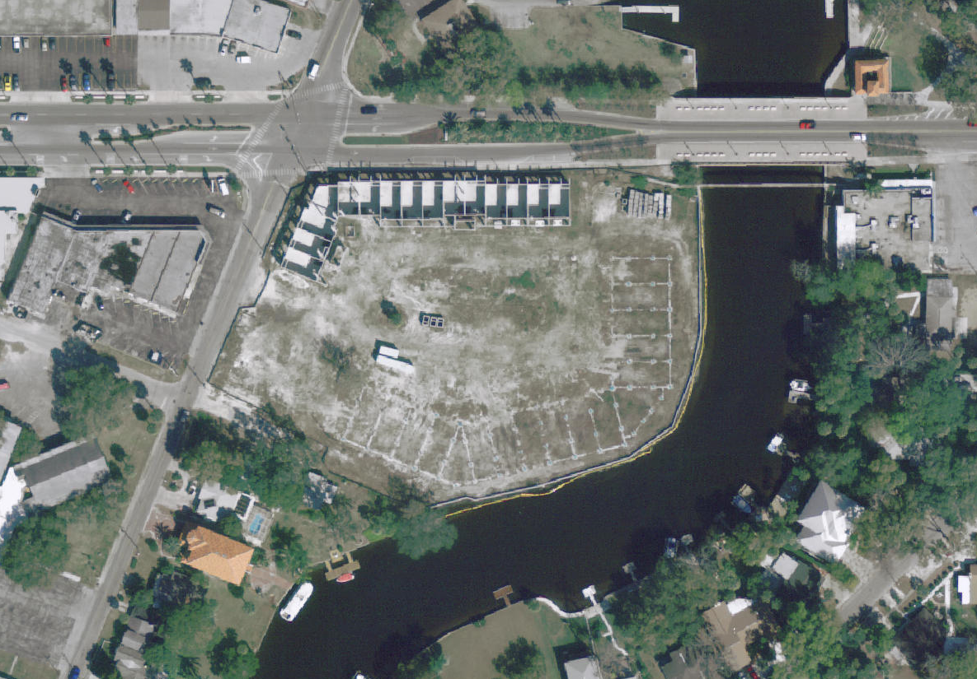
2007

Slide 7
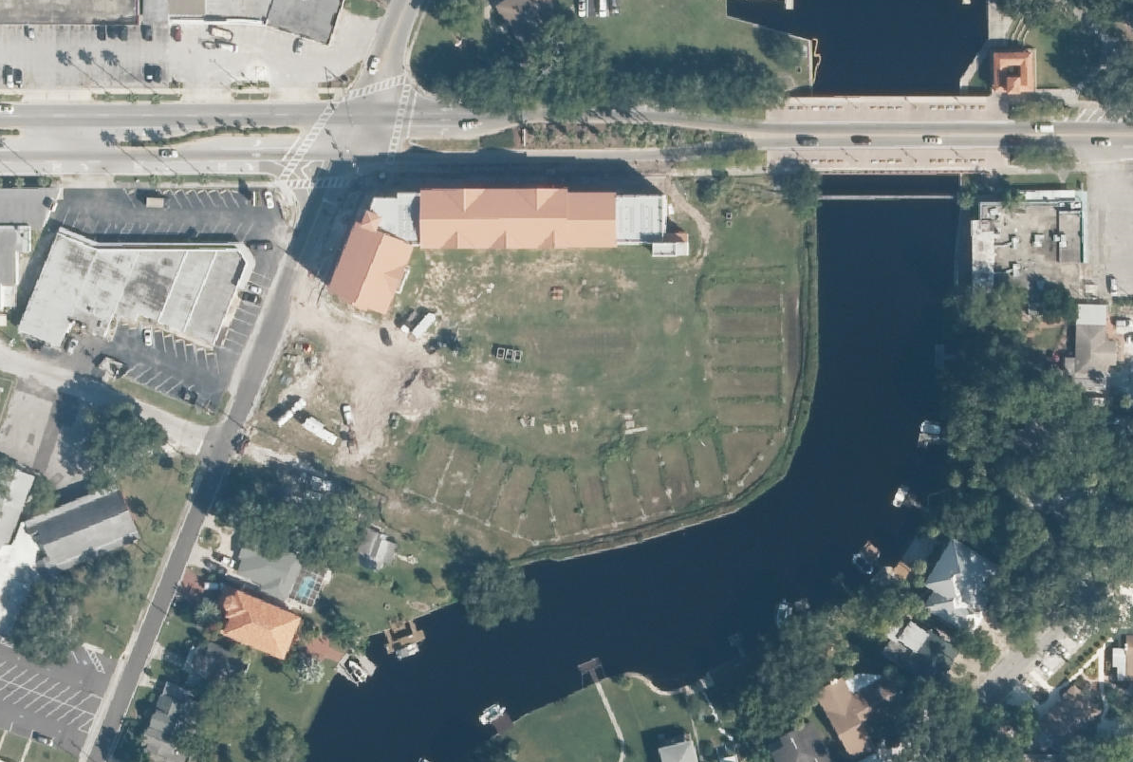
2013

Slide 8
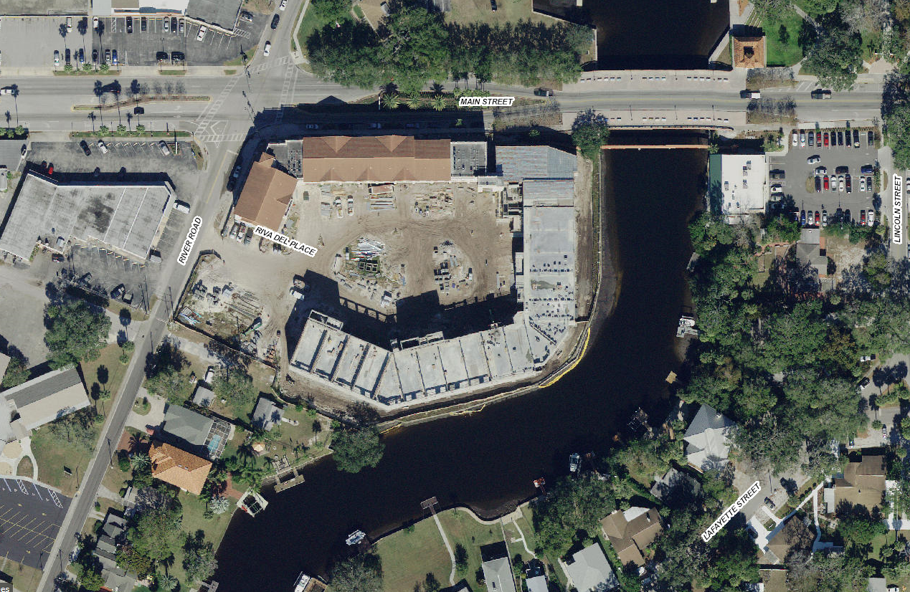
2018

Slide 9
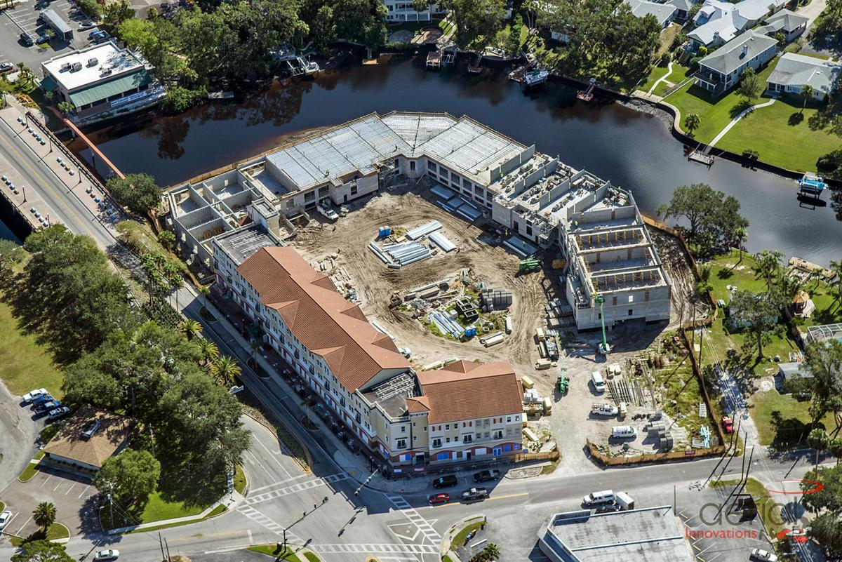

Slide 10
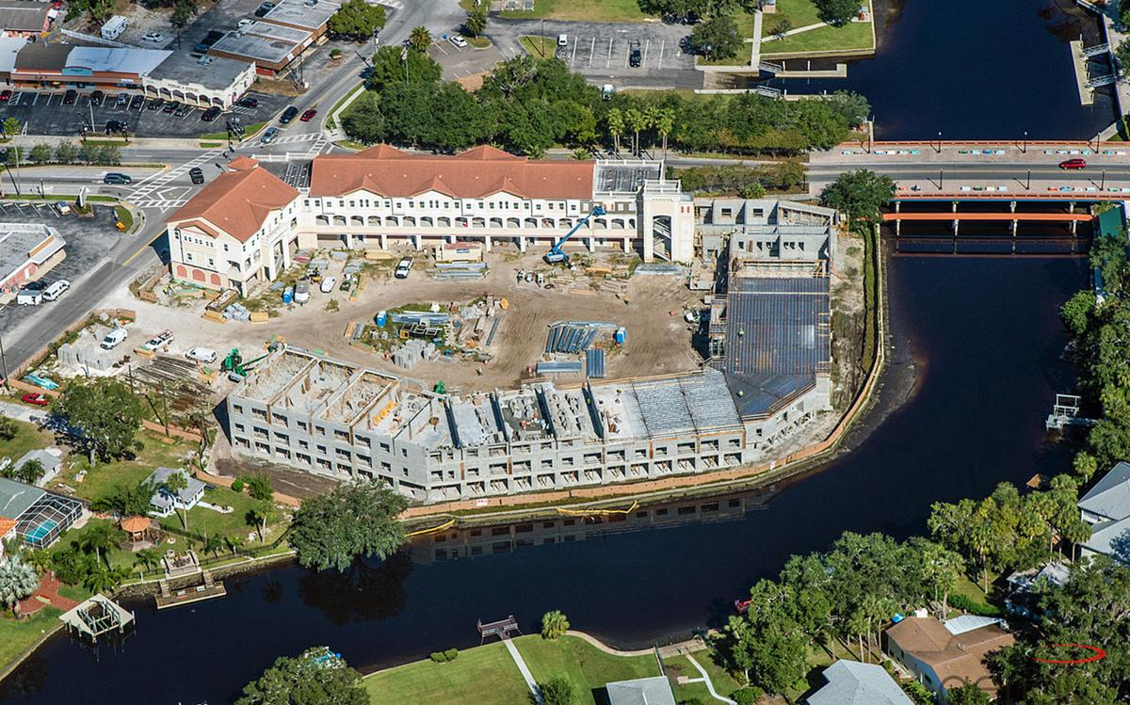

Slide 11
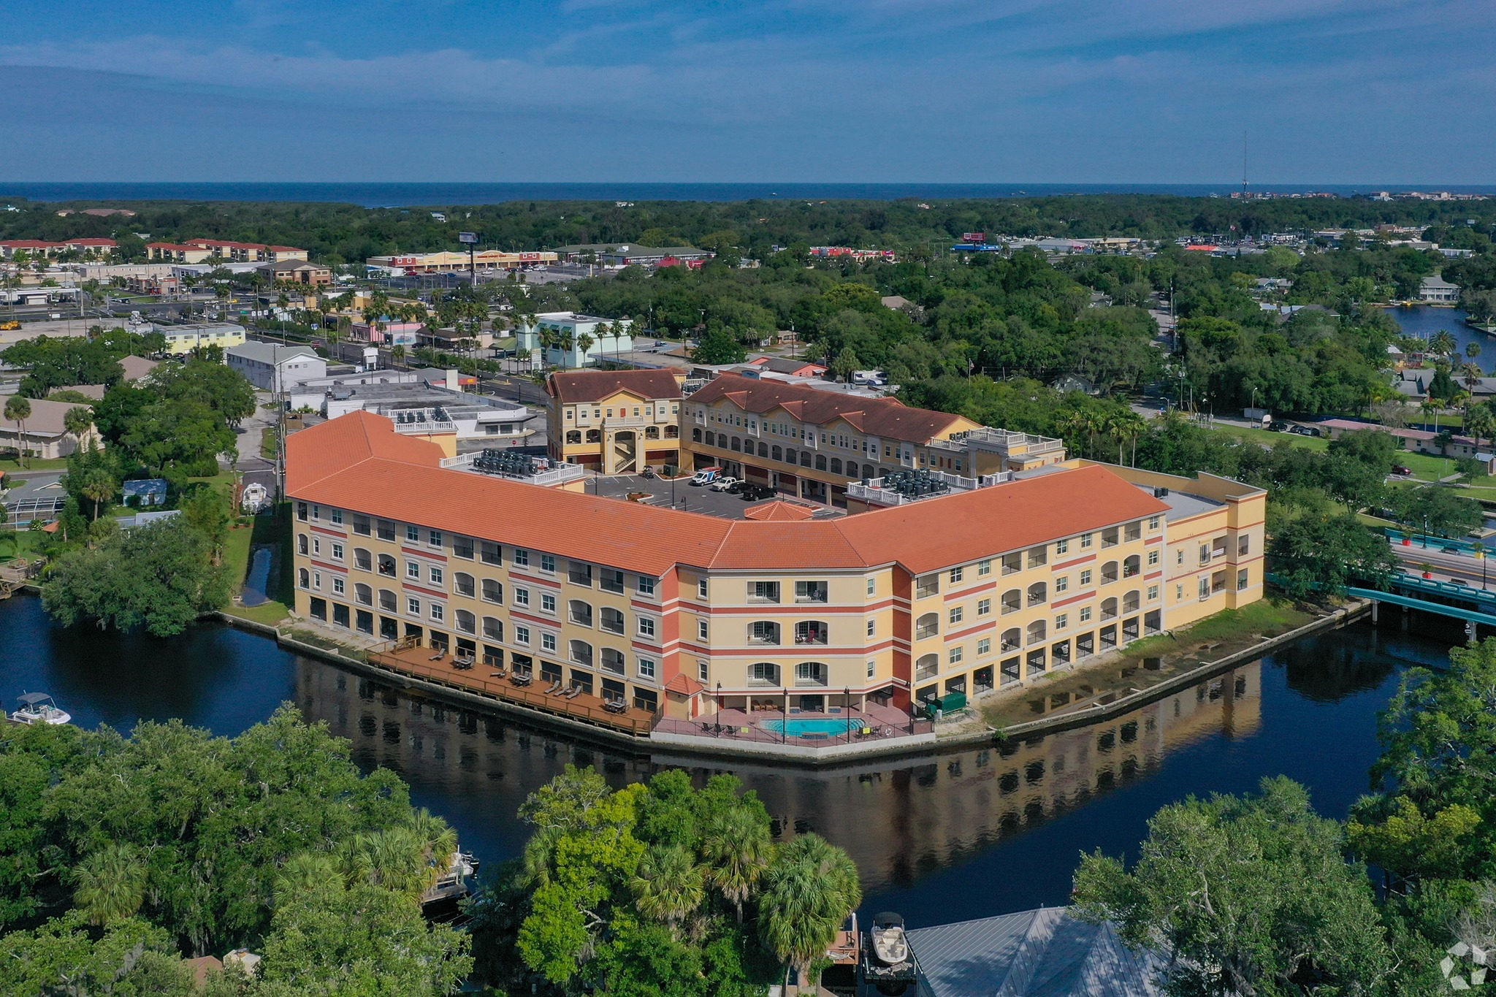

Slide 12
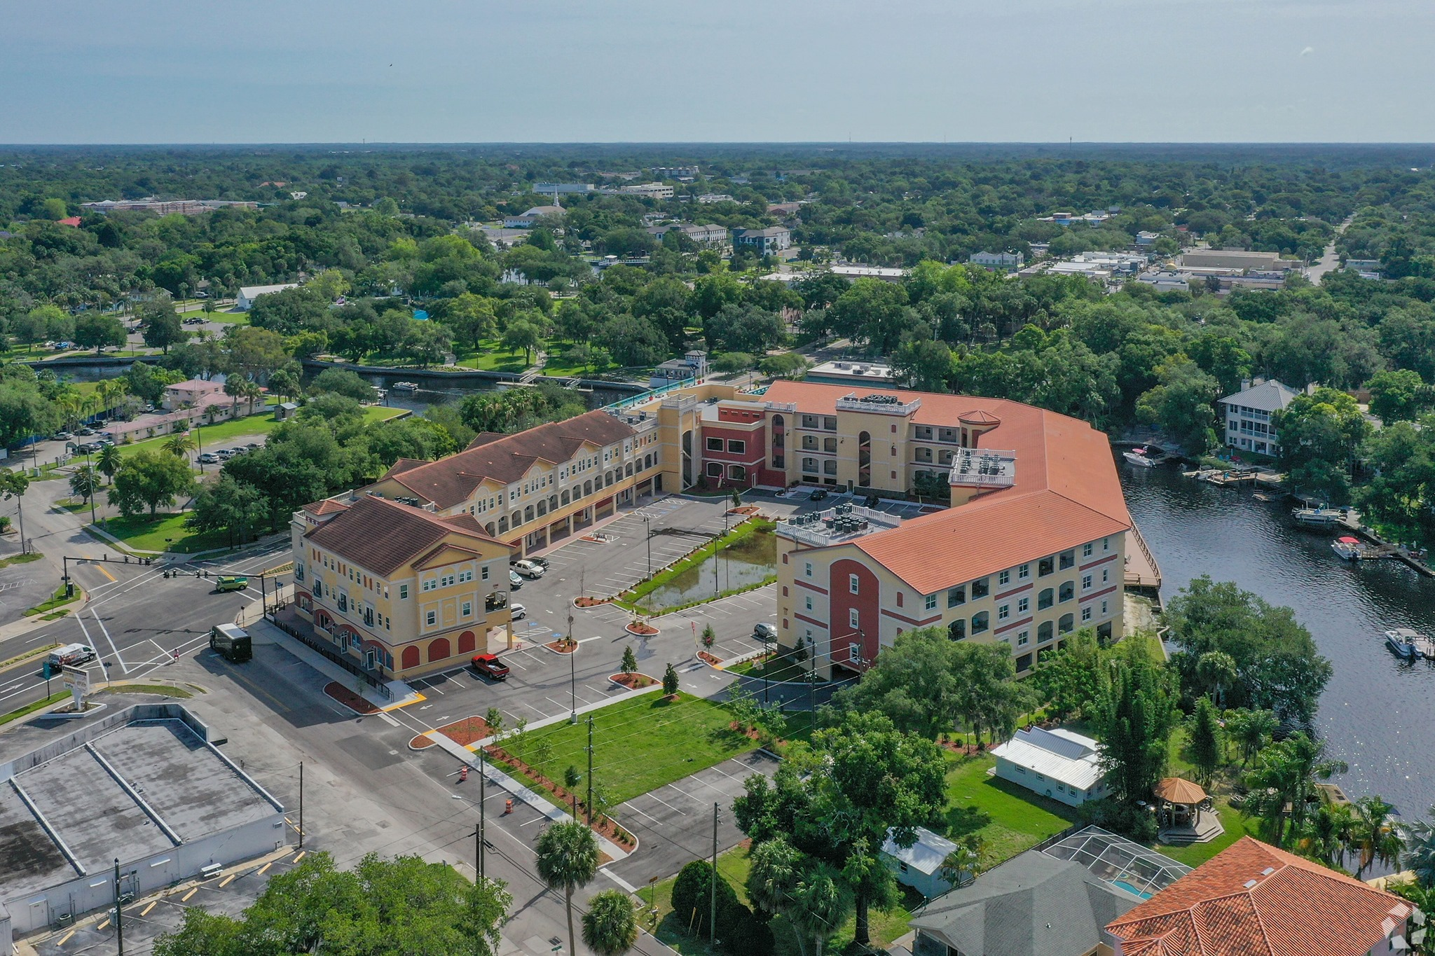

Slide 13
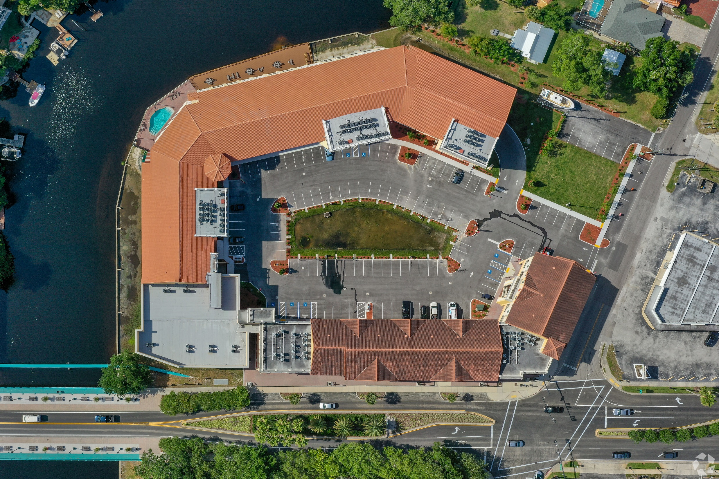

Slide 14
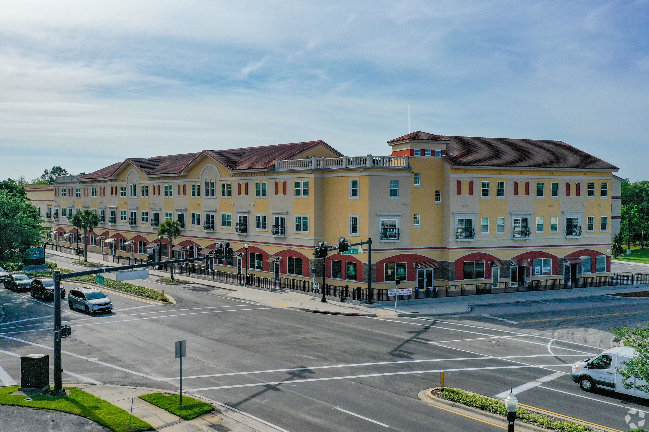

Slide 15
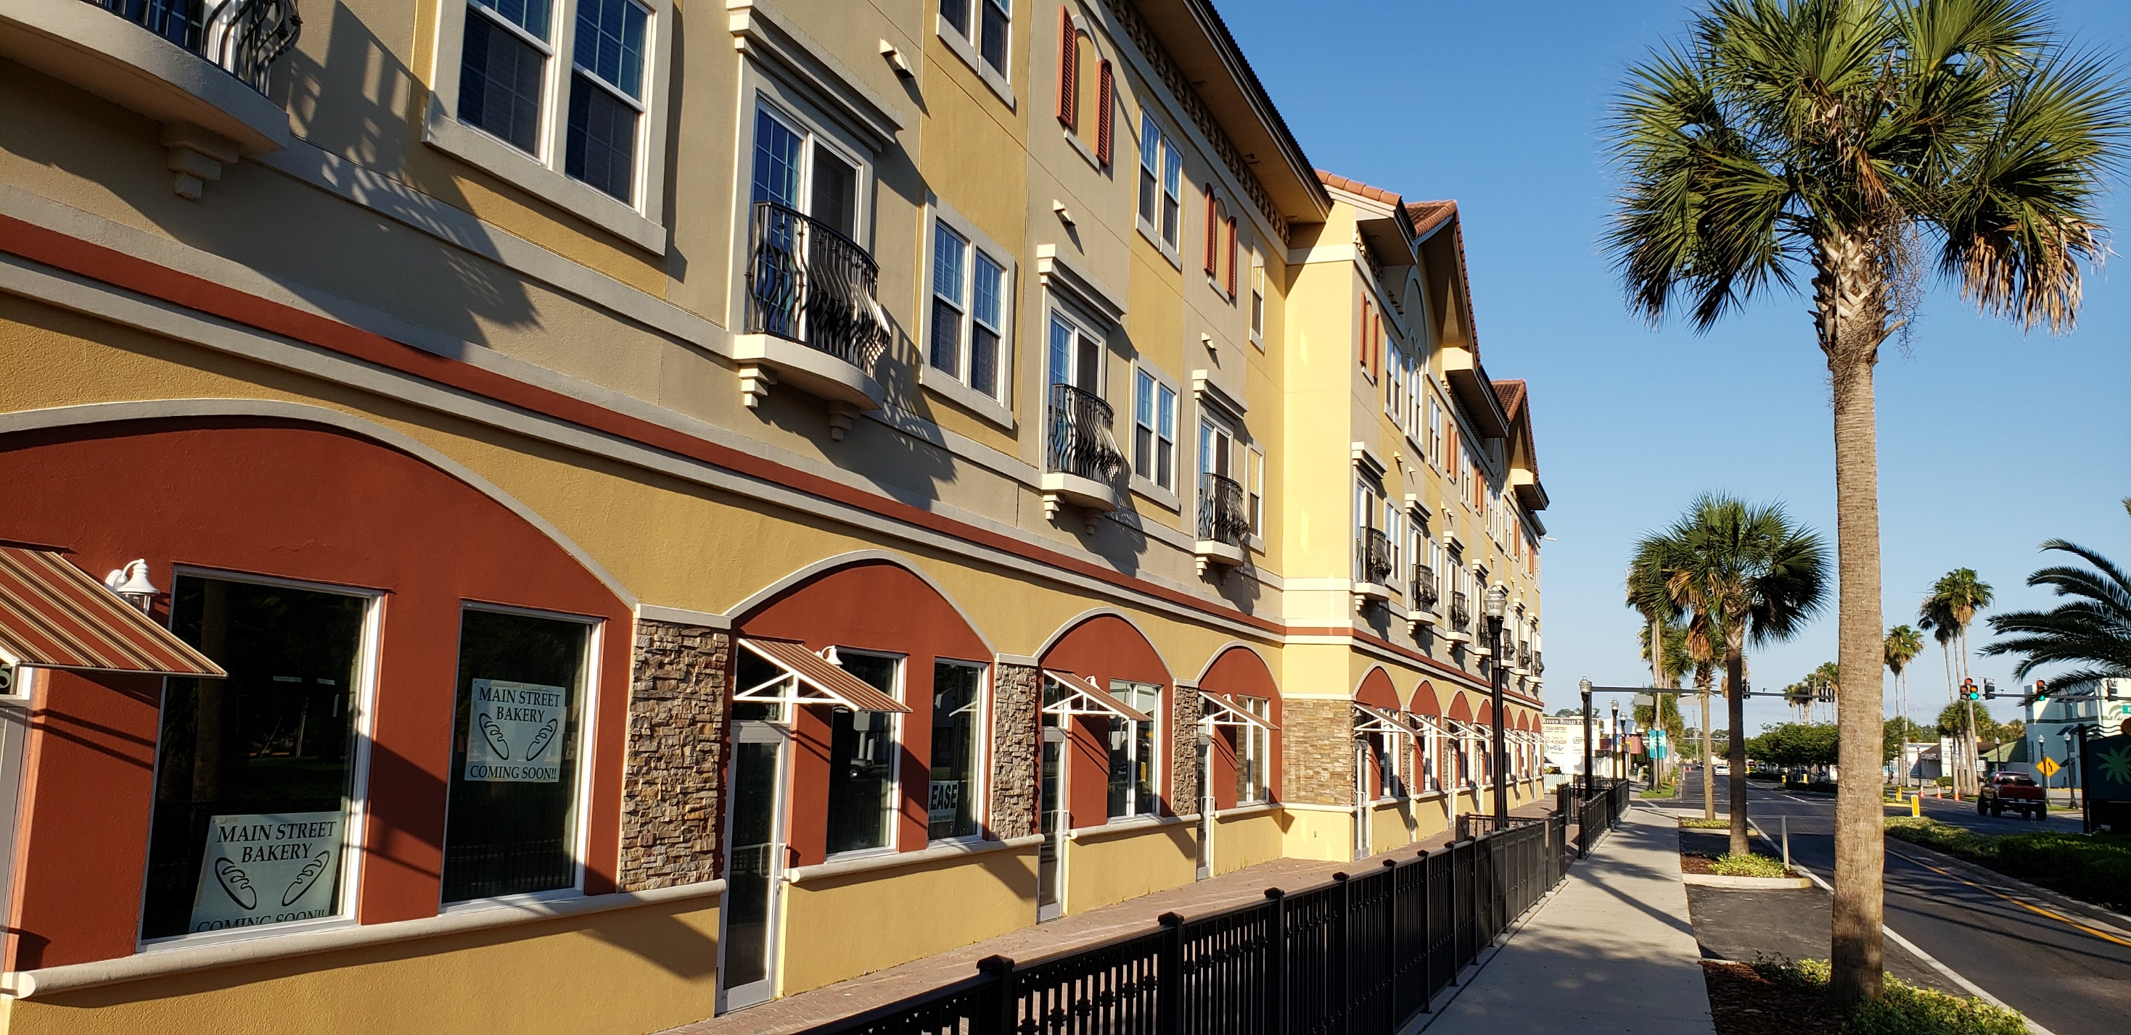

Slide 16
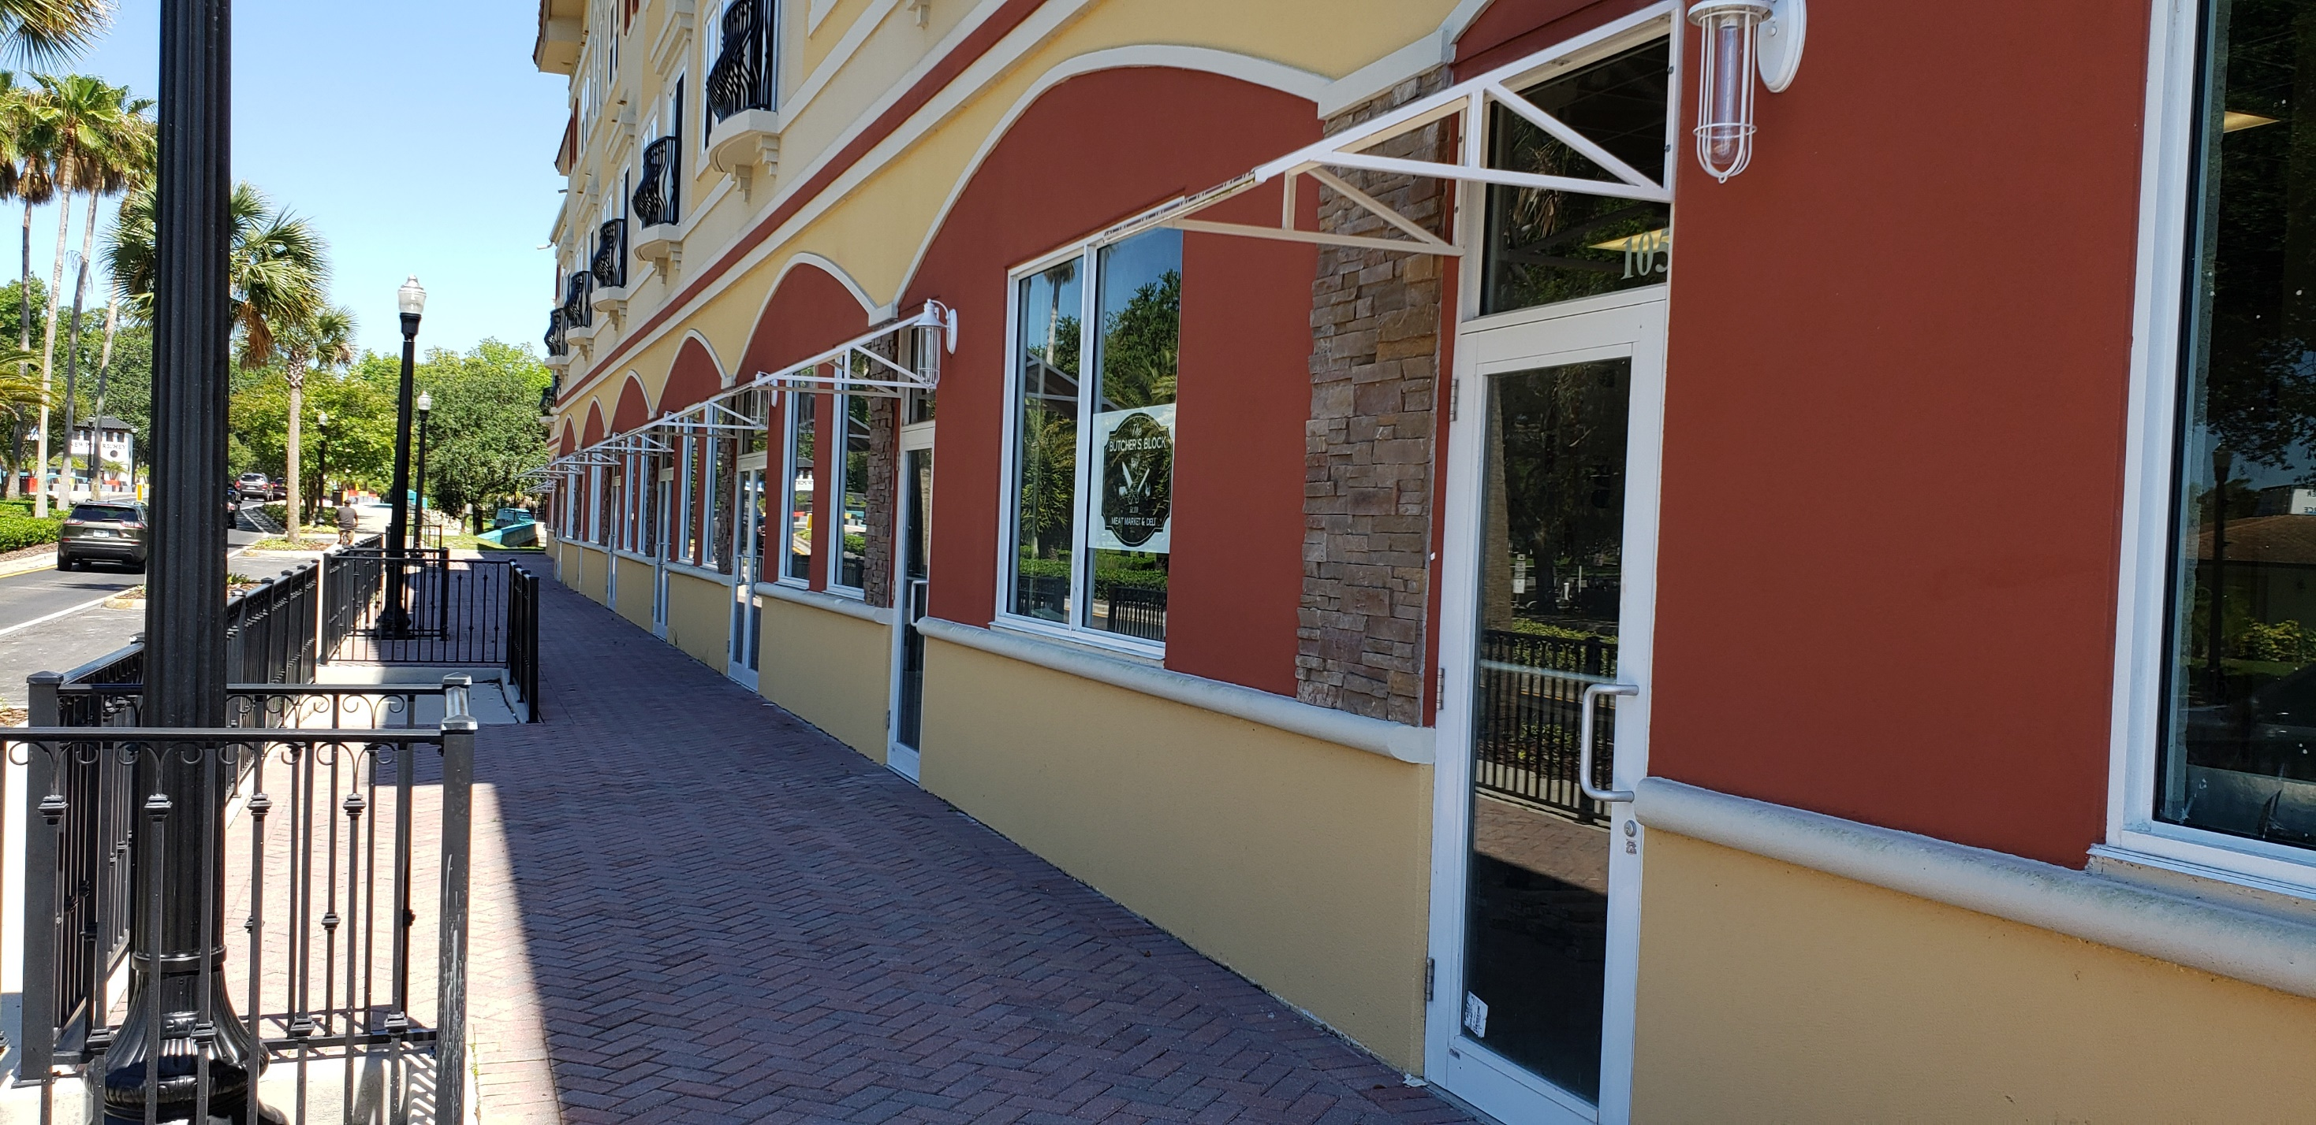

Slide 17
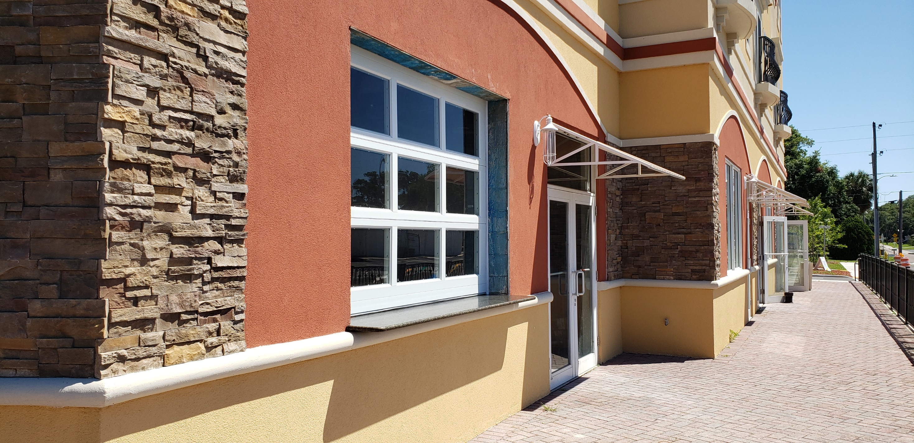

Slide 18
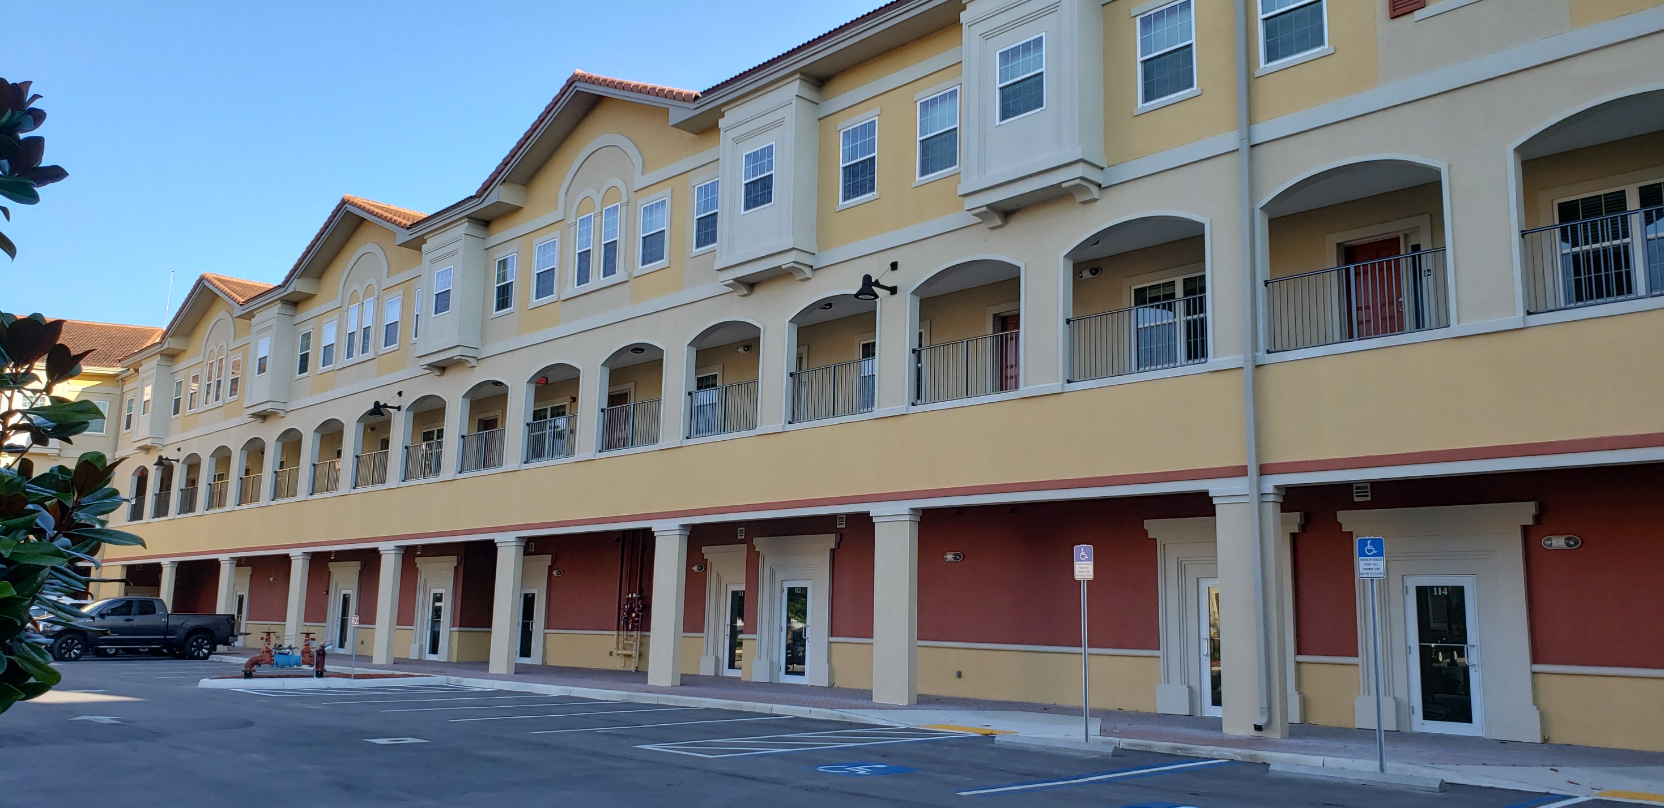

Slide 19
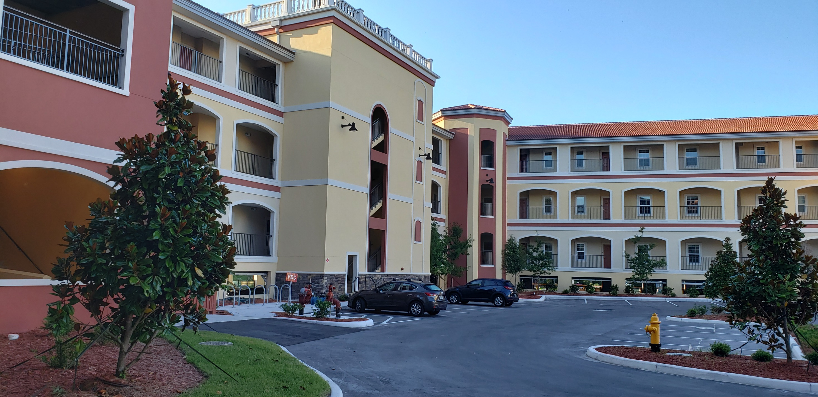

Slide 20
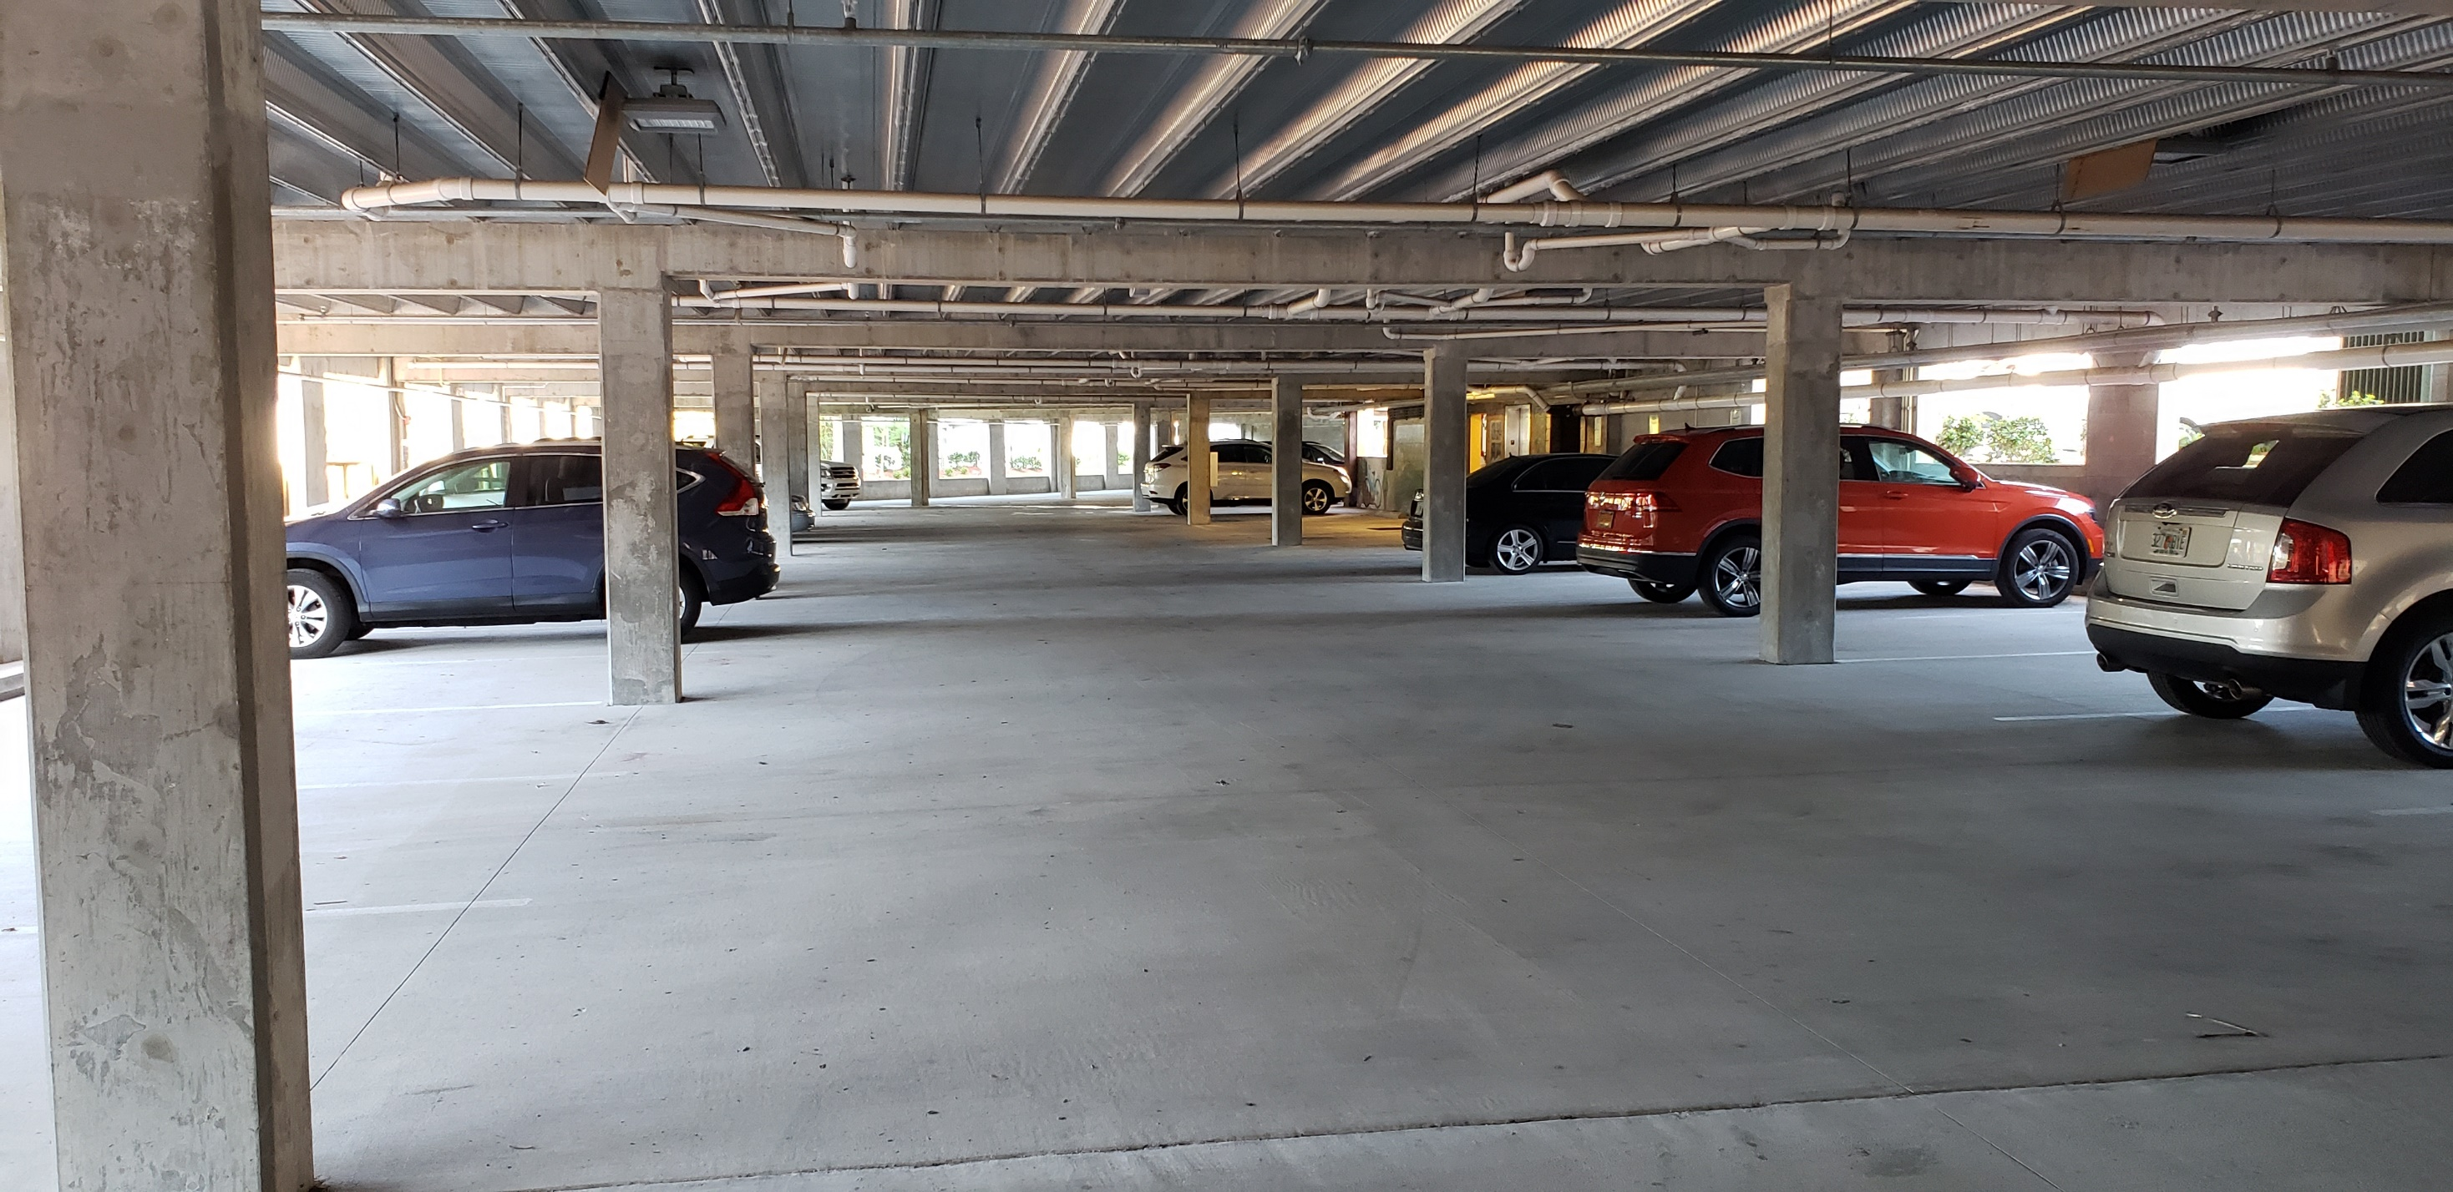

Slide 21
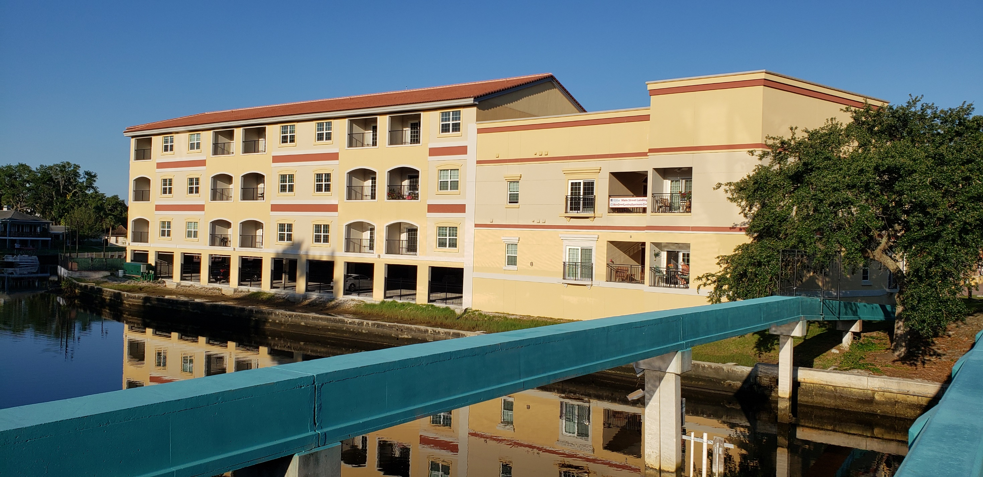

Slide 22
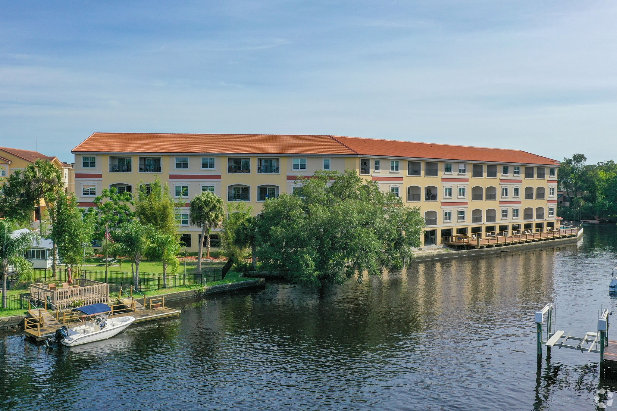

Slide 23
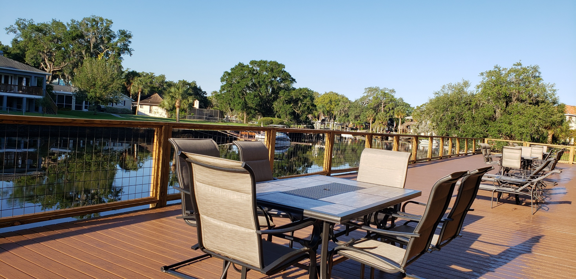

Slide 24
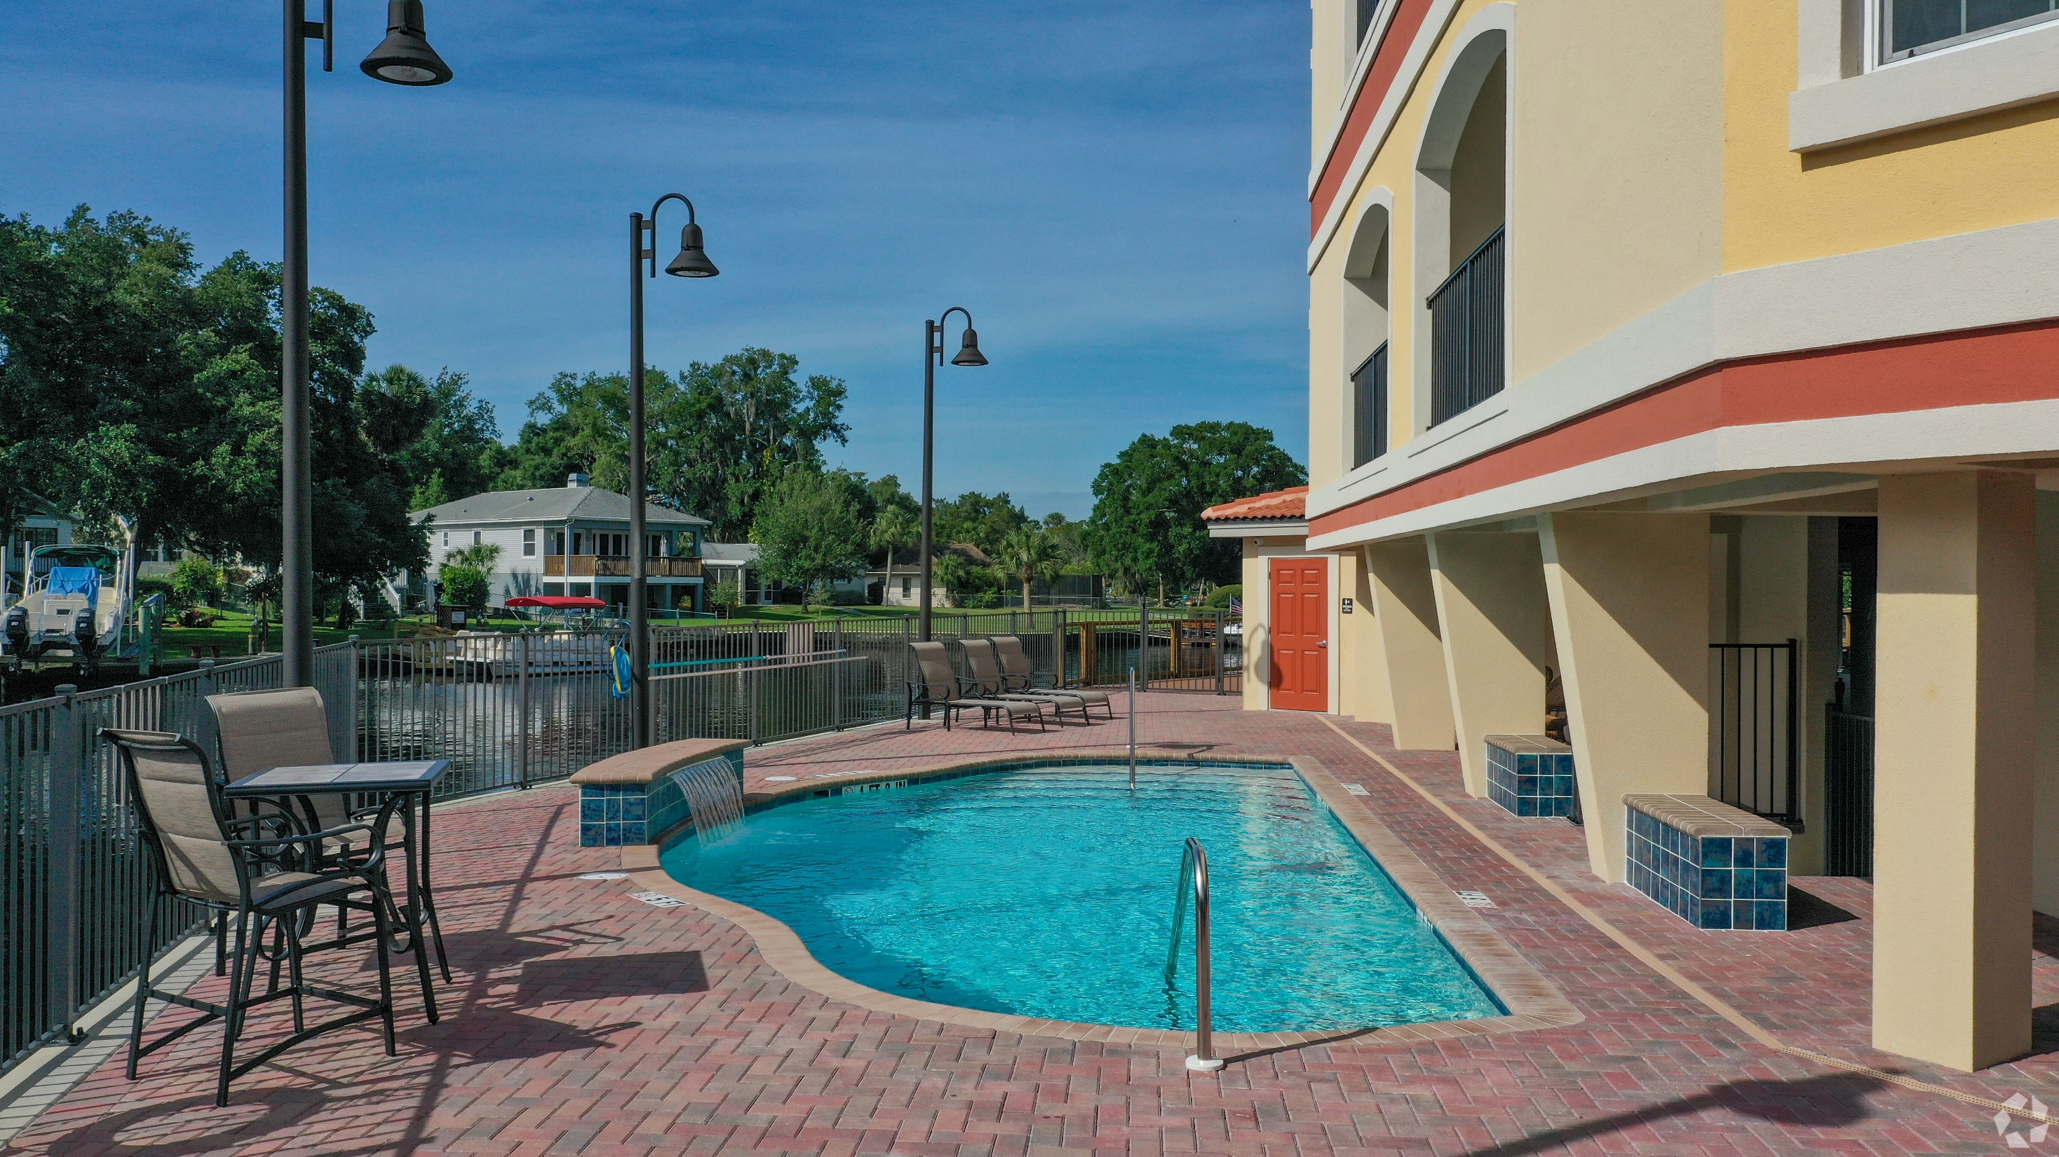

Slide 25
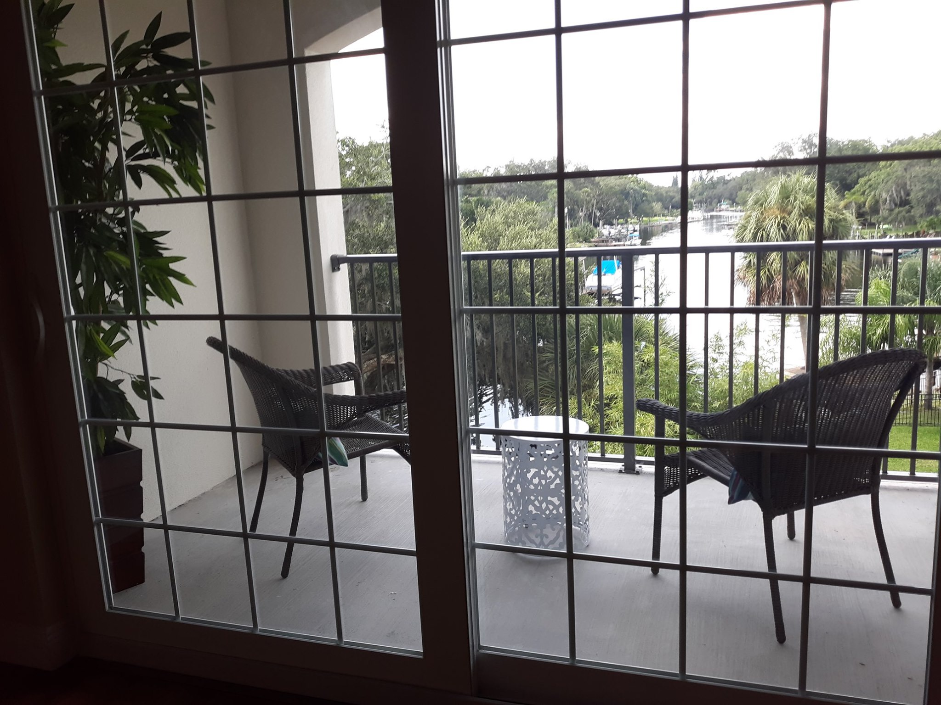

Slide 26
