Slide 1
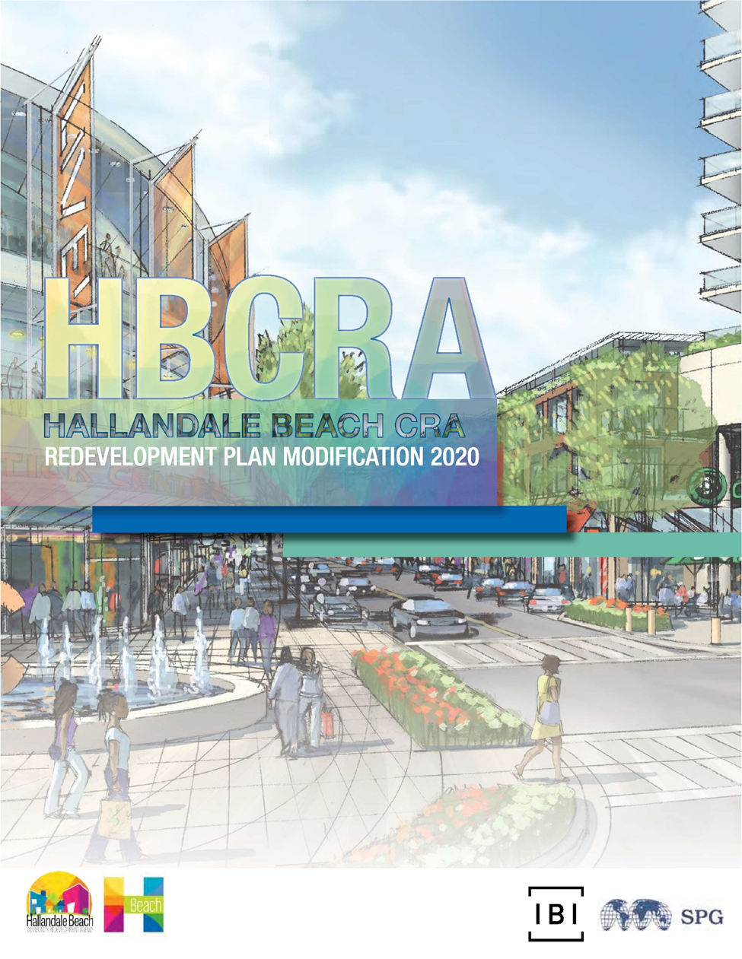

2020 Florida
Redevelopment Association
Roy F. Kenzie Awards
Award Entry Category: Planning Studies
Hallandale Beach Community Redevelopment
Plan Modification 2020
Submitted by
Hallandale Beach Community Redevelopment Agency
Jeremy Earle, Ph.D., AICP, FRA-RA │ Assistant City Manager/CRA Executive Director
City of Hallandale Beach
400 South Federal Highway
Hallandale Beach, FL, 33009

Slide 2
BEFORE & AFTER

Slide 3
Building on Previous Studies
BEFORE
AFTER

Slide 4
Transportation Network
BEFORE
AFTER

Slide 5
Connectivity
BEFORE
AFTER

Slide 6
Quadrant Improvements
BEFORE
AFTER

Slide 7
ADDITIONAL PHOTOS

