Slide 1
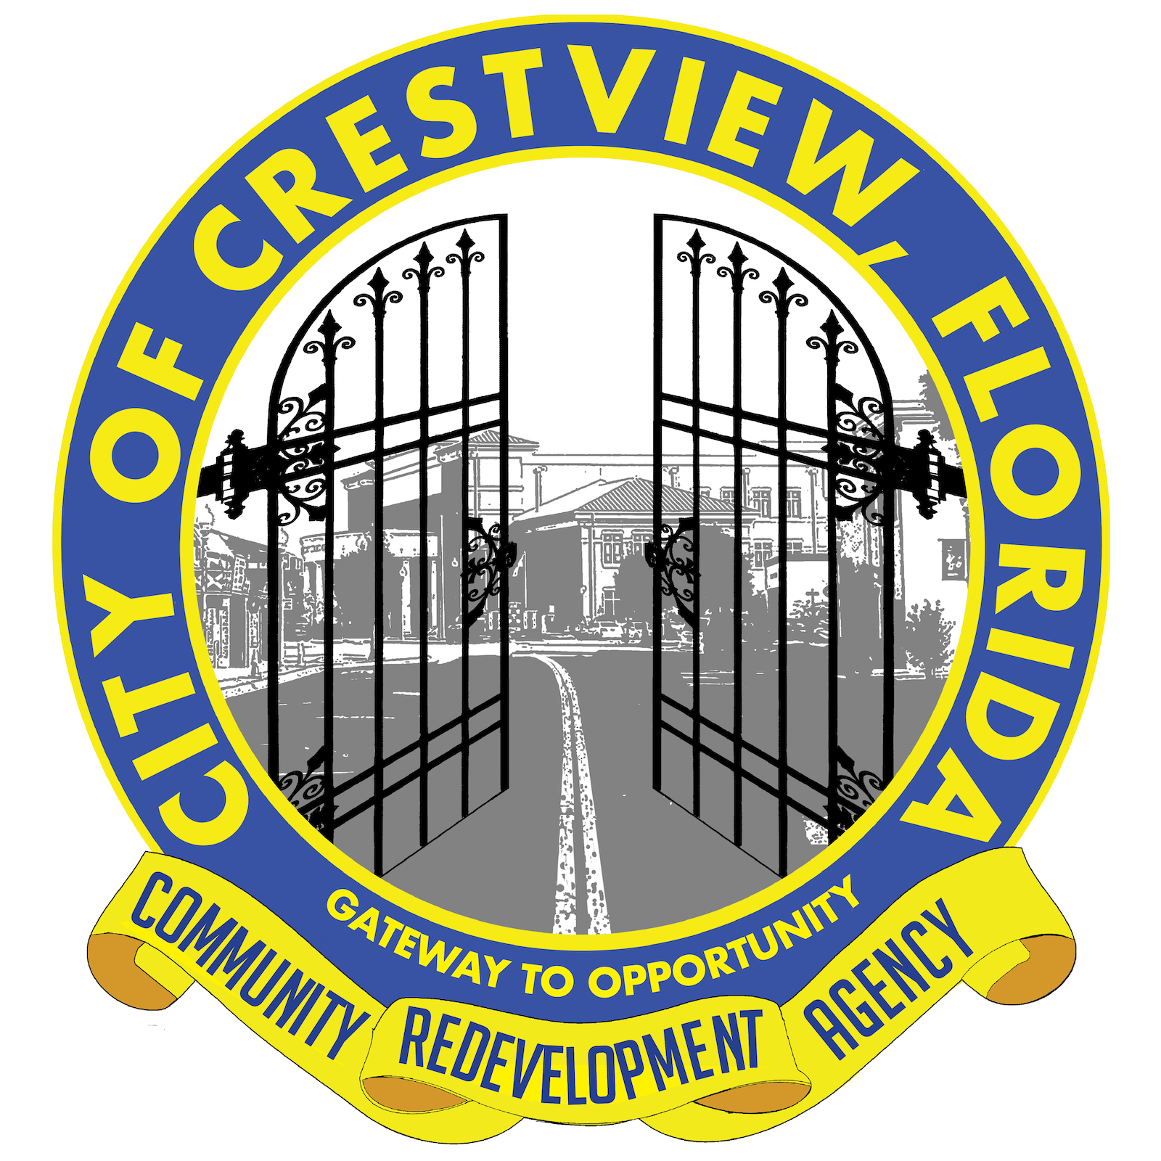
Crestview Community Redevelopment Agency
The City of Crestview Community Redevelopment Agency has awarded several grants to businesses in the CRA District. Two of these projects have created two Beautiful new buildings from older buildings in the District.
The Heights – This building has seen a lot of uses since it was built, including a Gym and a Feed and Seed Store, and now has new life as a Chicago Style Full Service Restaurant. Total CRA Investment $60,000.
Courthouse Suites was originally a Masonic Lodge and is one of the oldest buildings in Downtown Crestview. At one time it even had a Gas Station attached. It has been totally renovated to be a 2 story office building and also has space for a small restaurant.

Slide 2
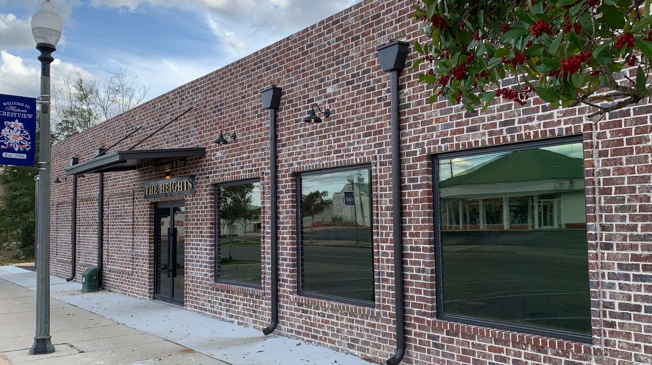
The Heights Chicago Cuisine From Beginning to End

Slide 3
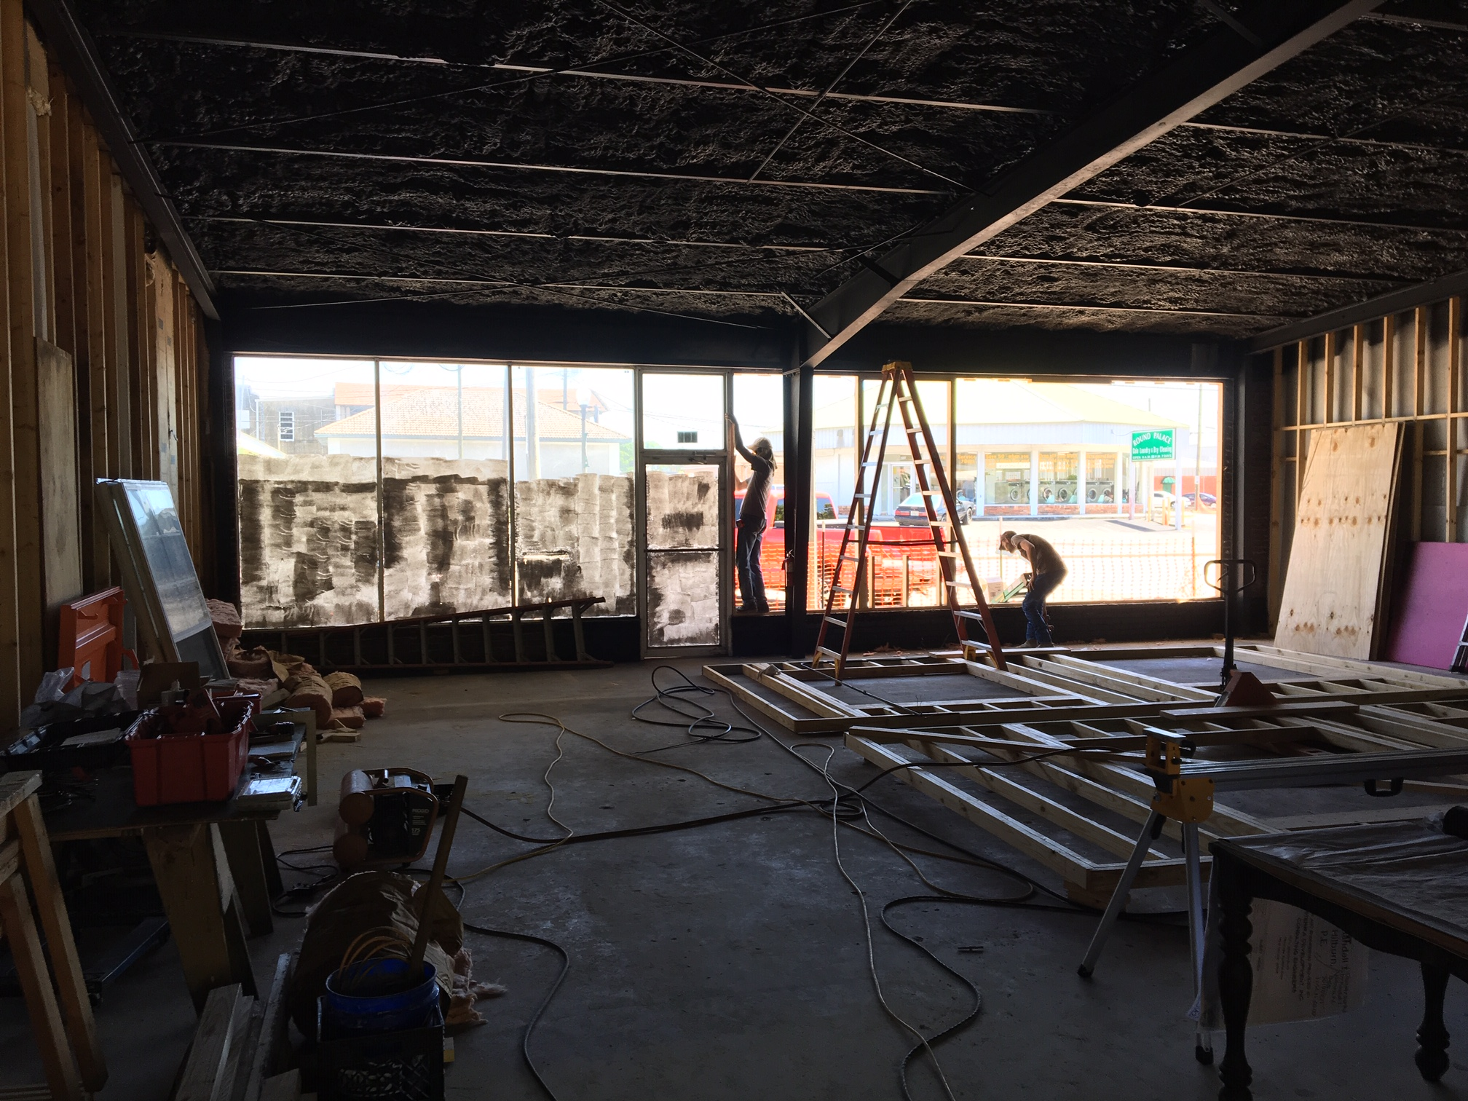
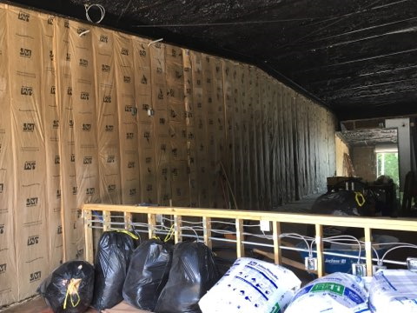
The next 4 slides will show the progress of the Building

Slide 4
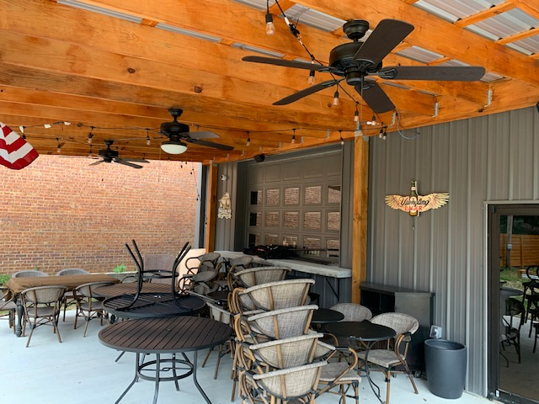
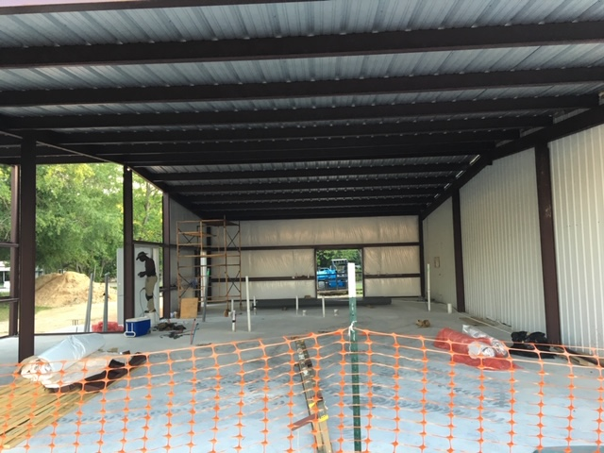
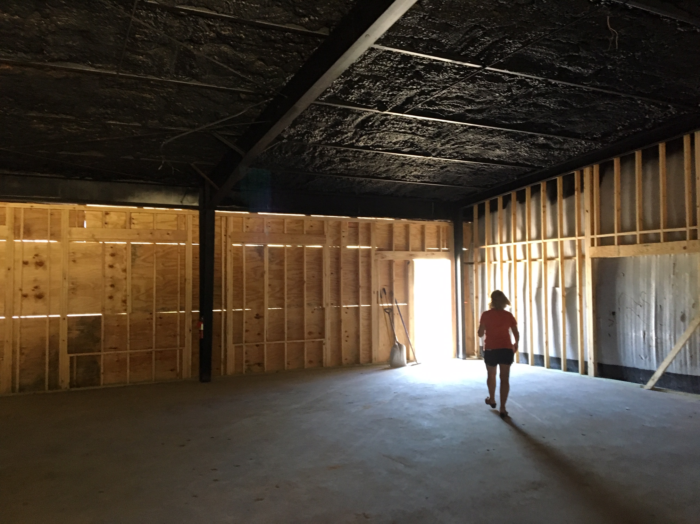

Slide 5
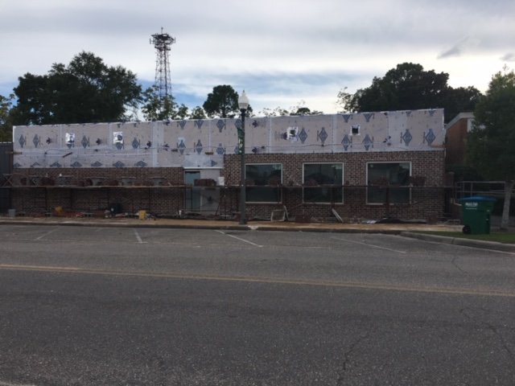
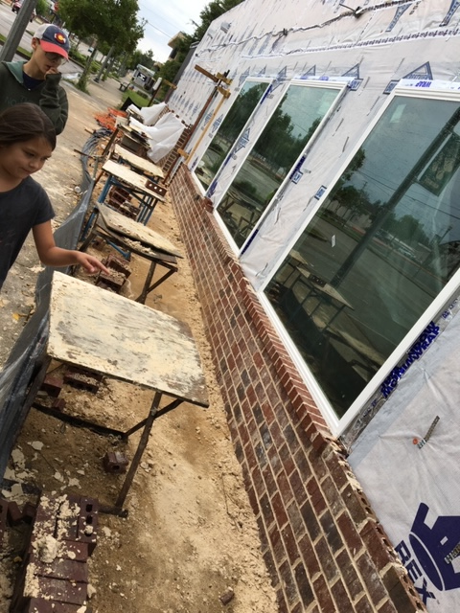

Slide 6
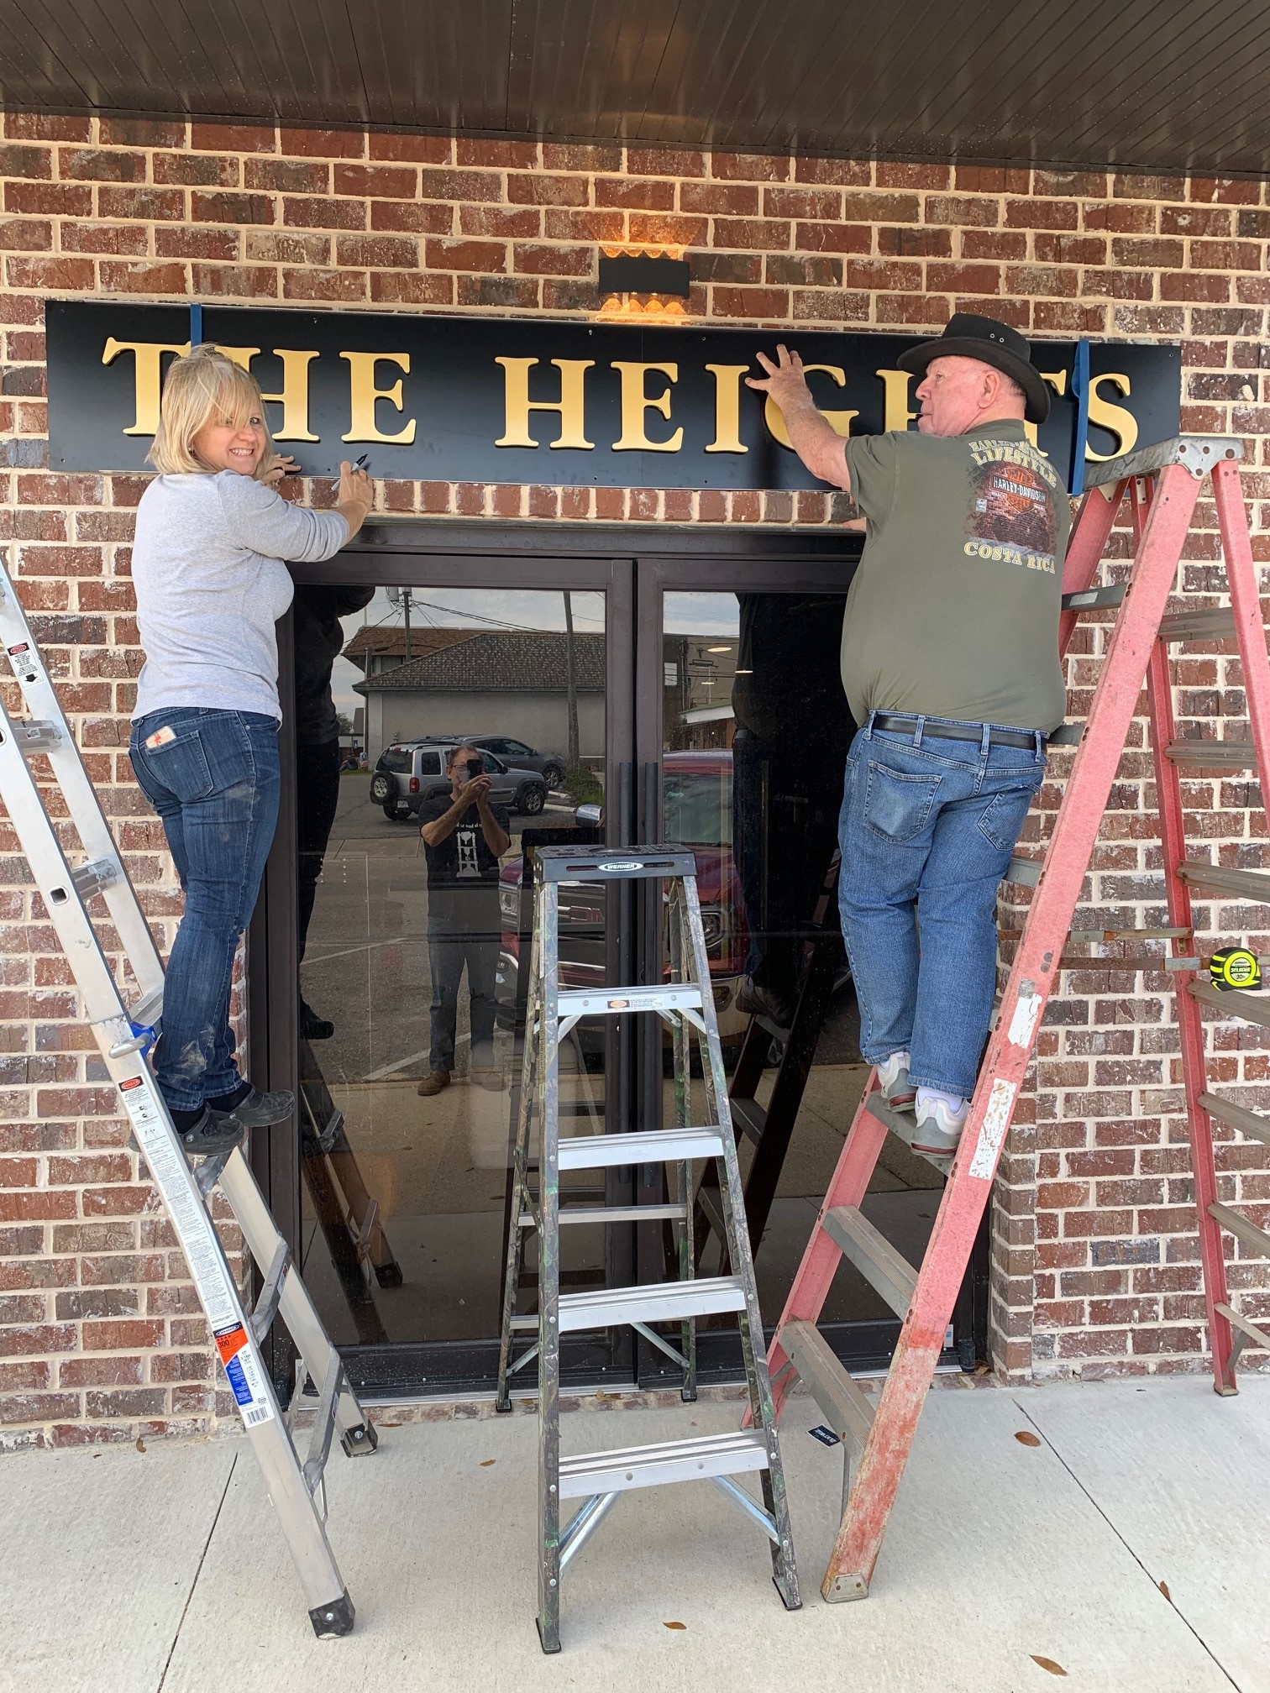
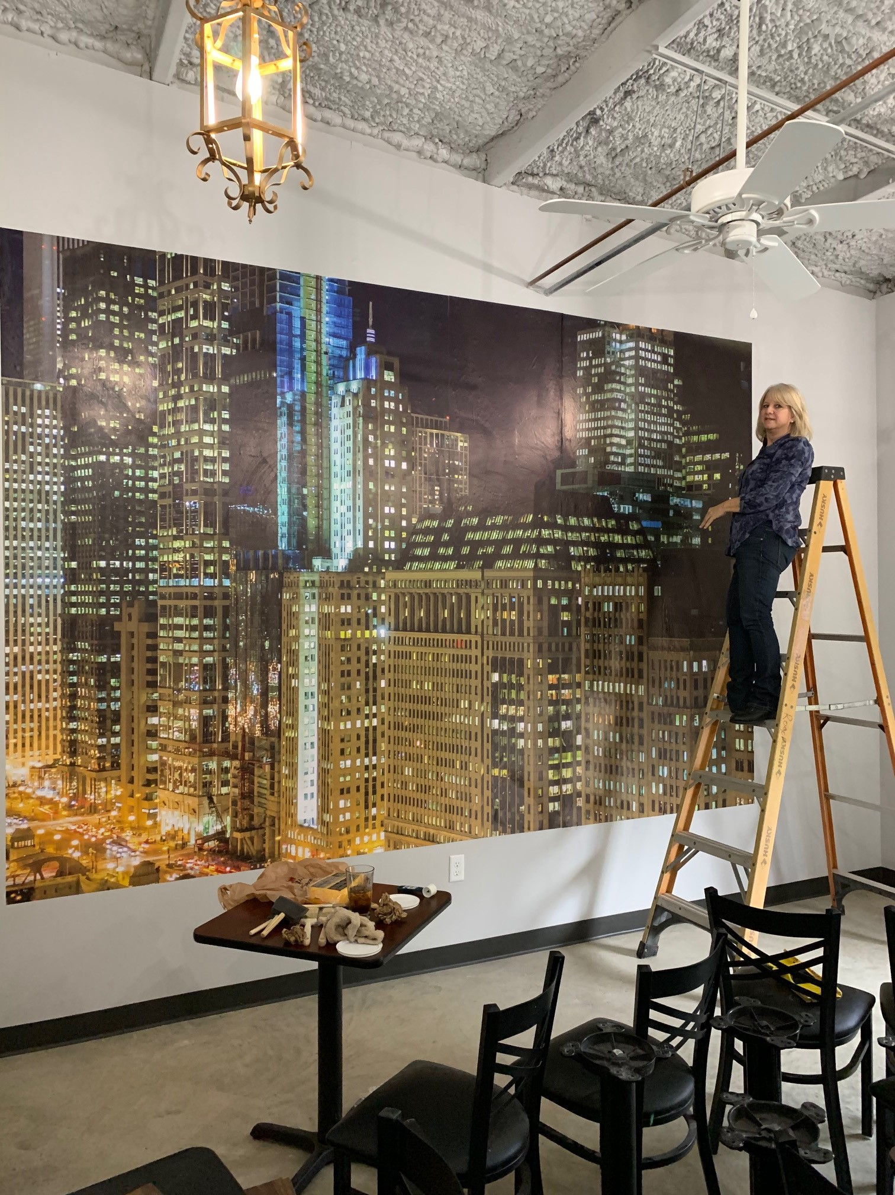
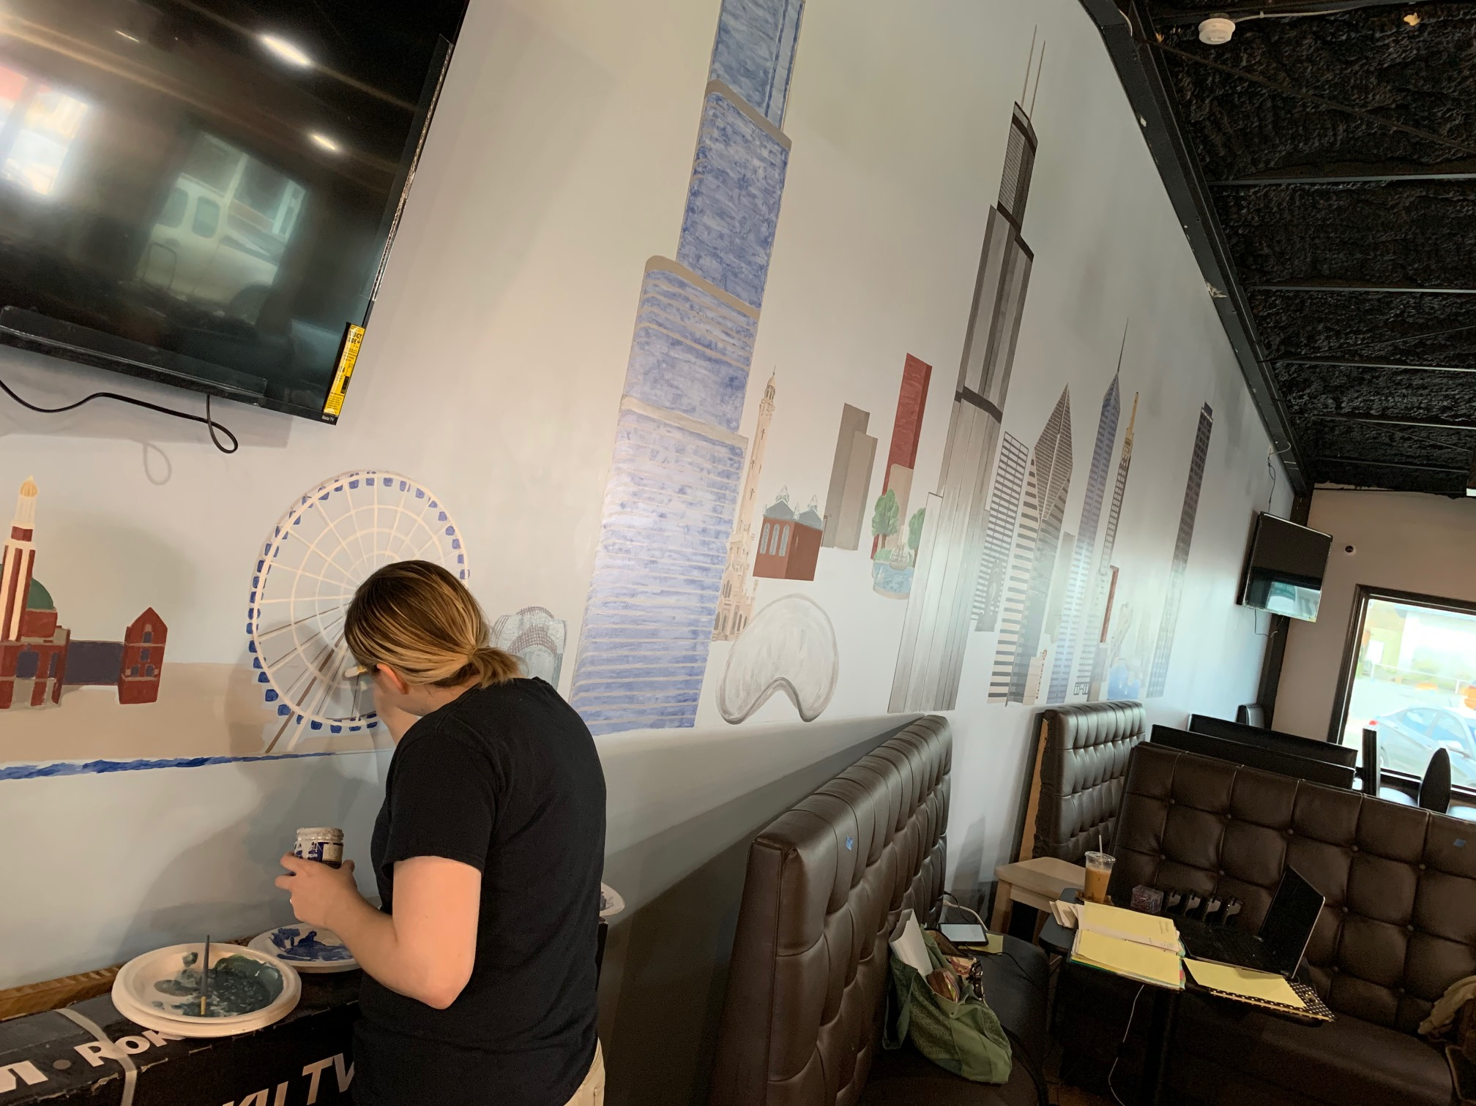
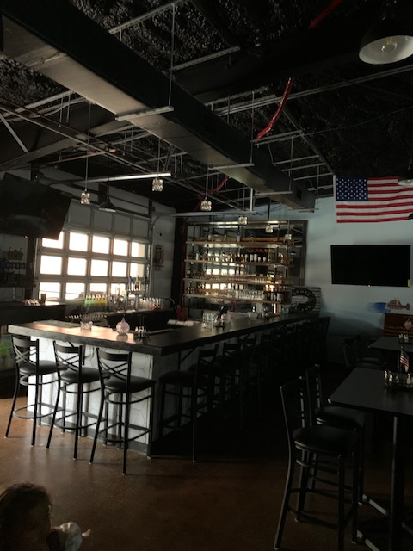

Slide 7
Just a quick Reminder: How it Started:

Slide 8
Where it is Today! (and the food is Awesome!)

Slide 9
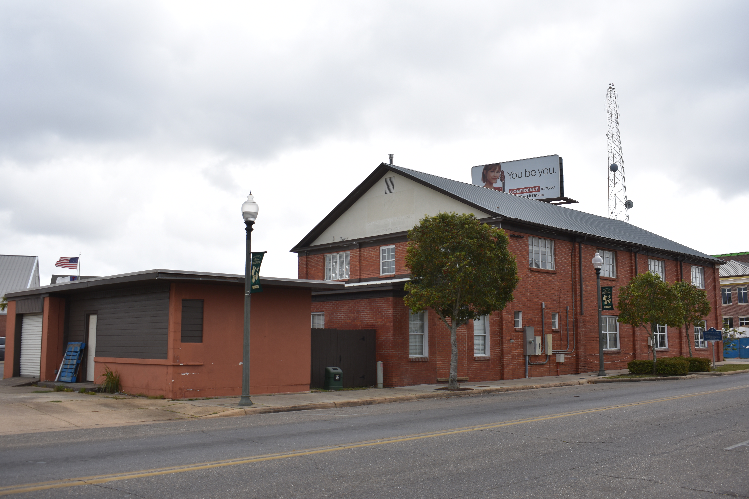
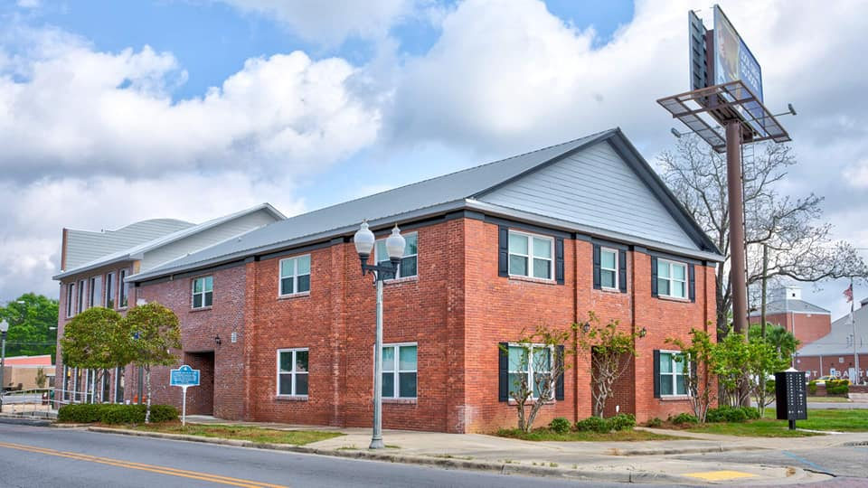
Courthouse Suites From Beginning to End

Slide 10
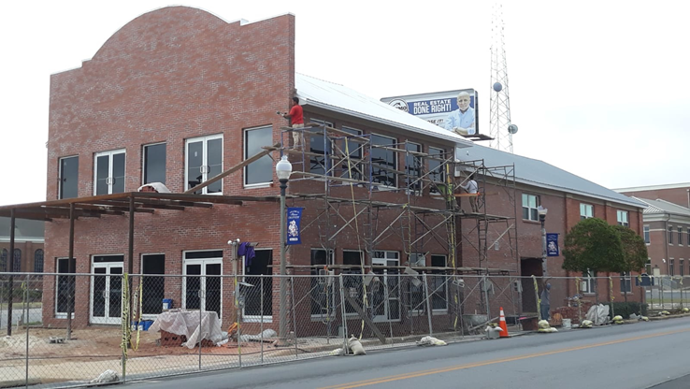
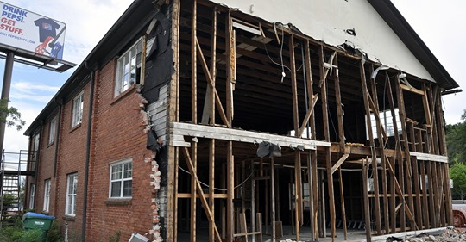
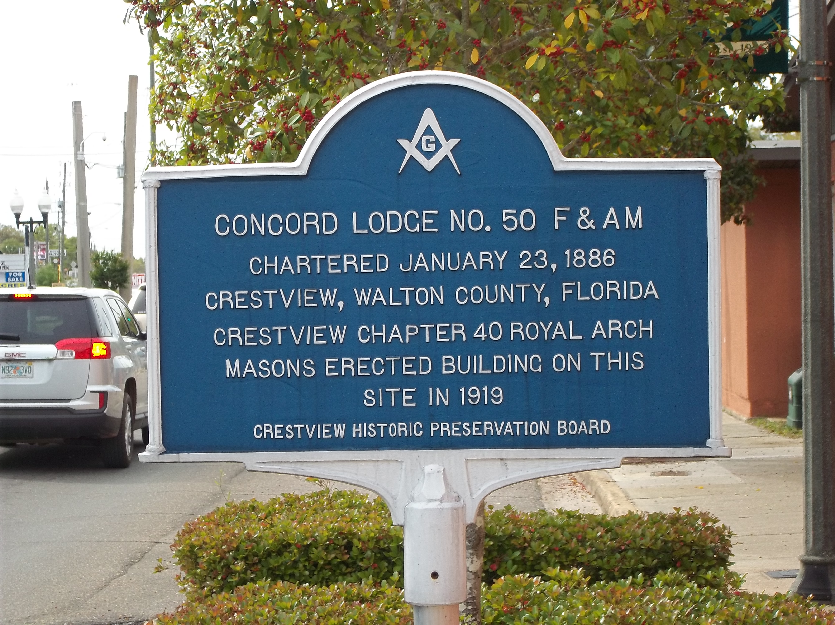
It took a lot of time, effort, and
hard work to transform
The Building, outside …….

Slide 11
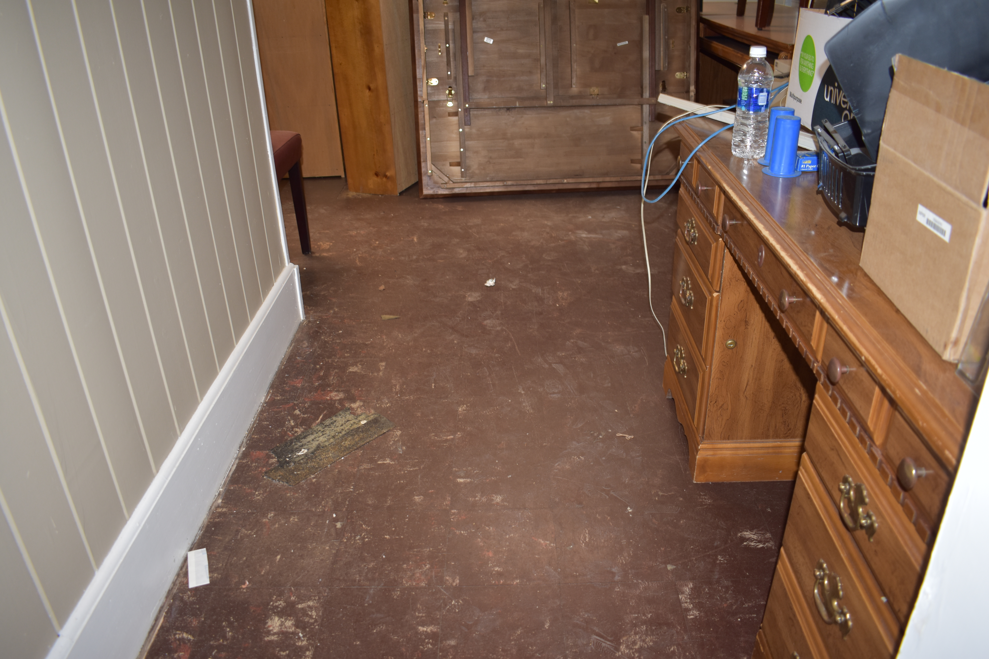
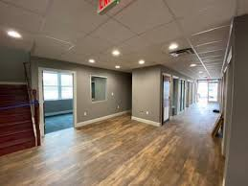
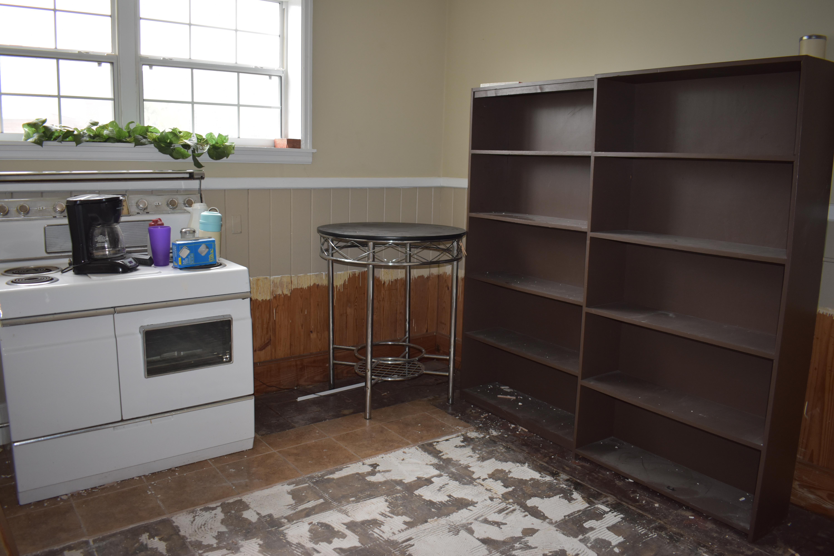
And Inside

Slide 12
Just a quick Reminder: How it Started:

Slide 13
Where it is Today! Already for offices to be rented and bring new business to Downtown Crestview

Slide 14
Crestview Community Redevelopment Agency
Thank You for your consideration!
Elizabeth Roy, CRA Director
elizabethroy@cityofcrestview.org.

