Slide 2
Holiday Magic!
The CRA hosted the second annual Winter Wonderland at the Marina by transforming the award winning Riviera Beach Marina into a festive and snow filled Holiday destination for the entire family.

Slide 3
More than 3,200 residents from Palm Beach County and surrounding areas attended the event, more than tripling the RBCRA’s goal of 1,000.

Slide 4
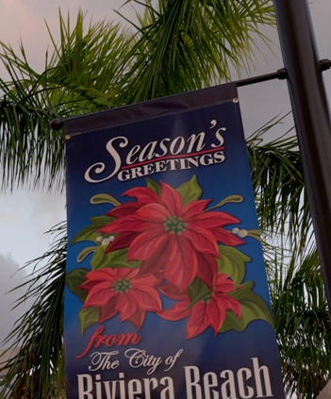
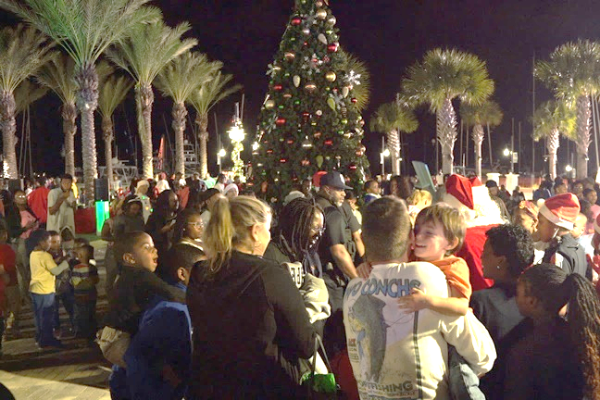
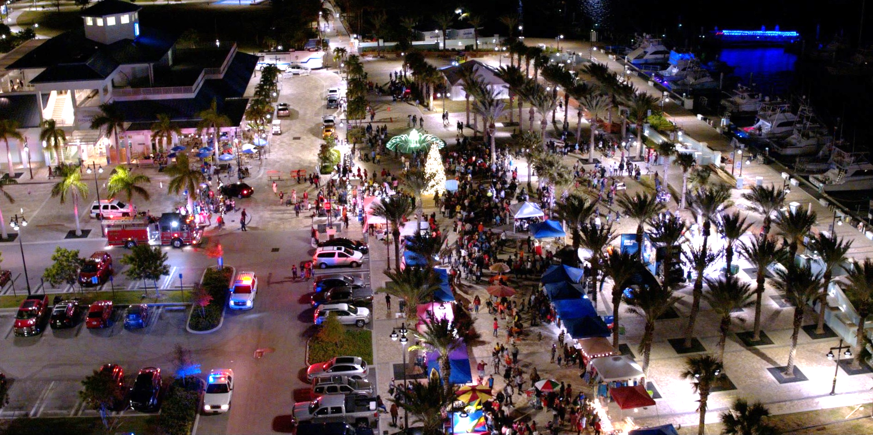
The main highlight was the countdown to the lighting of the magnificently decorated 24-foot holiday tree.
Children and families were treated to a flurry of “snow” South Florida-style, children’s gifts, cookies and hot cocoa. Digital Vibez, Inc. provided upbeat music for everyone to enjoy.

Slide 6
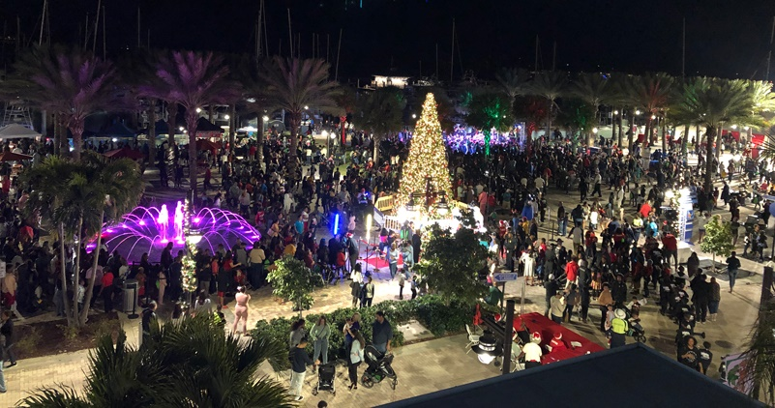
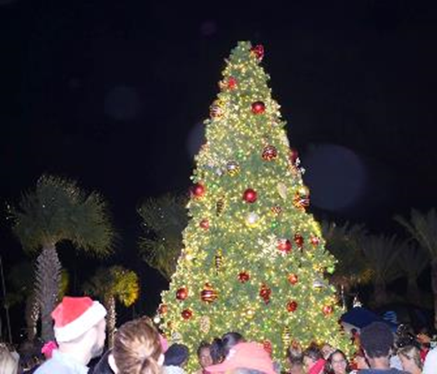
Immediately following the tree lighting, Summer Santa Claus arrived on the scene via fire truck during the Riviera Beach Fire and Police Departments parade.

Slide 7
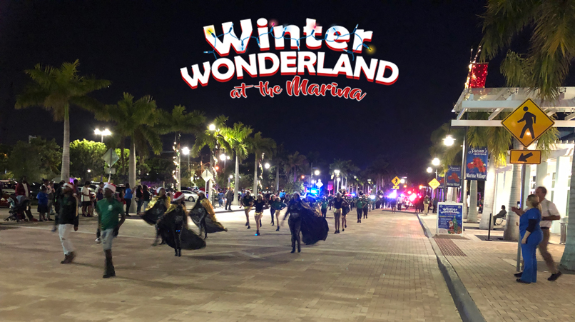
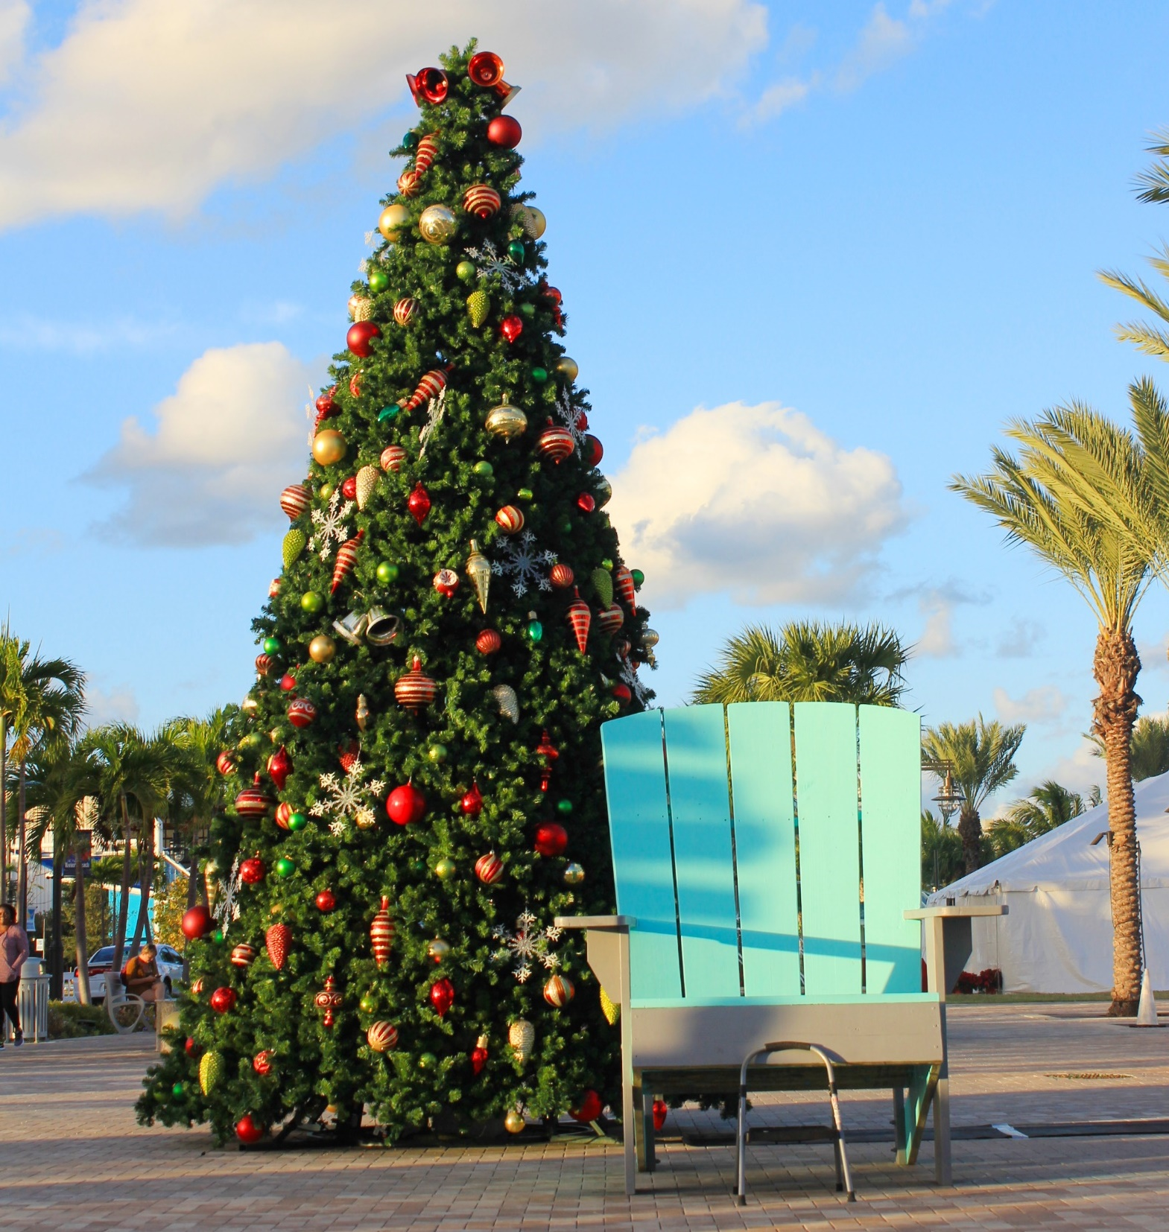
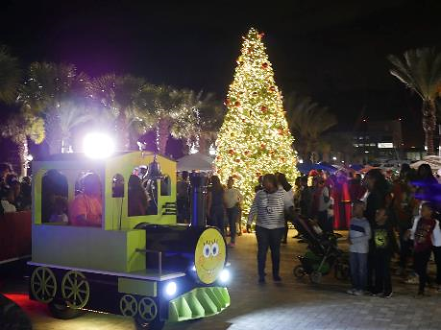
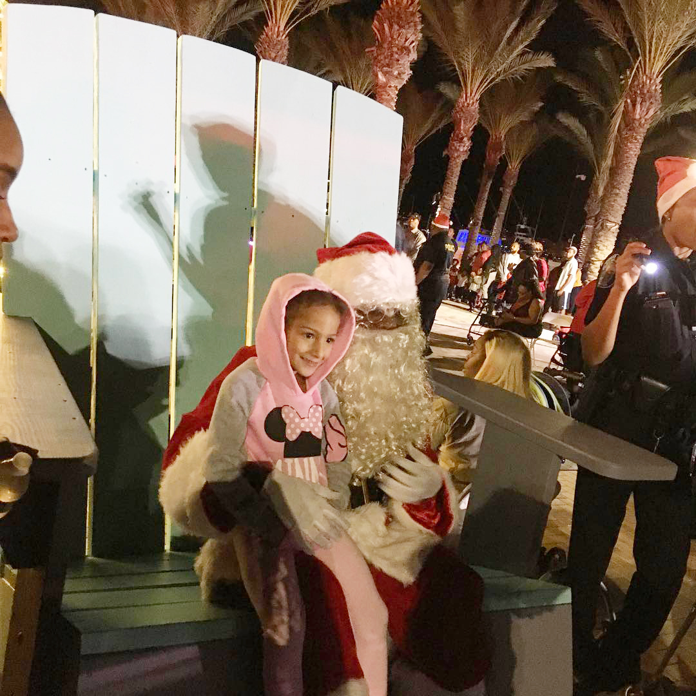
A giant Adirondack chair created by students of the Youth Empowerment Program and Riviera Preparatory Academy served as Summer Santa’s throne for photo ops and gift requests from Santa.

Slide 9
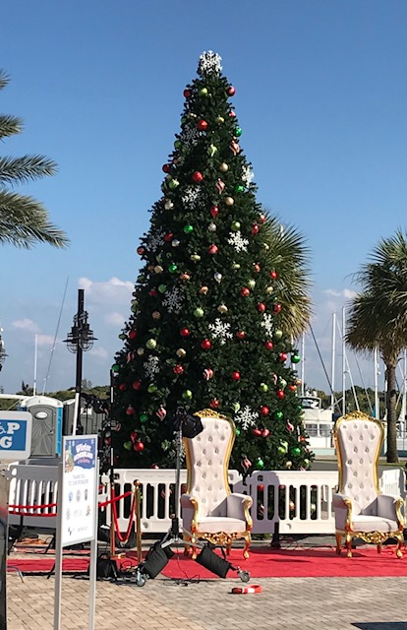
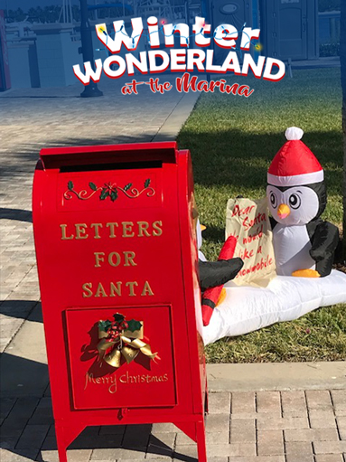
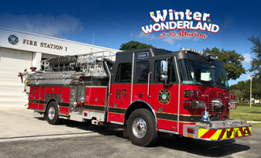
The event also featured:
musical performances by local choirs and youth groups
TikiMarket vendors
a free photobooth
live jazz music with fruit, cheese, and wine for the adults
a mailbox for mailing postcards
to Santa

Slide 10
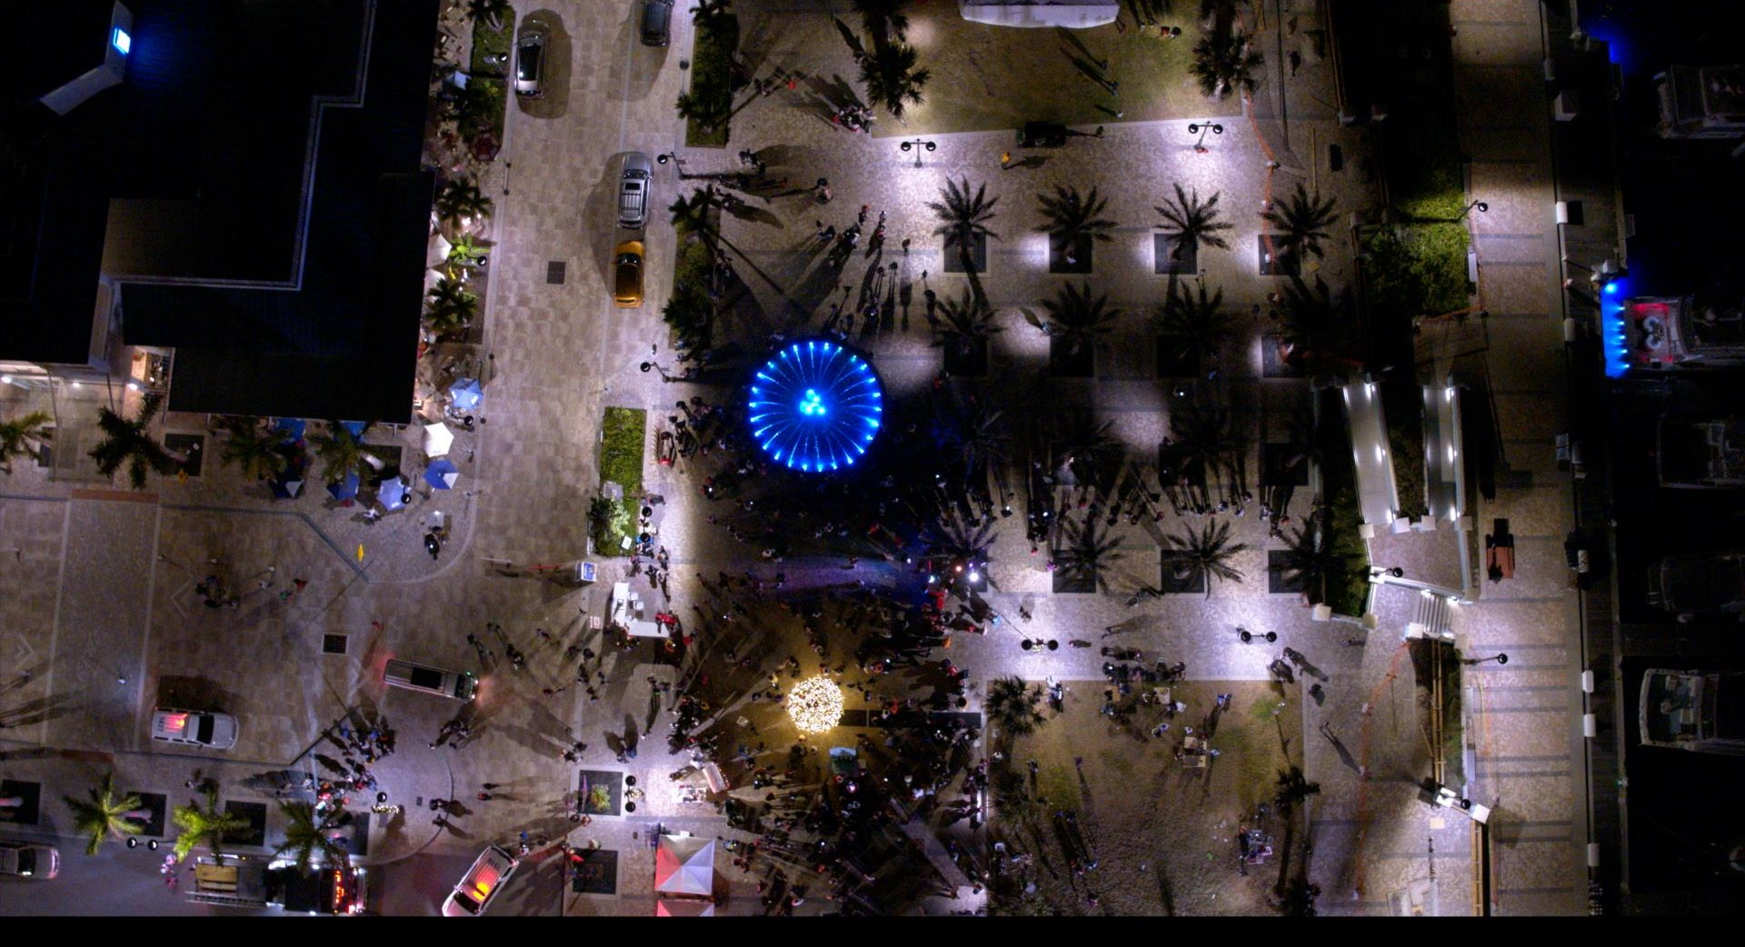
RIVIERA BEACH
COMMUNITY REDEVELOPMENT AGENCY
2001 BROADWAY
RIVIERA BEACH, FL 33404
CONTACT: (561) 844-3408
WWW.RBCRA.COM

