Slide 1
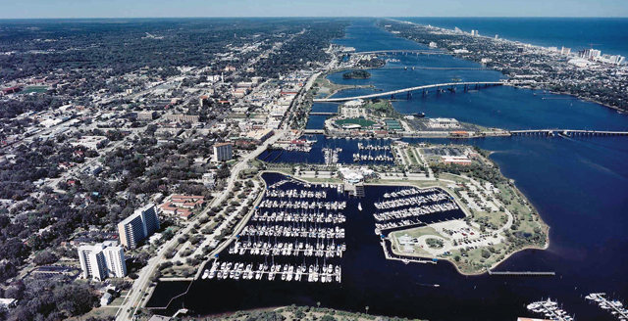

URBAN 360 PROGRAM
Affordable Homeownership on a LARGER SCALE.
Notes:
Photo by Fezbot2000 on Unsplash

Slide 2
NATIONAL AFFORDABLE HOUSING CRISIS
1
3
No County or City in the USA is Adequately Addressing Problem
Basic Two-Bedroom “Rental” in US
There is not a single city or County that can fill 100% of its low-income populations needs for safe and affordable housing.
To afford the basic two-bedroom apartment, let alone own a home, renters need to earn $20.30 per hour. Considering that the minimum wage is $7.25 per hour, a renter would need to work 112 hours to afford a modest two-bedroom rental.
URBAN 360 HAS A PROVEN SOLUTION
Currently expanding through Florida, then the Southeast, and then Nationally…
50%+ of Salary for Housing
The American Dream?
More than 11 million Americans pay more than half of their salaries on housing. This numbers in this category have skyrocketed by 30% over the last 5 years. These numbers are only going up.
Homeownership is key to wealth-building, upward mobility, and a foundation for the American Dream. Major urban centers have played a critical role in giving America its competitive edge globally. Will these urban centers be able solve their challenges?
2
4

Slide 3





U360 PROGRAM ADVANTAGES
LOCAL BUSINESS AND TAX BENEFITS
LONG-TERM HOME OWNERSHIP COMMITMENT
APPRECIATION TO CURRENT HOMEOWNERS’ HOMES
U360’s
PROVEN
AFFORDABLE HOME PROGRAM
AFFORDABLE HOME ACCESS WITH FREE EDUCATION
POLITICAL
RECOGNITION

Slide 4

CASE STUDY - CITY OF TAMPA PERFORMANCE
75
3
10
URBAN 360
City of Tampa
Partnership
Habitat for Humanity
CDC of Tampa
To date, we have 51 Current Homeowners Living in Affordable Homes. Additionally, 24 more homes have been purchased with homeowner move-ins by the Fall of 2020.
3 Affordable Homes Now Under Construction.
5 Current Homeowners Living in Affordable Homes. 5 More Families “Committed” to 5 more Affordable Homes by late 2020.

Slide 5
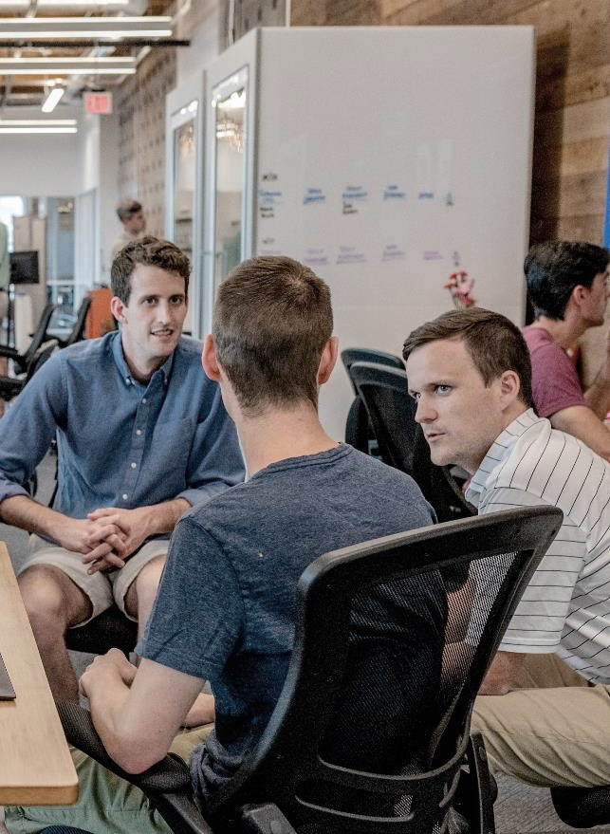


CASE STUDY - URBAN 360 PROGRAM ADVANTAGES
CITY OF TAMPA DOLLARS ARE
MULTIPLIED 11 TO 1
Property Values
We are seeing that the impact of these new homes is lifting surrounding property values and encouraging further private investment in the East Tampa area. This appreciation is being realized by current resident property owners in East Tampa.
The City of Tampa has made available of up to $1,375,000 that Urban 360 may utilize to deliver these affordable homes. Through the dollars in this program, the City of Tampa will be delivered over $15,000,000 in New, Occupied, Affordable Housing within City Limits.
The City benefits from the increased Tax Basis of this $15,000,000 in new housing stock and the resultant surrounding home appreciation that this new building is driving.
Annual Property Tax Basis
The Urban 360 Program COMPLETELY PAYS FOR ITSELF in approximately 1 year of New Property Taxes on these New Affordable Homes. Thereafter, the City of Tampa is PAID by this Program through Annual Property Tax Revenues after this 1st year. This U360 Program was Accomplished Without a TIF.
MULTIPLIED 55 TO 1
POST REFUND

Slide 6
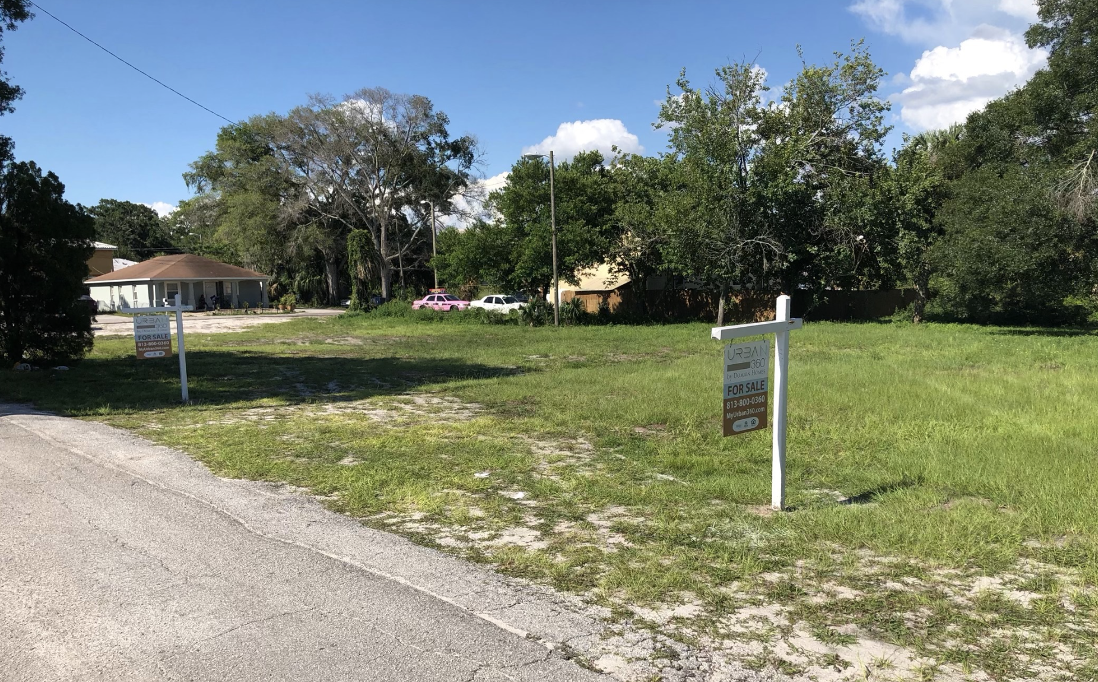
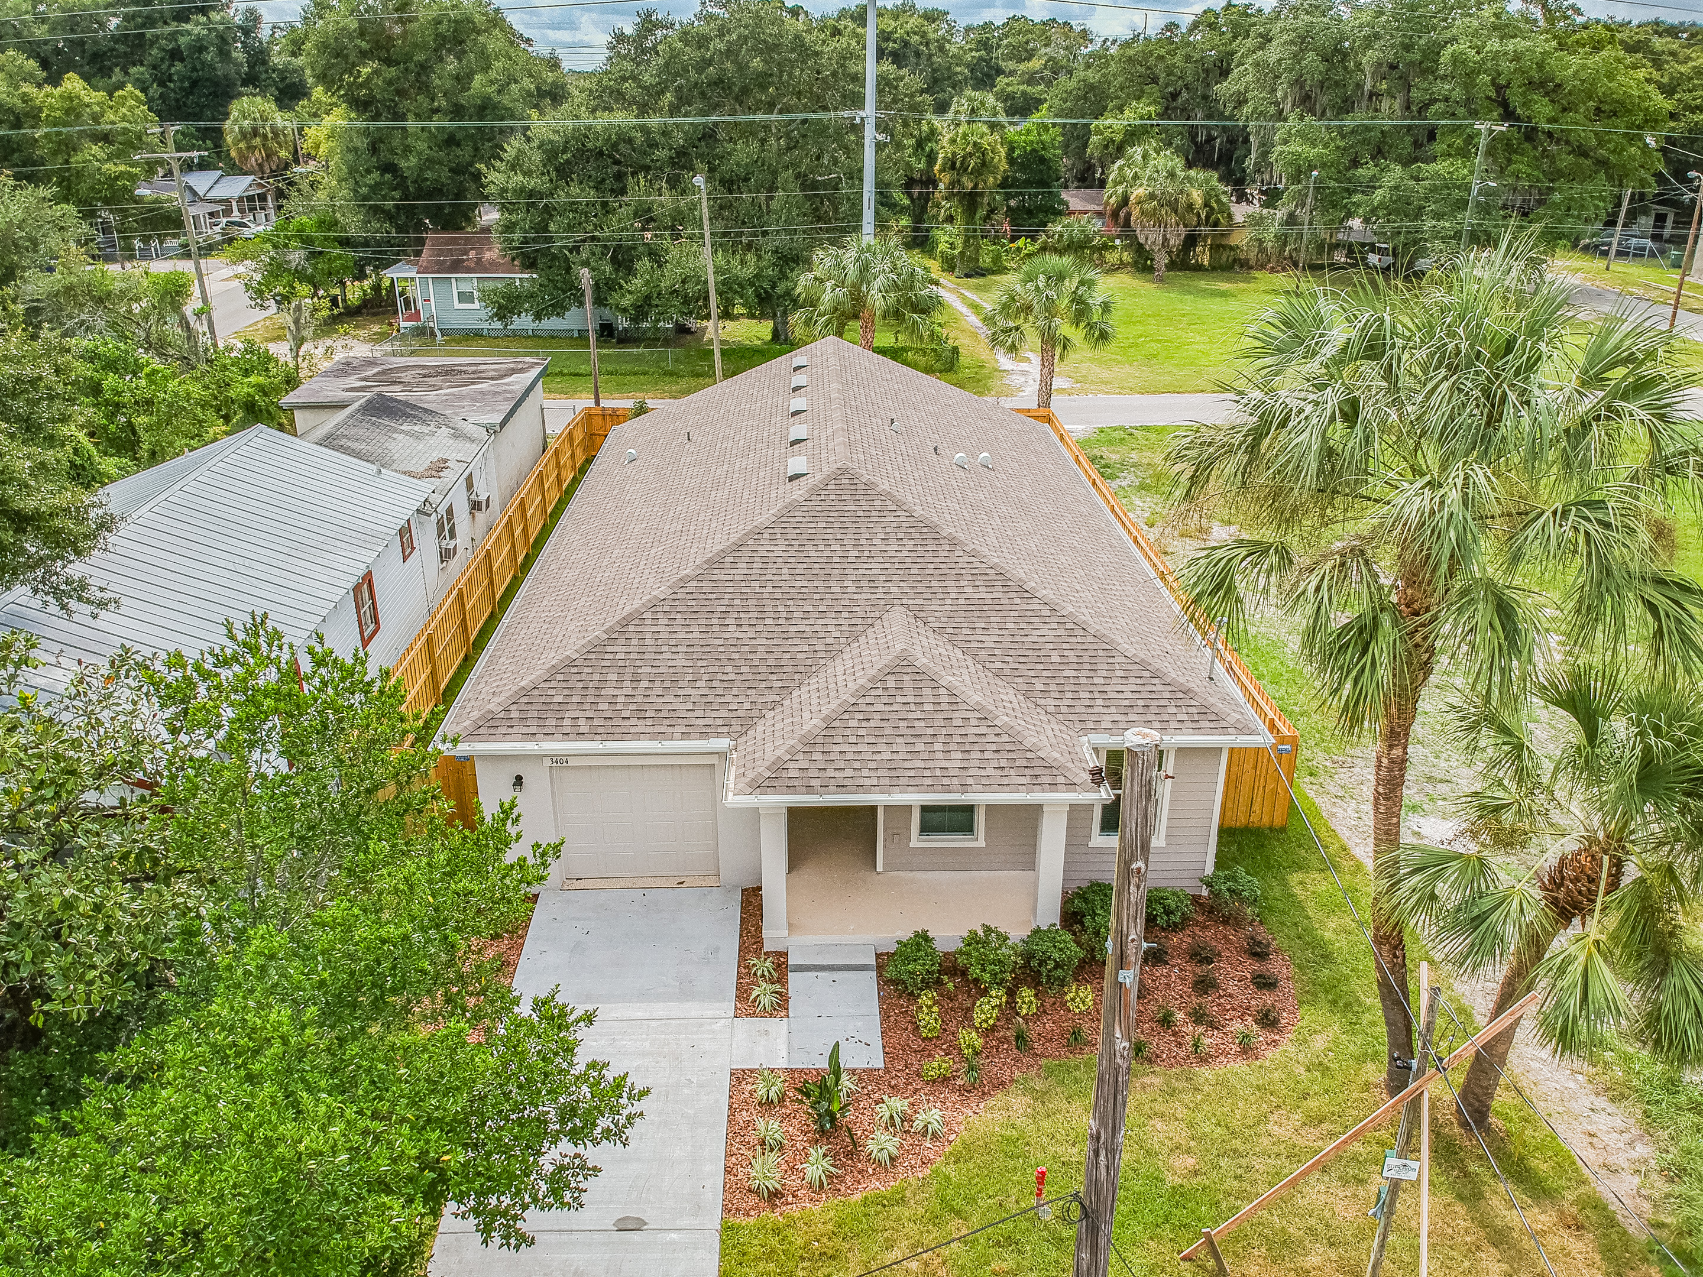
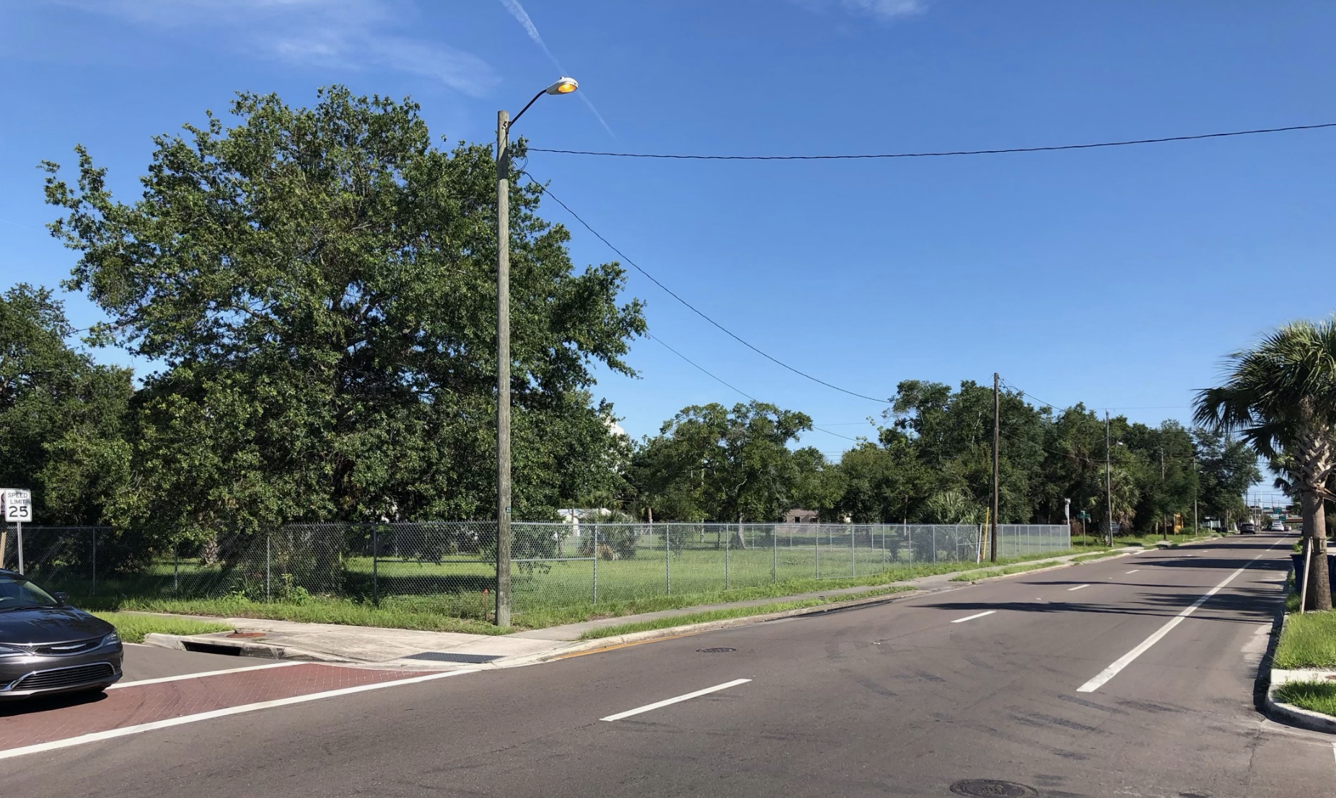
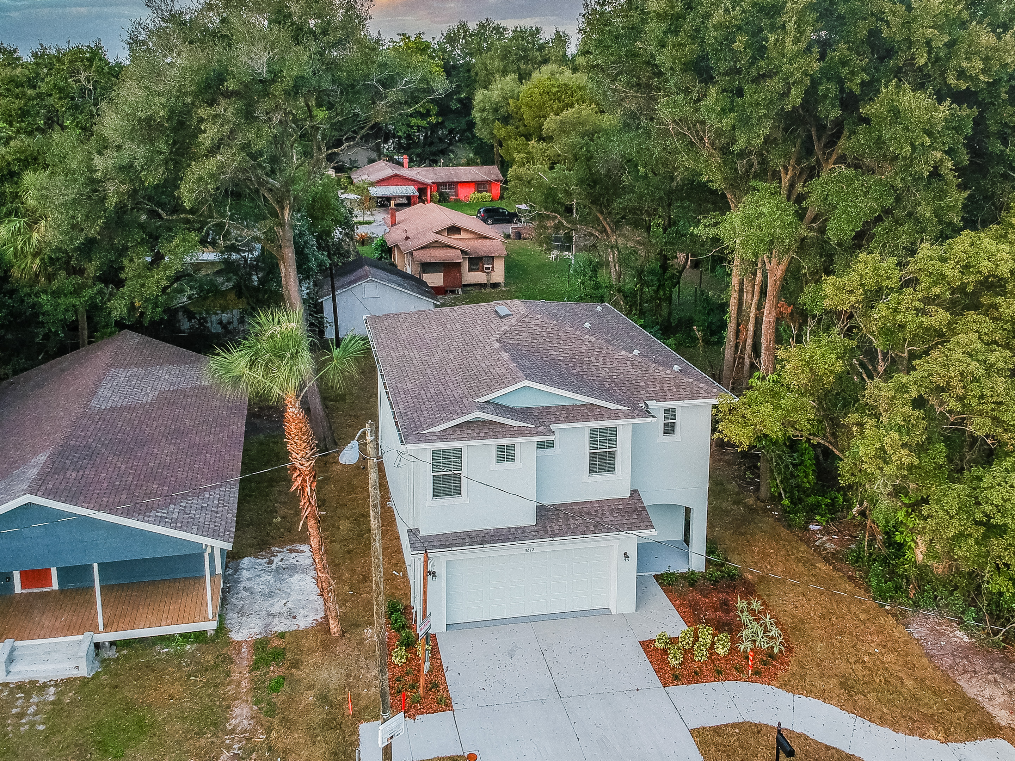
BEFORE
AFTER

Slide 7

EAST TAMPA IS OUR FUTURE
Please Right Click Below To Open Video Link In New Window:
https://www.youtube.com/watch?v=KBlOWsY6k6Q

Slide 8
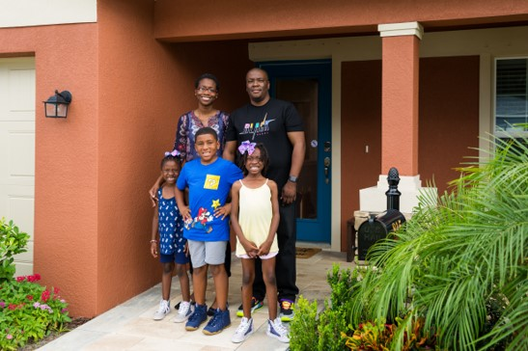
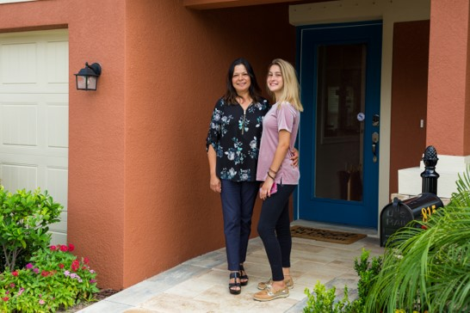
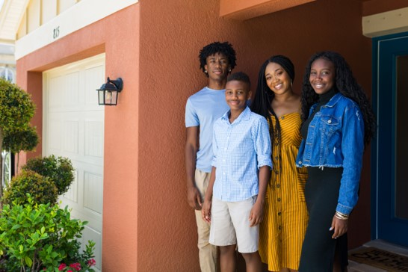
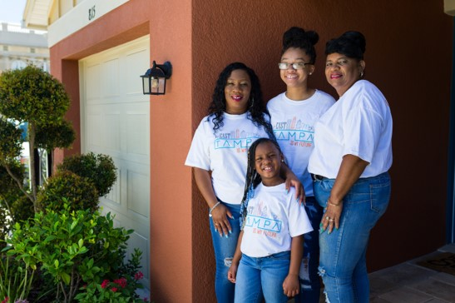
THE SWEETING FAMILY
THE OHANNES FAMILY
Ellis and Tiara moved to Tampa with their three children a few years ago with a five-year plan to buy a home. Ellis suggested they check out Urban 360º - they signed a contract just a week after their first visit.
Being able to buy a brand new home in her price range seemed too good to be true. When Maria discovered that Urban 360º was teamed up with the City of Tampa to provide loan assistance, she knew it was a safe bet.
THE COBB FAMILY
THE JONES FAMILY
“Urban 360° did an amazing job of making the home buying process comfortable,” says Alysha. “Every step just got more and more exciting. They did a great job of including our kids in the process and making it a fun and personal experience.”
She was frustrated because the homes she thought that she could afford were outside of Tampa. By contrast, her entire life — her support system, job, and her daughters' school and dance studio — were all in the city. One day she received a call from her Realtor and everything changed. Her realtor suggested that she look at the Urban 360º program.

Slide 9

UNITING THE PUBLIC AND PRIVATE SECTORS
Please Right Click Below To Open Video Link In New Window:
https://www.youtube.com/watch?v=C5dxuY2uBLQ

