Slide 1
St. Cloud CRA Video
Downtown Revitalization Project:
Phase 1 New York Avenue

Slide 2
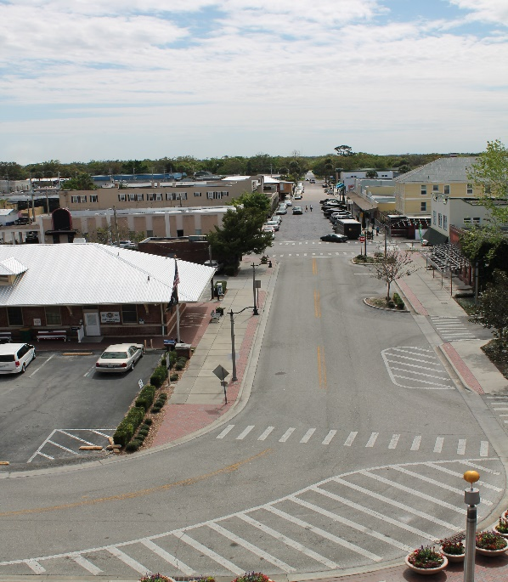
New York Avenue Before

Slide 3
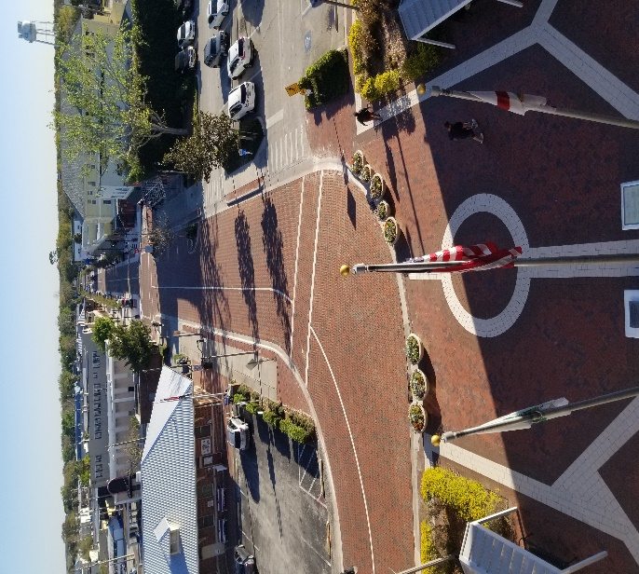
Downtown Revitalization Project: Phase 1 New York Avenue - After

Slide 4
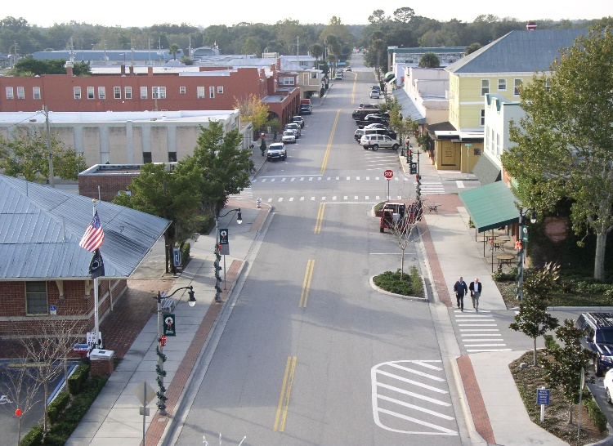
New York Avenue Before

Slide 5
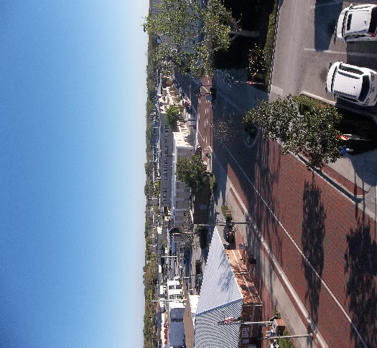
Downtown Revitalization Project: Phase 1 New York Avenue - After

