Slide 1
Ocala CRA Revitalizing Our Community Annual Report – Fiscal Year 2019
2019 FRA Awards Submission

Slide 2
Design Philosophy
The design for this document is intended to be simple, straightforward, and inviting. It is also intended to include all of the CRA and inspire pride for everyone in the city, especially the staff and citizen volunteer committee members. We accomplished this through the following:
Lead with mages and graphics in illustrating the stories we want to tell.
Write prose to be succinct and primarily to help explain photos or graphics.
Represent all of the CRA subareas in detail, while tying their goals to the overall mission of the CRA.
Educate, while inspiring pride and calling to future action, by including iconic images and interesting local history at the beginning of the document.

Slide 3
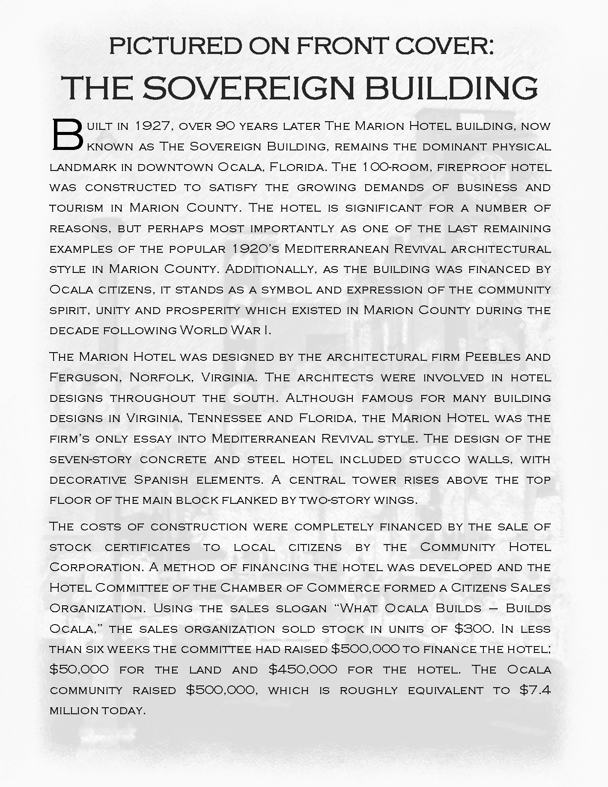
Pride in Local History
The front cover features three images of the tallest building in Ocala at different times in the past. We juxtaposed historical images with present-day images at different points in the report. The intent is to draw a connection in people’s minds from past visions of Ocala to the present. We believe strongly that it is at the intersection of pride in past achievements and the hope for new accomplishments that the best sort of redevelopment happens.
The story to the right is featured on the front-inside cover of the report. It tells the tale of the collective financing of The Sovereign Building in 1927, Ocala’s most prominent landmark and the tallest in the city. This short story serves as a call to action, by illustrating the strong community resolve that collectively funded the construction of Ocala’s tallest building.

Slide 4
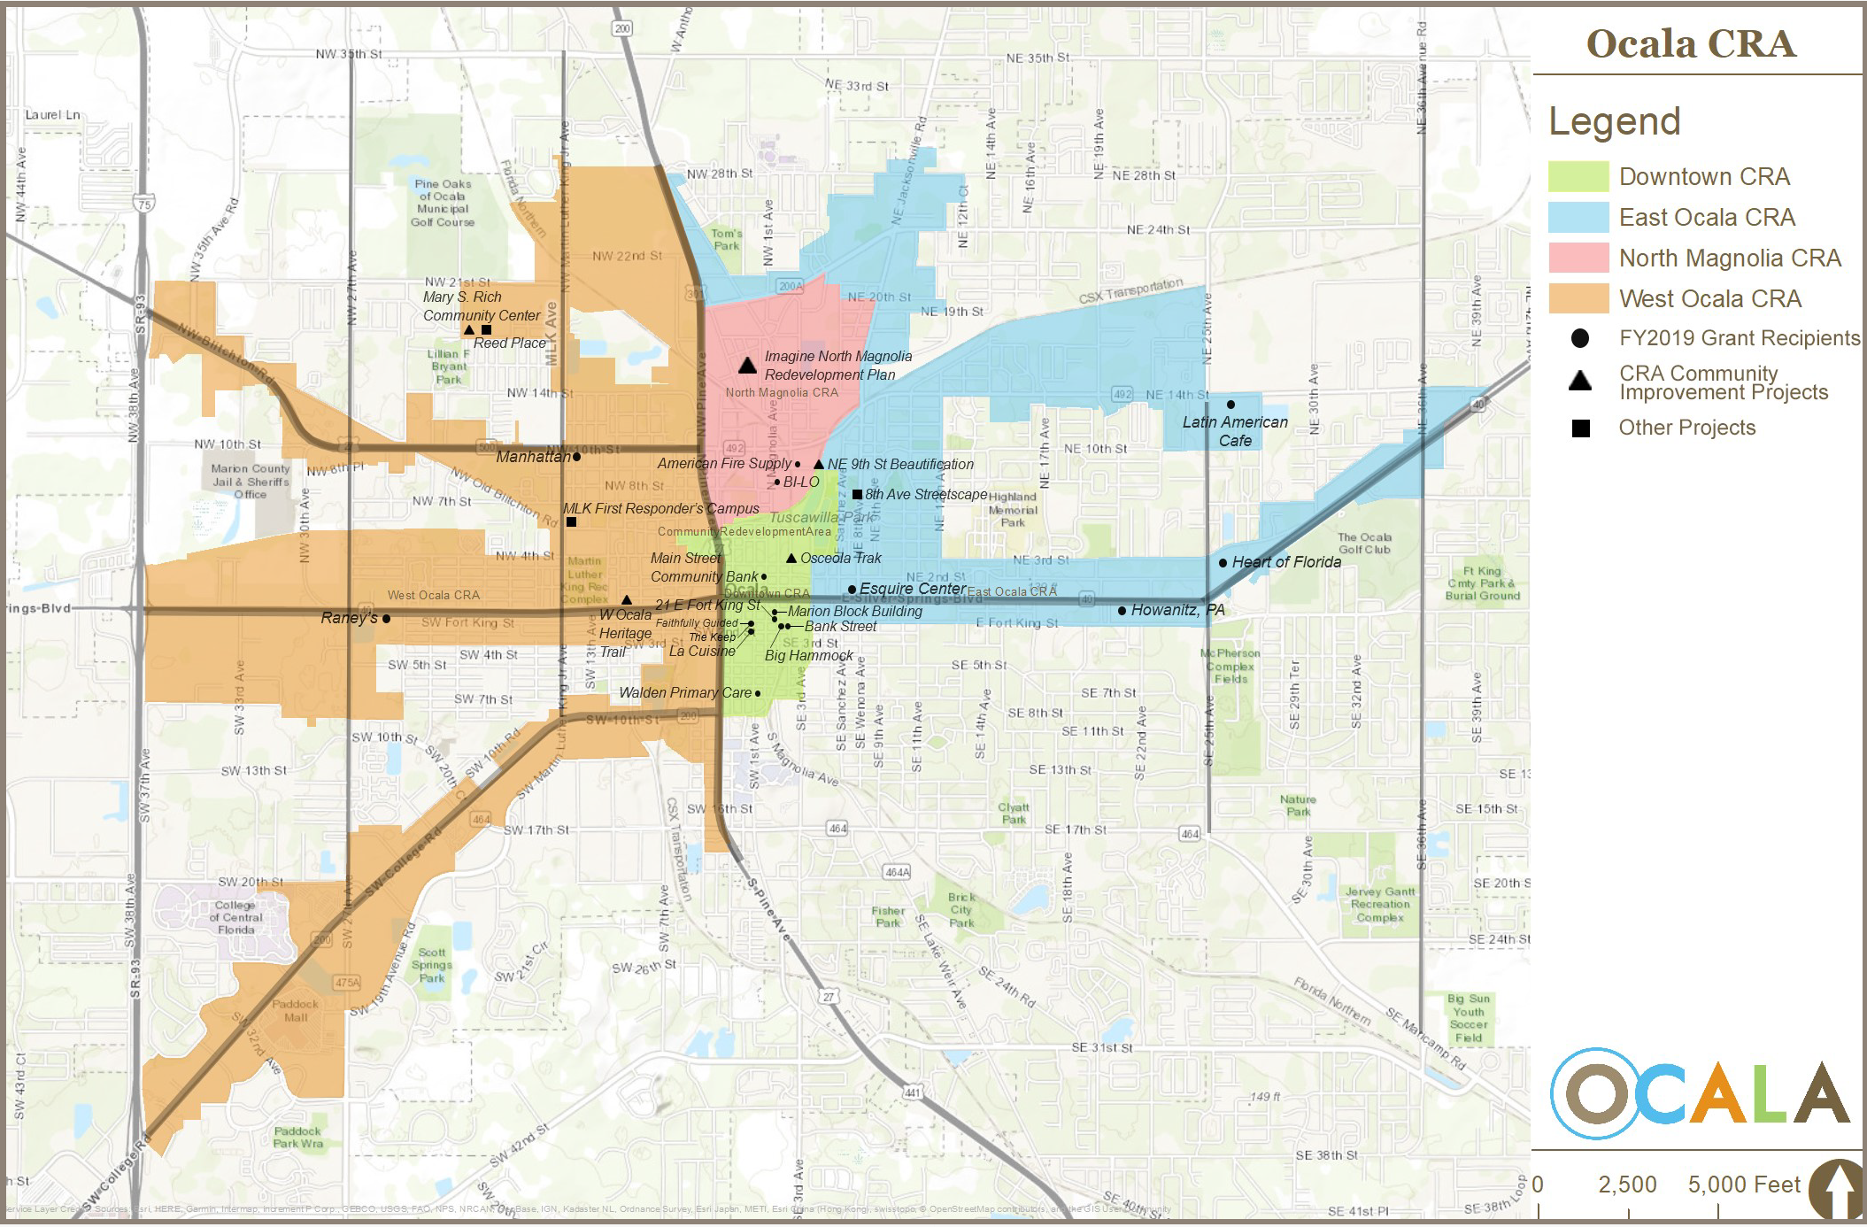
Ocala CRA: The Big Picture
Goals & Strategies:
Inform readers about the locations of the CRA subareas in a readable map.
Illustrate achievements for the entire CRA.
Foreshadow the contents of the report through the map symbology in an exciting and straightforward way.

Slide 5
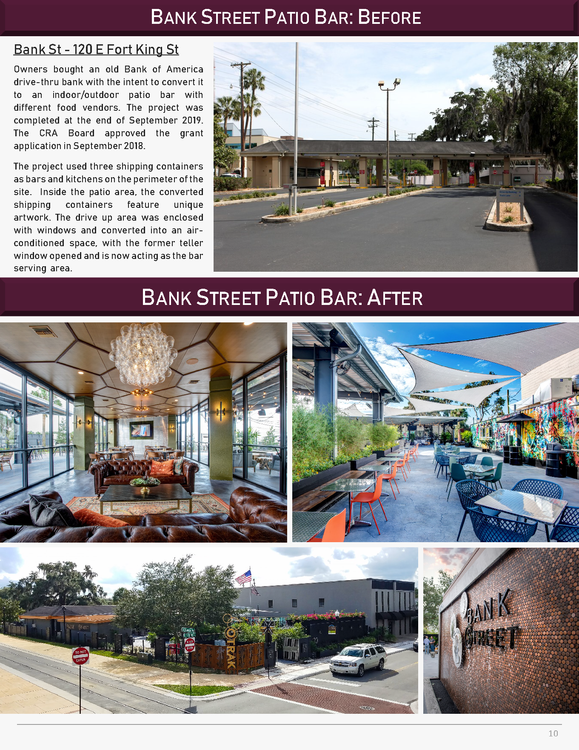
Highlighting our Accomplishments
Goals & Strategies:
Let the photos lead in telling the story.
Let the after photos take the spotlight.
Use a simple and visually pleasing layout.
Choose the best photos available. In this case, photos were both taken by staff and from the new establishment’s website.

Slide 6
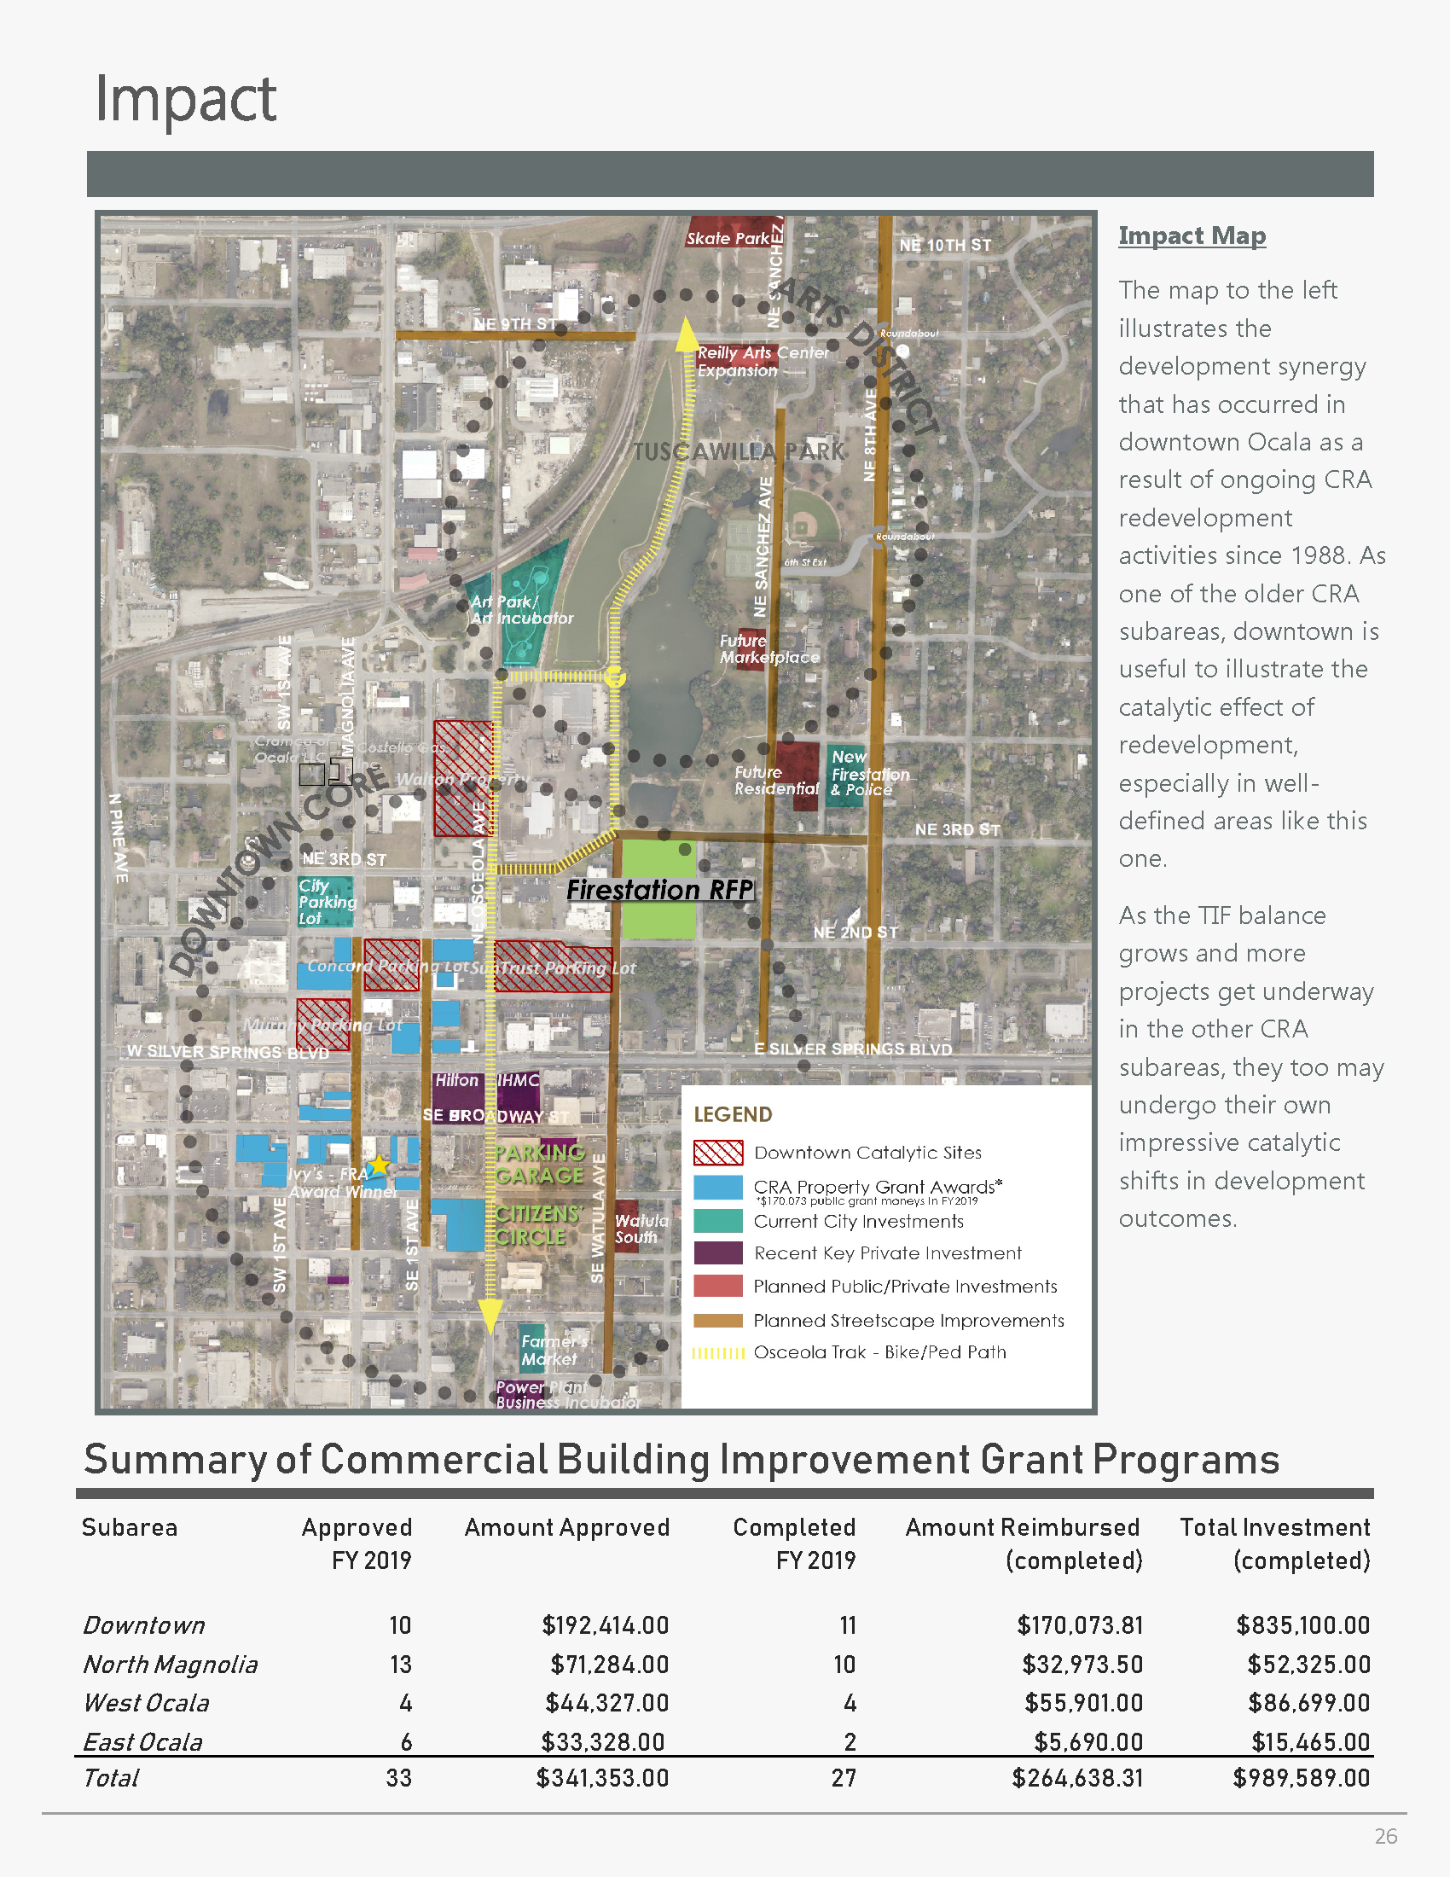
Educating on Redevelopment
We wanted this page to accomplish two major goals:
1) To highlight the real accomplishments and outlook for the oldest CRA subarea, downtown. We accomplished this through our public/private investment map, which illustrates the compact but substantial downtown urban renaissance in Ocala.
2) To try and interest those folks not trained or surrounded by the redevelopment world in their day-to-day. The small explainer to the right of the page works in tandem with the map to help clarify the value of CRAs and synergistic redevelopment.
In addition, the ‘Summary of Commercial Building Improvement Grant Programs’ serves this page well because it illustrates the leveraging of CRA dollars to greater private investment. This aligns with the principle of CRA activities as synergistic and catalytic.

Slide 7
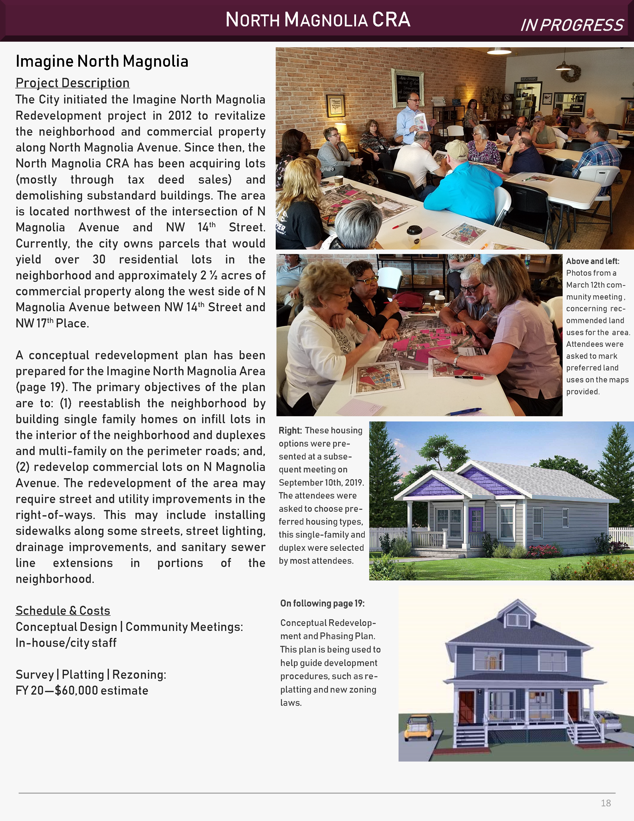
Participating in the Planning Process
Goals & Strategies:
The purpose of this page is to show public involvement in the redevelopment planning process. Developing plans with public participation is essential to the success of a redevelopment project. Buy-in is critical. Active participation ensures the long-term viability of a large multi-stage project.
The information on this and the following page are from a newsletter sent out to all businesses and residents in the area after this meeting. It helped to bring more people into the process at the subsequent public workshop.

Slide 8
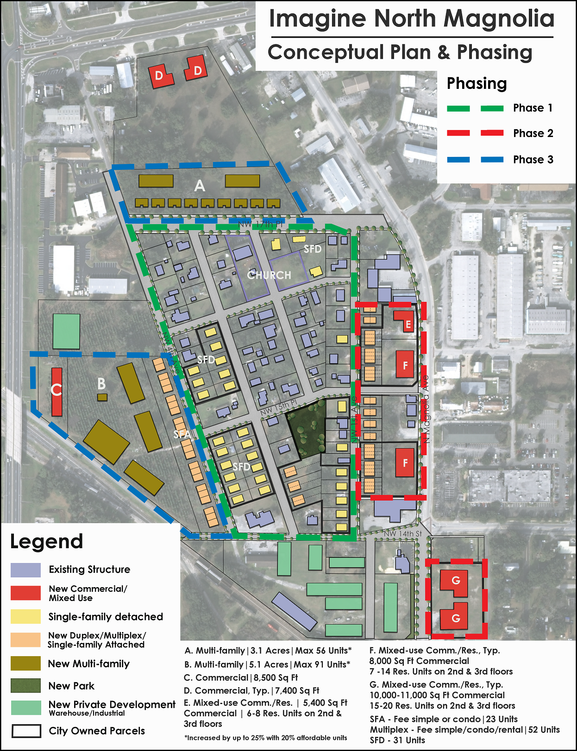
Accessible Planning Process
Goals & Strategies:
The design and presentation of this plan is meant to be simple to read and follow standard land use colors.
City-owned land is noted but vacant land is also included in a holistic conceptual design, which invites the idea of public-private partnerships going forward.
The aerial background gives context and is a familiar backdrop for most people.
We may say that, for better or worse, less people like to read if they don’t have to. So communicating clearly and engagingly visually (in terms of emails, newsletters, and meetings) and verbally (in one-on-one and public meetings) is a high priority.

Slide 9
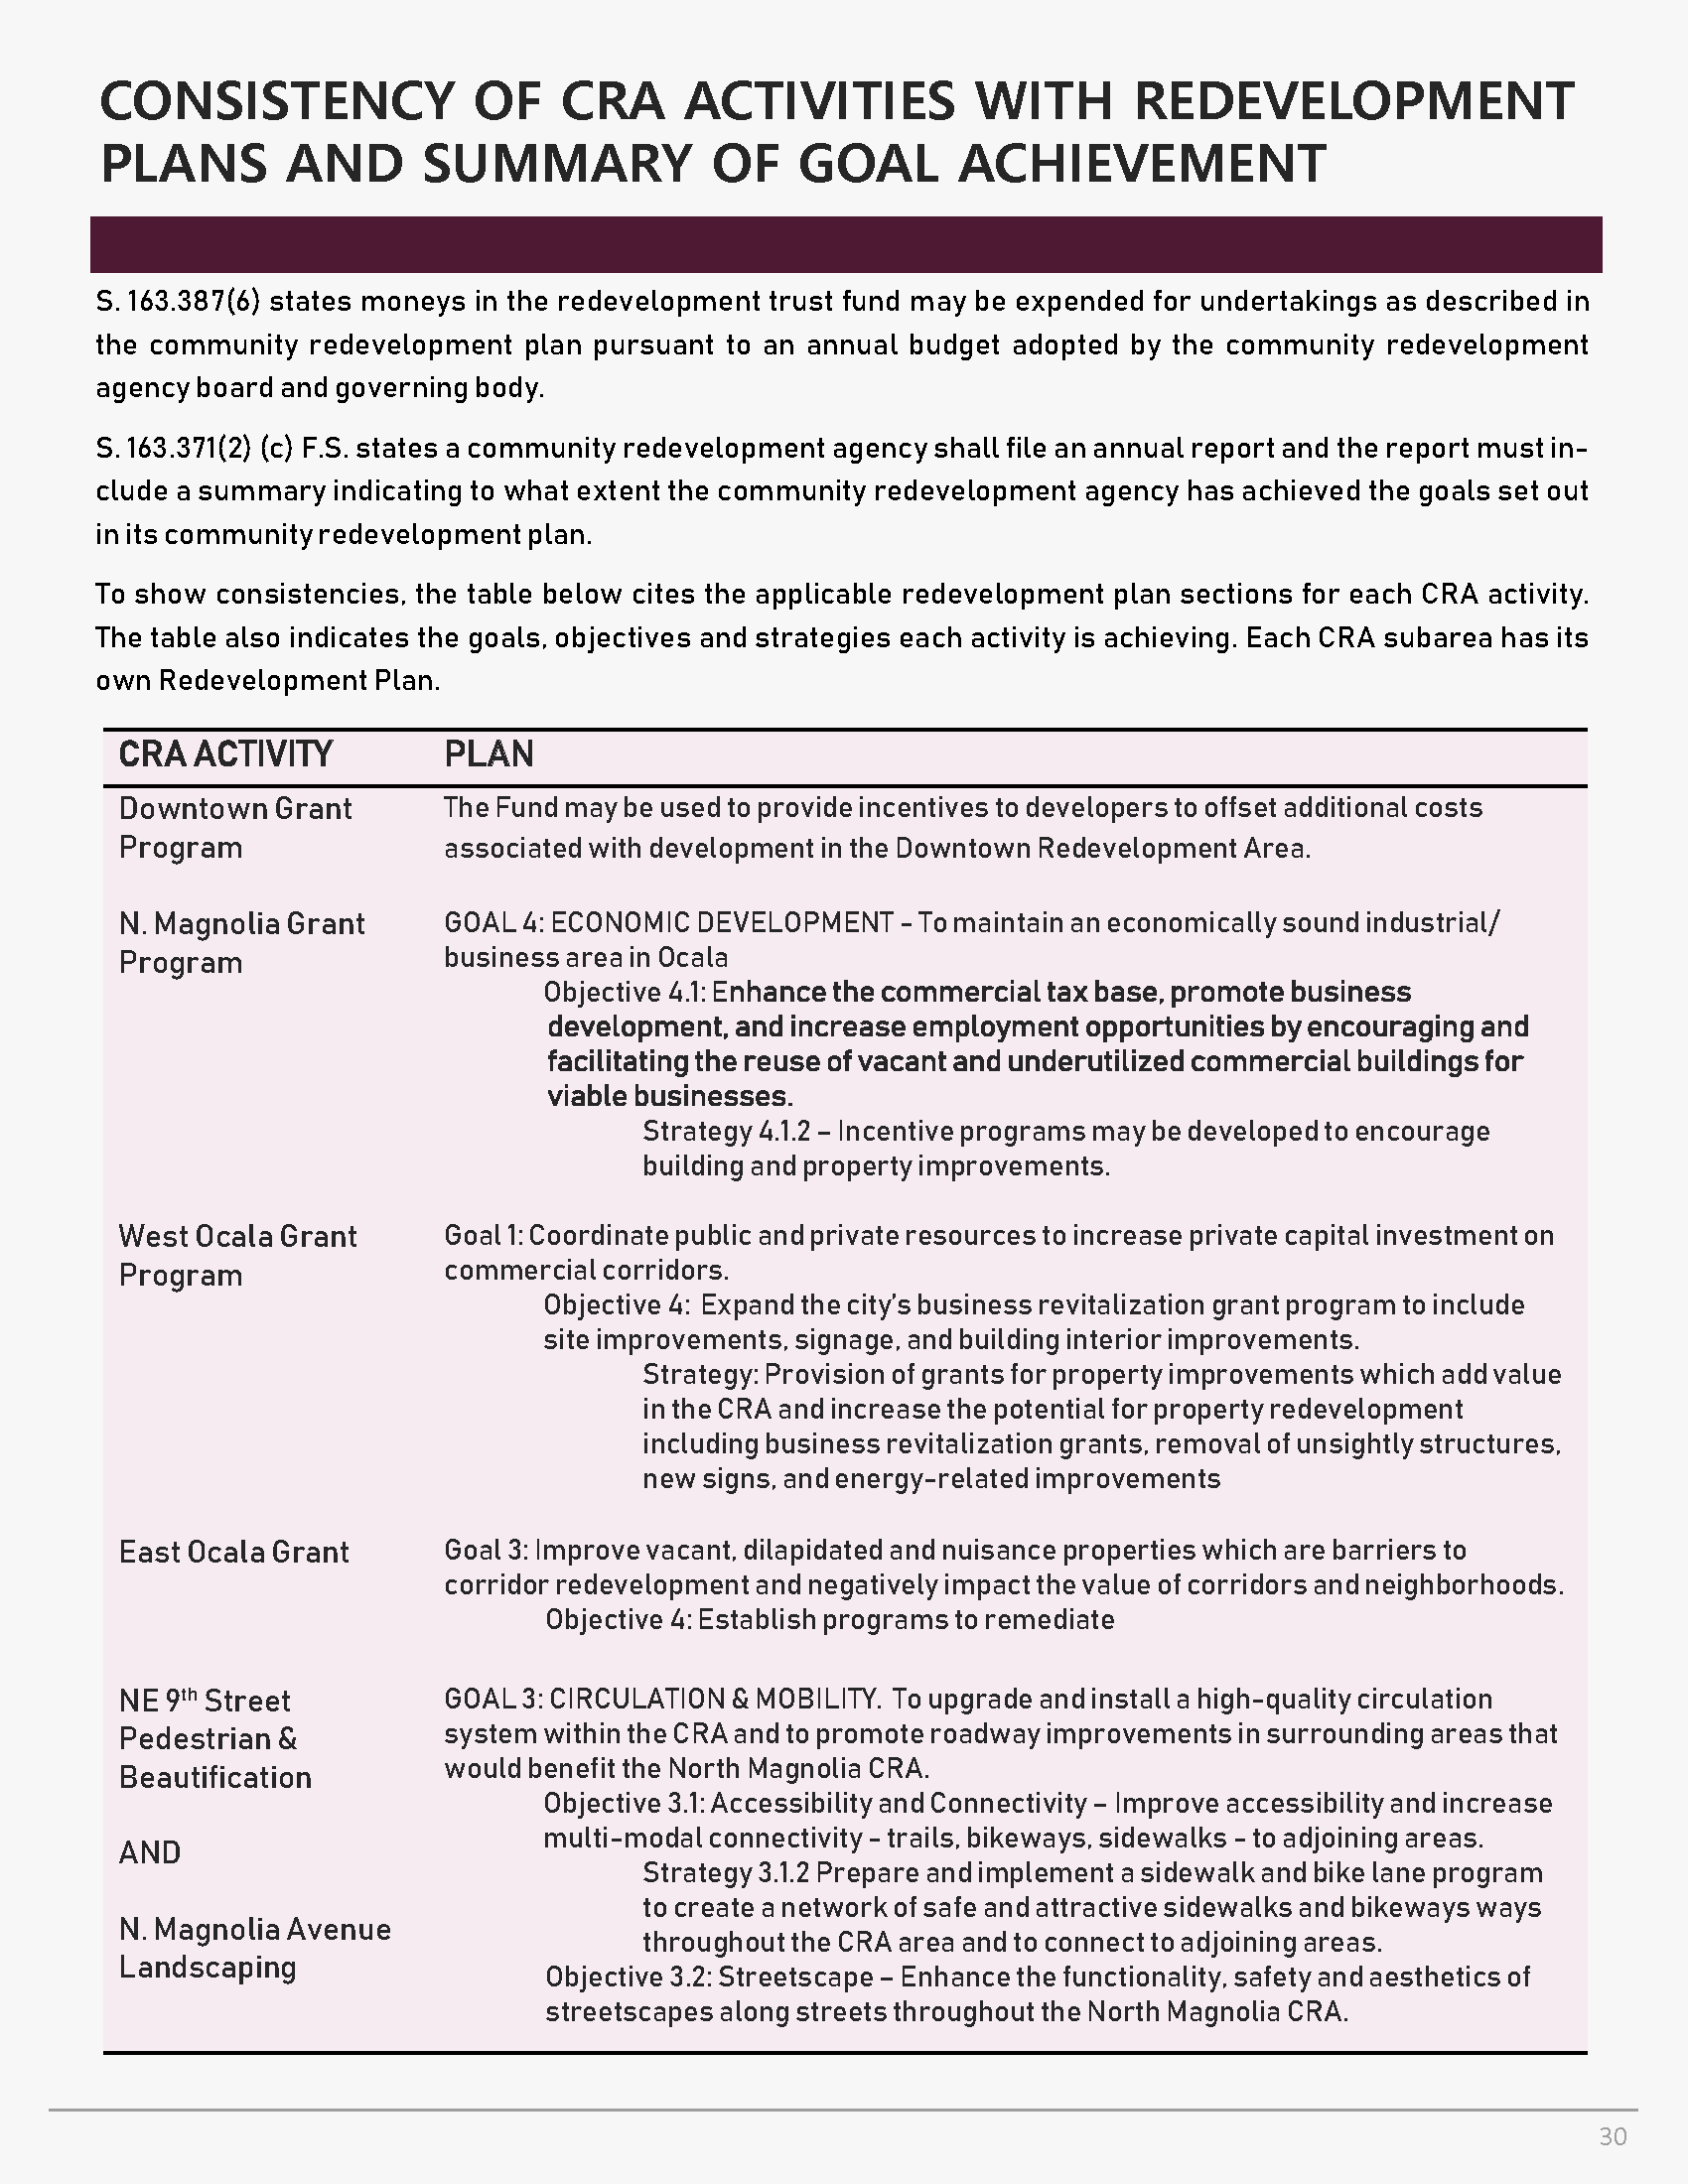
Reporting Requirements
Goals & Strategies:
Where it was impossible to reduce the footprint of text on a page, we tried to structure it in a way that makes it more readable and approachable.
So we created this simple yet effective consistency matrix for the new 2019 reporting requirements.
There are only two columns; one explaining the specific activity, and one explaining its corresponding goals and strategies in its respective redevelopment plan. Thus linking each activity to the applicable plan goal, objective an strategy.
Meeting the new requirements:
F.S. 163.371 (2) now includes a requirement that the CRA state in its annual report “a summary indicating to what extent, if any, the community redevelopment agency has achieved the goals set out in its community redevelopment plan.”
This new statutory requirement essentially invites CRA administrators to justify the existence of the CRA as best they can. We think this simple matrix, in tandem with the corresponding elements elsewhere in the annual report, makes the strongest and most straightforward case for how we have achieved the goals set out in our redevelopment plans.

