Slide 1
2020 Florida
Redevelopment Association
Roy F. Kenzie Awards
Award Entry Category: Management Programs
& Creative Partnerships
The Hallandale Beach Food & Groove Festival
and Foodie Movie Nights
Submitted by
Hallandale Beach Community Redevelopment Agency
Jeremy Earle, Ph.D., AICP, FRA-RA │ Assistant City Manager/CRA Executive Director
City of Hallandale Beach
400 South Federal Highway
Hallandale Beach, FL, 33009
Award Entry Category: Management Programs & Creative Partnerships

Slide 2
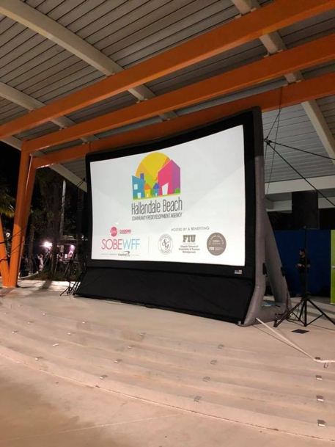
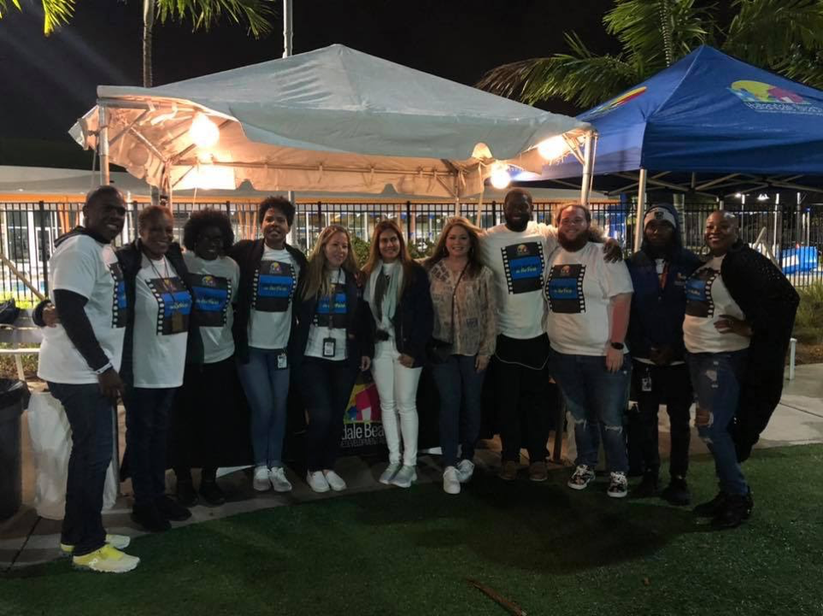
HBCRA Partners with South Beach
Food & Wine Festival (SOBEWFF®)
Hallandale’s Foodie Weekend
On August 15, 2019 the HBCRA held a teaser event called a Taste of Hallandale for the City employees. The purpose of the event was to celebrate Hallandale’s eateries and divine culinary creations and kick start a series of cultural events, which the HBCRA hopes will drive new tourism traffic to our restaurants and other businesses. This teaser event was the precursor to a larger scale event that would be open to the public that would not only promote economic development but also create brand awareness for the City of Hallandale Beach. October 4, 2019, HBCRA partnered with The Food Network & Cooking Channel South Beach Wine & Food Festival (SOBEWFF®) to host three signature events - Foodie Movie Nights in the Park (2) and the Hallandale Beach Food & Groove Festival. The sold-out events had 21 participating restaurants, 6 food trucks, live paintings curated by ArtServe, appearances by Food Network’s celebrity chefs including World Famous Chocolatier Jacques Torres and Food Network Star Valerie Bertinelli, and more than 800 participants over the weekend. These inaugural events were a first of their kind for the City of Hallandale Beach and garnered over 6.4 million unique media impressions.
Event Website | www.sobewff.org/hallandale

Slide 3
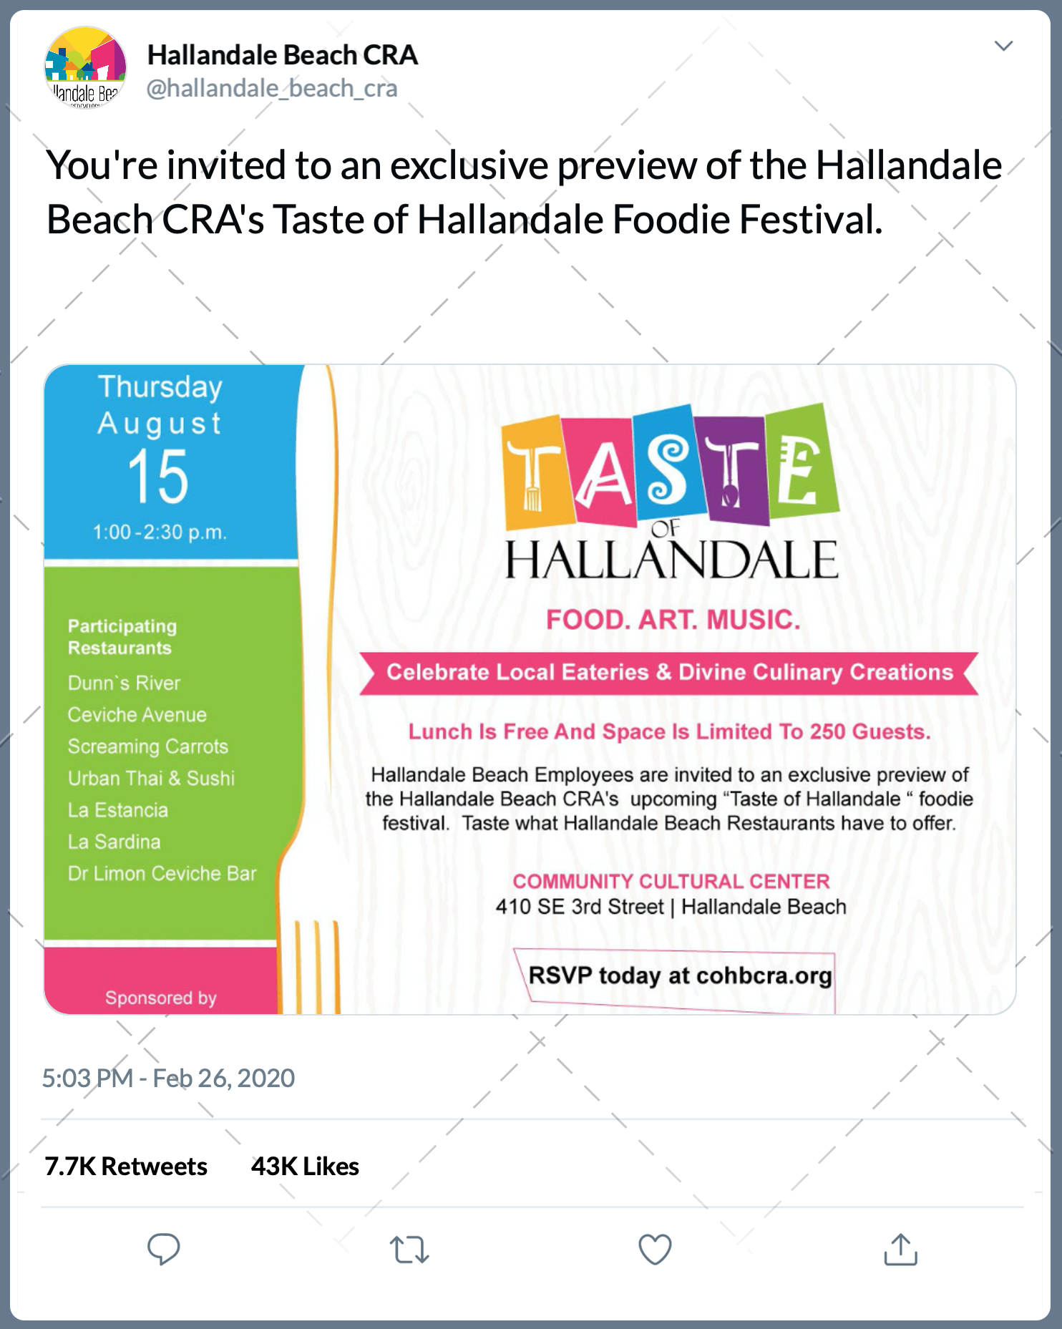
Social Media Graphics
Before
After

Slide 4
Collateral Material
EVENT FLYERS

Slide 5
Printed Advertisements

Slide 6
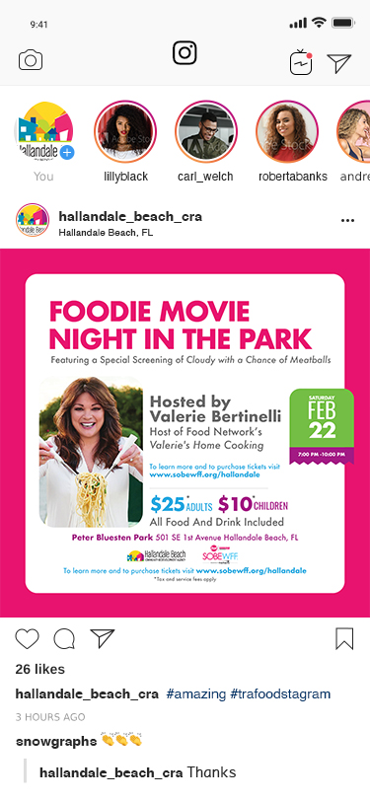
Social Media Graphics

Slide 7
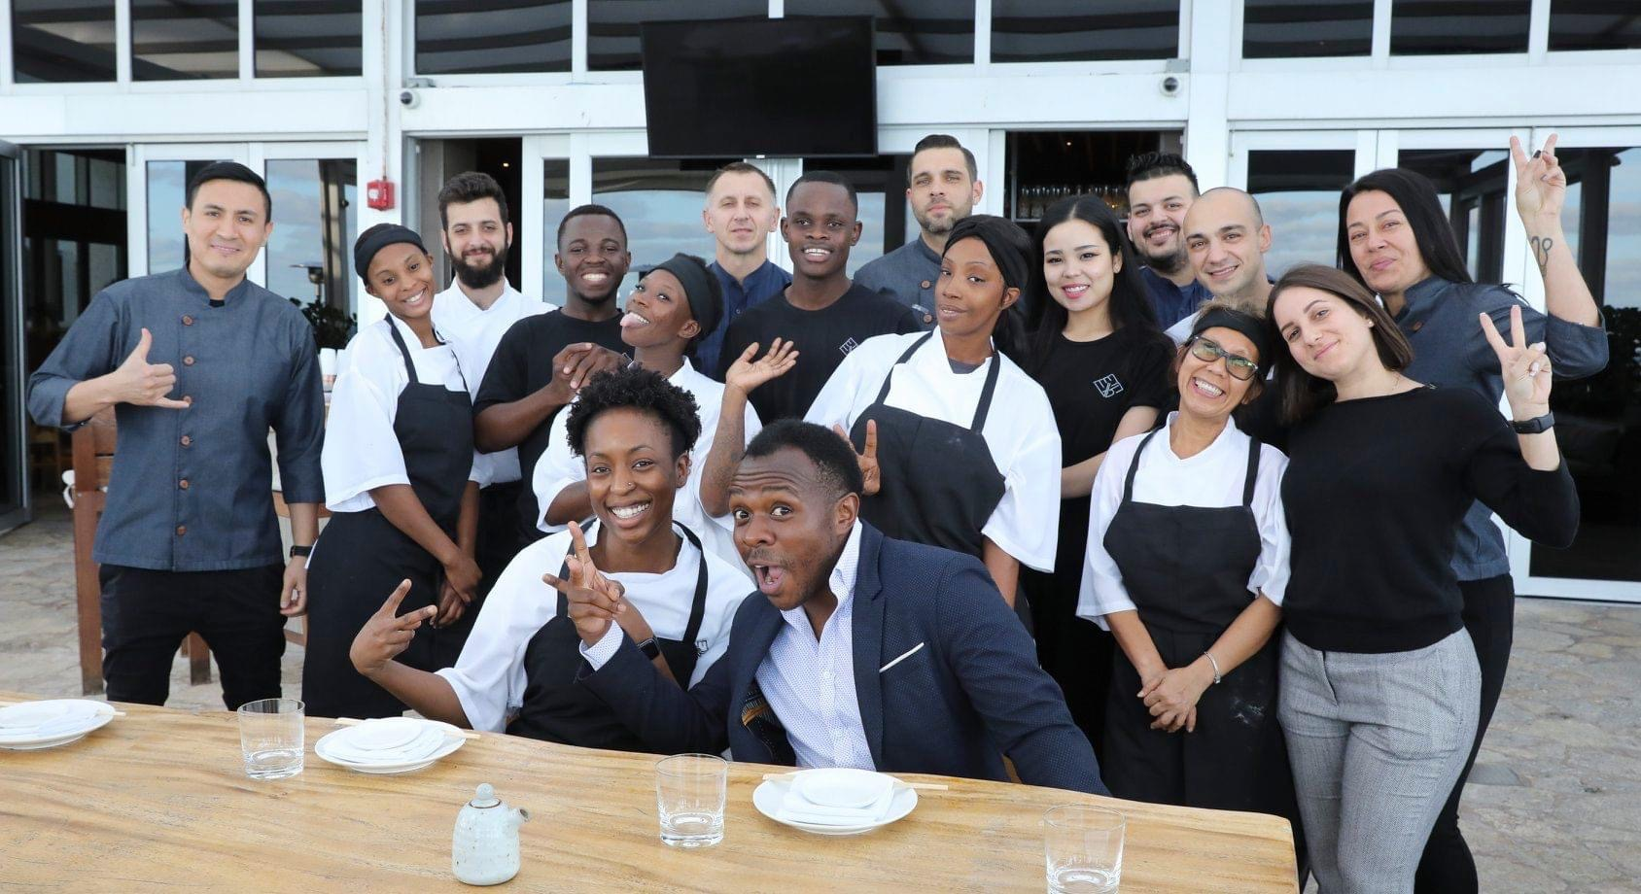
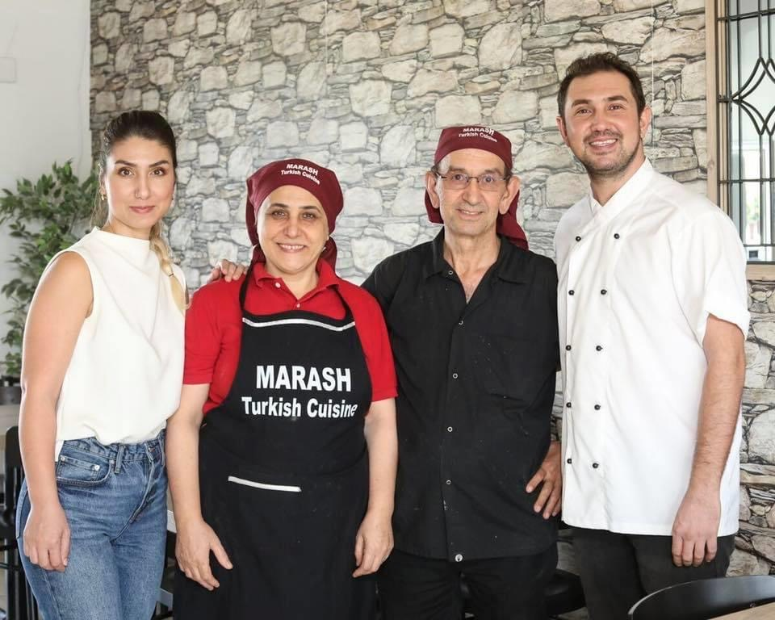
Social Media Graphics

Slide 8
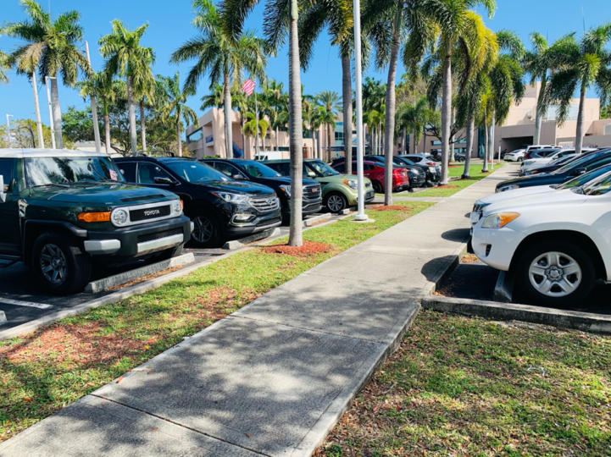
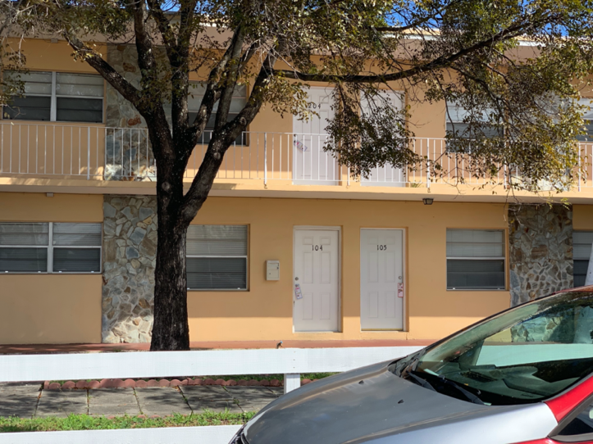
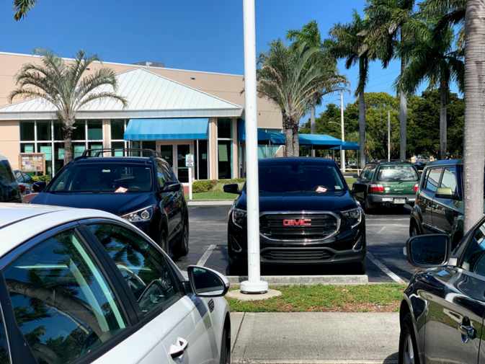
Public Outreach
HBCRA engaged a grass roots outreach community outreach team to deliver event flyers to local businesses, community partners & residents.

Slide 9
Media Outreach
PRESS RELEASE FOR IMMEDIATE RELEASE
Hallandale Beach Partners with SOBEWFF® for its First Foodie Takeover Weekend – February 21-22
Hallandale Beach, FL – February 10, 2020 – The Hallandale Beach Community Redevelopment Agency (HBCRA) in partnership with The Food Network & Cooking Channel South Beach Wine & Food Festival presented by Capital One (SOBEWFF®) will host their inaugural “Foodie Takeover Weekend” Friday, February 21- Saturday, February 22. The weekend will consist of three events showcasing local eateries, wine samples, music, art, movies, celebrity guests & more.
Residents and visitors currently enjoy Hallandale’s beautiful beaches, comfortable hotels, world-class shopping, dining, entertainment, two of South Florida’s premier “racinos” - Gulfstream Park and Mardi Gras Casino, and sporting activities including tennis, golf, swimming, boating, and salt-water.
Hallandale Beach boasts more than 100 diverse restaurants, most family owned. The Hallandale Beach Foodie Takeover Weekend was created as a result of the HBCRA’s commitment to support Hallandale’s local restaurants, highlight its diverse culture, and create fun filled events for the entire family. The Foodie Takeover Weekend is set to become a premier annual event that will take center stage of what’s hot in Hallandale Beach.
“Art and food have a unique ability to bridge cultural divides and bring communities together in a way that few other activities can,” said Assistant Manager & HBCRA Executive Director Dr. Jeremy Earle. “Food is a tremendous vehicle for sharing one’s culture with people from different backgrounds, and art has the ability to tell stories that inspire reflections that can transcend personal or cultural differences.”

Slide 10
Radio Advertising
HBCRA promoted the Inaugural Food & Groove Festival on Hot 105.1 One of South Florida’s premiere radio stations.

Slide 11
Promotional Videos
HBCRA created promotional videos for 13 of the featured Food & Groove Festival restaurants.
The goal was to not only draw patrons to the event but also encourage residents patronize these businesses post event.
Link to All Food & Groove Promotional Videos
https://www.youtube.com/playlist?list=PLRPIsi4oNnnhLu2nF7zxd9PirOpOiKrVd

Slide 12
Promotional Videos
HBCRA created a recap video encompassing all Hallandale Foodie Weekend events. The goal was to continue building anticipation for future events as well as provide on going promotion for the participating restaurants.
Link to Foodie Weekend Recap Video
https://youtu.be/_HE42HlX0Gc

Slide 13
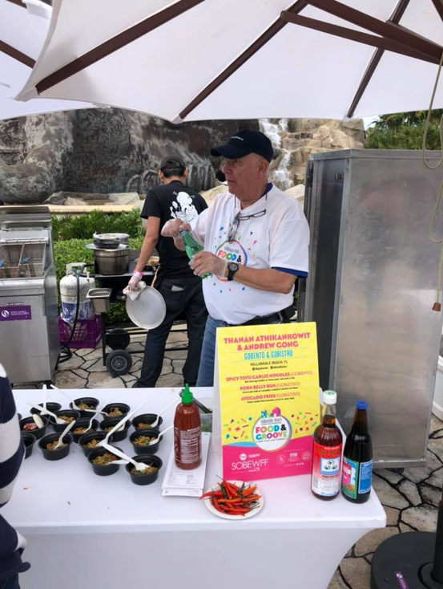
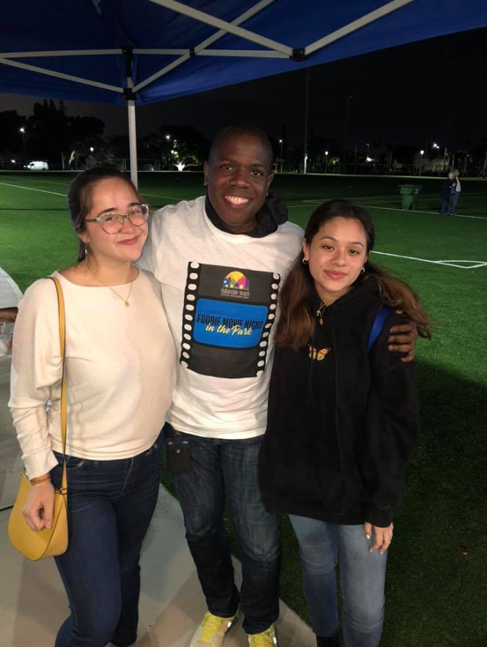
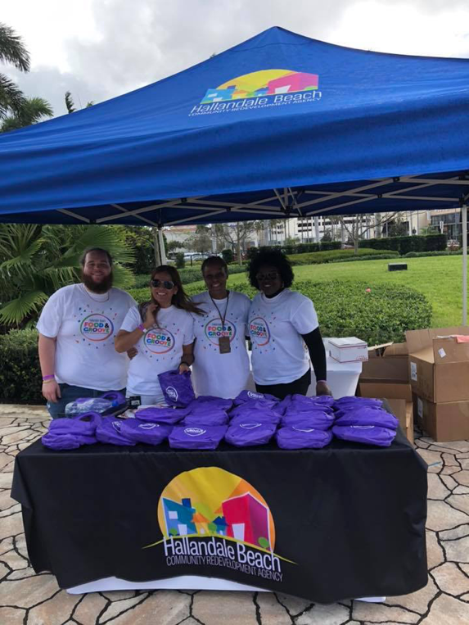
Event Photos

Slide 14
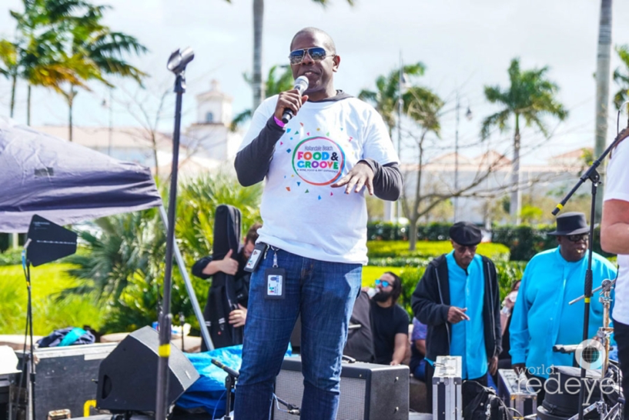
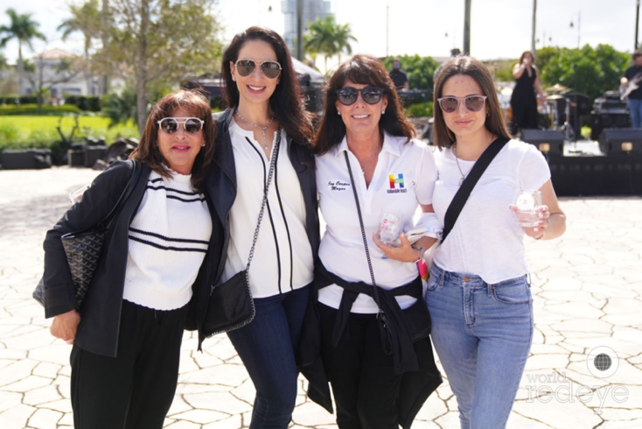
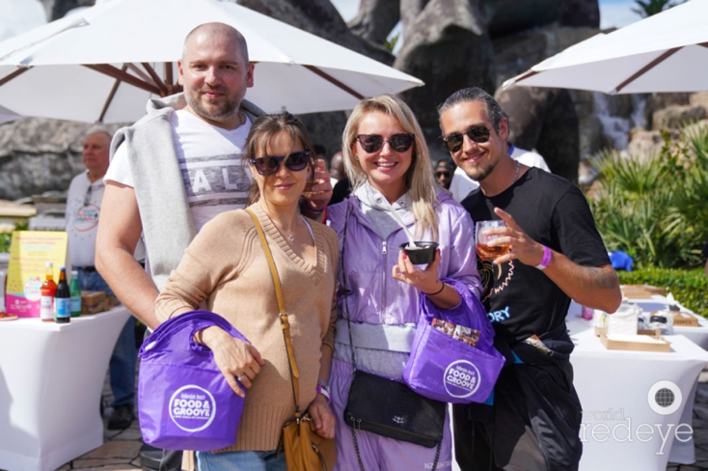
Event Photos

Slide 15
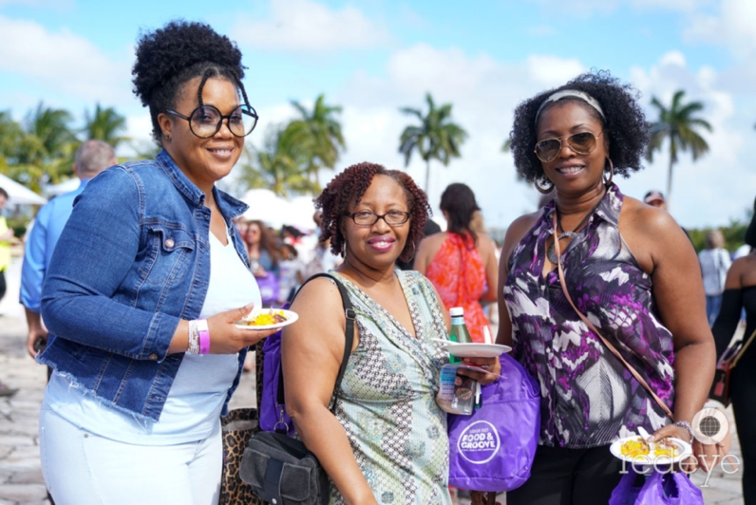
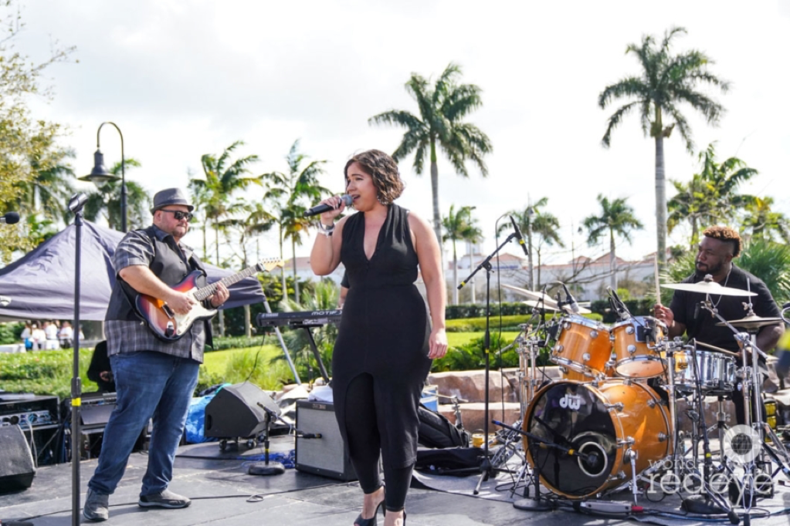
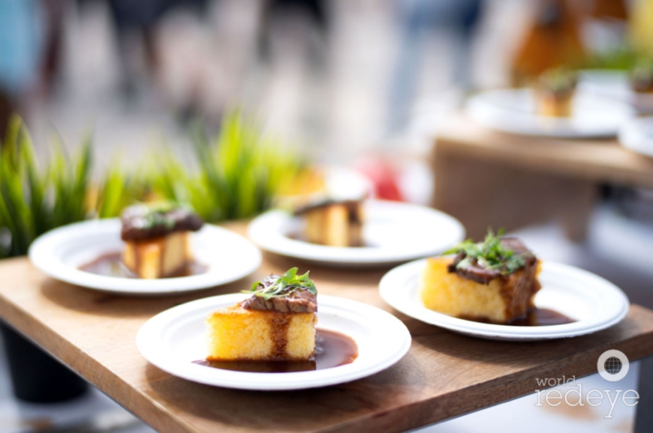
Event Photos

Slide 16
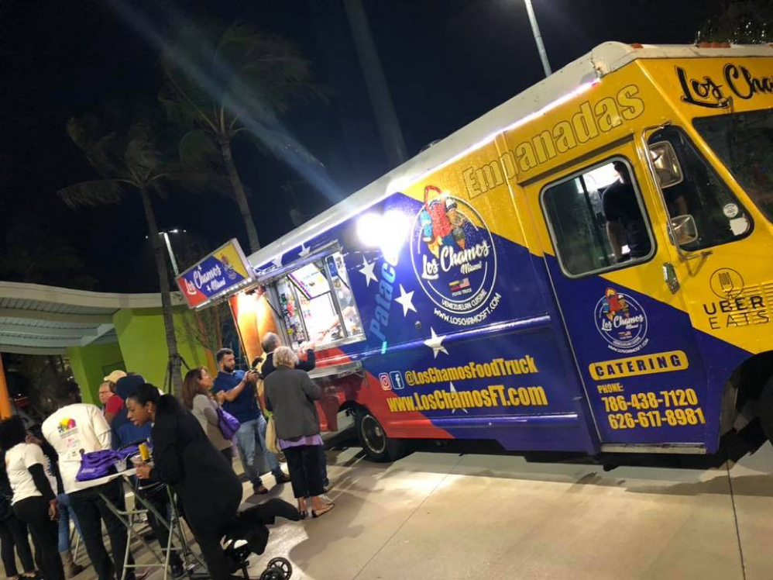
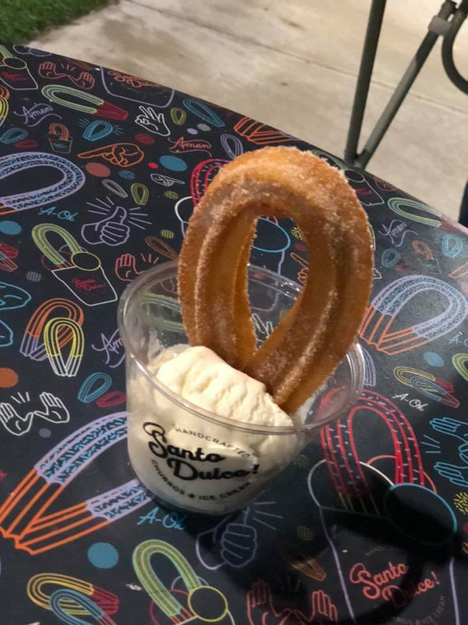
Event Photos

