Slide 1
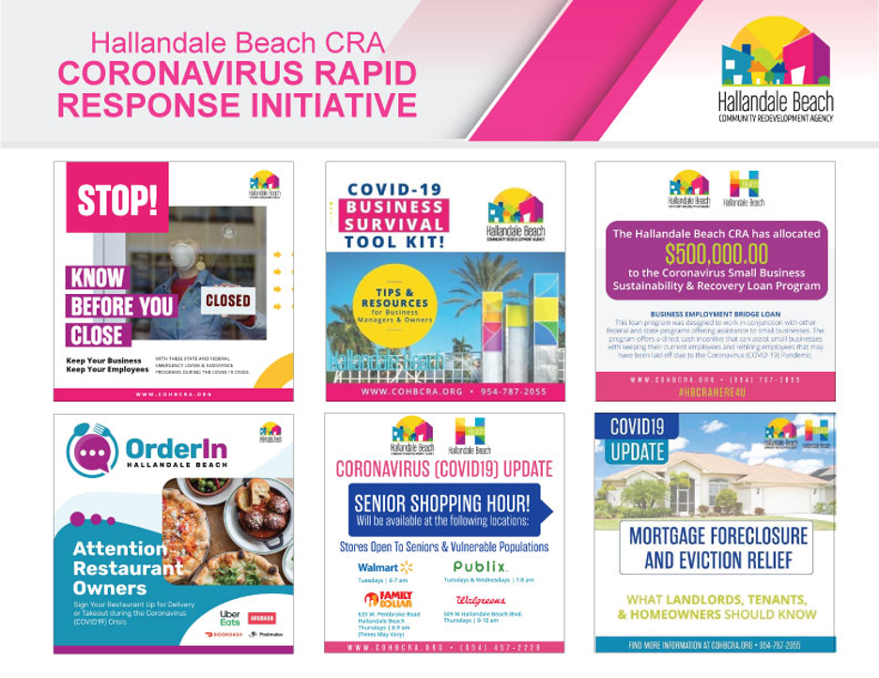
2020 FLORIDA
REDEVELOPMENT ASSOCIATION
ROY F. KENZIE AWARDS
Award Entry Category: Out of the Box
Hallandale Beach Community Redevelopment Agency
COVID-19 Rapid Response Initiatives
Submitted by
Hallandale Beach Community Redevelopment Agency
Jeremy Earle, Ph.D., AICP, FRA-RA │ Assistant City Manager/CRA Executive Director
City of Hallandale Beach
400 South Federal Highway
Hallandale Beach, FL, 33009
Award Category: Out of The Box

Slide 2
Hallandale Beach Community Redevelopment Agency
COVID-19 Rapid Response Initiatives
In response the COVID-19 pandemic, the HBCRA has developed an innovative and aggressive approach to providing relief for businesses and families including:
Development of the Business Rapid Response Program
$500,000 Small Business Sustainability and Recovery Loan Program
$300,000 Residential Rental and Mortgage Assistance Program
$30,000 Senior Rental/Utility Assistance Program
Creation of the Order-In promotional campaign for the sustainability of local restaurants
Aggressive marketing of financial resources and information to the community
Strategic partnerships with SCORE, the Urban League of Broward County, and the Hallandale Beach Chamber of Commerce
Creation of a Banking and Lending Consortium

Slide 3
Program Details
Hallandale Beach Community Redevelopment Agencies COVID-19 Rapid Response Initiatives
On March 9, 2020 the City of Hallandale Beach executed a declaration of emergency in response to the deadly Coronavirus/COVID-19 pandemic.
Uncertain of the immediate and long-term impact the COVID-19 crisis would have on the local economy, businesses and residents, the HBCRA immediately assembled its Coronavirus Rapid Response team. The team immediately began outreach to local businesses, surveying their needs, providing updates about available resources, tips, and general information to keep them and their employees safe, healthy and informed.
Within the first few weeks of the pandemic, the HBCRA established a hotline for businesses to call in and receive information and reached out to thousands of local businesses within the community through phone calls, emails, and actual business visitations in order to hand deliver important materials that could help save their business. The team was committed to ensuring businesses could not only be safe, informed, and healthy during these uncertain times, but to also provide information regarding financial, or mentoring assistance.
Resource Website |www.cohbra.org.corona
Loan Website | www.cohbcra.org/loan

Slide 4
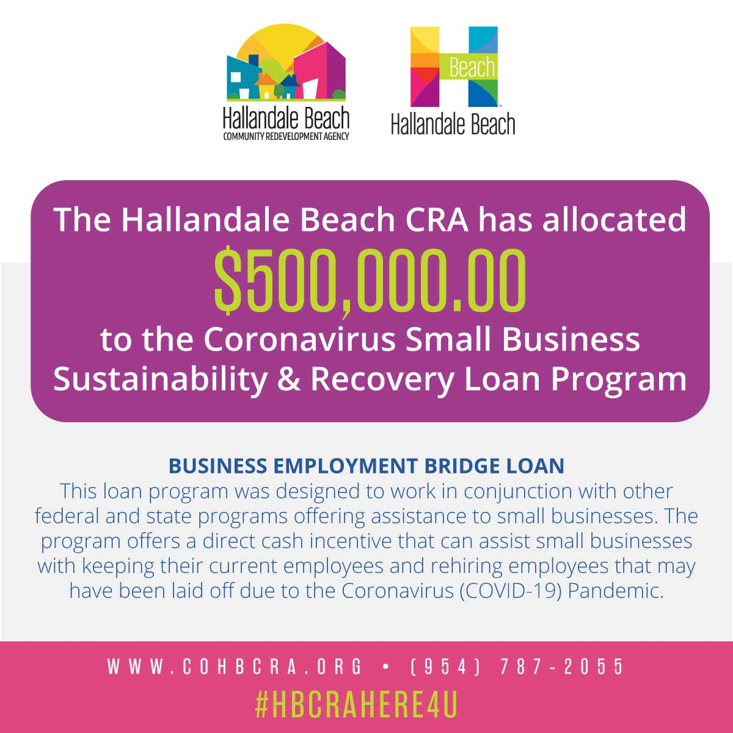
HBCRA Coronavirus Small Business Sustainability and Recovery Loan Program
BUSINESS EMPLOYMENT BRIDGE LOAN
A forgivable bridge loan designed to work in conjunction with other federal and state programs in order to provide a direct cash incentive for small businesses to keep their workers on the payroll.
Businesses are encouraged to rehire those that they may have previously laid off.
Provides a bridge loan of up to $50,000, and is available to qualified for-profit small businesses including, sole proprietors, partnerships, corporations, and limited liability companies, that as of March 9, 2020 had been in business within the CRA for at least one year.
EMERGENCY CASH INFUSION LOAN
A partially forgivable bridge loan, designed to work in conjunction with other federal and state programs in order to provide a direct cash incentive for small businesses to help them through this challenging period associated with the Coronavirus pandemic.
Provides funds up to $15,000 and is available to qualified for-profit small businesses including, sole proprietors, partnerships, corporations, and limited liability companies, that as of March 9, 2020 had been in business within the CRA for at least one year.
Qualified small business applicants must be an employer business with between 2 to 100 employees.

Slide 5
$300,000 CORONAVIRUS RESIDENTIAL
RENTAL AND MORTGAGE ASSISTANCE PROGRAM
$30,000 SENIOR RENTAL/UTILITY ASSISTANCE PROGRAM
Program Details
$300,000 Coronavirus Neighborhood and Housing Stabilization Program created to address the serious danger of the CRA (76% of the City) reverting to a slum and blighted condition if aggressive actions are not taken to stabilize the economy as well as housing.
Program is designed to assist families unable to make rental, utility, and mortgage payments.
Three separate grants, all of which are available only to those residents living within the Hallandale Beach Community Redevelopment Area (CRA) in accordance with Florida Statute 163 Part III.
Applicants can only select one of the three programs.
Program Details
Assist struggling individuals (62 years old and older).
Help low-income families facing eviction or utility shut-off.
Families will have access to emergency financial assistance for paying rent and utility expenses.

Slide 6
PARTNERSHIPS
WORKFORCE AND SMALL BUSINESS DEVELOPMENT PARTNERSHIP WITH THE URBAN LEAGUE OF BROWARD COUNTY (ULBC)
The Hallandale Beach Community Redevelopment Agency (HBCRA) launched a new workforce and small business development partnership with the Urban League of Broward County (ULBC). The partnership kicked off on Thursday, April 30th at 11am with a Workforce & Small Business Webinar aimed to inform and connect residents and business owners in Hallandale Beach and northeast Broward County to the numerous resources including emergency assistance for rent, mortgage, utilities, small business funding, employment training, business technical assistance and more.
The HBCRA Board approved the $111,792 ULBC Workforce & Small Business Development partnership on January 13, 2020. This partnership seeks to create a feeder system that ensures small business owners are connected to a deep labor talent pool and equipped with knowledge and resources to help their companies flourish. The goal of ULBC’s Workforce and Small Business Development Program is to provide employers with a skilled and trained workforce while building Hallandale Beach as one of the best cities to start, develop and expand a business.

Slide 7
PARTNERSHIPS
WORKFORCE AND SMALL BUSINESS
DEVELOPMENT PARTNERSHIP WITH SCORE BROWARD
HBCRA Partnered with SCORE to provide business assistance training and mentorship.
Several Virtual Business Survival Workshops were held for businesses.
Post Seminar Tools: https://cohbcra.org/2020/04/10/business-survival-material-apr9/

Slide 8
Order In Hallandale Beach Campaign
Campaign Details
HBCRA created Hallandale’s Order-In Hallandale Beach promotional campaign to assist local restaurants during the crisis. Restaurants were able to set up deliver mechanisms and residents were encouraged to order food from the participating restaurants.

Slide 9
Senior Shopping Hour Campaign
Campaign Details
HBCRA assisted in the promotion
of Senior Shopping Hours at local retailers

Slide 10
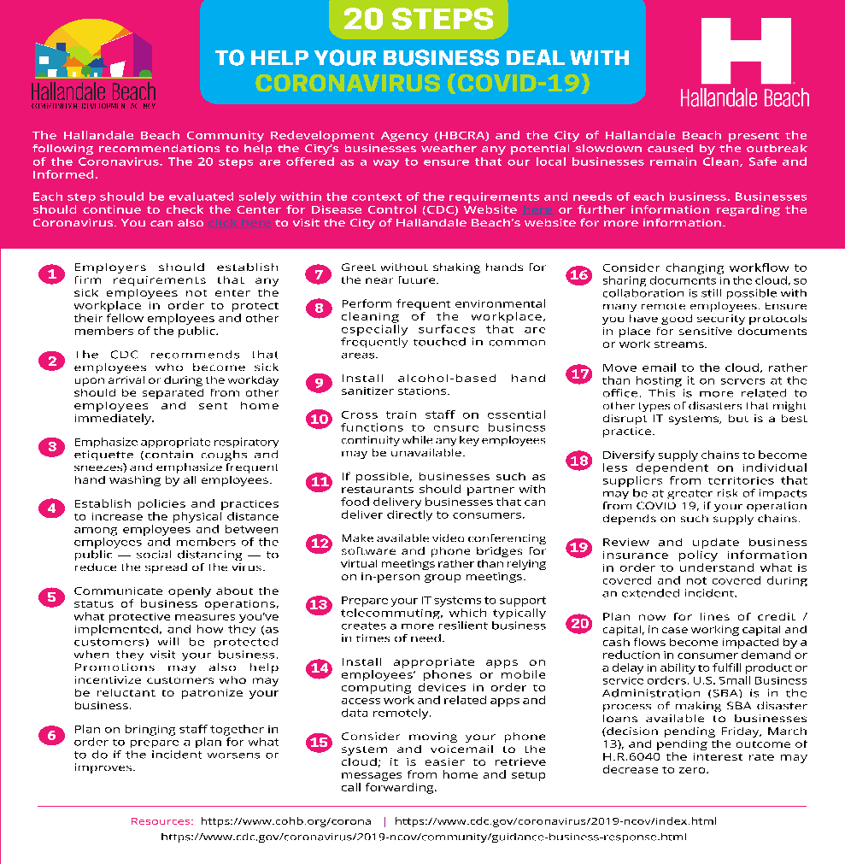
RESOURCES
BUSINESS SURVIVAL TIP
HBCRA created and distributed various resources to local businesses that provided business survival tools.
COVID-19 HOTLINE
HBCRA created A COVID-19 HOTLINE
to answer pressing questions about
city initiatives & resources.

Slide 11
RESOURCES
COVID-19 Business Survival Toolkit
HBCRA created this toolkit which provided guidance on steps that businesses could take to mitigate some of the effects of the Coronavirus, potential resources at the Federal and State level that businesses could access in order to receive financial assistance. This information was emailed to over 2,000 business within the community via email from the CRA and the Hallandale Beach Chamber of Commerce, posters and packages dropped off to businesses by the CRA staff, directly mailed to businesses, and posted on the CRA website and social media channels.

Slide 12
Resources
HBCRA provided resource information to Hallandale Beach, Tenants, Landlords, & Homeowners.

Slide 13
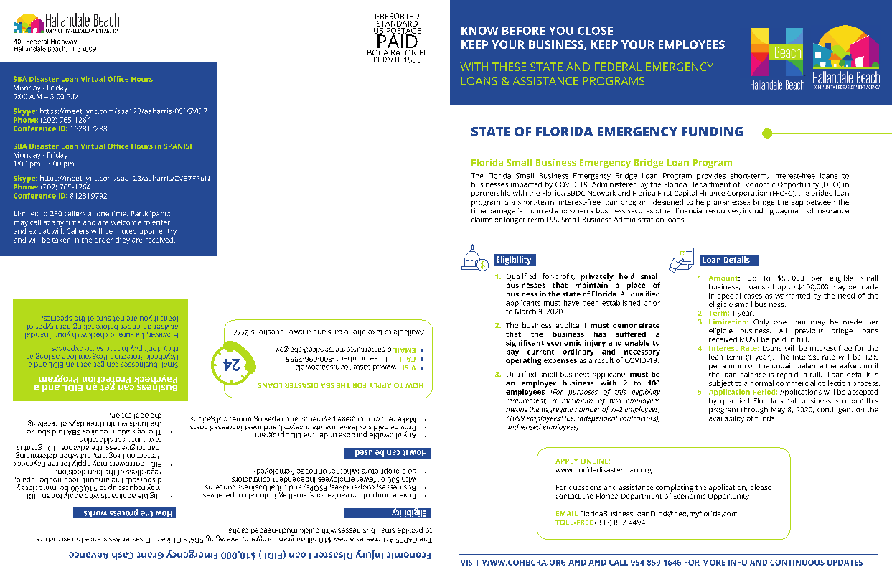
Collateral Material
HBCRA mailed & delivered a brochure displaying resources available to small business owners.

Slide 14
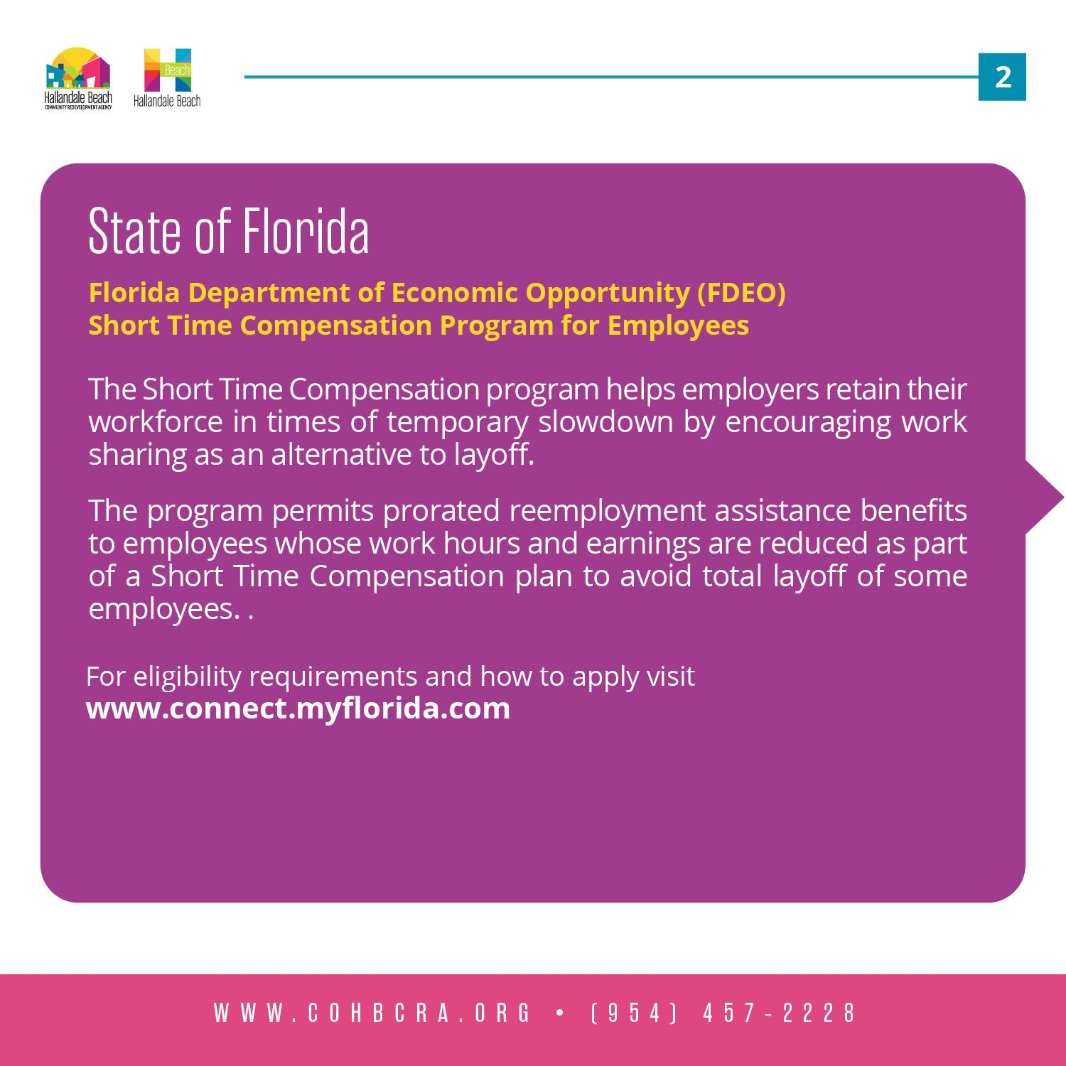
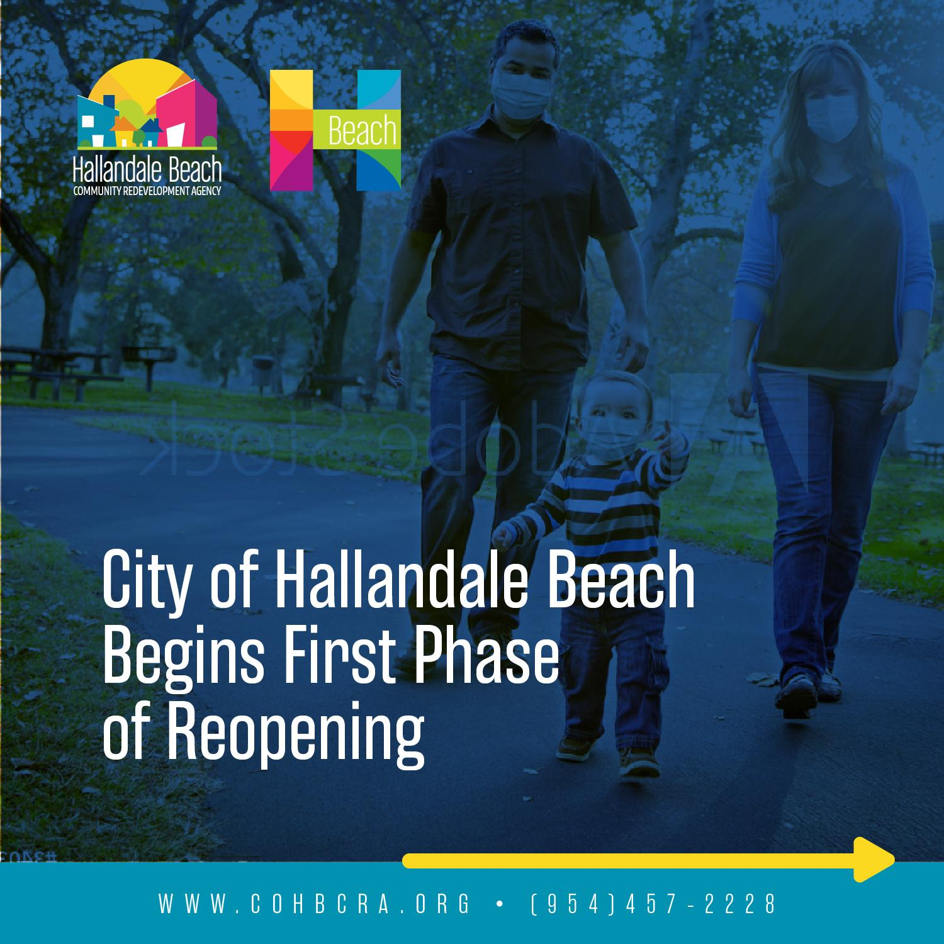
Social Media Graphics

Slide 15
Landing Page

