Slide 1
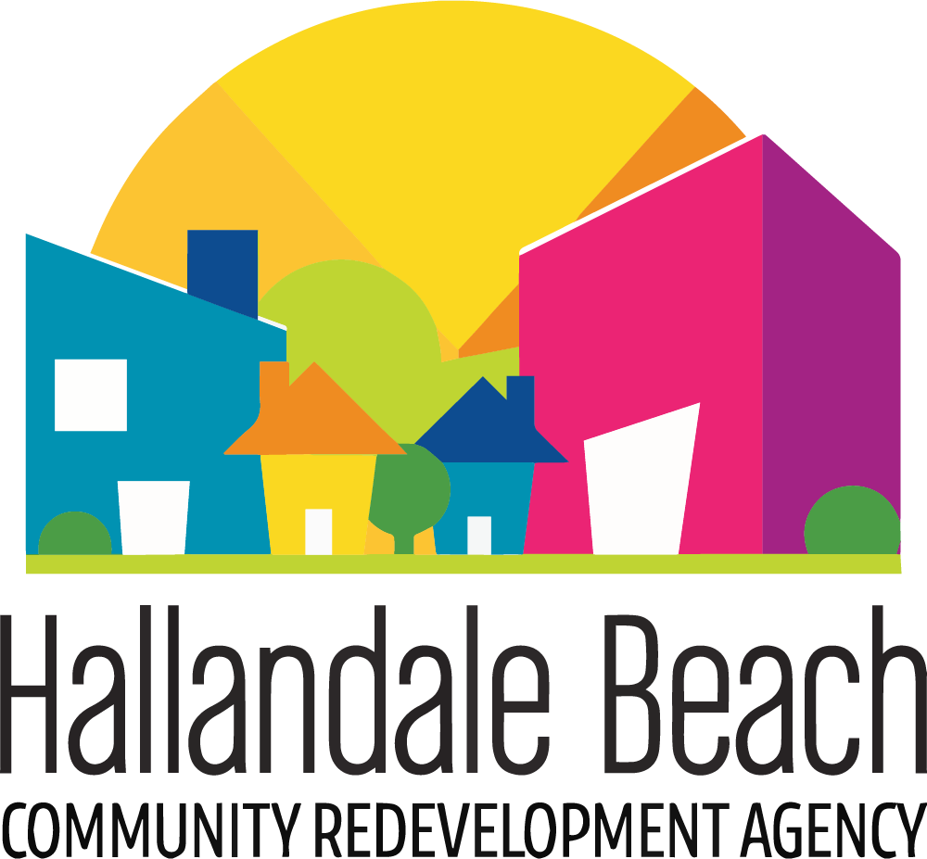
2020 Florida
Redevelopment Association
Roy F. Kenzie Awards
Award Entry Category: Cultural Enhancement
The Hallandale Beach Arts and Culture in Public Places Program
Submitted by
Hallandale Beach Community Redevelopment Agency
Jeremy Earle, Ph.D., AICP, FRA-RA │ Assistant City Manager/CRA Executive Director
City of Hallandale Beach
400 South Federal Highway
Hallandale Beach, FL, 33009

Slide 2
Program Details
The Hallandale Beach Arts and Culture in Public Places Program
The HBCRA developed a multi-tiered approach to infusing art into its economic development initiatives by creating the Arts and Culture in Public Places Program. The program includes:
A partnership with the City of Hallandale Beach for the creation of a Cultural Arts Initiative
The development of an Arts and Culture in Public Places Ordinance to include a creative funding structure including establishing an irrevocable Cultural Art Fund, generating revenue from a 0.125% percent for art fee on all development, redevelopment, renovation and repair of public, residential and private development projects in Hallandale Beach. The ordinance will also establish a Cultural Arts Committee to assist with the development of a Cultural Arts Master Plan and the selection of public art pieces and cultural art programming per the guidelines provided for in the Master Plan.
Strategic partnerships such as the engagement with ArtServe to create, manage and promote arts programming such as the 12 Months of Art.
Beautification initiatives such as the Commercial Business Mural Program and the Neighborhood Enhanced Paint Program (Paint The Town).

Slide 3
Program Highlights
The 12 Months of Art Program
In 2019, the HBCRA continued to work diligently with community partner ArtServe to create monthly programming of art and culture activities for the City of Hallandale Beach. 12 Months of Art not only brought the entire diverse community of Hallandale Beach together through live paintings of 35 fire hydrants, transformation of a local park through vibrant, beautiful murals painted by 5 local artists, and the attendance of over 300 residents who attended a series of movie nights in the park, but has created a new cultural experience that is rebranding and reshaping the community as told through numerous news stories garnered from these efforts
The Commercial Business Mural Program
The HBCRA Commercial Business Mural Program was created to curate contemporary outdoor murals at key locations to enhance and enrich the existing cultural fabric of our community to attract more art related activities, increase business retention and events.
The Neighborhood Enhanced Paint Program (Paint The Town)
The Enhanced Paint Program (EPP) Beautification Project officially known as “Paint the Town (PTT)” is the only initiative of its kind in the State of Florida. The objective of this beautification program is to eliminate slum and blighted conditions by addressing the appearance of all dilapidated or substandard housing in the CRA. To date, 61 single and multi-family homes have been selected and have undergone beautification. This initiative was provided to homeowners free of charge.

Slide 4
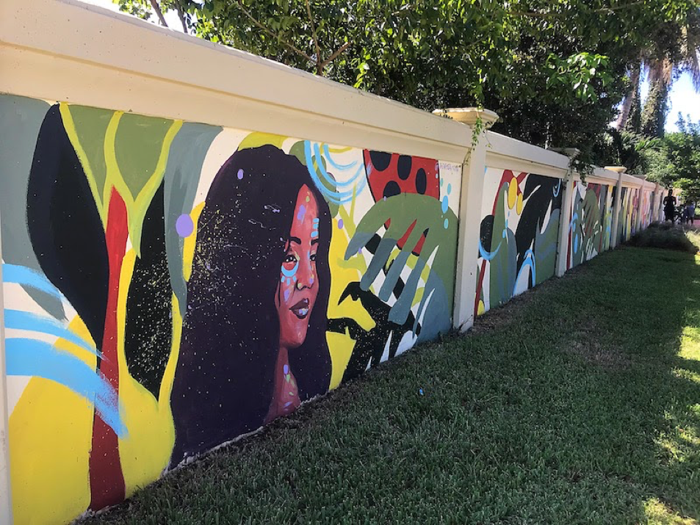
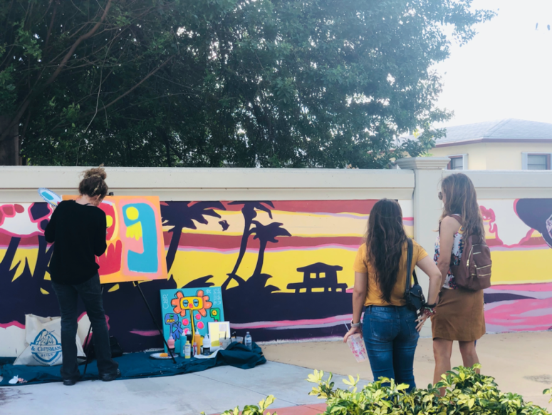
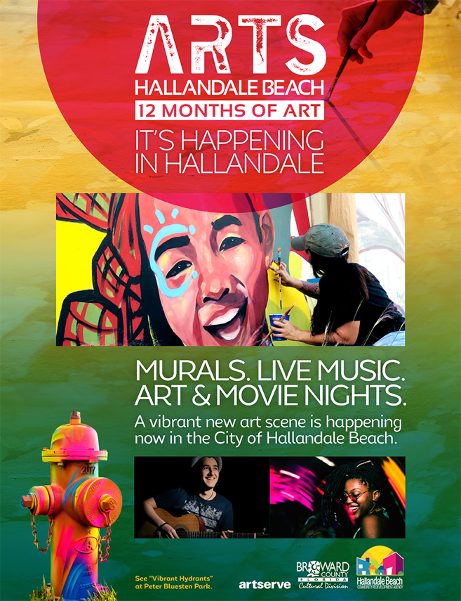
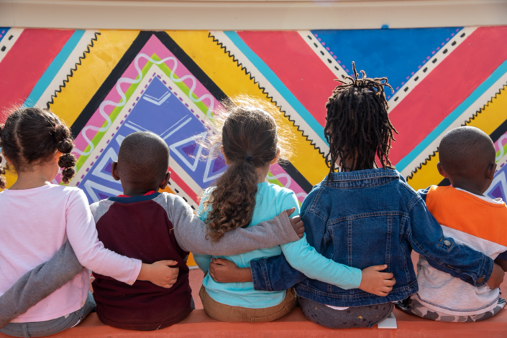
The Commercial Business Mural Program
Foster Park Mural
The HBCRA 12 Months of Art Mural Program brought together 5 local artists to transform Forster Park with vibrant, beautiful murals which creates a greater sense of place for residents and family who gather in the park.

Slide 5
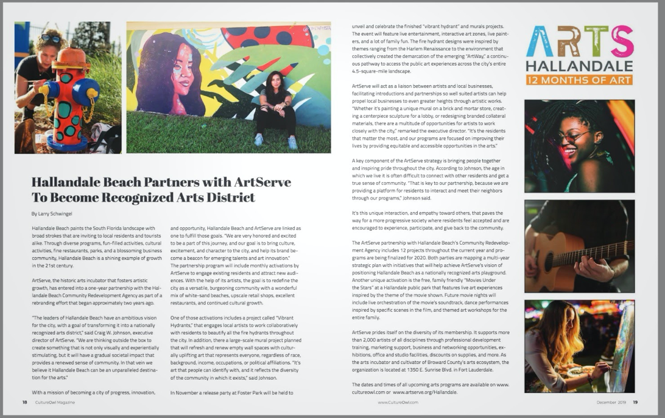
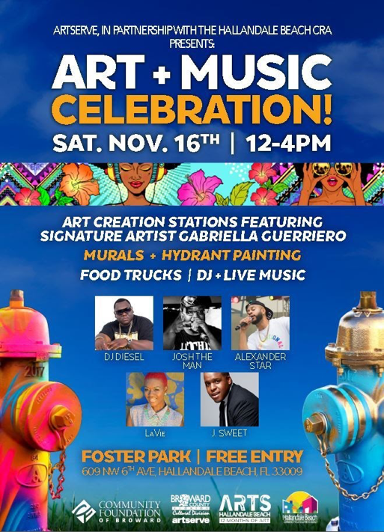
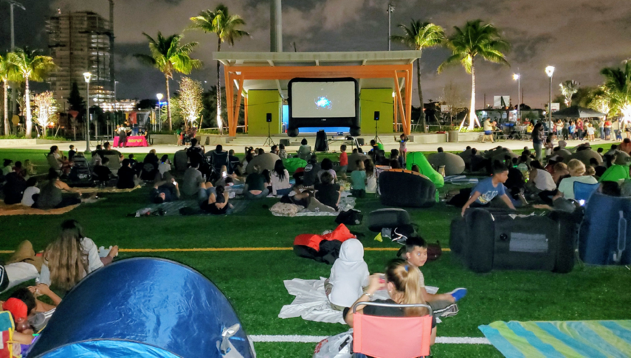
The 12 Months of Art Program
In 2019 the HBCRA continued to work diligently with community partner ArtServe to create monthly programming of art and culture activities for the City of Hallandale Beach.

Slide 6
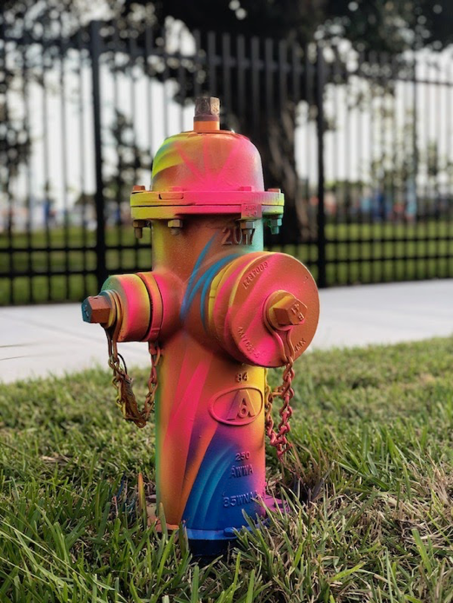
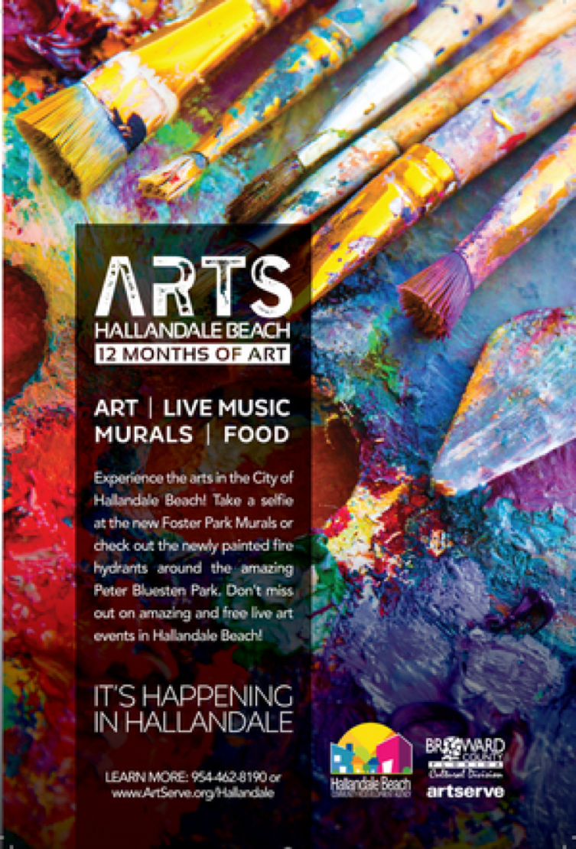
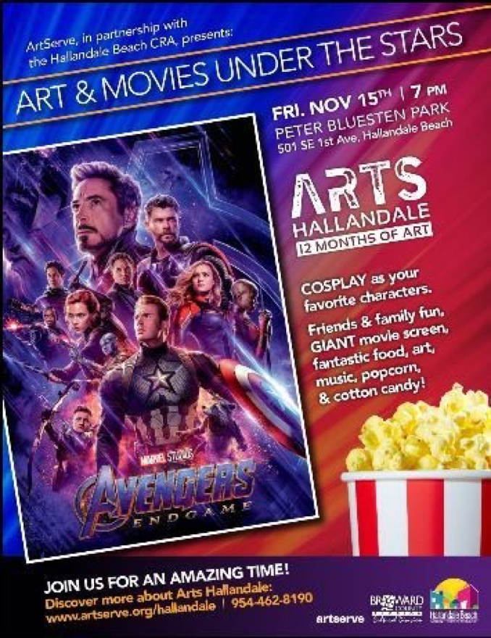
The 12 Months of Art Program

Slide 7
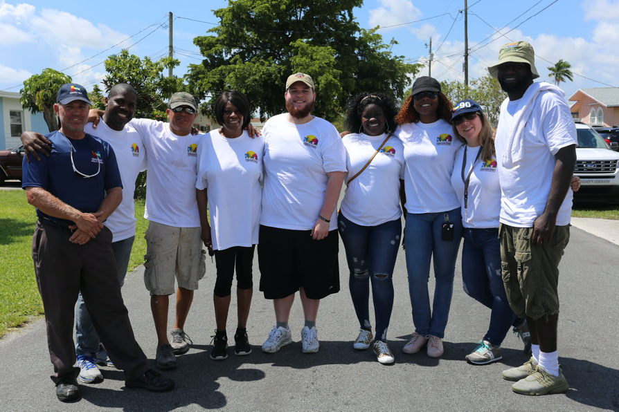
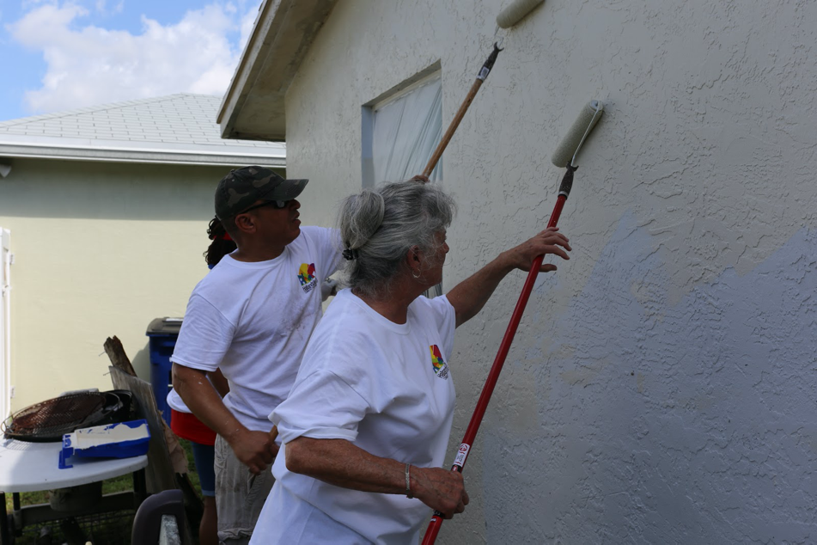
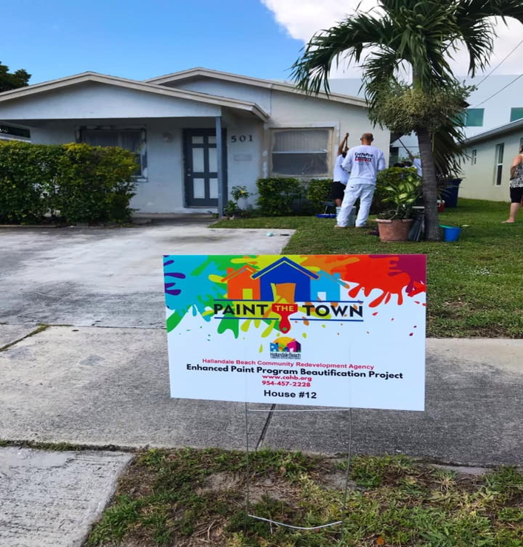
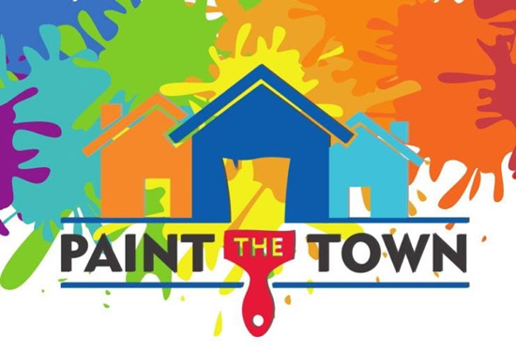
The Neighborhood Enhanced Paint Program (Paint The Town)
To date, 61 single and multi-family homes have been selected and have undergone beautification. This initiative was provided to homeowners free of charge.

Slide 8
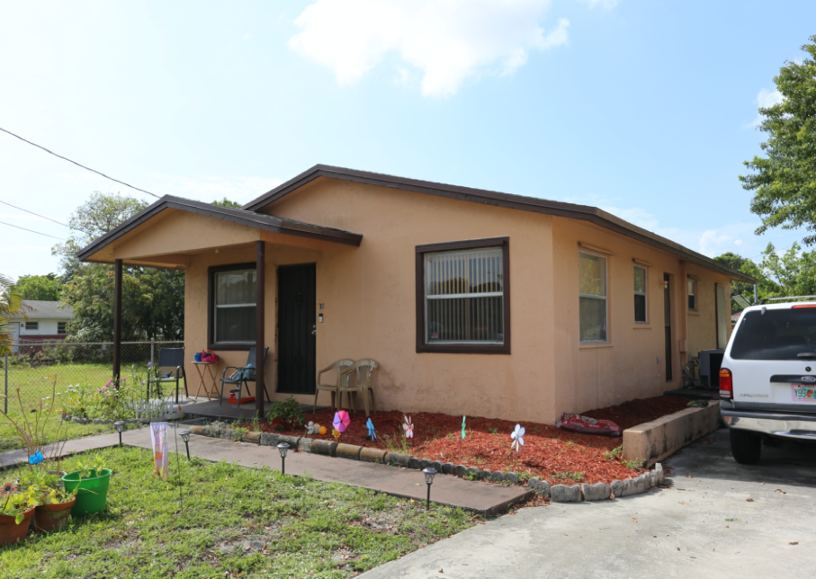
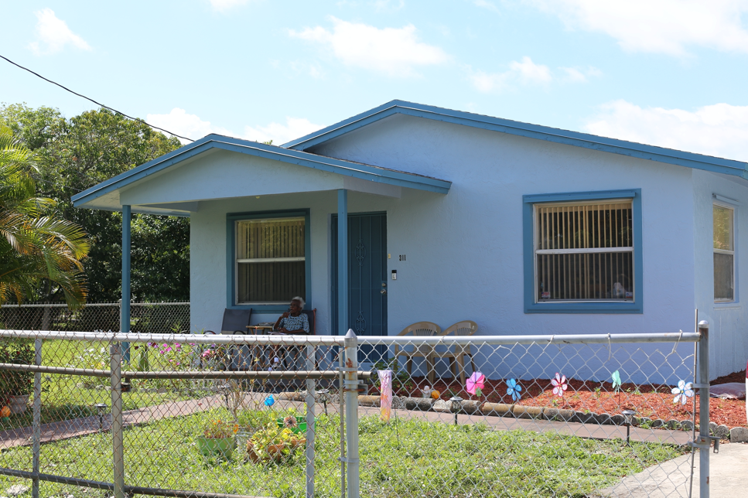
The Neighborhood Enhanced Paint Program (Paint The Town)
To date, 61 single and multi-family homes have been selected and have undergone beautification. This initiative was provided to homeowners free of charge.
BEFORE
AFTER

Slide 9
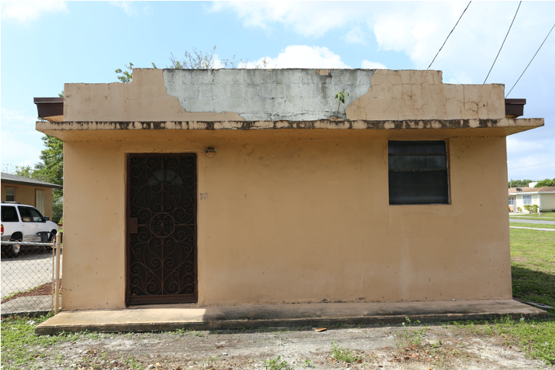
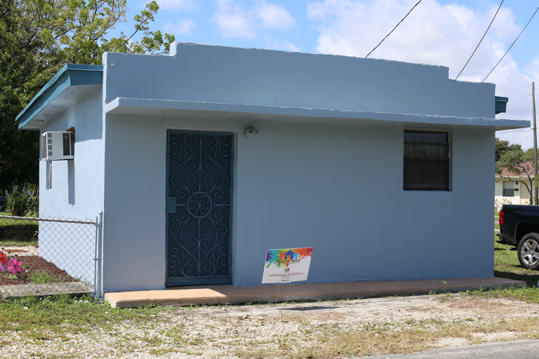
The Neighborhood Enhanced Paint Program (Paint The Town)
To date, 61 single and multi-family homes have been selected and have undergone beautification. This initiative was provided to homeowners free of charge.
BEFORE
AFTER

Slide 10
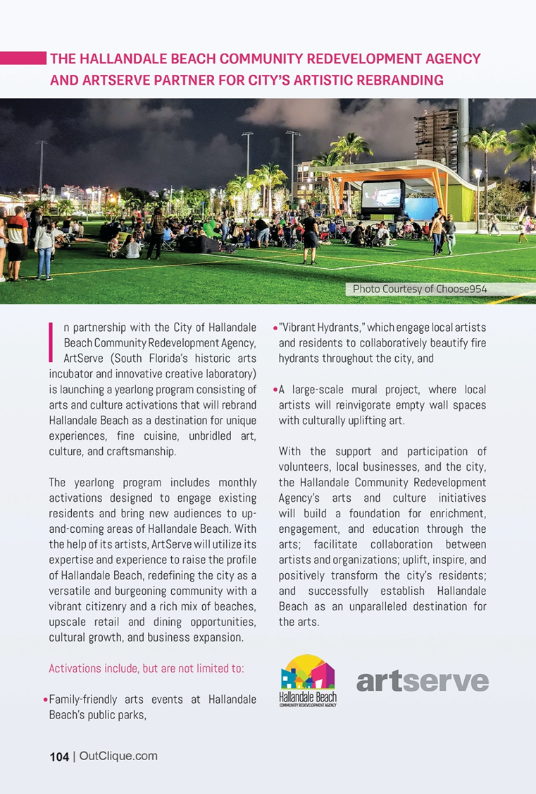
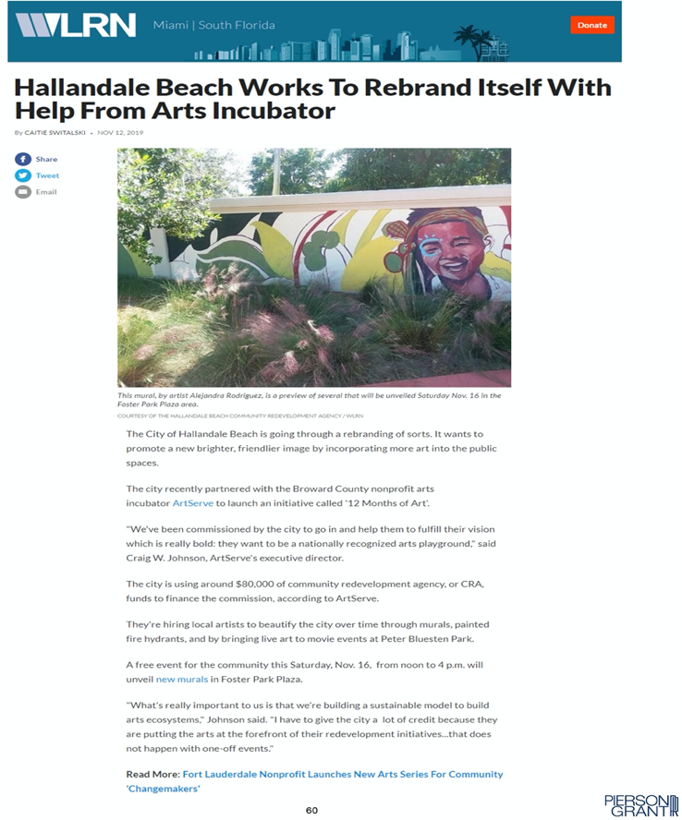
Media Outreach

Slide 11
Promotional Video
Link to Promotional Video
https://youtu.be/RWnOK0KvF3o

