Slide 1


GCRA
10 Year Reinvestment Plan
01.
02.
03.
Process for
Re-Envisioning
Plan Development & Community Engagement
10 Year
Reinvestment Plan
2020 FRA Award Entry

Slide 2

Process for Re-Envisioning
August 2016 – August 2017
COMMUNITY VITALITY REPORT
THEMES FOR SUCCESS
Layers
Connectivity
Scale
Authenticity
Partnerships
Health & Safety
Community Outreach
Community Surveys
Stakeholder Interviews
Advisory Board Feedback
October 2019-March 2020
10 Year Reinvestment Plan
August – December 2017
Community Outreach
Community Surveys
Neighborhood Meetings
Advisory Board Feedback
LAND-USE ECONOMICS STUDY
Urban3
REALTORS Partnership
January 2018
April 9th, 2019
September 5, 2019
Negotiations with County Begin
City and County sign Inter-local Agreement to fund new GCRA
City Commission pass Ordinance establishing the consolidated district

Slide 3
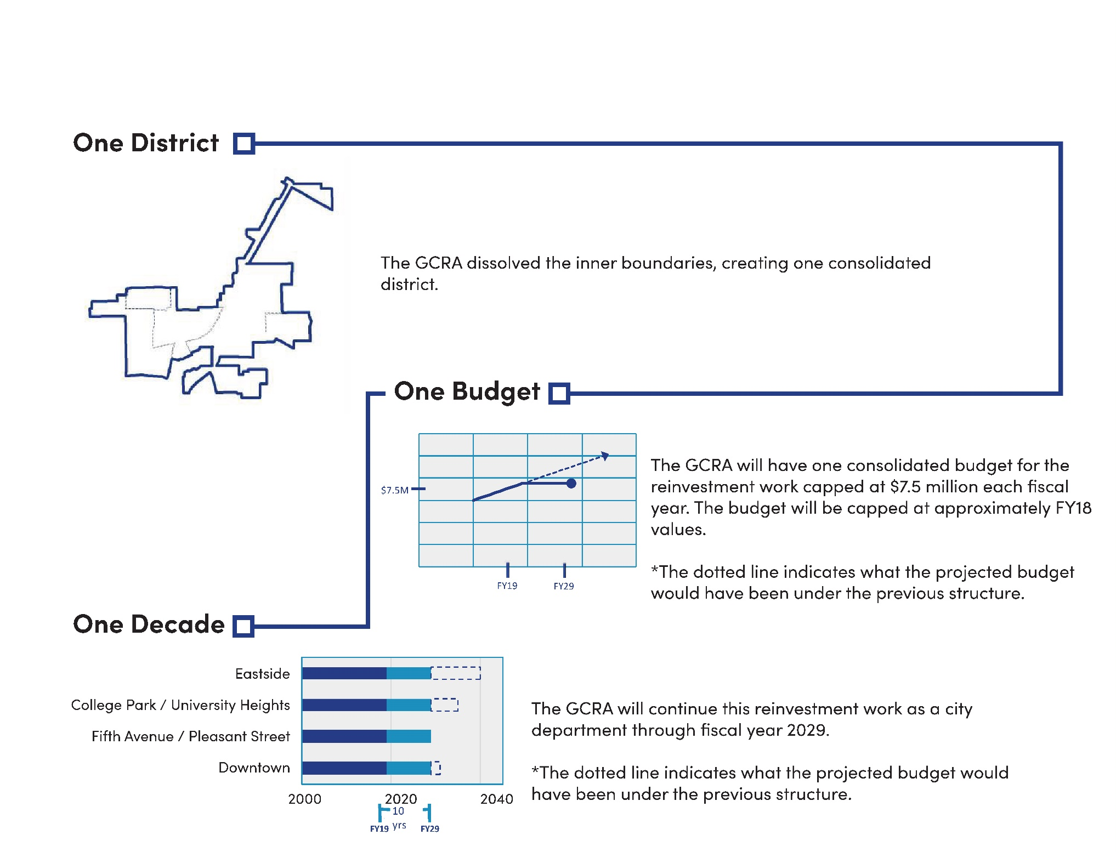
Process for Re-Envisioning

Slide 4
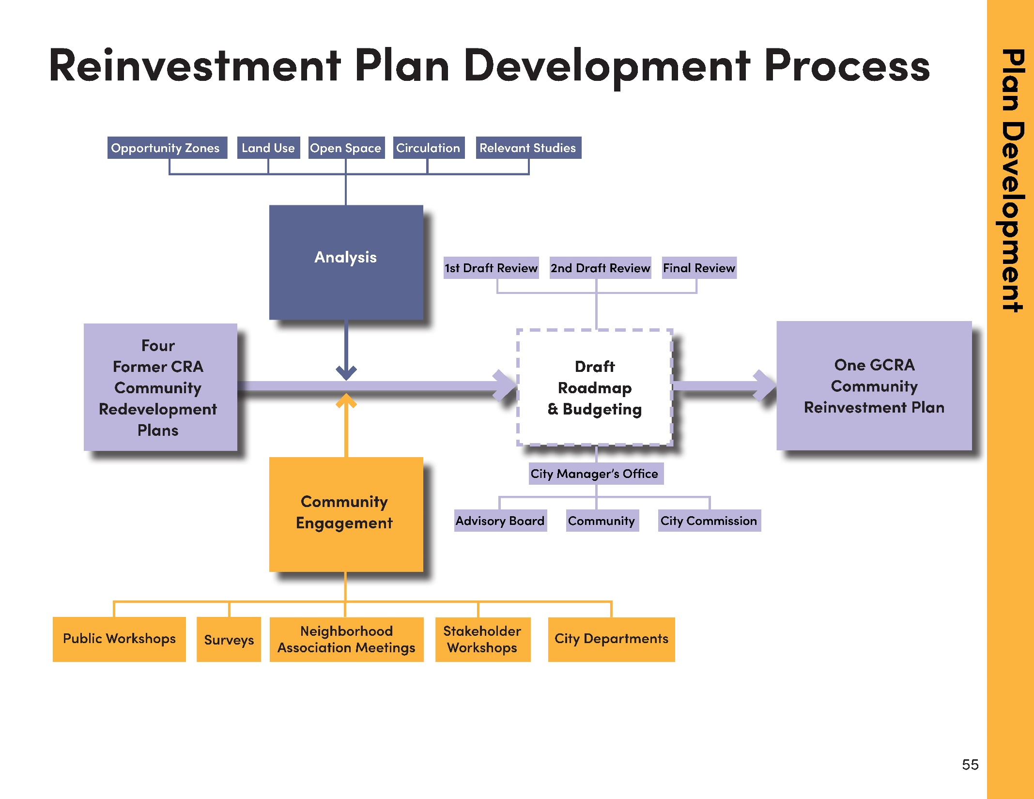

Slide 5
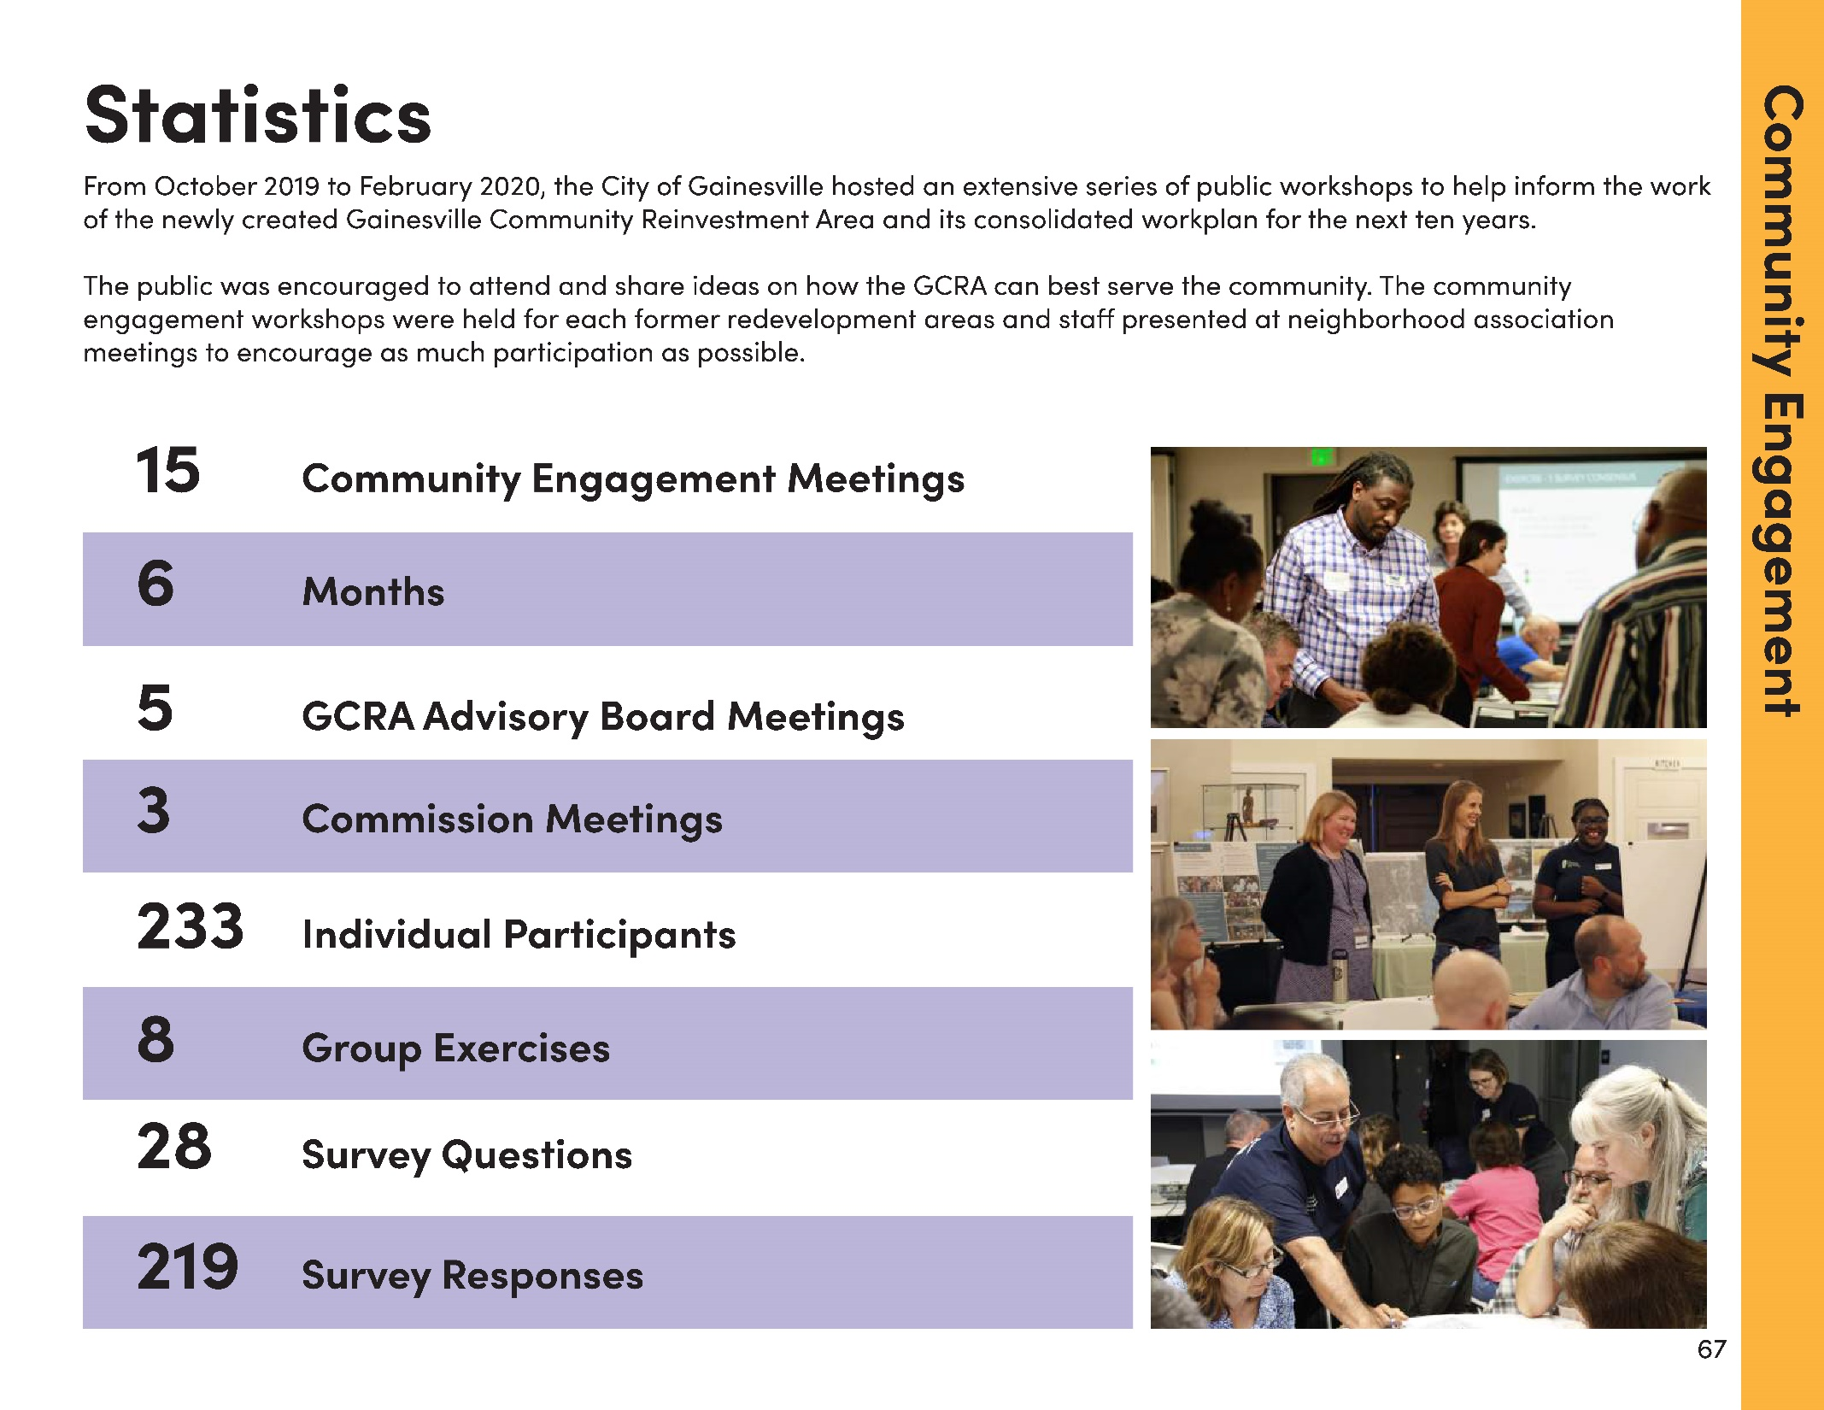
Community Engagement Statistics

Slide 6
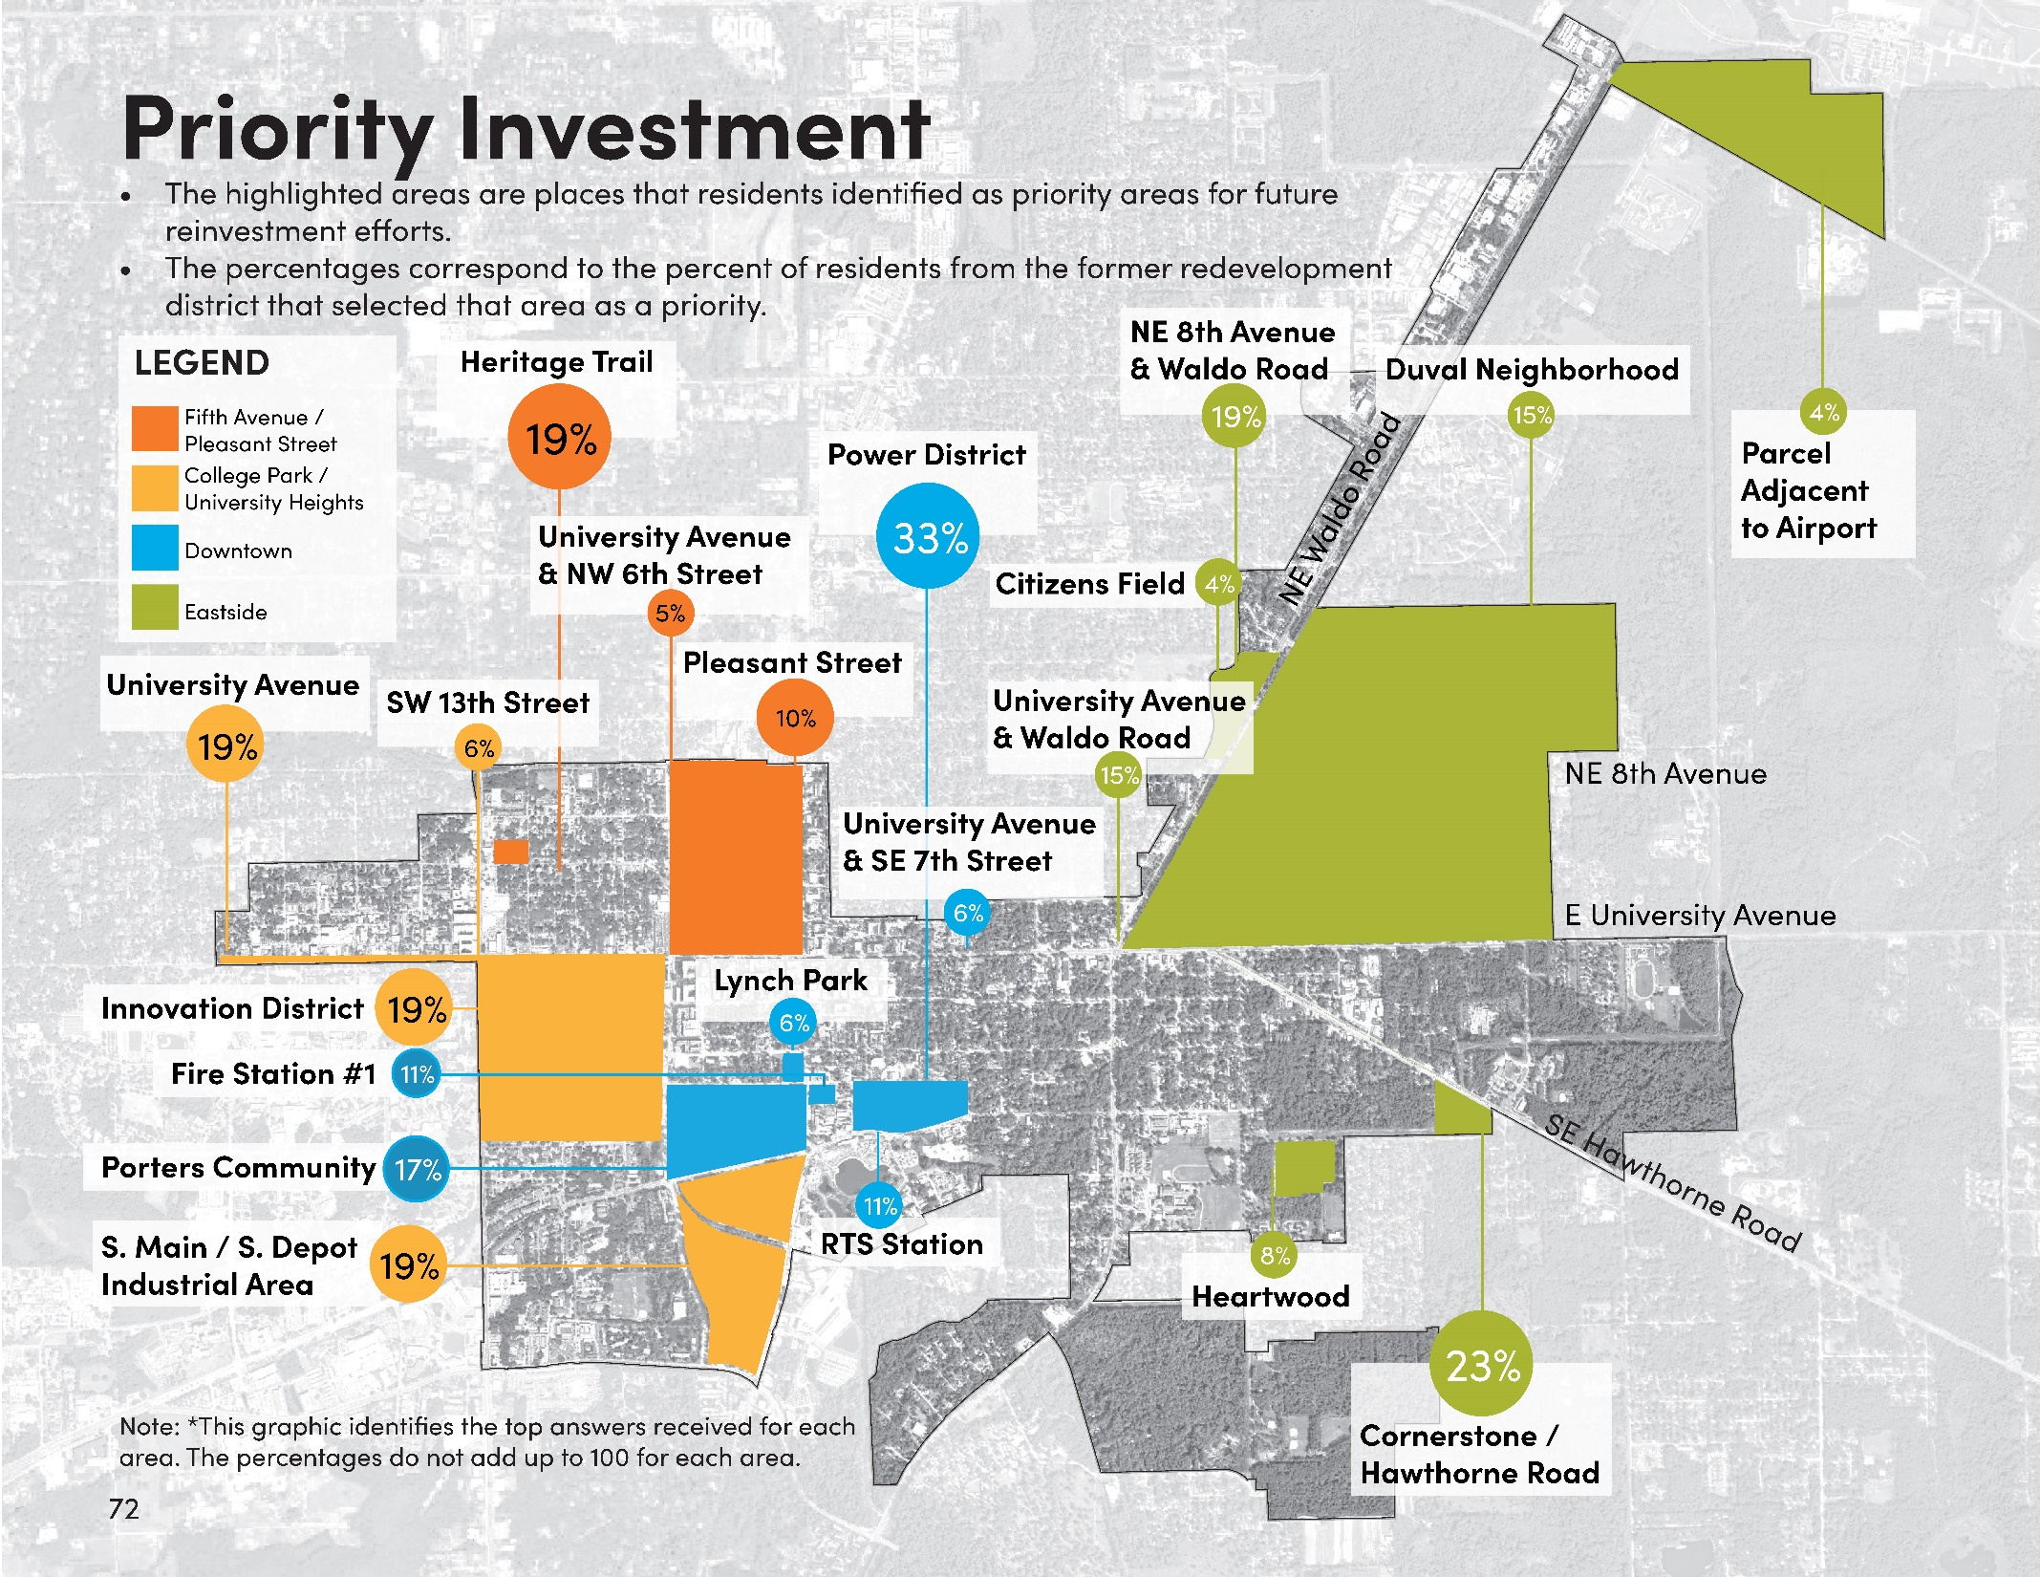
Community Priority Investment

Slide 7
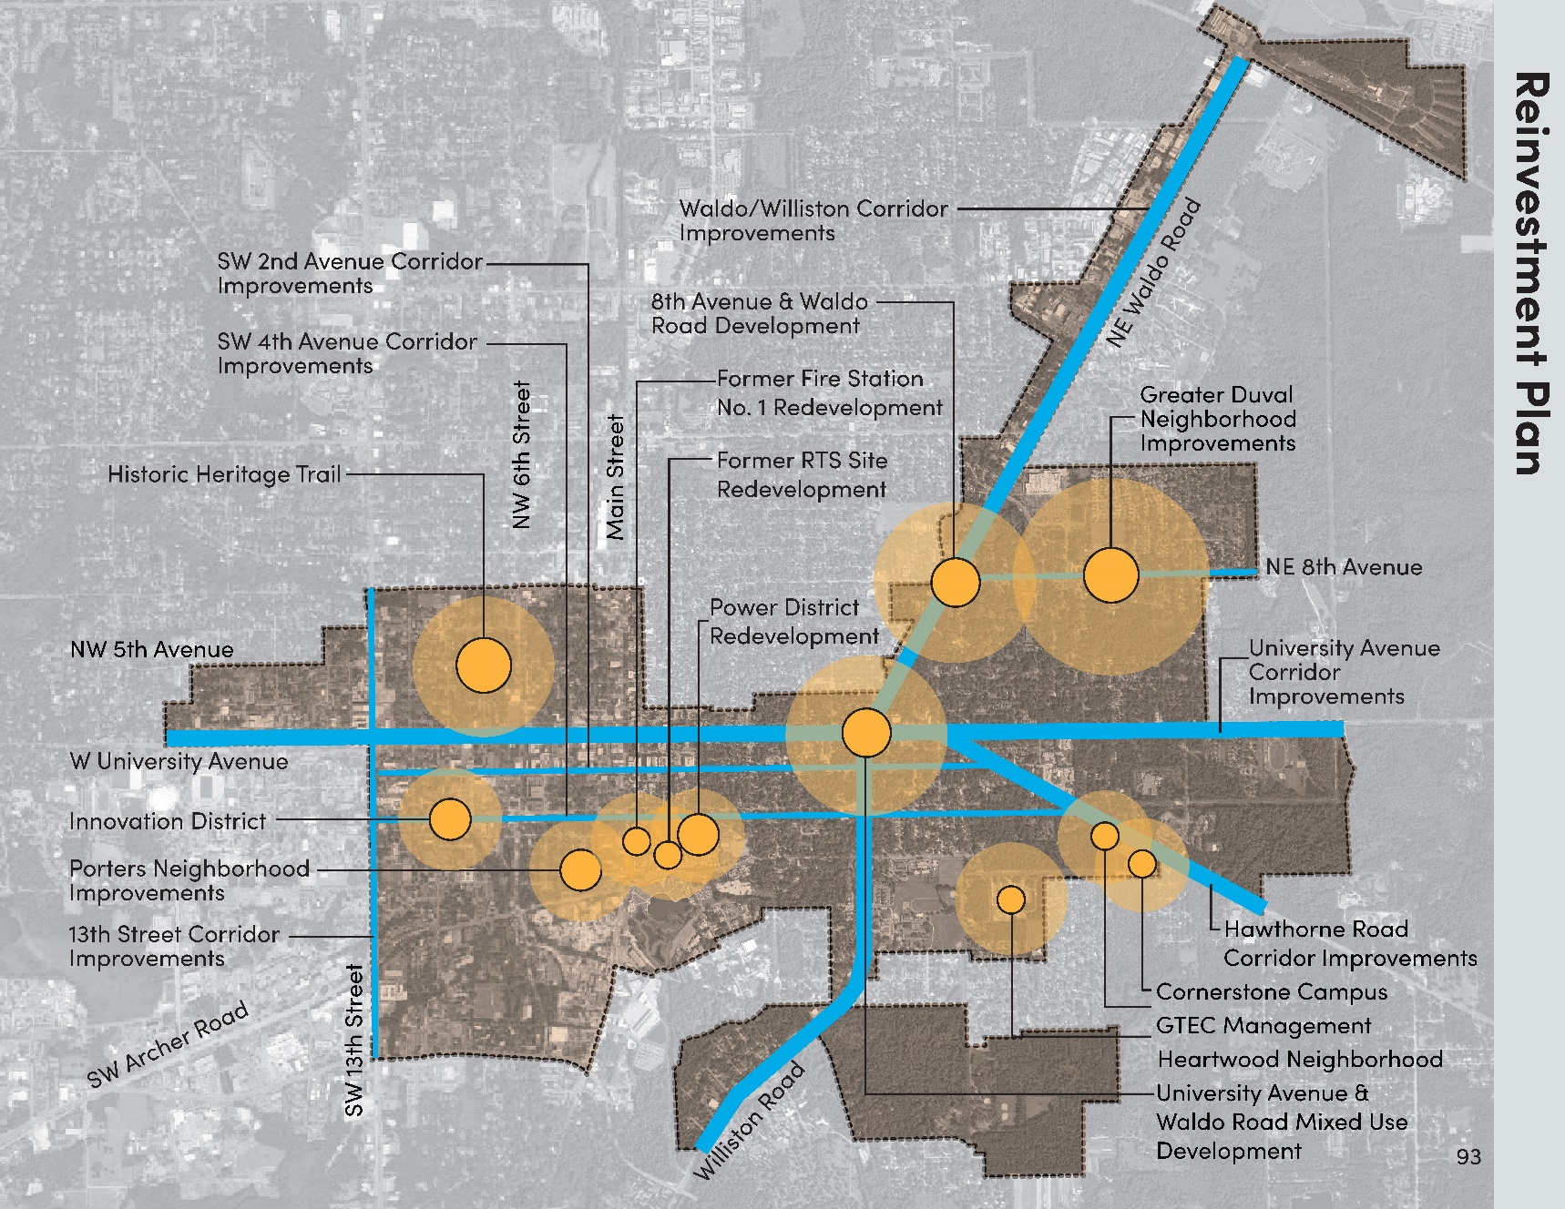
10 Year Reinvestment Plan
The following map highlights the main neighborhoods with reinvestment opportunities based on the feedback received in community meetings and consultant input.
The identified reinvestment projects are expected to be catalysts for redevelopment in each neighborhood. In addition, the entire Consolidated Reinvestment Area will remain eligible for ongoing GCRA initiatives including additional projects, development incentives, grant programs, etc.

Slide 8
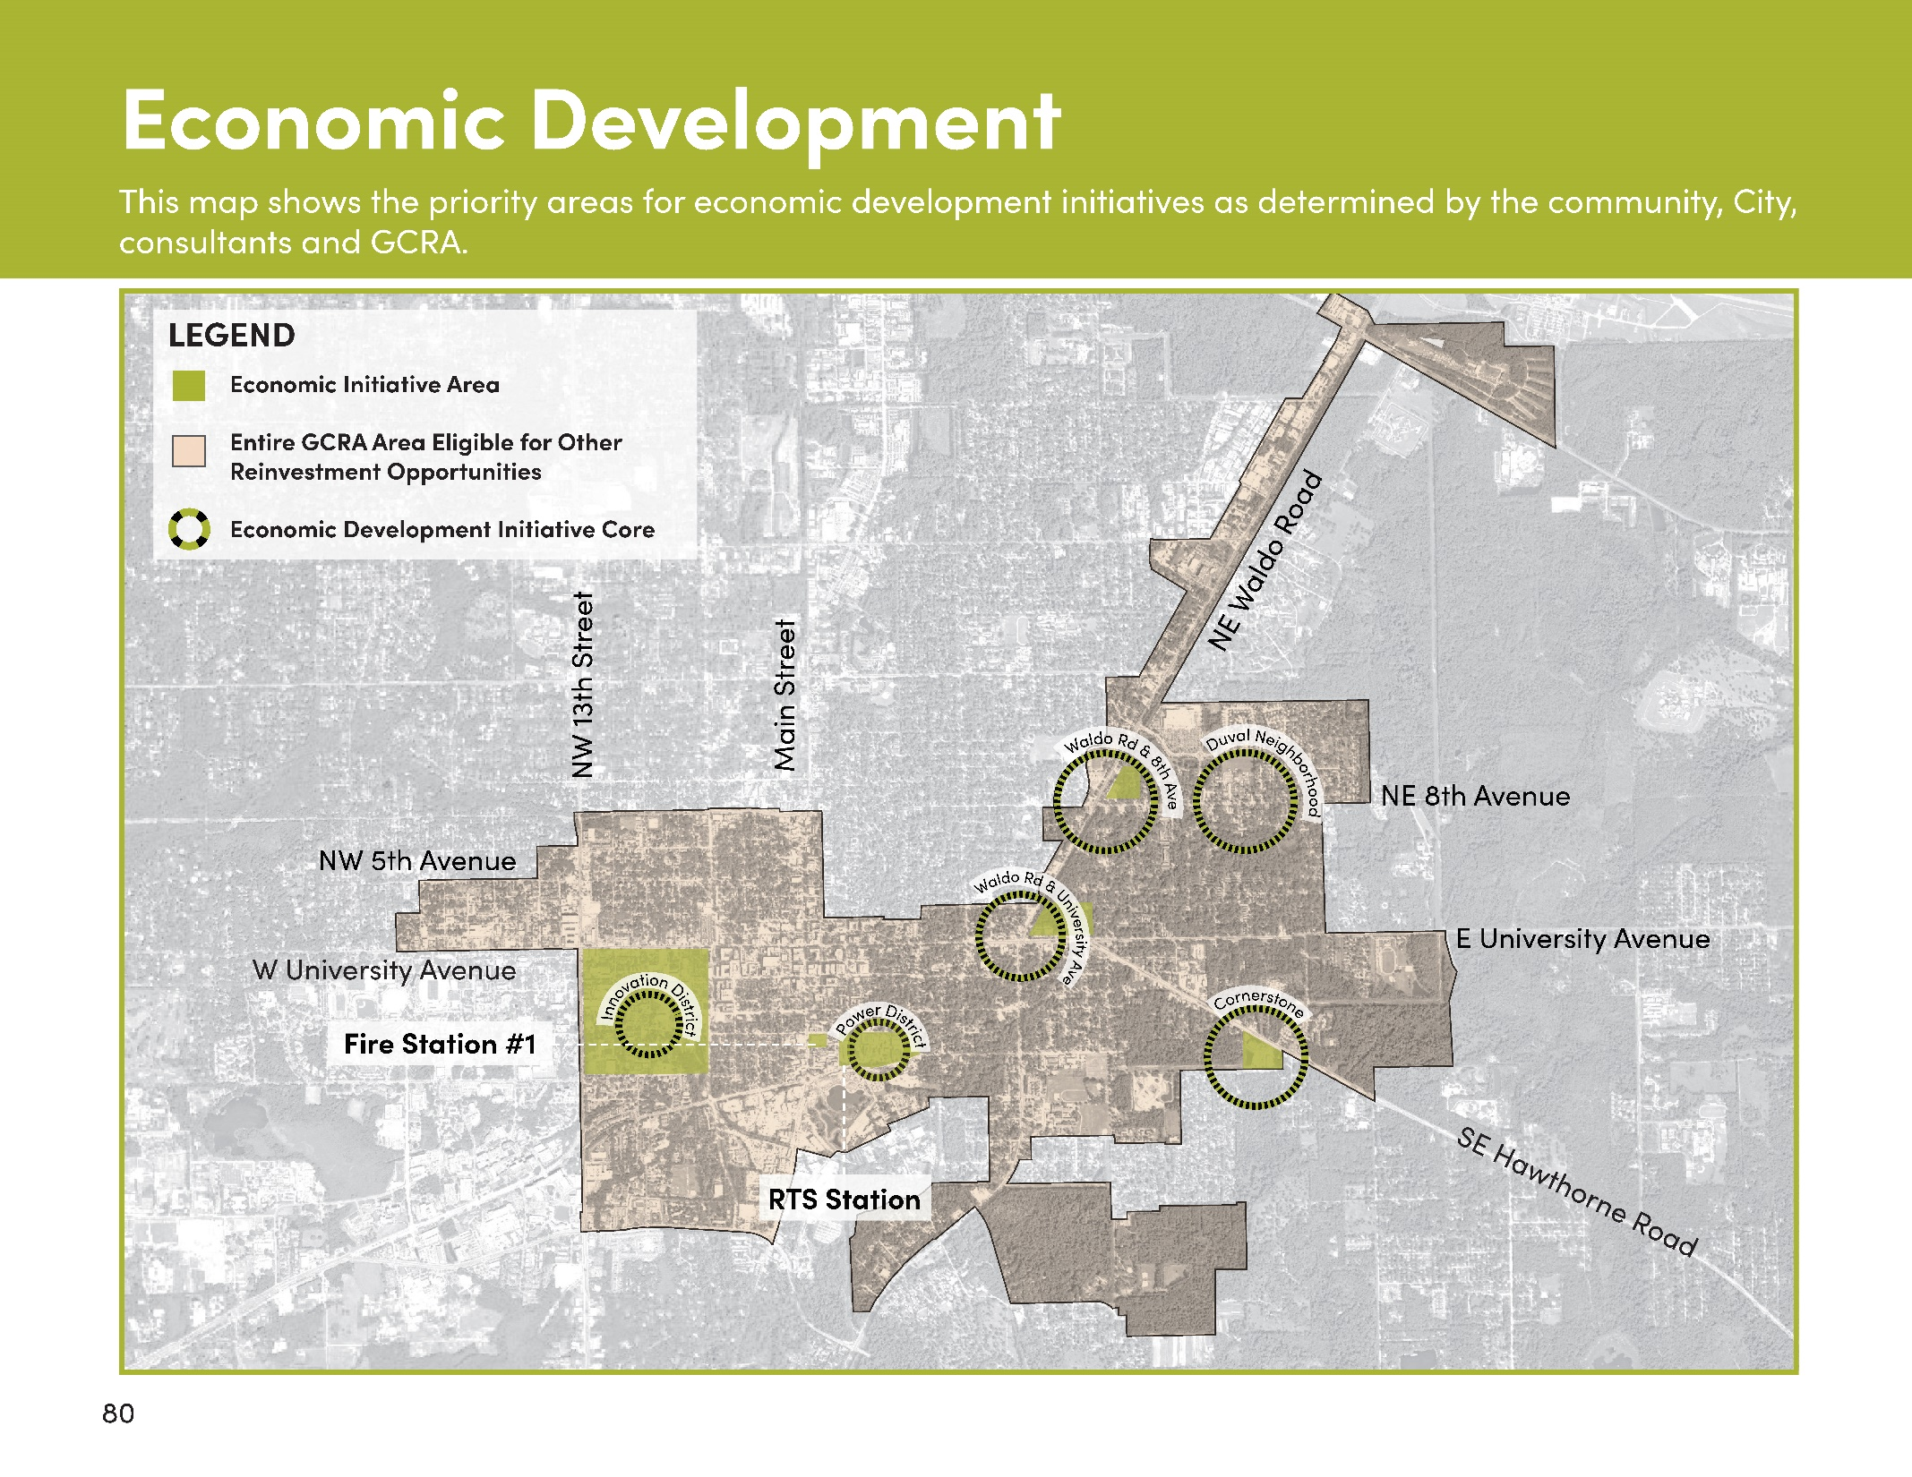

Slide 9
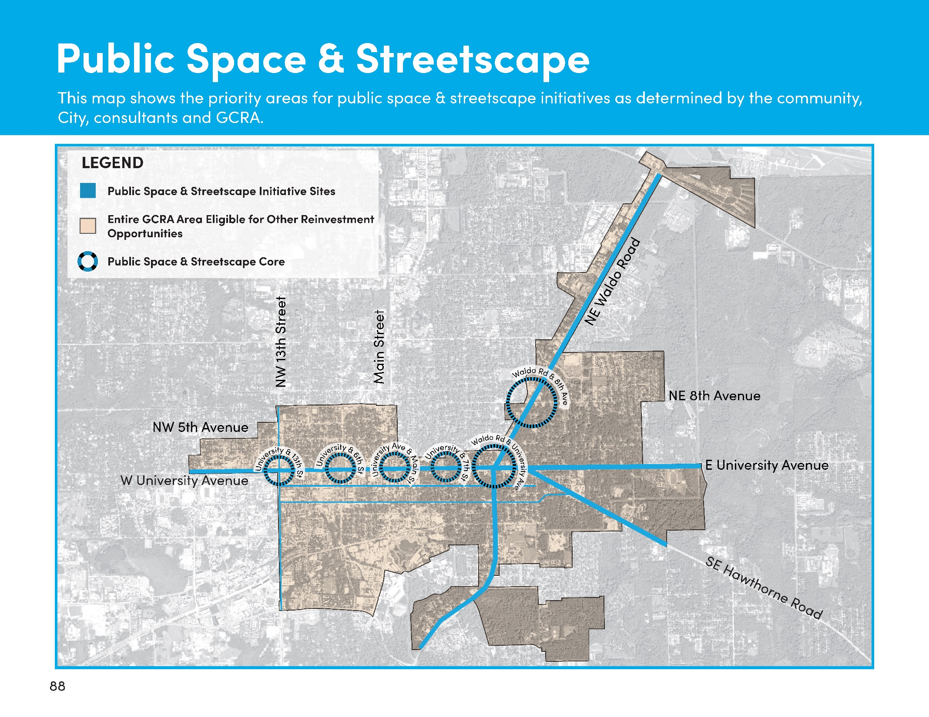

Slide 10
