Slide 1
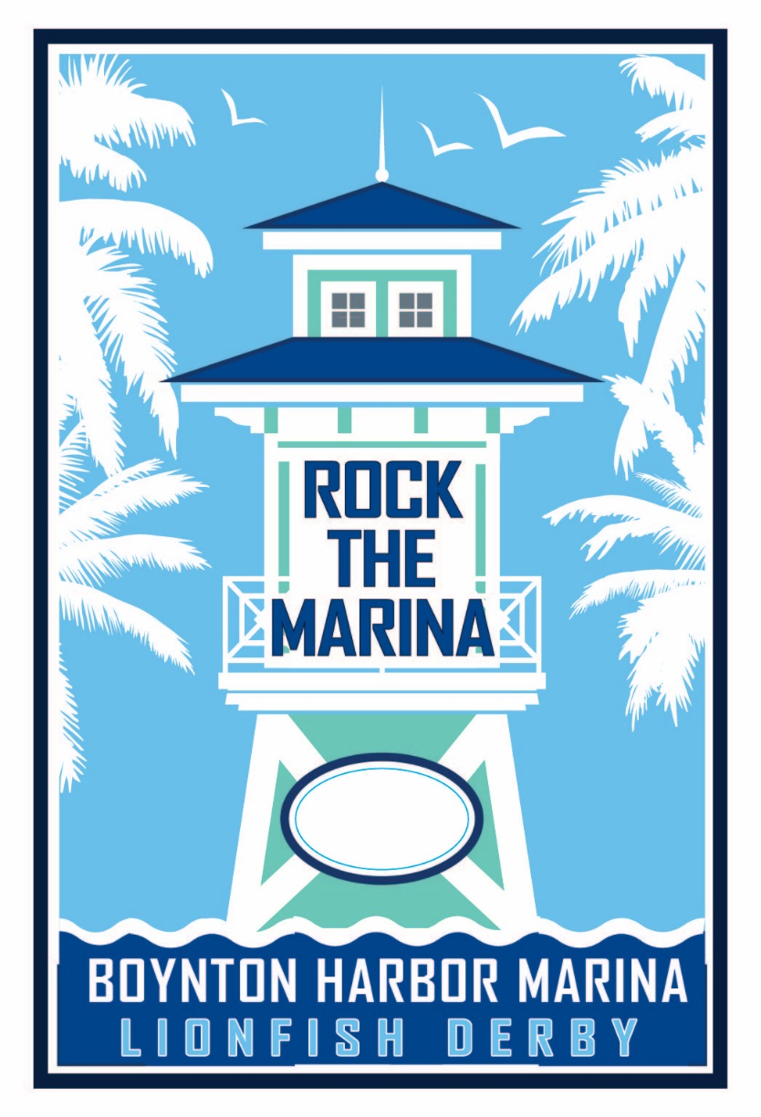
2020 FRA OUT OF THE BOX AWARD ENTRY

Slide 2
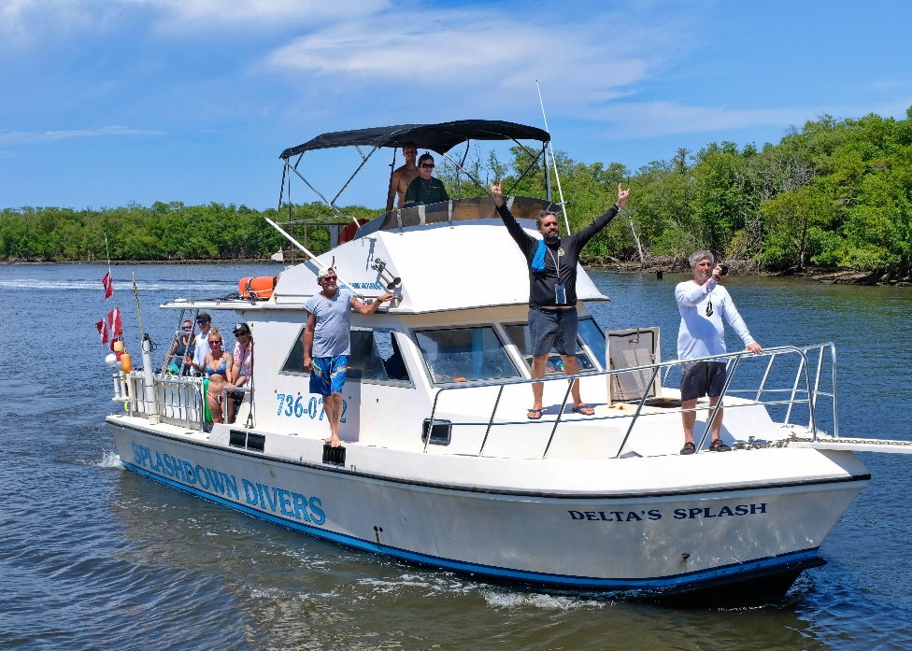
PROGRAM DESCRIPTION
In 2019, the Boynton Beach CRA introduced a new event called Rock the Marina & Lionfish Derby.
The business development initiative was created to spotlight the Boynton Harbor Marina and to bring exposure to businesses located within the BBCRA area.
The business promotional event provided exposure for 26 businesses located within the BBCRA area.

Slide 3
PROGRAM COMPONENTS
Business & Economic Development
Community Engagement
Marine Conservation
Social Media Outreach Program (SMOP)

Slide 4
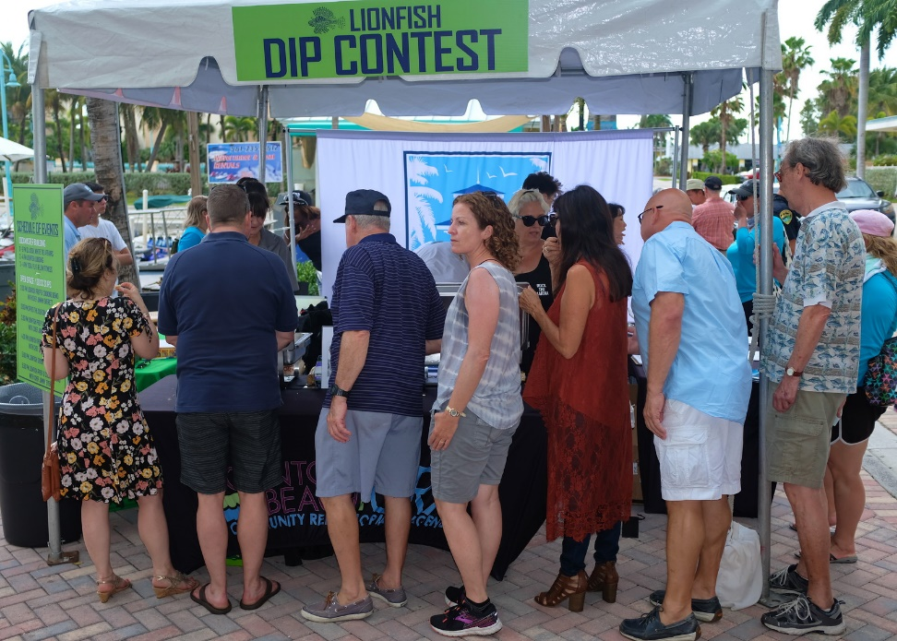
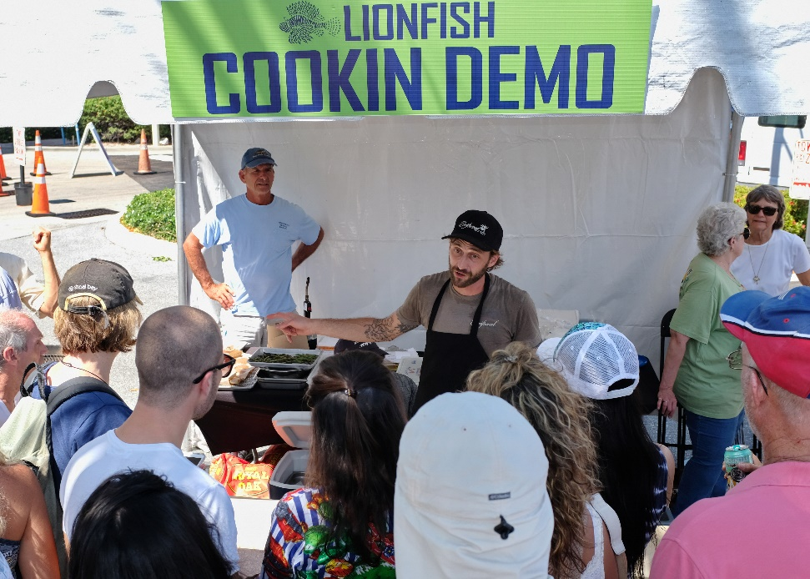
INNOVATION
The BBCRA developed a business promotional event that engaged the local community, while activating the Boynton Harbor Marina, and promoting 26 different businesses located within the BBCRA area.
BBCRA area businesses were placed in direct contact with event patrons, which provided the opportunity to showcase their products and services to a targeted audience in a unique setting.

Slide 5
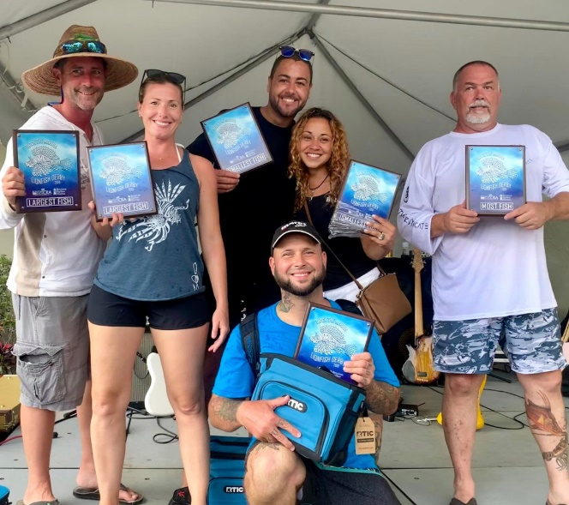
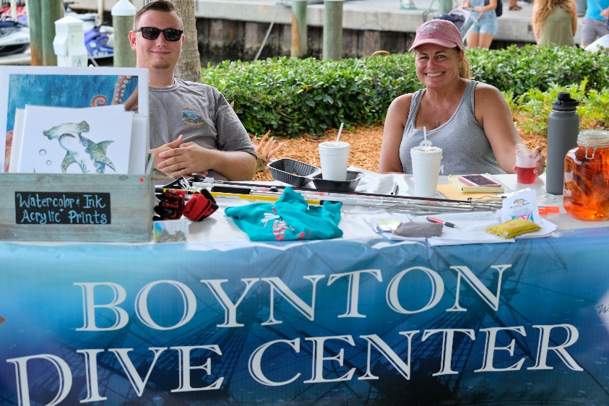
COMMUNITY IMPACT
The Rock the Marina & Lionfish Derby:
Activated the Boynton Harbor Marina.
Brought community members together for social interactions in a fun and laid back setting.
Provided BBCRA area businesses with an opportunity to promote their business and gain exposure with consumers in a fun and creative way.
Educated the public about marine conservation and various sustainability efforts.

Slide 6
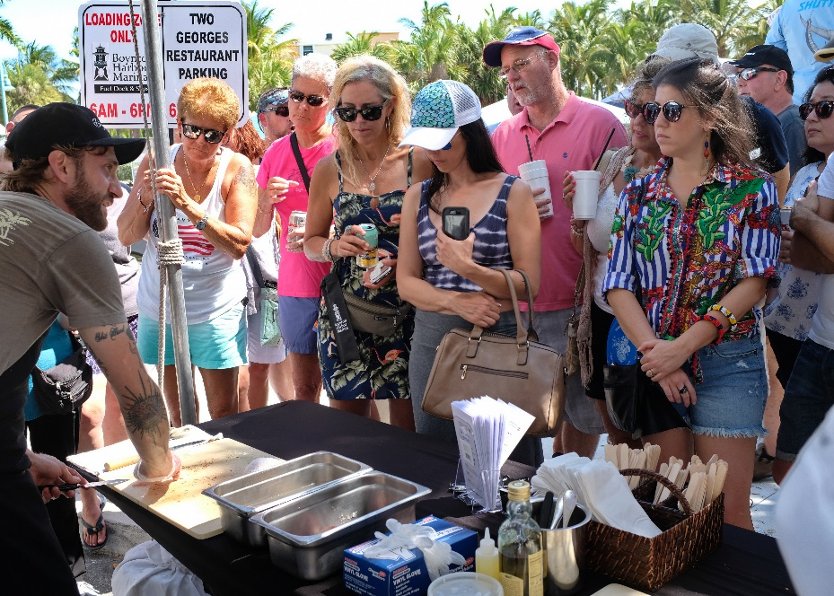
PROBLEM SOLVING
Showcased the Boynton Harbor Marina as a recreational destination.
Provided business owners, who previously experienced difficulties connecting with new customers, a unique opportunity to showcase their storefronts, vessels, and various offerings.

Slide 7
TRANSFER TO OTHER COMMUNITIES
Other communities could benefit by implementing similar programs to encourage patronage of local businesses that are in need of exposure.
This concept could be replicated in other communities that seek a unique way to showcase businesses while engaging the community to support an environmental or social issue.

Slide 8
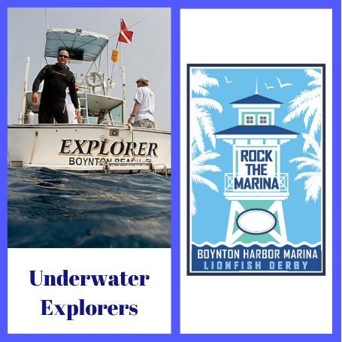
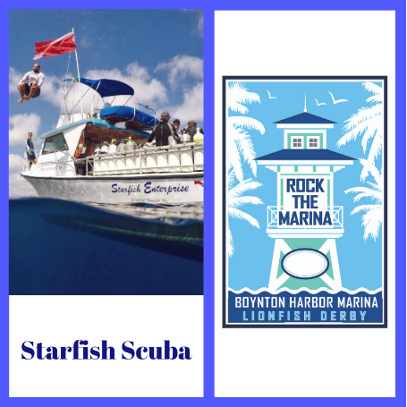
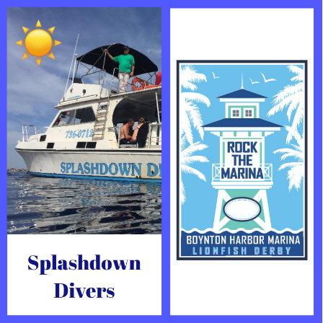
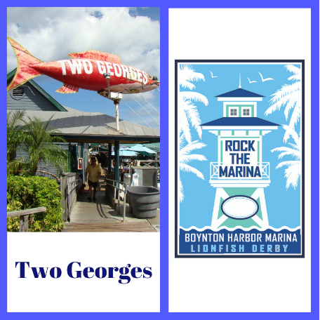
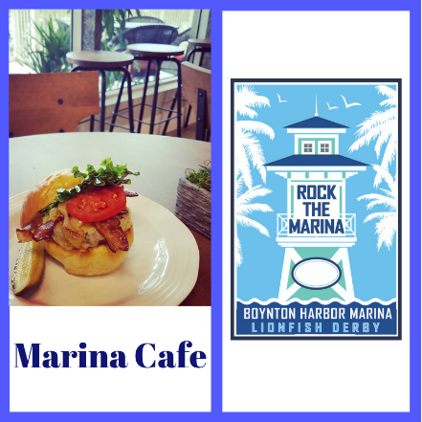
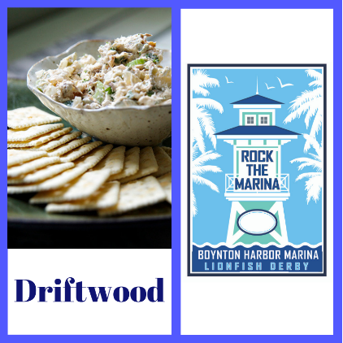
SOCIAL MEDIA OUTREACH PROGRAM
Twenty-six (26) customized social media kits were provided to local businesses.
The kits provided business owners with branded graphics, along with tips on how to cross promote the event to their social media platforms with the hashtag #RockTheMarina.

Slide 9
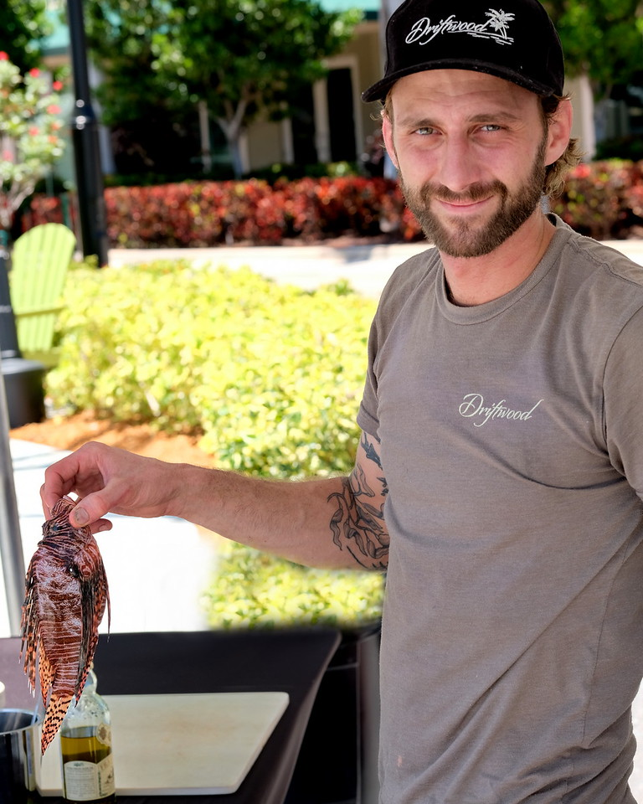
TESTIMONIALS
“It was a hectic day for us but we did definitely see some people coming in after the event that didn’t know about us beforehand. That’s a big deal for us, especially this time of year.”
– Jimmy Everett owner of Driftwood
“Great event and perfect spot to set up the band and tents. Estimate that cafe revenue was 80% higher than prior Saturday…new customers will certainly be forged from this event as many folks had never been to the cafe.”
– Scott McKay owner of Marina Café

