Slide 1
2020 FRA AWARDS CREATIVE ORGANIZATIONAL DEVELOPMENT & FUNDING SMALL BUSINESS DISASTER RELIEF FORGIVABLE LOAN PROGRAM (SBDRFLP)

Slide 2
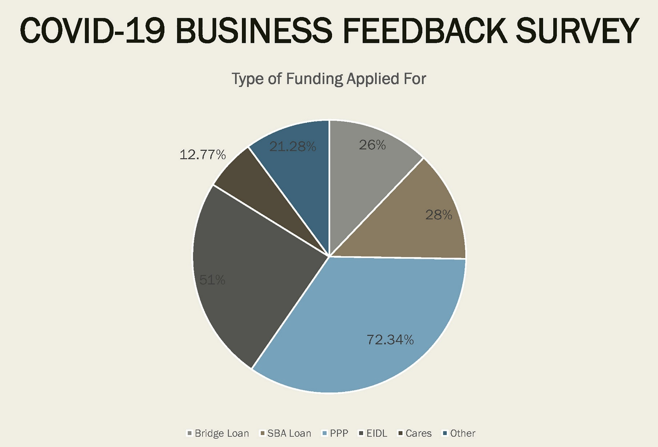
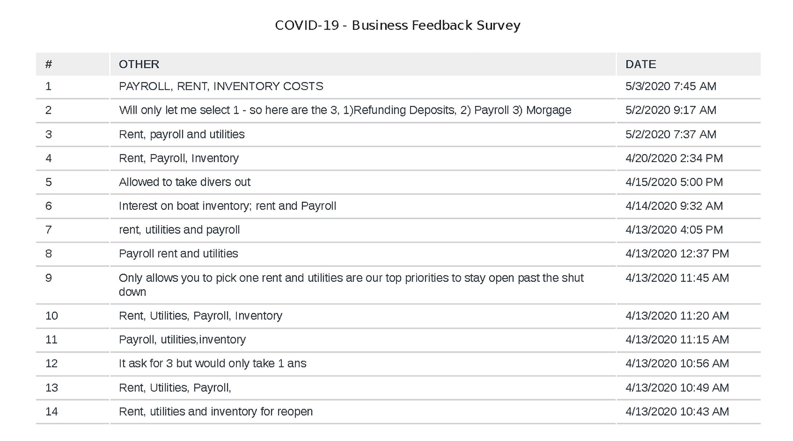
WE WANT TO KNOW HOW TO BETTER ASSIST YOU!
Small Business Disaster Relief Forgivable Loan Program (SBDRFLP) was based on results of BBCRA Small Business Survey distributed mid-April and research of Payroll Protection Program (PPP) and Florida Small Business Emergency Bridge Loan Program (FSBEBLP)
https://www.surveymonkey.com/r/6ZSVPB9
Rent, utilities, payroll, inventory are top three needs to sustain businesses over the next three months

Slide 3
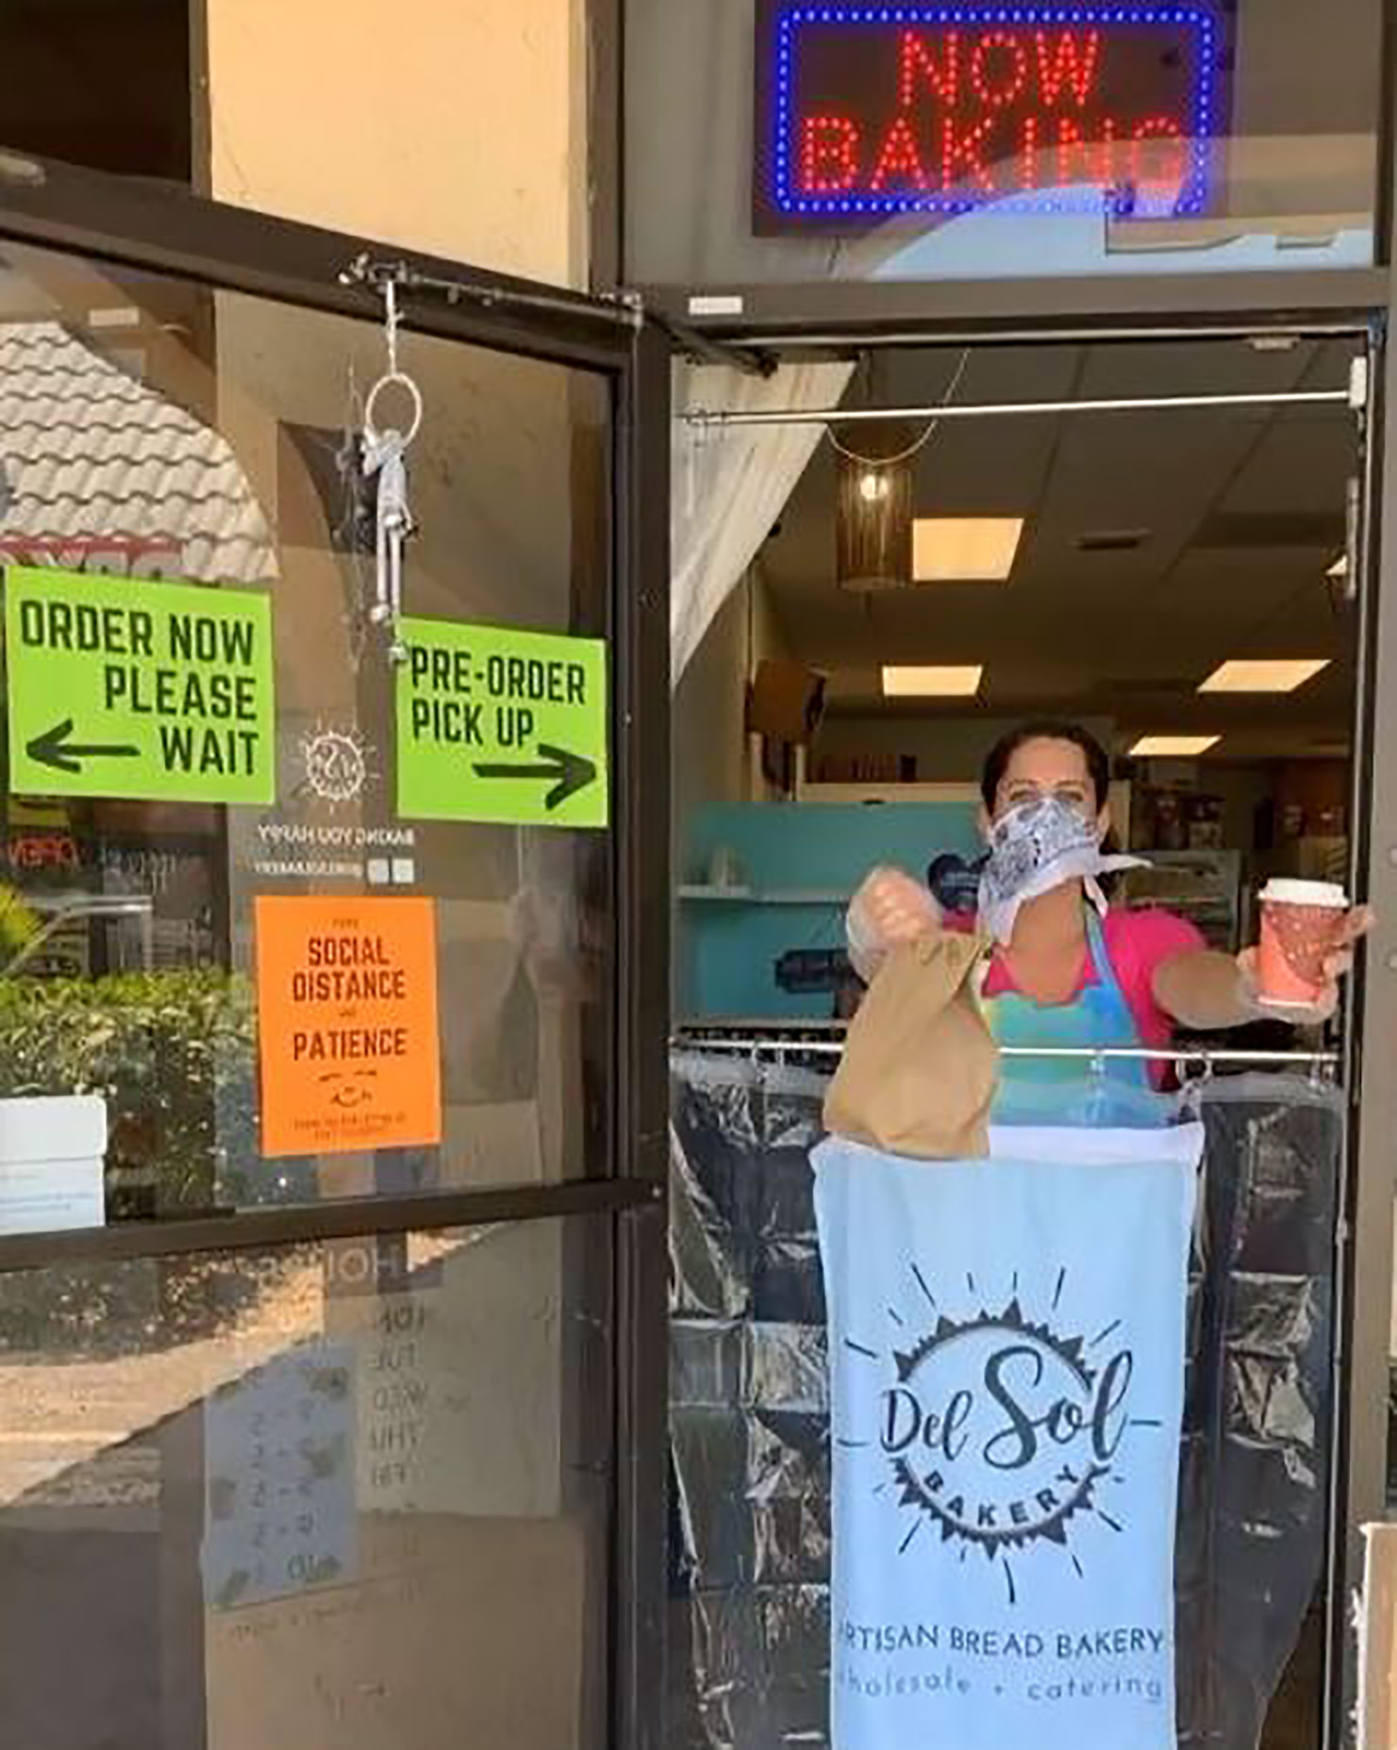
INNOVATION
Grant model is similar to affordable housing programs where Agency dollars are used to provide down payment, land costs, or gap funding assistance up-front instead of as a reimbursement
Existing COVID-19 relief programs such as the PPP (initial $349 Billion) and Florida Emergency Bridge Loan Program was either depleted or had limitations on expenditures and eligibility criteria preventing Boynton small businesses from applying or take full advantage of the program during mandatory closure
Eligible expenses up to $10,000 per business associated with payroll support, inventory purchases, and/or utility expenses (no min/max limitation for each of three categories)
1-yr interest free loan (secured by a Promissory Note) forgivable if documentation of eligible expenditures are submitted to the BBCRA

Slide 4
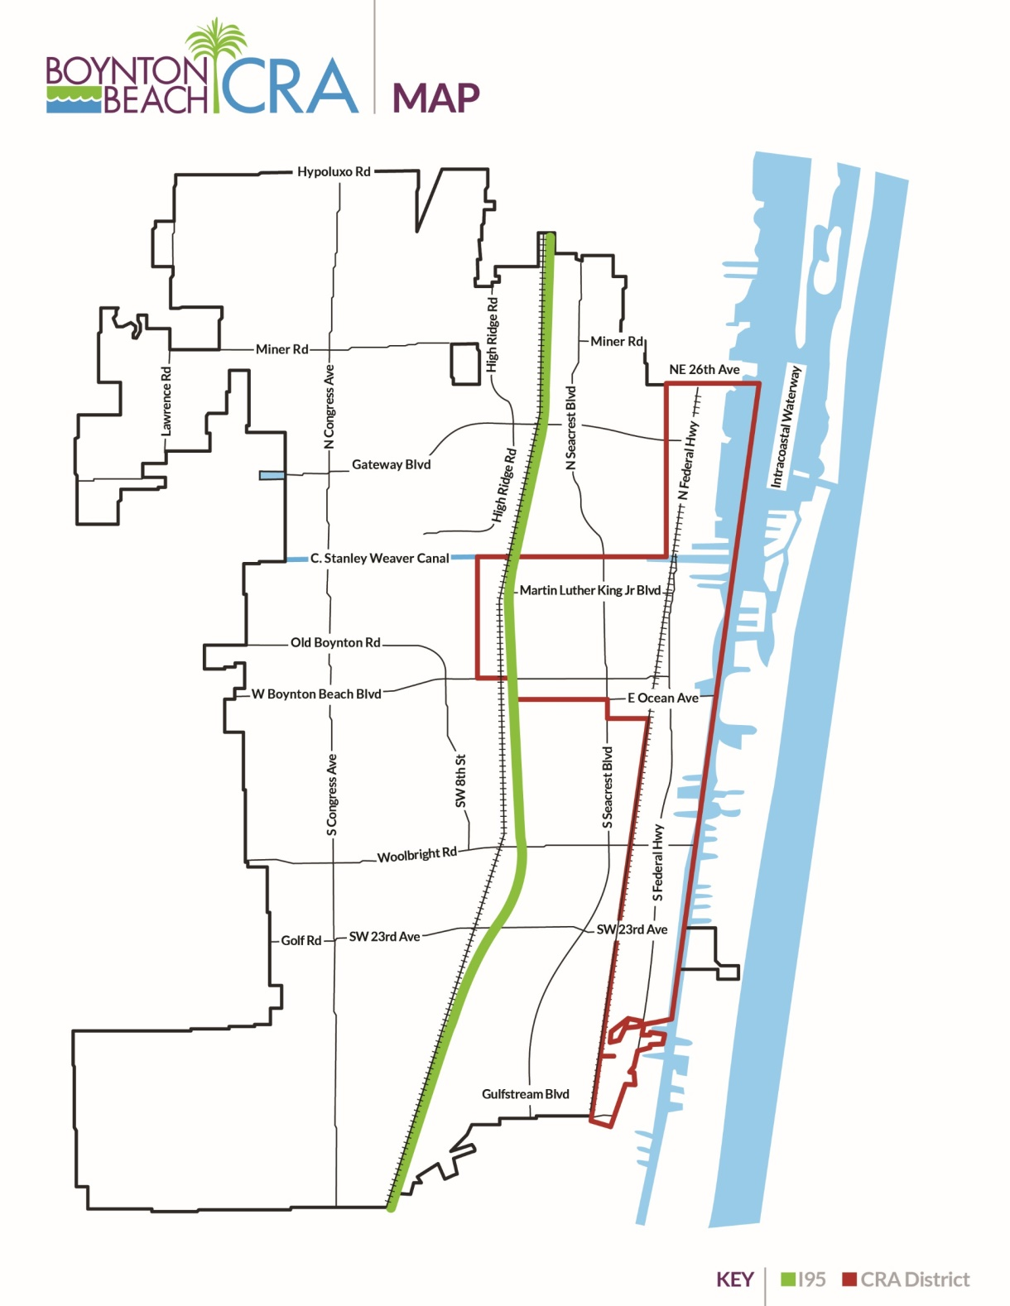
FUNDING ELIGIBILTY REQUIREMENTS
Operational prior to September 30, 2020
Must be a for-profit, privately held business or sole proprietor with no more than 50 employees
Commercial businesses located within the BBCRA area
Current City of Boynton Beach and Palm Beach County Business Tax Receipts

Slide 5
COMMUNITY IMPACT
$1 Million total (two $500,000 funding cycles) immediate cash flow into local businesses to use towards operational expenses (payroll, utilities, and/or inventory)
Over 100+ Boynton small businesses assisted such as restaurants, bakeries, gourmet food markets, professional offices, fitness facilities, specialty retail, boutiques, personal services, and florists
Preserve hundreds of jobs in the community
Protect prior public investments (commercial improvement and rent assistance grant programs)
Provide local small businesses access to customized funding and one-on-one support from BBCRA staff, unlike the PPP, EIDL, or Florida Emergency Bridge Loan Programs where individualized assistance is not readily available due to a larger pool of applicants.

Slide 6
FUNDING
Provide leveraging with following COVID-19 funds:
BBCRA COVID-19 6-month extension of rent assistance for 45 grantees in past 5 years
BBCRA COVID-19 marina slip tenant rent abatement program (10 tenants leveraged)
Paycheck Protection Program (PPP)
Florida Small Business Emergency Bridge Loan (FSBEBL)
Economic Injury Disaster Loan (EIDL) and EIDL Advanced Programs
Palm Beach County Restart Small Business Grant Program (Launched on 5/22/2020)
Provide flexible program criteria
Streamlined application process (completed application includes State Corporate documents, County and City BTRs, sample of supportive documents for eligible expenses – payroll, utility bills, inventory)
Provide immediate liquid capital and access to funding
Expedited review process (2-weeks turnaround from program creation
mid-April to April 30th disbursement)

Slide 7
PROBLEM SOLVING
Governor’s Executive Order in response to the COVID-19
pandemic forced business closures and job loss
1st cycle of $349 Billion PPP funding was depleted on 4/16/20
PPP was intended to keep money flowing to the employees but does not accomplish what is needed for the employers - provide financial assistance for operational expenses (rent, payroll, utilities, inventory) during mandatory closure
Local businesses in BBCRA area were ineligible for the FL Small Business Emergency Bridge Loan (2-100 employee threshold, 12% interest) and could not effectively use PPP (75-25 rule, 4% max. interest)
No other programs were available in early April from the City of Boynton Beach and Palm Beach County that had as much flexibility or streamlined process
The new SBDRFLP provided funds up-front to sustain the businesses for the initial two months of the “Safer-at-Home” order unlike the BBCRA’s other reimbursement grant programs
SBDRFLP funding, when leveraged with the BBCRA’s 6-month extended rent assistance program, will help local businesses recover more quickly from this crisis

Slide 8
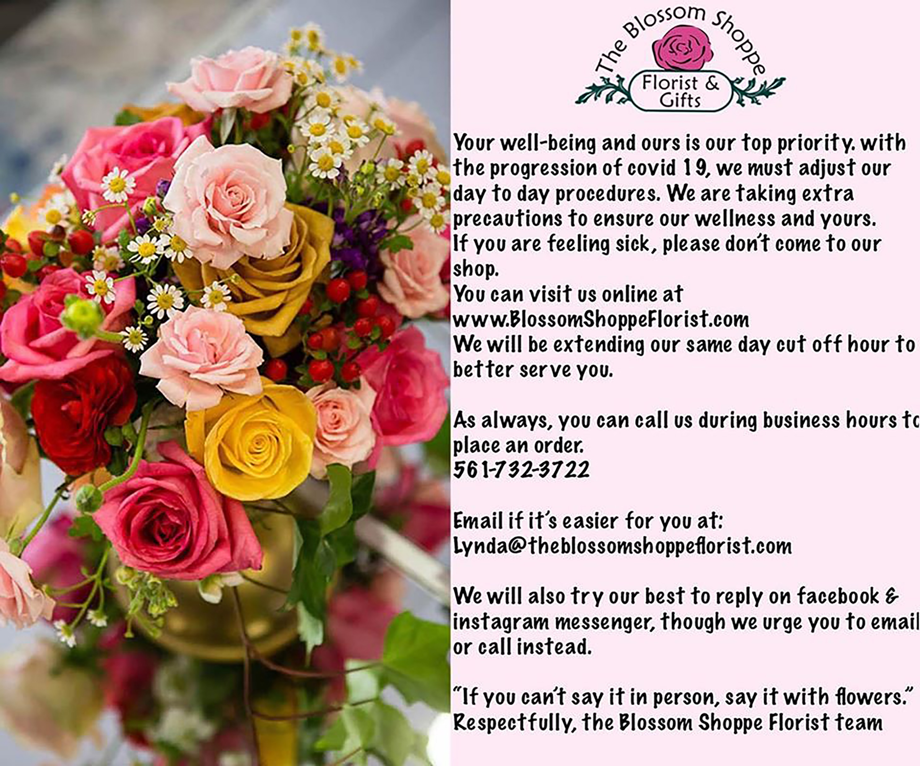
APPLICABILITY TO OTHER COMMUNITIES
All communities across the US has been disrupted by the COVID-19 pandemic and safer-at-home orders
Even though the business closures are temporary its devasting effect on small businesses across the globe is long term
Most small businesses do not have access to liquid capital and is dependent on economic relief assistance
The BBCRA SBDRFLP provided a solution to provide economic development assistance to recover from the crisis and return to full business operations
As evidence to the program’s replicability in communities of all sizes, the BBCRA received calls from Boca Raton, Riviera Beach, Naples, Delray Beach, and Coral Springs after the program’s launch
The City of Boca Raton approved on May 11, 2020 an almost identical program approving $500,000 in funding with maximum loans of $5,000 (3-25 employees)
The Riviera Beach CRA also approved an almost identical program in funding with maximum loans of $5,000 on May 22, 2020 (25 fewer employees)
Palm Beach County also launched its Restart Small Business Grant Program, a similar grant program launched on May 22, 2020 with $50 Million in funding for small businesses with maximum loans of $25,000

Slide 9
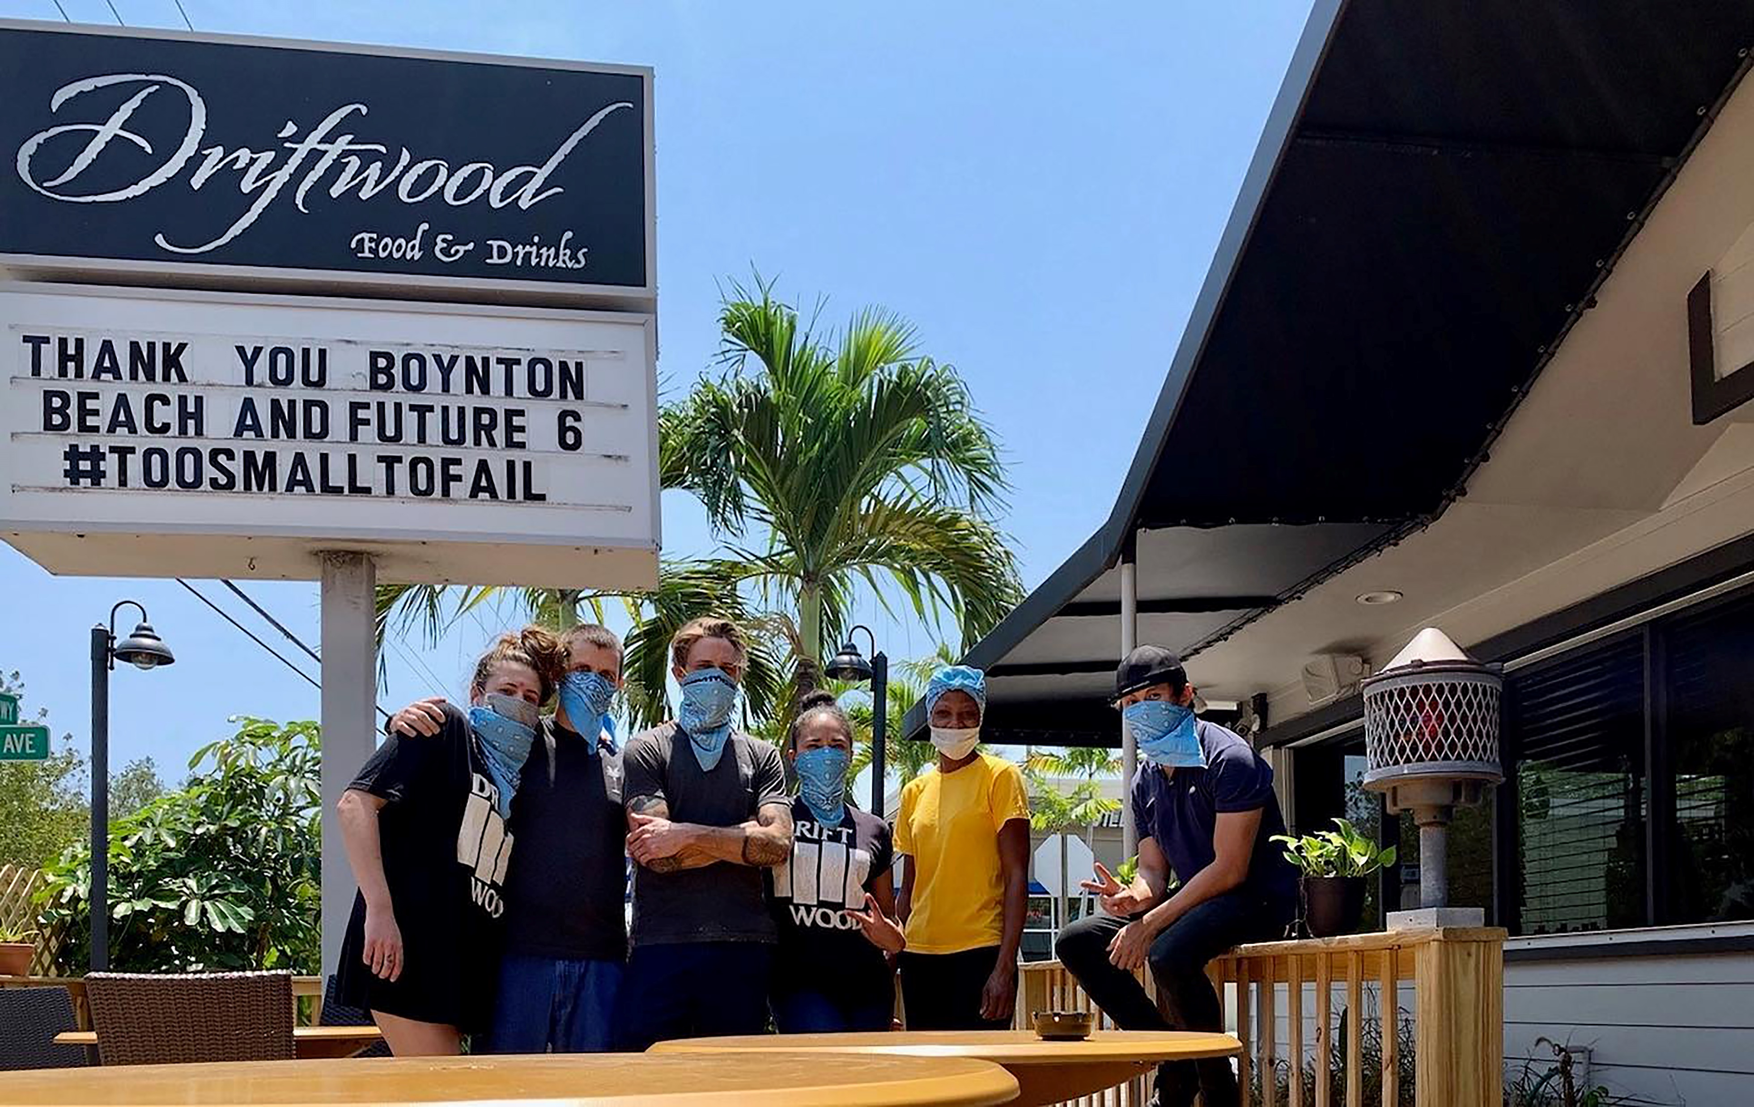
ADDITIONAL INFORMATION
BBCRA’s SBDRFLP was the first of its kind with the most flexible and funding allocations fully funded by a CRA.
BBCRA’s SBDRFLP application was simple with limited but important documentation, streamlined loan application review, and approval processes.
Success was due to dedicated staff and experienced and cooperative legal counsel.
BBCRA’s SBDRFLP was developed and implemented while staff was working remotely from home, utilizing readily available software and web-based applications and programs
101 Applications consistently processed by BBCRA staff in a record setting 2-week period
Over $1.25 Million in combined BBCRA COVID-19 relief programs (SBDRFLP, 6-month extension rent assistance, and marina slip rent abatement) was disbursed
BBCRA COVID-19 relief programs provided gap funding for local businesses in time of need since the CARES Act and relief funding addressed loss of potential income

Slide 10
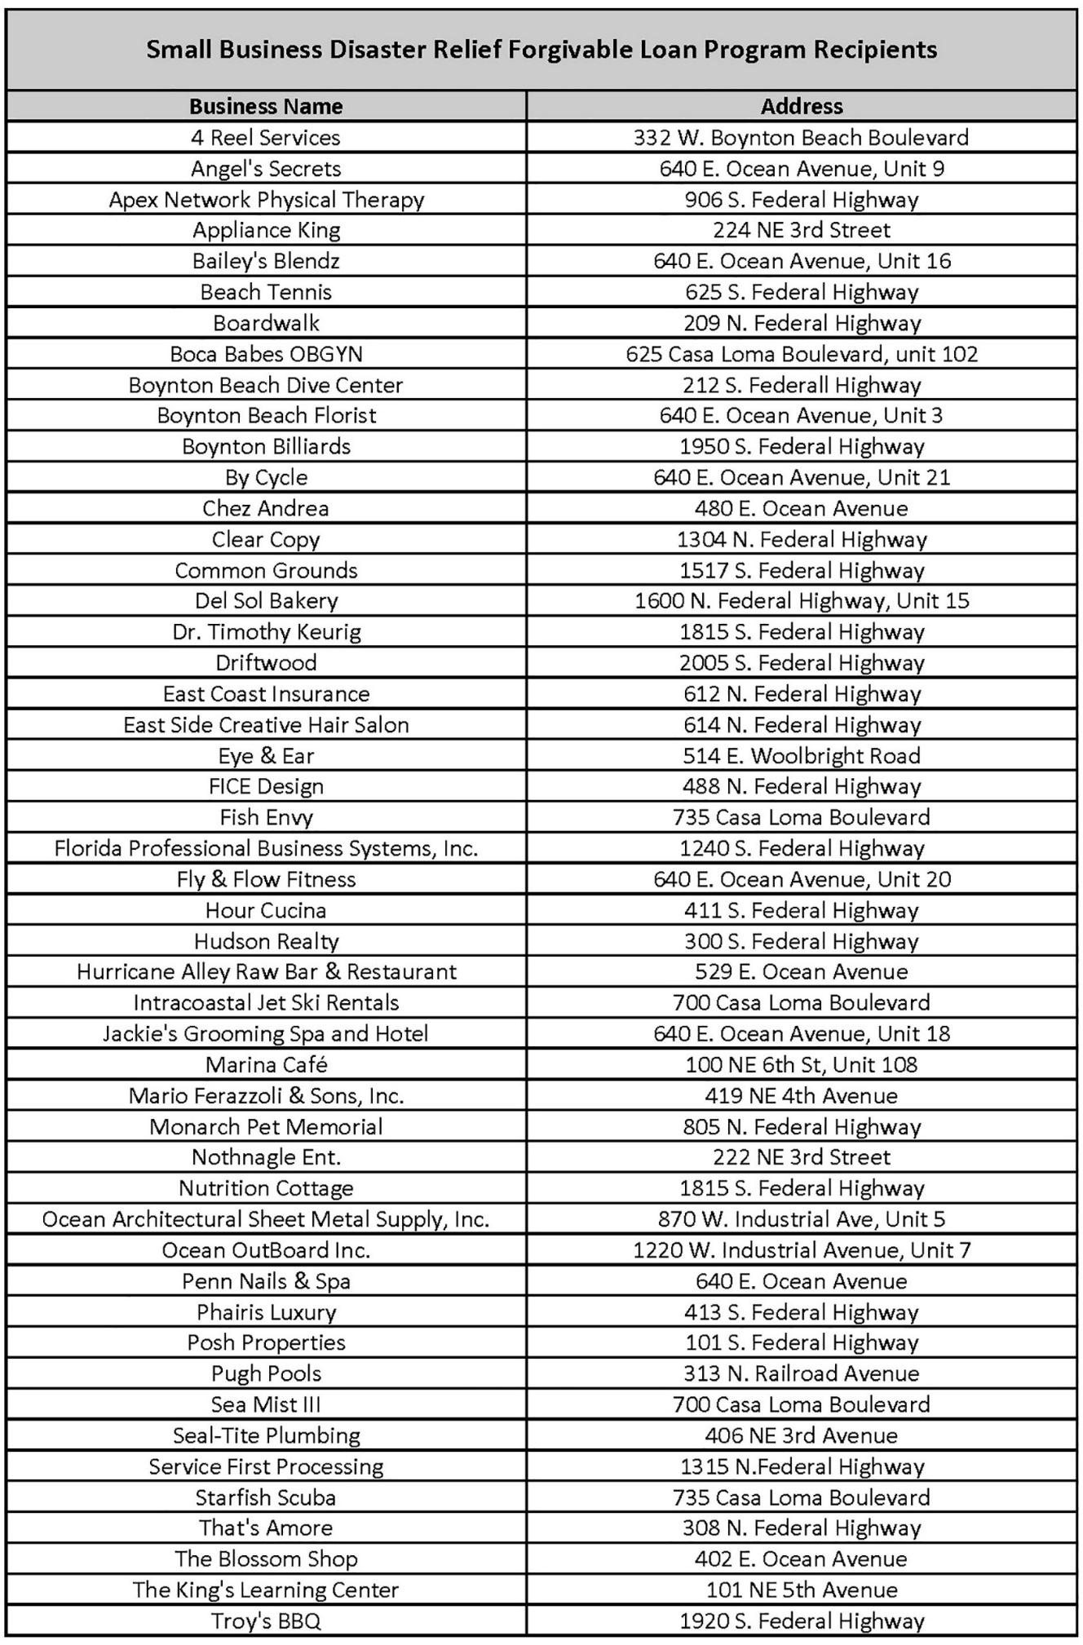
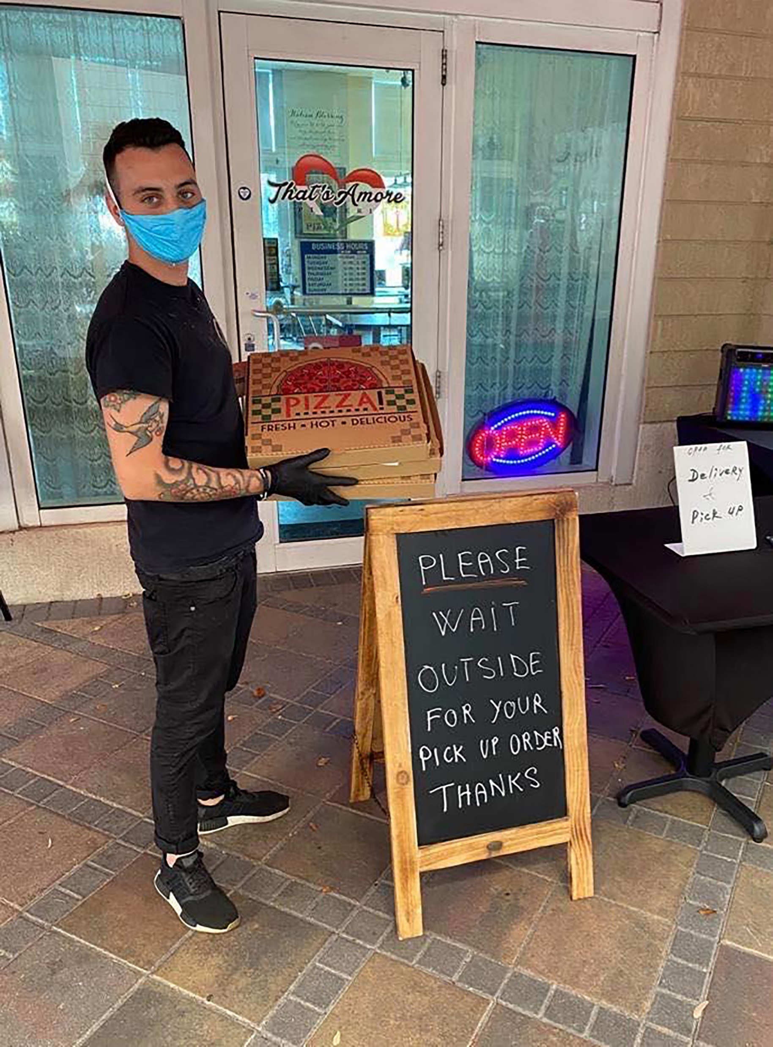
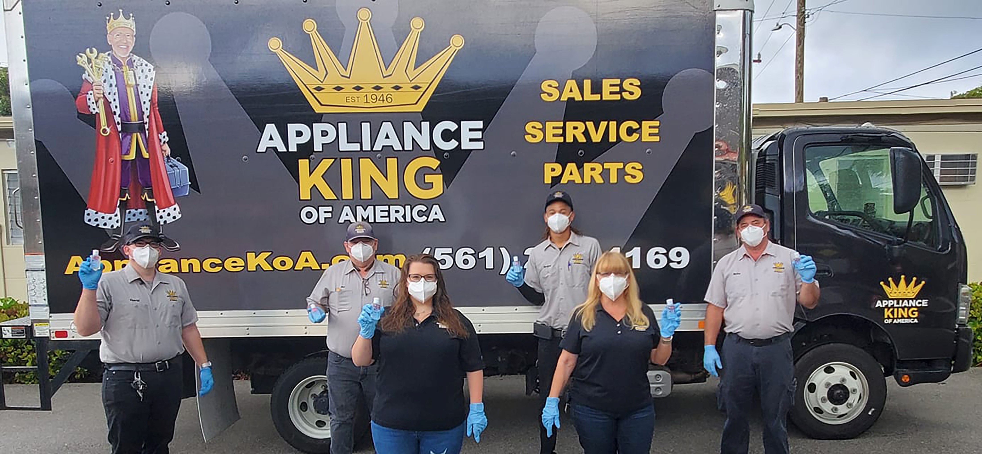
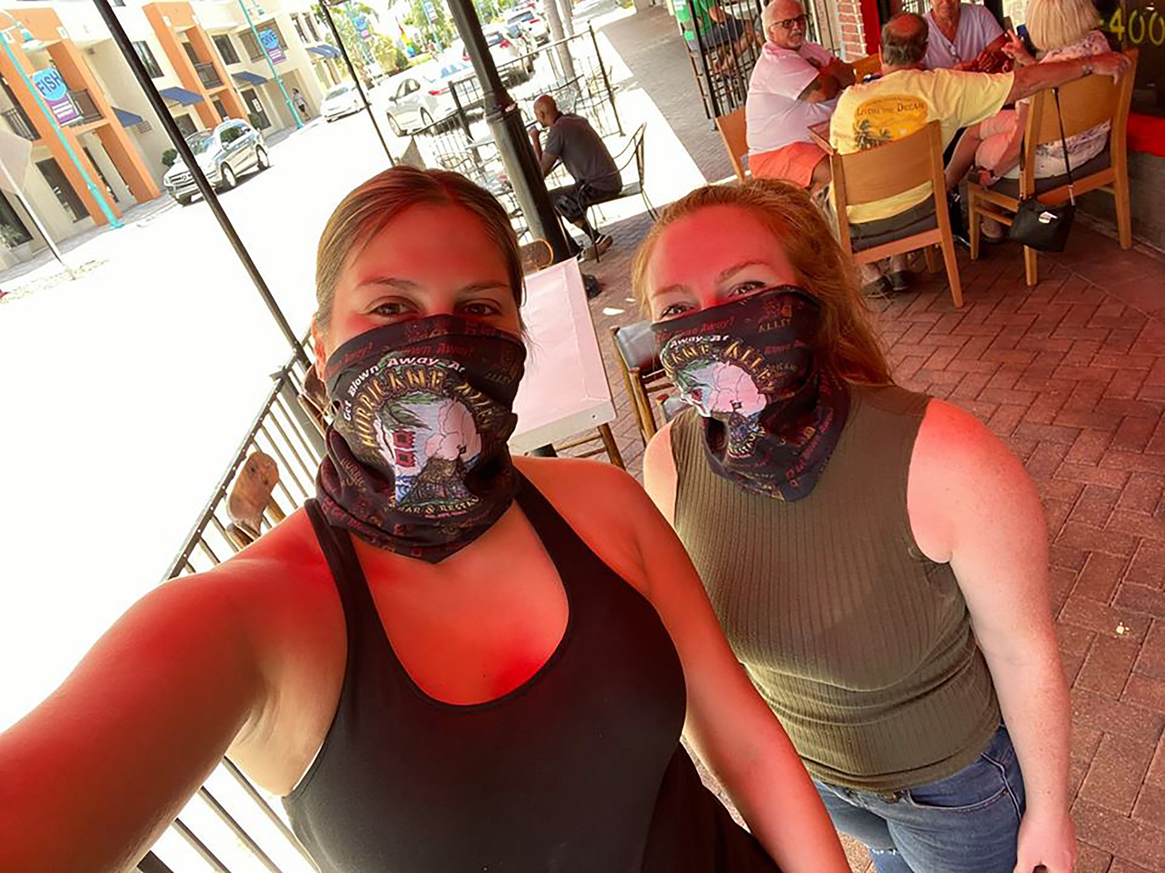
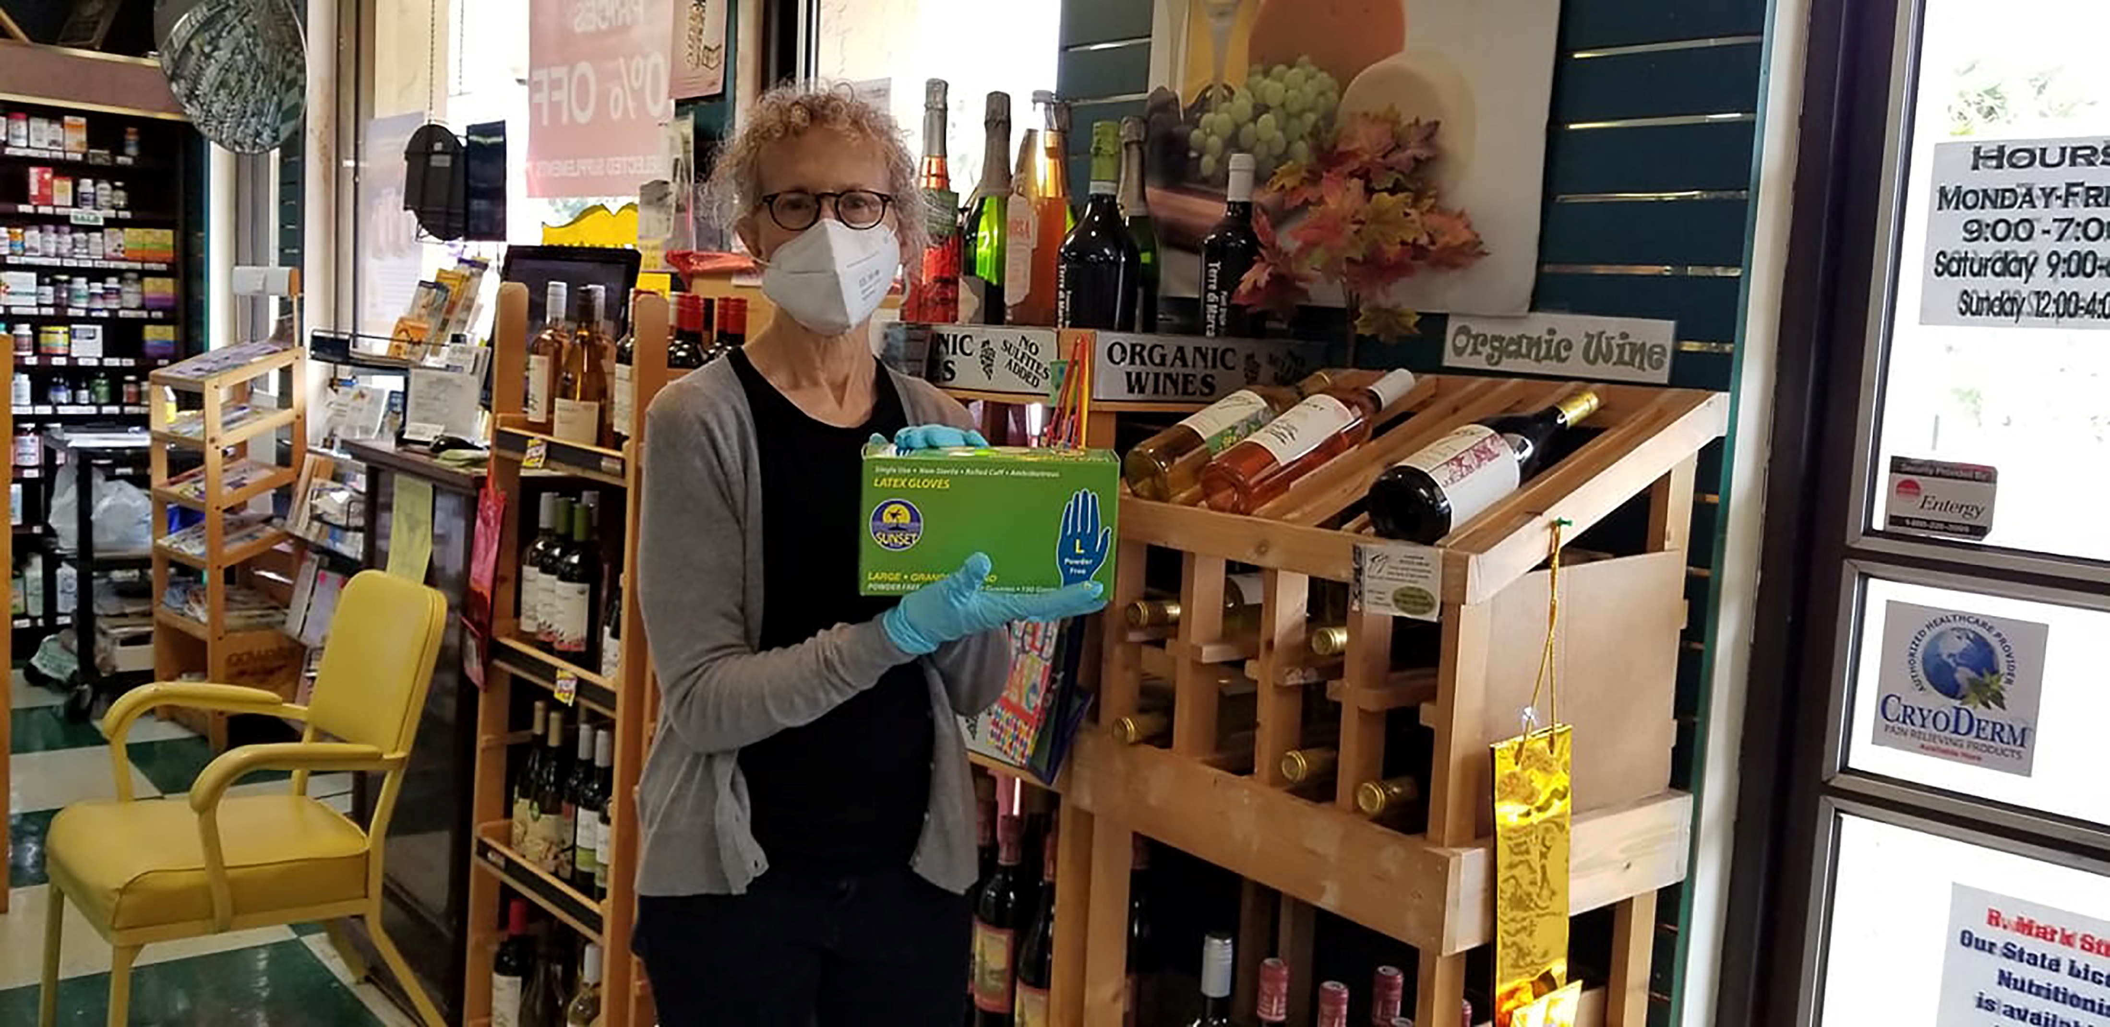
100+ TOTAL PROGRAM RECIPIENTS
1st Round - 50 Program Recipients

