Slide 1
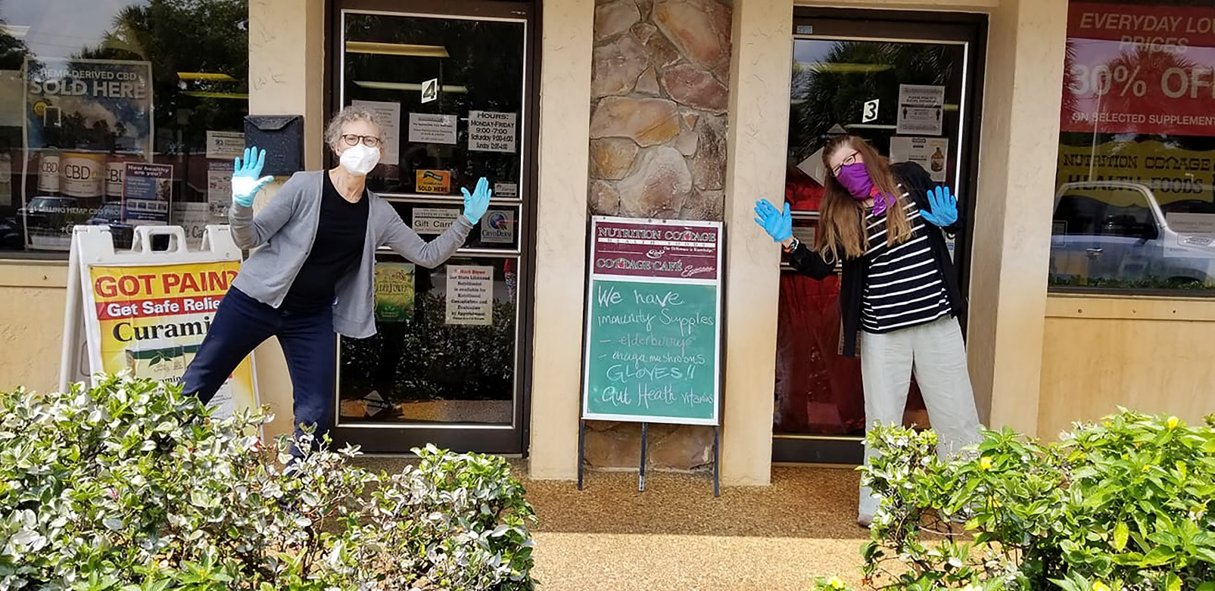
RESULTING TESTIMONIALS
At Nutrition Cottage Health Foods, we are very pleased, excited, and most appreciative to have been selected as a recipient of the Boynton Beach CRA’s Small Business Disaster Relief Program. Since 1978, we have been a long‐time part of the Boynton Beach small business community and we truly feel that the Boynton Beach CRA, not just in words, but in direct action, and at a very critical time, has gone above and beyond in their efforts to support and assist small business in Boynton Beach.” – Mark Stowe, Nutrition Cottage
My month end has been nuts, but I wanted to thank you and the CRA so much for allowing us to participate in this program. The Boynton Beach CRA has really gone above and beyond for the local community. You also executed the process flawlessly in a time where everything tends to be really confusing. So, a huge, gigantic thank you from myself and the Service First Family. Every little bit helps in this unprecedented time. - Amy Smith, Service First Processing
I wanted to email you guys to say thank you for everything you do. Not only the beautification of East Boynton, which is an amazing change by itself, but also with helping smaller business like myself stay afloat during these tragic times. It’s nice to see that you guys care. The staff you guys have seems to be amazing as well. Bonnie Nicklien as well as Thuy Shutt were both very helpful and spoke to me personally to help me with the loan process. I just want to say thanks for everything you guys are doing and please keep up the good work. – Christopher Gilbert, Unity Medical Consultants
We have put the BBCRA Small Business Disaster Relief Forgivable Loan Program funds received on 4/30/2020 to immediate use for our business…This infusion of capital into our business has given us the certainty to begin making investments in our business and thus our local economy immediately. We have begun the process of bringing back a furloughed employee. We have also opened a new position previously eliminated due to the uncertainty and reduction in revenue caused by the COVID-19 crisis. I want to thank you, Michael, Mercedes, and the CRA Board for stepping up and finding creative ways to help our small business continue to operate during these trying times. - David Costanzo, Appliance King of America
We have put the BBCRA Small Business Disaster Relief Forgivable Loan Program funds received on 4/30/2020 I am definitely out of words to accurately express my level of appreciation for everything you, the CRA, the City and the Board have done to help Boynton’s small businesses through this difficult time. I know that your hard work will result in many businesses surviving this ordeal that otherwise, would not have been able to reopen, bring their staff back to work and serve this great community again. I am continually grateful to have opened Bailey’s Blendz in such a supportive city with the most amazing staff. Thank you for making such a difference! - Danielle Tarrant, Bailey’s Blendz

