Slide 1
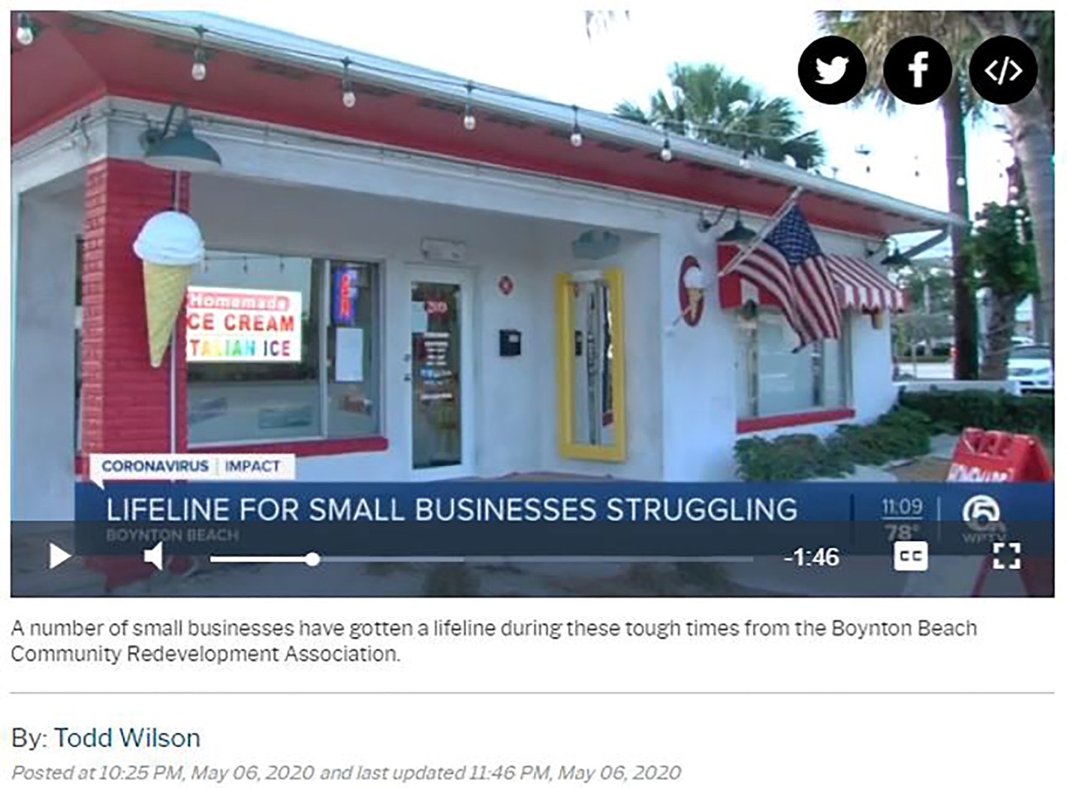
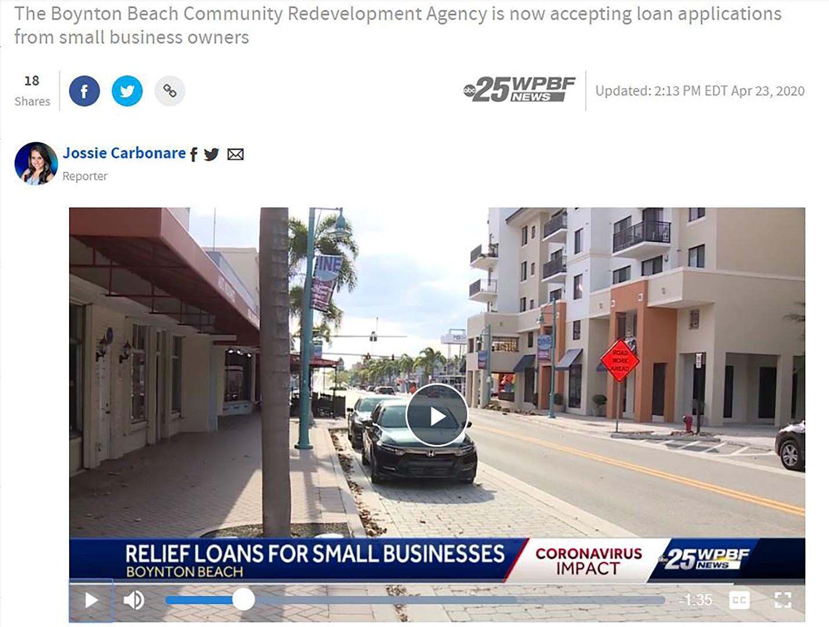
MEDIA COVERAGE
May 7, 2020 WPTV news coverage of the BBCRA's Small Business Disaster Relief Forgivable Loan Program and Commercial Rent Reimbursement Grant program aired at 10:00 pm and 11:00 pm.
https://www.wptv.com/news/coronavirus/boynton-beach-cra-steps-in-to-help-small-businesses
April 23, 2020 WPTV news coverage of the BBCRA's Small Business Disaster Relief Forgivable Loan Program aired at 9 a.m., 12 p.m., and 6 p.m.
https://www.wpbf.com/article/boynton-beach-cra-offering-disaster-relief-loans-to-local-small-business-impacted-by-covid-19/32253691

