Slide 1
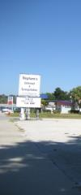
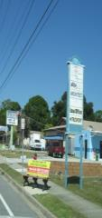
City of Edgewater
Community Redevelopment Agency
Annual Report FY 2019
March 31, 2020

Slide 2
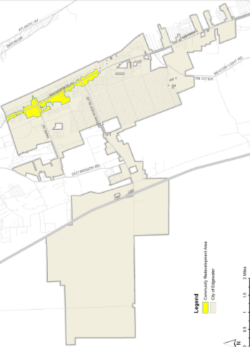
Redevelopment Area Boundaries
  400 acres
  2.8 % of total City area
  Focus Ridgewood Avenue (US-1)
Planning Area 1
Planning Area 2
Planning Area 3
Planning Area 4

Slide 3
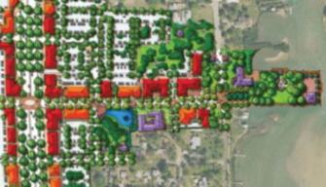
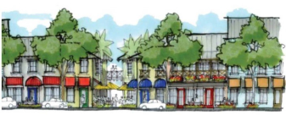
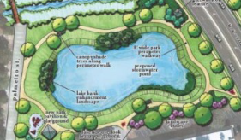
Process
May 5, 2014 Resolution 2014-R-08 Finding of Necessity
November 20, 2014 Volusia County Council Resolution 2014-159
January 14, 2015 Planning & Zoning Board Community Redevelopment Plan consistent with Comprehensive Plan.
March 2, 2015 Resolution 2015-R-08 Create CRA (Agency)
March 2, 2015 Resolution 2015-R-09 Appoint Governing Body
March 2, 2015 Resolution 2015-R-10 Adopting CRA Plan
March 2, 2015 Ordinance 2015-O-04 Establish CRA Trust Fund (First Reading)

Slide 4
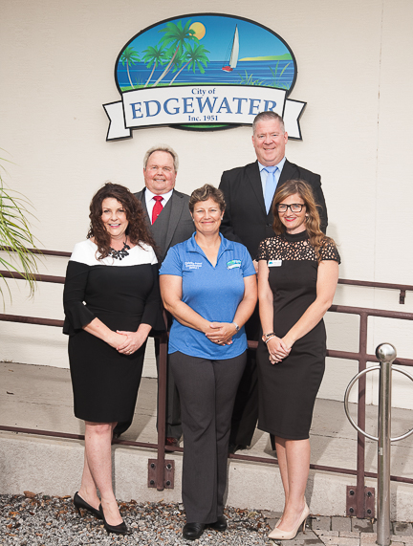
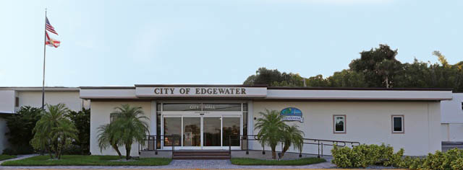
Governing Board
City Council
Contact: Samantha Bergeron
Director Parks & Recreation
Economic Development / Redevelopment Coordinator
City of Edgewater
104 N. Riverside Drive, Edgewater, FL 32132
Phone: 386-424-2400 ext. 7201
Fax: 386-424-2469
E-Mail: sbergeron@cityofedgewater.org
URL: www.edgewatercra.org
Governing Board Members:
Back Row: Michael Thomas, Chair and Gary Conroy
Front Row: Kimberly Klein-Yaney, Christine Power and Megan O’Keefe

Slide 5
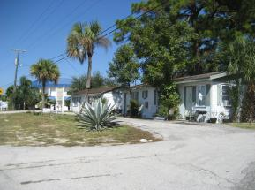
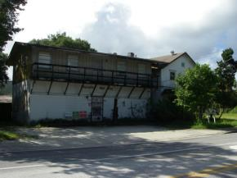
Primary Objectives
Primary Objectives: (pages 50 – 58)
Road Network Infrastructure
Road Network Connectivity
Stormwater Management
Utilities
Parks and Open Spaces
Beautification
Infill Development (When Feasible Land Acquisition of Critical Properties to Facilitate Development)
Historic Preservation (When Feasible Creation of Direct Plan for Purchasing Specific Buildings)
Funding

Slide 6
Primary Objectives
Community Objectives:
(pages 58 – 60)
Code Enforcement and Maintenance
  Encourage Neighborhood and Business Stabilization
  Special Maintenance Standards
Business Support
  Create Façade Grant Program
  Target Strategic Development Projects
  Job Support Programs
  Purchase Required Land for Parking Lots in Coordination with Developing Public Spaces, New Developments

Slide 7


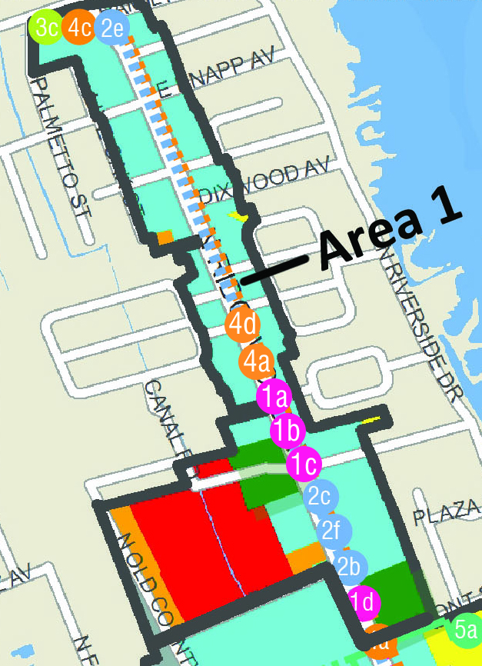
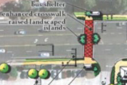
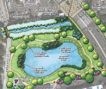
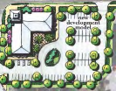



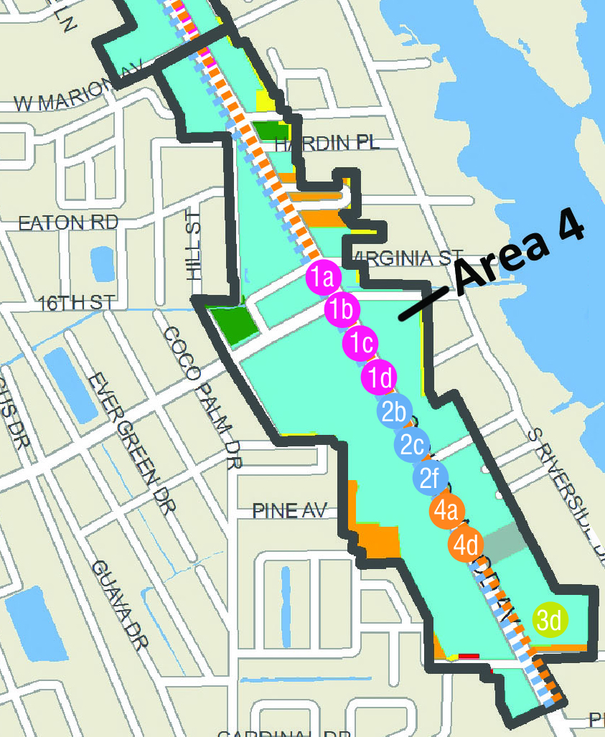




CRA Plan – Area 1
(North Limit to Lamont Street) (Page 40-41)
Key Capital Projects Include:
Enhanced Pedestrian Crosswalks
Enhanced Transit Stops
Improved Utilities
Stormwater Management Strategy & Improvements
Pedestrian Lighting, Traffic Lights & Signage
Wayfinding Signage
Downtown Edgewater Redevelopment Concept
Blight Factors

Slide 8
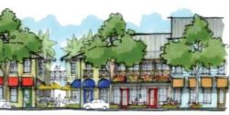
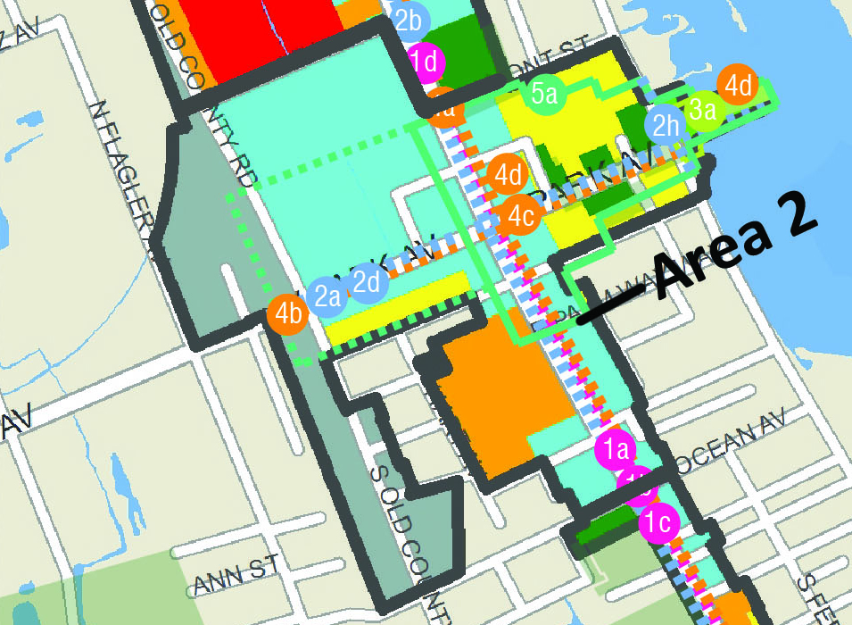

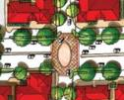
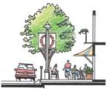




CRA Plan – Area 2
(Lamont Street to Ocean Avenue) (Page 44 – 45)
Key Capital Projects Include:
Park Avenue Enhancement Plan (Network Connectivity, Median Landscaping, Intersection & Public Realm Improvements, Joint Storm Water, Property Assemblage)
Enhanced Pedestrian Crosswalks
Extend East Central Florida Regional Rail Trail to the Indian River
Riverwalk Improvements
George R. Kennedy Memorial Park Improvements
Park Ave – (Cross Section Improvements, Landscape, Signage, & Design Standards)
Gateway (Destinations & Public Facilities)
Wayfinding Signage
Downtown Edgewater Redevelopment Concept
Blight Factors

Slide 9

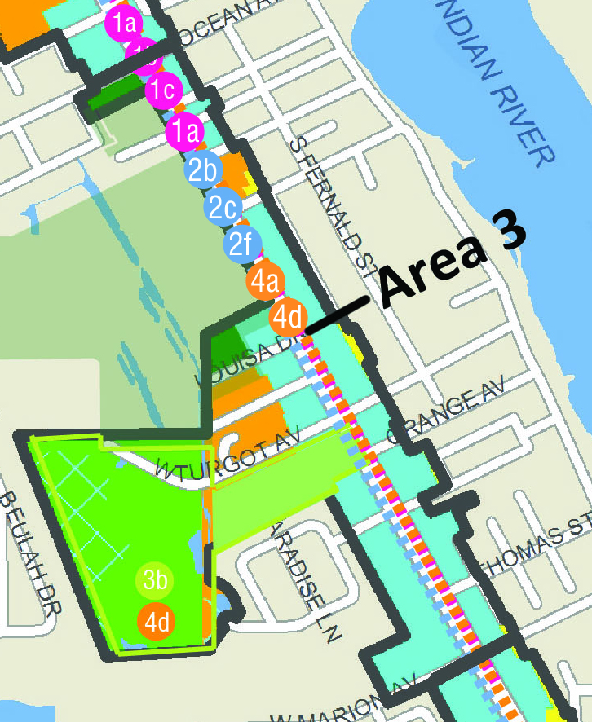

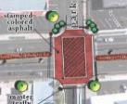
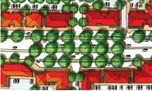






CRA Plan – Area 3
(Ocean Avenue to Marion Avenue) (Page 46 - 47)
Key Capital Projects Include:
Enhanced Pedestrian Crosswalks (Including Ridgewood Avenue)
Enhanced Transit Stops
Improve Utilities (Including Ridgewood)
Ridgewood Avenue – Future Phase (Pedestrian Lighting, Traffic Lights, Signage)
Wayfinding Signage
Blight Factors

Slide 10



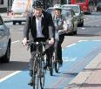





CRA Plan – Area 4
(Marion Avenue South) (Page 48 – 49)
Key Capital Projects Include:
Enhanced Pedestrian Crosswalks (Including Ridgewood Avenue)
Enhanced Transit Stops
Improve Utilities (Including Ridgewood)
Ridgewood Avenue – Future Phase (Pedestrian Lighting, Traffic Lights, Signage)
Wayfinding Signage
Blight Factors

Slide 11
Financial Statement
 | FY 2019 | FY 2018 | FY 2017 | FY 2016 | FY 2015 |  | FY 2014
Revenues: (TIF) | $154,233 | $112,081 | $41,146 | $9,398 | $0 |  | $0
Investment Earnings | $408 | $187 | $50
Total Revenues | $154,641 | $112,268 | $41,196 | $9,398 | $0 |  | $0
Expenditures
Community Development | $305 | $306 | $175
Capital Outlay |  | $2,500 | $6,900
Total Expenditures | $305 | $2,806 | $7,075
Net Change in Fund Balances | $154,336 | $109,462 | $34,121
Beginning Fund Balance | $152,981 | $43,519 | $9,398
Ending Fund Balances | $307,317 | $152,981 | $43,519
Number of Personnel | 0 | 0 | 0 | 0 | 0 |  | 0
Debt | $0 | $0 | $0 | $0 | $0 |  | $0
Focus: Land Acquisition, Wayfinding Signs, Capital Projects to encourage redevelopment, access and infrastructure |  |  |  |  |  |  | Base Year

Slide 12
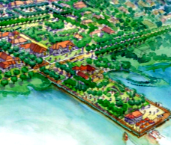
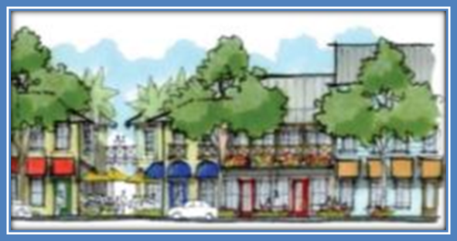
2019 Expense Detail
 | FY 2019
2019 Expenses Detail
DEO Special District Report & Fee | $175
Legal Advertisement | $130
Total Expenses | $305
Focus: Land Acquisition, Wayfinding Signs, Capital Projects to encourage redevelopment, access and infrastructure

