Slide 1
Marketing Plan Implementation 2018

Slide 2
The Vision
The vision for Downtown NoMi is to be known as a place where you will enjoy a rich, diverse, cultural experience with live music, great food, stunning art and unique shopping.

Slide 3
Implementation
New logo and tagline
Brand Standards Manual
Branded stationary and business cards
Photography for marketing campaign
Downtown pole banner campaign
Advertising templates
Social media templates
Scrim banner
Downtown walkers guide
Grant recipient stickers
New CRA website
Promotional video

Slide 4
New Logos and Tagline

Slide 5
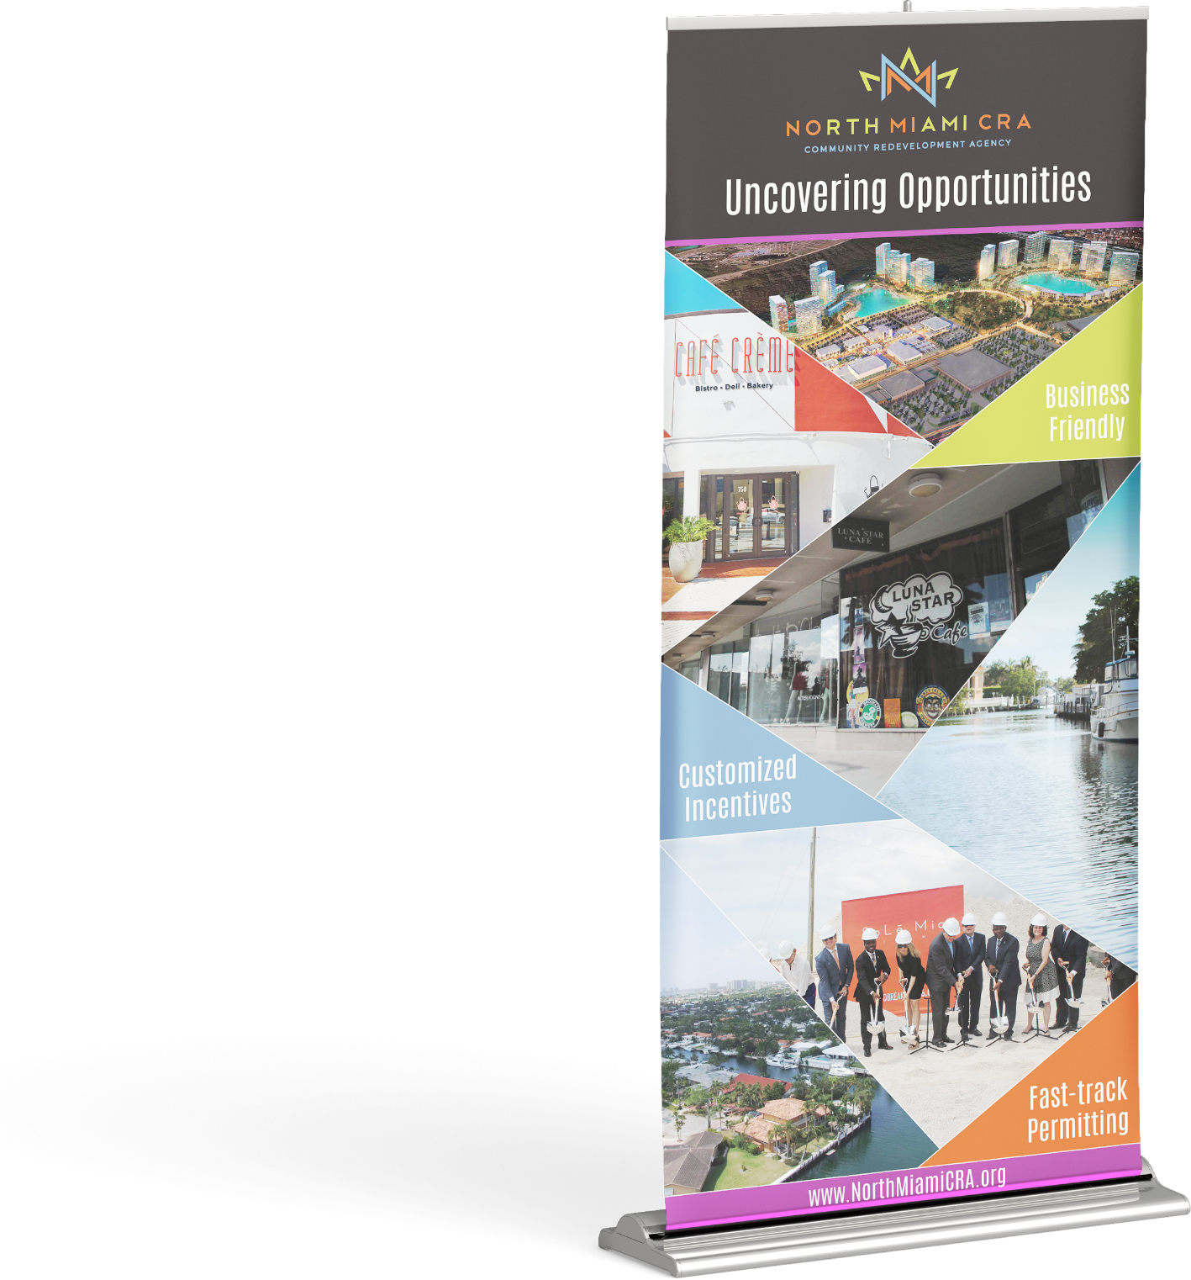
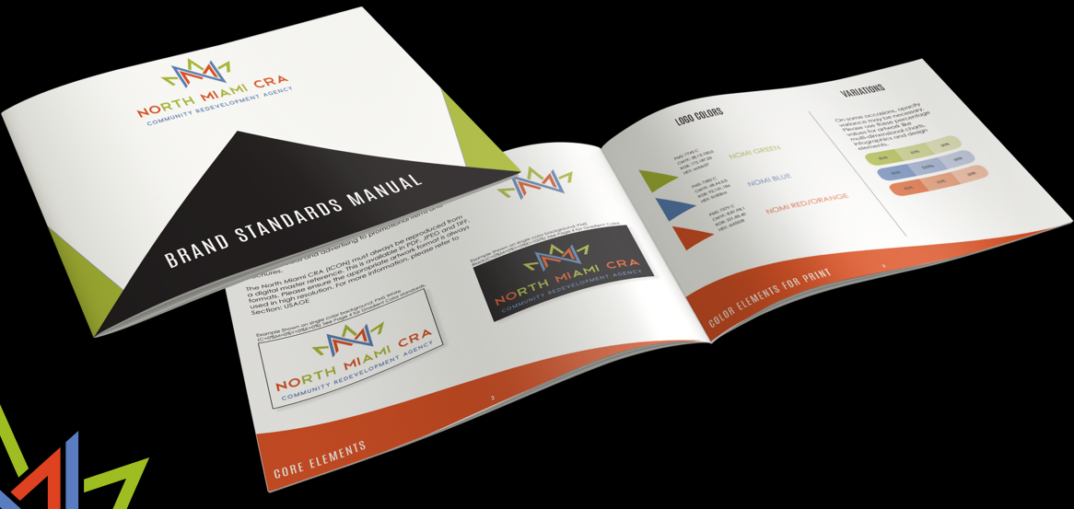
Scrim Banner
Brand Standards Manual

Slide 6
Photography for Marketing Campaign
Approximately 500 photos were taken in Downtown NoMi at various businesses and events for use in marketing collateral/To NoMi is to Love Me campaign and the new CRA website

Slide 7
Downtown Pole Banner Campaign
A total of 52 [24 designs] banners in the Downtown
On NE 125th St. from 5th – 14th Ave.
On W Dixie from 123rd – 130th

Slide 8
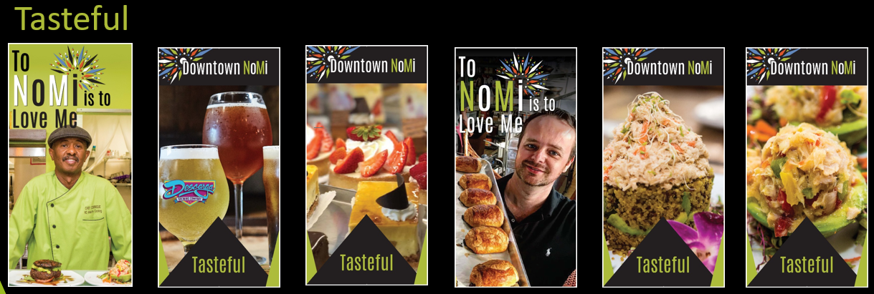
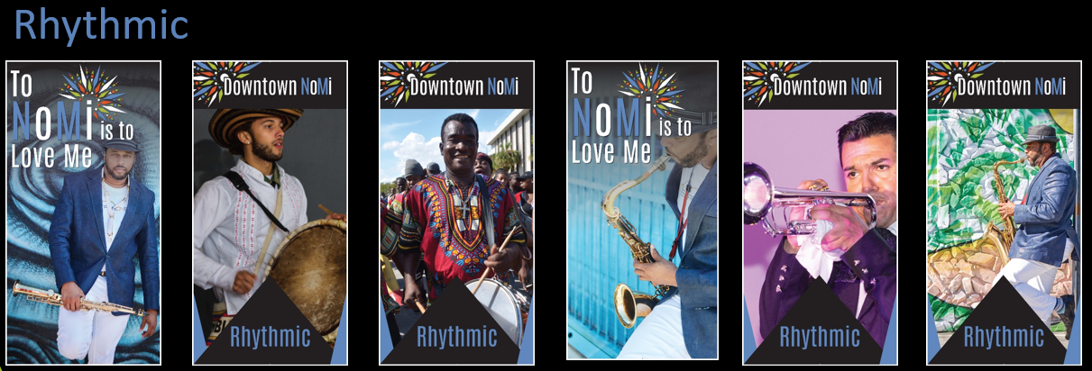
Downtown Pole Banner Campaign

Slide 9
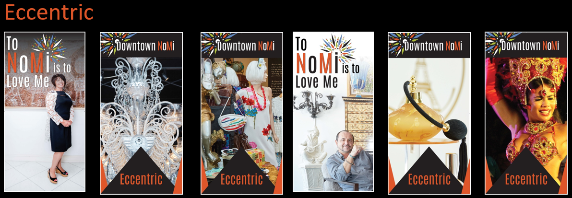
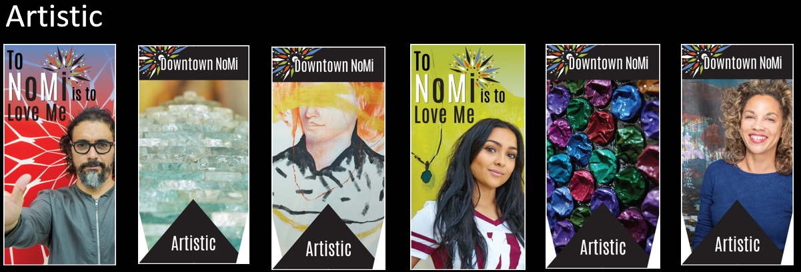
Downtown Pole Banner Campaign

Slide 10
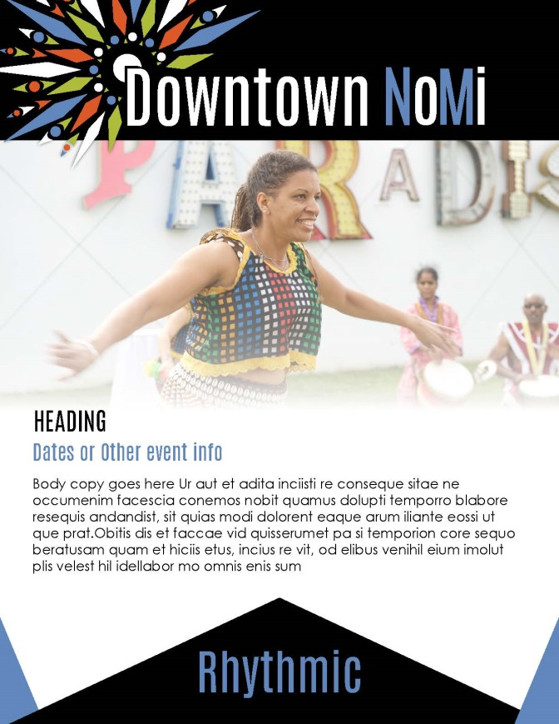
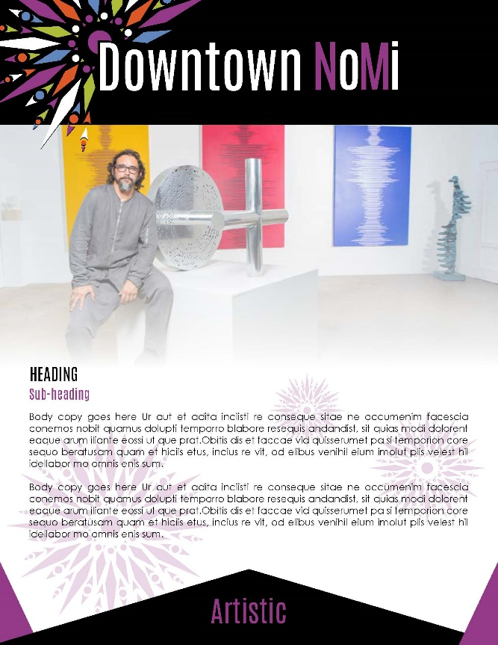
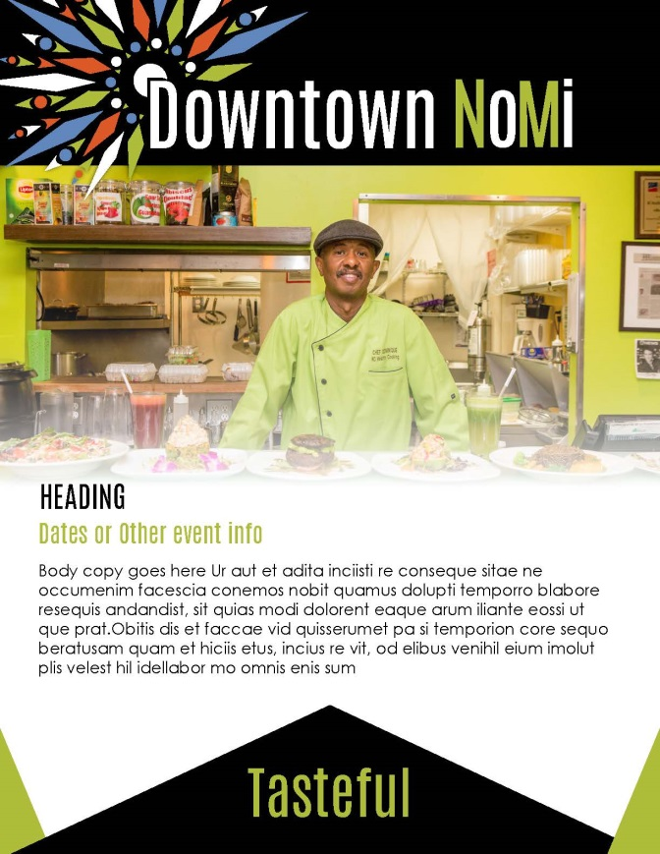
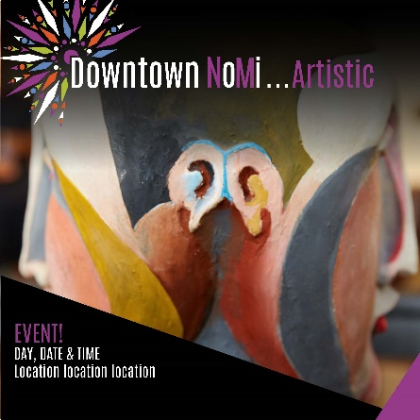
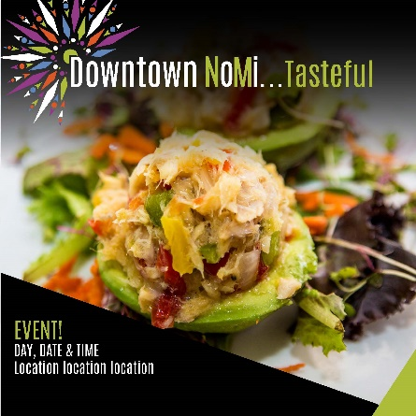
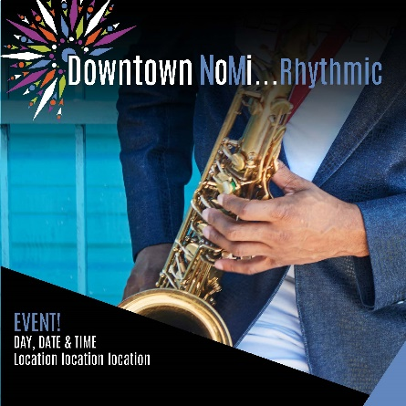
Advertising Templates & Social Media Templates

Slide 11
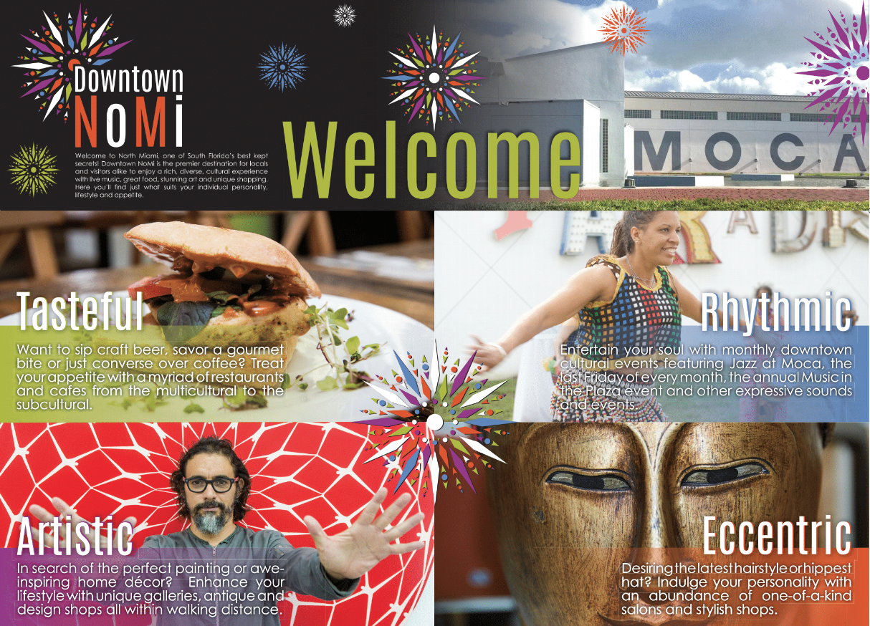
Downtown Walker’s Guide
Printed 10,000 for distribution from downtown NoMi businesses, at events and other CRA/City functions and area hotels.

Slide 12
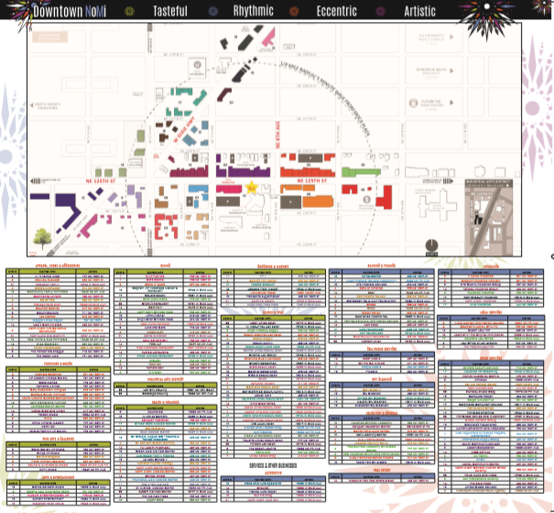
Downtown Walker’s Guide

Slide 13
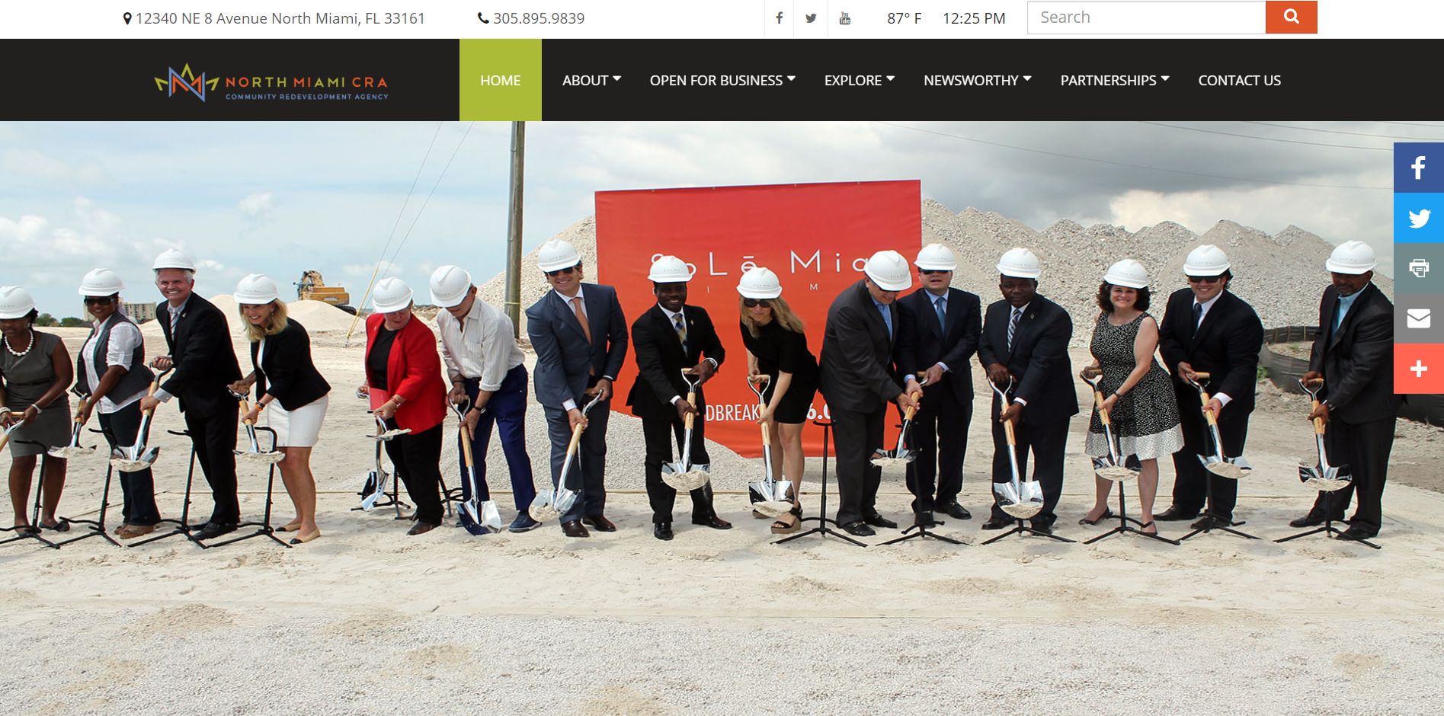
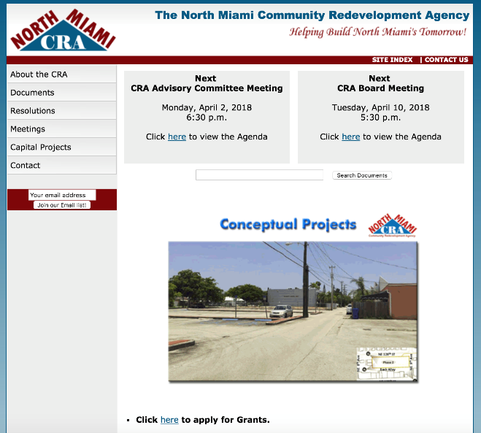
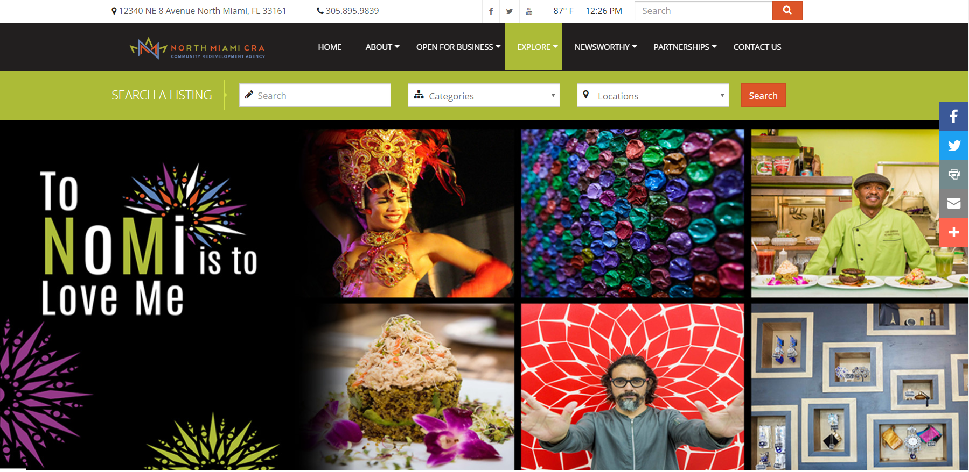
New CRA Website DowntownMoMi.com NorthMiamiCRA.org
The current NorthMiamiCRA.org website will be converted Summer 2018 and all mandatory CRA information will be available on the new site with 2 distinct URL’s for visitor’s ease of access.
Notes:
http://miami.vupinteractive.com/

Slide 14
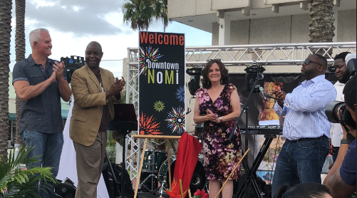
Launch Event & Promotional Video
Notes:
http://miami.vupinteractive.com/

