Slide 1
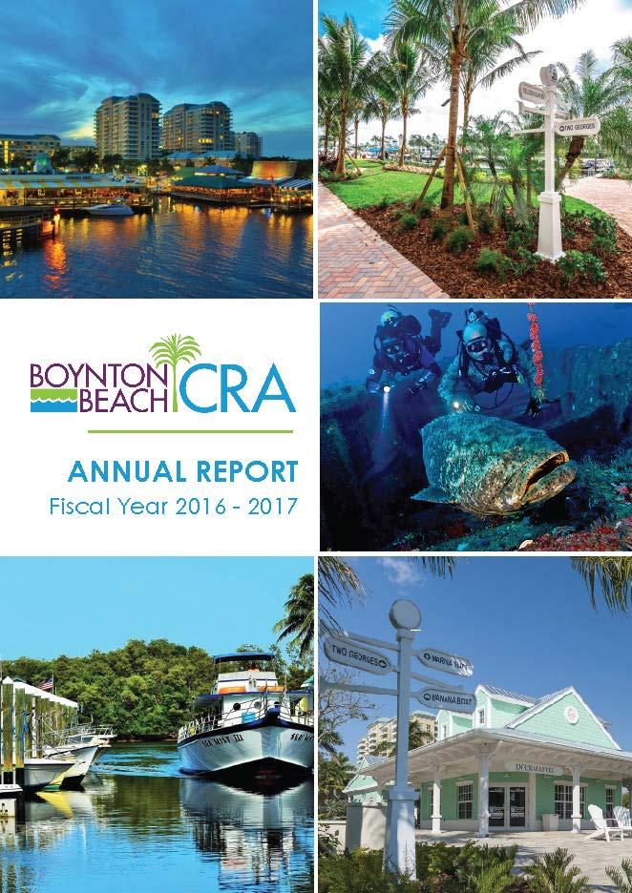
Boynton Beach CRA Annual Report Boynton Beach Community Redevelopment Agency 2018 Roy F. Kenzie Awards
Contact: Tracy Smith-Coffey
561-600-9096
Smith-CoffeyT@bbfl.us

Slide 2
Boynton Beach CRA Annual Report 2017 In Numbers

Slide 3
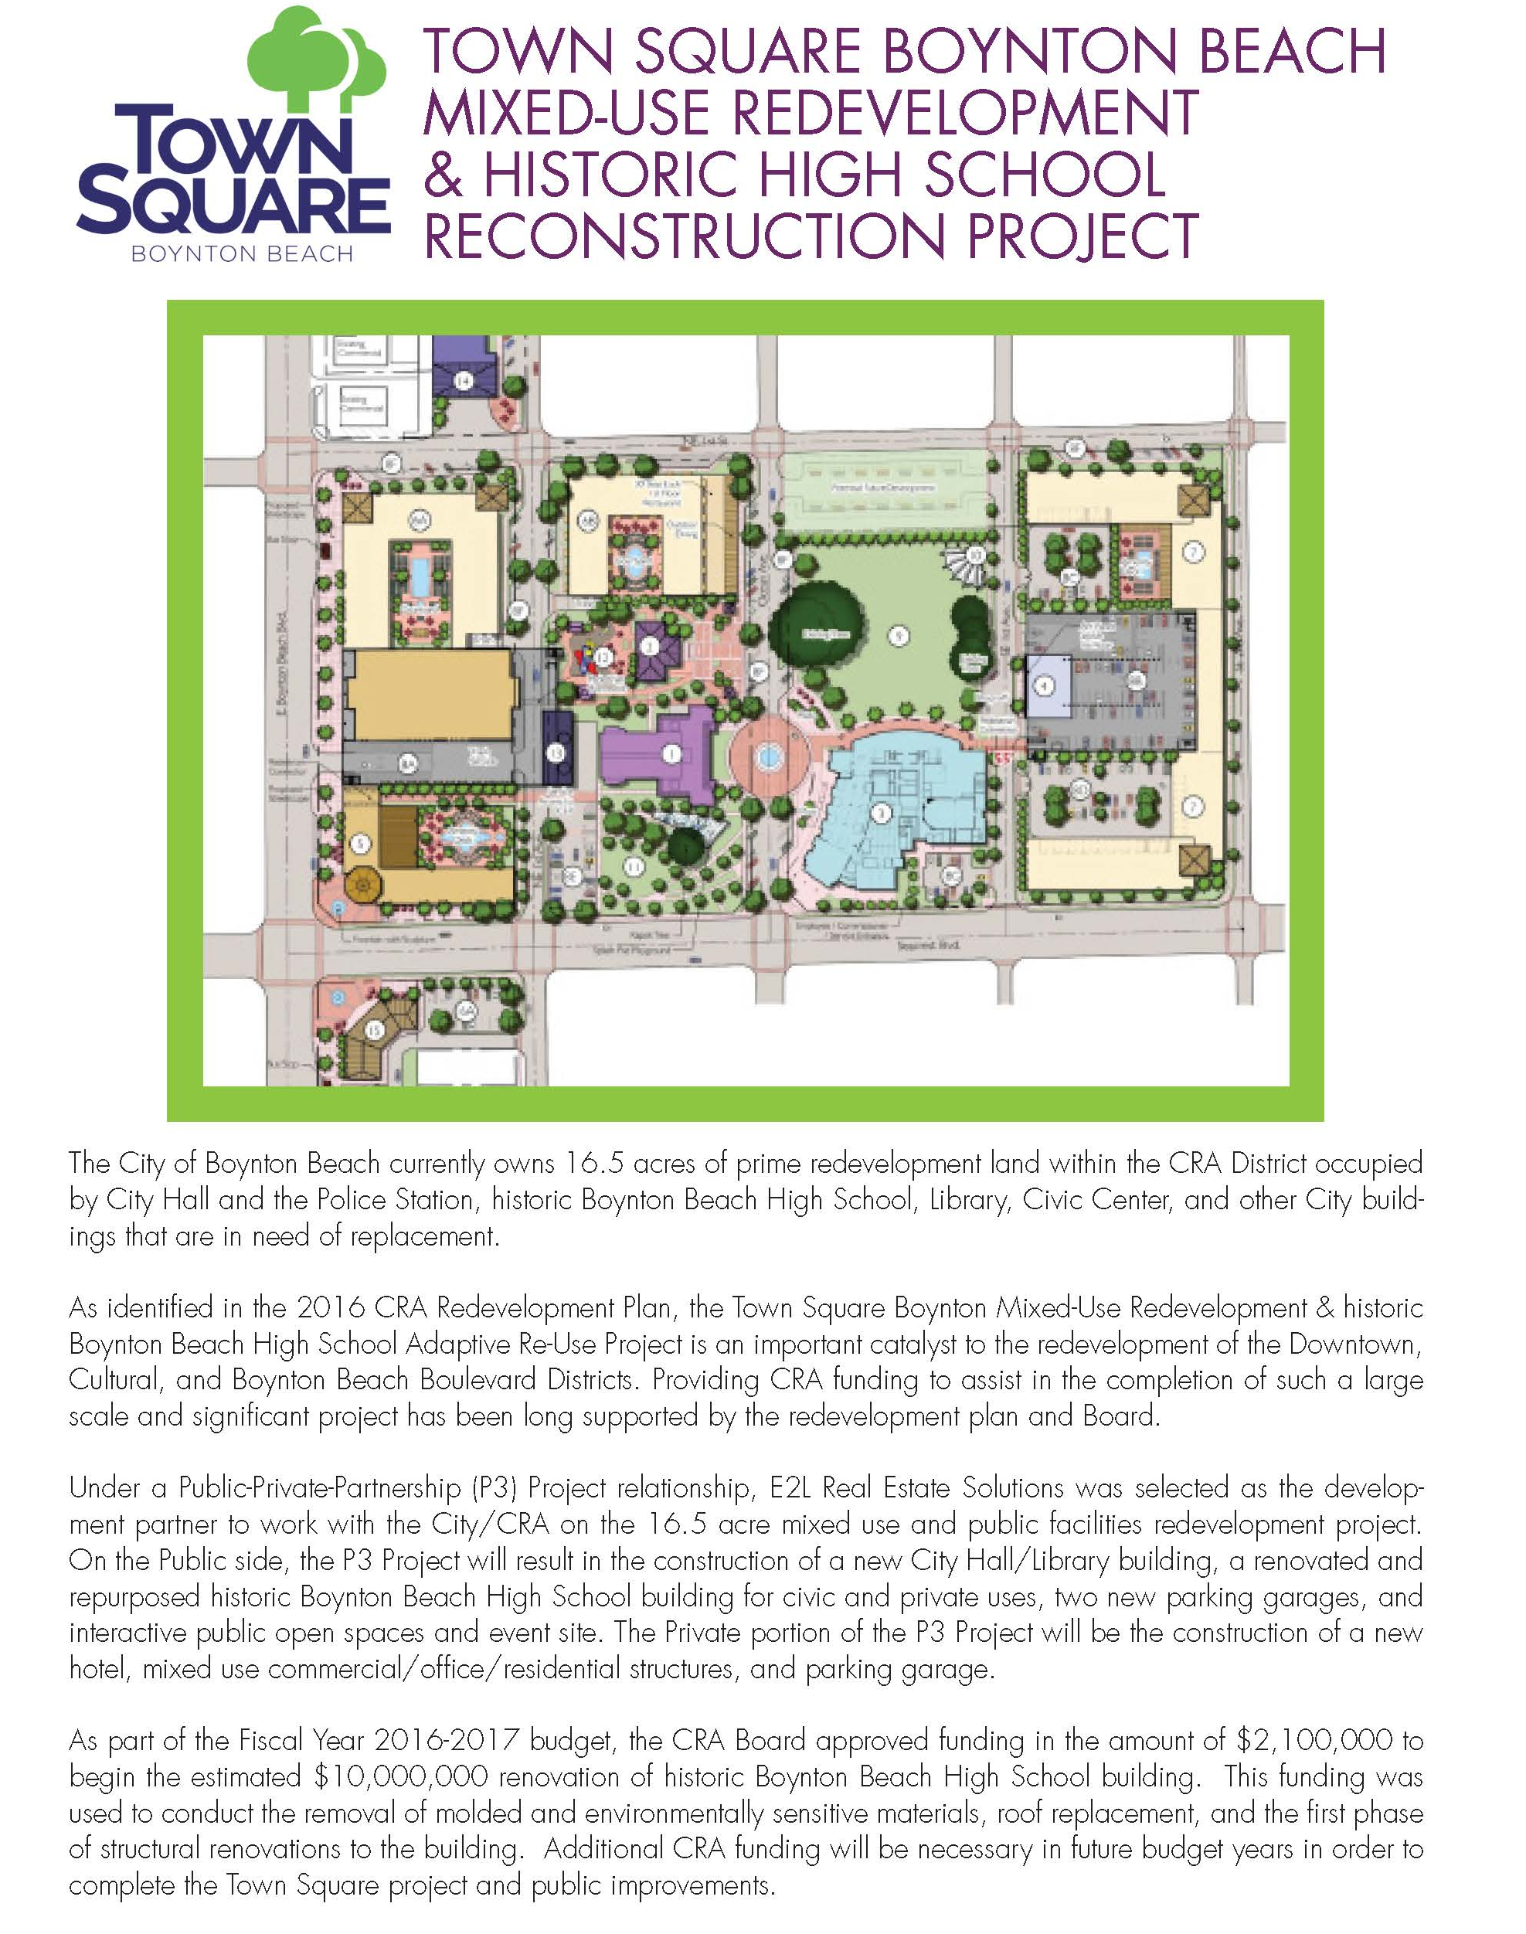
Informing the community about the types of development projects

Slide 4
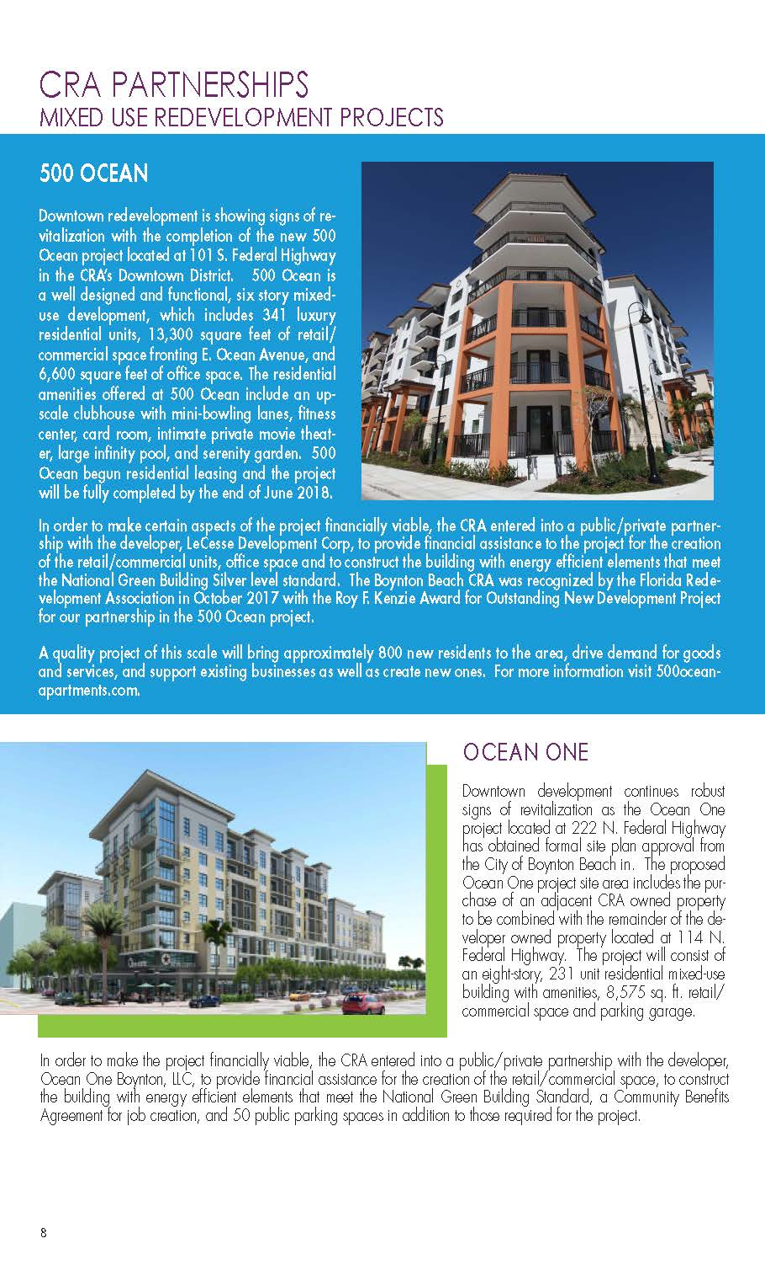
Mixed Use Redevelopment Projects

Slide 5
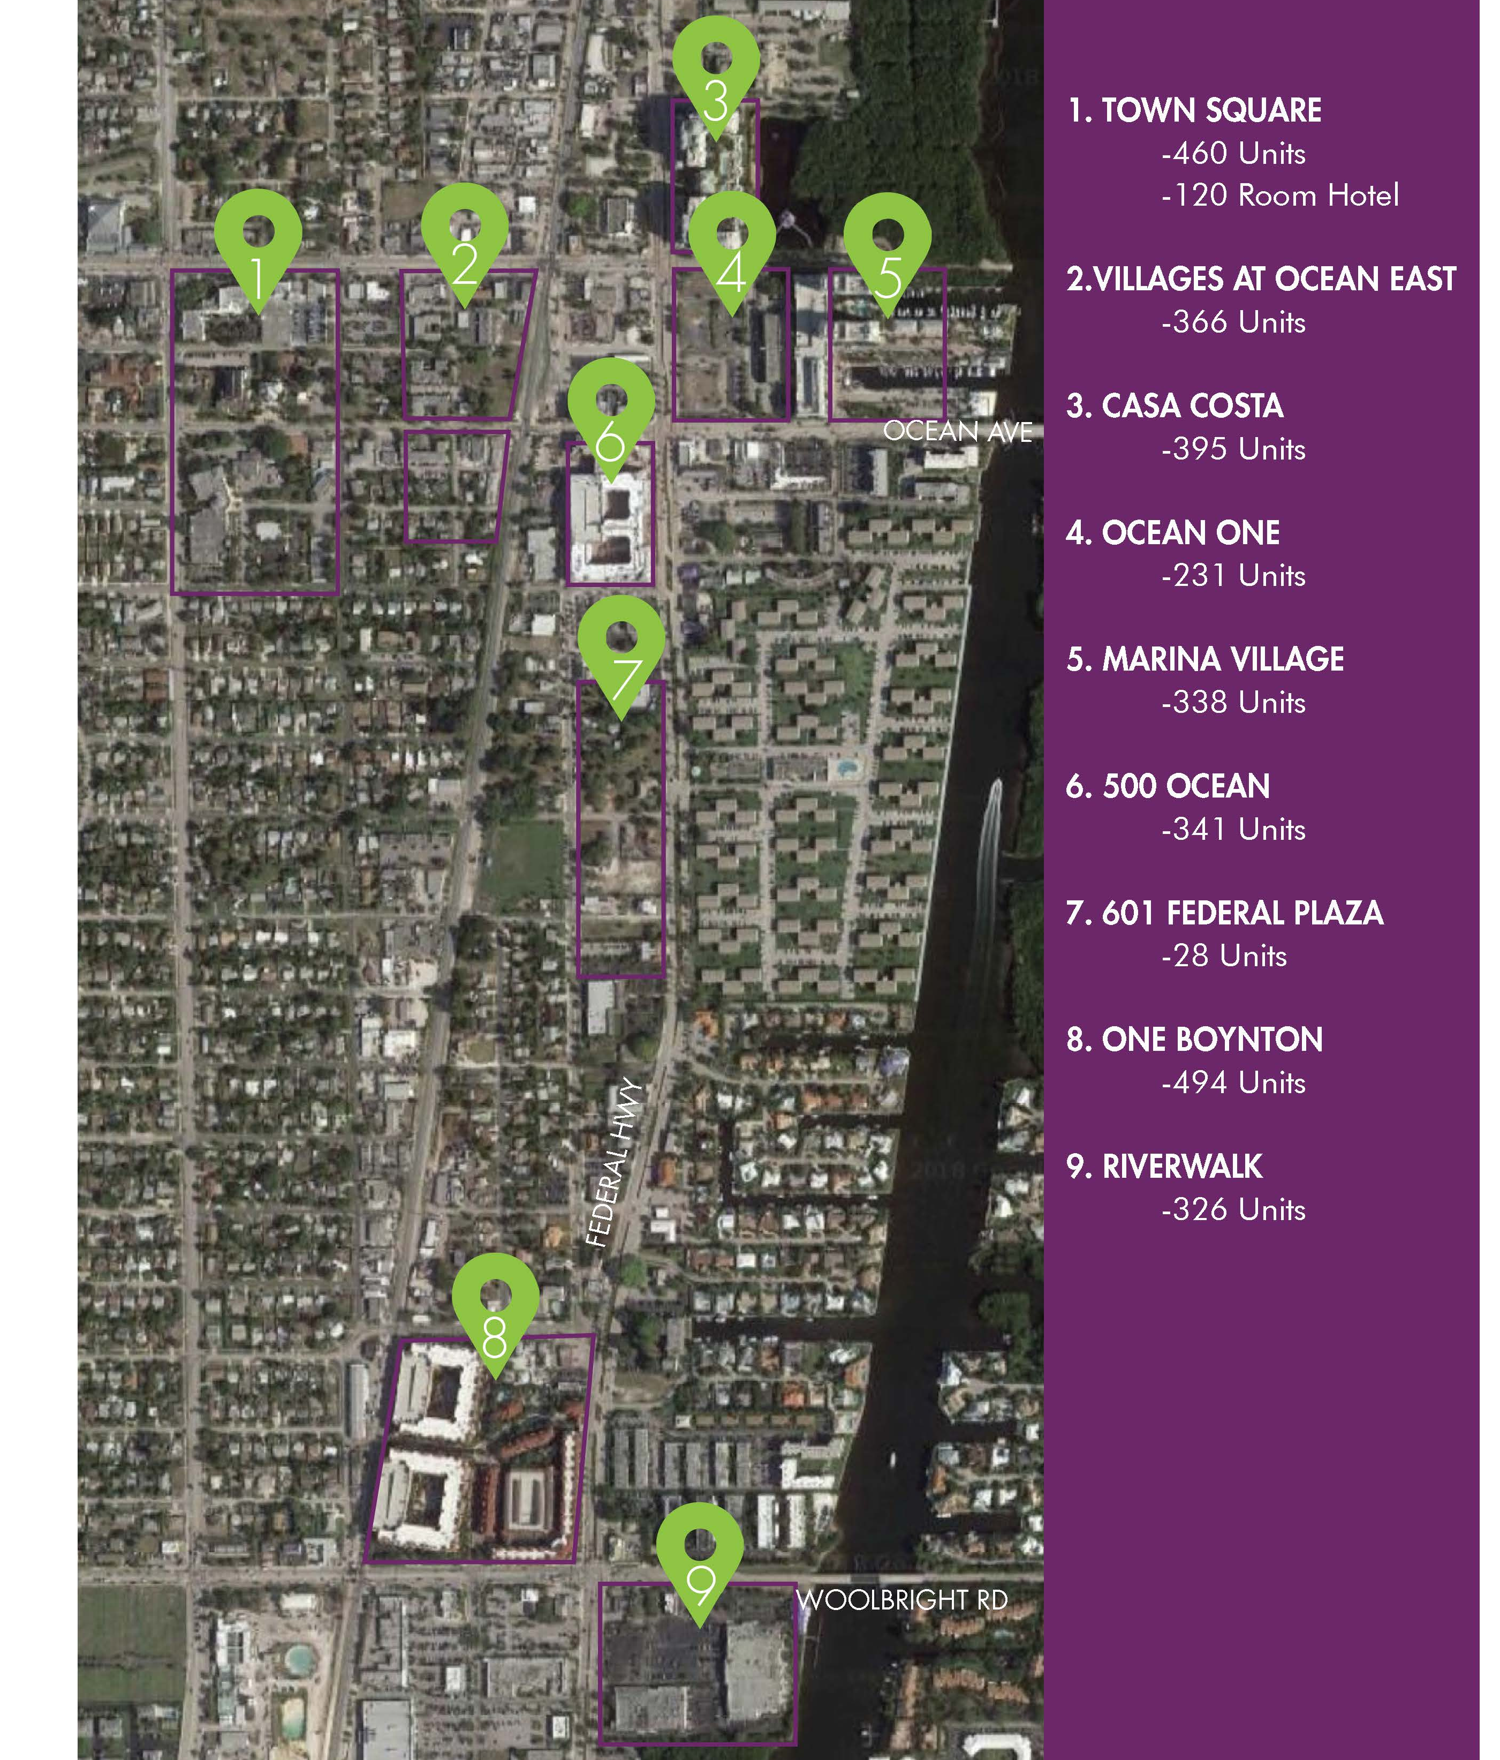
Downtown Development Projects

Slide 6
Neighborhood Policing Program

Slide 7
Making a Difference Affordable Housing Projects

Slide 8
Making an Impact on the Business Community

Slide 9
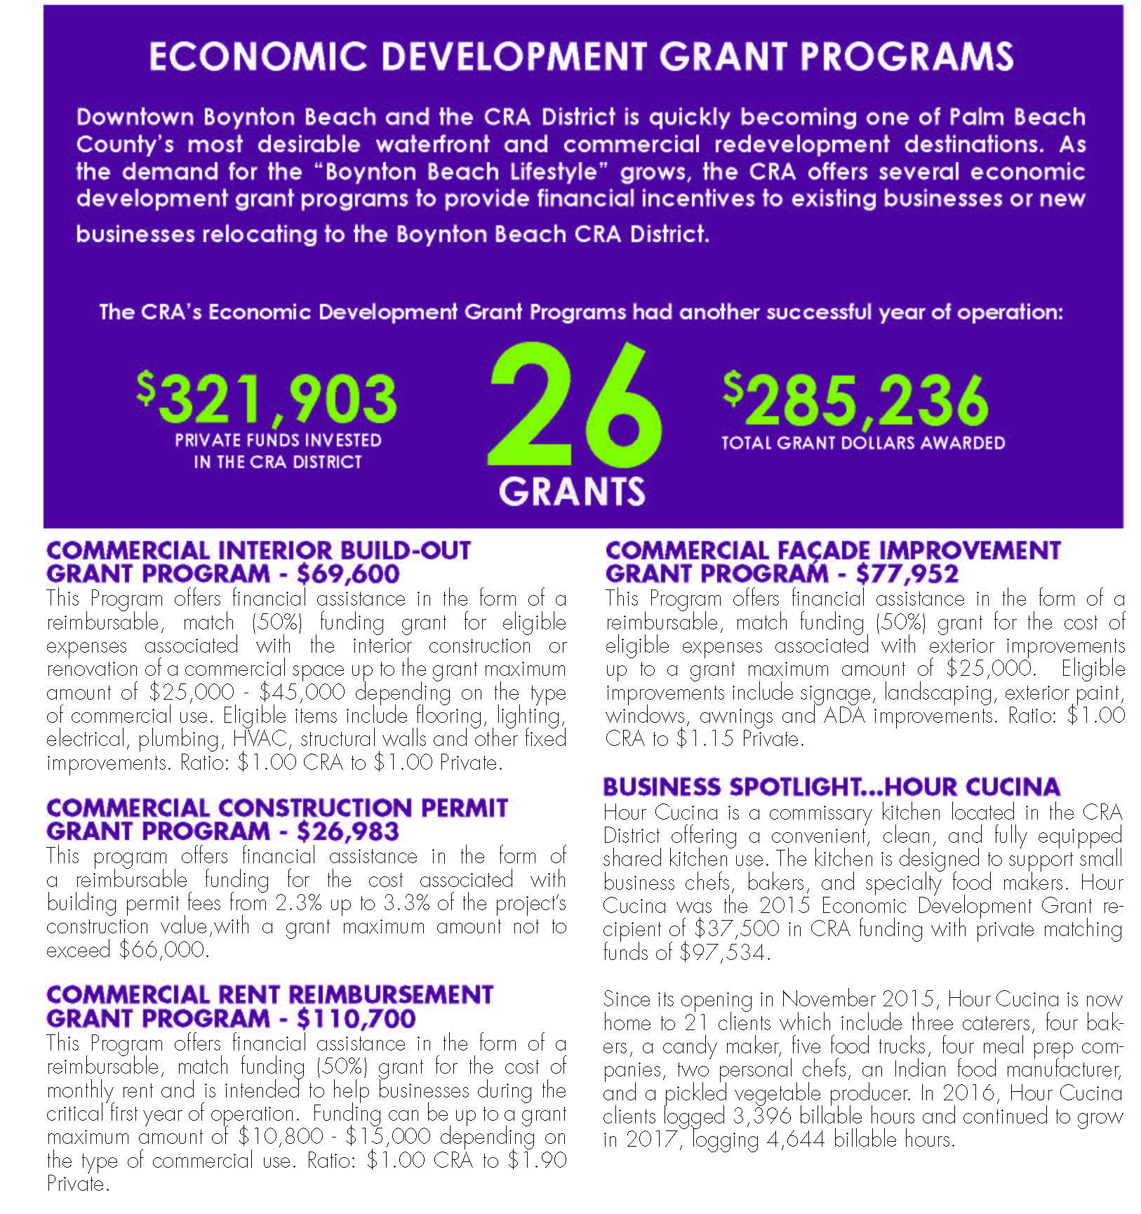
Changing the Community with Economic Development Grants

Slide 10
Economic Development InitiativesThrough Events

Slide 11
Community Planning & Investment

Slide 12
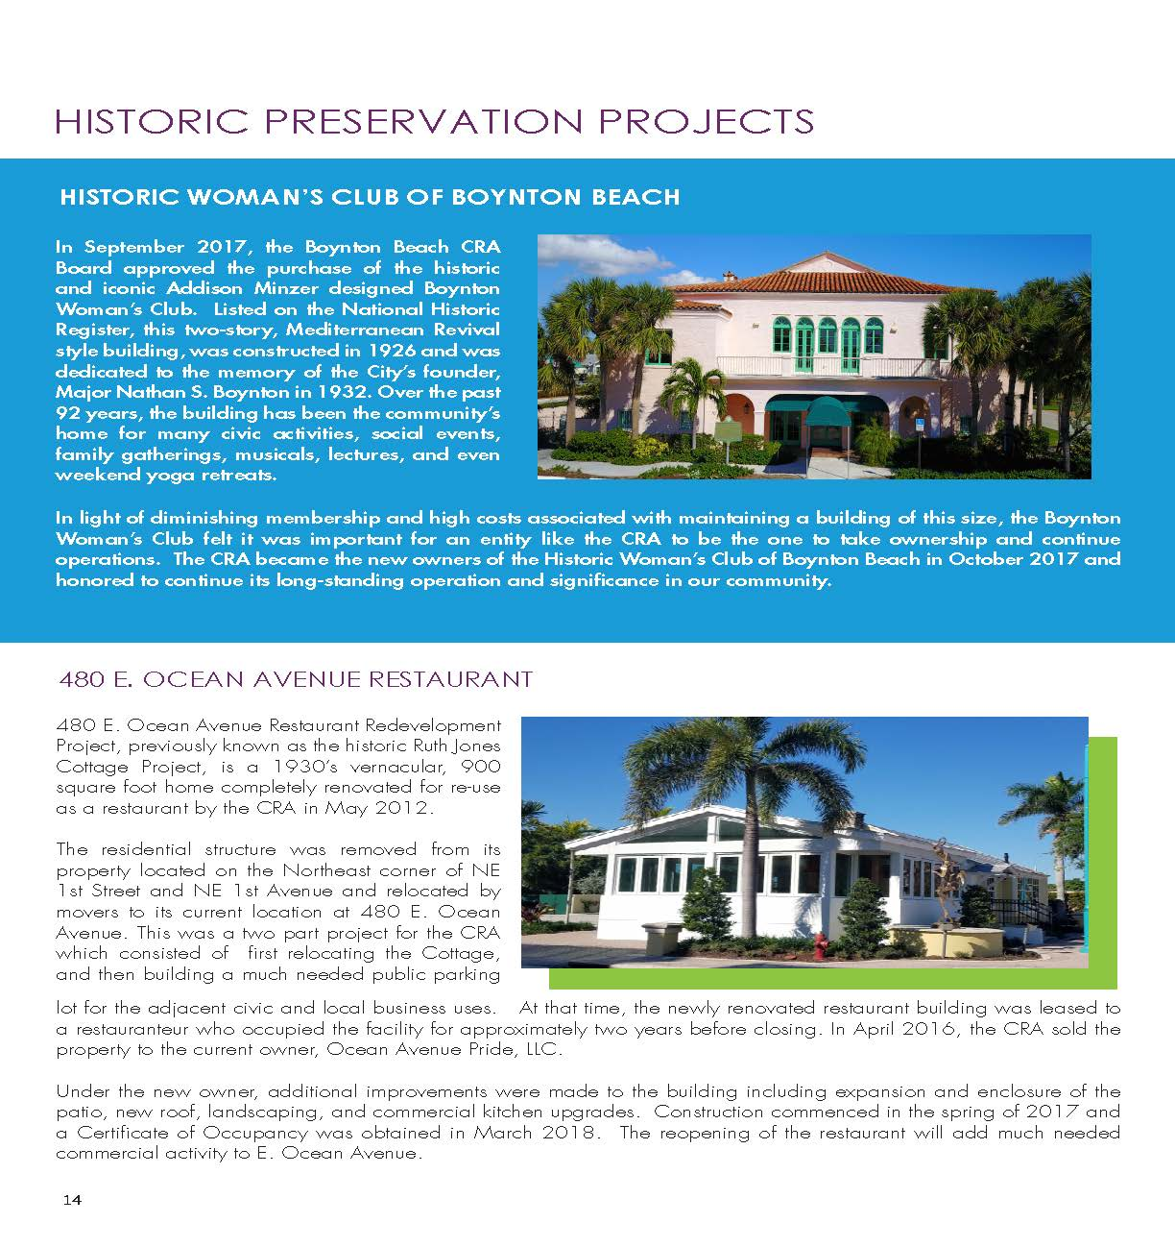
Historic Preservation

Slide 13
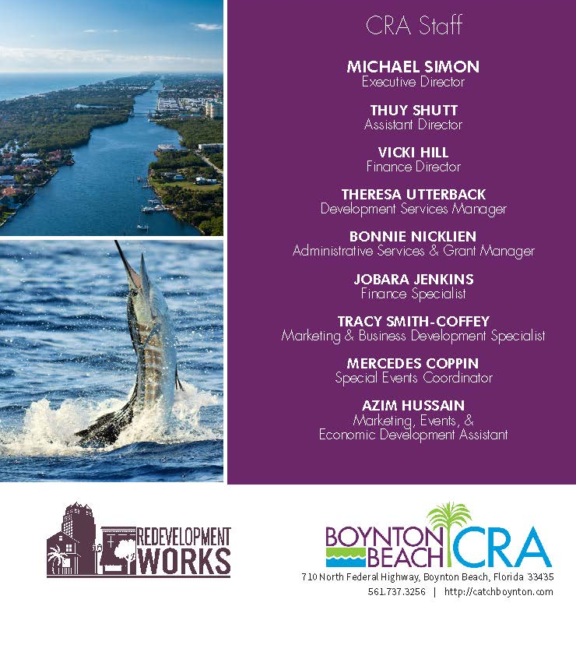
Boynton Beach CRA Making it Happen

