Slide 1
Hillsborough County Historic Preservation Challenge Grant Program
July 2018
Sample Projects

Slide 2
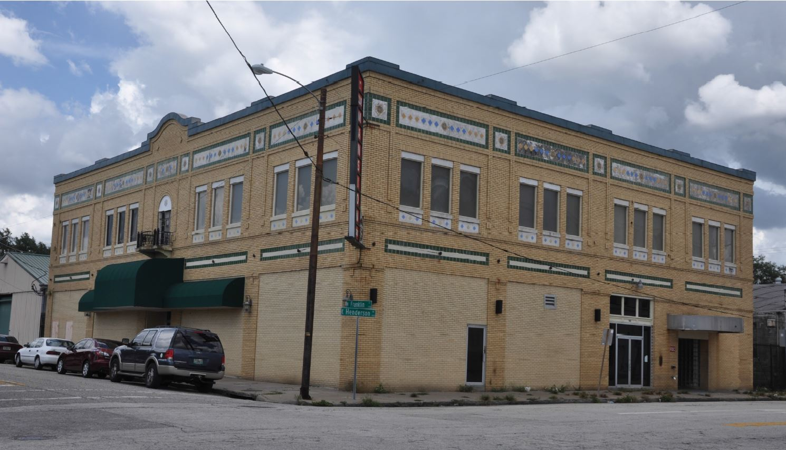
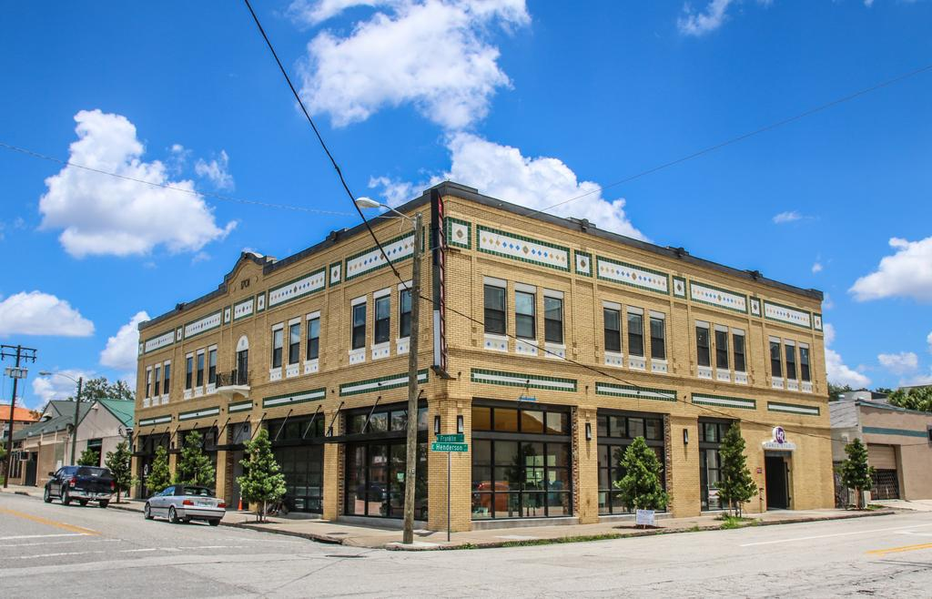
Fariss Building
Tampa, Florida
Franklin Food Hall Project

Slide 3
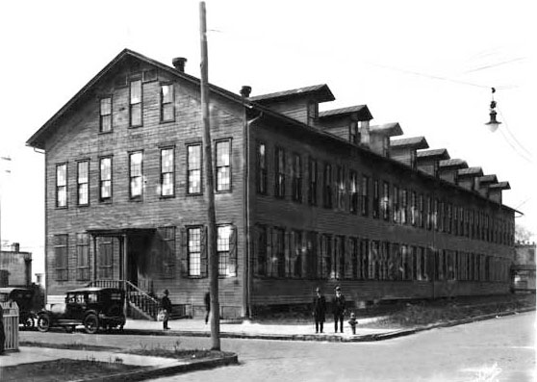
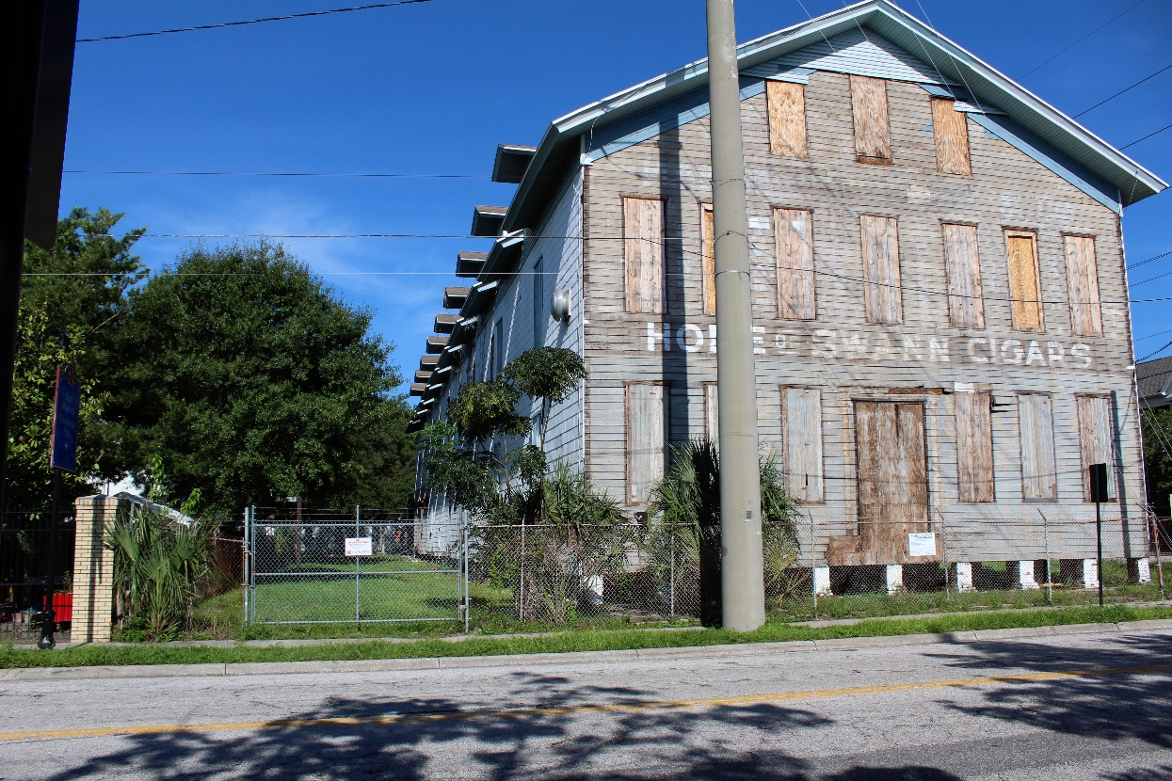
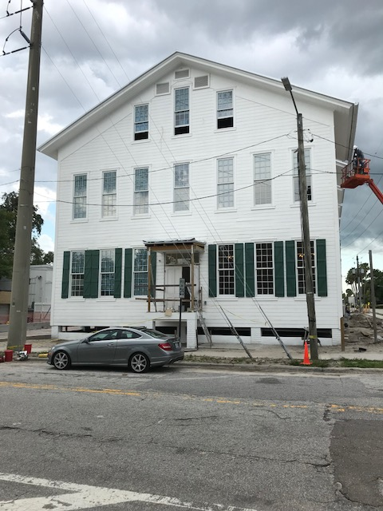
Oliva Cigar Factory
Ybor City, Florida
Multi-family Housing Project

Slide 4
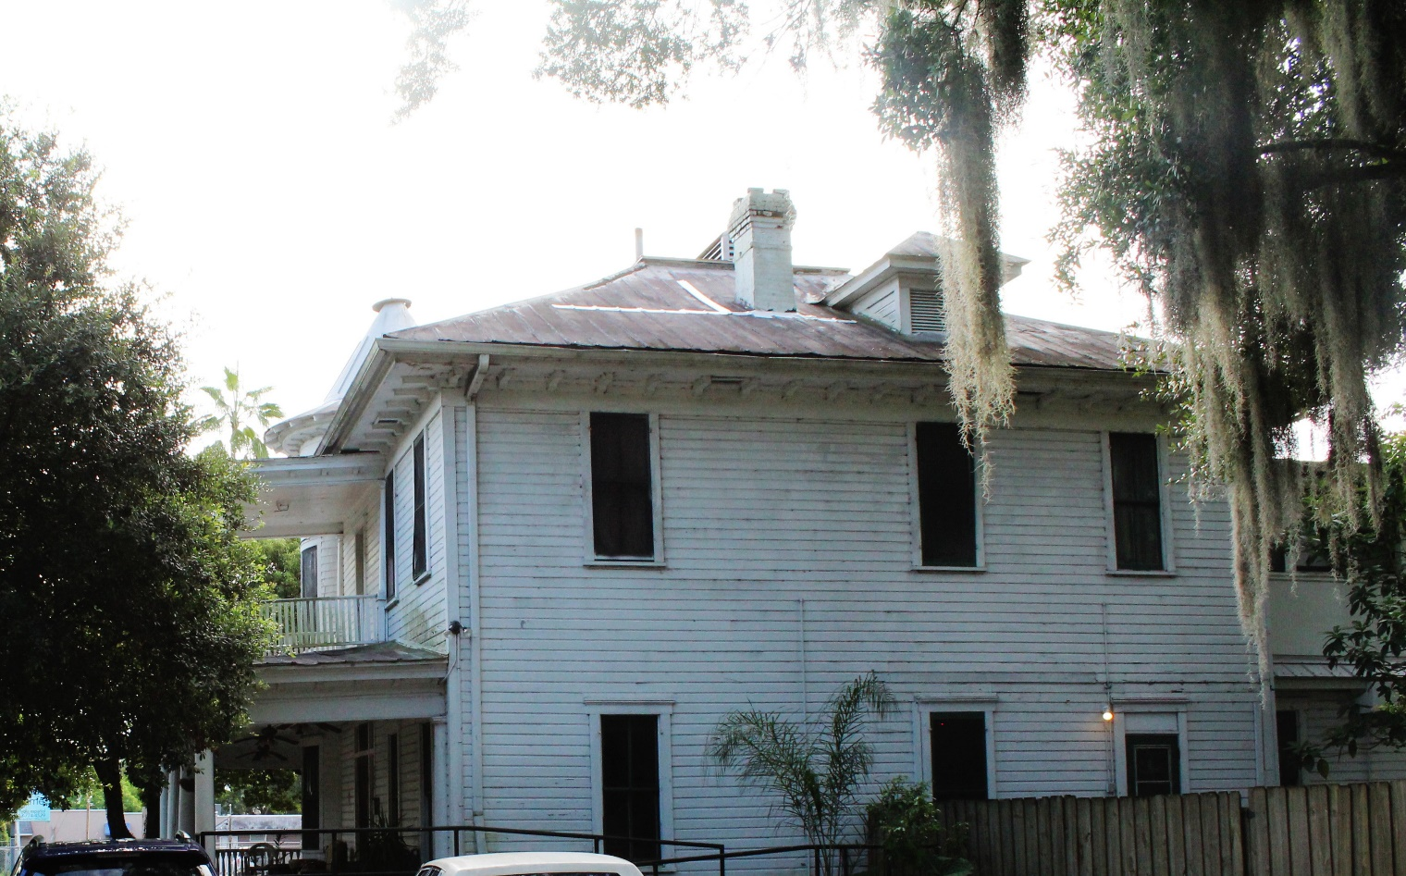
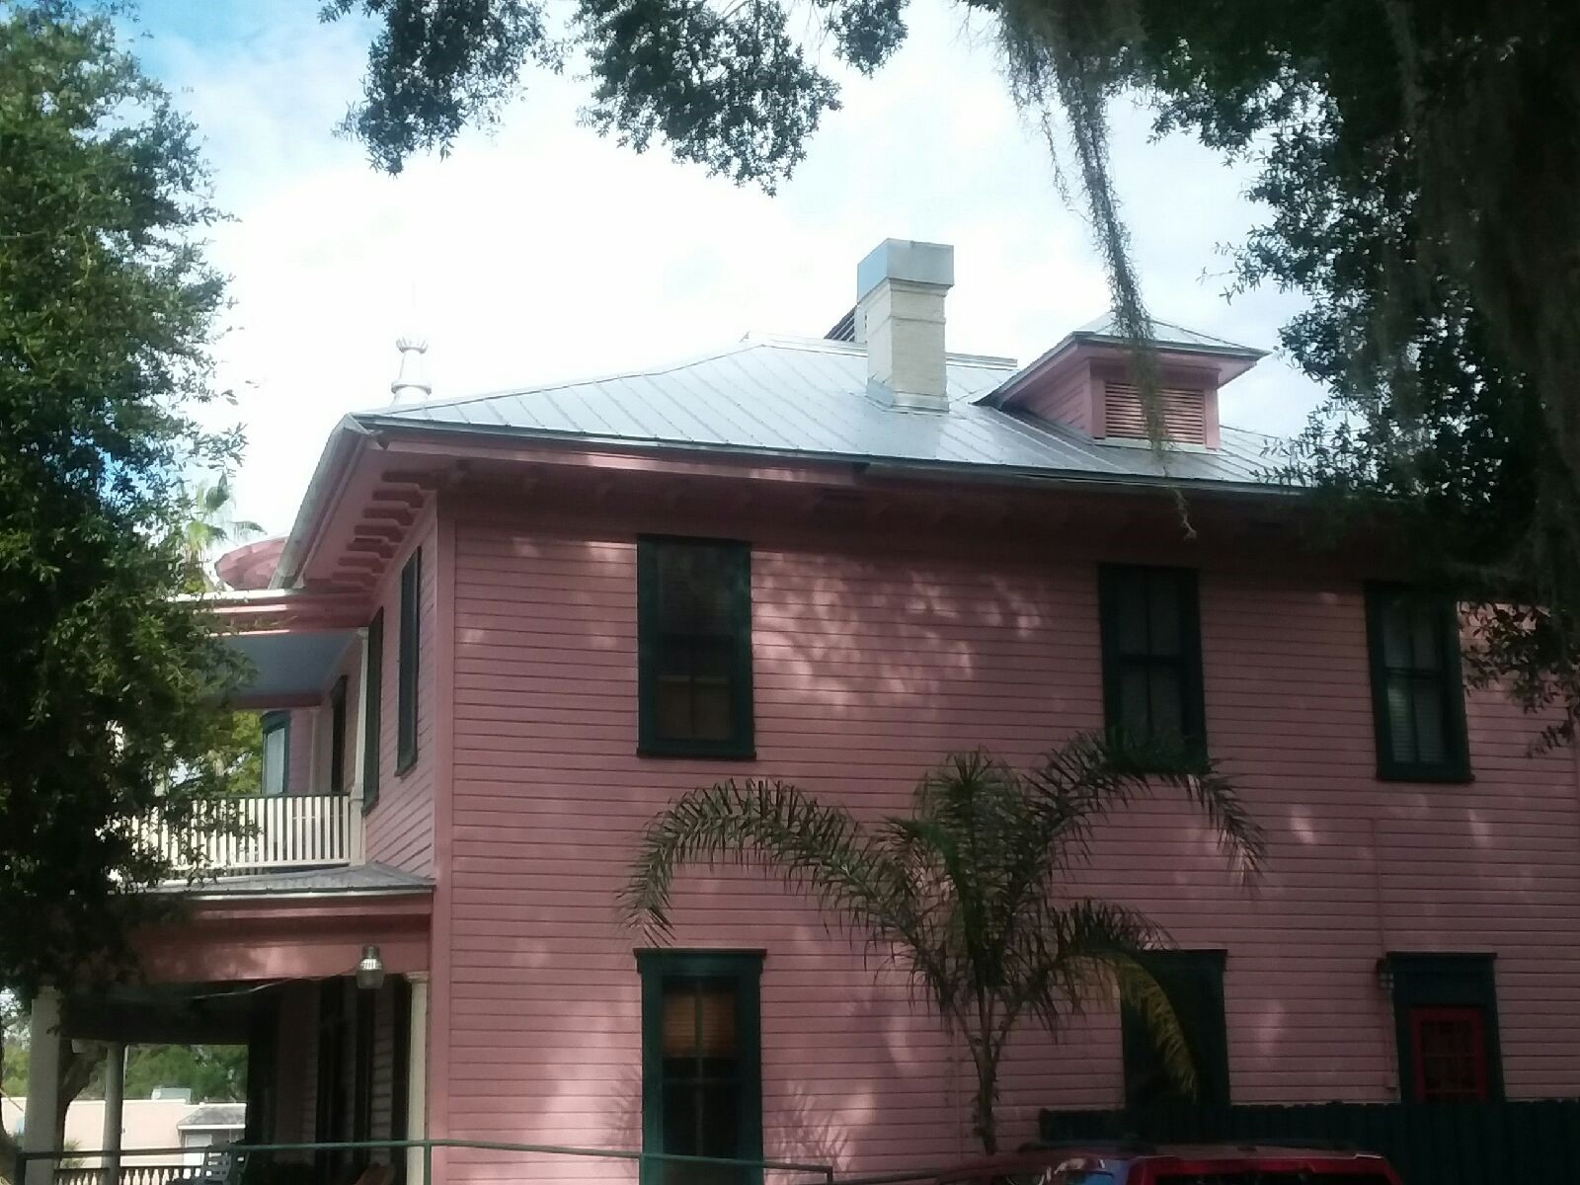
Rose Manor
Tampa, Florida
Group Home Facility

Slide 5
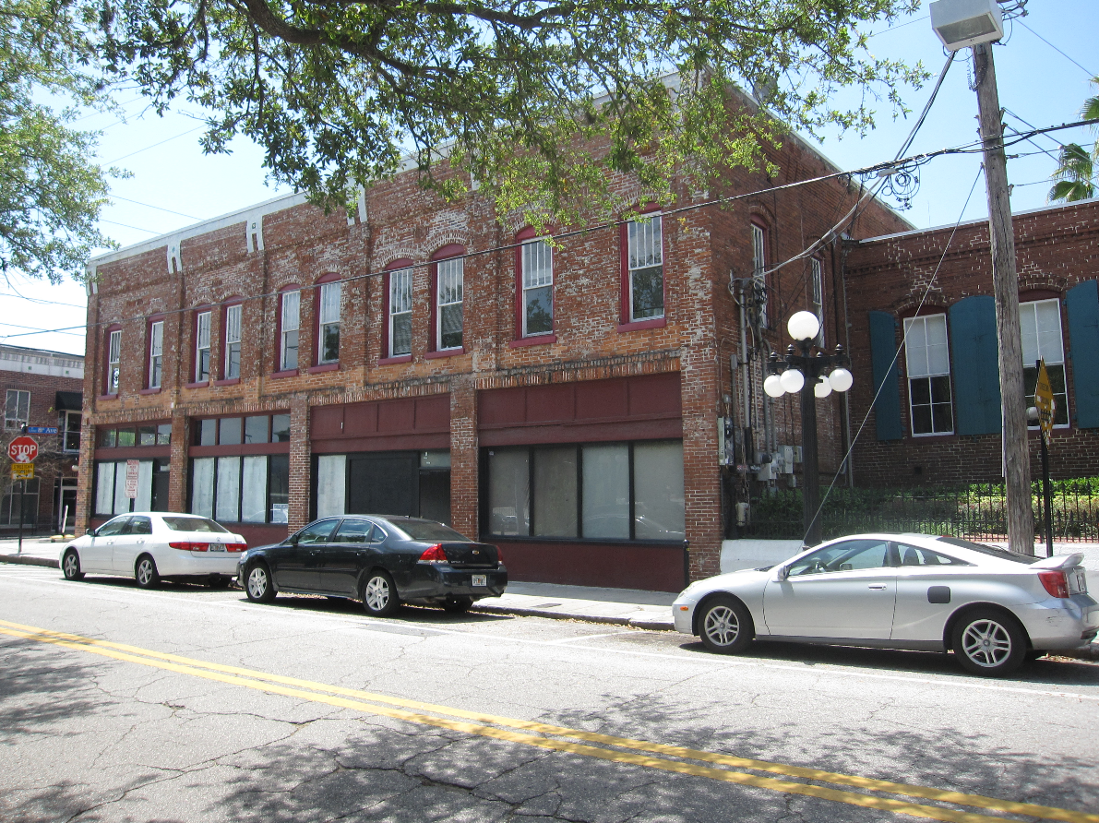
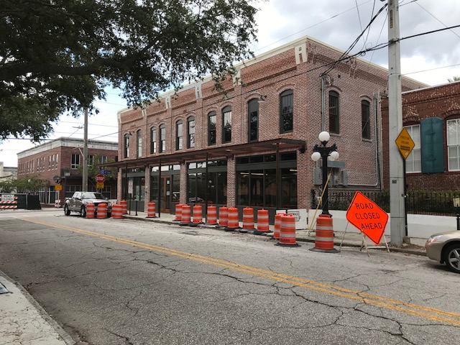
VM Cigar Factory
Ybor City, Florida
Commercial Office
Building Projects

