Slide 1
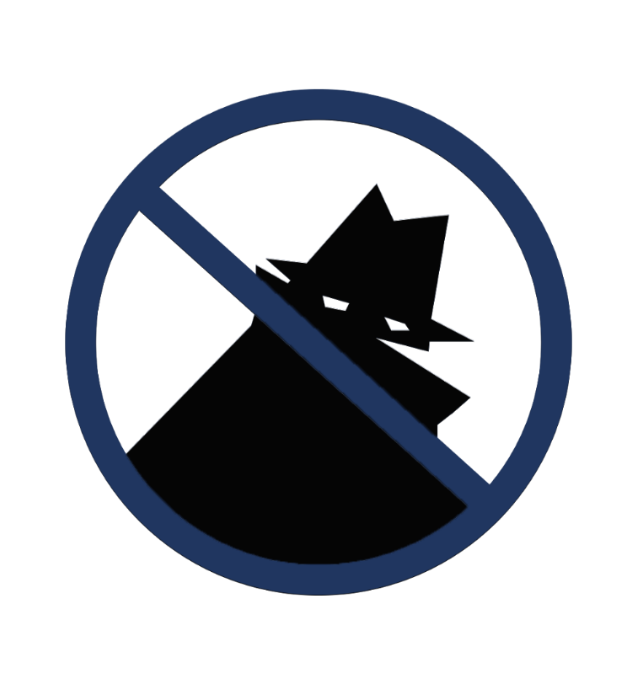
Riviera Beach CRA
Clean and Safe
NEIGHBORHOOD
WATCH PROGRAM

Slide 2
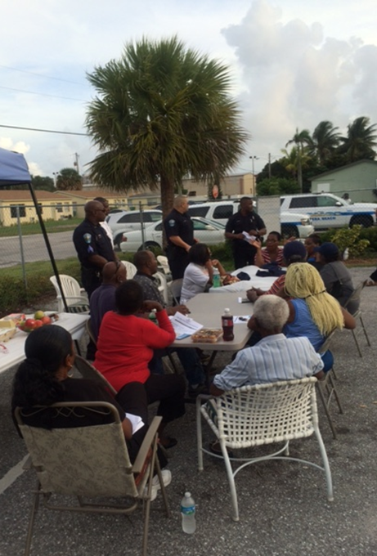
What is Neighborhood Watch?
Neighborhood Watch is a crime prevention program that enlists the active participation of residents in cooperation with law enforcement to reduce crime, solve problems, and improve the quality of life in your neighborhood.

Slide 3
Why Neighborhood Watch?
It works: throughout the country dramatic decreases
in burglary and related offenses are reported by law
enforcement in the communities with neighborhood
watch programs.
Neighborhood watch also help build pride and
serves as a springboard to address other community concerns such as recreation for youths, child care,
and affordable housing.

Slide 4
What is the Goal of the
Neighborhood Watch Program?
To help prevent crime in the community

Slide 5
The Benefits of a
Neighborhood Watch Program
Unites the community and increases
neighborhood cohesion
Reduces fear of crime in the community
Improves crime reporting by citizens
Prevents and reduces crime
Creates a stronger partnership between
the residents and law enforcement

Slide 6
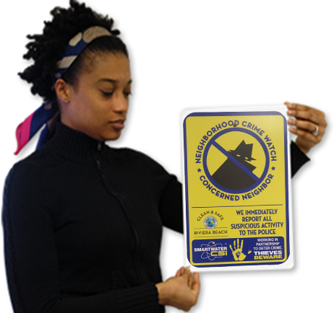
Neighborhood Watch Program
Neighborhood Watch Informational Meetings
Block Captains Overview Training
Issue Uniforms
Schedule monthly Neighborhood Watch meetings

Slide 7
Neighborhood Watch Meeting

Slide 8
Neighborhood Watch
Captains Responsibilities
Relay information to members
Recruits senior and youth
Convenes and chairs block meetings
Recruits newcomers
Help identify block problems and arranges to fix them

Slide 9
Qualities of a Block Captain
Will sustain the effort
Conduct meeting effectively
and efficiently
Get along well with people
and listen constructively
Have a long-term vision of
neighborhood and community
improvement
Use good communication
and negotiating skills
See the position as a civic duty,
not a power trip or a chance
for personal gain
Will delegate tasks

Slide 10
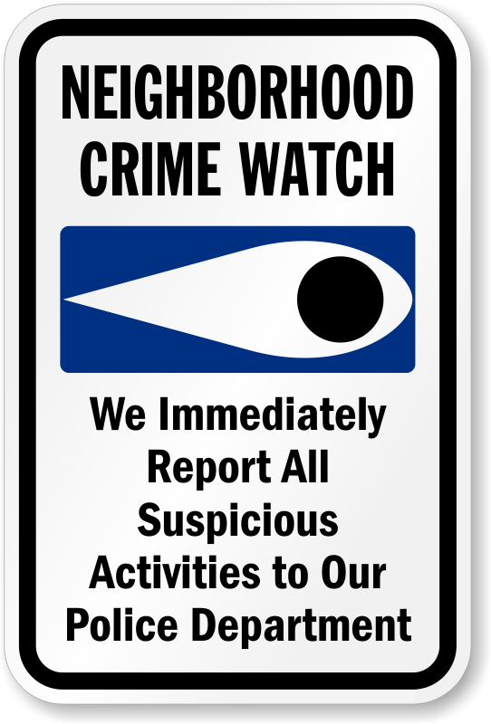
Duties and Responsibilities of
Neighborhood Watch Members
Establish a strong Neighborhood
Watch program
Hold monthly meetings
Conduct nightly neighborhood patrols

Slide 11
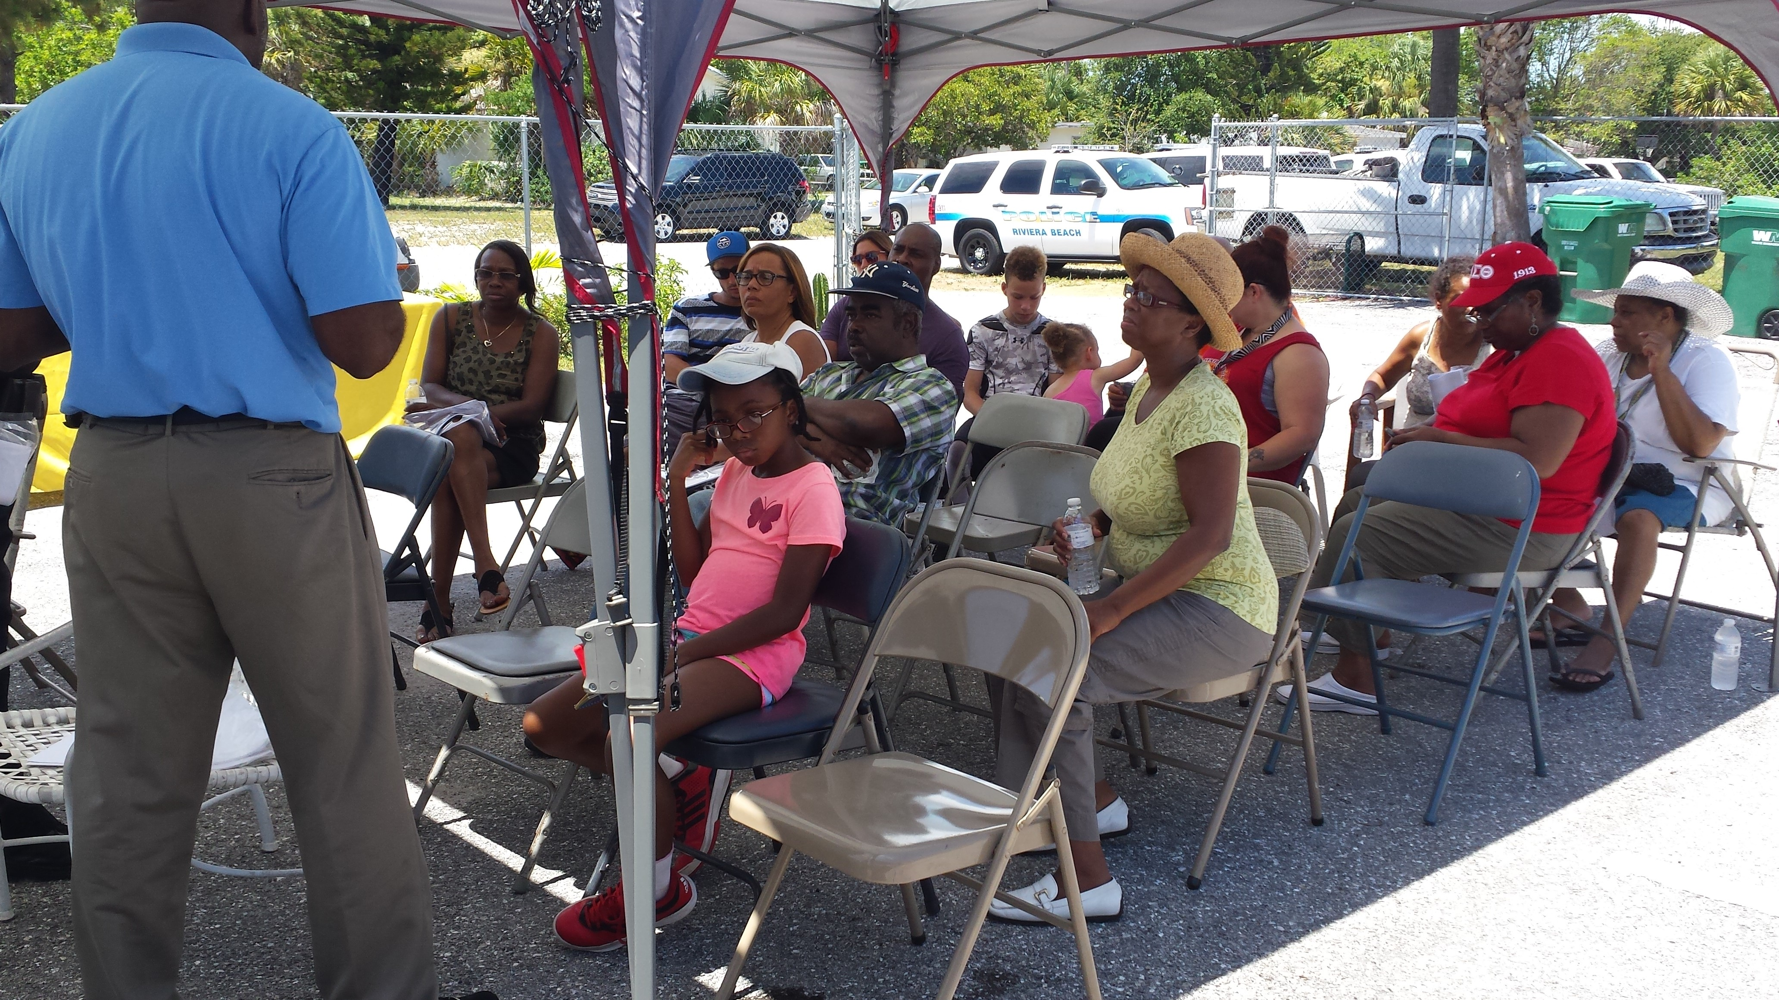
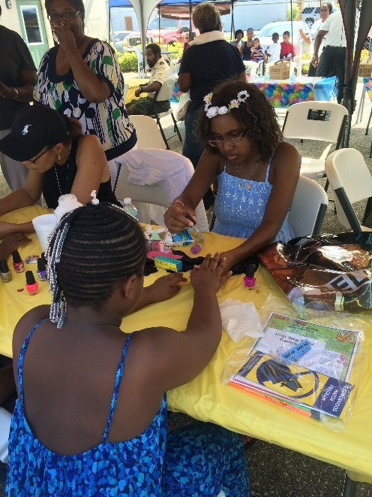
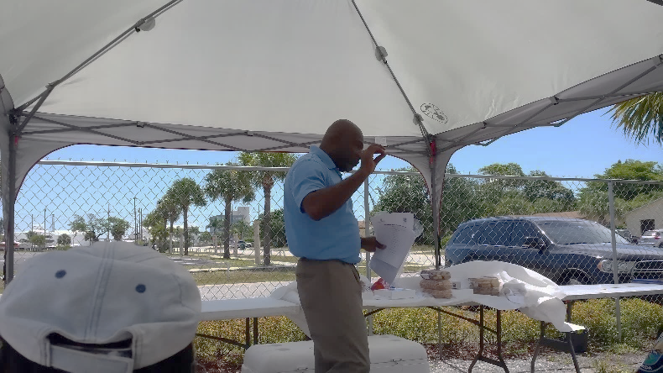
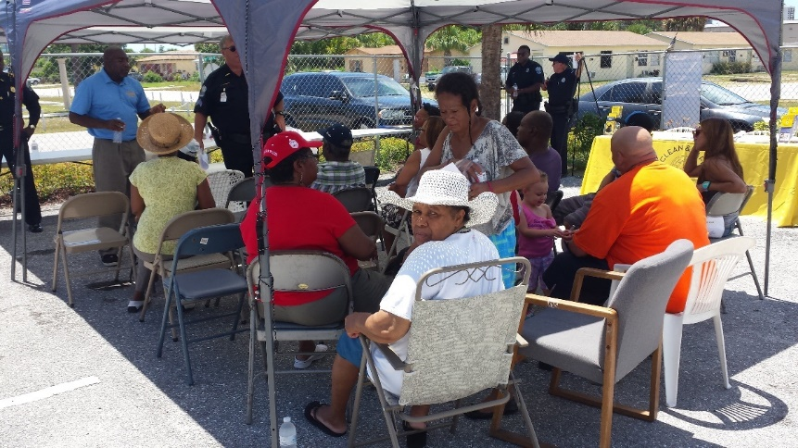
Build Participation
Every neighborhood resident
can help
Young children can pick up litter
and take part in specialized
child safety programs
Youth can teach younger children
how to stay safe
Seniors can observe from their
homes and make phone calls
Everyone should have a
responsibility, be it small or large

Slide 12
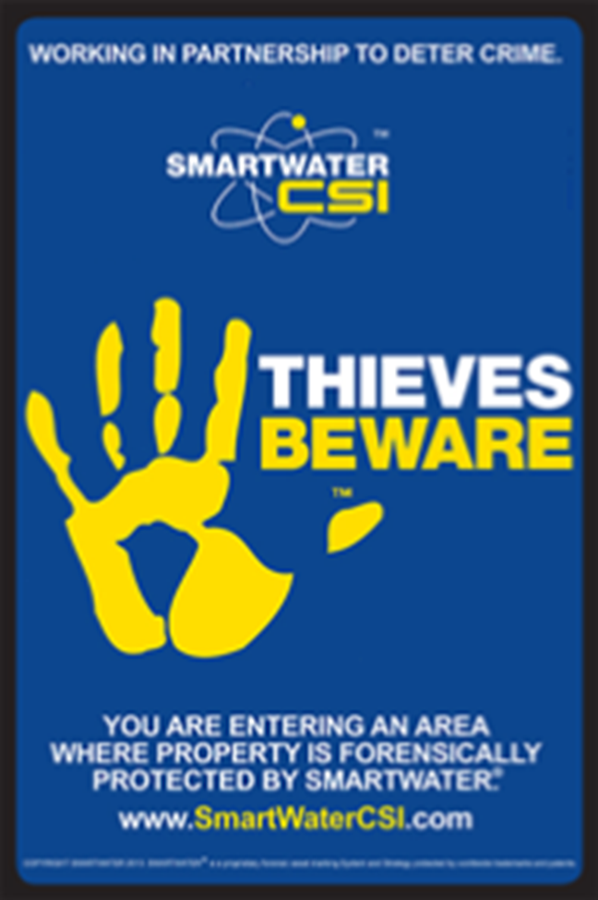
SMARTWATER™ CSI
Smart Water™ is a traceable liquid applied to deter theft and identify offenders for prosecution.
The non-hazardous liquid leaves a long lasting and
unique identifier that is invisible to the naked eye
except under an ultraviolet light.
This crime prevention tool has proven to reduce
burglaries and robberies in neighborhoods.
Posted watch signs at neighborhood entry points.

Slide 13
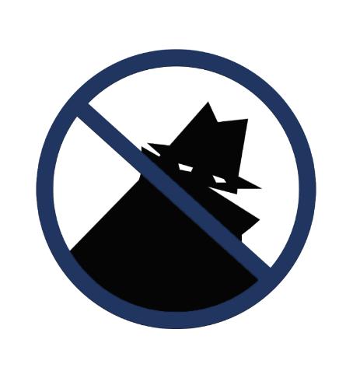
Conclusion
The Neighborhood Watch program will be
solely run by the citizens. However, the Clean and Safe program has a partnership with the Riviera Beach police department that will help set up the program and give guidance when
needed. This strategy gives the community
the confidence to prevent and/or eliminate
crime while building a stronger community.
Overall, starting a Neighborhood Watch
program is a great idea in any neighborhood.
Not only does it have a positive result on
crime reduction, but it also helps neighbors
build strong relationships and more importantly, it gives residents a sense of community pride.
NEIGHBORHOOD
WATCH PROGRAM

