Slide 2
SPONSORS

Slide 3
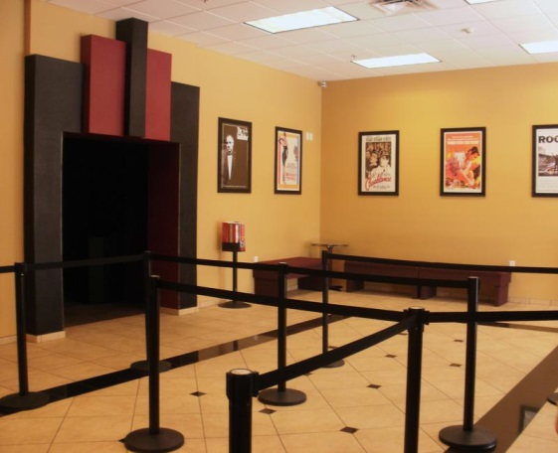
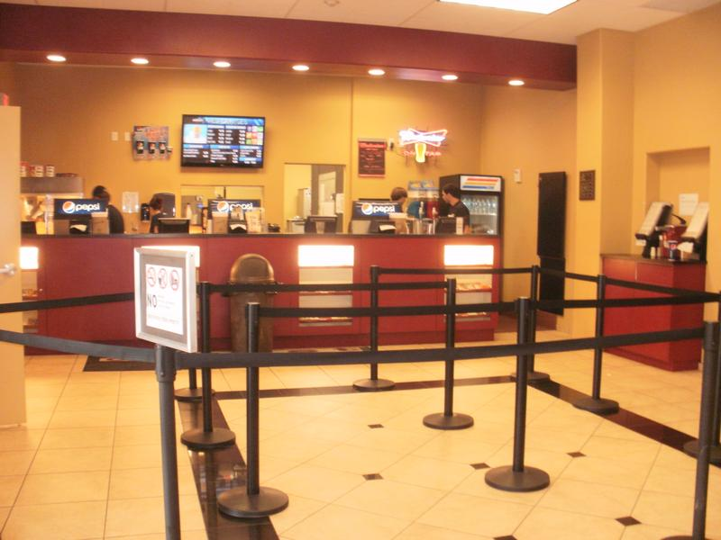
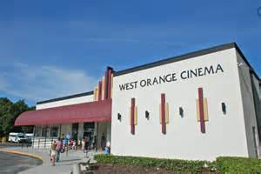
WHERE THE ACTION HAPPENS
The West Orange Cinema was one of the first successful CRA supported projects in Ocoee. It was renovated in 2012.
The West Orange Cinema welcomed CENFLO and all its aspiring artists in 2009.
CENFLO and the West Orange Cinema promote the Ocoee CRA and businesses all year round.
This community icon serves meals, beer, wine, and draws from a 20 mile radius.

Slide 4
ON THE MAP
The West Orange Cinema is conveniently located off of Highway 50 in Ocoee’s CRA in Orange County, Florida.
We are here

Slide 5
2016 STATS
LENGTH OF FESTIVAL: THREE-DAY EVENT
TOTAL ATTENDEES: 2,227
HOTEL ROOMS BOOKED: 163
(Rooms booked at Ocoee’s Fairfield Inn & Suites and Red Roof Inn)
ATTENDING FILMMAKERS: 51
FOREIGN FILMMAKERS REPRESENTING ELEVEN COUNTRIES
CENFLO’s ANNUAL BUDGET: $40,000

Slide 6
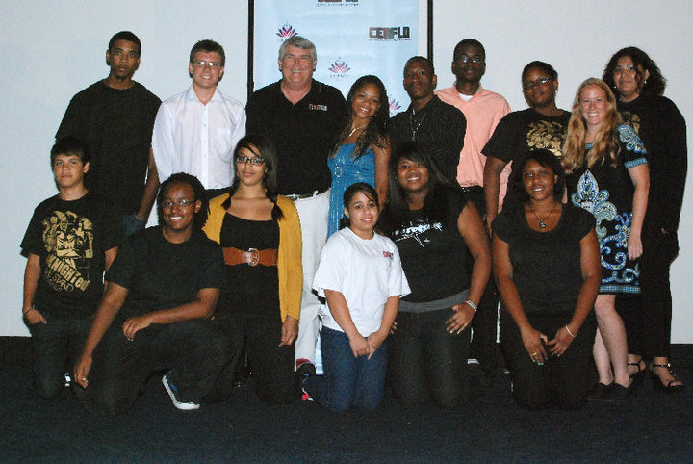
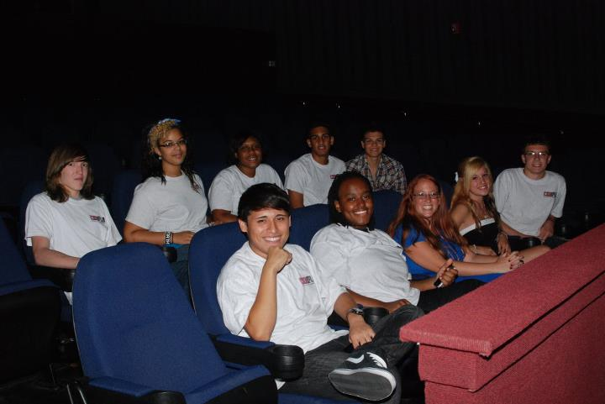
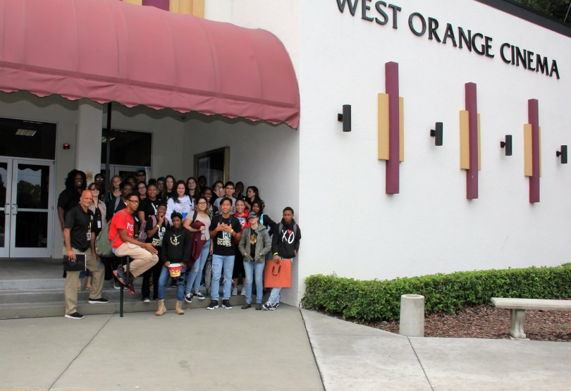
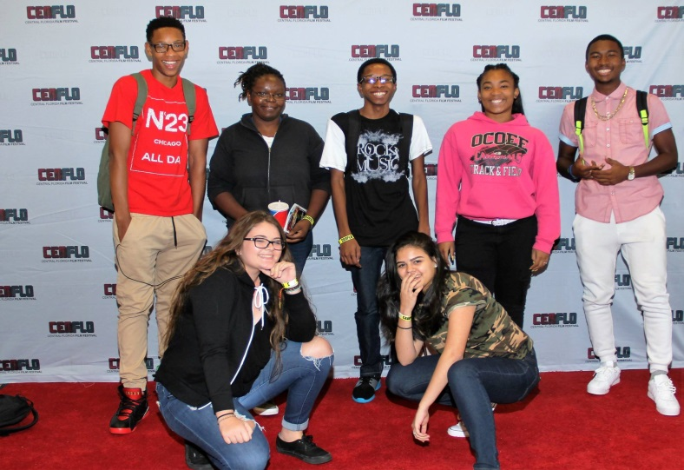
STUDENTS MAKING A DIFFERENCE
Ocoee High School TV/Film students volunteer their time at CENFLO

Slide 7
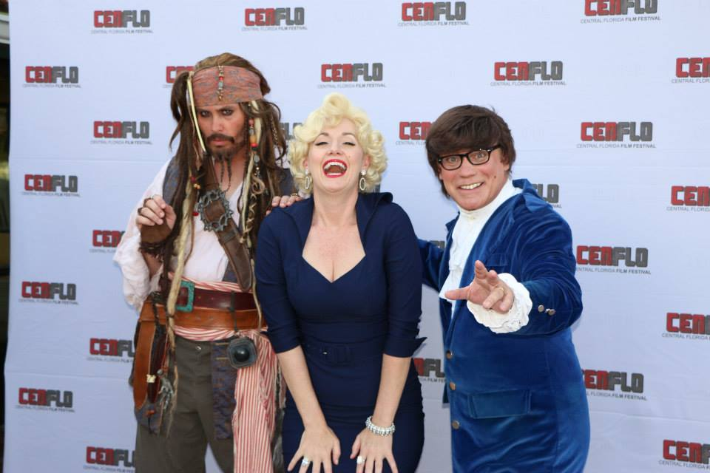
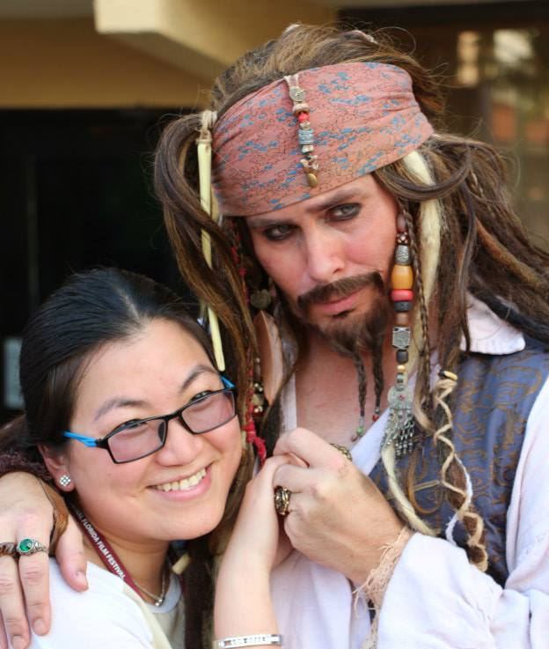
IS THAT WHO I THINK IT IS?
Several enthusiasts reach within and bring to life their favorite movie icon and then join us at CENFLO.
IT’S YOUR DAY TO BE A STAR!

Slide 8
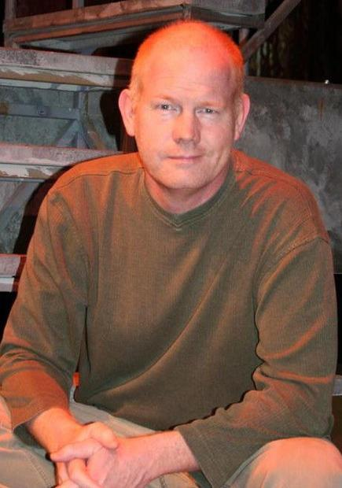
CELEBRITY APPEARANCES
A popular aspect of CENFLO is its Q&A with filmmakers and actors. Among those who have made an appearance include John Ashton and Lisa Eilbacher from the classic 80’s film Beverly Hills Cop, and Glenn Morshower from Transformers: Dark of the Moon and the Netflix Original Series: Bloodline.
Glenn Morshower
John Ashton and
Lisa Eilbacher

Slide 9
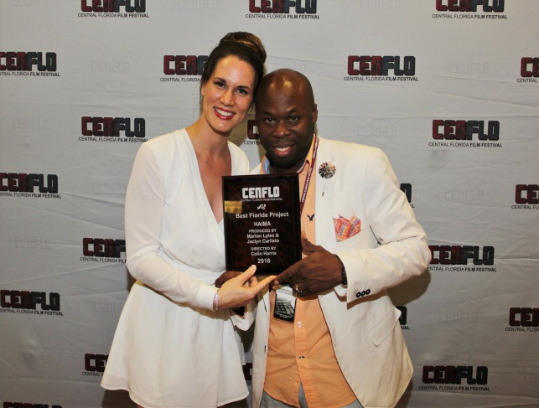
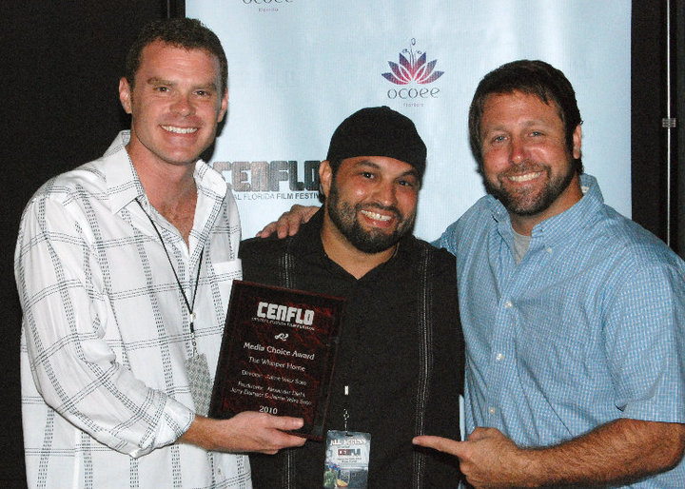
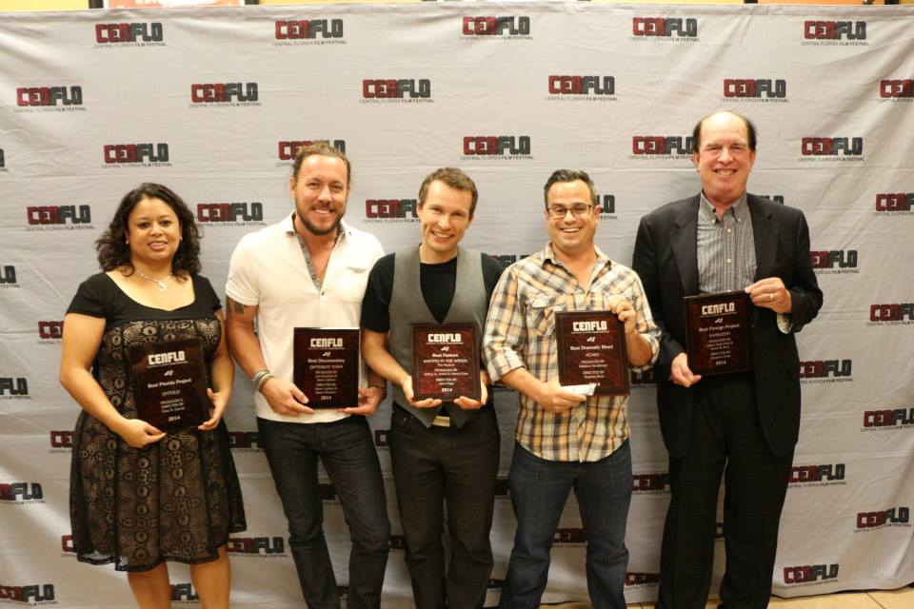
AWARDS
Today is your day!
Over the years, many talented individuals have received awards recognizing their outstanding accomplishments.

Slide 10
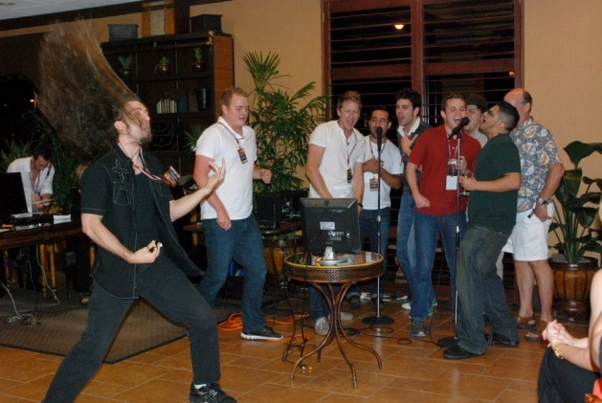
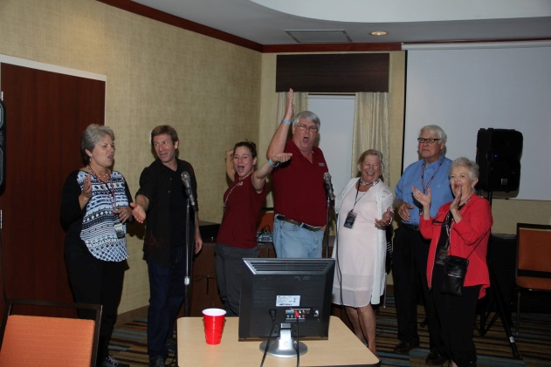
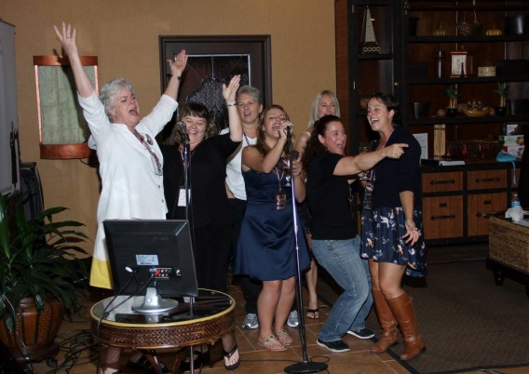
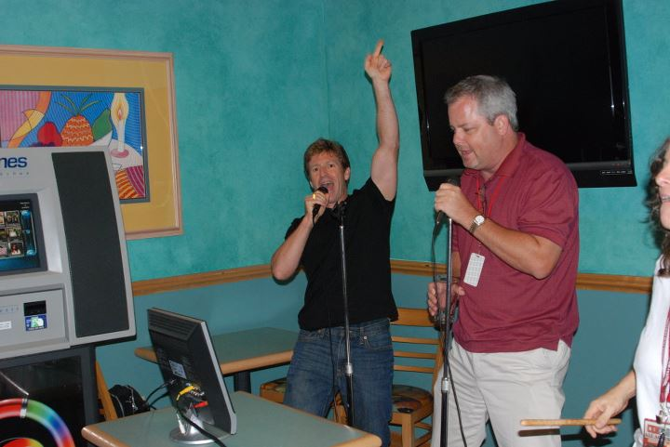
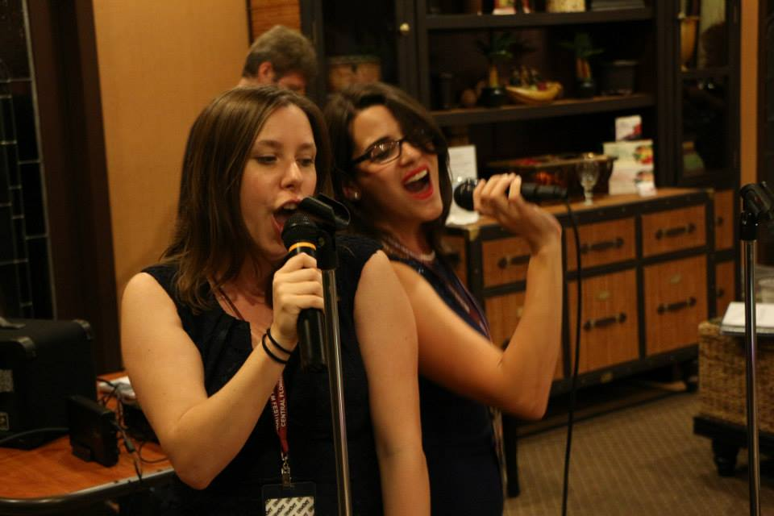
KARAOKE ANYONE?
Film fans get vocal at one of Ocoee’s local hotels for evening karaoke.

Slide 11
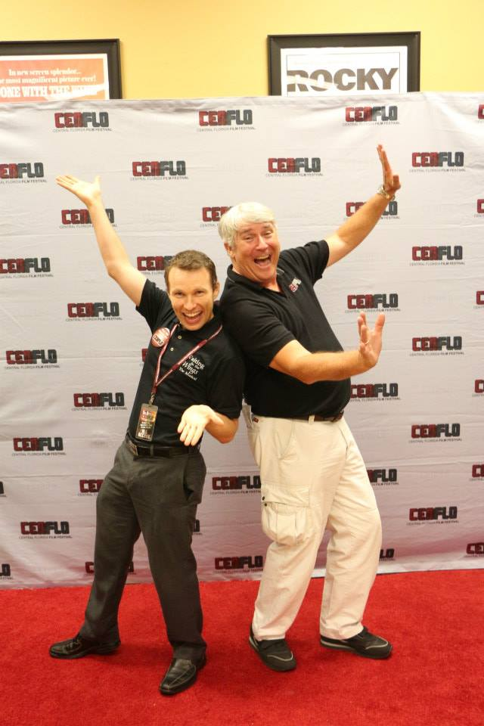
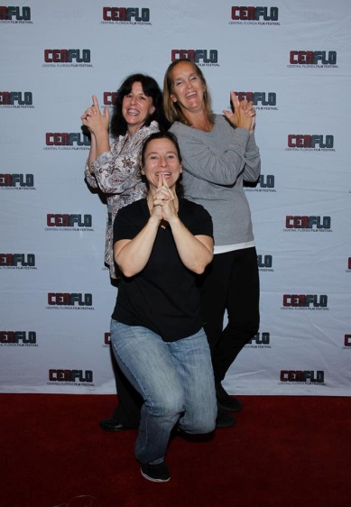
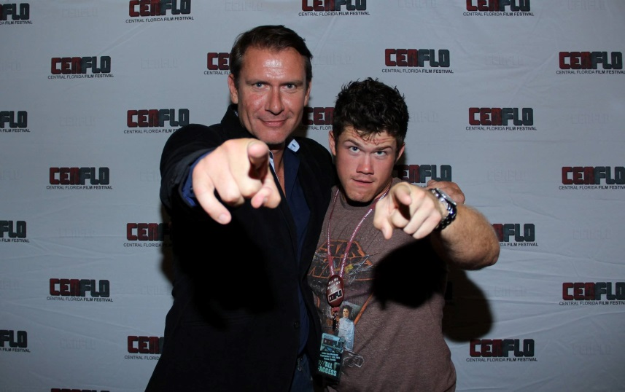
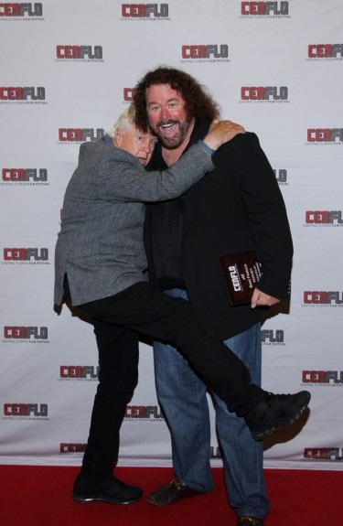
RED CARPET FUN
The red carpet at CENFLO has brought a smile to so many faces. Now it’s calling your name.

