Slide 1
Pompano Beach Downtown Innovation District

Slide 2
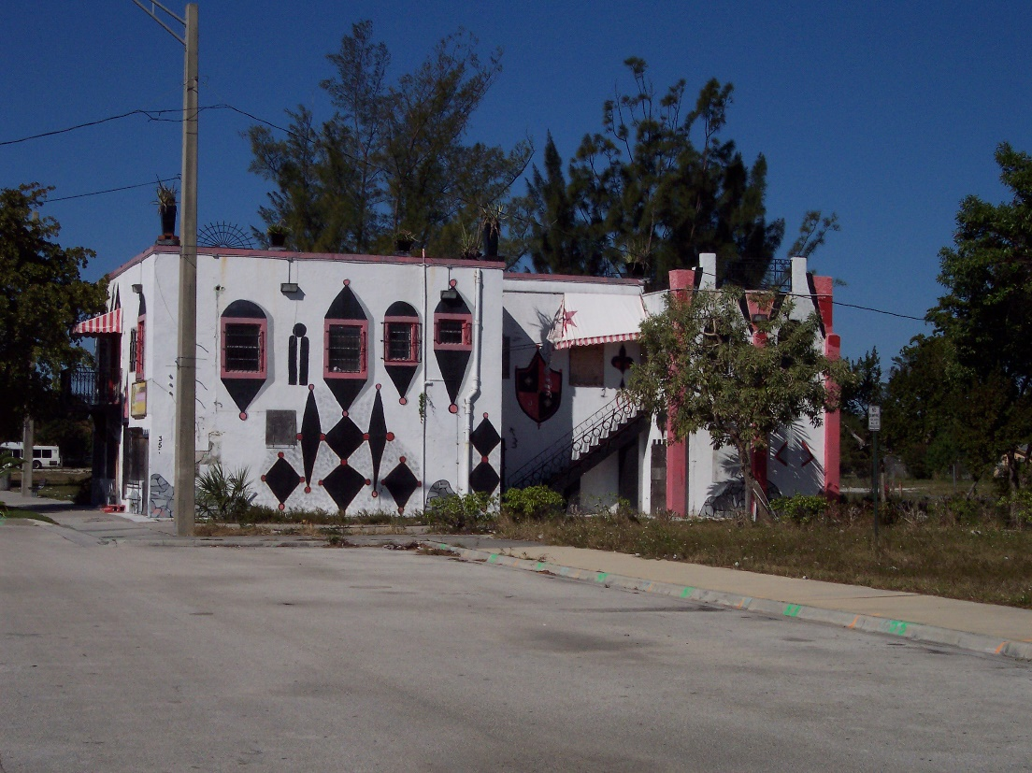
Before: Ali Building

Slide 3
After: Ali Cultural Arts

Slide 4
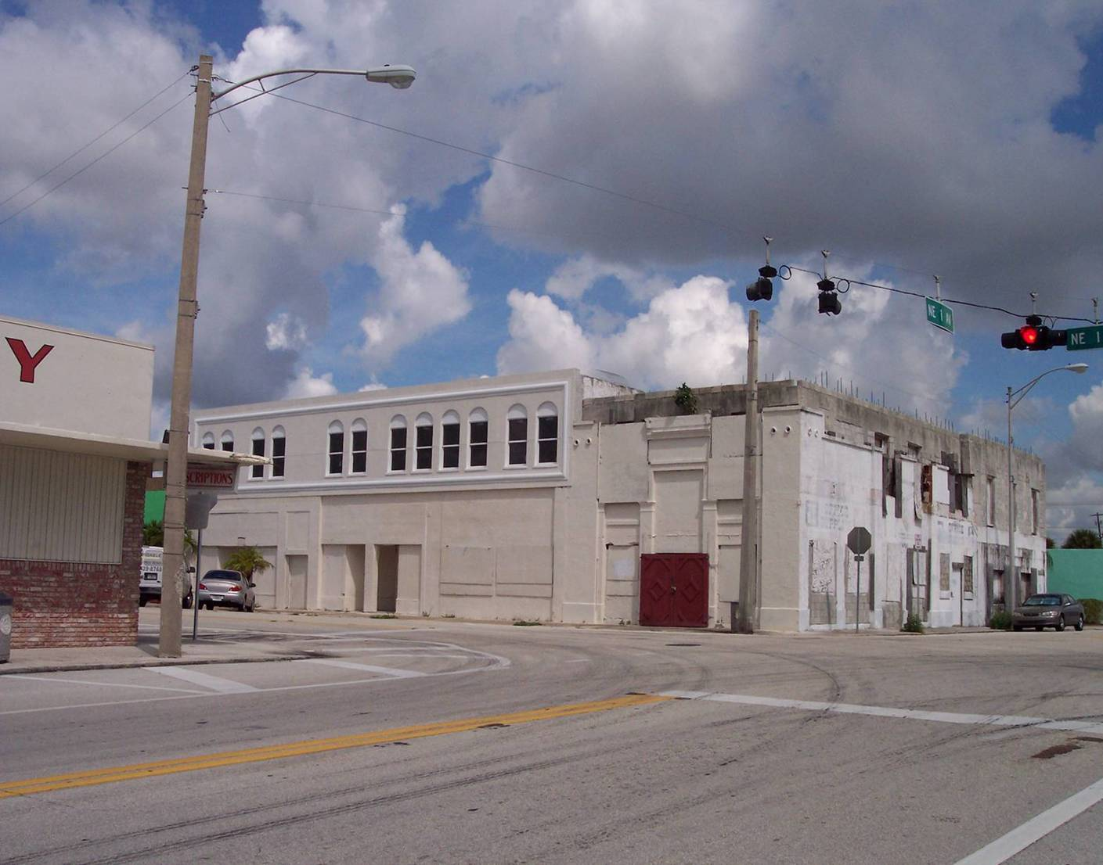
Before: Bailey Hotel

Slide 5
After: Bailey Contemporary Arts

Slide 6
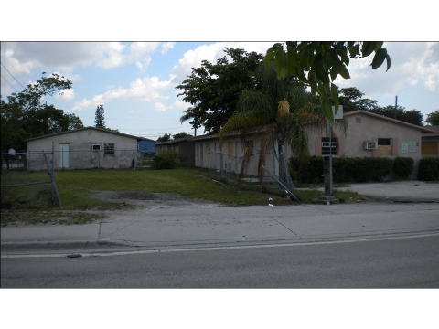
Before: 731 MLK Blvd

Slide 7
After: 731 MLK Blvd Retail Shops

Slide 8
Before: MLK Blvd

Slide 9
After: MLK Blvd Streetscape

Slide 10
Pompano Beach Economic Assets and the strategic location of the Downtown Innovation District

Slide 11
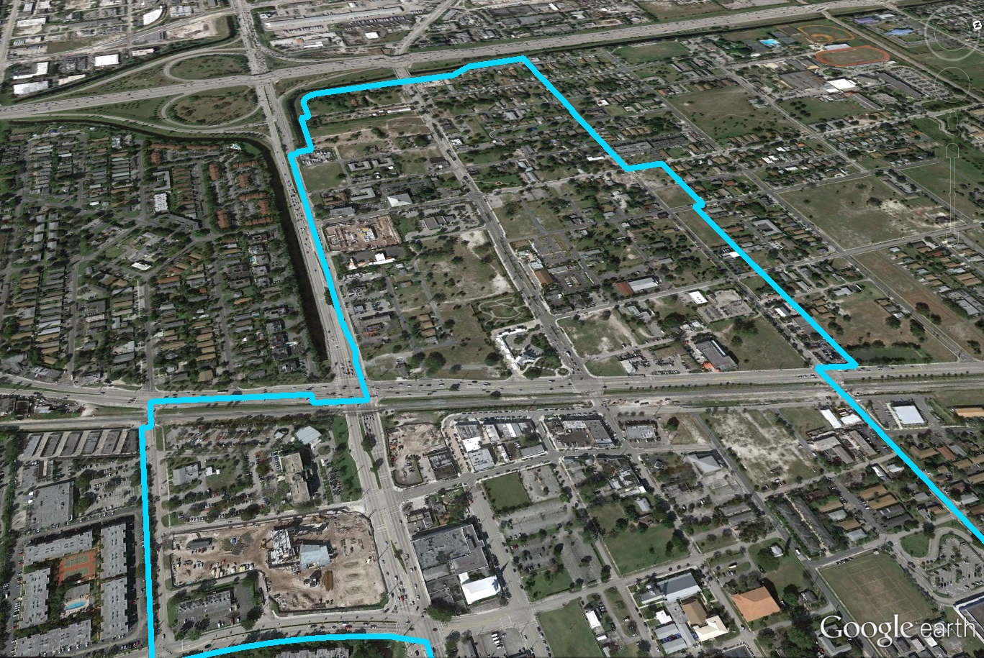
Downtown Innovation District Transportation Connections
I-95
MLK Blvd
Atlantic Blvd
Dixie Highway

Slide 12
Pompano Beach Downtown Innovation District Completed Projects and Proposed Riverwalk Drainage System

Slide 13
Pompano Beach Downtown Master Plan

