Slide 1
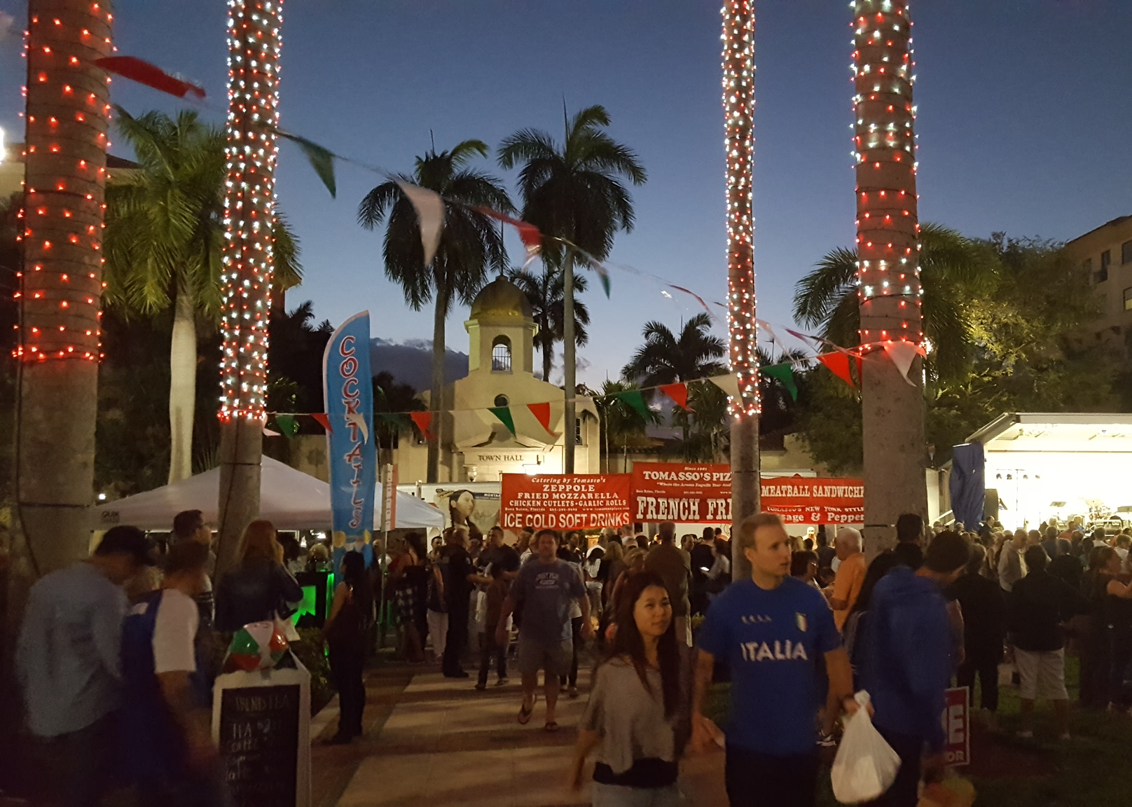

Slide 2
Italian Fest
The Boca Raton Community Redevelopment Agency (CRA) continually strives to attract local and regional area consumers to our downtown district to enjoy quality dining, shopping, services and events. The recent opening of multiple residential buildings and a hotel downtown heightened the need to develop additional programming for the district, worthy of its new prominence within the City of Boca Raton, Palm Beach County and south east Florida. The idea for the event was conceived in 2016 and adjustments to the debut event resulted in Downtown Boca’s 2nd Annual Italian Fest in 2017. The improved event was an overwhelming success, with over 8,000 attendees. Guests arrived in Sanborn Square Park to sway to the music, dine well, dance the night away, enjoy wine samples, with free kids rides and experiences of a night in Italy – all right here in Downtown Boca!

Slide 3
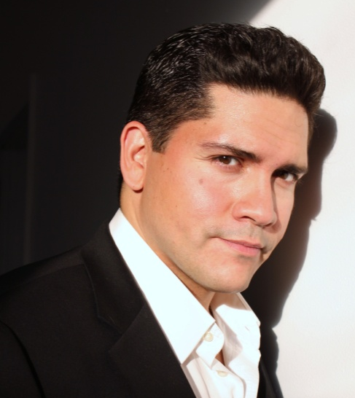
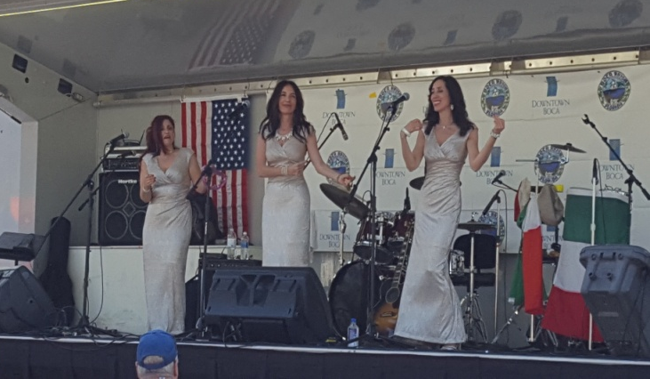
Live Entertainment
Italian Fest consisted of no less than 6 hours of live entertainment, specially arranged to feature an amazing array of Italian music and talented musicians. The highlight of the event, the musical acts engaged the audience, having them sing along to favorites and literally dance in the street, making everyone feel Italian that evening.
Aaron Caruso Italian Tenor & Singer
Tre Bella Harmony Girl Group

Slide 4
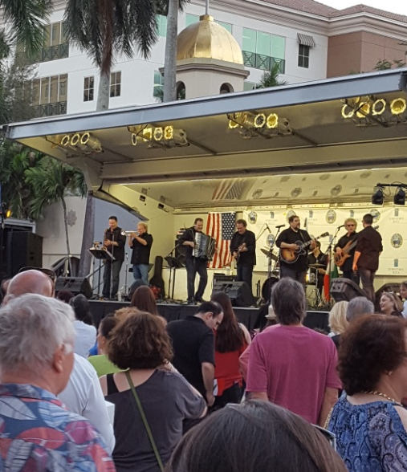
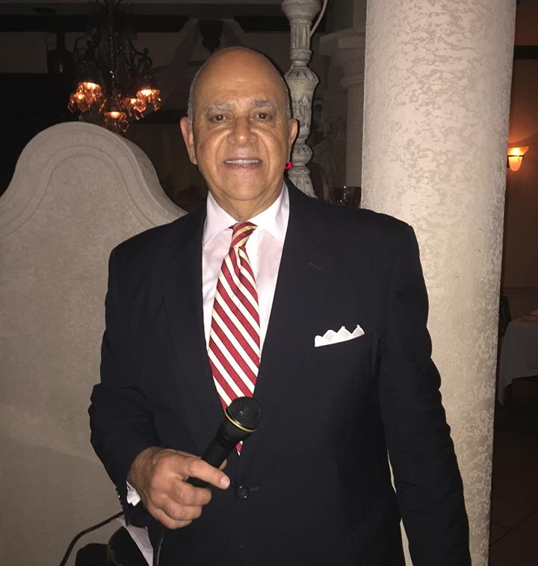
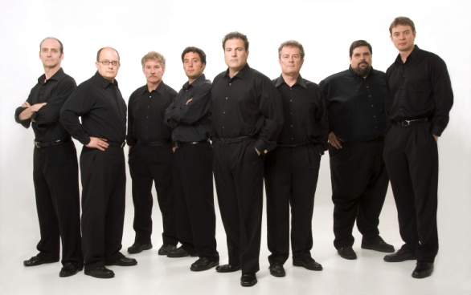
Live Entertainment
The CRA worked closely with a key member of the group Ray Massa’s EuroRhythms – Marco Capoccia – in securing the entertainment line-up. Marco’s ties to the local Italian American community proved to be invaluable in creating an authentic event.
Ray Massa’s EuroRhythms Italian American Band
Frank ‘Sinatra’ Todaro Sinatra Tribute Singer
Marco Capoccia!

Slide 5
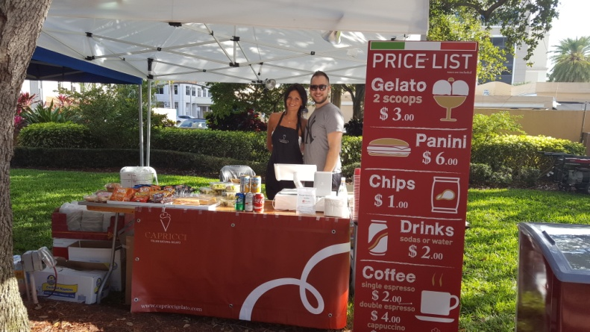
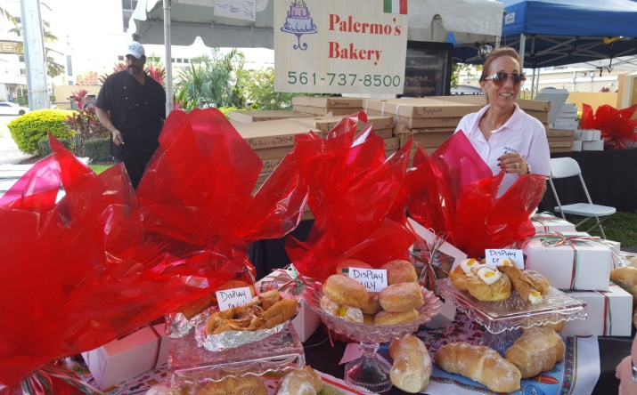
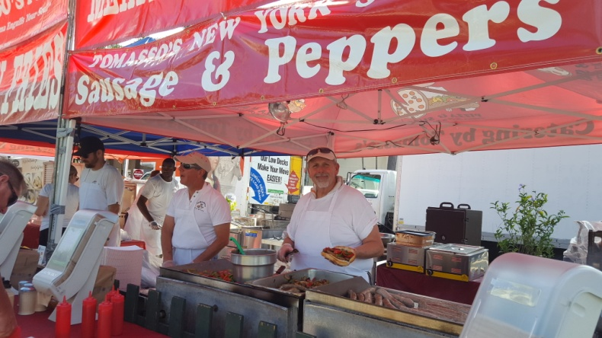
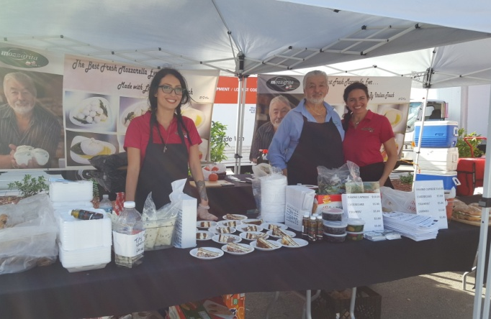
Business Community Involvement
One of the most important aspects of Italian Fest is the high level of involvement from our local business community – who all benefited greatly from exceptional event sales and exposure amongst thousands of potential customers.
Local Businesses with Presence at Italian Fest:
Capricci Gelato
Giuseppe Sausage
The Godmother’s
Mozzarita
Nipotis Bakery
Palmero’s Bakery
Potions in Motion
Tomasso’s Pizza
Trend Teas
Tucci’s Pizza

Slide 6
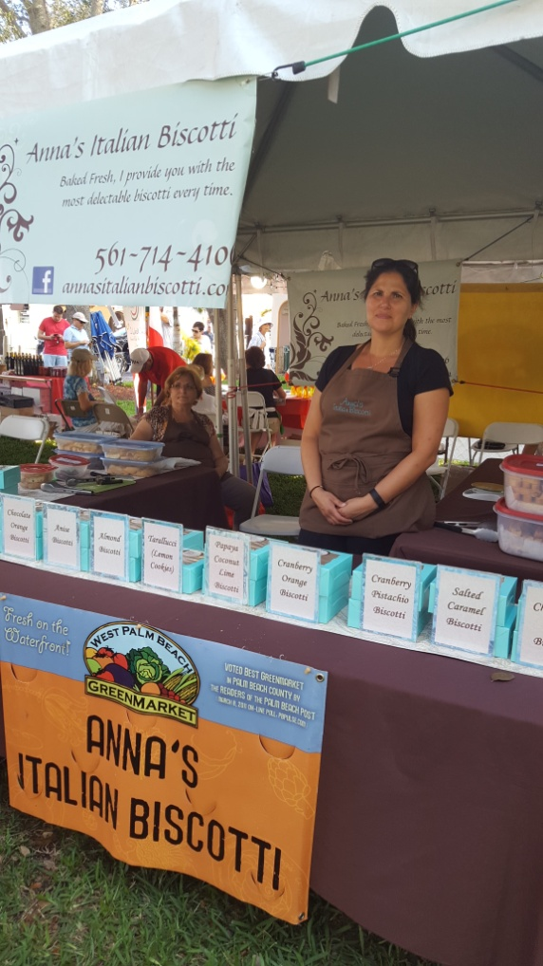
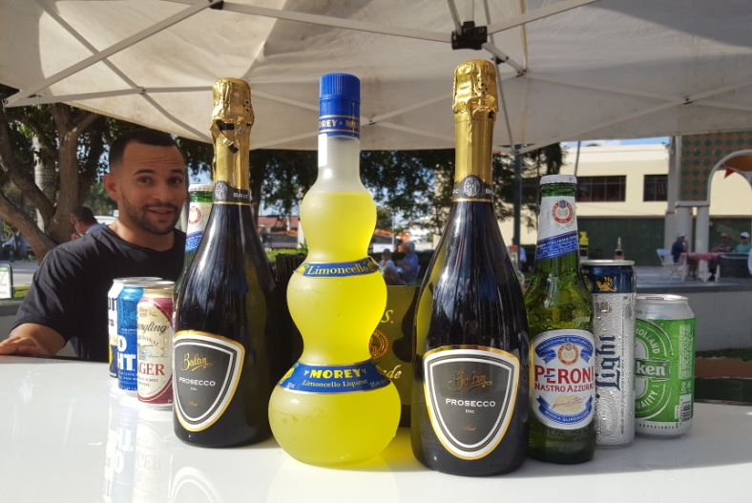
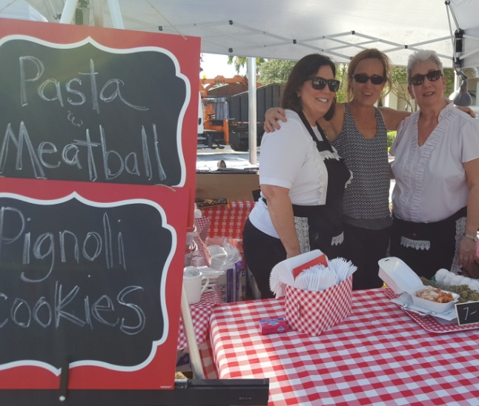
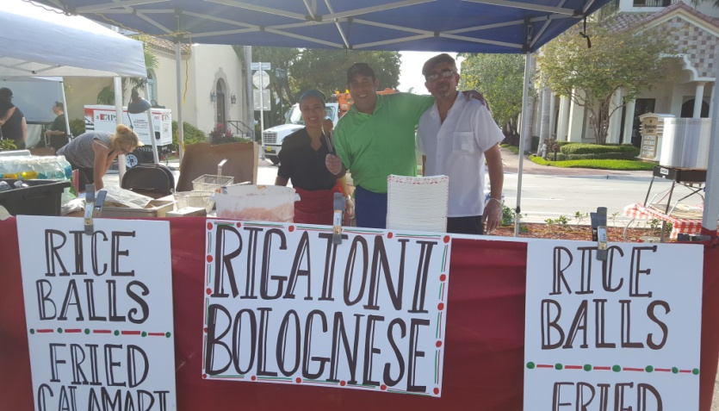
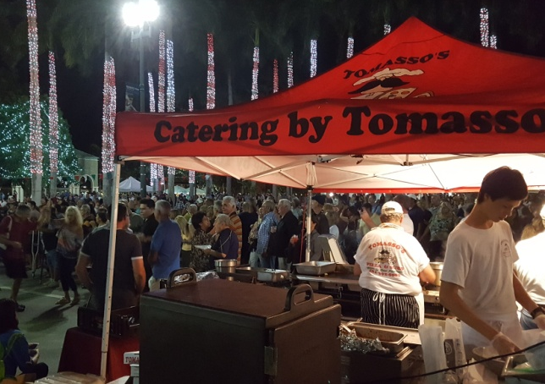
Business Community Involvement

Slide 7
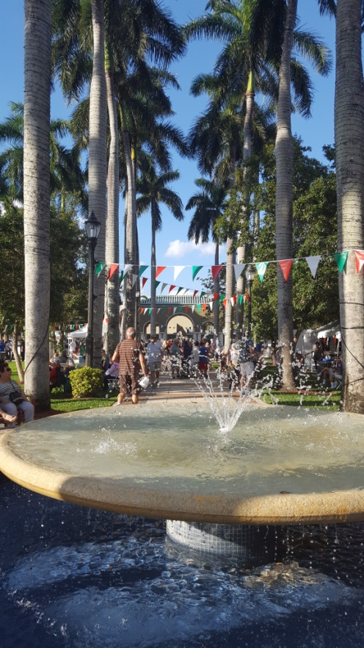
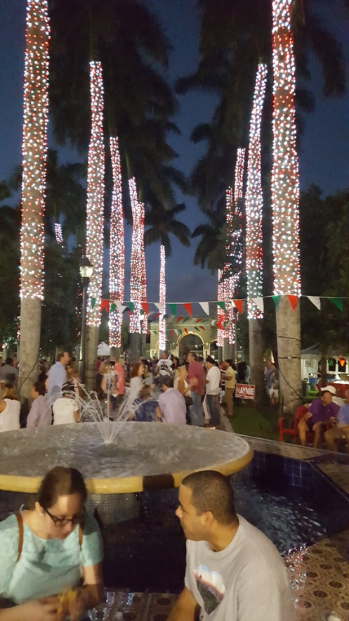
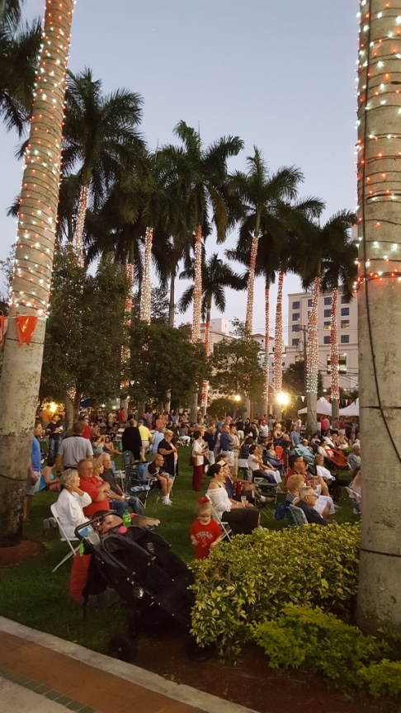
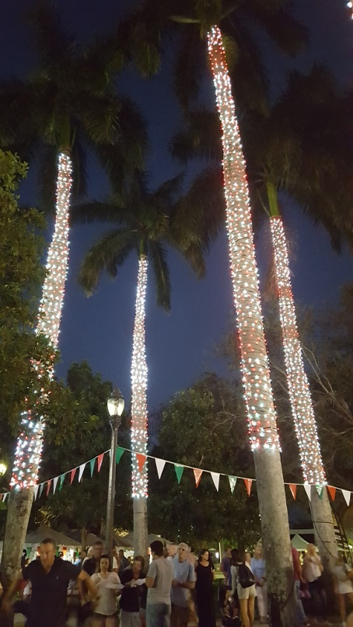
Ideal Atmosphere: Sanborn Square Park
Holiday lights that wrapped the trees in Sanborn Square Park in white and red were intentionally left up through the end of February, adding an ambiance that perfectly complemented the theme of Italian Fest, that otherwise would have been cost prohibitive.

Slide 8
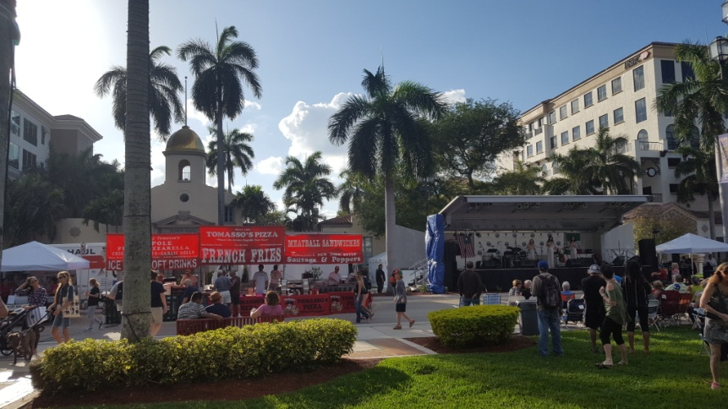
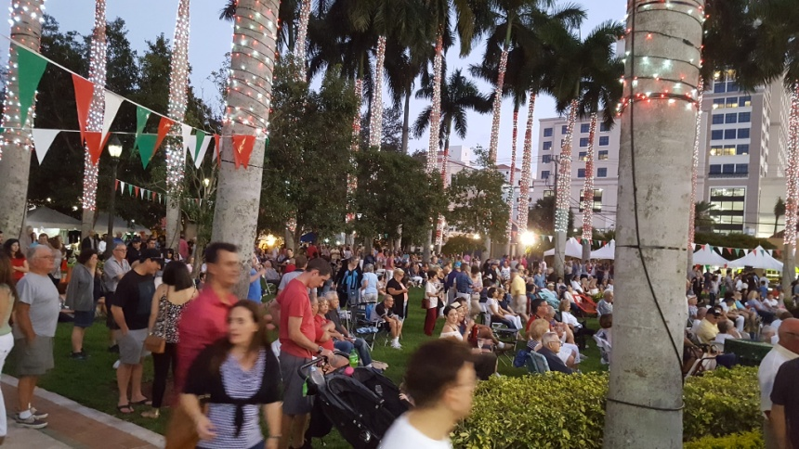
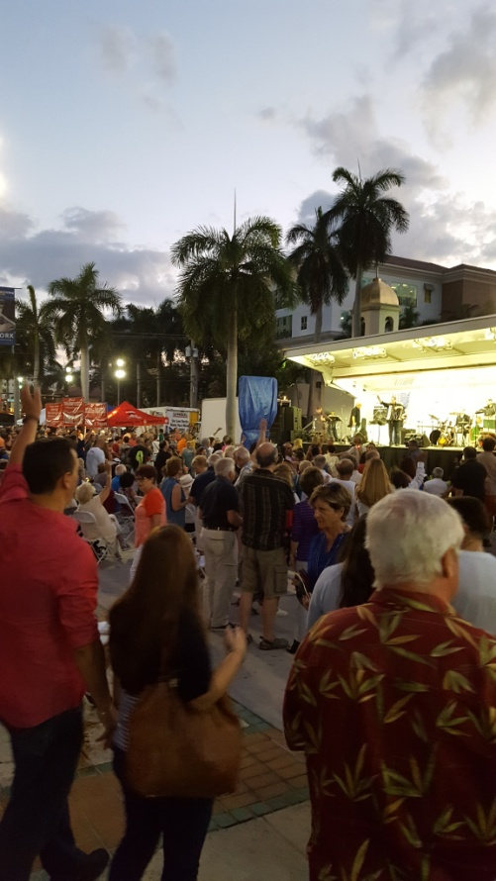
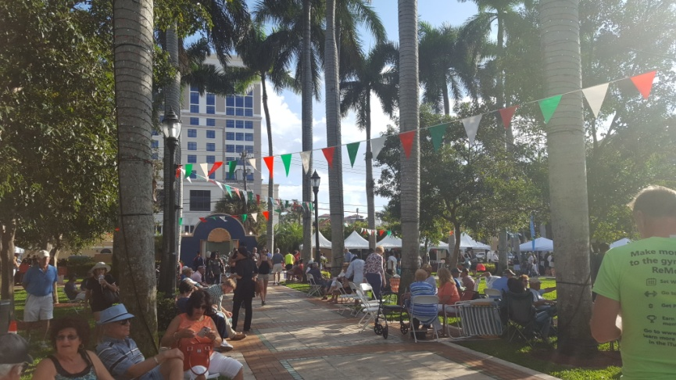
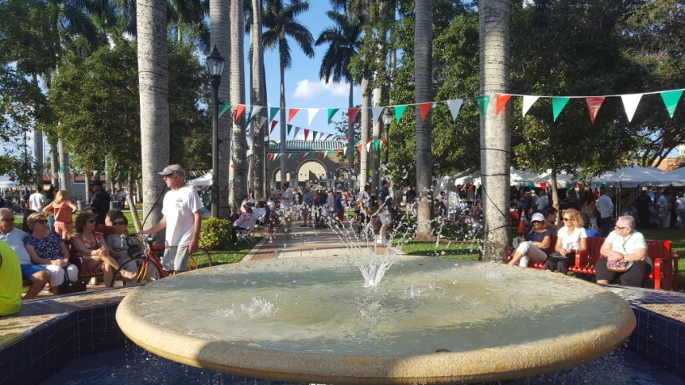
Ideal Atmosphere: Sanborn Square Park
Utilizing picturesque Sanborn Square Park – located in the heart of Downtown Boca – to draw consumers to the downtown district is a key goal of the CRA. The public space proved to be an ideal setting for the event, providing an intimate and festive Italian atmosphere.

Slide 9
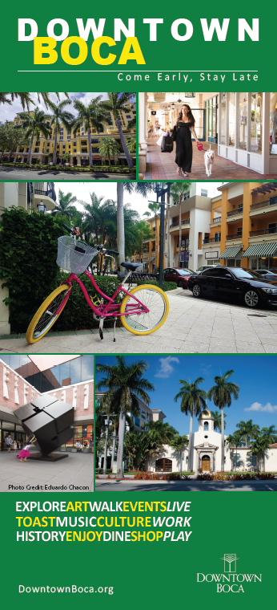
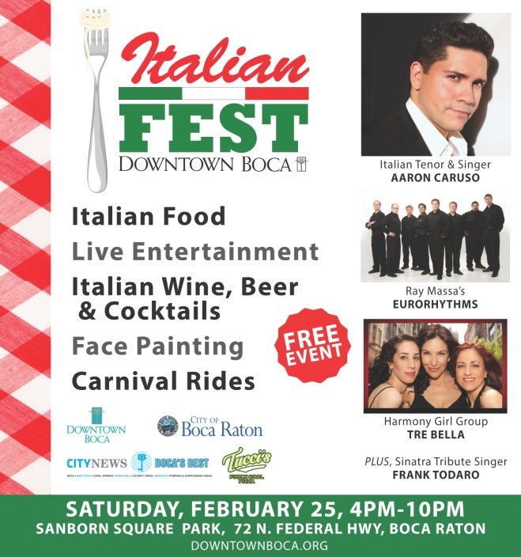
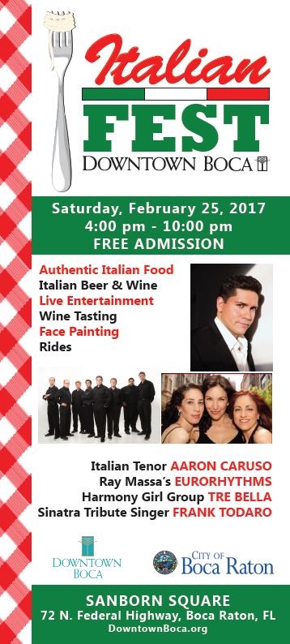
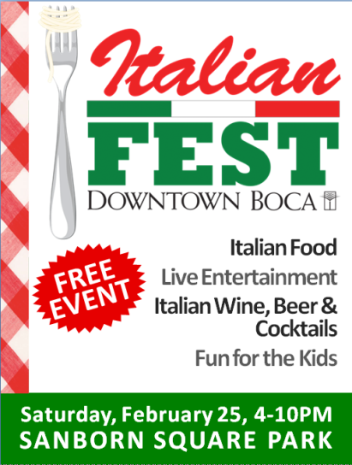
In-House Marketing Efforts
All marketing and promotional efforts for the event were designed and created in-house at a significant cost savings. Advertising elements consisted of promotional flyers, online banners, print ads, outdoor banners and social media marketing.

Slide 10
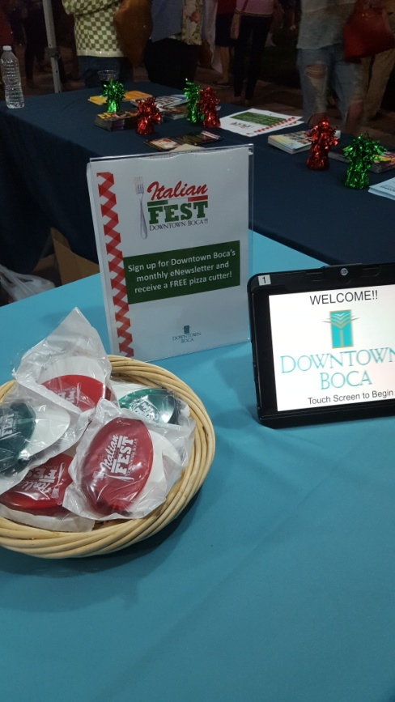
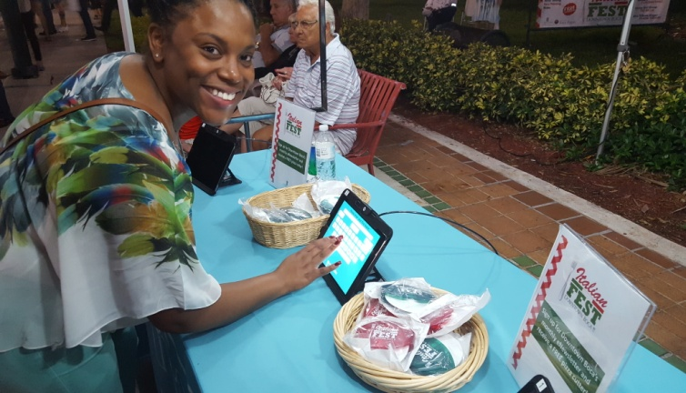
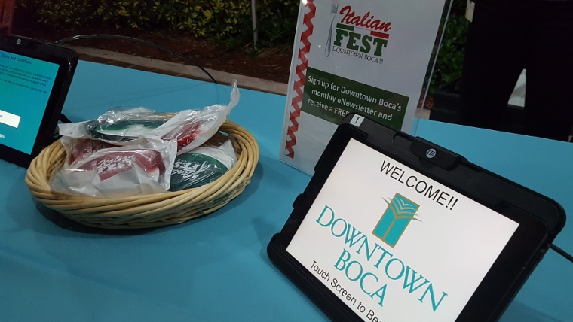
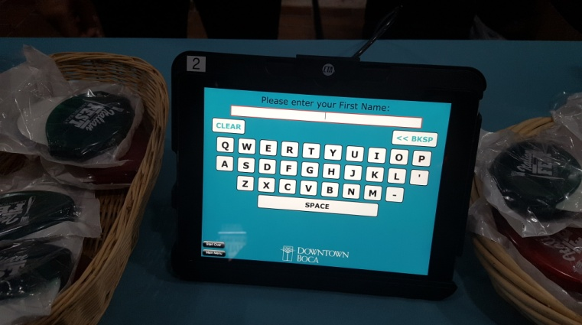
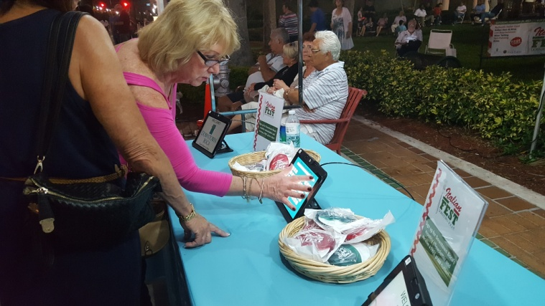
Relationship Building Efforts
In an effort to strengthen Downtown Boca’s ongoing interaction with the local community, the CRA offered event attendees a free pizza cutter when they signed up to receive Downtown Boca’s monthly eNewsletter. In-house iPads were used with a customizable app that collected the information and provided branding for Downtown Boca.
Nearly 200 new contacts gained

