Slide 1
The City of Crestview
The Hub of Innovation

Slide 2
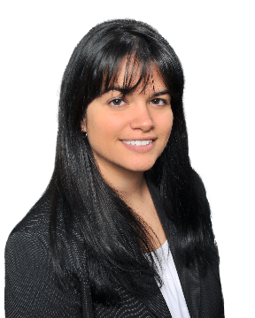
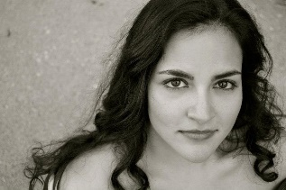
On Behalf of Crestview’s Community Redevelopment Association & Main Street Crestview Association
SPECIAL THANKS TO OUR SPONSORS

Slide 3
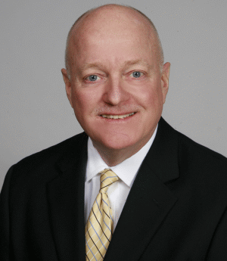
On Behalf of Crestview’s Community Redevelopment Association & Main Street Crestview Association
SPECIAL THANKS TO OUR SPONSORS
Mike Gilmore
Andy Thoms
850-684-4321 Andy@AndyThoms.com
EmeraldQuarters.com
PEARL MABRY
SCHOOL
OF
MUSIC
Mike Gilmore

Slide 4
Speakers & Presenters
Additional Talent
Benjamin Hein, Financial Advisor......…………………………………Master of Ceremonies
David Cadle, Mayor of the City of Crestview.....................Welcoming Presentation
Nathan Boyles, Okaloosa County Commissioner…………………..Promenade Speaker
Teresa Gaillard, Growth Management Dir…..……… Promenade Secondary Speaker
Rev. Mark Broadhead, First Presbyterian…………………………….……………………Blessing
Nathan Sparks, Economic Development Council Exec. Dir…………….………Presenter
Brenda Smith, CRA and Main Street Project Leader……….…….……………... Presenter
Kelly Glyptis………………………………………………………………………........................Vocalist
Doria Grace......……………………………………………Professional Hair and Makeup Artist
Andrew Johnson………………………………………………….......Photographer/ Commercial
Ashlee Karin…………………………………………………………..Event Coordinator/ Assist. Dir
William Legaretta……………………………………………………......Commercial/ Multi Media
Ryan Mabry……………………………………………….Founder/ CEO Mabry School of Music
Gino Rosaria………………………………………………………………Live Pianist/ Jazz Performer
Pg 2

Slide 5
Okaloosa County Courthouse – 1940’s
Community Redevelopment Association
The City of Crestview formally adopted the Community Redevelopment Agency concept in 1995 for the expressed purpose of development and redevelopment within a defined community redevelopment area, which encompasses all of the downtown area. The CRA Board (consisting of the five city councilmembers) adopted a Community Redevelopment Plan, which was sanctioned by the Florida Department of Community Affairs.
http://www.cityofcrestview.org/gallery.aspx?PID=156

Slide 6
Main Street Program
Harris Department Store 1940’s
In 1997, the City applied, and was approved, for a Main Street Program designation by the Secretary of State. This program is embraced nationwide and encompasses the tasks of scheduling and promotion of events such as block parties, downtown days, street festivals, parades, sidewalk sales and cultural events to cultivate and enhance downtown redevelopment.
http://www.cityofcrestview.org/gallery.aspx?PID=156

Slide 7
Crestview Theatre 1940’s
Main Street Crestview Association, Inc.
In 1998, the City hired a full time Main Street Program Director and assisted in the establishment of the Main Street Crestview Association, Inc., whose membership consists of business owners, citizens and other interested parties desiring to revitalize the downtown area. Today, the organization is proud of its many members who are pledged to support the City in their development efforts.
http://www.cityofcrestview.org/gallery.aspx?PID=156

Slide 8
Streetscape Project
North Main Street 1940’s
From 1996 through 2003, the City embarked on a three-phase development effort to construct a major streetscape project in the CRA area. All three phases were earmarked for the restoration of Main Street to the tune of $3.7 million, funded by Tax Increment Financing funds (a revenue source created through the authority of the CRA plan), state grants and general revenue funds. Additional state grants will probably be sought in the future to assist with downtown restoration and infrastructure improvement projects.
http://www.cityofcrestview.org/gallery.aspx?PID=156

Slide 9
Rice Building 1920’s
Structure History
In 2001, the City Council designated a Historic Preservation District and applied for grant funding to research and document the histories of approximately 200 structures within the CRA area and district. The survey was completed in June 2003 at which time all structures surveyed were evaluated and documented with histories that qualified for a State or National historical significance designation. A specific area of downtown Crestview was proposed for national register historic district designation. State of Florida approval of the designation was received by the city in early 2006 and final national level approval was rendered in late July of 2006. Properties within the district may seek grant funding for historical restoration as part of the redevelopment efforts by the city.
http://www.cityofcrestview.org/gallery.aspx?PID=156

Slide 10
Okaloosa County
Okaloosa County Veterans’ Memorial
In 1915 the County was created by an act of legislature. The County seat is located at the City of Crestview.
Total Population of the County was 180,822 in 2010 according to the US Census Bureau, and estimated to be 191,898 in 2015, according to the 2015 Florida Estimates of Population published by the University of Florida, Bureau of Economic and Business Research.
One of the largest US Air Force installations in the free world is located in Okaloosa County. The Base employs approximately 11,000 military employees and 24,000 civilian employees. According to the EDC of Okaloosa County approximately 70% of the County’s economic activity comes from the military and civilian installations connected to the Eglin Complex.
It is estimated that over 3,500,000 tourists visit the County each year. Tourism employs approximately 32,000 tourism-related positions. Such economic activities generate nearly 1 billion dollars per year. Okaloosa County ranked third as a drive-in vacation destination in Florida, behind Orlando and Miami.
http://www.cityofcrestview.org/gallery.aspx?AID=12

Slide 11
Crestview
Veterans’ Memorial Gazebo
Crestview, the “Hub” earned its designation due to the towns position which is located at the junction of 3 major highways: US 90, State Rd. 85 and interstate Highway 10. US 90 running from Jacksonville westward through Tallahassee, the State Capital passes through Crestview and continues to Pensacola, and New Orleans.
Crestview is the largest city in Okaloosa County. Executive and private planes are accommodated at the Robert L. F. Sikes Airport located 3 miles northeast of the central business district Boasting one of the longest landing strips in the state at 8,005 ft.
Crestview also houses the only pharmaceutical college on the panhandle at the Florida A & M University Durrell Peaden Jr. Center located in the heart of Historic Downtown Crestview. Northwest Florida State College is also located in the heart of Historic Downtown Crestview next to Twin Hills Park in Downtown.
The City is currently in the process of rebuilding a fully functioning Train Depot for downtown Crestview. Amtrak is finalizing their plans and completing the negotiations needed in order to make Crestview an official stop on the rail that will travel from Orlando to New Orleans.
http://www.cityofcrestview.org/gallery.aspx?AID=12

Slide 12
Demographics
Household
Population: 24,533. Population in Crestview has grown 16.95% since 2010
***within a 10-mile radius of 506 W. 1st Ave. Crestview, FL 32569 the population count in 2013 was 53,959 with a 2018 projection of 59,306***(Data Provided by Gale Cengage Learning) 506 W. 1st Ave. is located 1 mile from the Courthouse.
Median Age: 31.19
Male: 49.48% Female: 50.52%
White: 70.57% Black: 18.52%
Asian: 3.29% Hispanic: 8.04%
Number of Home Dwellings: 9,989
1 person: 24.08% 2 persons: 31.47%
3 persons: 19.09% 4 persons: 15.2%
5 persons: 6.19% 6+ persons: 2.49%
Number of Home Dwellings: 9,989
63% more households who own their homes than there are renters.
Owners Renters
61.91% 64.37% 38.09% 35.63%
Community Nation Community Nation
Household Median Income: $54,713
44.7% of households earn more than the national average per year.
Household expenditures average $50,918 per year. The Majority is spent on:
Shelter ($10,440), Transportation ($9,824), Food/Beverage ($7,603), Health Care ($4,141) & Utilities ($3,931)

Slide 13
Labor
Education
Labor Force: 11,346. Job Growth Rate of 2.25% in 2015.
Blue Collar 33% White Collar 66%
Employed 90.04% Unemployed 4.63%
Total Establishments: 1,209 businesses. In 2016 the leading industries were:
Retail, Education, Health Care/ Social Svcs. , Accommodations/ Food Svcs., Public Admin
Number of Employees businesses have in Crestview.
1-4 65.18%
5-9 18.28%
10-19 8.77%
20-49 5.38%
50-99 1.24%
100+ .99%
Bachelor’s Degree or higher: 20.81%
Daycare Facilities: 5
Private Schools K-12: 3
Elementary Schools: 5
Middle Schools: 2
High School: 1
High School Attendees: (2014) 1,190 students
High School Athletic Teams: 21
Higher Level Education: 3
North West Florida State College Robert L. F. Sikes Education Center,
Florida A & M University College of Pharmacy and Pharmaceutical Sciences,
Troy University

Slide 14
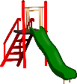
Overview of Main St.
Twin Hills Park
Courthouse
Dog Park
544 N. Main St. – Dinner location
Fire Station
City Hall
For Sale
Rail Road Crossing
210 S. Main St. – Welcome location
FAMU
NWFSC
Please note that additional properties are available, but are either in a private listing agreement, or not uploaded into the MLS. Please speak with Melissa Simpson regarding additional available properties.

Slide 15
ACTIVE ON MAIN ST.

Slide 16
ACTIVE ON MAIN ST.

Slide 17
ACTIVE ON MAIN ST.

Slide 18
ACTIVE ON MAIN ST.

Slide 19
ACTIVE ON MAIN ST.

Slide 20
ACTIVE ON MAIN ST.

Slide 21
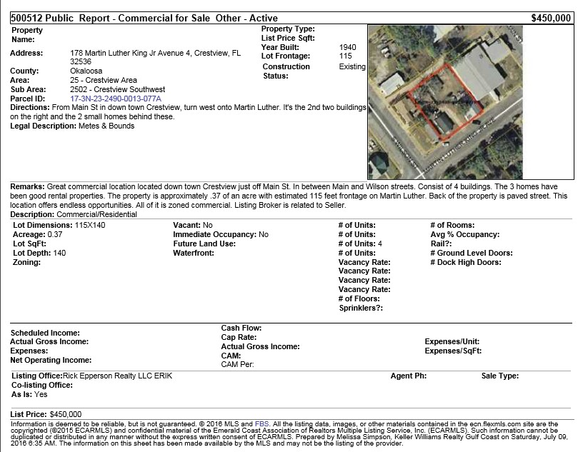
ACTIVE ON MARTIN LUTHER KING BLVD.

Slide 22
ACTIVE ON MARTIN LUTHER KING BLVD.

Slide 23
ACTIVE ON WOODRUFF AVE.

Slide 24
ACTIVE ON WILSON ST.

Slide 25
ACTIVE ON WILSON ST.

Slide 26
ACTIVE ON WILSON ST.

Slide 27
ACTIVE ON WILSON ST.

Slide 28
ACTIVE ON OAKDALE AVE.

Slide 29
ACTIVE ON OAKDALE AVE.

Slide 30
ACTIVE ON COLEMAN ST.

Slide 31
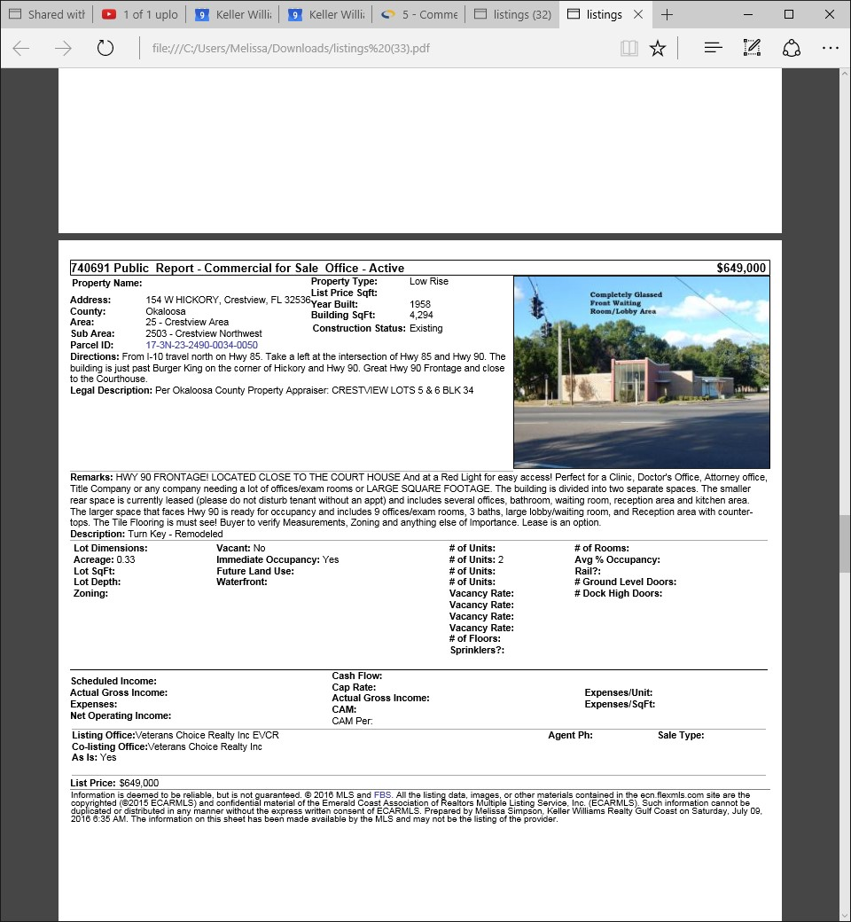
ACTIVE ON W. HICKORY AVE.

Slide 32
ACTIVE ON JAMES LEE BLVD.

Slide 33
ACTIVE ON JAMES LEE BLVD.

Slide 34
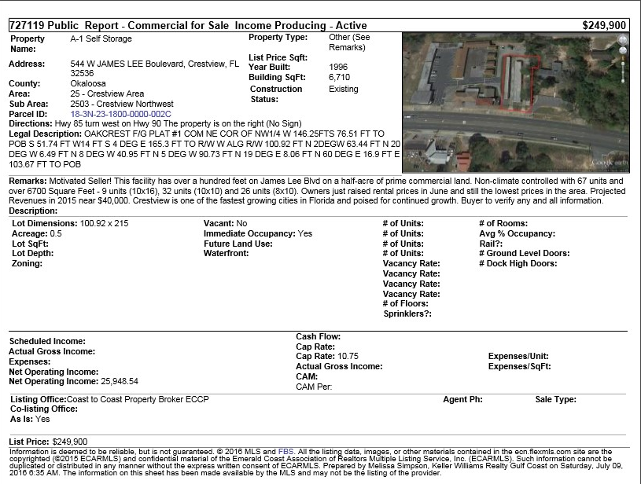
ACTIVE ON JAMES LEE BLVD.

Slide 35
ACTIVE ON HWY 90 E.

Slide 36
Notes

Slide 37
Notes

Slide 38
Notes

Slide 40
Brenda Smith
Crestview Community Redevelopment Association / Main Street Association Director
The Peterman Agency
CRA/ Main Street Project Leader
198 N. Wilson St. Crestview, FL 32536
850-689-3722
mainstreet@cityofcrestview.org
Ben Hein
Financial Advisor
Edward Jones
7000 Pine Forest Rd. Suite, B. Pensacola, FL 32526
850-944-7526
Benjamin.hein@edwardjones.com
Melissa Simpson
Commercial / Residential Listing Specialist
The Machado–Elliott–Reed Group
Keller Williams Realty Gulf Coast
800 Langley Ave. Pensacola, FL 32504
850-733-6532 cell
850-466-8385 office
melissasimpson@kw.com
https://www.surveymonkey.com/r/InvestInCrestview

Slide 41
Comments / Follow Up Card
Name: Business:
Phone: Email:
Would like additional information on:
Individual you would like to have follow up with you:
Brenda Smith Melissa Simpson Ben Hein Other______________________

