Slide 1
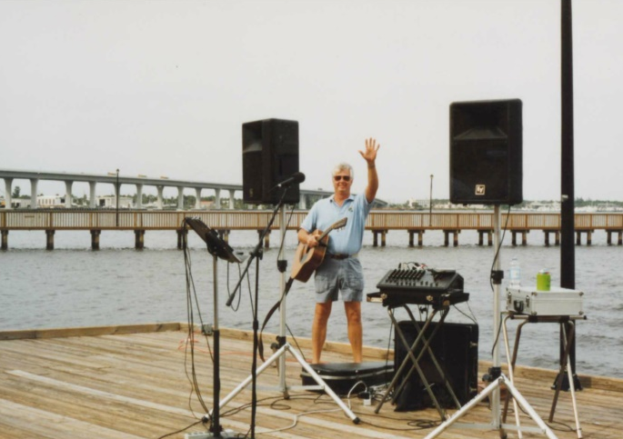
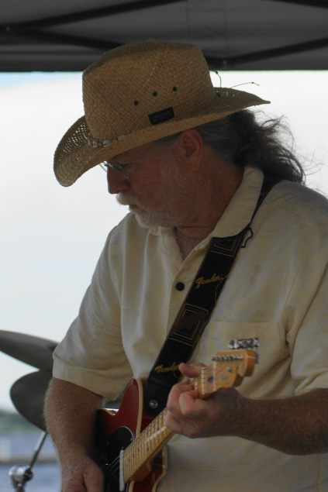
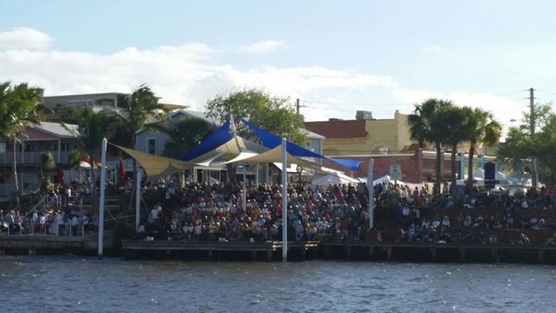
Riverwalk Music 2000-2016
16 Years of building the community and the economy

Slide 2
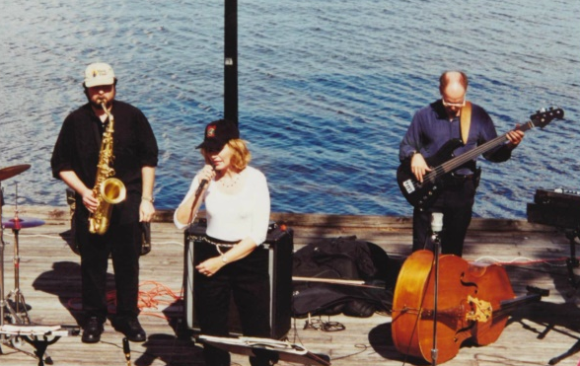
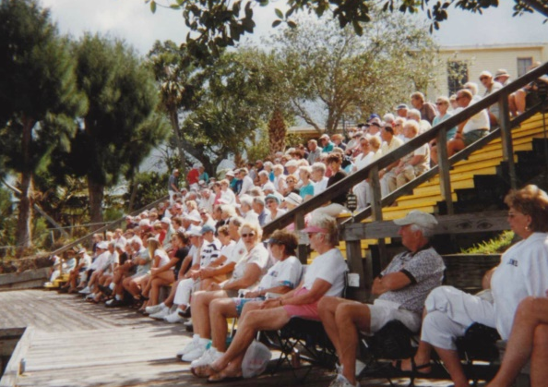
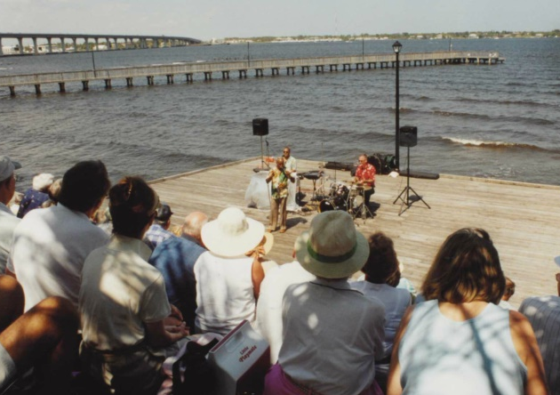
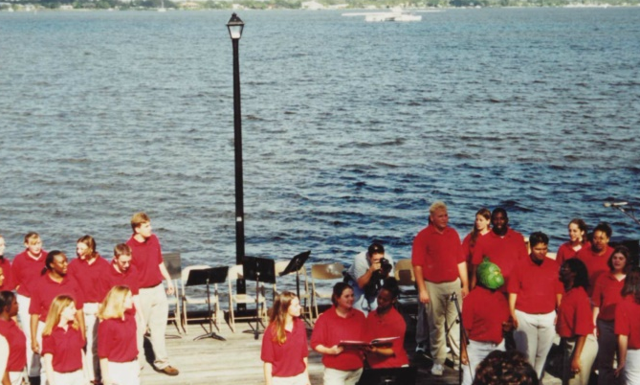
The Inspiration
Lunchbox Concert Series
Riverwalk Stage 2000-2004
Free concerts 12:00-1:30 on 3rd Friday October-June
Martin County Arts Council
Wide variety of music
Bobby & the Blisters, Bill Porter, and Bob Swinton
Many local performing artists
Built traffic downtown on concert days
Moved to Gazebo Park for 2004-2005

Slide 3
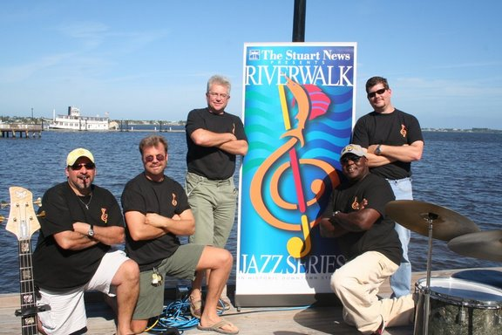
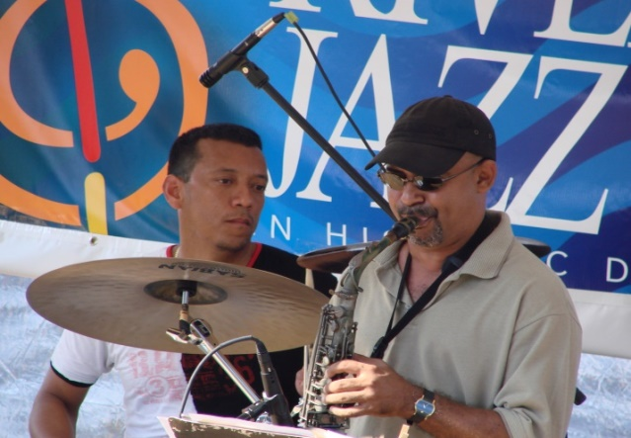
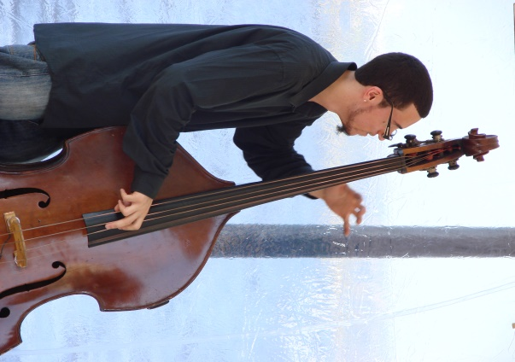
New Vision
RiverWalk Jazz Series
2006-2010
1st Sunday November-April
Ad hoc committee led by City Recreation Department and Media Partners
Jazz Arts Education featured different jazz forms
Professional performers
Hard costs advertising underwritten by Stuart News
6 Florida Festival & Events Association Awards

Slide 4
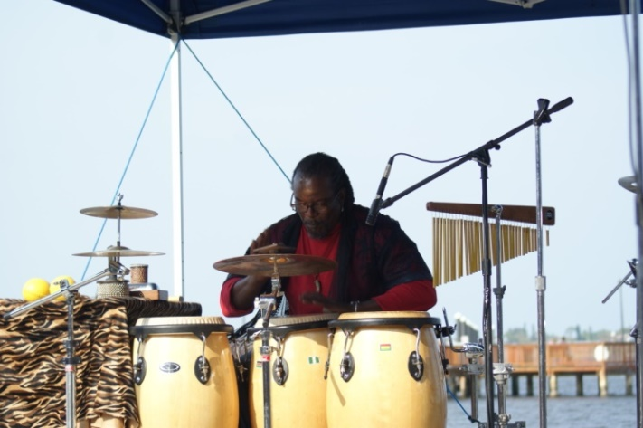
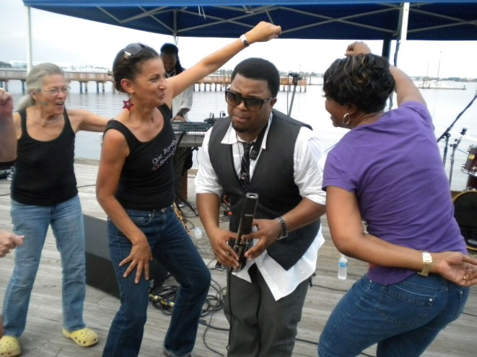
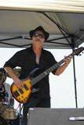
Challenges
RiverWalk Jazz Series
No shade
Budget limited number of performances
One show/month
7 shows/year
Increased downtown visitors, but not consistent enough to warrant businesses opening regularly

Slide 5
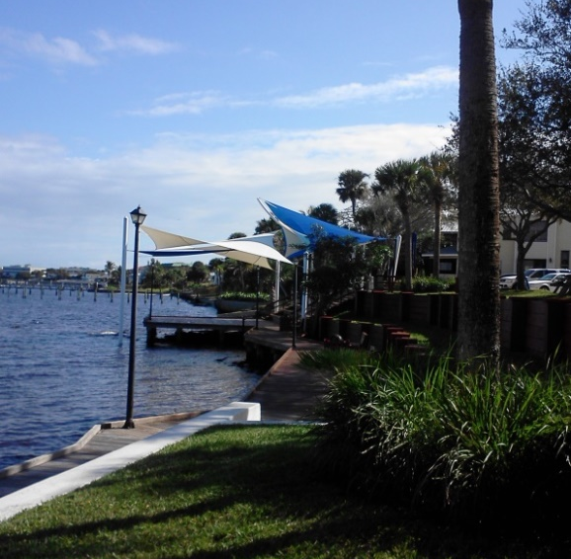
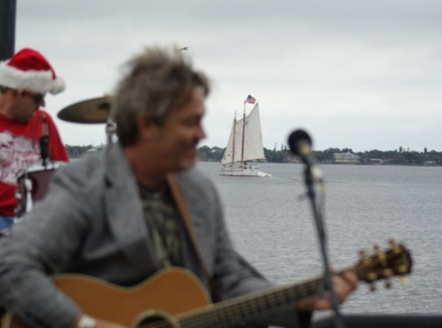
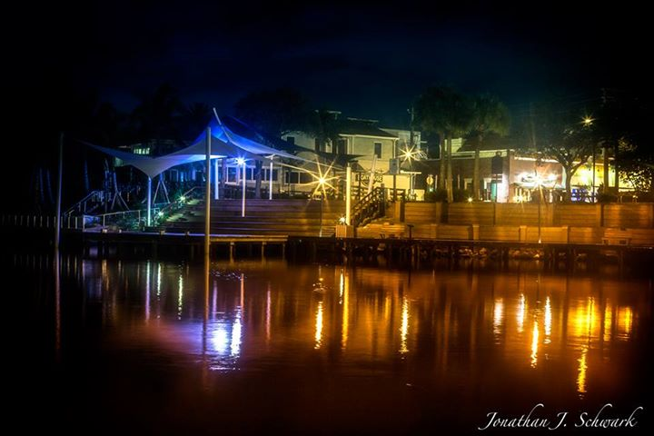
New Opportunities
RiverWalk Music Series
Downtown Business Association
Weekly concerts
October-May
Multiple musical genres
Additional volunteers & sponsors
Florida Inland Navigation District (FIND) grant
Shade makes stage and seating area comfortable for performers and visitors
Community Services Department designed iconic sails create destination
Notes:
2010 name changed to Riverwalk Music Series
2010 alternate indoor venue at recreation center at Flagler Park

Slide 6
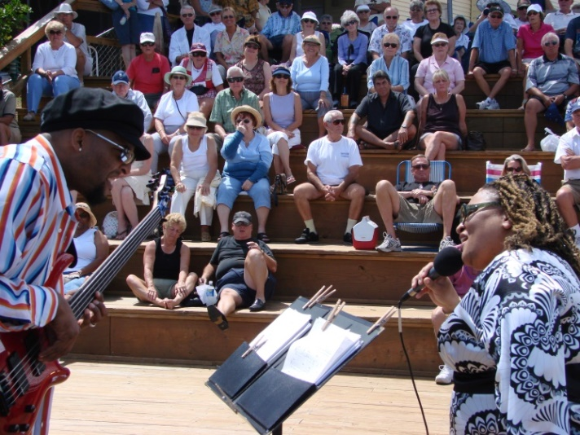
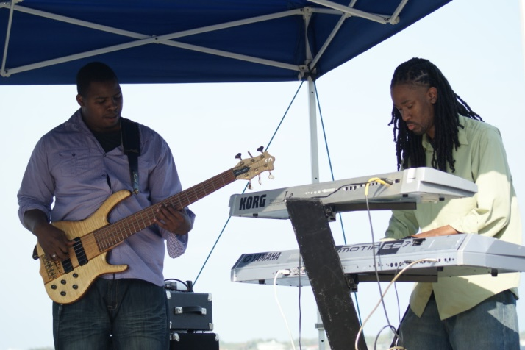
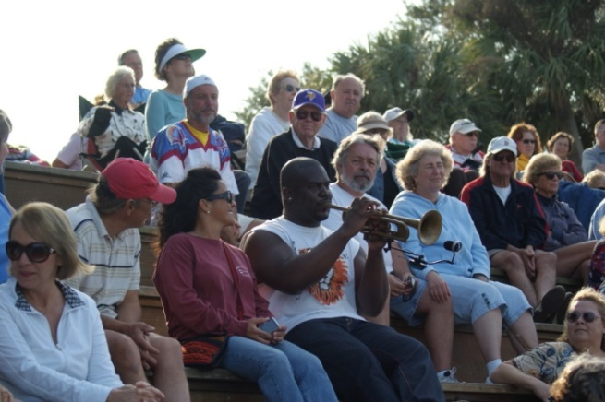
Rock’n Riverwalk Jazz
Two Concert Series
RiverWalk Music Series
Jazz
Ad hoc committee
1st Sunday/month
Rock’n Riverwalk
Blues, Country, Reggae, Rock, Latin and Pop
Downtown Business Association
All other Sundays
1st Saturday Summer Series June-September 4-7 p.m.
Notes:
2010-2011 Parallel, separately branded concerts
2011 Audience confusion

Slide 7
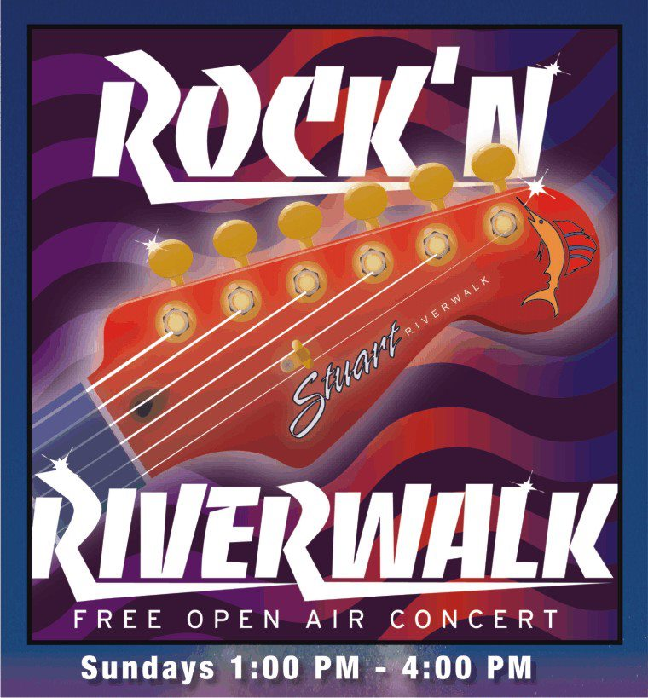
Consolidation
Rock’n Riverwalk
Fall 2011-present
Unified two concert series
Downtown Business Association
Consistency of every Sunday in season (November-May)
Diversity of musical genres
Local and regional musicians
Green Market relocation effectively expanded hours
Very loyal following

Slide 8
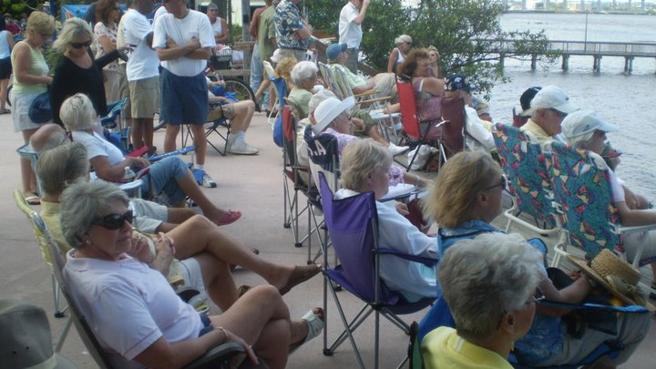
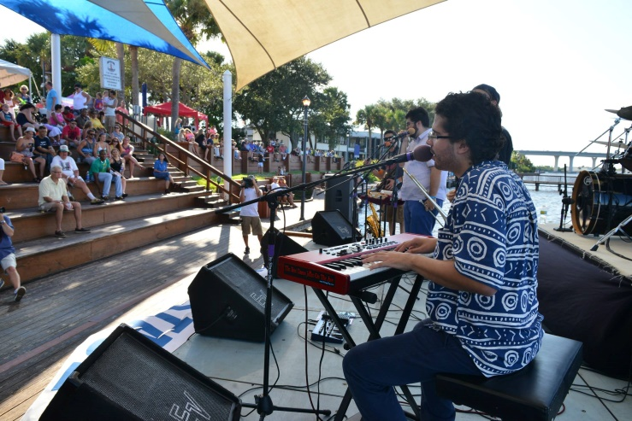
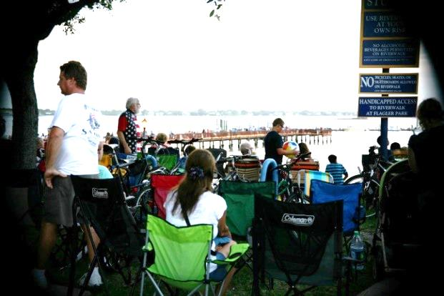
Expansion
Rock’n Riverwalk
Year-round since June 2015
Weekly concerts
Consistent hours & weeks
2nd full summer season
50/52 weeks
Effective partnerships
Stuart Main Street
Green Market
Downtown businesses
Sponsors
City of Stuart
Notes:
2012 promotion partnership with Stuart Main Street & shared vendors with green market

Slide 9
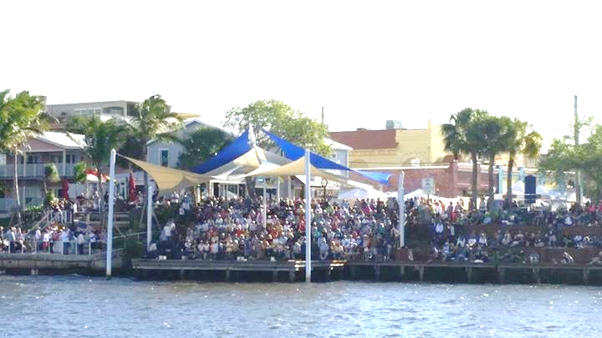
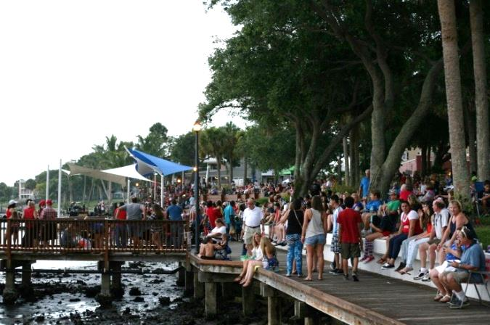
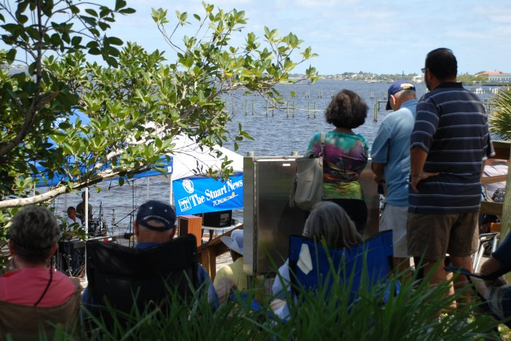
By The Numbers
Rock’n Riverwalk
In-season attendance 1,500+
Summer attendance 700+
Year-round Stuart Green Market with 50% full day vendors
Business participation
50% open on Sundays
25% sponsor
Cost $1,000/week + insurance and permitting costs
In-kind match for marketing and management
Public satisfaction
Notes:
Funded by annual and event sponsorships, vendor fees, city sponsorship, and fundraisers like 10/28

Slide 10
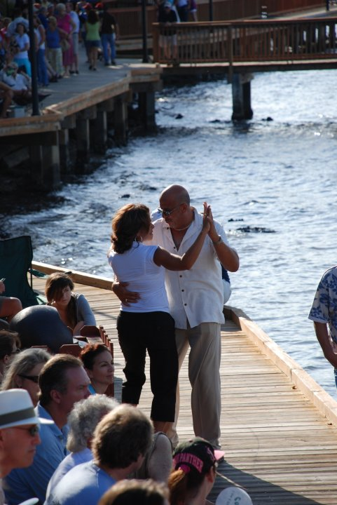
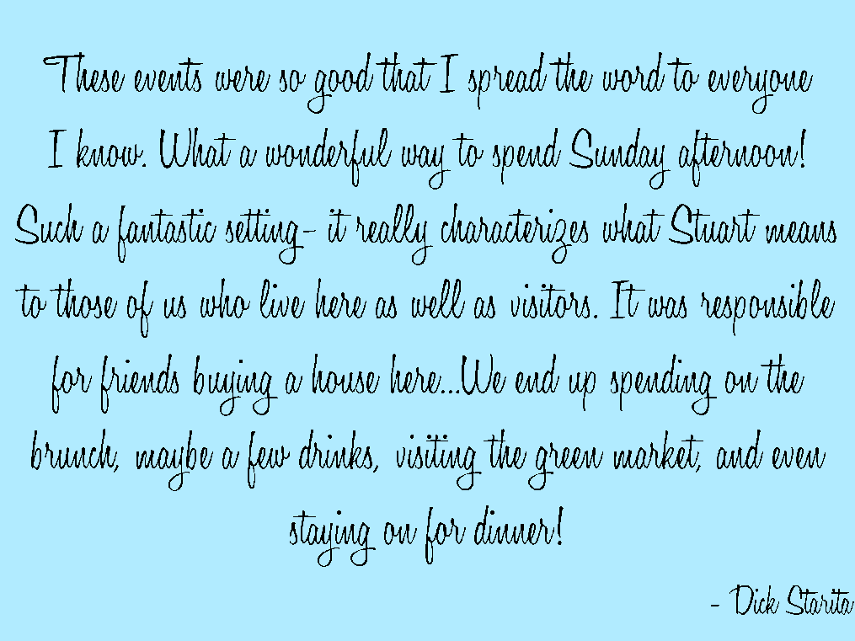
Thank You!

