Slide 1
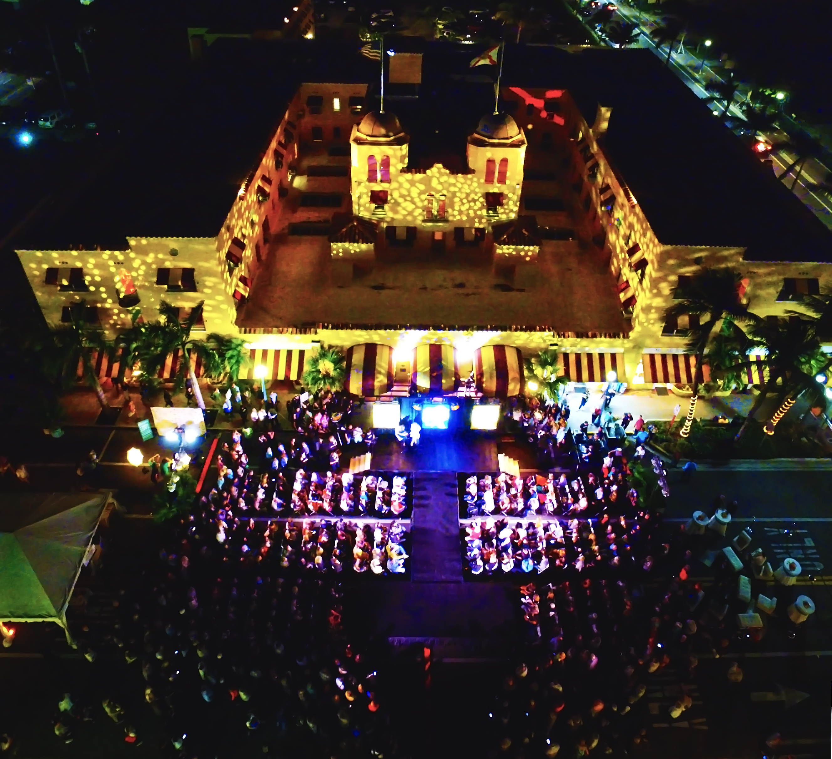
As part of our submission, please watch the Delray Beach Fashion Week Recap/Highlight video available at DelrayFashionWeek.com & YouTube.com/DelrayDDA
DelrayFashionWeek.com
#DelrayFashionWeek

Slide 2
4th annual Delray Beach Fashion Week at a Glance
DelrayFashionWeek.com
#DelrayFashionWeek

Slide 3
RECORD-BREAKING PARTICIPATION
12
Downtown SALONS
22
Hair Stylists
38
Downtown
Fashion
Boutiques
70
VOLUNTEER
MODELS
DONATED
100s
OF HOURS OF THEIR TIME
Exposure to 6,000+ attendees
DelrayFashionWeek.com

Slide 4
RECORD-BREAKING PARTICIPATION - CONTINUED…
DelrayFashionWeek.com
#DelrayFashionWeek

Slide 5
8
Video
Screens
Strong sponsor and merchant visibility during all of the runway fashion shows
11
Delray Designers featured

Slide 6
Print & Online Advertising& window Poster for downtown businesses
DelrayFashionWeek.com
#DelrayFashionWeek

Slide 7
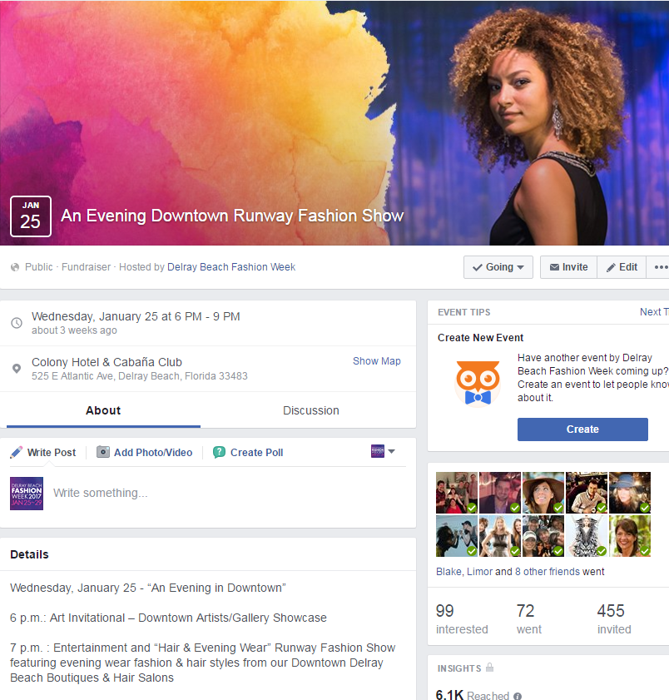
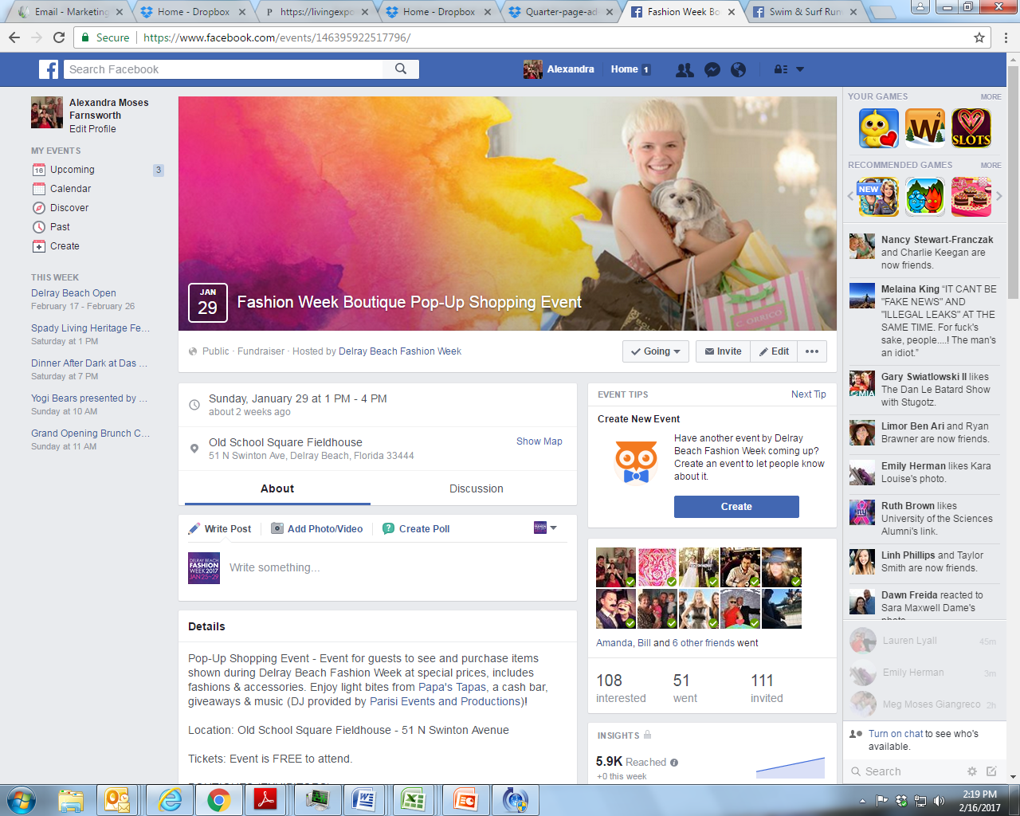
Facebook events – www.Facebook.com/DelrayFashion
Dedicated Facebook page for Delray Beach Fashion Week with sponsored Facebook Event Posts for each Delray Beach Fashion Week Event
Reached: 21,135 unique individuals within 50 miles of Delray Beach, interested in Fashion, Design, Fashion Designers and who were likely to shop at high-end merchants with event promotions on Facebook and Instagram
In this same demographic, we had an estimated 30,000+ total impressions for the Event Facebook advertising alone
Responses: 314 people said that they planned to “attend” – which was then organically shared with their Facebook friends
DelrayFashionWeek.com
#DelrayFashionWeek

Slide 9
DIGITAL signage & TV COMMERCIAL
DelrayFashionWeek.com
#DelrayFashionWeek

Slide 13
PUBLIC RELATIONS - COVERAGE
Coverage in
26+
Publications
105+
Media Placements
Press Releases:
“Delray Beach Fashion Week Hits Downtown Jan. 25-29”
“Delray Beach Fashion Week Kicks Off Jan 25 and Runs Through Jan 29 Media Advisory and Photo Opp”
“Delray Beach Fashion Week Swim & Surf Show Media Advisory and Photo Opp”
Photo/Video Attendance at Events:
Carl Dawson, VMA Studios: Photographer
Andrew Fogell, VUP Media: Videographer
Guest photographers/videographers:
Photographer: Mohammed F. Emran - twoseventymag.com
Photographer: Van Johnson Sr.
Photographer: Charles McCurdy – LOCAL magazine
Photographer: Humberto Vidal
Photographer: Pedro Heshike
Photographer: Garrin Evan
Photographer: Gary Rothstein - UPI
Videographer: Alexis Paige - twoseventymag.com
Videographer: Rod Estrada
Videographer: Runway Solutions
Videographer: Cam Brooks
DelrayFashionWeek.com
#DelrayFashionWeek

