Slide 1
Redevelopment Incentives for Pilot Project Areas
August 2016
Ron Barton, Assistant County Administrator
Hillsborough County

Slide 2
Economic Development Strategic Environment
To remain competitive, the County must have viable sites for job generating projects
Appropriate sites for targeted industries are diminishing
As an urban county, redevelopment of core sites is a necessity and fiscally prudent
Facilitating development within redevelopment areas increases the County’s competitive positioning
Redevelopment program is designed to reprioritize spending and redefine the rules of engagement

Slide 3
Redevelopment Program
Overview
Focus on the distressed areas of our commercial office/ industrial / manufacturing buildings and built environment in need of restoration or revitalization
Defined program strategy that will engage private capital and stabilize/grow tax base
Collaborative synergy with transportation improvements and other infrastructure
Emphasized BOCC message that we are committed to addressing formerly developed areas that are in need of reinvestment

Slide 4
Redevelopment Program
Pilot Area Selection Criteria
Defined as any census block group that meets HUD’s low to moderate income criteria and is located inside the Urban Service Area boundary
Focused on office and industrial job creation redevelopment opportunities (not retail/not residential)
Focused on sites in which the land values are at least 50% of the total just value or greater
Primarily requires a private sector partner to engage in the redevelopment activity (not solely a public sector effort)

Slide 5
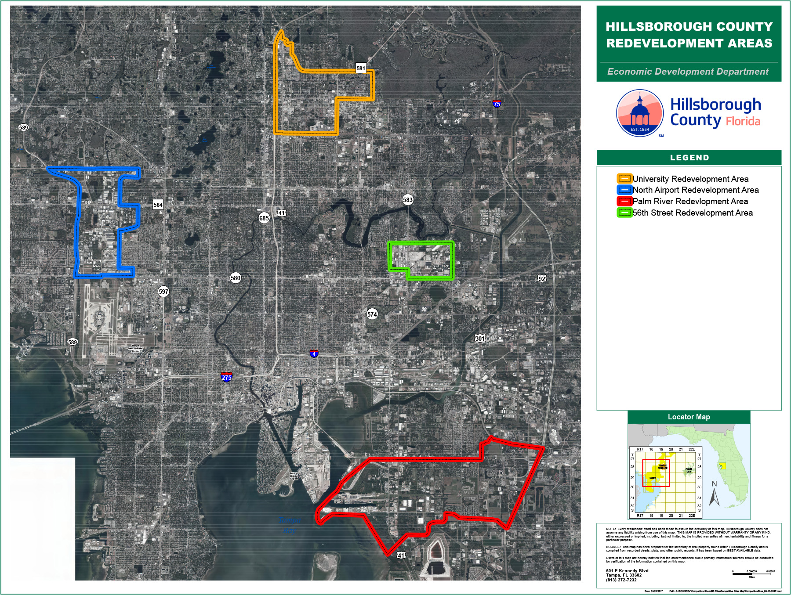

Slide 6
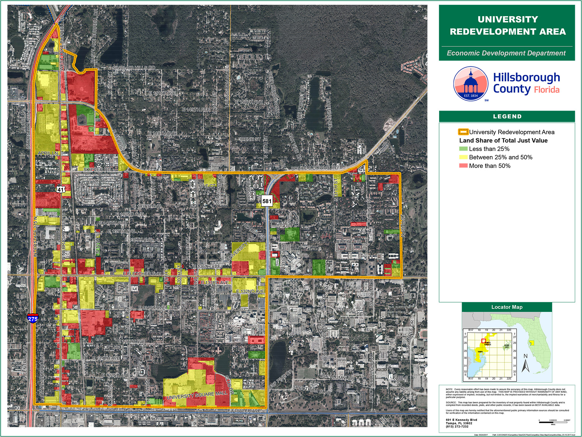
Detailed View - 1 of the 4 Pilot Project Areas:
University Redevelopment Area / !p - Innovation Place

Slide 7
Redevelopment Program
Objectives
Eliminate/prevent blight and deterioration
Promote redevelopment in accordance with Comprehensive/Community Plans
Promote higher quality environment through urban design and land use principals
Retain existing businesses and jobs
Encourage private investment by eliminating impediments
Stabilize and increase tax base
Overall Guidelines
    Eligible Applicants
    Use of Multiple Incentives
    Eligibility After Maximum Grants Awards
    Ineligible Costs
    Receipt of County Funds

Slide 8
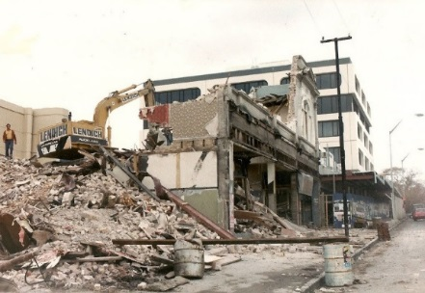
Redevelopment Incentives
Site Permitting Assistance
Expedited Site Development and Construction Plan Review Program
  Not to exceed 10 working days
Permit and Impact Fee Grant Program
  50% of total fees up to $50,000
    Mobility Fee Buydown Incentive Program
      75% of fees assessed; 100% if targeted industry
      Effective Jan 1, 2017

Slide 9
Redevelopment Incentives
Office/Industrial Building Assistance
Demolition of Distressed Structures Program
  50% of total costs up to $100,000
Infrastructure Assistance Program
  50% of construction costs up to $100,000

Slide 10
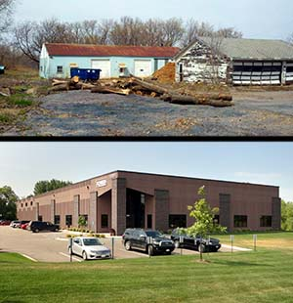
Redevelopment Incentives
Office/Industrial Building Assistance
Contaminated Site Assessment and Remediation Program
  Up to $15,000 for Phase II Site Assessment
  50% of total RAP and clean-up costs up to $50,000

Slide 11
Redevelopment Incentives
Office/Industrial Building Assistance
Building Interior Improvement Program
  50% of total costs up to $80,000
Building Exterior Improvement Program
  50% of total costs up to $100,000

Slide 12
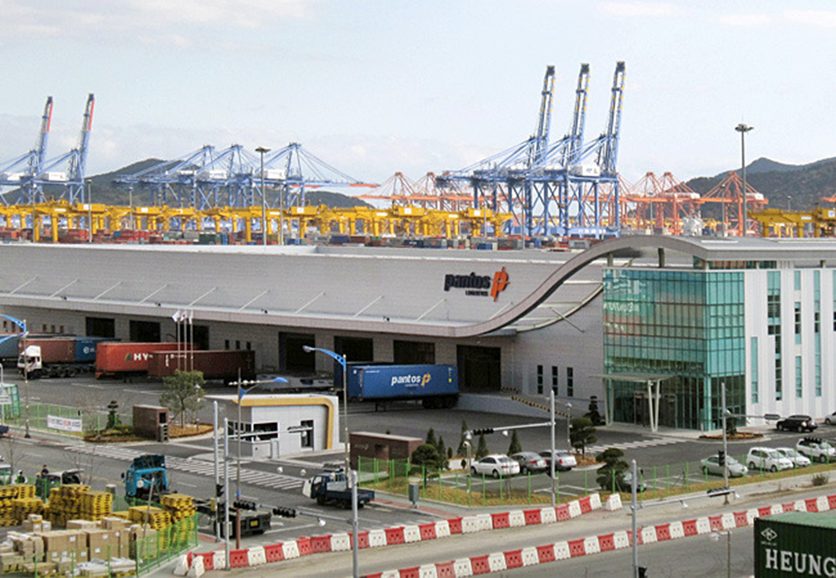
Redevelopment Incentives
Catalyst Project Incentive Program
Catalyst Project Incentive Program
  10% of total costs from a minimum of $50,000 up to maximum of $350,000
New Construction
Renovation / Addition

Slide 13
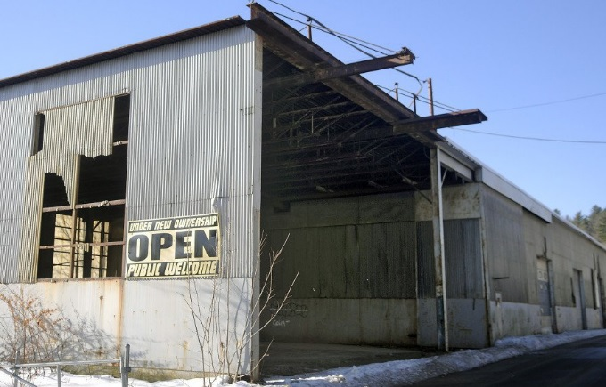
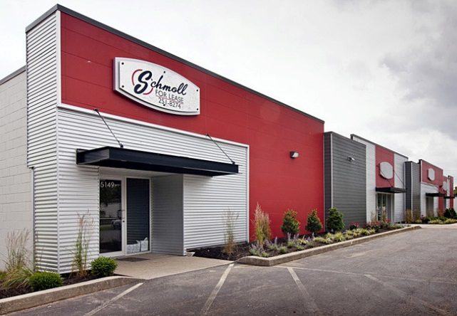
Redevelopment Incentives
Small Business Façade Program
Small Business Facade Program
  50% of total costs and fees from a minimum of $5,000 up to a maximum of $50,000

Slide 14
In recognition of the support from our past and present county leaders:
2017 Hillsborough County Board of County Commissioners:
Victor Crist
Ken Hagan
Al Higginbotham
Pat Kemp
Lesley "Les" Miller, Jr.
Sandra Murman
Stacy White
Industry partners:
NAIOP, FGCAR, CREW, REL and ULI
Hillsborough County Economic Development:
Ron Barton, Lindsey Kimball, Eric Lindstrom, Troy Salisbury, Cecilia Gayle
Successful projects:
5400 Southern Comfort
Danger Zone LLC
Florida Research Group
Blue Steel
Thank you!

