Slide 1

Welcome Center
March Visitors
Total: 909
(5% Increase Since February)
Average Daily: 39.5

Slide 2
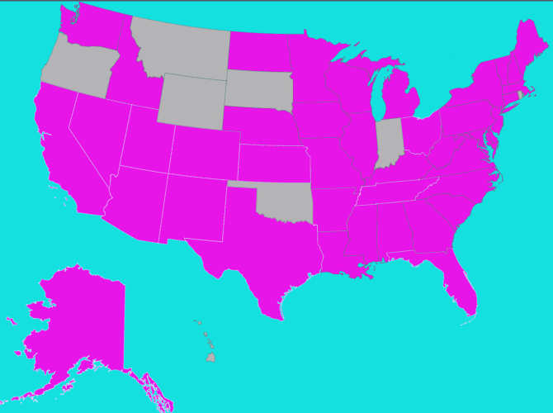
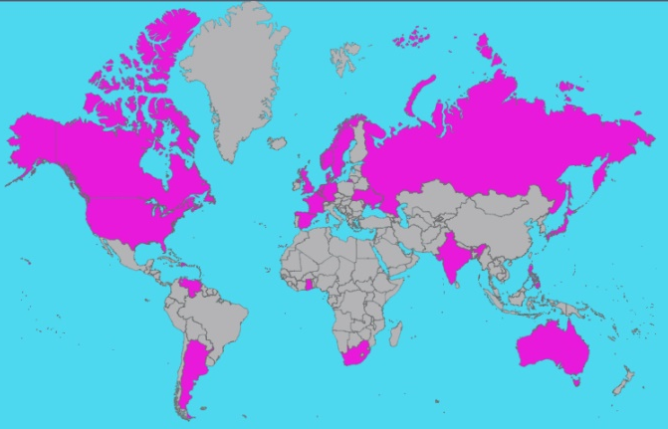
Welcome Center Visitors
February 1 – April 19
6 Continents
25 Countries
42 States
Alaska Alabama Arizona Arkansas California Colorado Connecticut Delaware Florida Georgia Iowa Idaho Illinois Kansas | Kentucky Louisiana Massachusetts Maryland Maine Michigan Minnesota Missouri Mississippi North Carolina North Dakota Nebraska New Hampshire New Jersey | New Mexico Nevada New York Ohio Pennsylvania South Carolina Tennessee Texas Utah Virginia Vermont Washington Wisconsin West Virginia
Argentina Australia Canada Denmark Dominican Republic France Germany Ghana | India Japan Netherlands Norway Panama Philippines Russia South Africa | Spain Sweden Switzerland Trinidad Ukraine United Kingdom United States Venezuela

