Slide 1
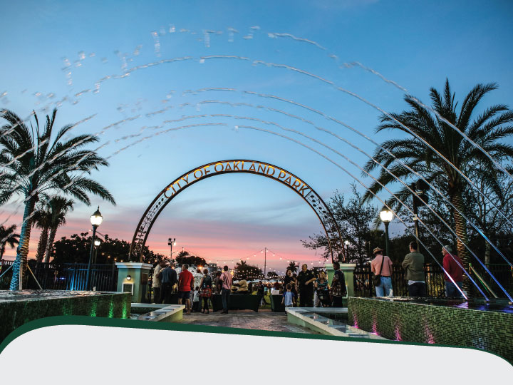
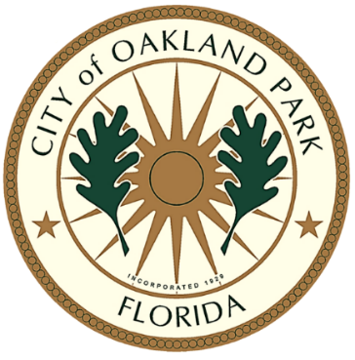
Grand Plaza
Downtown Connector to Jaco Pastorius Park
Florida Redevelopment Association 2017 Capital Project and Beautification Award Application

Slide 2
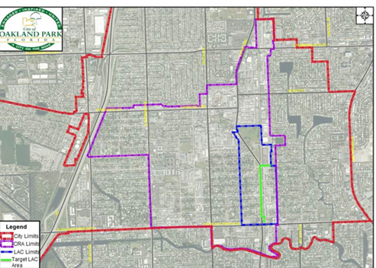
CULINARY ARTS DISTRICT
2004-Local Activity Center designated
2004-Downtown Mixed Use Guidelines adopted to facilitate redevelopment
2008-2011- Great Recession
2010-Adaptive Reuse Incentive Guidelines adopted
2011-Branded as Culinary Arts District
2014-Home to Funky Buddha Brewery- South Florida’s Largest Craft Brewery

Slide 3

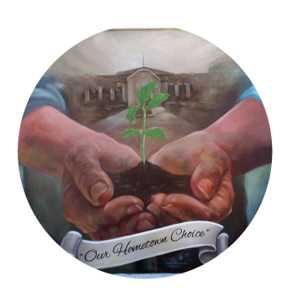
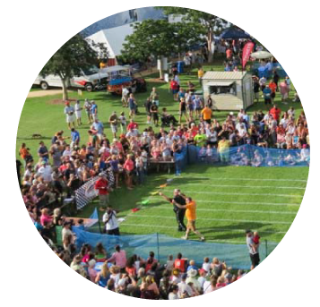
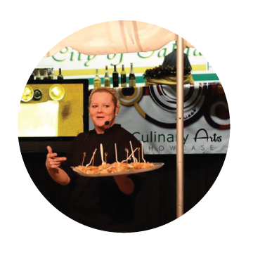
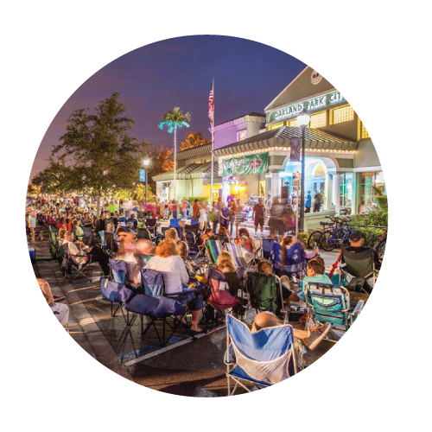
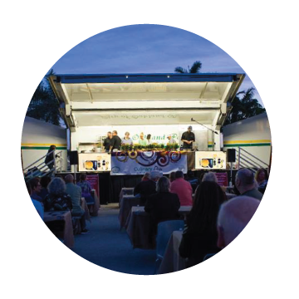
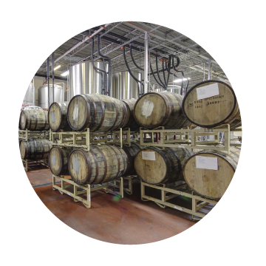

Our BUZZ
Art Park
Cultural
Events
Culinary
Classes
Music
on Main
(Monthly)
Oktoberfest
(Annually)
Culinary Arts Showcase
(Monthly)
Funky Buddha Craft Brewery Tours
Over 100 Events &
Activities Annually

Slide 4
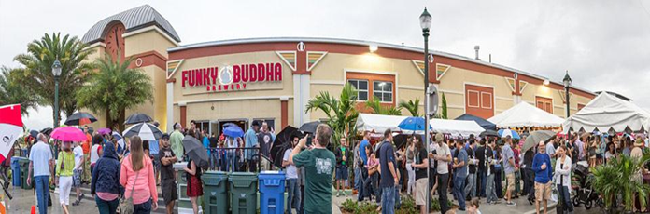

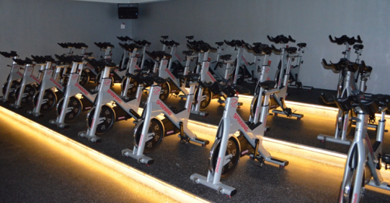
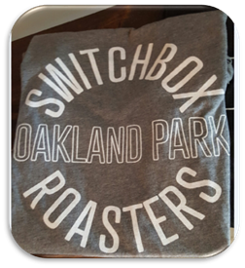
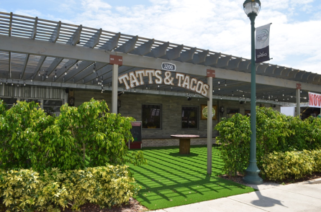
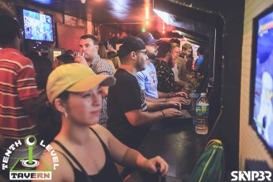
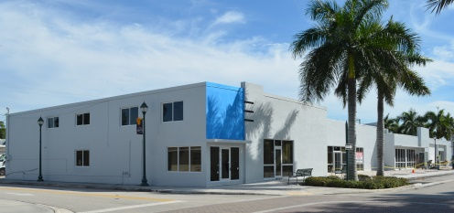

New Businesses
Funky Buddha Brewery -expanded from 18,000 to 60,000 sf in from 2013-15
Alberte’s
Tenth Level Tavern
Switchbox Coffee Roasters
Allied Kitchen and Bath
G21 Spinning Studio
Tatts and Tacos
Yellow Pear Design
Design Moves
Lucky’s Market
ChainBridge Distillery

Slide 5
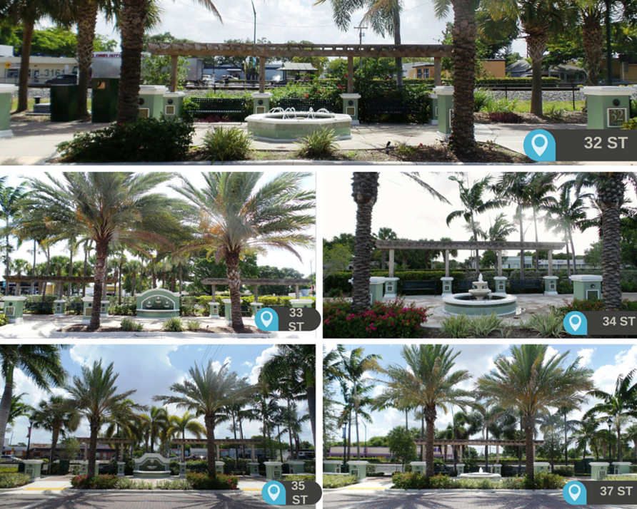
Branding the District
South end fountains

Slide 6
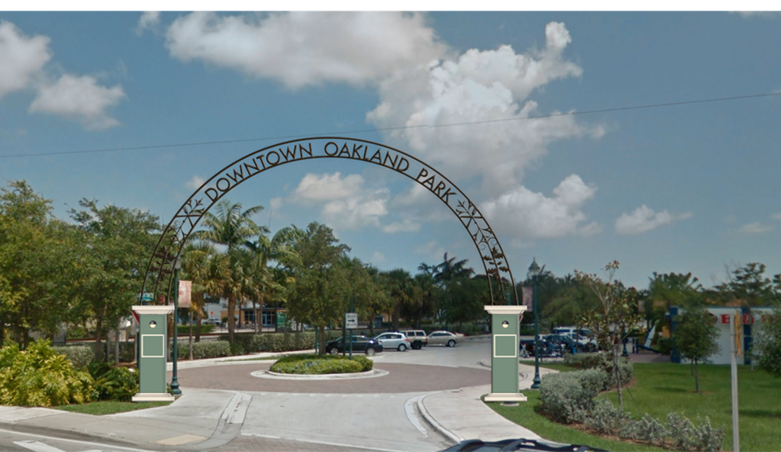
Branding the District
Southern entry at Oakland Park Boulevard
Completed June 2016

Slide 7
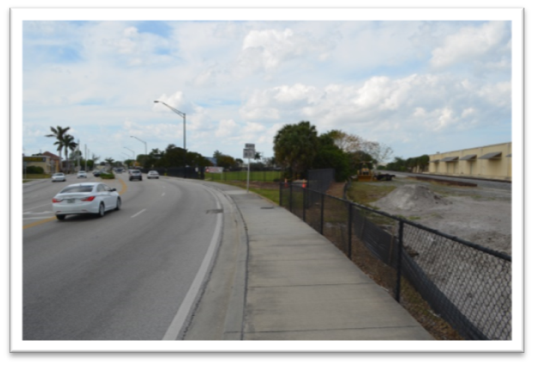
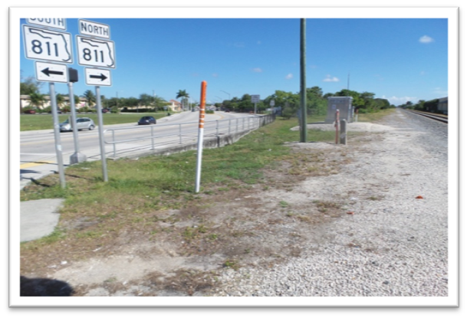
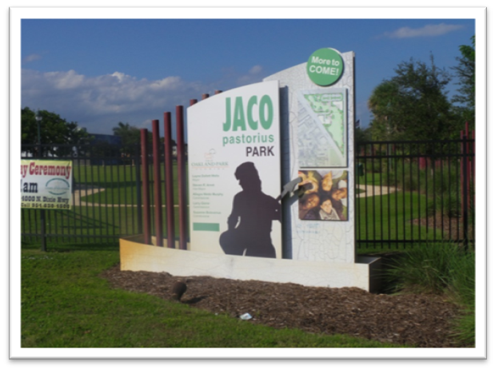
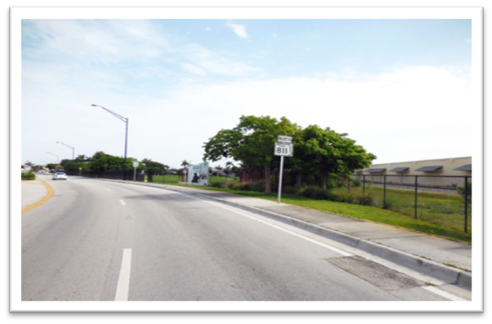
Branding the District
Before
Entry to Jaco Pastorius Park

Slide 8
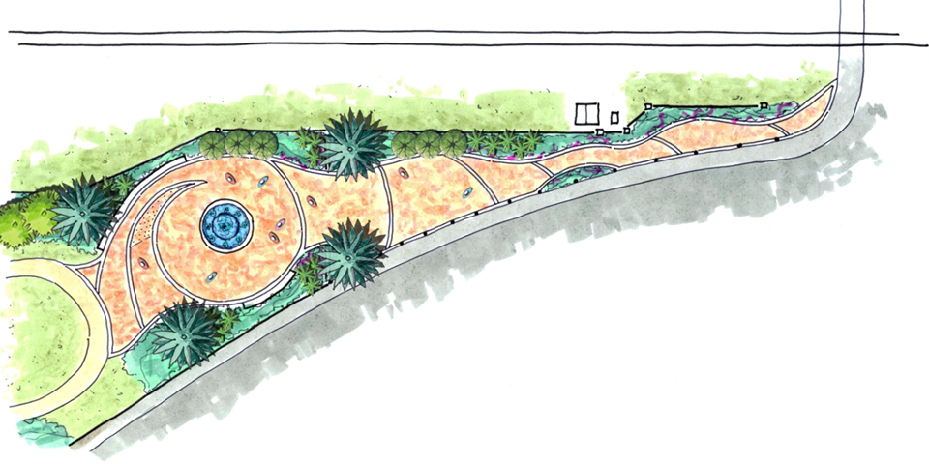
Connector Project Goals
Vibrant, walkable Downtown with restaurants, services, events that provide jobs
Safer, more accessible entryway to Jaco Pastorius Park, site of many major events, from Main Street
Provide incentive for redevelopment on Main Street and west side of Dixie

Slide 9
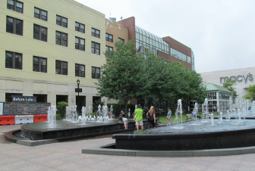
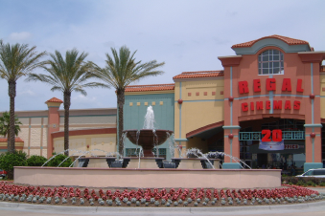
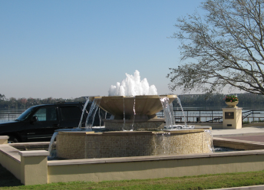
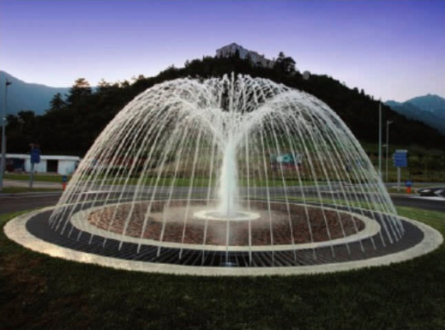
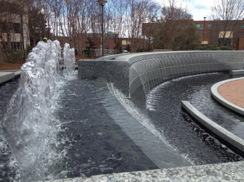
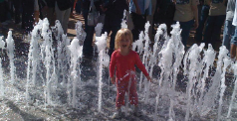
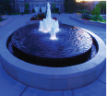
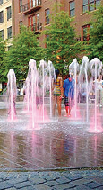
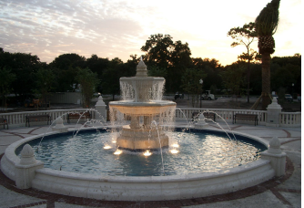
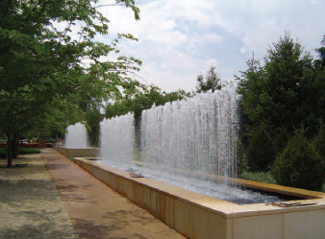
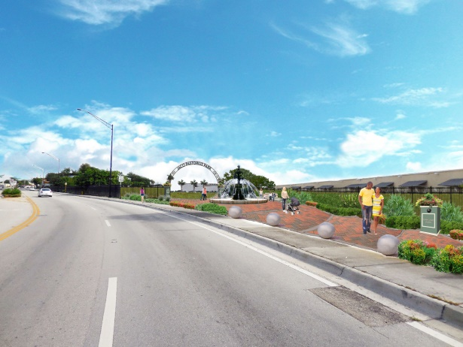
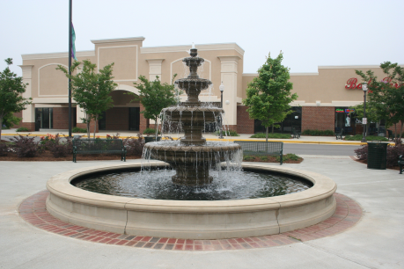
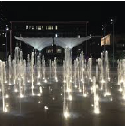
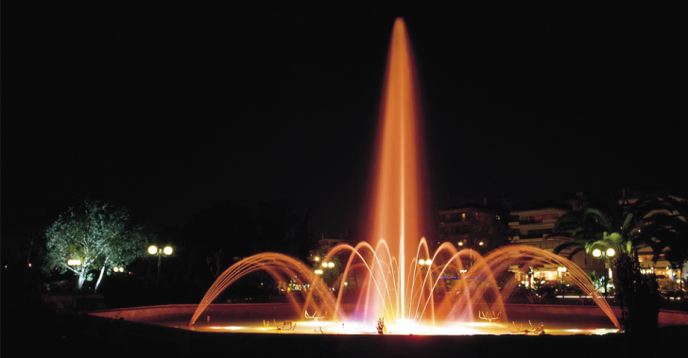
150 fountains later…

Slide 10
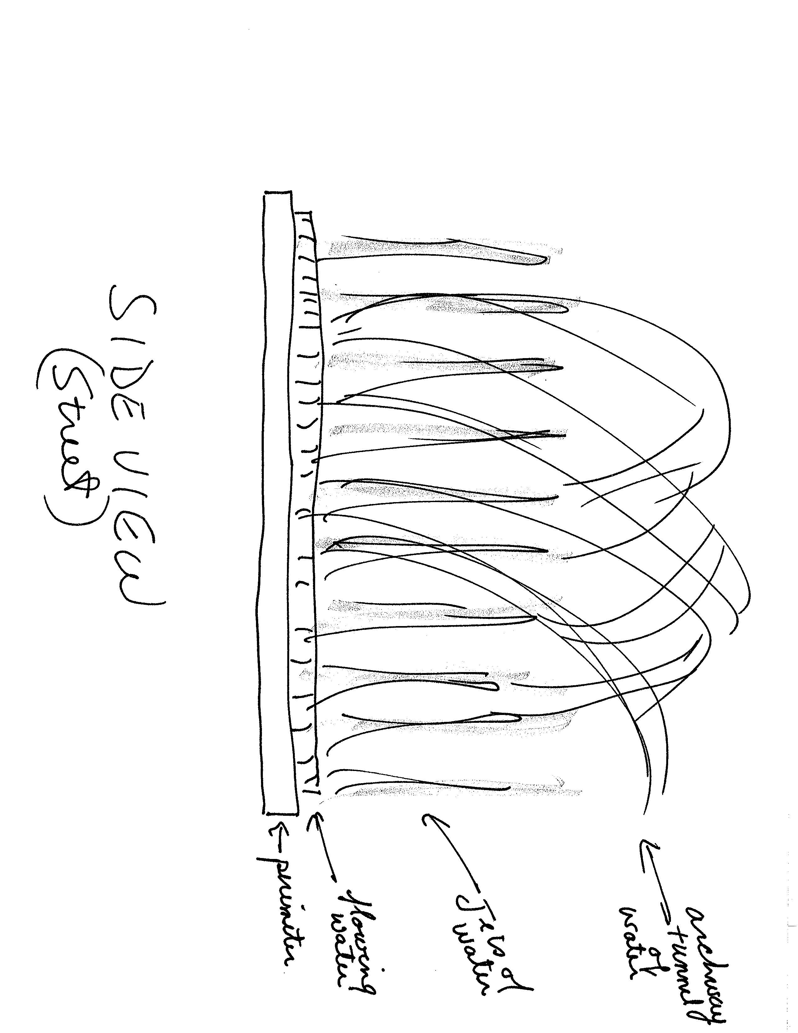
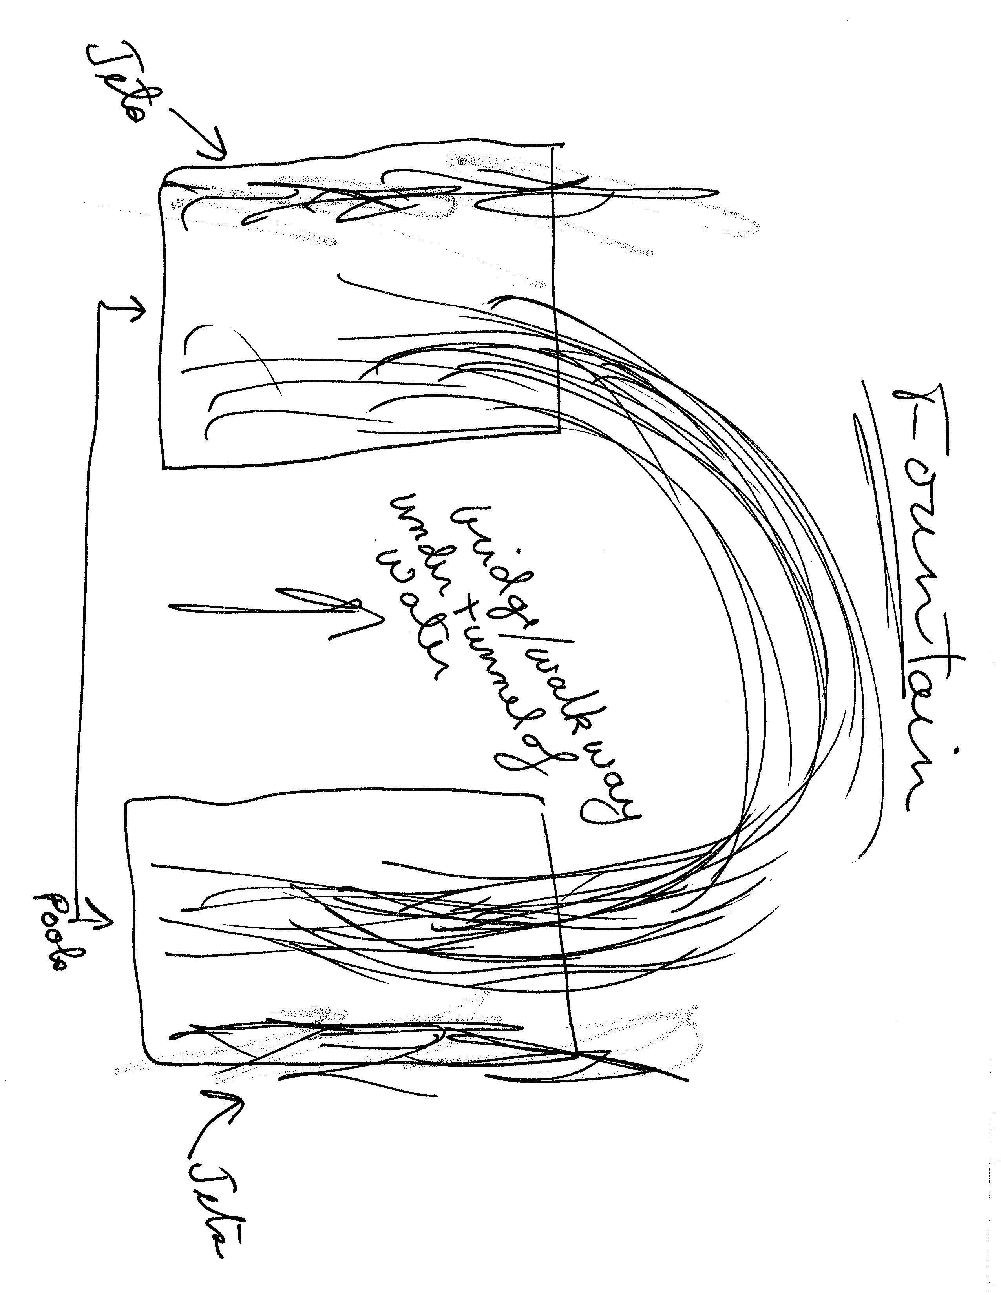
How the Concept Evolved

Slide 11
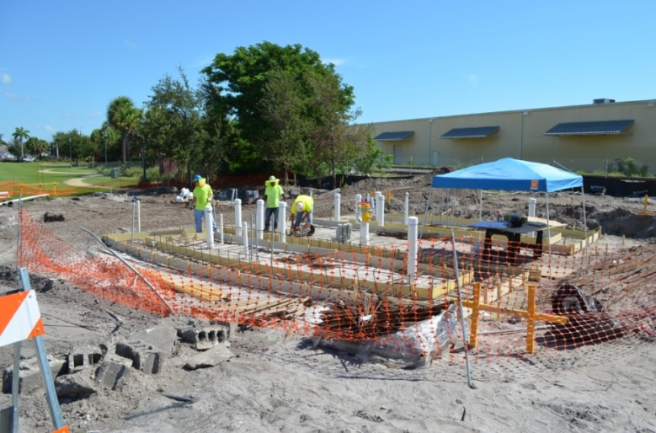
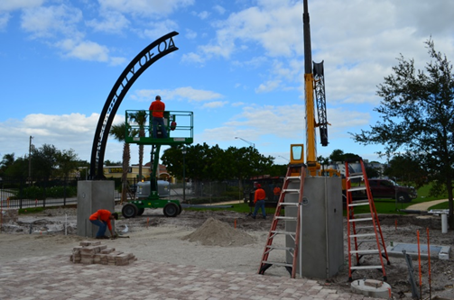
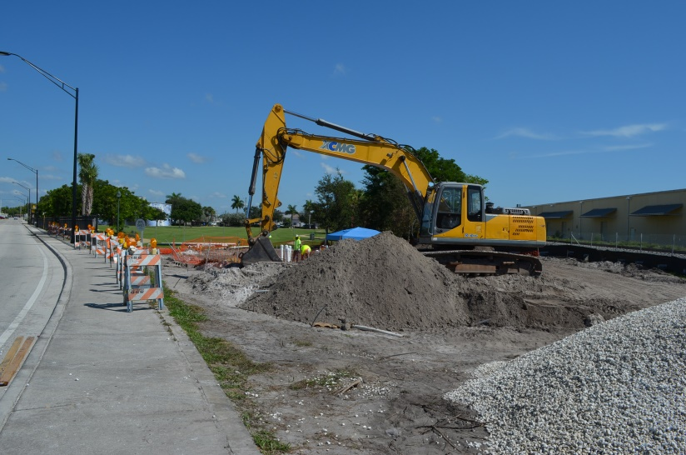
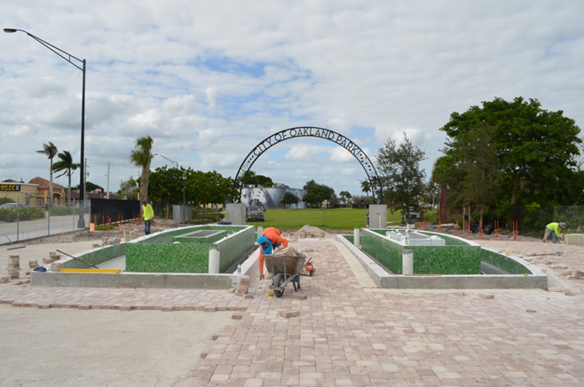
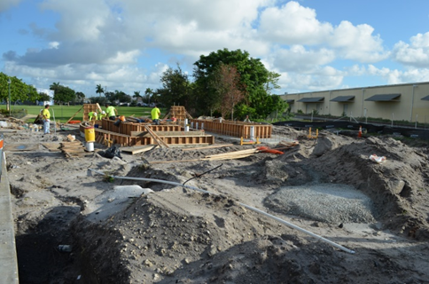
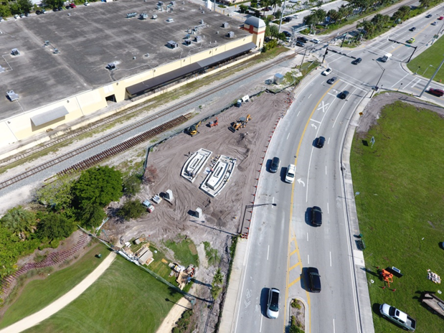
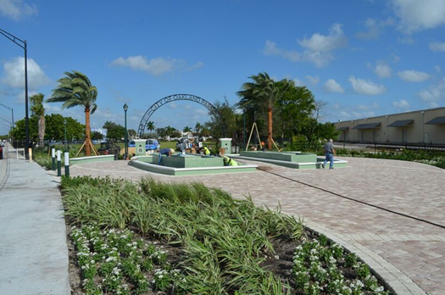
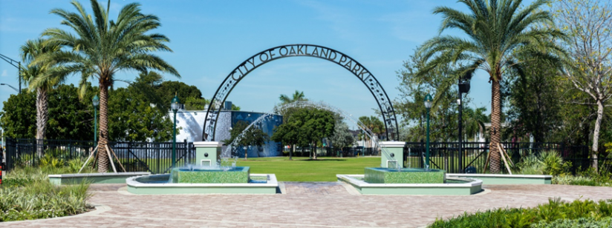
Construction

Slide 12
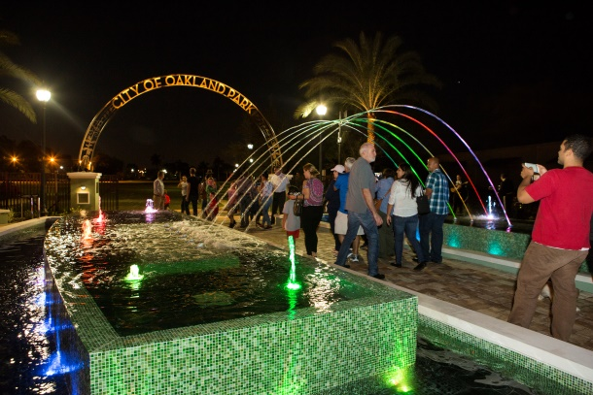
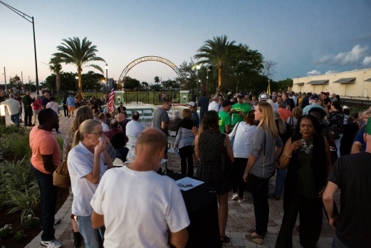
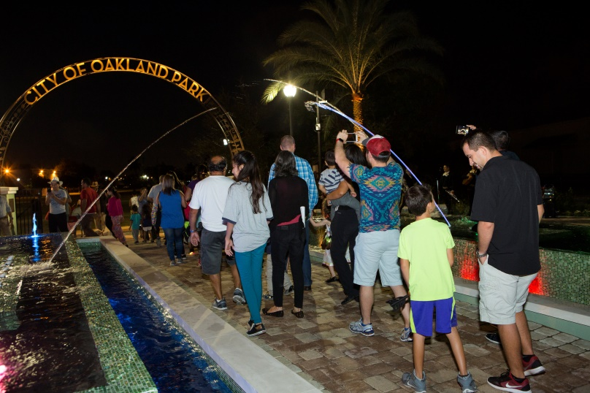

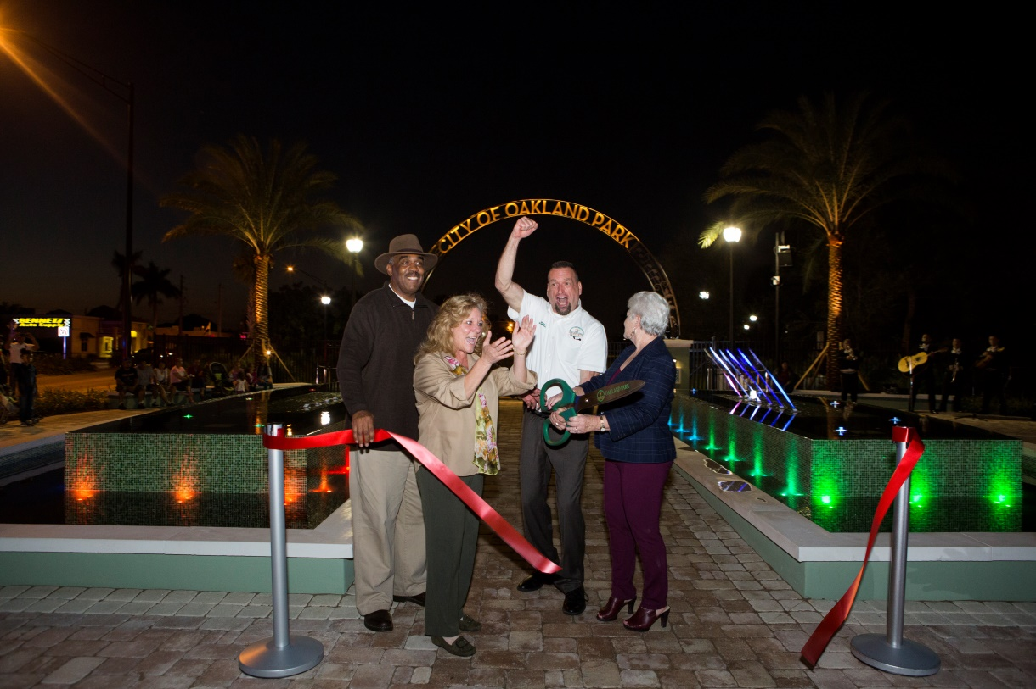




Slide 13











New Events Connecting Jaco Pastorius Park to Main Street
Holiday Village
Taste of Oakland Park
Dancing in the Street

Slide 14

A Vision Made Reality
For additional information on our City visit our website at www.oaklandparkfl.gov
To view a video of “Our Story” please visit www.oaklandparkfl.gov/civicmedia?vid=6#player

