Slide 1
Hammock Shores Subdivision
Town of Palm Shores

Slide 2
Inspiring Investment – New Residential subdivision
Damaged by Hurricane Jeanne in 2004 complete with blue tarp roof and squatters this property was demolished in 2008
The property was purchased and a 52 affordable home subdivision called Hammock Shores began construction in January of 2016 was completely sold out and the last home was completed in August of 2016.

Slide 3
Before

Slide 4
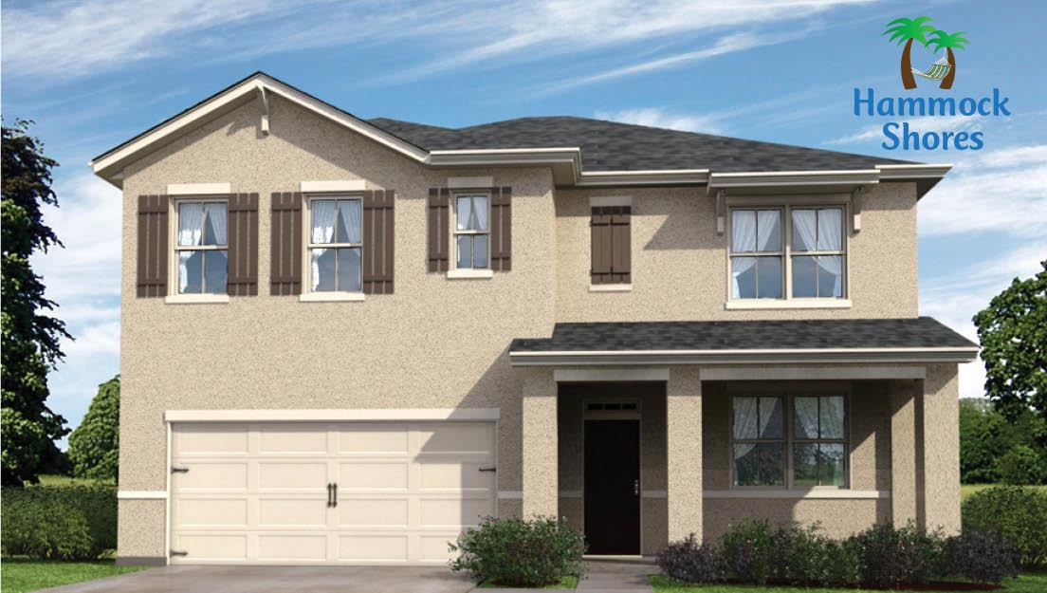
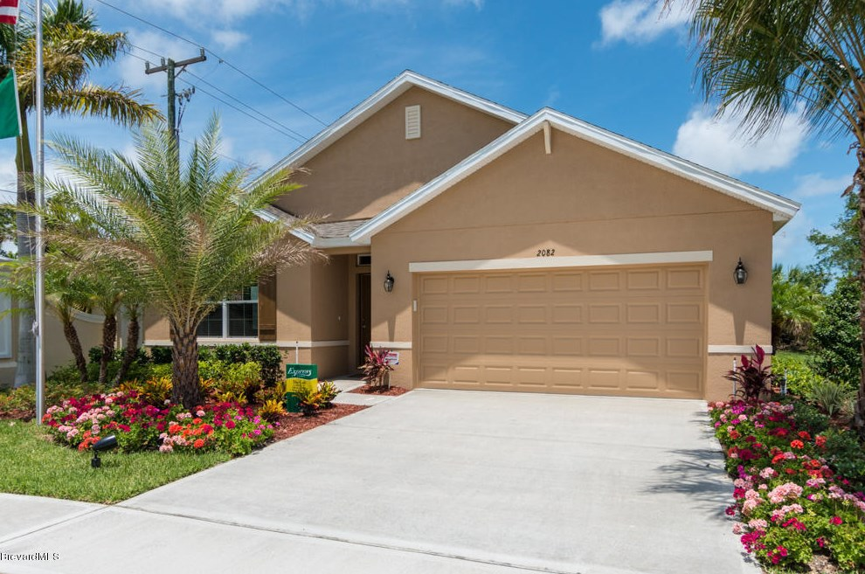
After

