Slide 1
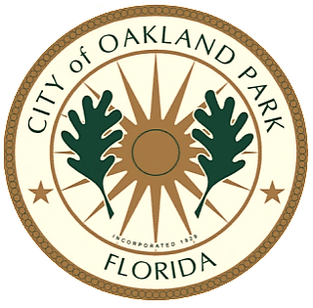
Oakland Park Community Redevelopment Agency
Drawing Development and Culinary Innovation to Downtown Oakland Park Through Events

Slide 2
We are cultivating a Downtown Culinary Arts District
The Culinary Arts District is bordered in the south by Oakland Park Boulevard and the north by NW 40th Court, and three blocks east and west from Dixie Highway. On the east side of Dixie, Main Street (NE 12th Ave.) runs from Park Lane East to Oakland Park Boulevard along the FEC railway. City Hall is located at 3650 Main Street.

Slide 3
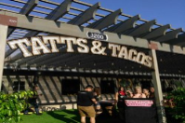
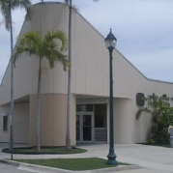
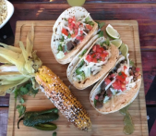
Culinary Arts District Downtown Map

Slide 4
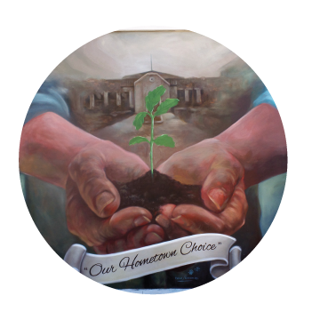
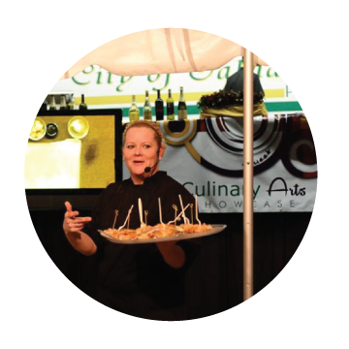
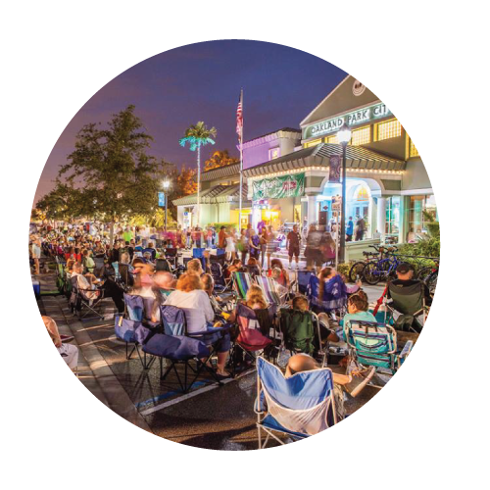
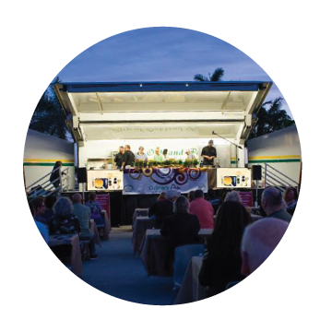
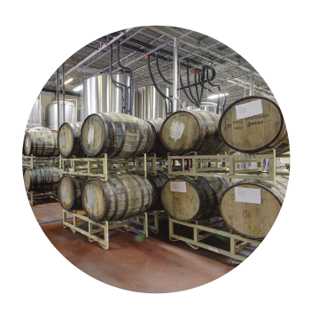
Our BUZZ
Art Park Cultural Events
Culinary Classes
Music
on Main
(Monthly)
Oktoberfest
(Annually)
Culinary Arts Showcase
(Monthly)
Funky Buddha Craft Brewery Tours
Over 100 Events & Activities Annually

Slide 5
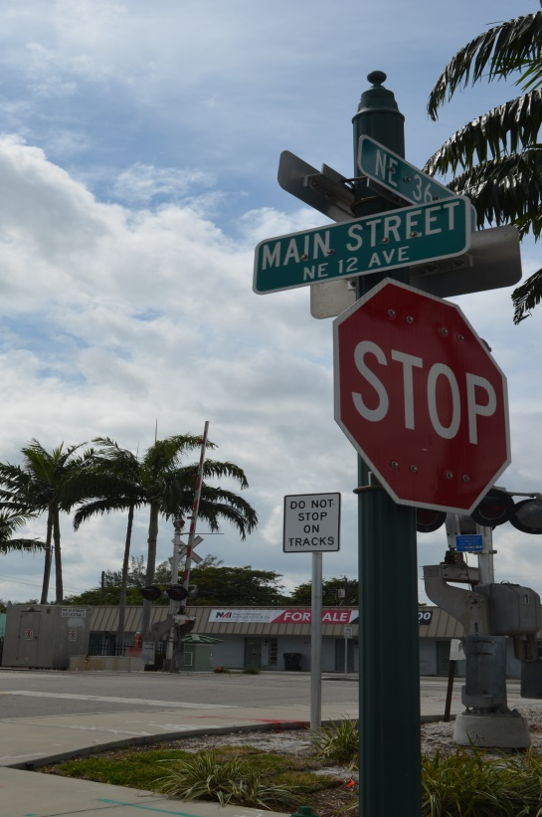
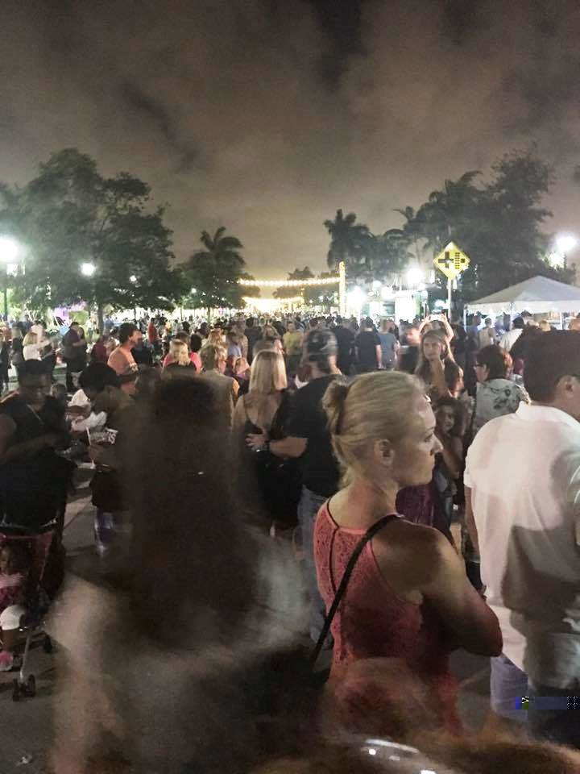
Cultural Facilities Grant
The City was awarded a $500,000 Florida Cultural Facilities Grant designating Main Street as a “cultural facility”. This is the first time the State of Florida has designated a street as a cultural facility.

Slide 6
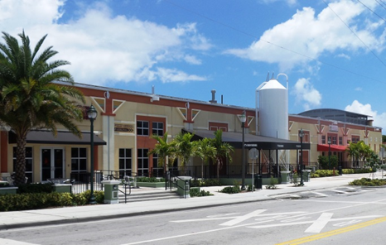
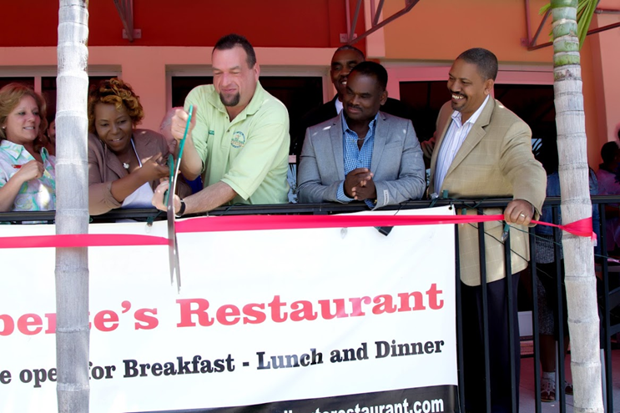
North Anchor Oakland Station Plaza
Since opening in 2013, Funky Buddha Brewery has created 53 full-time and 62 part-time jobs. Last year, the brewery expanded its facility to host special events and meetings, offer catering services, and open a new craft kitchen.
Alberte’s Restaurant , a Caribbean cuisine restaurant, held a ribbon cutting on April 9th. Several members of the City Commission and the Haitian American Chamber of Commerce were in attendance.

Slide 7
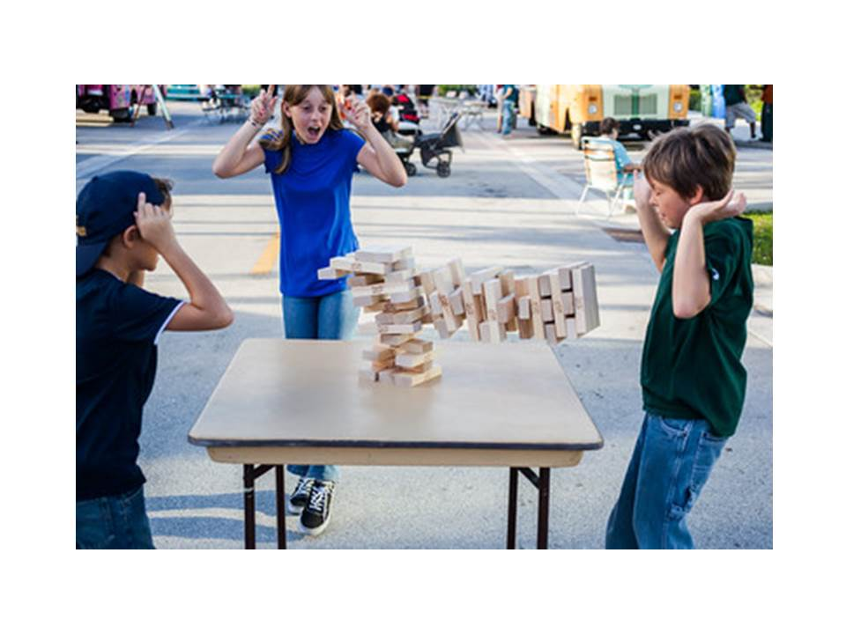
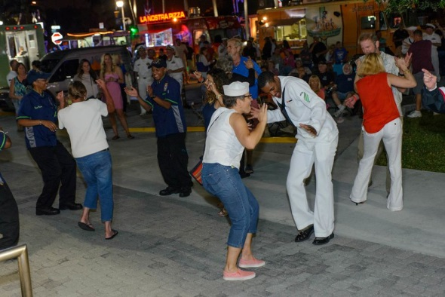
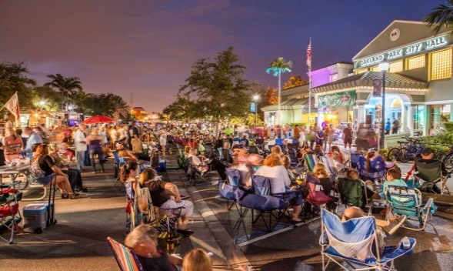
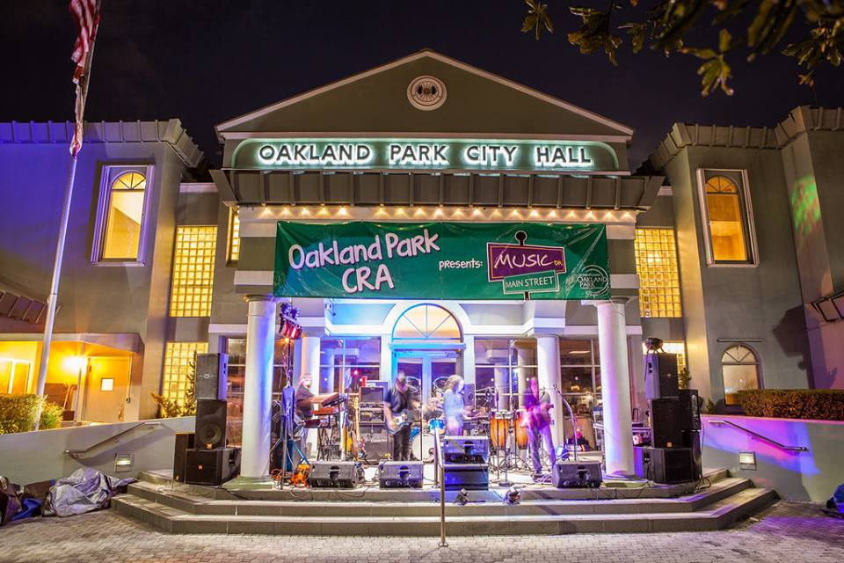
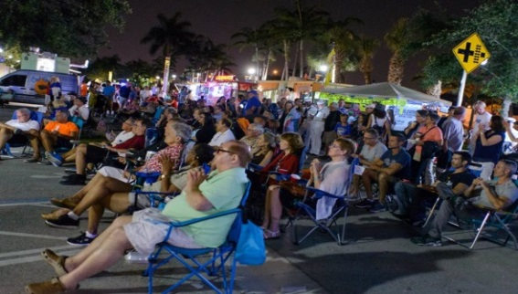
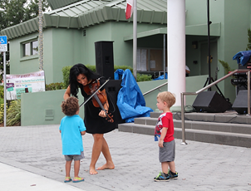
Our Community Events Music on Main Street
The 4th Friday of each month, the Oakland Park City Hall turns into a stage to host Music on Main Street, a monthly concert and food truck event, designed to bring traffic to the downtown, to attract investors and build community.

Slide 8
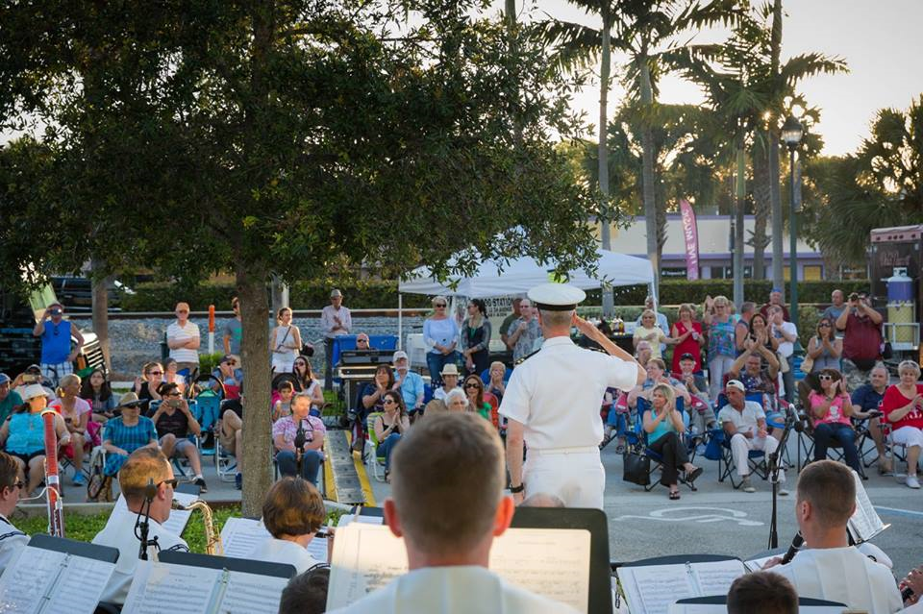
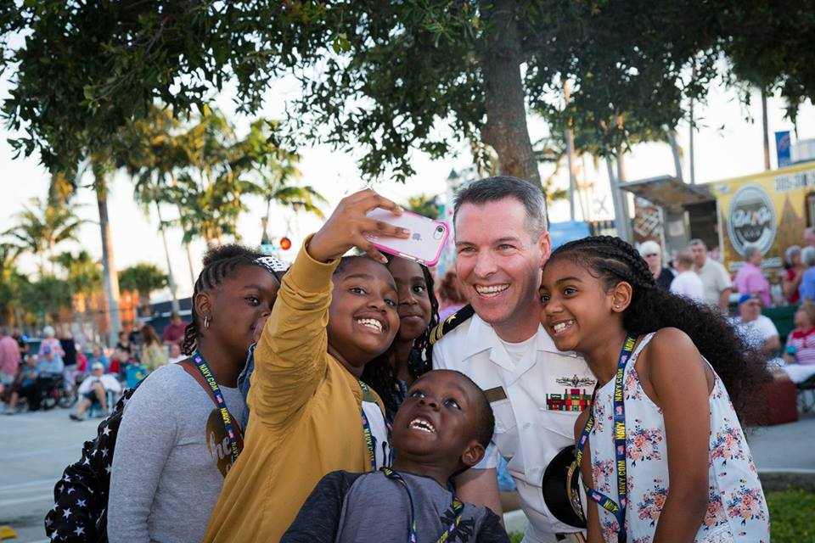
Our Community Events
Music on Main Street Navy Days
Broward Navy Days is an annual countrywide event held during Fleet Week. In 2016, the 7-piece Navy rock band gave a concert at City Hall. In 2017, due to the overwhelming positive reception, they asked to return and brought the 35- piece Navy Band Southeast.

Slide 9
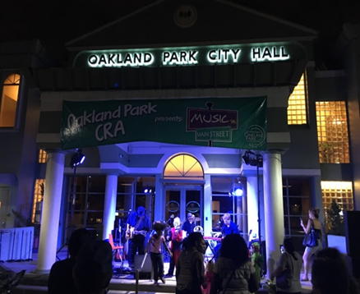
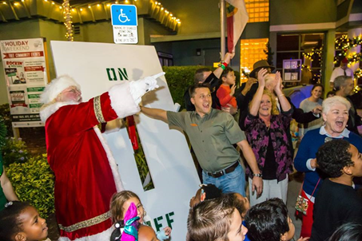
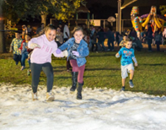
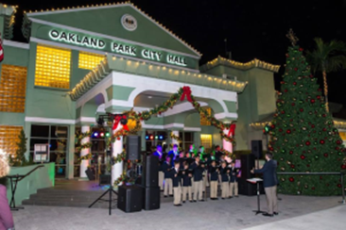
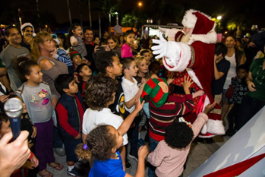
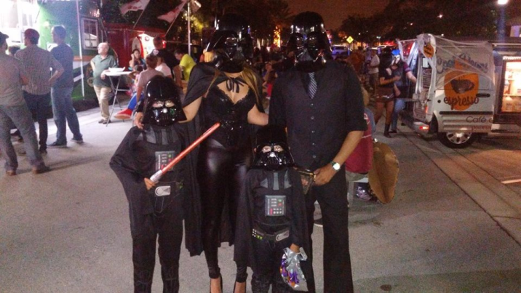
Our Community Events
Music on Main Street Falloween
Music on Main Street Rockin’ Santa

Slide 10
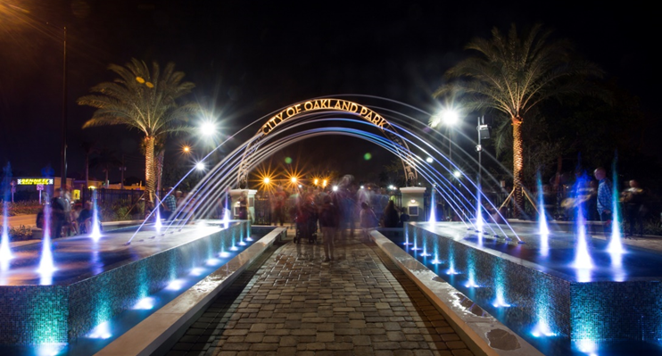
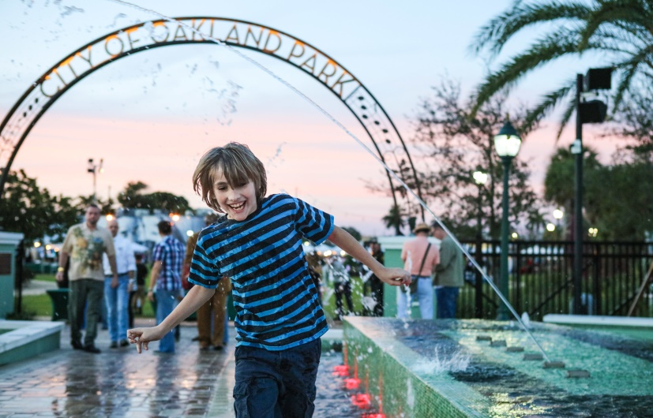
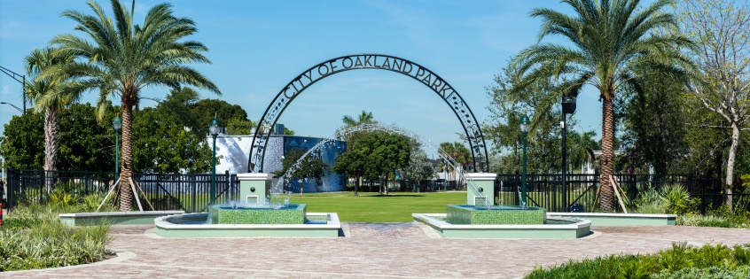
The Grand Plaza at Jaco Pastorius Park
The recently constructed Grand Plaza expands the City’s downtown event park and serves as the northern gateway to Oakland Park’s Culinary Arts District. The Plaza – with its decorative fountain and archway – connects Jaco Pastorius Park to Main Street.

Slide 11
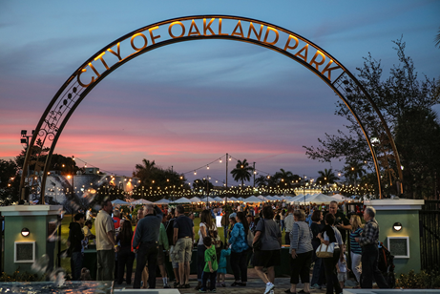
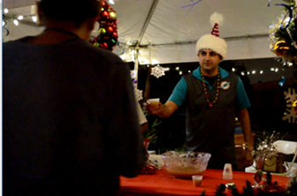
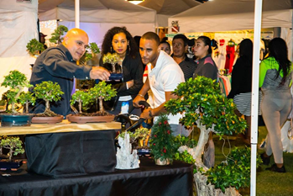
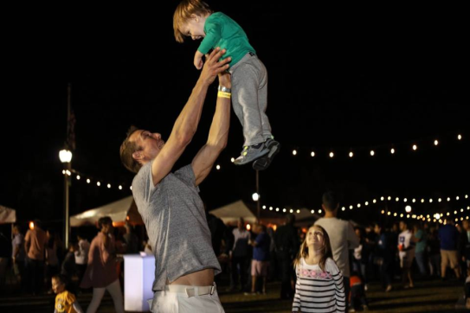
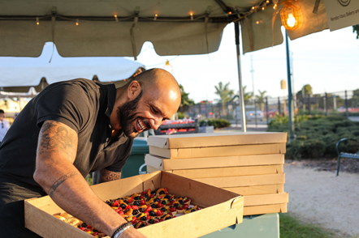
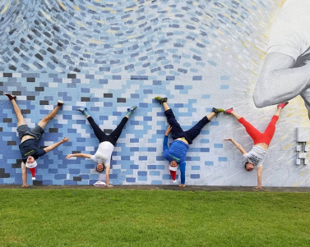
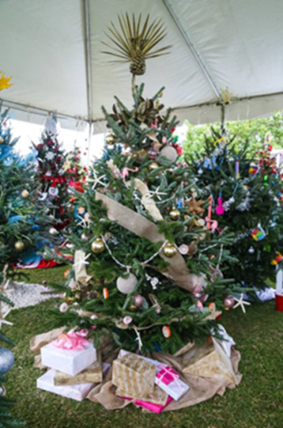
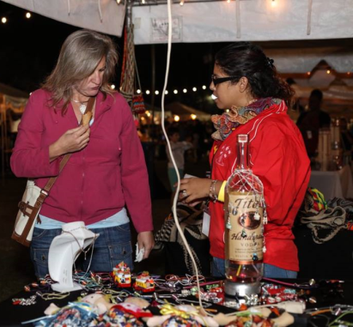
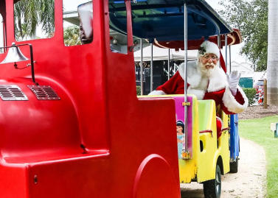
New Events at Jaco Pastorius Park
Holiday Village
Taste of Oakland Park

Slide 12
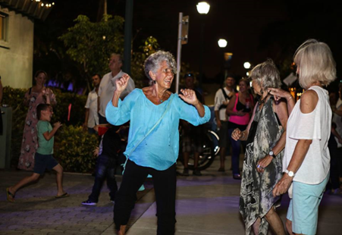
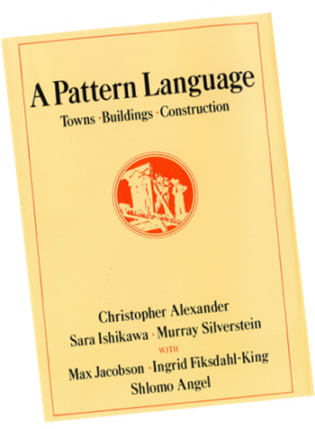
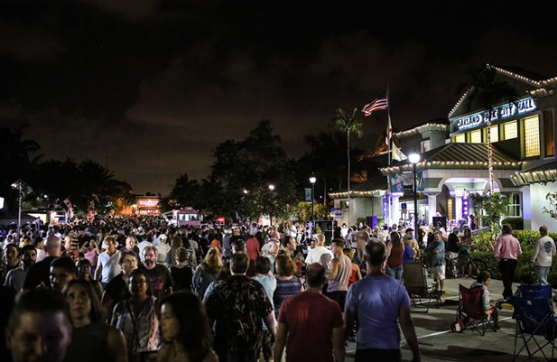
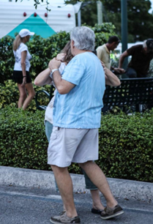
New Signature Event Music on Main Street… Dancing in the Street
All over the earth, people once danced in the street: in theatre, song and natural speech, “dancing in the street” is an image of supreme joy

Slide 13
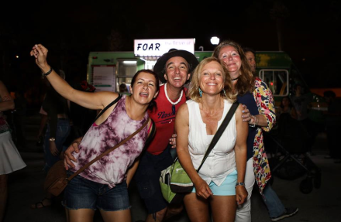
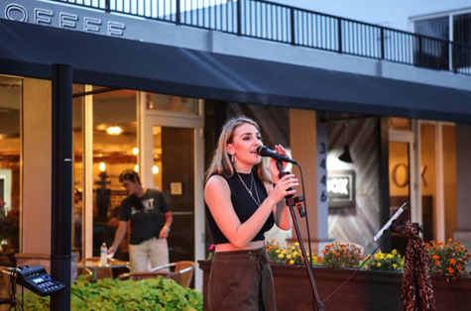
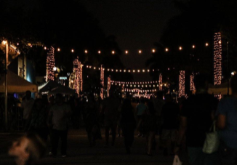
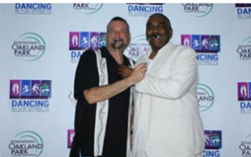
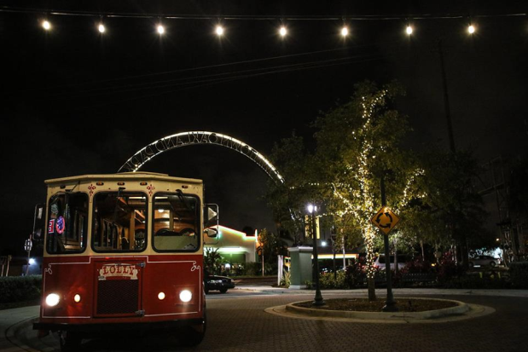
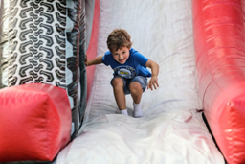
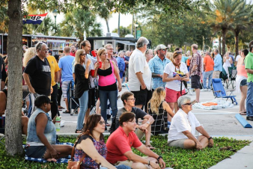
New Signature Event Music on Main Street… Dancing in the Street
On Friday, April 28th, the City held its first Dancing in the Street event, a mile-long block party on Main Street (N.E. 12th Ave.) from Jaco Pastorius Park to Oakland Park Boulevard. The event featured 9 stages, food trucks, local bands, and activities sponsored by local businesses.
The inaugural event attracted 5,000 people.

Slide 14
Attracting New Businesses “How Oakland Park Got Cool”
ChainBridge Distillery
Tatts & Tacos

Slide 15
For additional information on our City visit our website at www.oaklandparkfl.gov
To view a video of “Our Story” please visit www.oaklandparkfl.gov/civicmedia?vid=6#player

