Slide 1
2016 Roy F. Kenzie Awards Creative Partnerships – Titusville Welcome Center Partnership

Slide 2
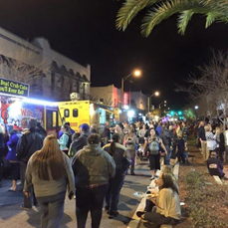
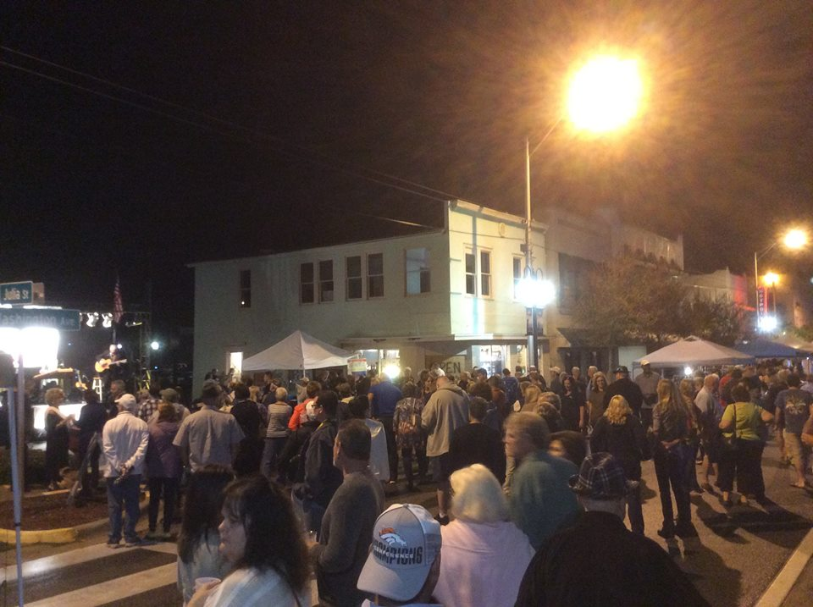
Creative Partnership – Titusville Welcome Center Partnership
Issue: A need for public restrooms in the downtown to accommodate shoppers and special event crowds.

Slide 3
Creative Partnership – Titusville Welcome Center Partnership
Titusville found itself positioned to be the East Central Florida Trail Hub with the convergence of 3 major planned trails:
Florida Coast to Coast Trail
Eastern Greenway Trail
St. Johns to Sea Loop Trail
City/CRA Goal of becoming a “Trail Town”

Slide 4
Creative Partnership – Titusville Welcome Center Partnership
Idea – build a Welcome Center with restroom facilities to service downtown and the expected trail users while also promoting the city/area and priming the trail use with a bike shop concessionaire.

Slide 5
Creative Partnership – Titusville Welcome Center Partnership
The Titusville CRA funded the construction of the Welcome Center at a cost of $329,278.
The City entered into a memorandum of understanding with the Titusville Chamber of Commerce to provide ambassadors & materials for viewing and distributing about the trails & local attractions.
The City issued a Request for Proposals for a Welcome Center Bike Shop Concessionaire to operate a professional bike shop for repair, sales & rentals at an attractive rate.
Together the entities provide a superior visitor experience that none could provide themselves.

Slide 6
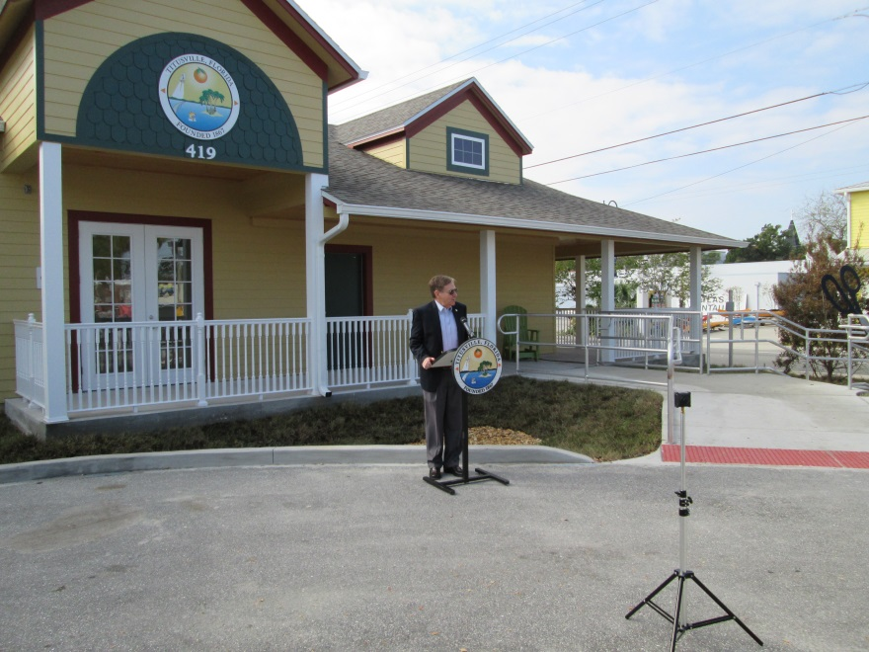
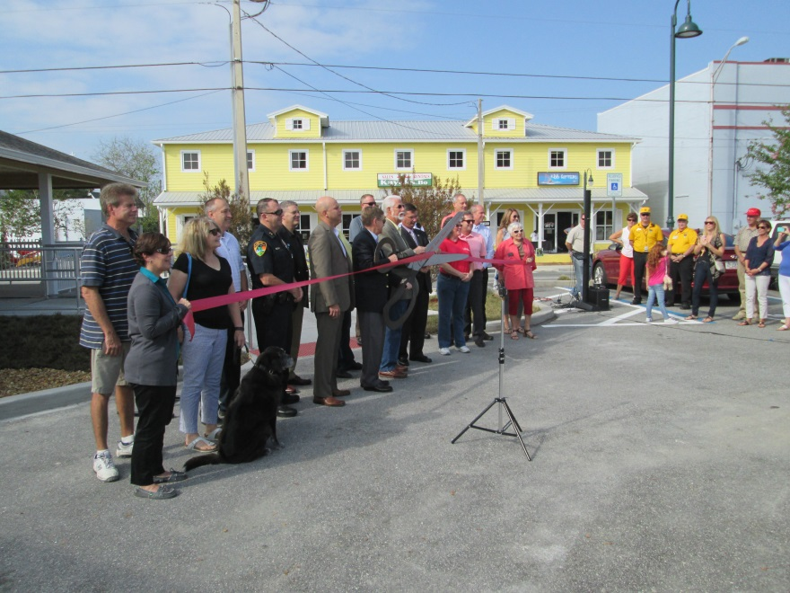
Creative Partnership – Titusville Welcome Center Partnership
The Welcome Center opened in January, 2017

Slide 7
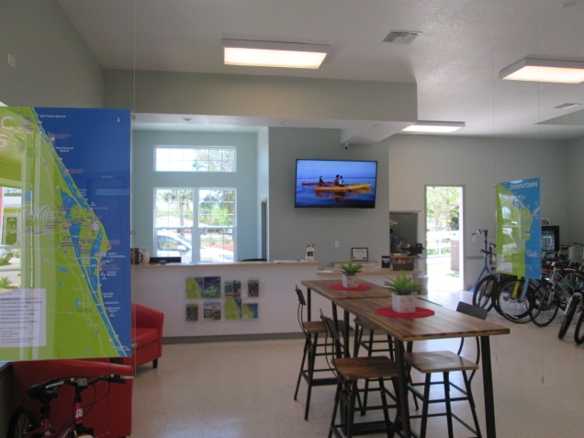
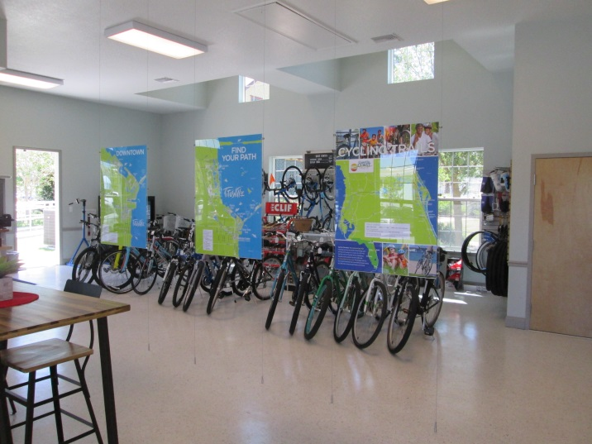
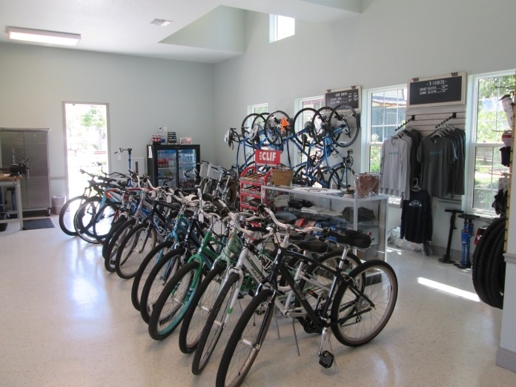
Creative Partnership – Titusville Welcome Center Partnership
Photos of the Welcome Center shared interior space between the Chamber of Commerce informational area & the Coast to Coast Bicycle Company.

Slide 8
Creative Partnership – Titusville Welcome Center Partnership
Impact on the Community of the partnership:
864 people visited in February, 2017, the first month of full operation.
909 people visited in March, 2017.
Visitors have come from:
6 Continents
25 Countries
42 States

Slide 9
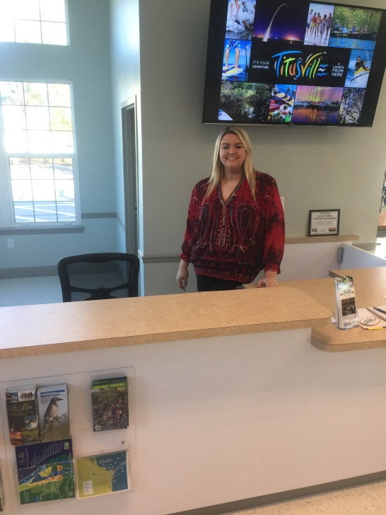
Creative Partnership – Titusville Welcome Center Partnership
Carrie Overfelt, Coast to Coast Bicycle Company, Co-Owner
Nicole Hall, Chamber of Commerce Welcome Center Ambassador
Together We Can Become a Trail Town!

Slide 10
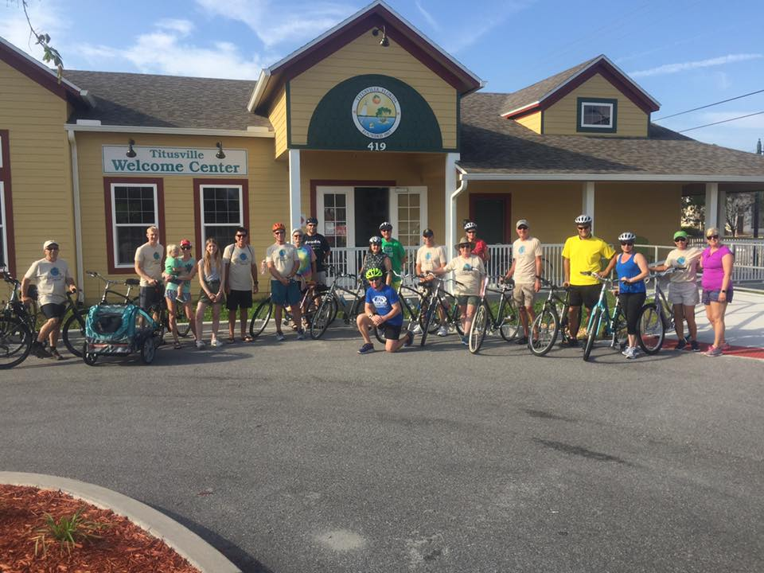
Creative Partnership – Titusville Welcome Center Partnership
Group ride organized by the Coast to Coast Bicycle Company
Together We Can Become a Trail Town!

