Slide 1
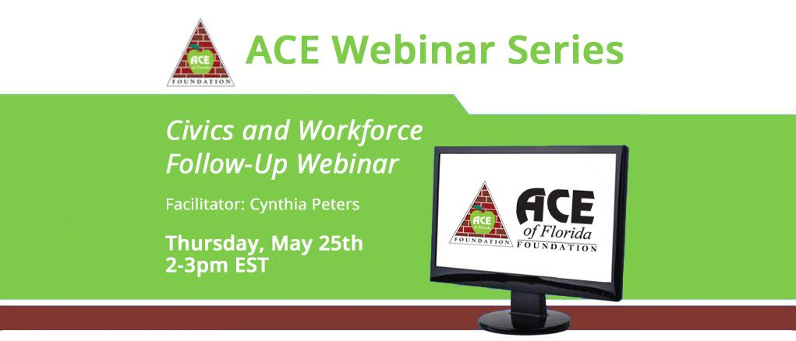
Cynthia Peters
cpeters@worlded.org

Slide 2
Agenda for webinar, 2-3
2:00 – 2:10: Intros./Welcome
2:10 – 2:45: Teacher share:
Daisy Shah – human bar graph
Dayna Foster – human bar graph
Bryce Forrester – workplace safety
Tracy Dean – All about Food
2:45 – 2:50: Tips and tricks for how to navigate hard conversations in the classroom
2:50 – 2:55: Ideas for using the Audio

Slide 3
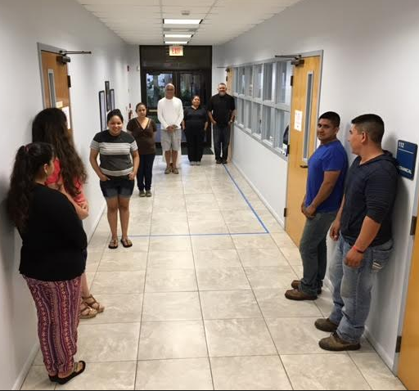
Dayna Foster’s Class at Indian River State College: The Human Bar Graph

Slide 4
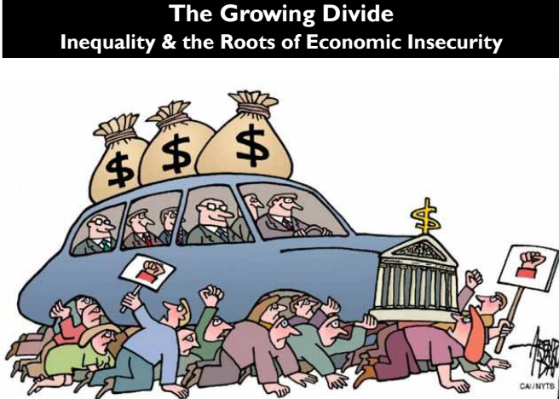
Dayna used these slides from faireconomy.org/growing_divide
Notes:
This one and next two are Dayna’s

Slide 5
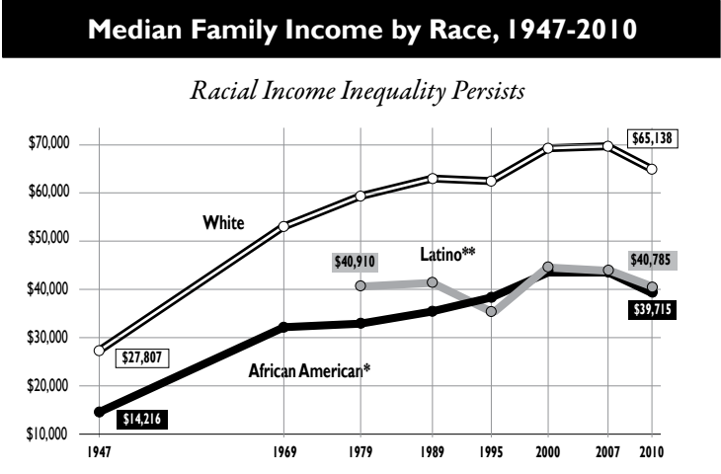

Slide 6
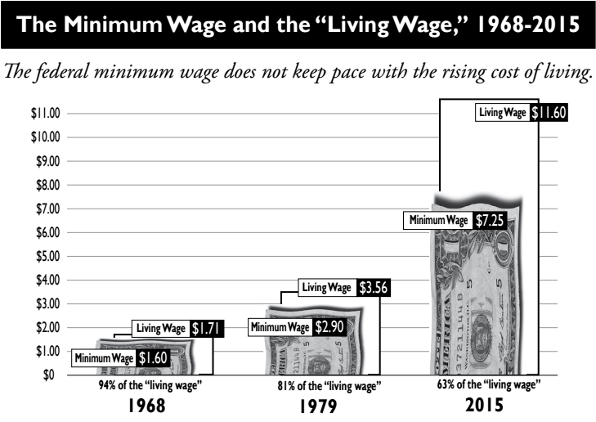

Slide 7
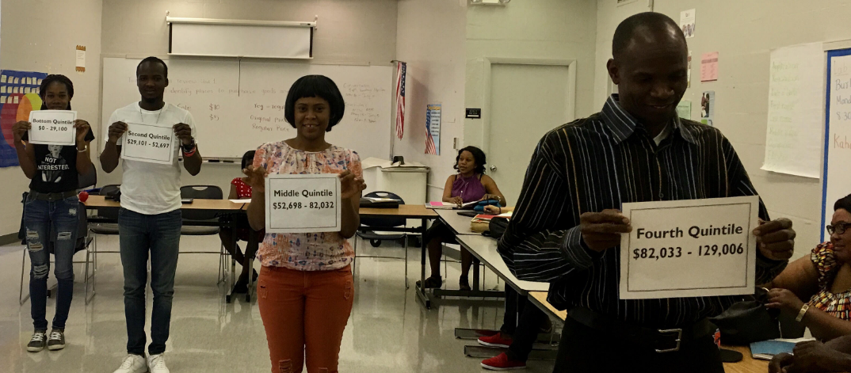
Daisy Shah, Palm Beach Schools: Human Bar Graph & Equality vs. Equity image

Slide 8
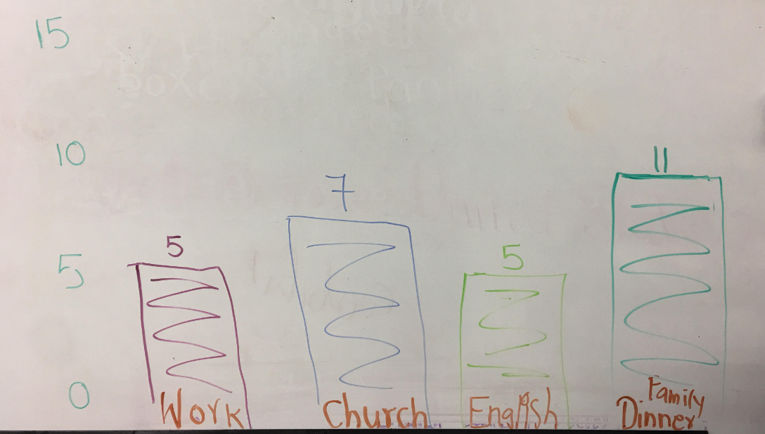

Slide 9
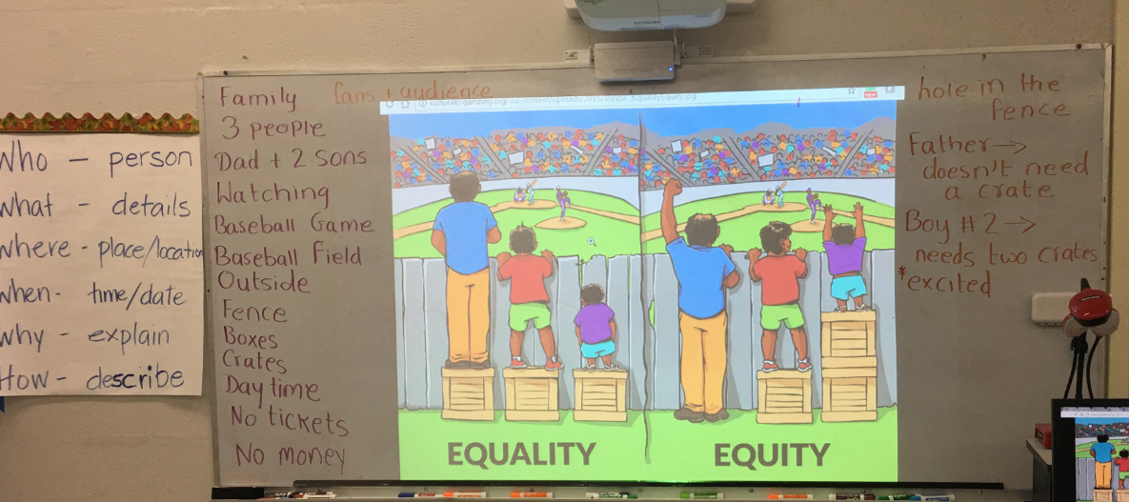

Slide 10
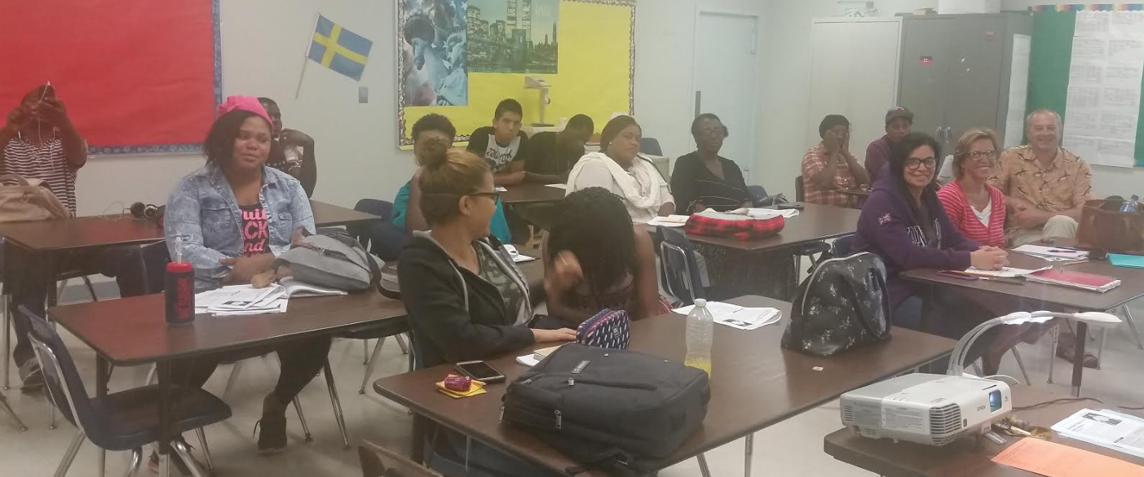
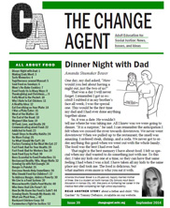
Tracy Dean, Broward Schools: “All about Food”

Slide 11
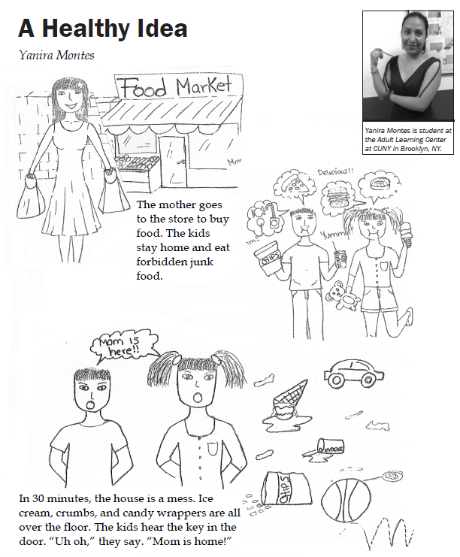
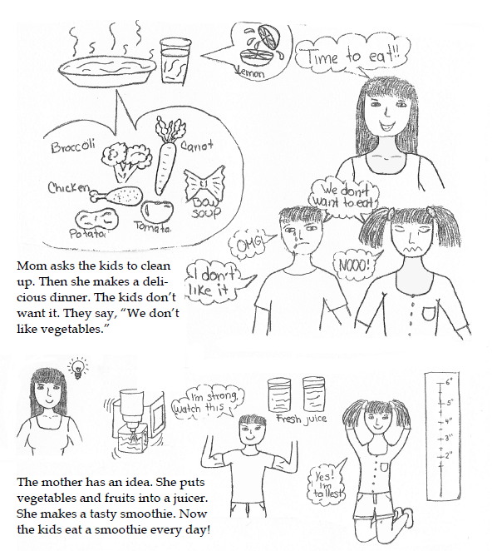
pp. 12-13 of the “All about Food” issue.

Slide 12
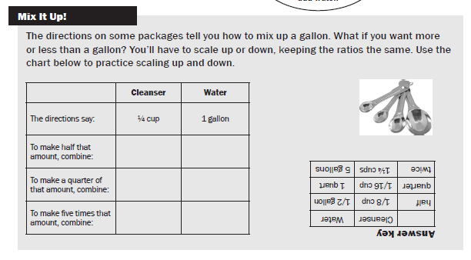
p. 38 of the “Staying Safe in a Toxic World,” issue #32.

Slide 13
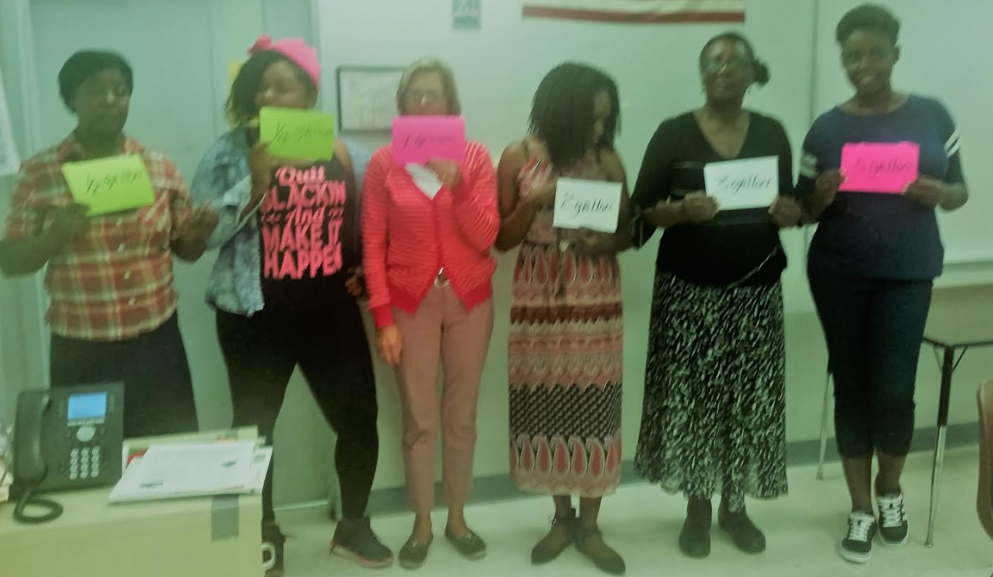

Slide 14
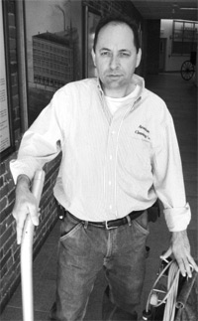
Bryce Forrester, Florida Dept. of Corrections: Workplace Safety – Learn It and Teach It! changeagent.nelrc.org/in-the-classroom/lesson-packets/
“This was a great opportunity to read and talk with the students at a different level than just teacher/student.”

Slide 15
OSHA materials!
OSHA materials (workplace safety poster and pamphlet) came in the mail very quickly once requested. So it is possible to do the complete lesson including the last activity using the OSHA reference.

Slide 16
“The Case of the Frozen Trucker”
This article fit nicely in our group discussion. Reading the article together after completing the worksheets allowed us to more intelligently form opinions.
www.cnn.com/2017/03/21/opinions/judge-gorsuch-the-frozen-truck-driver-opinion-callan/

Slide 17
Resources for Hard Conversations in the Classroom
LGBTQ:
Be clear about your goals.
Check in with yourself.
Make a plan.
Prepare your class.
Launch your lesson.
Evaluate!

Slide 18
Resources for Hard Conversations in the Classroom
Race:
Think programmatically.
Build community in the class.
Weave in communication and basic skills.
Be intentional about topics you bring to class.
Interact with wider community.
Get Support!

Slide 19
Using Audio in the Classroom
Give students access on their phones. Have them keep a log of what they listen to and what level it is.
Give them UNpunctuated version of the article and ask them to punctuate it based on how it sounds.
Use for dictation!

Slide 20
Scores of Change Agent audio available online and sortable by LEVEL
changeagent.nelrc.org/in-the-classroom/reading-levels
One month free log-in is over today!
Please consider subscribing: $20 per teacher per year!
Notes:
Explain how helpful to sort by level. Teachers with just beginners will have plenty to choose from. Students have a degree of transparency about where they are comfortable. Can see increasing mastery in themselves.
Log in for FREE for ONE MONTH. This username and PW is NOT on your powerpoint, so please copy it down now.

Slide 21
Cynthia Peters
cpeters@worlded.org; changeagent.nelrc.org
Notes:
Let people know about survey coming in email.

