Slide 1
Executive Director Report
DDB/CRA
2017 Florida Redevelopment Awards
Capital Projects/Beautification
Downtown Dog Run
City of Orlando, CRA

Slide 2
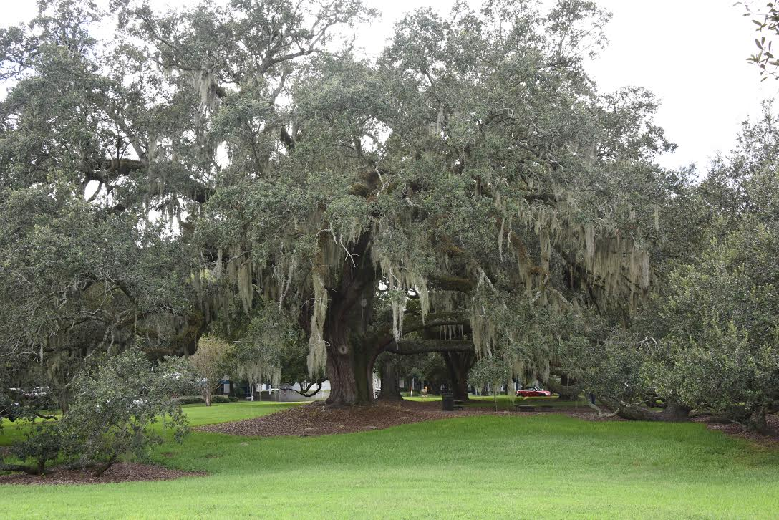
Downtown Dog Run
Overview
The City of Orlando is committed to providing a diverse array of amenities that will enhance the lives of all our residents, ensuring that Orlando is a City for everyone.
In 2015, the City purchased privately-owned property – Constitution Green - preserving this important green space in the heart of Downtown Orlando and saving the historic live oak tree located there.
The City sought ways to further enhance this
community gathering space. Proposed plans
included the creation of Downtown’s first public
dog run.

Slide 3
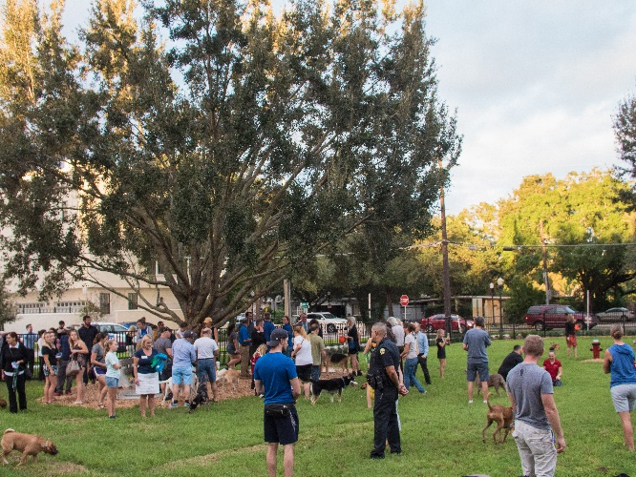
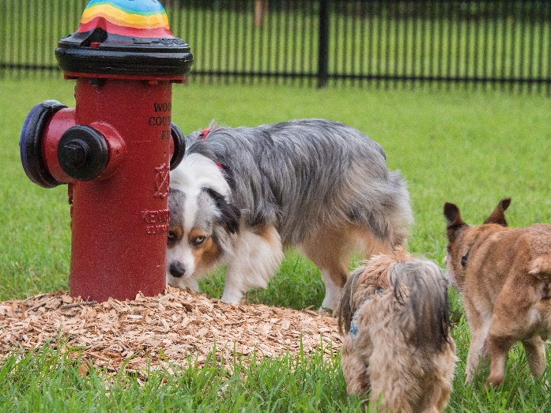
Downtown Dog Run
Innovation
The design builds on the City’s desire for the park to continue to magnetize people to it, strengthening the City and neighborhoods and making Orlando a more attractive place to live, work, play and thrive.
Incorporating a dog run aligns with the Project DTO Vision Plan as one of the 10 vision themes is to create an awesome outdoor City.

Slide 4
Downtown Dog Run
Impact on the Community
Further connects our community and ensure our City Beautiful remains just that, beautiful.
By investing in unique public spaces like Constitution Green we provide our residents, families and children important opportunities to interact, gather, share, create memories, relax and enjoy our awesome outdoor City.
In 2016, Orlando was named the most pet-friendly city in America by WalletHub.com. We will continue to be a City for everyone – including a place for our four-legged friends.
By investing in unique public spaces like the dog run on Constitution Green, we provide our residents, families and children important opportunities to interact, gather, share, create memories, relax and enjoy our awesome outdoor City.

Slide 5
Downtown Dog Run
Funding
In 2015, the City of Orlando purchased Constitution Green for $5.85 million in cash, using funds from its Community Redevelopment Agency budget.
Significant costs were absorbed by other City divisions, including:
Streets and Stormwater provided walks, drainage, and ADA improvements
Families, Park & Recreation provided design, construction oversite, the cost of a new potable water meter, and on-going maintenance of the site now that it is open.
The total cost of the Dog Run at Constitution Green was about $115,000.
Problem Solving
Preserving green space.
In 2014, the City’s Community Redevelopment Agency launched Project DTO, an initiative that laid out ten vision themes for Downtown. One of the vision themes is to create an awesome outdoor City. The dog run furthers this purpose.

Slide 6
Downtown Dog Run
Applicability to Other Communities
Enhancing green space to further community.
Utilizing other departments to work together to share costs and fulfill objectives.
Other Exemplary Aspects of the Design, Plan or Program
The proposed design also builds on the City’s desire for the park to continue to magnetize people to it, strengthening our City and neighborhoods and making Orlando a more attractive place to live, work, play and thrive.
There is free on-site parking available on adjacent roads
A new eight-feet-wide sidewalk was added to improve pedestrian safety and access.
A new flowering tree will be added just outside the dog run adding visual interest and color to the park. This also supports the City’s efforts in planting more trees.
Additional ADA access was provided and upgraded at the intersections surrounding this park. Additionally, an ADA compliant drinking fountain is available.

Slide 7
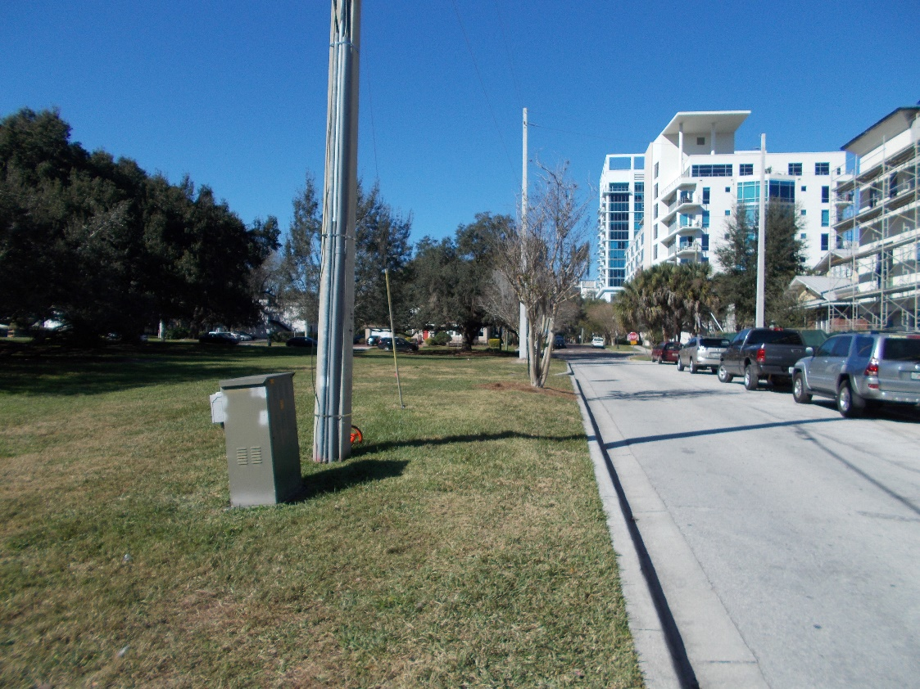
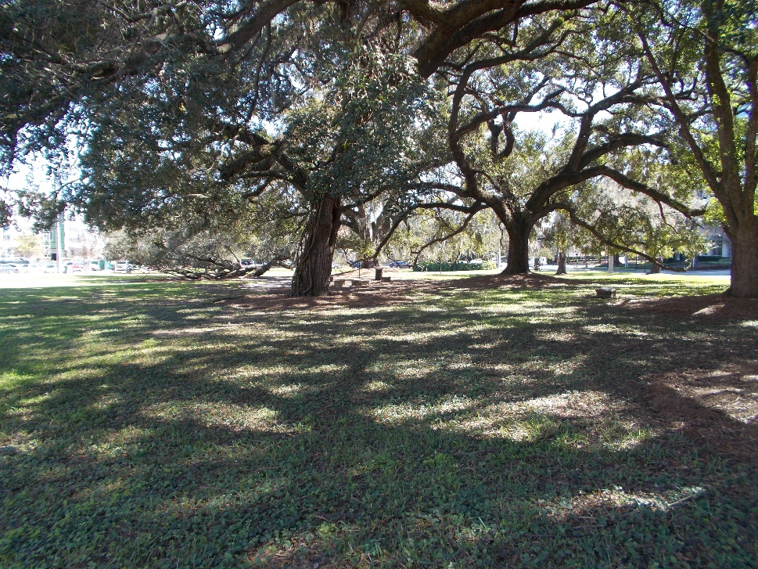
Downtown Dog Run
Before

Slide 8
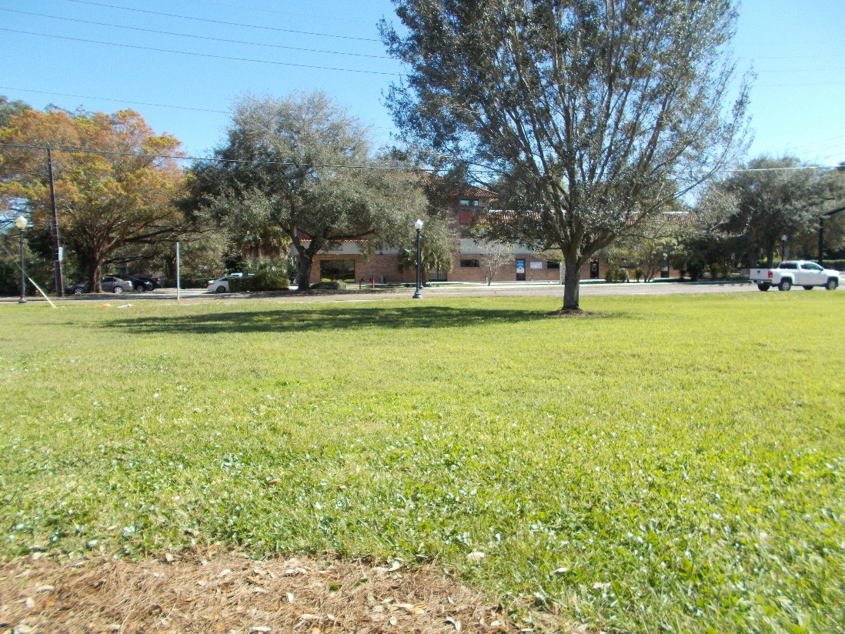
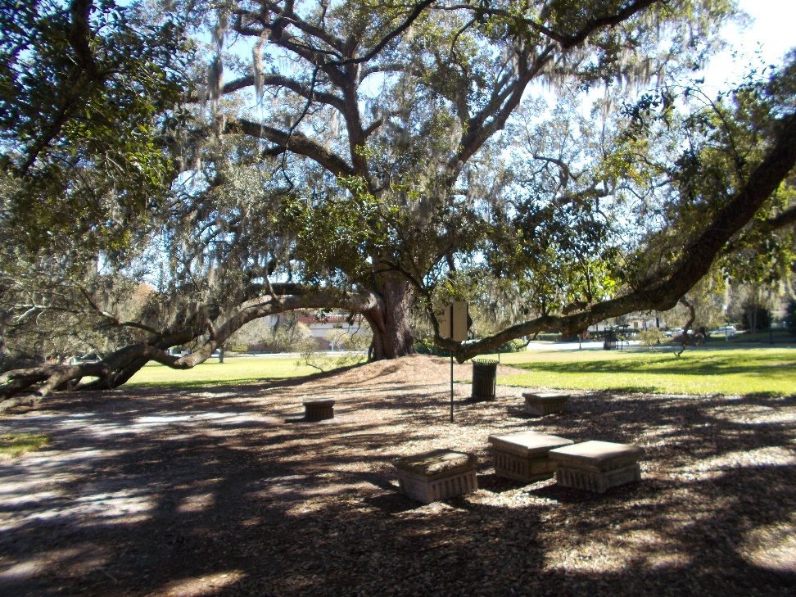
Downtown Dog Run
Before

Slide 9
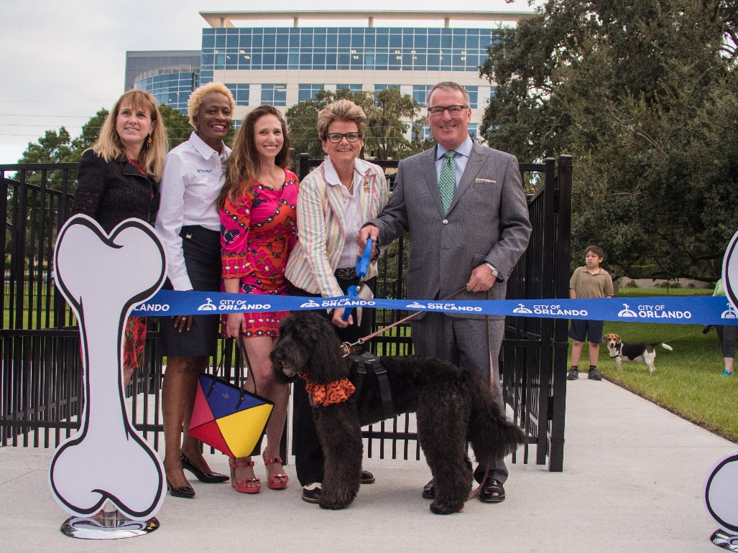
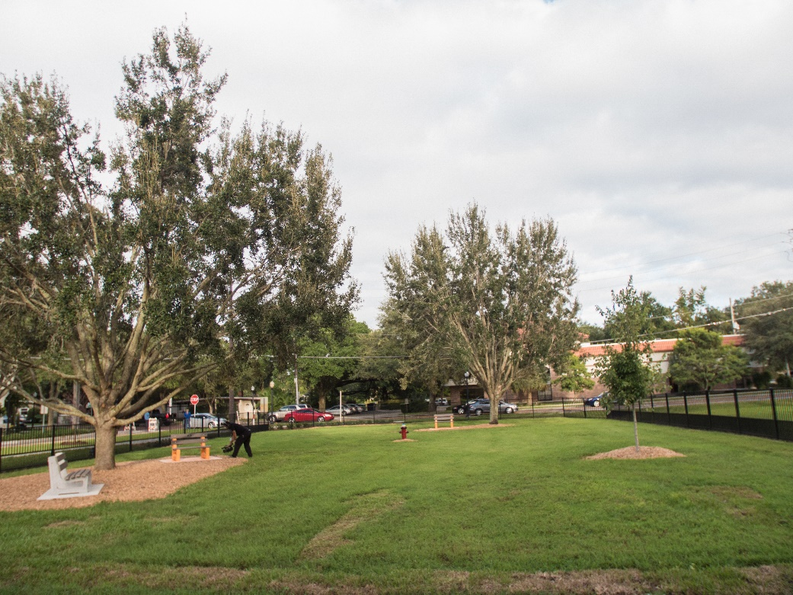
Downtown Dog Run
After

Slide 10
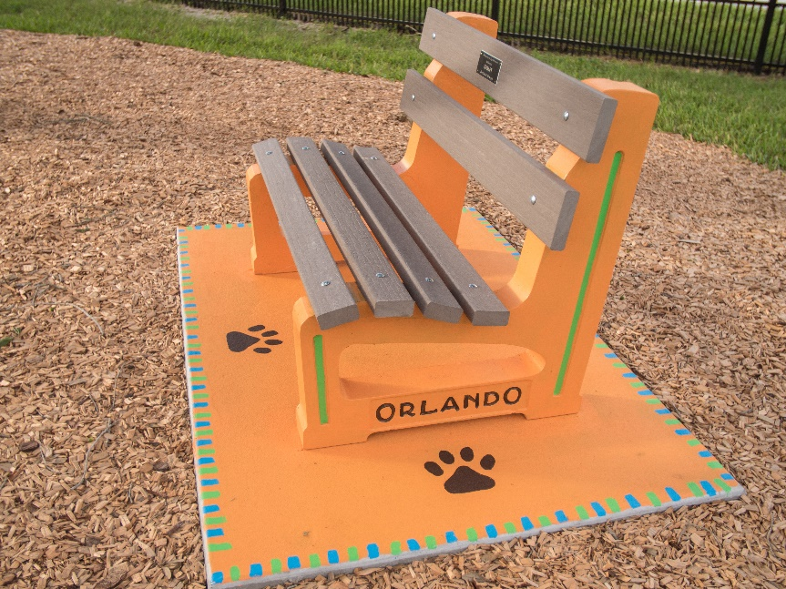
Downtown Dog Run
After

