Slide 1
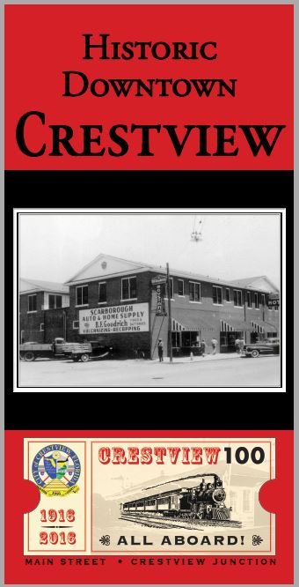
Crestview CRA Banners
Crestview CRA Banners
The old hotel- now Desi’s Resturant

Slide 2
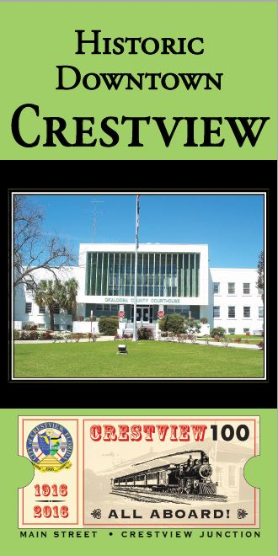
Crestview CRA Banners
The courthouse which will be torn down and rebuild in 2017

Slide 3
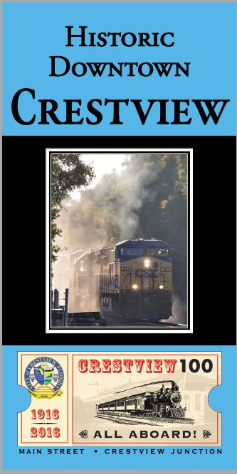
Crestview CRA Banners
The creation of Crestview was due to the railroad. CSX currently operates in the downtown and the city is in hopes that Amtrak will return passenger services to the area within the next 5 years.

Slide 4
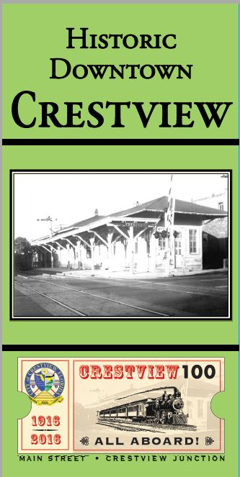
Crestview CRA Banners
The creation of Crestview was due to the railroad. CSX currently operates in the downtown and the city is in hopes that Amtrak will return passenger services to the area within the next 5 years. Here is the beloved Depot which was torn down in the 1980’s.

Slide 5
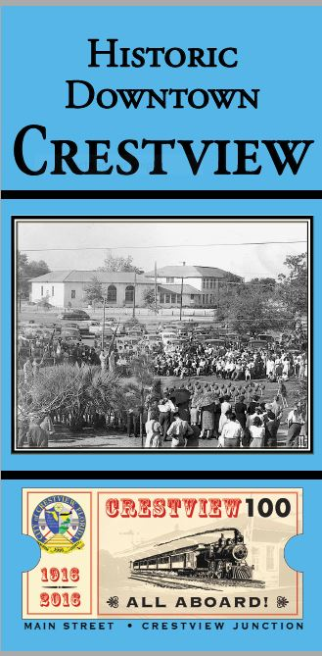
Crestview CRA Banners
No one could forget the original high school! It burnt down in the 1950’s.

Slide 6
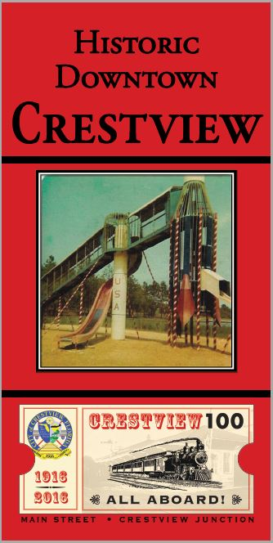
Crestview CRA Banners
This by far was the most memorable banner! The rocket ship at the playground.

