Slide 1
Executive Director Report
DDB/CRA
2017 Florida Redevelopment Awards
Cultural Enhancement
Creative City Project
City of Orlando, CRA

Slide 2
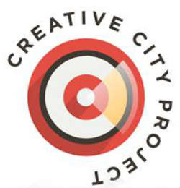
Creative City Project
Overview
The Creative City Project was birthed out of the belief that artists can change a city for the better by making it a more beautiful, meaningful and interesting place to live.
In the fall of 2016, the Creative City Project came to Downtown Orlando.
More than 800 artists and 20,000 people experienced
performances at various Downtown locations including
CityArts Factory, the Gallery at Avalon Island, locations
along Orange Avenue from Robinson Street to
Central Boulevard, and more.

Slide 3
Creative City Project
Innovation
Innovation is central to the Creative City Project as well as the process by which the event comes to life each year.
The 2016 annual event included performances and installations by more than 800 artists for an audience of more than 20,000.
The hundreds of experiences presented at the annual event ensures that each audience member has a different, yet equally, compelling experience.
These experiences highlight the innovative heart of the annual event in which artists are encouraged to “consider how architecture and environment affect the relationship between artist and audience” to create unique experiences.

Slide 4
Creative City Project
Impact on the Community
Creative City Project 2016 brought thousands of out of town visitors to Downtown Orlando.
Local vs. Out of Town attendance breakdown of the 15,088 Eventbrite tickets:
7,149 booked with an Orlando address
7,939 booked with an address other than Orlando
6,160 from locations farther outside Orlando
Local art organizations reported direct ticket sales for regular season performances as a result of their participation in the annual Creative City Project.
Based on information received from Downtown Orlando hotels, occupancy was above 95% on the weekend of October 15, 2016 (the date of the event). Total room nights are being estimated at 445.
One of the sponsorship opportunities specifically targets Downtown Orlando businesses and restaurants. For these partners, their business was highlighted on the Creative City map and schedule - encouraging attendees to visit.

Slide 5
Creative City Project
Funding
Financing for the Creative City Project, a registered 501c3 Arts Nonprofit, comes from three main sources:
Government
Corporate
Individual
Total amount received was $155,345.
Additionally, in-kind funding was received.

Slide 6
Creative City Project
Problem Solving
Supports one of the 10 Vision Themes from the CRA’s vision plan, which is to have stellar music, arts, sports, and entertainment.
By amassing the city’s artists and inviting innovative artists from around the country as part of this annual event, we bolster creative momentum that increases Downtown Orlando’s cultural scene.
Downtown Orlando has a diversity of unique offerings, but the local perception of Downtown after dark can be limited to clubs and bars. Creative City Project helps expel that perception as it is a unique, family-friendly, art-centric experience.
One of the long-terms goals of the Creative City Project is to “shape the global perception of Orlando as a city known for creativity and innovation.” The Creative City Project’s annual event addresses the unique challenge of Downtown Orlando’s identity by creating a destination-worthy event that is specifically and strategically tied to the urban core of Downtown Orlando.

Slide 7
Creative City Project
Applicability to Other Communities
Collaboration: Seek out artists that are willing to collaborate and form a sense of togetherness and lack of competition.
Cross-industry collaboration: Creative City Project is made possible by collaboration between nearly 1,000 Central Florida artists, government, the private sector, non-profits, educational institutions, and individuals.
Policy flexibility: The Creative City Project’s annual event is only possible through collaboration and innovation in policy and procedure.
Elevation of artists: By platforming artists and paying them for their work, we are essentially saying that “we value you and believe in what you contribute to our city.”
Risk: Doing anything new or innovative involves some sort of risk. The Downtown Development Board/Community Redevelopment Agency was an early investor in the Creative City Project’s annual event - even before it was as successful as it has become. Some level of risk is necessary for a city to be innovative.

Slide 8
Creative City Project
Other Exemplary Aspects of the Design, Plan or Program
This annual event is free to attendees.
The event featured performers from over 25 ethnicities and cultures, including a celebration of Latin American culture. The performances brought together musicians and dancers from Mexico, Colombia, Cuba, and Puerto Rico.
The Creative City Project worked with many of Downtown Orlando’s private building owners to make use of the extra space afforded by large businesses and condominium plazas. These larger spaces help accommodate large crowds, stages, and artistic performances.

Slide 9
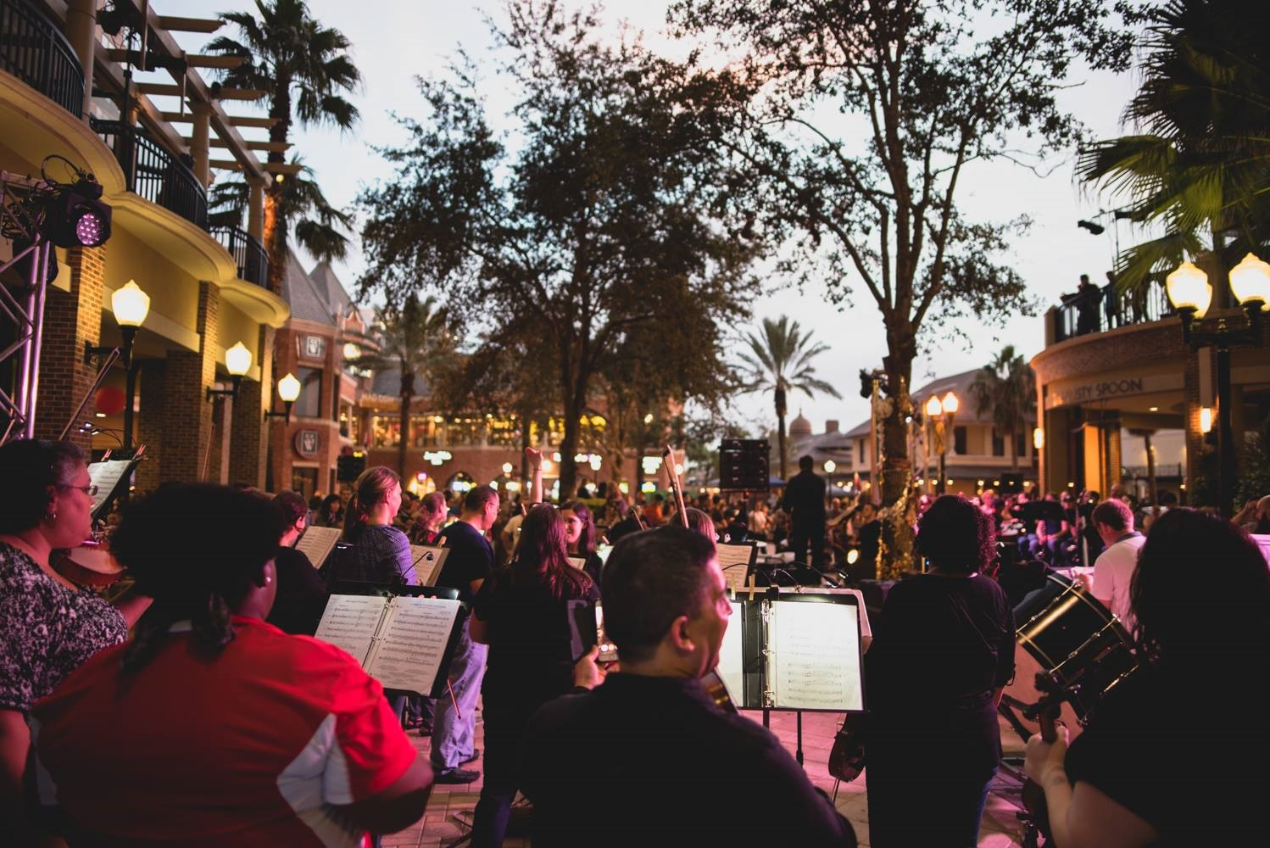
Creative City Project

Slide 10
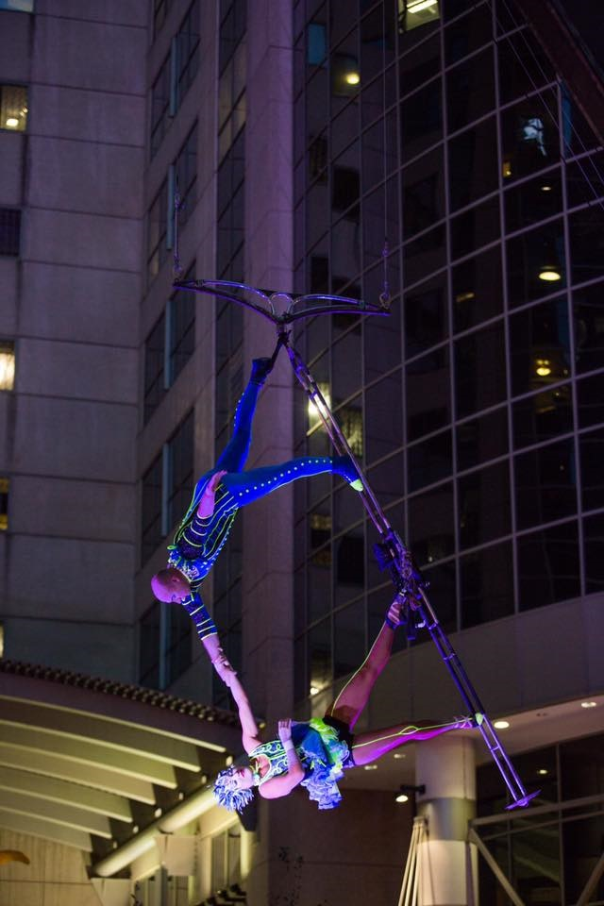
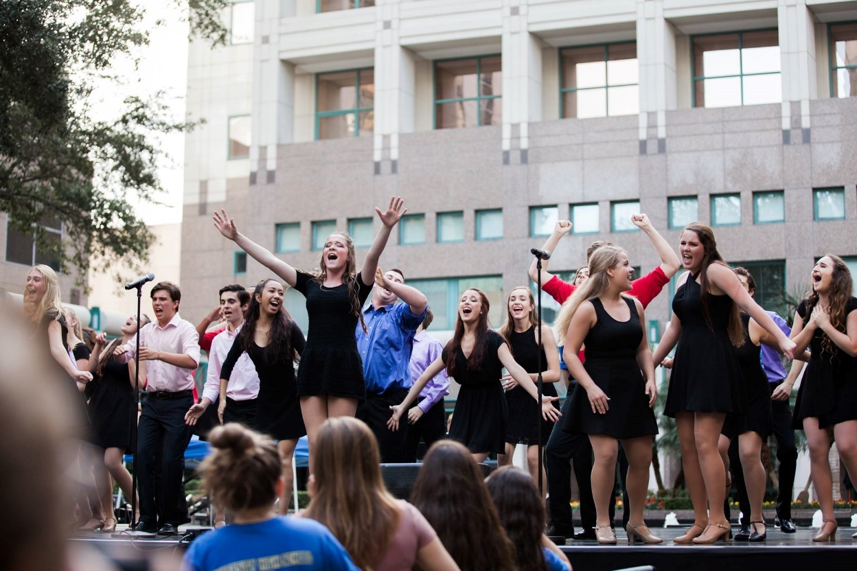
Creative City Project

Slide 11
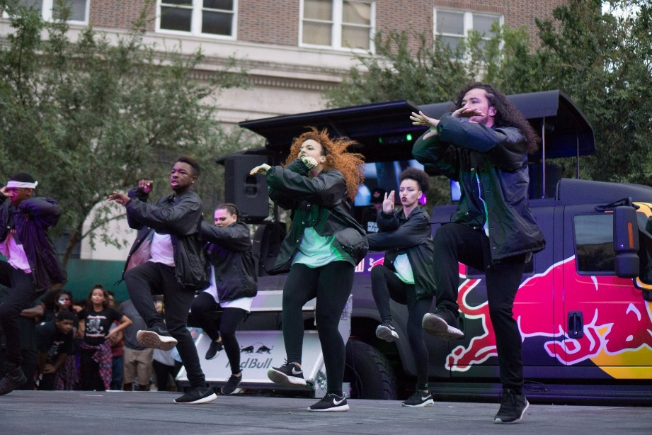
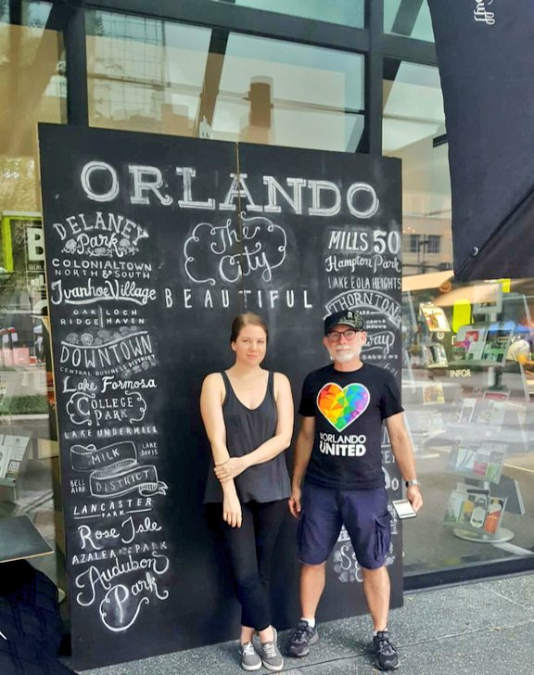
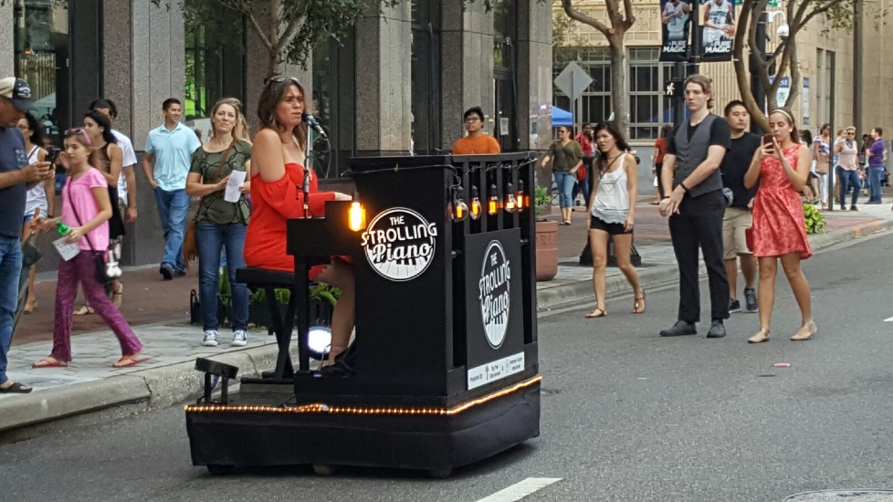
Creative City Project

Slide 12
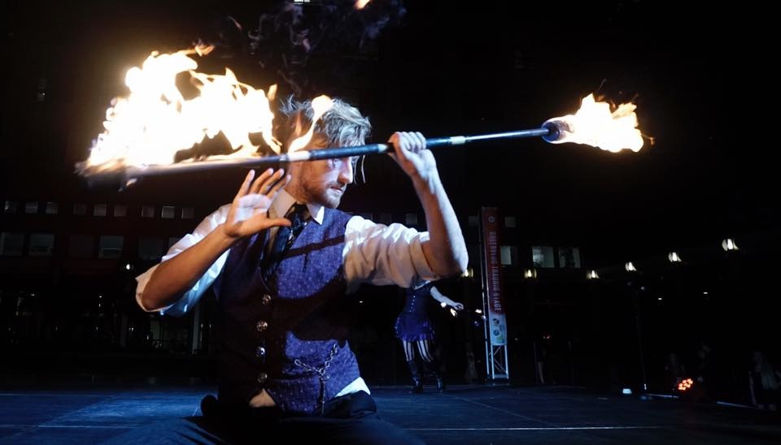
Creative City Project

Slide 13
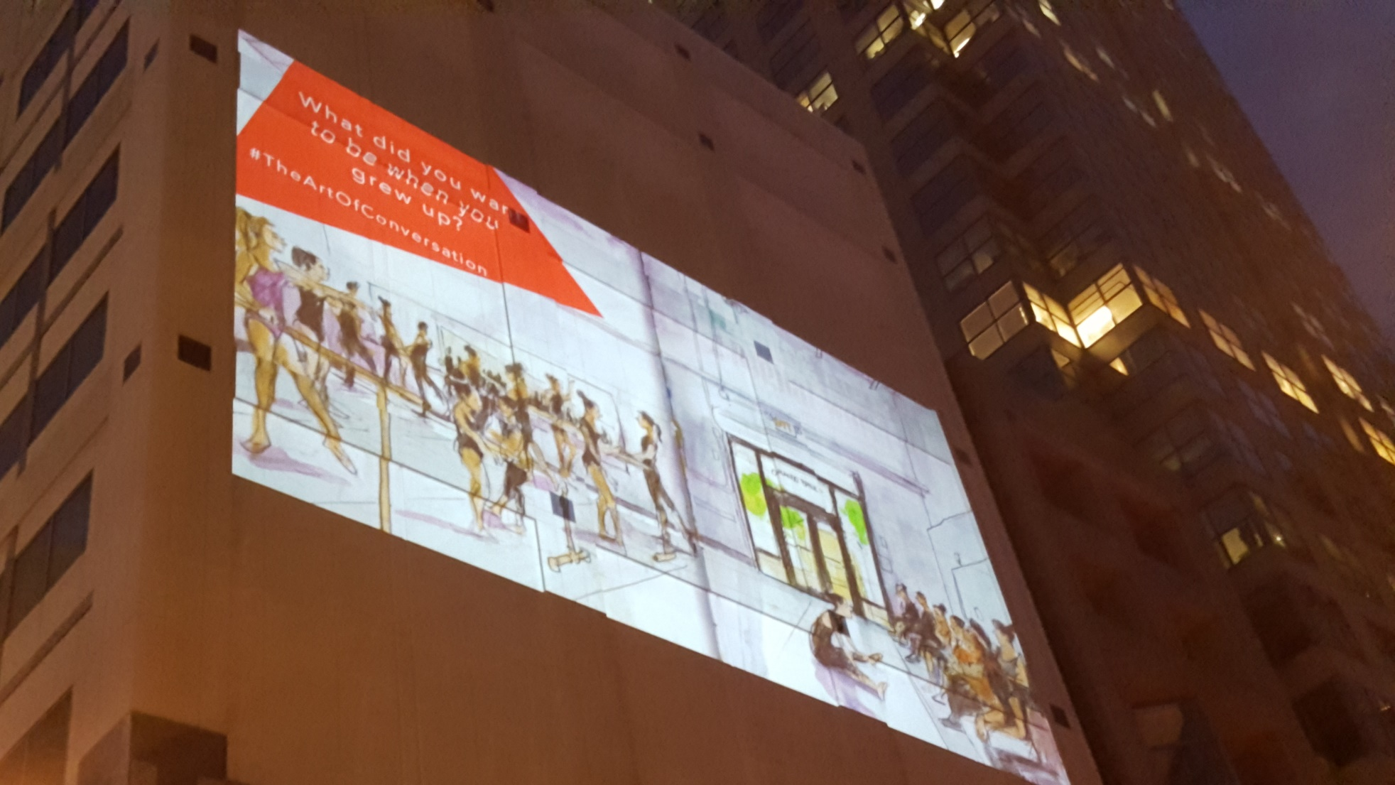
Creative City Project

Slide 14
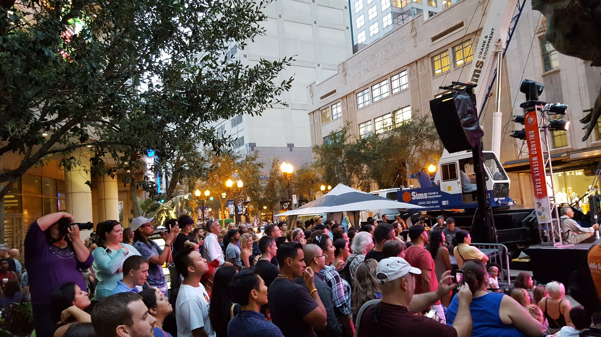
Creative City Project

