Slide 1
Redevelopment Academy

Slide 2
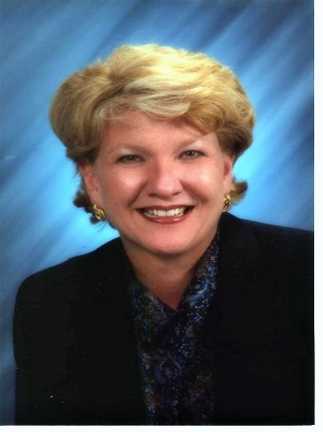
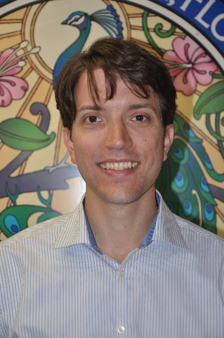
Presenters: Gail Hamilton, Board Member, Academy Committee Co-Chair Peter Moore, Board Member, Academy Committee Member Rick Stauts, Board Member, Academy Committee Co-Chair

Slide 3
Q: Who is eligible to take the courses?
A: Anyone
Q: Who is eligible to receive a designation?
A: FRA Members Only

Slide 4
History
The FRA Board saw a need for a quality and unique training program in 2010. Education for practitioners of all types of stakeholders in the redevelopment sphere is available through courses for CRA staff, Board members, and professionals who provide services to CRAs. That initial concept has developed into the training provided through the Academy.

Slide 5
What is the Redevelopment Academy?
One day training courses with a test
Available to anyone
Professional Designation
Five courses, three core topics
Two categories of designation:
FRA-Redevelopment Administrator
FRA-Redevelopment Professional

Slide 6
What Courses Are Available?
Redevelopment 101 (CORE)
Budgeting, Funding, and Reporting (CORE)
Operations and Capacity Building (CORE)
Redevelopment Incentives
Capital Project Management

Slide 7
Redevelopment 101
History of Redevelopment (Main Street, DDAs, CRAs)
Main Street Designation (Process, Criteria, Funding)
Creating and Managing a CRA
Chapter 163, process to establish, authorities
CRA Plan contents, modifications, eligible expenditures
Governance types, powers, bond issuance, staffing, legal council, working with City/County departments
State Statutory Requirements (Sunshine, Ethics, Reporting, Annual Reports, Public Records)
Redevelopment Organizations as Resources

Slide 8
Operations and Capacity Building
Florida Local Gov’t 101 (Types and forms, Charters, Home rule)
CRA governance (Boards, Roles, Relationships)
Capacity and Resources (Leadership, Leveraging resources, Eligible projects, Budgets)
Strategic Planning (Basics, Success and failures, Benefits)
Grants & Contract types
Finding Federal Funding
Program Evaluation and Performance Measurement (Types and uses, Dashboards)

Slide 9
Budgeting, Funding and Reporting
Budgeting Theory and Principles (Revenues, Best Practices, Types)
Increment Revenue Financing
Grants and Outside Resources (CDBG, HOME, SHIP, Ezones, non-profits)
Cost Sharing
Developer Extractions (Impacts, Infrastructure, Payment in lieu of taxes)
Public Private Partnerships
CRA Record Management/ Reporting Requirements

Slide 10
Redevelopment Incentives
Chapter 163 Incentives
Redevelopment Finance (Debt, Equity, Liquidity)
Risk vs. Benefit (Understanding risk, Phasing incentives, Performance based)
Types of Incentives (Admin, Financial, Planning/Land, Marketing)
Targeting Incentives (Types, Goals)
Establishing Policies
Timing of Incentives
Calculating ROI
Written Agreements/Contracts (Purpose, Protection, Evaluation)

Slide 11
Capital Project Management
Planning the Project (Selecting, Building Consensus, Build vs. Buy)
Organizing the Project (Design, Procurement, Consultants, Evaluating Vendors, Compliance based on fund source)
Implementing the Project (Contract execution, Build Process)
Closing the Project (Documentation, Audit, Records, Final Report)
Typical CRA Capital Projects (Infrastructure, mini grants, landscaping, streetscaping, loans, land acquisition)

Slide 12
Courses Under Development
Housing as a Redevelopment Tool (2015)
Marketing and Promotion (TBA)

Slide 13
How Much Will It Cost to Get My Designation?
Administrator Designation: $345 per course
Professional Designation: $445 per course
Non-FRA Member: $545 per course
If you do not pass on the first try you may take the course and exam one more time without any additional cost.
All classes include study materials and lunch.
You must be a member of FRA to receive a designation, but not to take any course.
A CRA Trust Fund can pay for this under Chapter 163, Part III.

Slide 14
How Do I Attend?
Academy training is provided in several central locations through out the year. Redevelopment 101, the introductory class, is usually held the day before the FRA Annual Conference. Another course is held immediately after the conference, on a rotating basis. During the year, we try to offer all the courses at least once.

Slide 15
FRA – Redevelopment Administrator (RA) Designation
The FRA-RA is someone who works in a CRA every day and meets the criteria for educational and experience requirements.
The criteria is outlined in the “General Academy Application” which is posted online at www.redevelopment.net under the Academy page link.

Slide 16
FRA-Redevelopment Professional (RP) Designation
An FRA - RP is someone who is not involved in the direct administration of the CRA on a regular basis. Professionals who provide services to CRA’s (e.g. architects, engineers, contractors, planners, and vendors) are eligible to receive this designation. This FRA-RP is also available for elected officials, CRA Board members, government employees, and others who are involved in redevelopment, but do not currently meet the criteria for the FRA-RA. Once an individual meets the criteria, they can apply to switch to the other designation.

Slide 17
Continuing Education
As with most professional training certification programs, we will implement a re-certification process over time. This will be done through webinars, on-line training, annual conference courses and other related professional training.

Slide 18
Credit for Training by other Organizations
We work with state and national professional organizations
We reciprocate on credit for our courses and other credits
FRA annual conference offers a variety of credits for AICP, ASLA, IEDC, Florida Bar and AIA

Slide 19
Course Development
There are many disciplines related to redevelopment that can contribute to the success of CRA administrators and professionals, and consequently to the success of the CRA’s for which they work.
If you have suggestions, know someone who may be interested in developing a course, or would like to take a course, please contact us at cwestmoreland@flcities.com.

Slide 20
Florida Redevelopment Association 301 S. Bronough Street, Suite 300 Tallahassee, FL 32301 www.redevelopment.net/Academy

