Slide 1

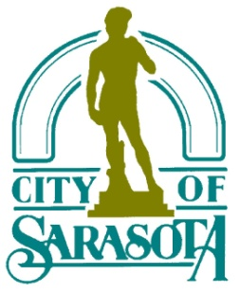
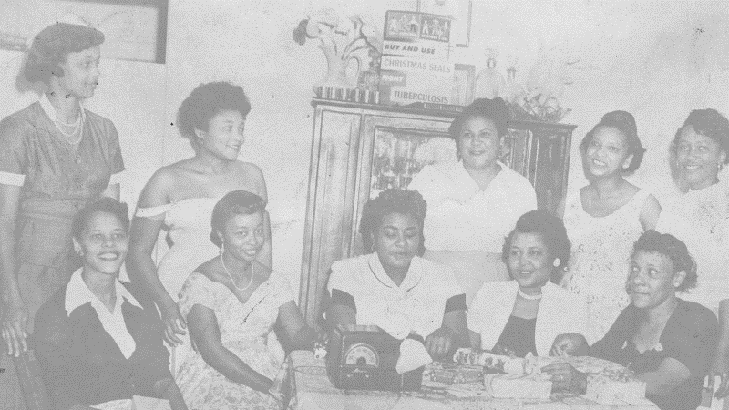
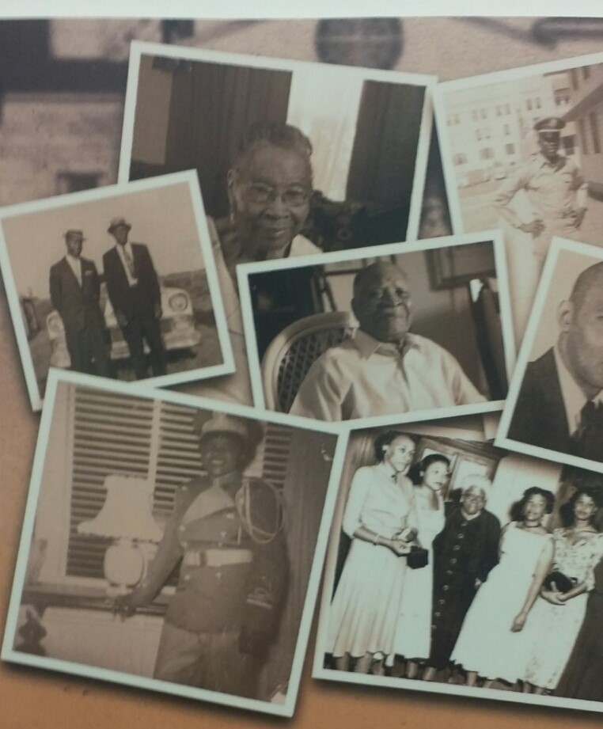
The Newtown neighborhood came into being on April 20, 1914, when the original Newtown Plat was filed with Manatee County. The original plat consisted of 96 building lots. Approximately 3 1/2 months later, on August 6, 1914, the First Addition to the Newtown Plat was filed, creating an additional 74 lots. Driven by market demand, what is known as Newtown today continued to grow as additional plats were created resulting in the robust and vibrant community that we know today.
Newtown Conservation Historic District/Newtown Alive
City of Sarasota, Newtown Community Redevelopment Area (CRA)
HISTORY PRESERVED

Slide 2
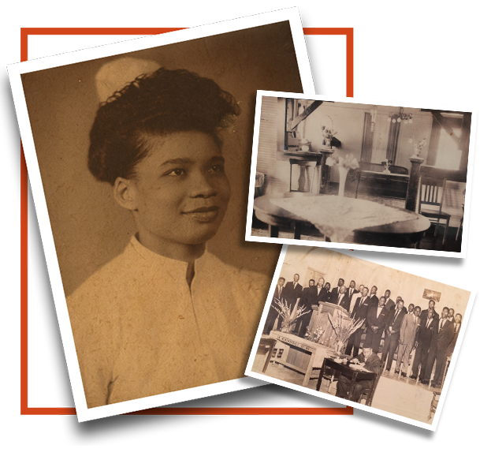
VIDEO
VOICE OF THE PEOPLE
https://drive.google.com/file/d/0Bx5jPZfIm_R5OGVNY3lzc1NOVmM/view
WEBSITE LINK
http://www.newtownalive.org/

Slide 3
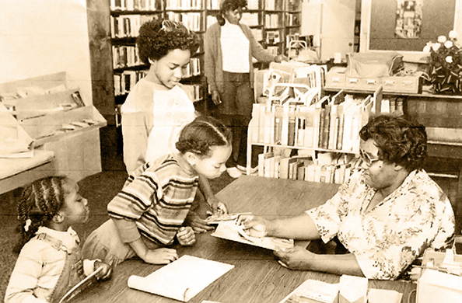
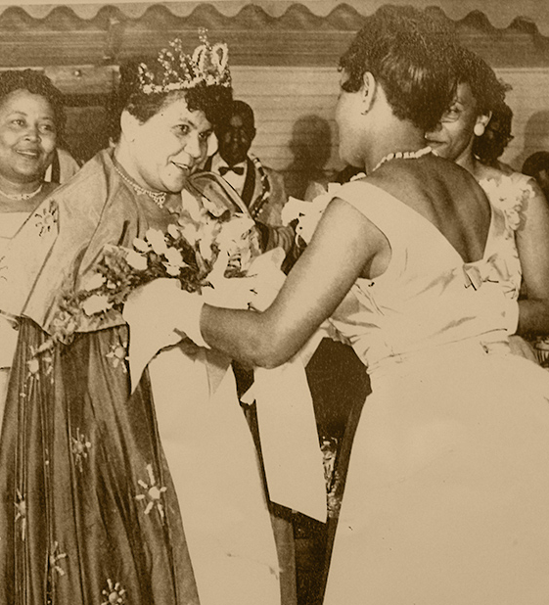
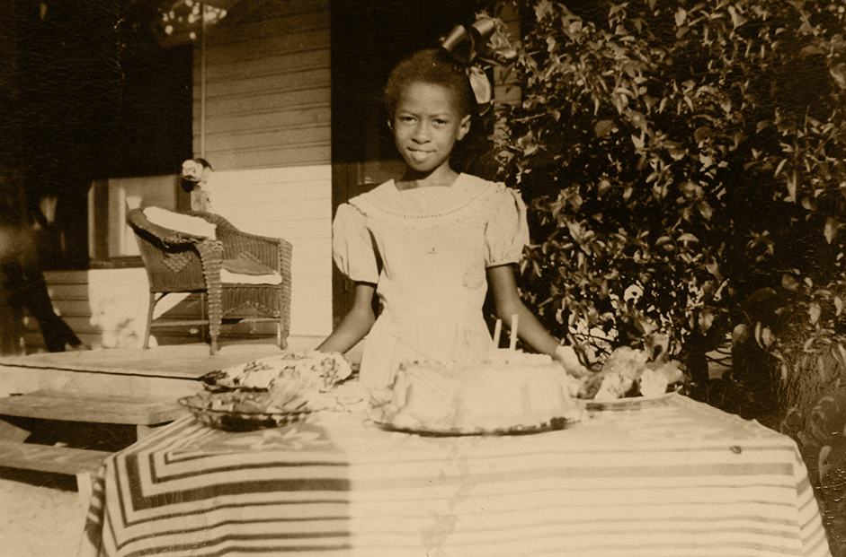
EARLY SETTLEMENT: NEWTOWN & OVERTOWN
EDUCATION
ELEGANCE
FAMILY

Slide 4
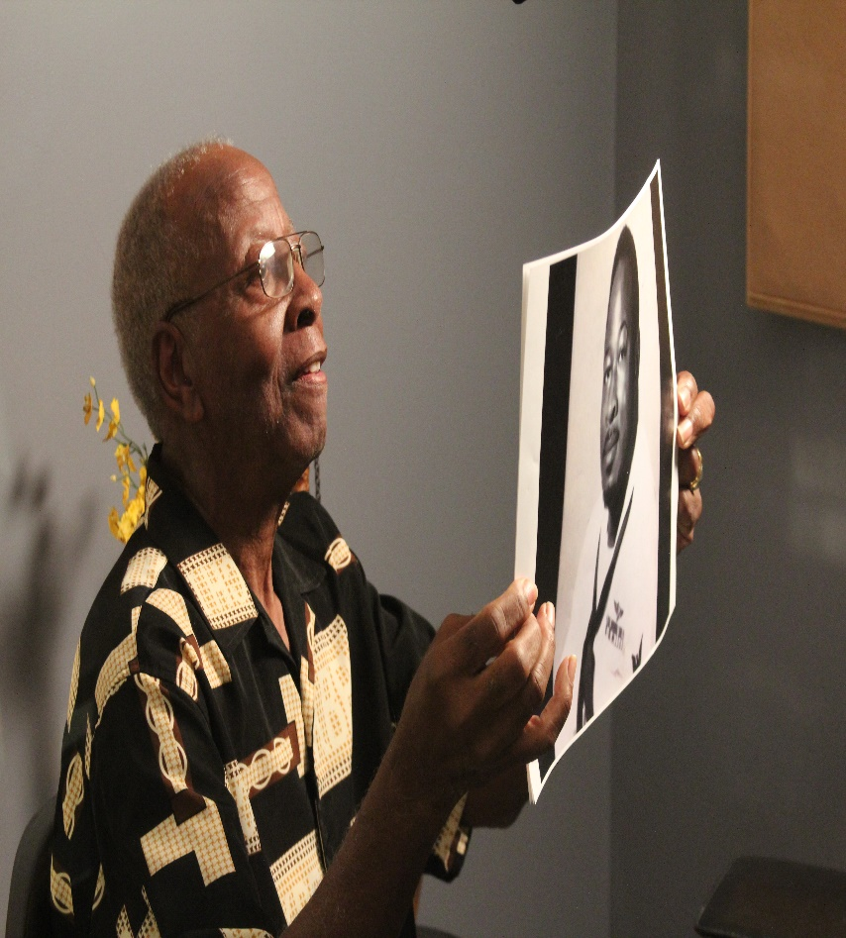
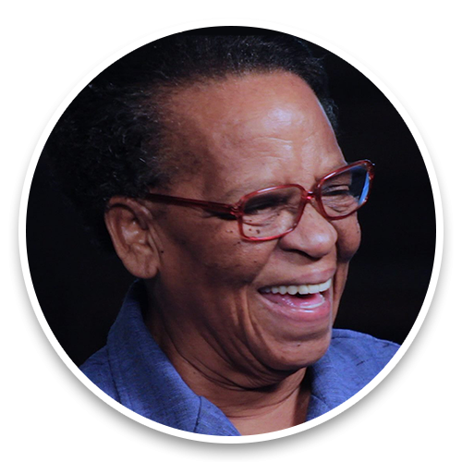
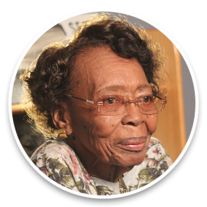
STORYTELLERS BEHIND THE PROJECT
BANKER
ENTREPRENEUR
EDUCATOR

Slide 5

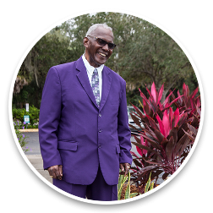
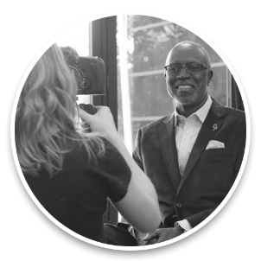
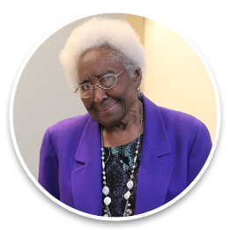
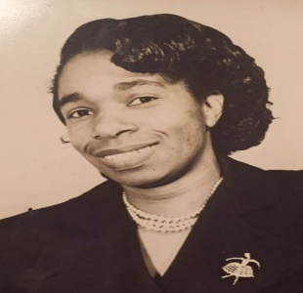
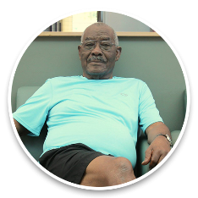
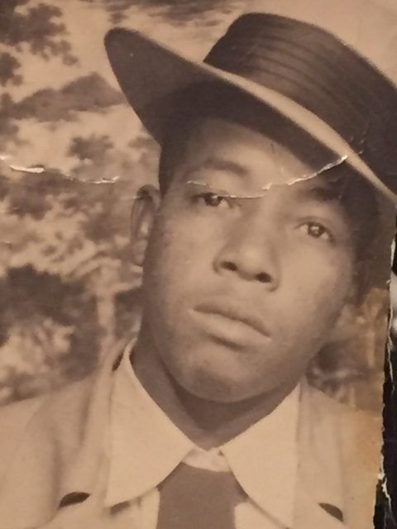

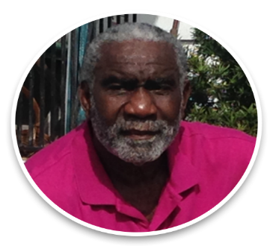
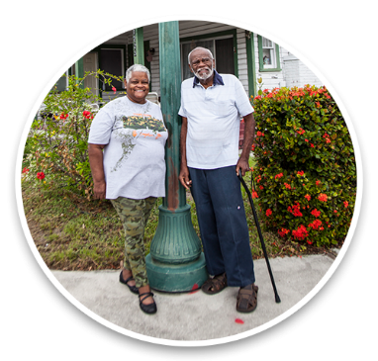
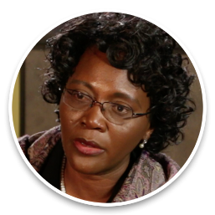
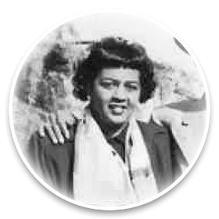
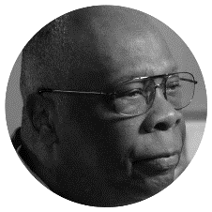

Slide 6
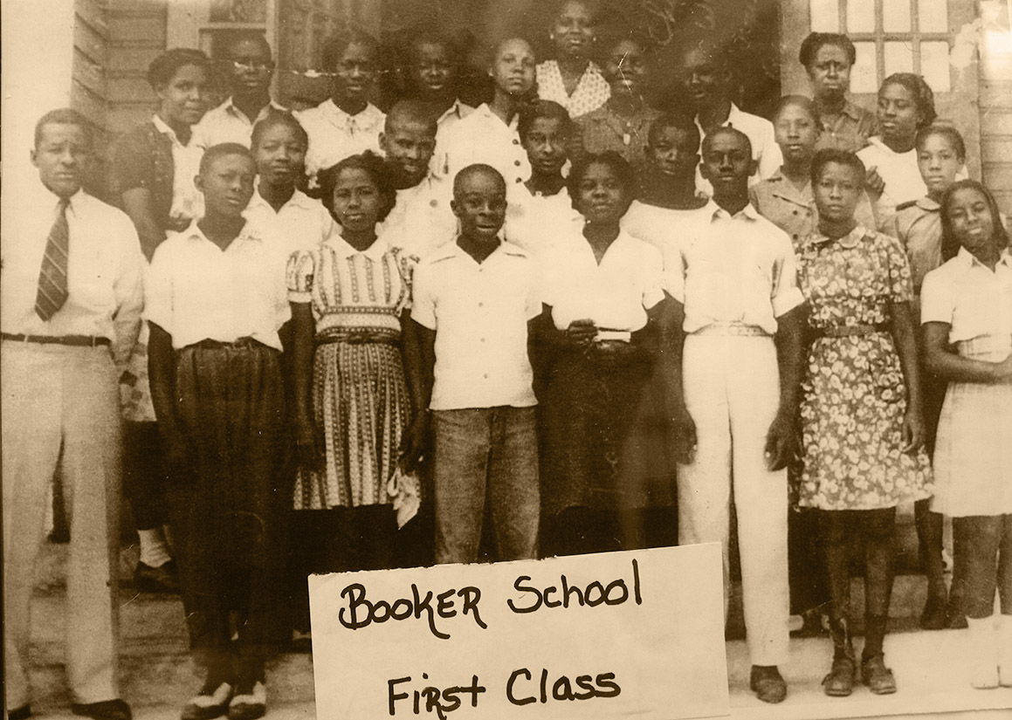
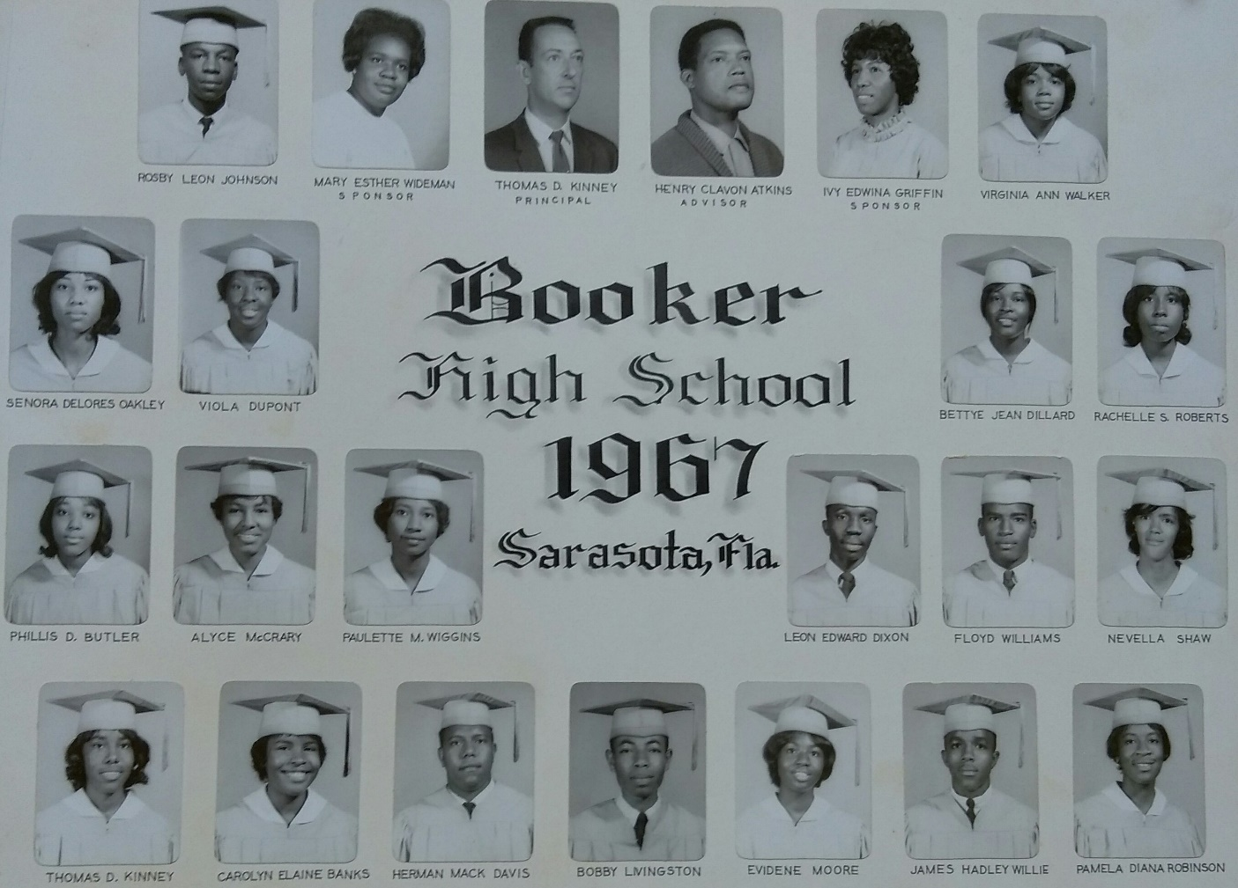
EDUCATION-GATEWAY TO PROGRESS

Slide 7
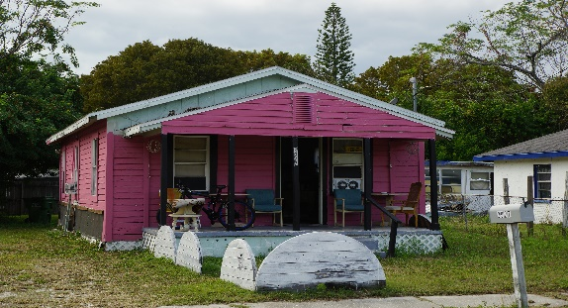
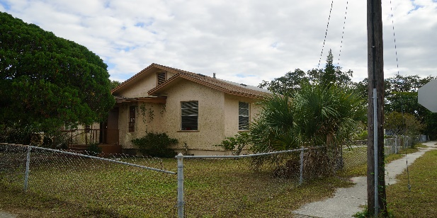
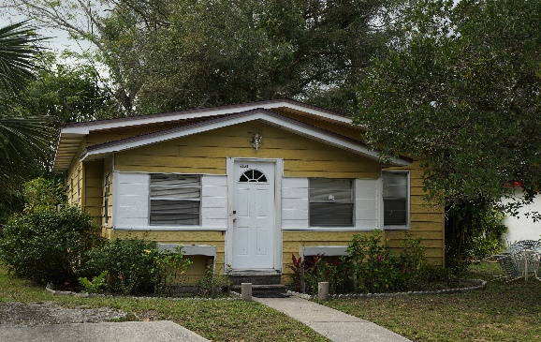
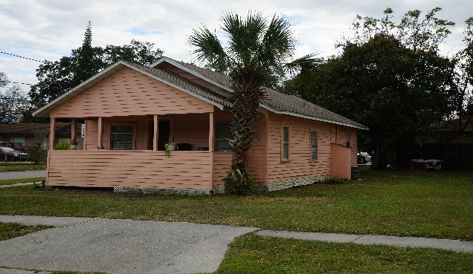
2927 Dixie Ave
1904 29th St
2953 Gillespie Ave
1864 29th St

Slide 9
The War of 1812 begins (THE PATRIOTS WAR). In West Florida, British forces enlist both Blacks and Native Americans. Sarrazota (also known as Angola) existed in the Tampa Bay-Sarasota-Manatee area.
During the Patriots War, more Blacks ally with the British. In 1815, the British leave a fort at Prospect Bluff on the Apalachicola River to Blacks where they reside and create villages nearby with Native American allies. The place becomes known as Negro Fort.
Under the direction of then Gen. Andrew Jackson, the U.S. Navy attacks Prospect Bluff Fort, killing 270 out of 320 inhabitants.
Jeffrey Bolding, formerly enslaved in North Carolina came to the area in 1857 and worked for the Whitaker Family. He died at age 70 in 1904.
SARASOTA’S FIRST BLACK SETTLERS: Lewis Colson came to Sarasota with his wife Irene and assisted Richard Paulson in platting the town of Sarasota at Five Points in 1885. Sarasota was platted by the Florida Mortgage and Investment Company, a Scottish entity.
In 1885 Colson worked with Robert E. Paulson to survey and plat the original town of Sarasota for the Florida Mortgage and Investment Company.
The first African American Church: In 1899, Bethlehem Baptist Church was the first church built by and for African Americans. Lewis Colson was appointed as the first minister of Bethlehem Baptist Church.
1812
1814
NEWTOWN HISTORIC
TIMELINE
1816
1857
1884
1885
1899

Slide 10
NEWTOWN HISTORY
1. SETTLEMENT
  The Newtown neighborhood came into being on April 20, 1914, when the original Newtown Plat was filed with Manatee County.
  2. PLATTING OF MAPS
  The original plat consisted of 96 building lots. Approximately 3 1/2 months later, on August 6, 1914, the First Addition to the Newtown Plat was filed, creating an additional 74 lots.
  3. INTEGRATION
  Driven by market demand, what is known as Newtown today continued to grow as additional plats were created resulting in the robust and vibrant community that we know today.

Slide 11
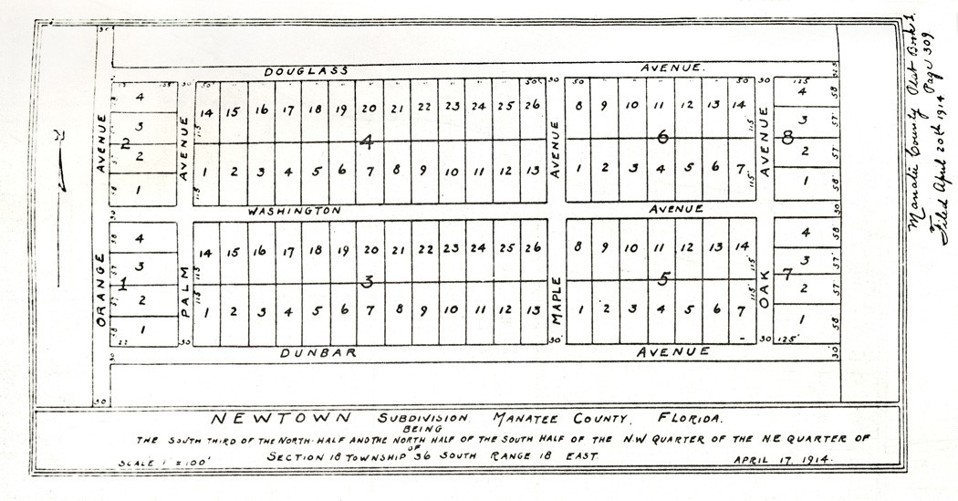
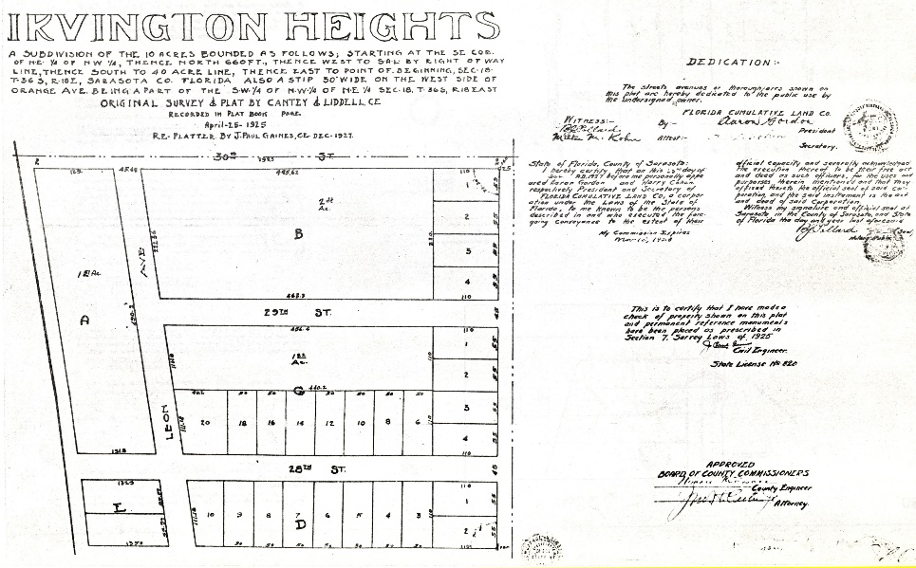
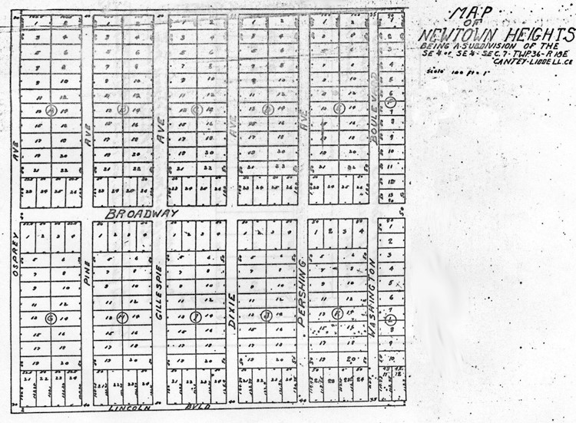
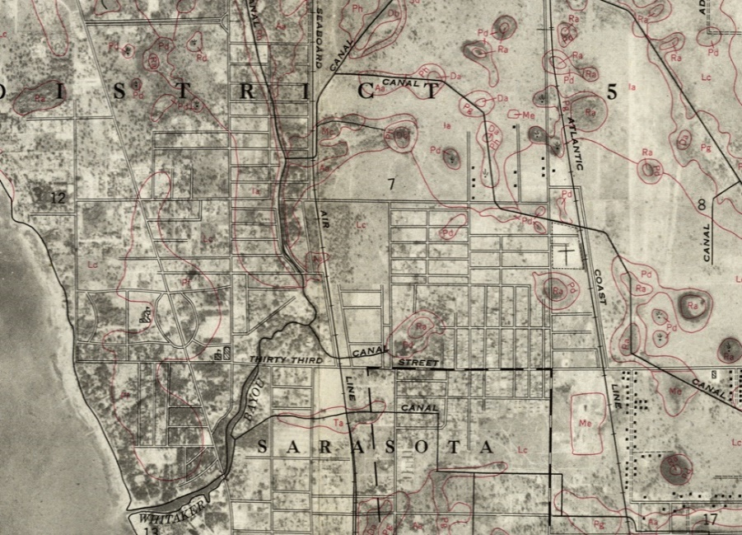
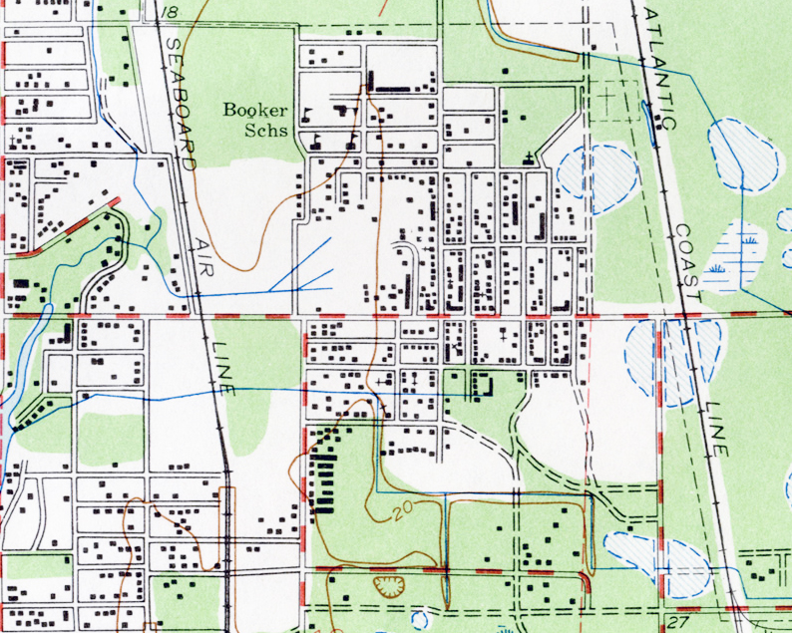
ORIGINAL NEWTOWN PLAT MAPS
Irvington Heights, 1925
Newtown, 1914
Newtown Heights, 1925
Soil Survey, 1959 land types, drainage with street overlay
Newtown, 1914

Slide 12
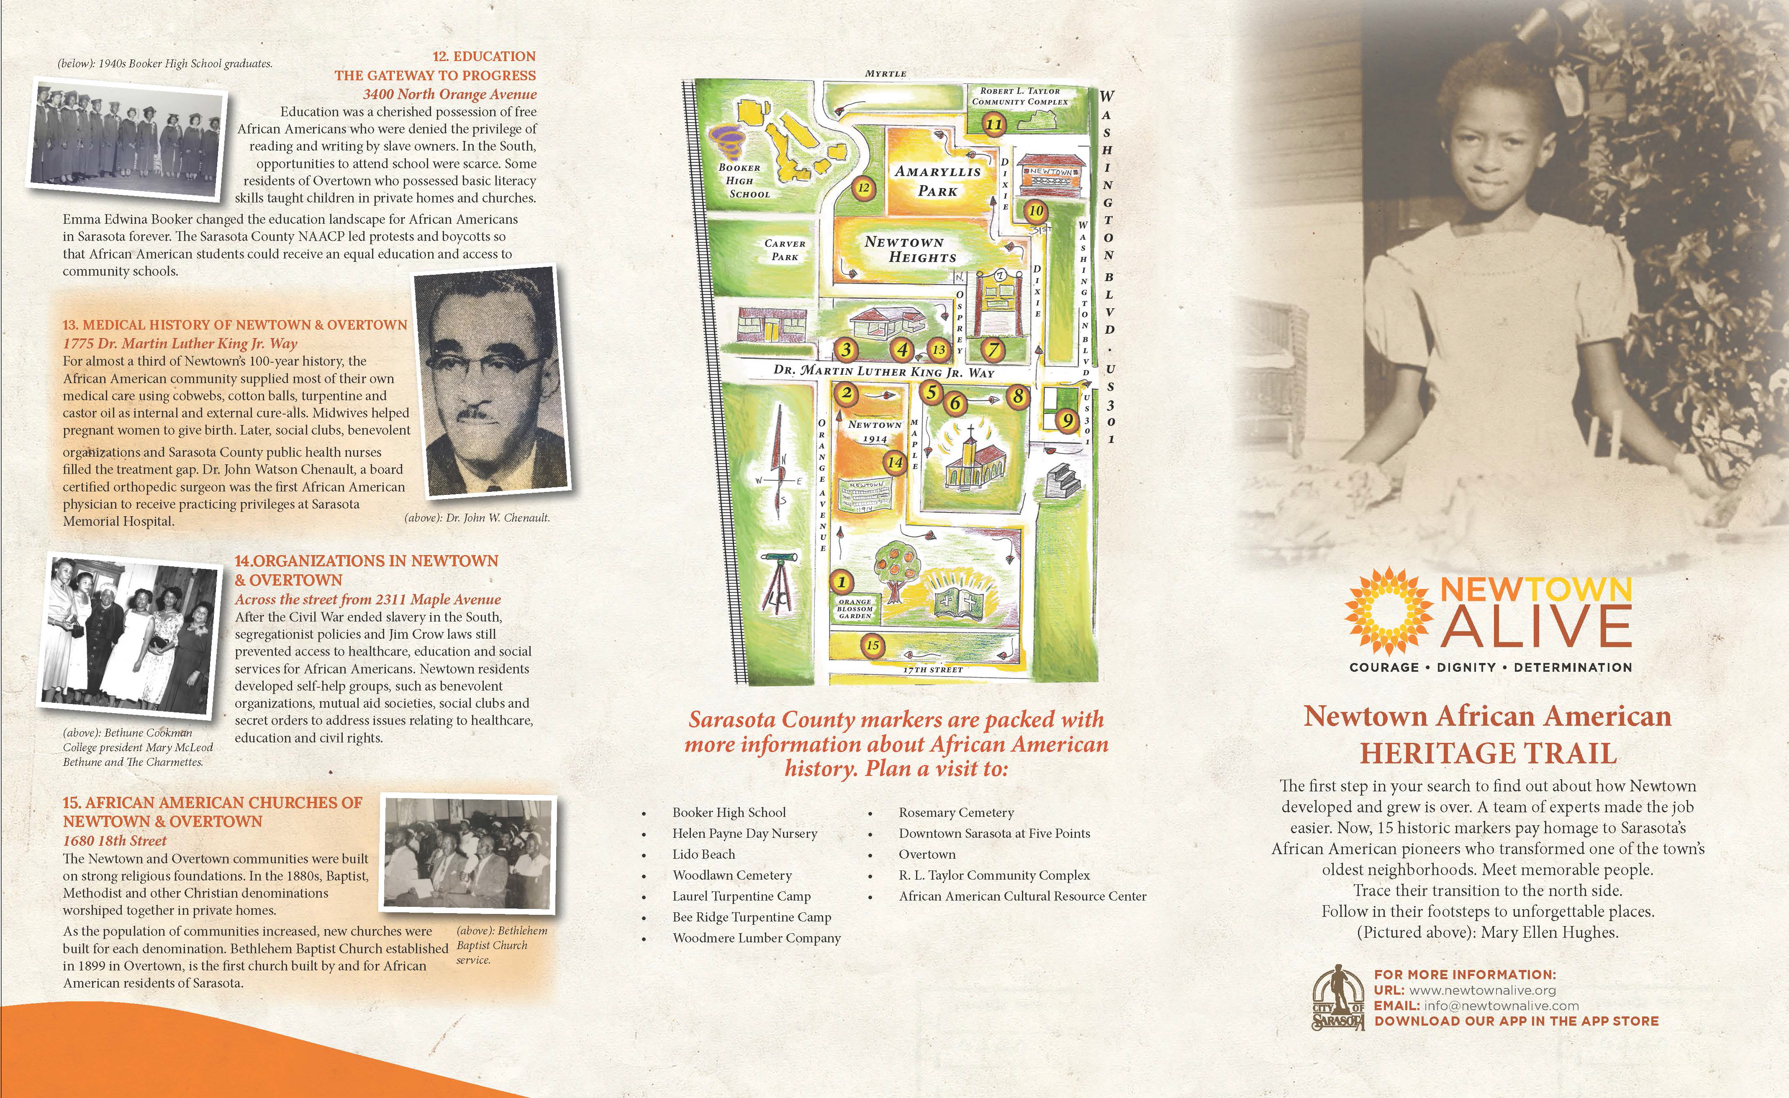
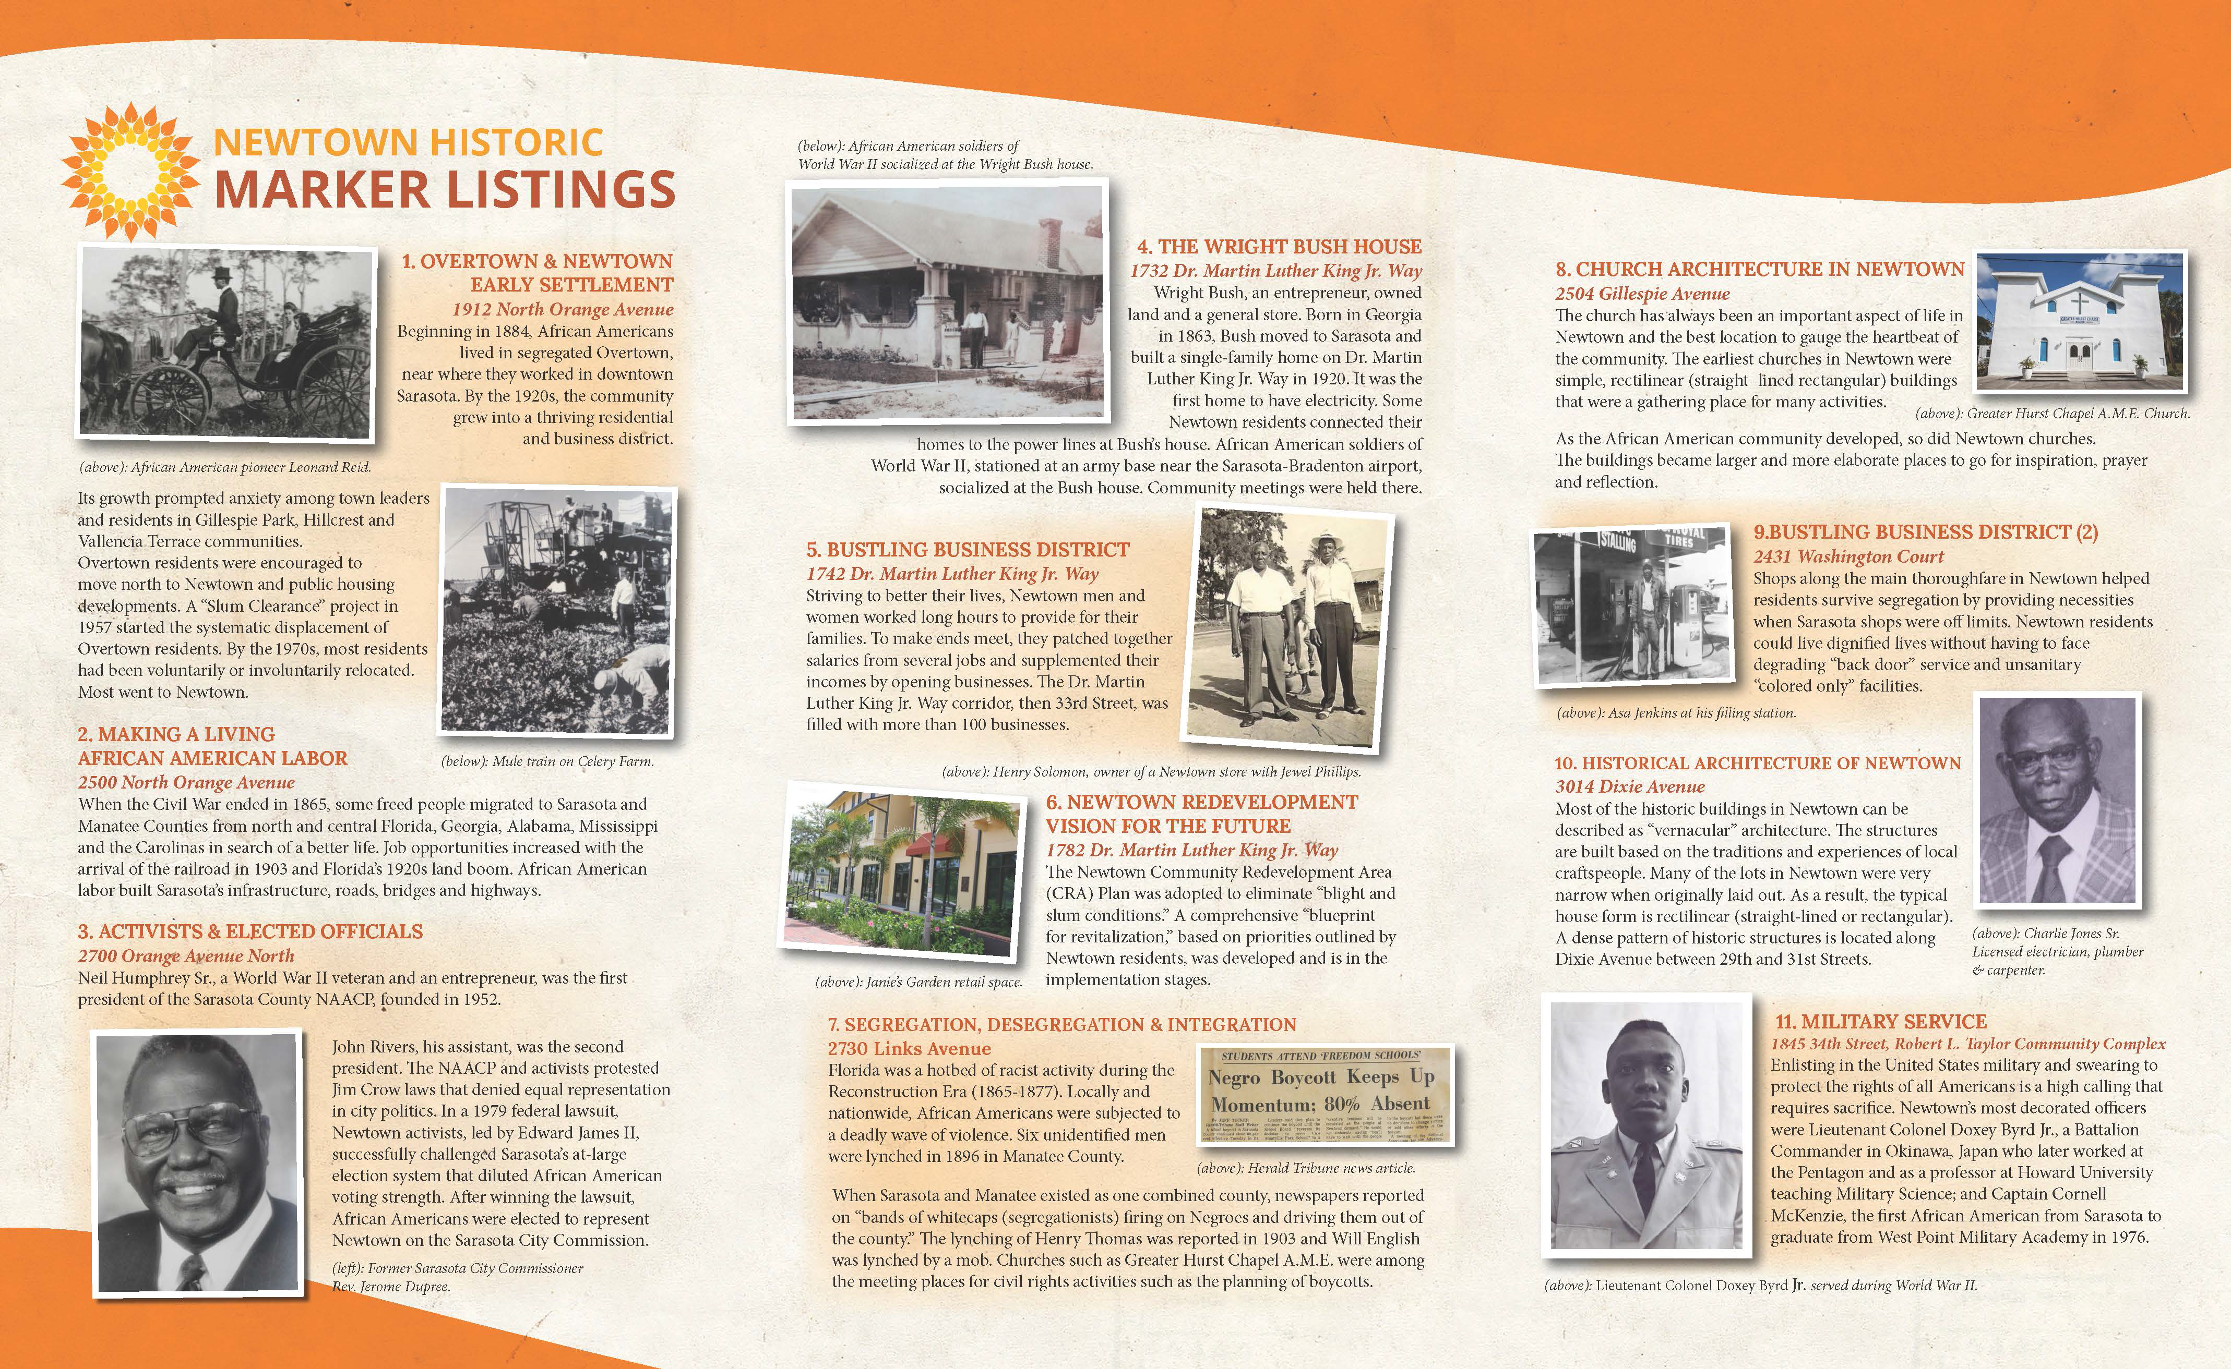
INFORMATION BROCHURE

Slide 13
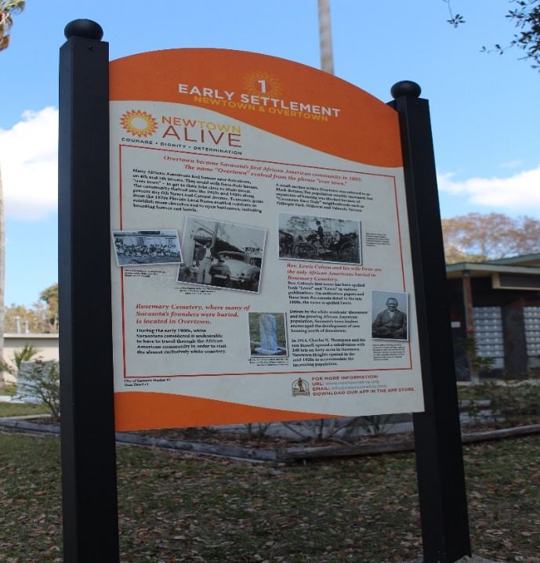
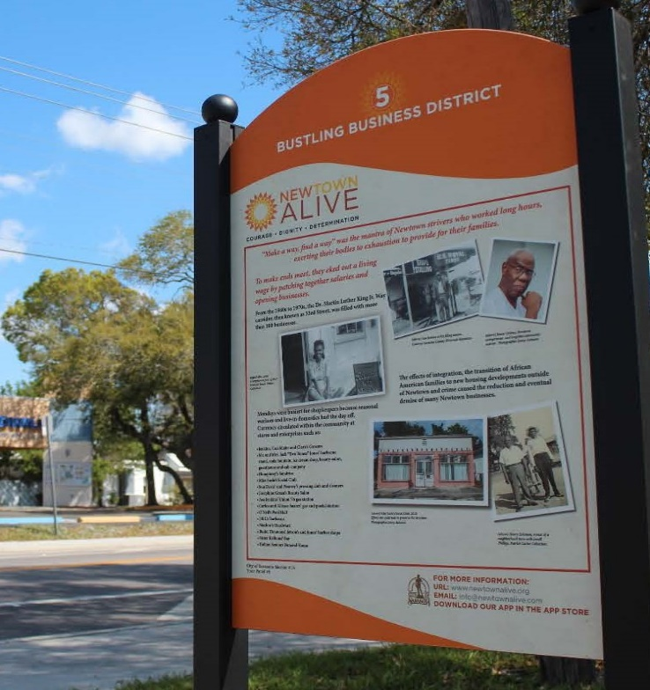
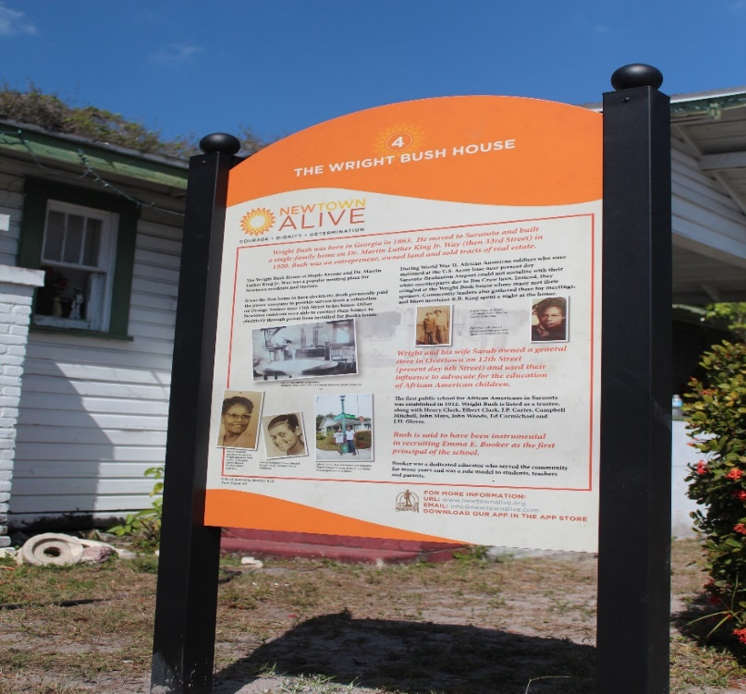
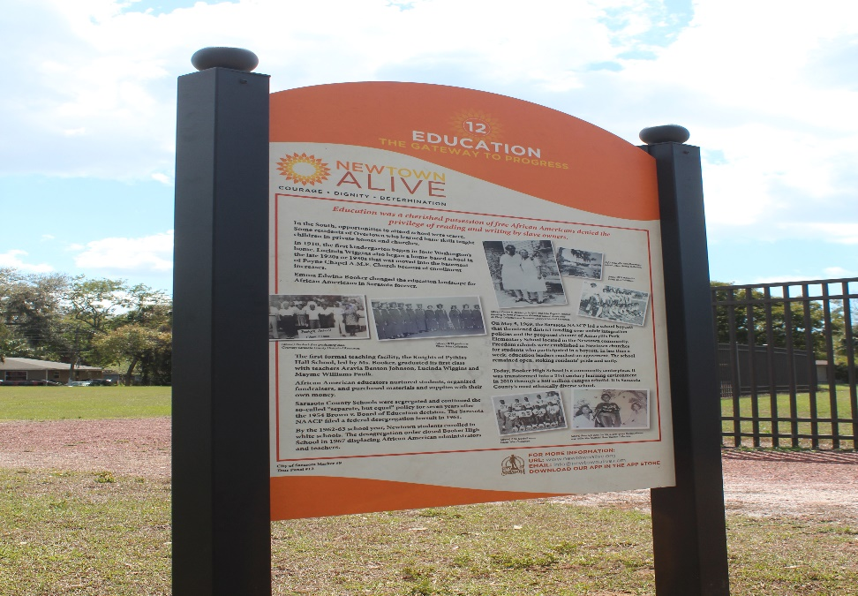
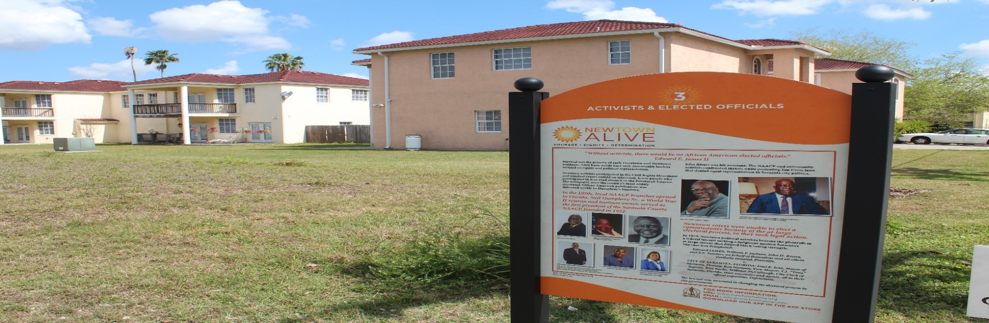
HISTORIC MARKERS
EARLY SETTLEMENT OVERTOWN & NEWTOWN
BUSTLING BUSINESS DISTRICT
THE WRIGHT BUSH HOUSE
EDUCATION
GATEWAY TO PROGRESS
ACTIVISTS & ELECTED OFFICIALS

Slide 14
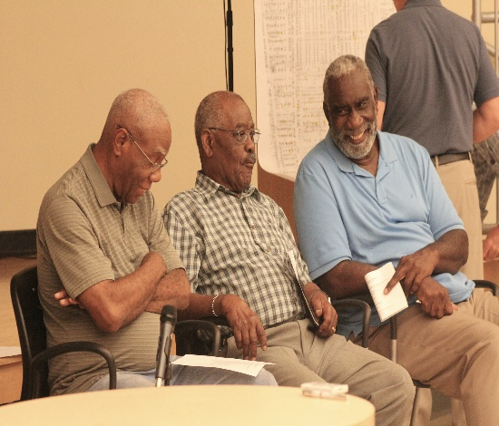
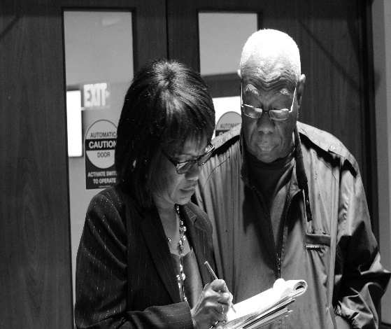
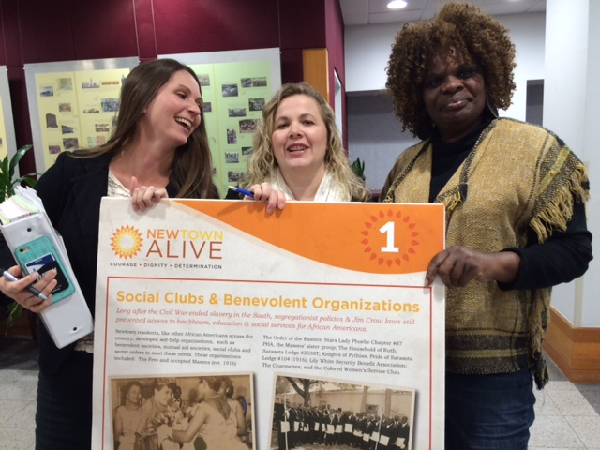
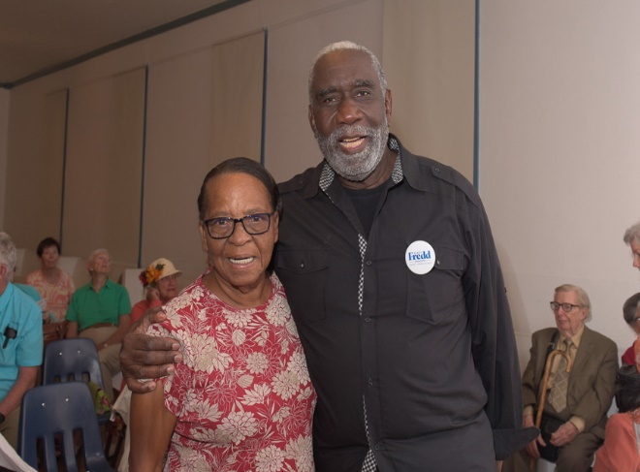
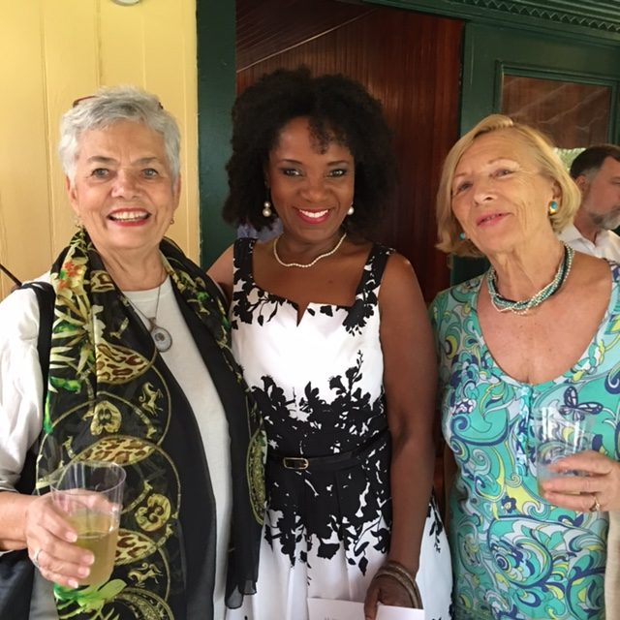
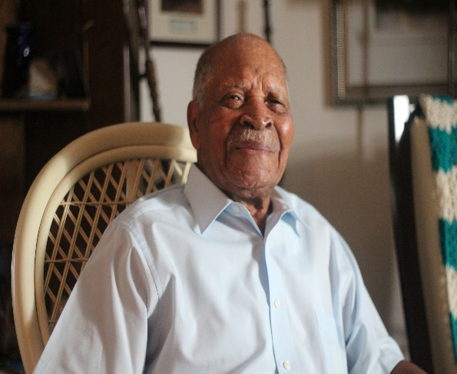
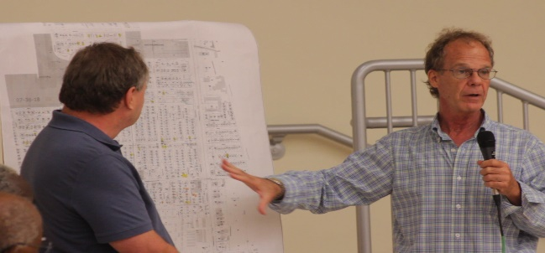
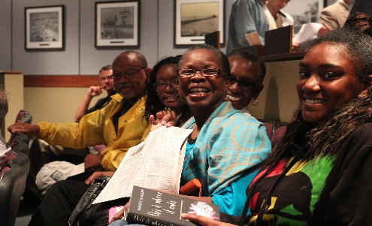
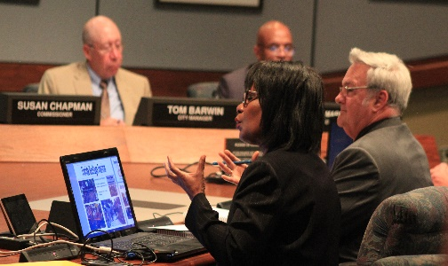
Thanks:
City of Sarasota, staff
Newtown Conservation Historic Taskforce
Vickie O Heritage Production, Inc. & Team
City of Sarasota
Economic Development Division
1782 Dr. Martin Luther King Jr. Way
Sarasota, FL 34234
941-365-2200 Ext. 4229

