Slide 1
Florida’s Future Transportation Corridors Presented to: Florida Redevelopment Association Presented by: Bob Romig State Transportation Development Administrator Florida Department of Transportation
October 24, 2012

Slide 2
Presentation Outline
Why future corridors?
How do we plan and develop future corridors?
Initial study areas
What’s next?

Slide 3
Why Future Corridors?
Coordinate long-range growth/transportation plans and visions
Provide solutions for or alternatives to existing congested corridors
Meet growing demand for moving people and freight to support economic development
Growth in population, visitors, and domestic and international trade
Improve connectivity
Between regions
Between Florida and other states and nations
Notes:
Brief reminder: 4 major reasons we are thinking about future corridors.
First, we need to do a better job coordinating our long term plans and investments for transportation and growth.
Second, there are many parts of the state where congestion has reached the point where we need to consider major investments in existing corridors (such as creating managed lanes) or alternative corridors or modes.
Third, we need to plan for growing demand for moving people and freight as our economy recovers.
Population – 37% increase from 2010 to 2040, to 26 million
Visitors – 44% increase from 2011 to 2040, to 124 million per year
Freight – 39% increase from 2010 to 2035, to 797 million tons
Finally, we recognize the role transportation connectivity can play in supporting economic development opportunities.
Many forecasts suggest over time much of Florida will compete globally as an integrated “megaregion” – a vision that will be achieved by better connecting Tampa to Jacksonville, or Orlando to Southwest Florida.
We also want to improve connectivity to other states and nations needed to help Florida become a global hub for trade and logistics.

Slide 4
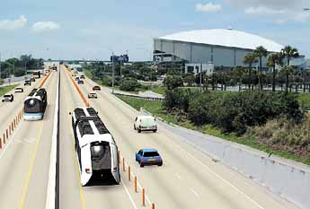
What Is a Future Corridor?
Function
Connect Florida regions or connect Florida to other states
Focal point for trade and economic development
Characteristics
High-speed, high capacity connection
Multiple transportation modes
Co-location with utility, communications, and other linear facilities
Advanced technologies, materials
Notes:
Before we get into the detail, let me define what we mean by a statewide corridor.
A statewide corridor is one that connects Florida to other states or connects broad regions within Florida. But it’s about more than transportation – these are the parts of Florida that we anticipate to serve as a focal point for future trade and economic development.
Key characteristics:
Generally, these are high-speed, high-capacity facilities. We’re talking about major highways such as our Interstates or other limited-access roadways; major rail lines; and waterways.
Generally will involve multiple modes of transportation-- e.g., highway and rail together.
Often may involve other linear facilities such as telecommunications or utility systems.
Will draw upon advanced technologies and materials so these corridors are safe, efficient, and environmentally friendly.

Slide 5
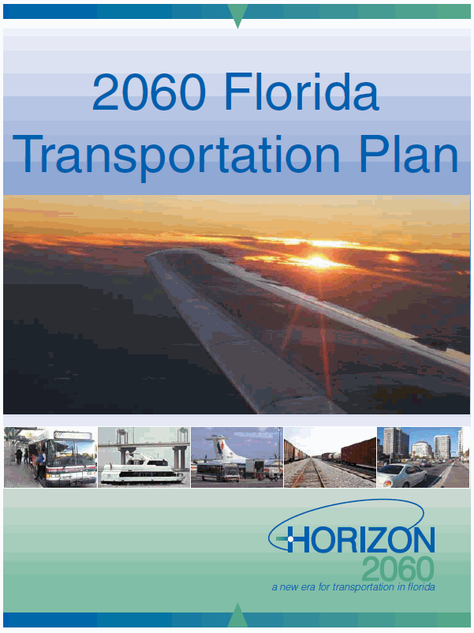
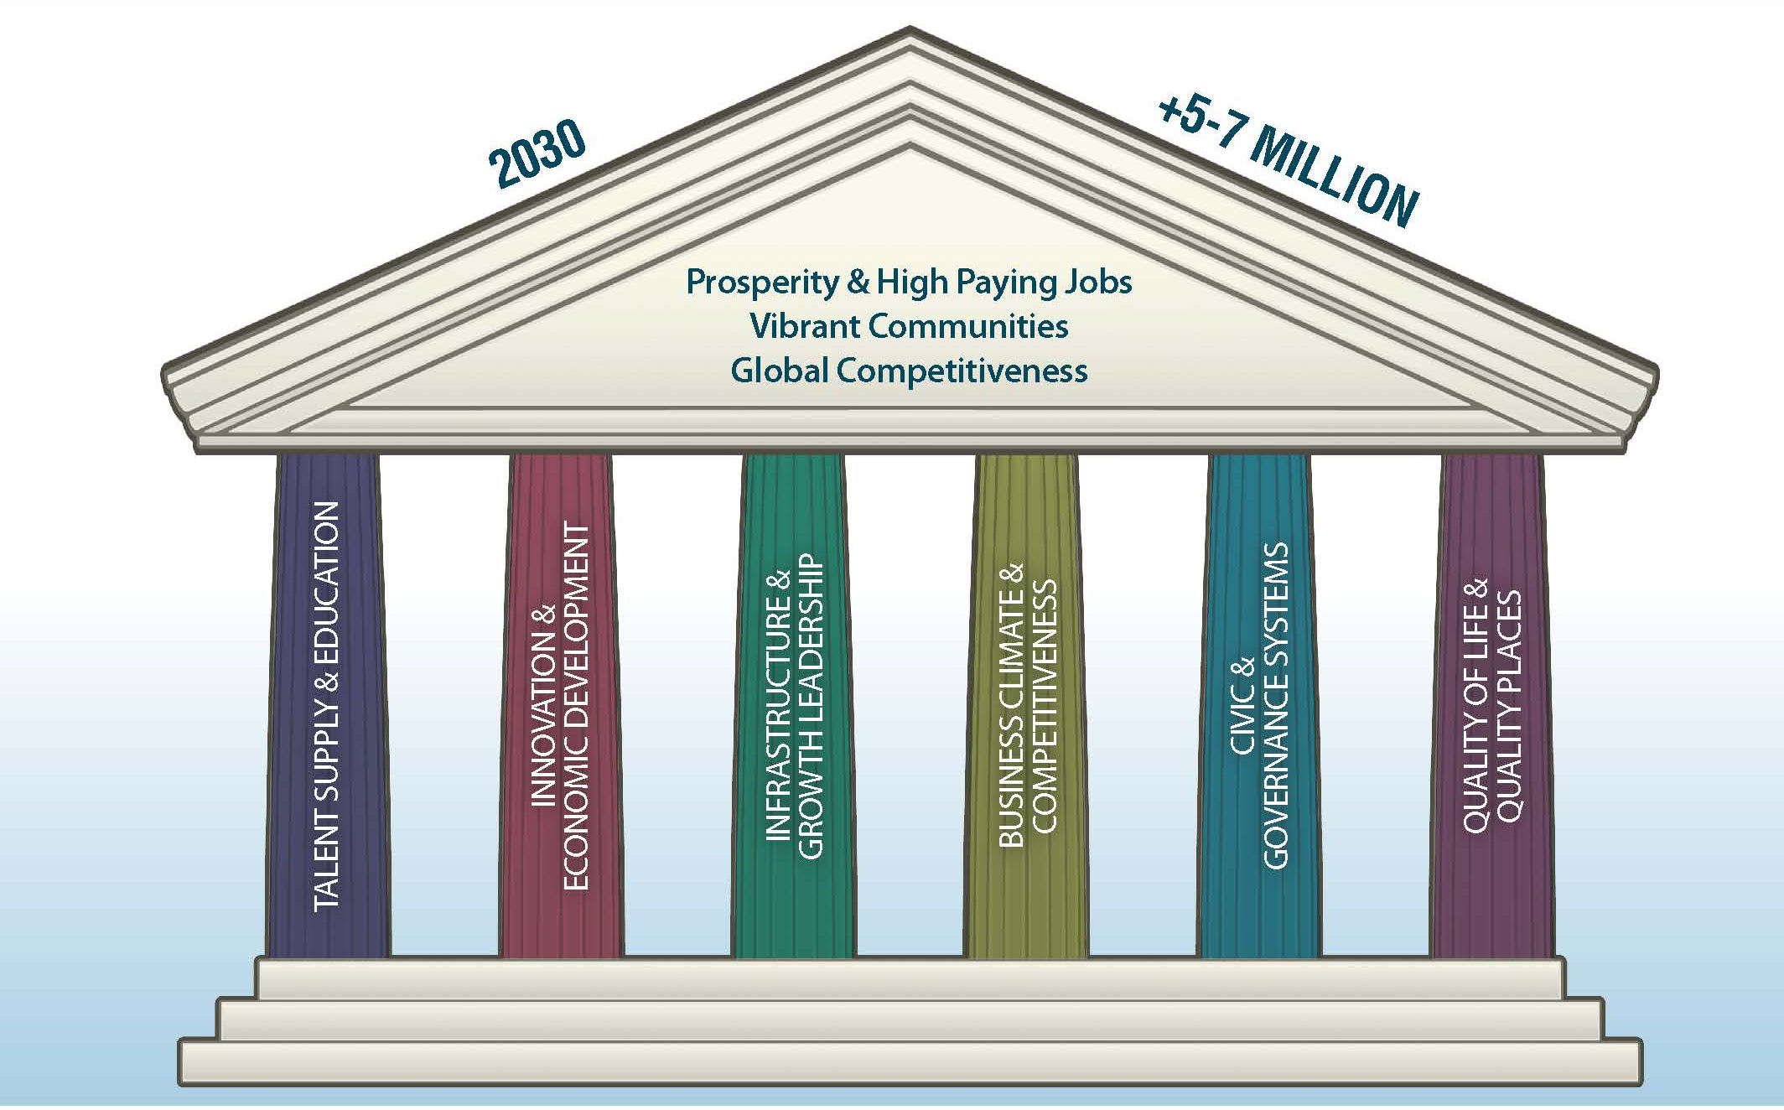
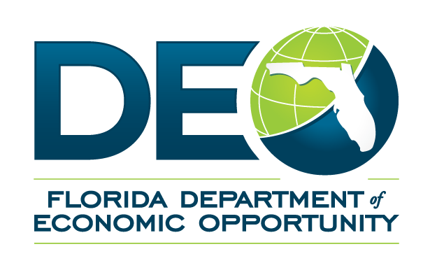
Many Partners Calling for Greater Emphasis on Future Corridors
2060 Florida Transportation Plan
Florida Trade and Logistics Study
Six PillarsTM 2030 Strategic Plan
Department of Economic Opportunity’s 5 year Strategic Plan for Economic Development
Notes:
Over the past few years many of our partners have called for greater emphasis on planning for future transportation corridors.
In 2005-2006 we worked closely with the Florida Transportation Commission to develop the Future Corridor Action Plan which was adopted by Secretary Denver Stutler in Dec. 2006. This plan set forth a planning framework to identify long-range transportation needs and solutions to meet those needs.
In 2010, FDOT worked with a 29 member Steering Committee and with input from more than 10,000 Floridians to develop the 2060 Florida Transportation Plan (FTP). The 2060 FTP emphasizes the importance of making transportation investments to support a prosperous, globally competitive economy. The FTP recommended creating an integrated statewide vision to provide a context for planning the future of our major transportation corridors.
Also in 2010 FDOT worked with numerous partners to develop the Florida Trade and Logistics Study under the leadership of the Florida Chamber Foundation. One of the key recommendations was to develop an integrated statewide network of trade gateways, logistics centers, and freight corridors building on the Strategic Intermodal System.
The Foundation’s Six Pillar Strategic Plan for Florida’s future economy emphasizes the importance of proactive infrastructure investments with a perspective of ‘growth leadership’ – a theme that also is included in the draft of the Department of Economic Opportunity’s five-year strategic plan.

Slide 6
Regional Visioning Processes
In Planning
In Progress
In Implementation
Completed
Notes:
The concept of looking at future corridors also has been a theme of many of the long-range regional visions around the state. This map shows completed or ongoing regional visioning efforts throughout the state. Each of these processes is working to create a long range (typically 50 year) view of the future of each region, integrating decisions about economic development, land use, transportation and environmental stewardship.
The key themes emerging from many of these efforts include focusing growth in centers and developing multimodal corridors connecting these centers.
As these regional visions are completed, they will provide specific guidance to help identify future corridor needs.
A regional visioning effort to cover the North Central Florida area is scheduled to begin soon. This much needed effort will provide valuable information on the vision for this mostly rural area.

Slide 7
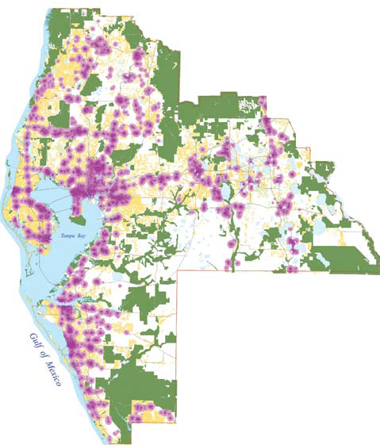
How Can a Regional Vision Provide Input to Corridor Planning
Can indicate desirable regional growth patterns and long-range scenarios for:
Future land development
Conceptual locations for future corridors (including modes and access points)
“Must save” community and environmental resources
Potential for development or redevelopment
Notes:
These regional visions and other long-range planning initiatives can provide valuable input to planning for future corridors. A regional vision can indicate desirable regional growth patterns and long-range scenarios for:
Future land development
Conceptual locations for future corridors (including modes and access points)
“Must save” community and environmental resources
Potential for development or redevelopment

Slide 8
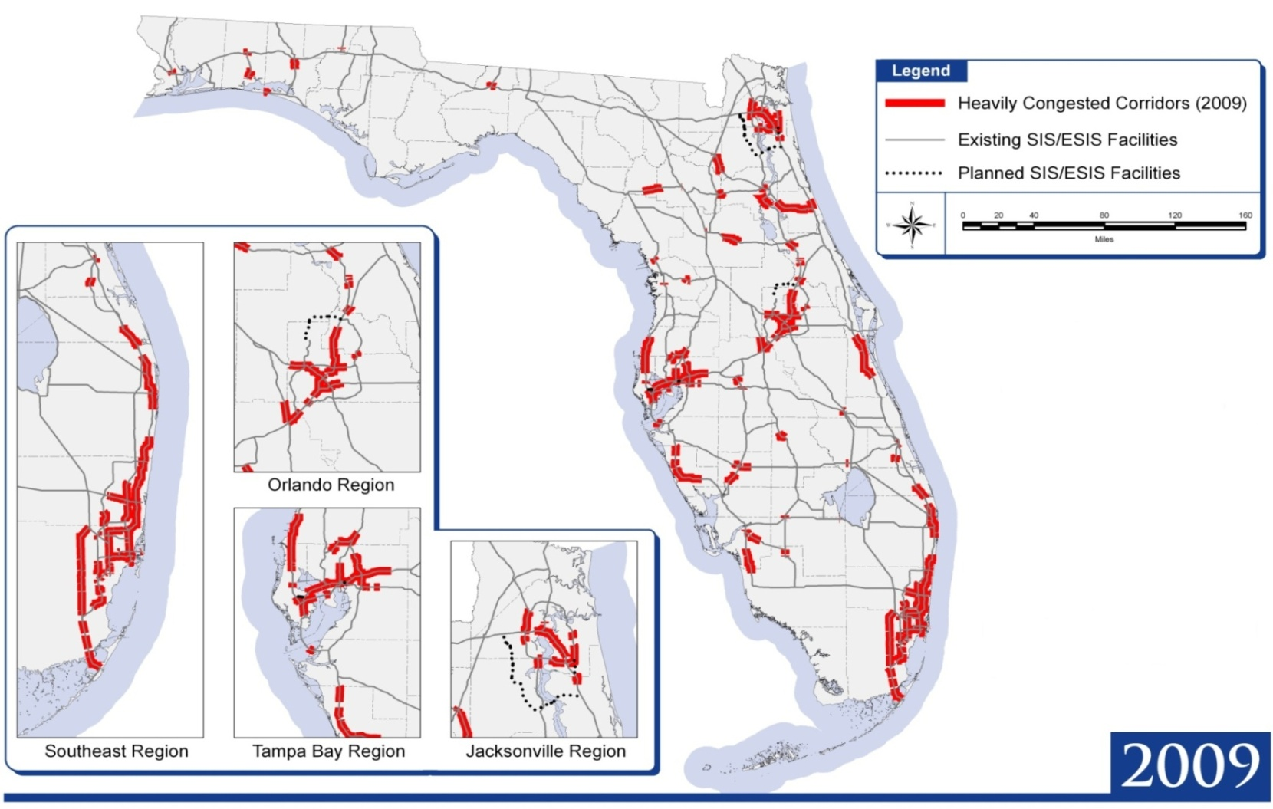
Today’s Transportation System Cannot Meet Increase in Demand
Source: FDOT Systems Planning Office
Notes:
Let’s briefly review a few key trends.
The growth in travel by residents, visitors, and freight will increase pressure on Florida’s transportation system, especially on the highway corridors. This map shows the SIS highways that were congested in peak periods in 2009; that is, they did not meet level of service standards.
Highways that fall below the standards include portions of the Interstate I-4, I-75, and I-95 corridors and other key corridors in Florida’s urban areas– but also a few corridors in emerging regions and rural areas.
NOTES:
Heavy congestion in Urban Areas means that traffic is either moving bumper to bumper or is stop and go during peak periods (Level of Service E or worse).
Heavy congestion in Rural Areas means that passenger and truck traffic is so heavy during peak periods that changing lanes is very difficult (Level of Service D or worse).

Slide 9
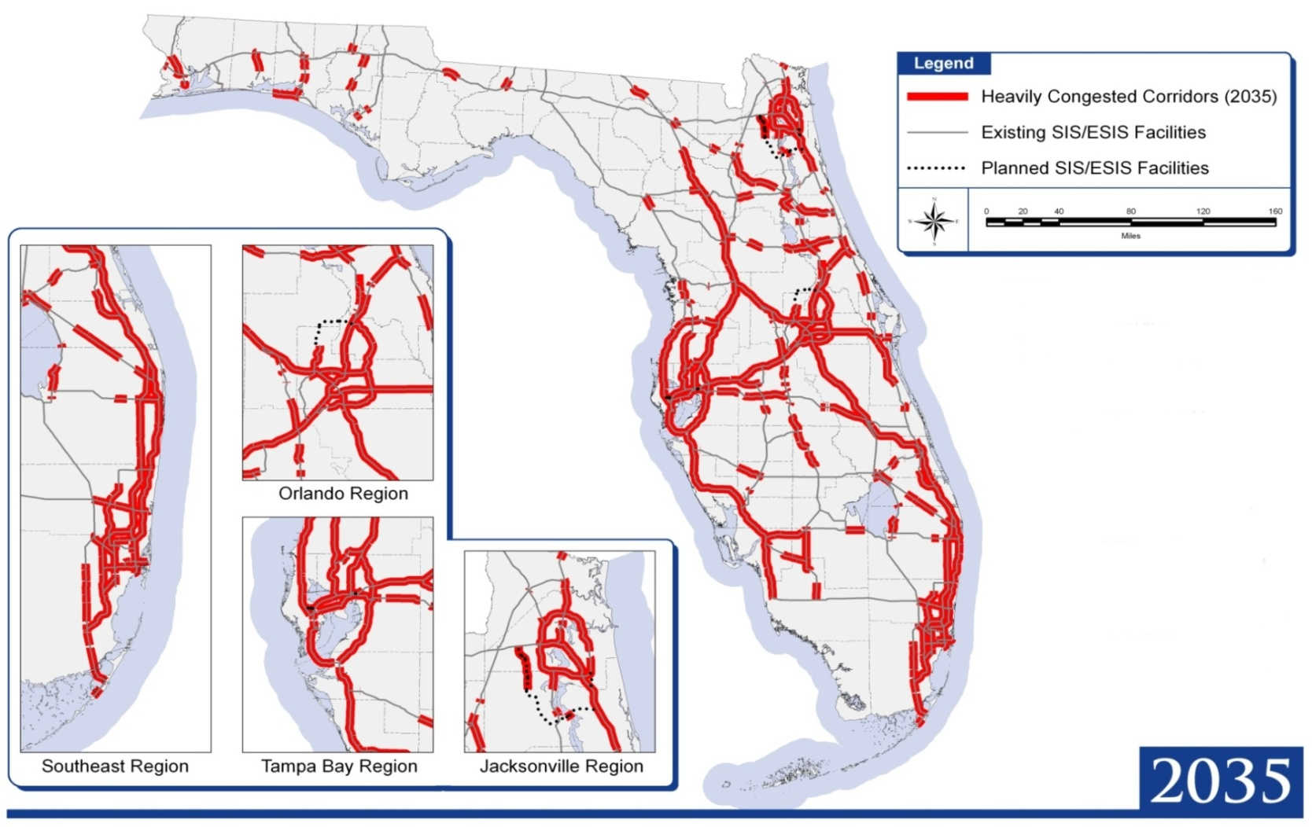
Today’s Transportation System Cannot Meet Increase in Demand
Source: FDOT Systems Planning Office
Notes:
This map shows congestion in 2035 – even after making all the roadways improvements included in the SIS Cost Feasible Plan through 2035.
Congestion is anticipated by 2035 to become a problem during peak periods along virtually all of Florida’s major highway corridors in our urban, transitioning, and rural areas.
With these trends continuing, the delay experienced by users will reach levels that could significantly reduce Florida’s economic competitiveness and quality of life.

Slide 10
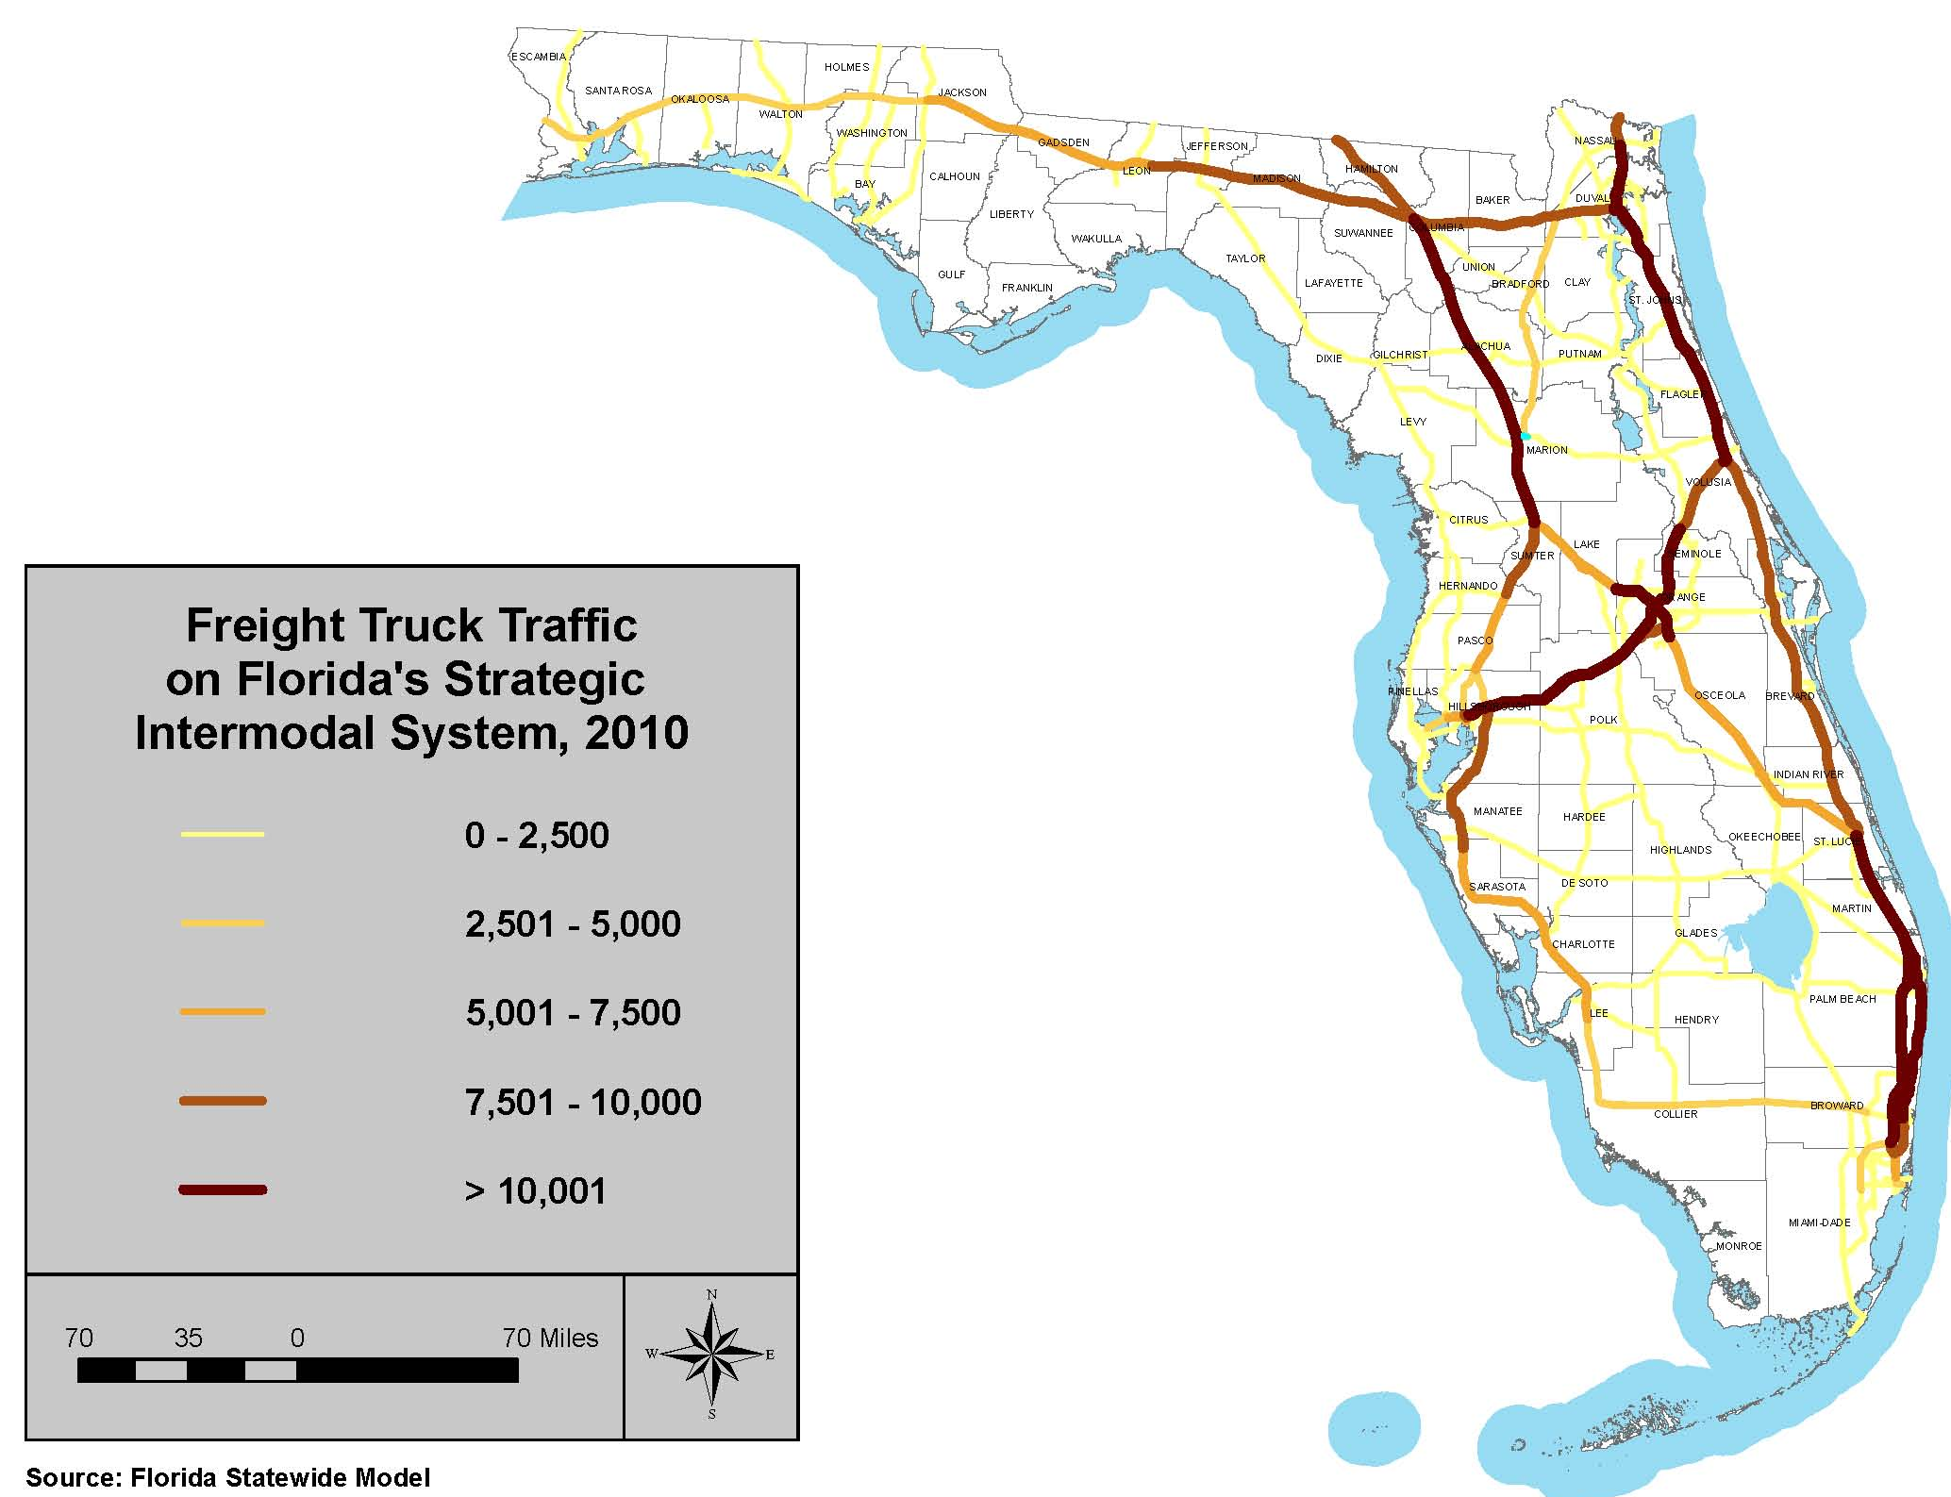
Freight Traffic on the SIS, 2010
Notes:
Trucking will remain the dominant way in which we move freight. (78.9% truck, 13% rail, 7.9% International waters & 0.2% air share in Florida as of 2010 [Florida Trade & Logistics study]) This map shows average annual daily truck traffic on SIS in 2010. Note the heavy traffic along all of the Interstate system, particularly I-95 in Southeast Florida; I-95 in Northeast Florida; I-4 between Tampa and Orlando; and I-75 from Wildwood to I-10. Also note the large volume of truck traffic on other key roads.

Slide 11
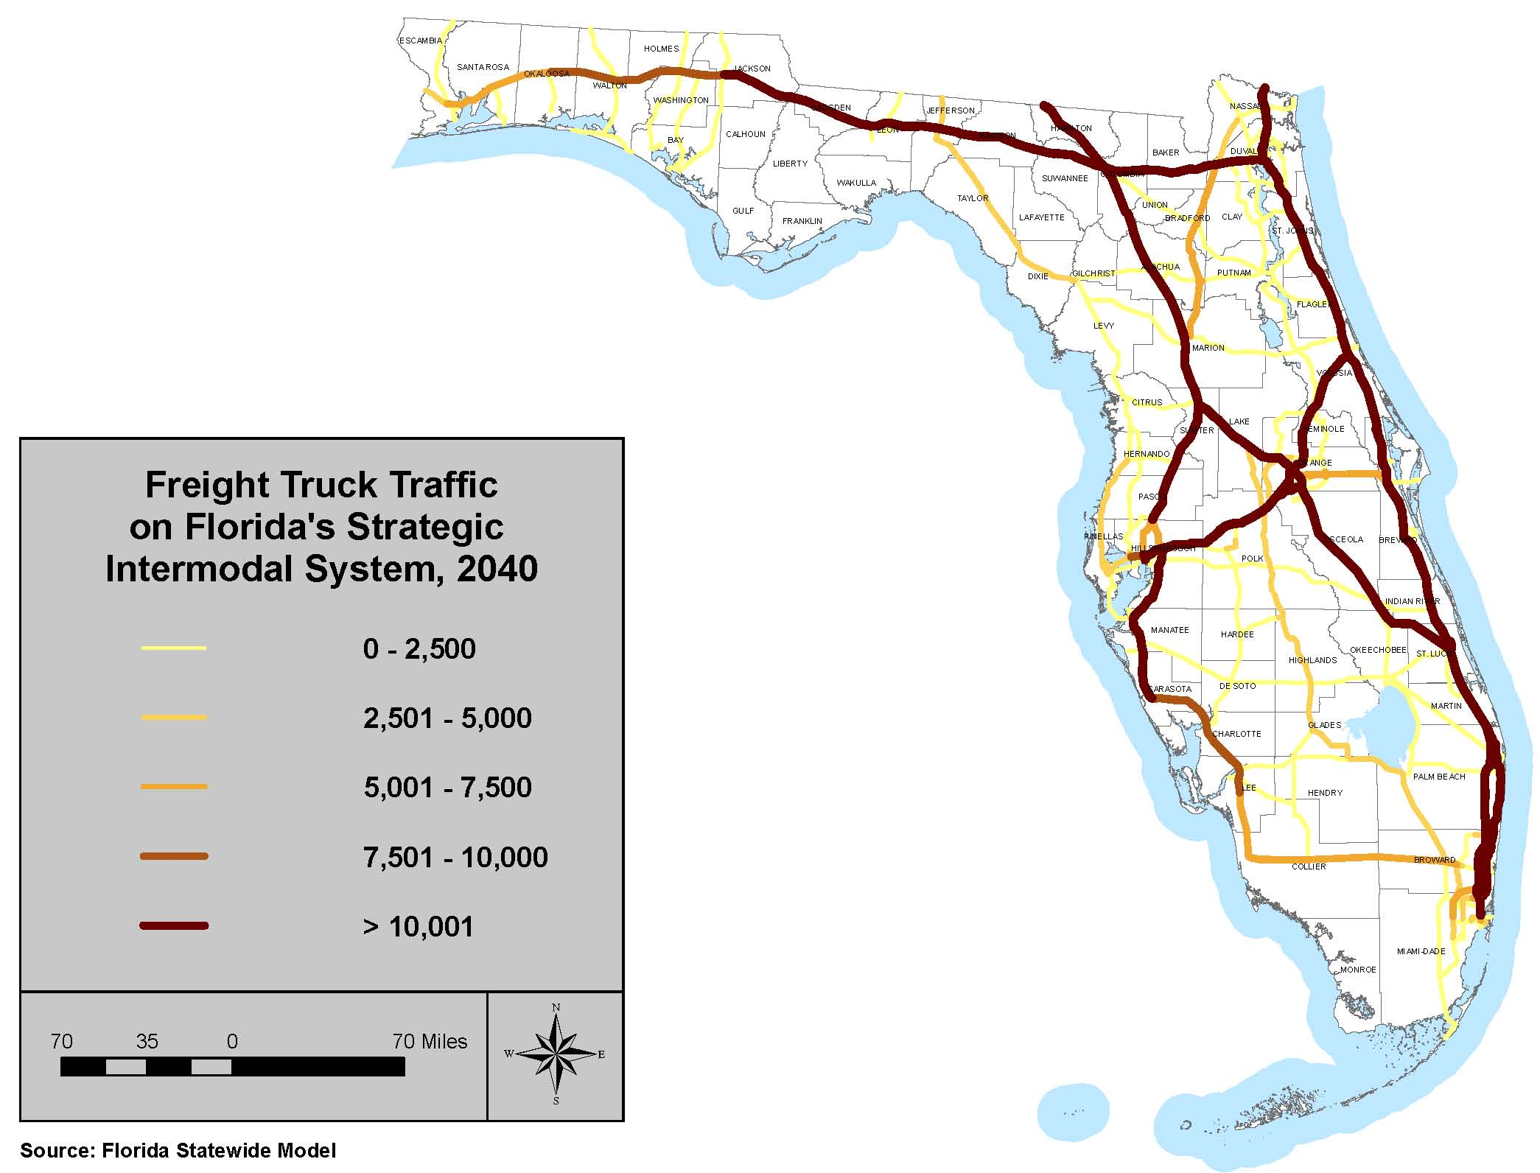
Freight Traffic on the SIS, 2040
Notes:
Freight activity is growing rapidly (much more faster rate than the passenger car) as well. Trade & Logistics Study produced by Florida Chamber foundation, December 2010, suggest that more than 640 million tons of freight will move to, from, and through Florida by the year 2035, compared to 452 million tons in 2010 by trucks, an annual growth of 1.4% in terms of demand. As a result, truck traffic is expected to grow significantly on all of Florida’s major roads. This is one reason that we are beginning to explore dedicated truck lanes and other solutions on the Interstates. Also note the anticipated growth in truck traffic along other key highways such as US 27, 301 and I-75 in south Florida.

Slide 12
Presentation Outline
Why future corridors?
How do we plan and develop future corridors?
Initial study areas
What’s next?

Slide 13
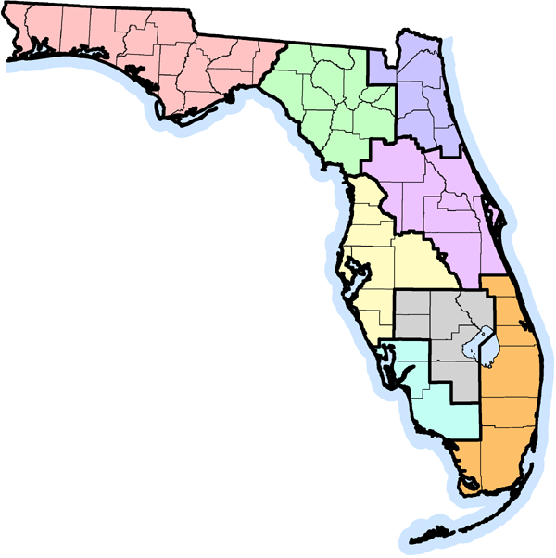
How Are Study Areas Identified?
?
FDOT
Connectivity “gaps”
Current and projected constraints on existing system
Statewide modal plans
Transportation alternatives studies
District and Turnpike Enterprise analyses
Partners and Stakeholders
Regional visions
MPO long-range plans
Expressway authority master plans
Other stakeholder proposals
?
?
?
?
?
?
?
Notes:
We’ve had many questions about how study areas are identified as part of the Future Corridors initiative, so I’d like to review this process:
FDOT has several established procedures for identifying potential corridor needs:
We develop and periodically update a multimodal needs plan for those facilities identified as part of the SIS
Statewide modal offices develop and periodically update plans for individual modes.
Our highway planning process includes a structured approach to developing transportation alternative studies, sketch plans, master plans and action plans for key corridors. Most major existing highway corridors have an adopted master plan, or action plan and others are in progress today.
The FDOT Districts and the Turnpike Enterprise regularly conduct a wide range of special studies to analyze particular needs, often in response to partner requests.
We often receive input from our partners on potential corridor needs. These may include:
MPO long-range transportation plans, as well as regional long-range transportation plans being developed by groups of MPOs;
Regional visions being developed in many regions of the state;
Expressway authority master plans;
Proposals from economic development organizations and business coalitions
We are open to ideas from a wide range of partners, and part of the goal in developing this process is to have a structured approach for evaluating all such proposals in the future.

Slide 14
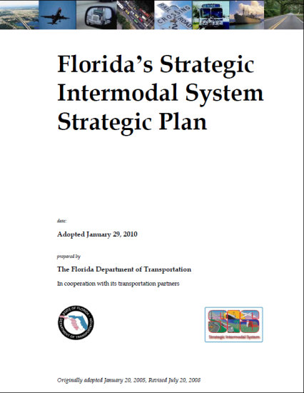
Policy Framework
Focus on connecting economic activities and moving people and freight
Maximize use of existing facilities
Consider alternatives to highways
Add capacity to existing facilities to support growth in demand and relieve congestion
Consider new facilities when needed to fill major connectivity gaps
Notes:
Over the past few years we’ve worked with our partners to develop policies to guide planning for future corridors, including:
SIS Strategic Plan, updated in 2009
2060 FTP, updated in 2010
Each successive plan reaffirms the need to plan for future corridors, often using similar principles or strategies. Some of the key points:
Our focus should be on supporting economic activities and moving people and freight.
We need to maximize use of existing corridors, including efforts to improving efficiency through use of technology and operational strategies, as well as identifying new roles for underutilized facilities and right of way (e.g., a freight rail line now used for passenger rail).
Second we need to consider alternatives to highways for moving people and freight, such as rail and water.
Third, we do need to add capacity to existing facilities where needed to support growth in demand and relieve congestion.
We also should consider developing new facilities when needed to fill major connectivity gaps .
The adopted plans give guidance on how we can plan capacity investments in appropriate locations consistent with regional and community visions and plans.

Slide 15
Key Policy Issues
Consistency with statewide and regional visions/plans including DEO Strategic Plan, Six PillarsTM
Linkage to local government comprehensive plans, sector plans, rural land stewardship areas, DRIs, etc.
Coordination with Cooperative Conservation Blueprint and other land conservation plans
Integrating corridor concepts into regional and local transportation and land use plans
Partnership opportunities with landowners, utilities
Design principles for 21st century corridors
Notes:
Listed here are some of the key policy issues we need to address as we implement the Future Corridors initiative.
Consistency with statewide and regional visions and plans including the Department of Economic Opportunity Strategic Plan, and the Florida Chamber Foundation’s Six PillarsTM Strategic Plan.
Linkage to local government comprehensive and transportation plans, sector plans *, rural land stewardship areas, developments of regional impact, etc.
Coordination with Cooperative Conservation Blueprint (FWCC) and other statewide and regional land conservation and ecosystem plans; potential approaches for reaching consensus and defining mutual commitments on corridor alignment and surrounding land uses in sensitive areas, building on the Wekiva Parkway model.
Partnership opportunities with public and private landowners and utilities to reserve right of way.
We also need to start thinking about what these future corridor look like - -everything from how we take advantage of emerging information and vehicle technologies and alternative fuels to principles about how to manage access and design facility in the context of the communities and environment through which it passes. Quite simply, we can’t develop 21st Century Corridors with 20th Century design and engineering guidelines.
* Adopted by 1 or more local governments to promote and encourage long-term planning for conservation, development and agriculture for areas of at least 15,000 acres

Slide 16
Corridor Planning Approach
Notes:
We have developed a three stage process for planning future corridors. The intent is to have a Consistent, Predictable, and Repeatable approach for the entire agency. The basic steps are:
Concept stage – basic discovery activities:
Identify and validate statewide connectivity and mobility need(s) in the study area
Determine whether a significant transportation investment in the study area is consistent with statewide policies and available regional and community visions and plans for future growth
Identify key issues to be considered in future stages
Evaluation stage
Identify and evaluate potential alternative solutions to identified mobility/connectivity needs
Work with partners to build consensus around potential corridor solutions
Develop an implementation plan for future work on viable corridors, including partner commitment
Project development – established processes to
Conduct thorough analyses of alternative corridor improvements
Select the best projects for implementation
Advance through environmental review process

Slide 17
What Have We Accomplished?
Studies of existing corridors
I-95 (completed), I-75 (underway), US 27 (underway)
Initiated government agency coordination group
Department of Economic Opportunity, Department of Environmental Protection, Department of Agriculture and Consumer Services, Fish and Wildlife Conservation Commission, Federal Highway Administration
Identified initial priority study areas
Initiated Concept studies of priority areas
Initiated outreach to stakeholders
Environmental/land use advocates, regional planning councils, MPOs, local governments, public and private landowners, etc.
Notes:
We’ve made a lot of progress in the last six years…
An alternative analysis for I-95 was conducted and completed as well as implementation of managed lanes on parts of I-95.
We are nearing completion of our alternatives analysis on I-75.
We recently began an alternatives analysis on US 27.
We’ve created a state agency coordination group, reaching out to the Department of Economic Opportunity, the Department of Environmental Protection, the Fish and Wildlife Conservation Commission, the Florida Department of Agriculture and Consumer Services and FHWA.
Working with these agencies, we have sketched out a general progress for planning these corridors, consistent with the 2060 FTP. We also have identified the first study areas we will examine with this process.
We’ve also initiated outreach to stakeholders (environmental/land use advocates, state agencies, Regional Planning Councils, MPOs, public and private landowners, utilities, etc.)

Slide 18
Presentation Outline
Why future corridors?
How do we plan and develop future corridors?
Initial study areas
Tampa Bay-Northeast Florida
Tampa Bay-Central Florida
Southeast Florida-Heartland-Central Florida
Southwest Florida-Heartland-Central Florida
What’s next?
Notes:
Now Id like to touch on a few of the initial study areas.

Slide 19
Tampa Bay-Northeast Florida Study Area Potential Solutions
I-75 managed lanes/ truck only lanes
Enhanced rail system
Suncoast Parkway extension
Florida Turnpike extension (NEFT)
Possible I-75 reliever from Suncoast to Gainesville/Ocala area
Improved connections between
I-75 and Jacksonville
Notes:
The immediate issue is how to provide relief on what we refer to as the “aneurysm” on I-75 between Wildwood and Gainesville. Some statistics:
I-75 today carries more than 77,000 vehicles per day between the Turnpike and Ocala, and vehicle flows drop gradually as we move north toward I-10. About 1 in every 5 vehicles are trucks. (increases to 60% at 4 am period)
We expect to see travel along I-75 increase by up to 67% by the year 2035, exceeding 110,000 vehicles per day on the segment between the Turnpike and Ocala. Most of this facility will be congested during peak periods in 2035.
The congestion and large number of trucks creates a safety risk, Over the past 3 years, 60 fatalities occurred along this corridor and nearly 3,800 incidents. In Sumter County, crash rates along I-75 are similar to those on Interstates in major urban areas.
Meeting future demand would require up a total of 16 lanes on I-75 by 2035- a scale with tremendous impact on adjacent communities and sensitive environmental areas such as Payne’s Prairie.
We are working to determine if there are some immediate solutions for I-75 itself, such as interchange improvements or operational solutions. We plan to begin work later this year to study the use of truck only lanes.
Concurrently, we will reexamine some of the proposals developed in the past – for example, extending the Suncoast Parkway into Citrus County or extending Florida’s Turnpike to the North.
The next step would be to explore parallel corridors to I-75, such as extension of the Suncoast Parkway from Citrus County to I-75, near Ocala or Gainesville. Can we create a viable facility to divert some traffic from I-75?
Long-term, we need to look at the entire corridor between Tampa Bay and Jacksonville – two large regions without a direct connection via a high speed corridor. There are potential economic benefits from better linking these large regions as well as improving access to communities in between such as Port Citrus and Gainesville. We would start by working with partners to understand how transportation investments can support the region’s economic future.

Slide 20
Tampa Bay-Central Florida “Super Region” Potential Solutions
I-4 managed lanes
Future SunRail extensions
Parallel facilities on segments
of the corridor
Possible new
corridors consistent
with regional visions
and adopted land
uses
Notes:
The critical issue will be the future of I-4, which is the key spine of this superregion. Alternatives to improving I-4 may include express lanes; parallel facilities (likely on segments of the corridor); alternative modes (e.g., future SunRail extensions), or new corridor to fill connectivity gaps.
Some improvements such as the Wekiva Parkway are about to get started; others such as the Central Polk Parkway are under final stages of their environmental review. Note: Central Polk Parkway PD&E approved by FDOT, waiting final approval of interchange with I-4 from FHWA. Given this early stage, the connection to I-4 is still being evaluated with several options being considered.
However, we do not have an overall picture of the future connectivity that will make this combined region succeed.
So some next steps here would be to identify initial projects ready to move forward; and to begin working with our partners on a long term framework for the entire area is the context of regional visioning.
A key part of the strategy will be working with partners to build consensus around connectivity needs and potential solutions.
We will determine over the next few months how best to work with all partners as we move into the more detailed studies –

Slide 21
Southeast Florida-Heartland- Central Florida Study Area
Potential for increased freight flows from Southeast Florida seaports and connections to proposed intermodal logistics centers
US 27 Alternatives Study initiated to examine options including truck-only lanes, freight rail service
Heartland 2060 regional vision will help guide future decisions about US 27
Notes:
Let me briefly mention the two other areas we will study beginning in 2013.
The Heartland region is a part of the state with potential for great change over the next few decades. In particular, we are examining the potential for increased freight flows from the Southeast Florida ports, connecting to several major freight/distribution sites in the region (CSX Winter Haven ILC, Sebring Rural Catalyst site, potential ILCs around Lake Okeechobee, etc.),
Our Systems Planning Office just initiated a transportation alternatives study of the existing US 27 corridor from Miami-Dade to Marion Counties. This study will examine how we can maximize the use of the existing US 27 facility and right of way. Options may include truck only lanes, freight rail service, bypasses of existing communities, etc.
We also are participating with the Central Florida Regional Planning Council and its partners in the Heartland 2060 regional visioning process. This process will identify future growth strategies for the region and the role that transportation can play in meeting regional goals.
These two studies will guide decisions about the future of US 27 and other corridors in this region.

Slide 22
Southwest Florida-Heartland- Central Florida Study Area
Examine need for more direct connection between Southwest, Central Florida
Potential future need to provide alternative to I-75 for people and freight
Heartland 2060 regional vision will help guide decisions about future growth and development
Notes:
As the US 27 process moves forward, we also will examine the need for a more direct connection between Southwest Florida and Central Florida. As the economy recovers there may be a need to provide an alternative to I-75 to improve connectivity and mobility for both people and freight. The solution for this study area could involve a connection to US 27, as well as additional east-west connectivity. We expect the Heartland 2060 process will help guide this study area as well.

Slide 23
Tampa Bay-Northeast Florida Study Area Targeted Development Sites
Examples of planned redevelopment sites in the study area:
Alachua County Fairgrounds Business and Industrial Park
Cecil Field and Commerce Center
Williston Airport Industrial Park
Source: Planned development sites were obtained from the most recent Comprehensive Economic Development Strategies (CEDS) provided by the Regional Planning Councils.
Notes:
We are moving forward on the Tampa Bay to Northeast Florida study area and Tampa Bay to Central Florida or Super Region study area this year. As part of our review, we have obtained many data sets from various partners and sources to consider as we take a snapshot of what is happening today as well as planned for the future in each of these areas.
One data set we reviewed were the targeted development sites as identified in the Comprehensive Economic Development Strategies provided by the Regional Planning Councils. This data set identified some planned redevelopment projects. I’ve listed a few here.
Alachua County Fairgrounds Business and Industrial Park – this planned project would convert fairgrounds into a business and industrial park, project is contingent upon relocating the current fairgrounds to land the county purchased on Waldo Road north of the airport. (per CEDS)
Williston Airport Industrial Park – This site boasts 7000' and 4330' runways and thousands of acres of industrially zoned land, projected to be completed between 2018 and 2020.

Slide 24
Tampa Bay-Central Florida “Super Region” Targeted Development Sites
Examples of planned redevelopment sites in the study area:
Creative Village Redevelopment
Taveres Downtown Redevelopment Area
City of Cape Canaveral Redevelopment
Cove Welcome Center/Cove Area Development
Tarpon Springs Development Plan
Source: Planned development sites were obtained from the most recent Comprehensive Economic Development Strategies (CEDS) provided by the Regional Planning Councils.
Notes:
There also are a few planned redevelopment projects identified in the Super Region study area list of targeted development sites. A few examples are listed here. We will work with the RPCs to ensure we understand the future plans for development and redevelopment as identified in their most recent CEDS. Understanding where future development and redevelopment will occur is vital to our planning for future corridors.
Some examples:
Creative village Redevelopment - The Creative Village project is located in a minority neighborhood in the core of downtown Orlando. Redevelopment for this site as a sustainable, mixed-use, transit oriented development based on educational technology, digital media education built in a cluster, and technology commerce that will create upper income, sustainable jobs. Built on a foundation of three public university technology and research facilities as well as creative industry corporate tenants, when complete, Creative Village will provide over 8,000 jobs.
Cove Welcome Center/Cove Area Development - The Cove Area Redevelopment area will include waterside family dining, entertainment and retail with pedestrian friendly walks. The community will serve cruise passengers, tourists, and local residents in a family friendly multigenerational age group with active and passive recreation. The welcome center will be completed in 2013.

Slide 25
Presentation Outline
Why future corridors?
How do we plan and develop future corridors?
Initial study areas
What’s next?

Slide 26
What’s Next?
Support statewide and regional visioning/strategic planning
Continue to coordinate with agencies
Continue to conduct outreach to stakeholders
Complete alternatives studies on existing corridors
Develop concept reports for priority study areas
Initiate pilot evaluation studies
Develop potential agreements for reservation or dedication of right of way for potential viable future corridors
Notes:
Next steps:
Support on-going visioning/strategic planning efforts such as the Florida Chamber Foundation’s Six Pillars of Florida’s Future Economy, the DEO Strategic Plan for Economic Development, and regional visioning processes on-going throughout the state.
Continue to coordinate with state and federal agencies
Continue public and partner outreach in these study areas. This includes outreach to major public and private landowners and utilities
Complete ongoing studies to evaluate how we can maximize the use of existing corridors like I-75 or US 27
Develop concept reports for the first two priority study areas: Tampa Bay to Northeast Florida, Tampa Bay to Central Florida.
Initiate one or more evaluation studies in these two study areas to test the proposed planning process and explore potential partnerships to develop future corridors
Develop potential agreements with public or private landowners for reservation or dedication of right of way for viable corridors– so even if we determine we don’t need to build the facility for a few decades, we can begin preserving right of way at today’s prices for when it is needed.

Slide 27
Questions?
For more information:
http://www.dot.state.fl.us/planning/policy/corridors/

