Slide 1
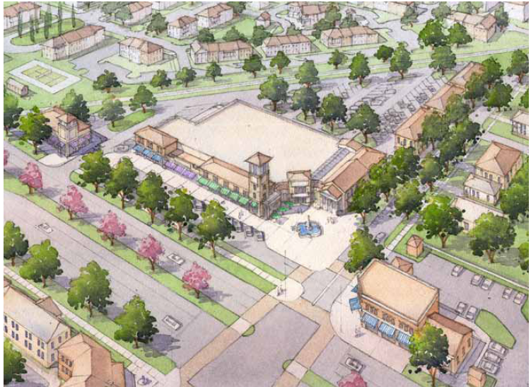
Central Community Redevelopment Agency: A Catalyst Grocery Store Project in Development

Slide 2
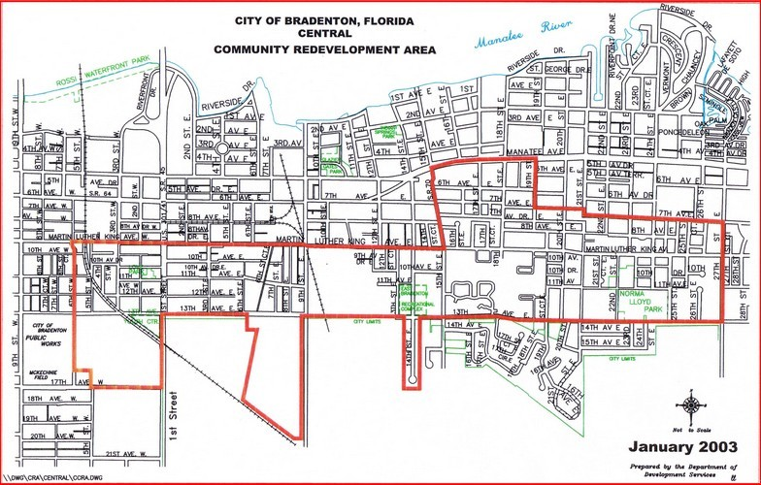
CCRA Facts
Created in July 2000
Acres – 598
Residents - 4,506
Low income, minority population

Slide 3
CRA Capital Project Development: A 3 Leg Stool
Capital Projects
Public Partners
Private Partners
Non-Profit Support

Slide 4
Role of the CCRA
Initiating a land swap with the City of Bradenton.
Supporting the existing tenant in their move to a new location
Building community and stakeholder support for a grocery store at this location.
Serving as a broker between the community, government, and development community interests.
Participating in the developer and tenant search.
Facilitating creative financing options.
Managing the interests of stakeholders throughout each phase of the project

Slide 5
Incentives & Alternate Funding Possible Through CRA Partnership
Strategic planning and use of incentives allows for the completion of capital projects in challenging times.
CED Grants
OCS Grants
CDBG Funding for Site Infrastructure
Donated / Low Cost Land
Tax Rebates
New Market Tax Credits
Brownsfield Incentives
Section 108 Loans
Catalytic land investments combined with creative funding solutions, make this project a win for the CRA, the developer, and the community.

Slide 6
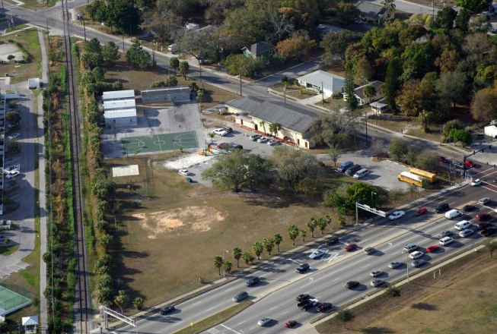
Additional Information
CED Grant through the Office of Community Services
Support employment and commercial development projects designed to provide economic self-sufficiency for low-income residents and their communities.
CDBG
Can be used for “prevention or elimination of slums or blight” in low to moderate income communities.
New Market Tax Credits
Department of the Treasury tax rebate credit, returning 39% of the project investment over a 7 year period
Brownsfield Incentives
Brownfield Redevelopment Bonus Refund ($2,500/job created)
Section 108 Loans
Loans secured by future CDBG allocations

