Slide 1
Urban
Development
Solutions
For more information, please contact:
Larry J. Newsome, CEO
Urban Development Solutions, Inc.
6538 1st Avenue North
St. Petersburg, FL 33710
T: 727.345.6684/F: 727-384-3325
E: larrynewsome@i-uds.com

Slide 2
Company Profile (Our Work – Past & Present)
URBAN DEVELOPMENT SOLUTIONS is an award-winning niche developer committed to fostering sustainable development and revitalization in underserved markets throughout Florida.
UDS was founded in 2003 and completed its flagship project in 2005 – the 47,000 square foot Tangerine Plaza Shopping Center, anchored by a Sweetbay Supermarket.
PAST & CURRENT PROJECTS
Lakewood Apartments
Happy Workers Children’s Center
13th Avenue Dream Center
21 Single-Family Housing
Popeye’s Restaurants
Miami Art & Technology Center
The Midtown Enterprise & Retail Ctr
The MLK, Jr. Enterprise Center
The McCollum Hall Revitalization Project

Slide 3
Industry Honors
UDS is recognized as a pioneer in the field of
inner-city development
Winner of the 2006 Outstanding Project of the Year Award by the Florida Redevelopment Association
Winner of the 2006 Best of the Best Project Award by the Florida Redevelopment Association
Winner of the 2007 Outstanding Minority Business of the Year Award by the St. Petersburg Area Chamber of Commerce
Listed in 2009 in the Who’s Who Tampa Bay Reference Guide for “Raising New Forms of Wealth.”
Winner of the 2009 Community Developer of the Year Award by the Florida Minority Community Reinvestment Coalition

Slide 4
Unique Skill Sets
UDS is one of the few developers in the nation who has won multiple consecutive awards of specialized “social equity” funding sources, including EDGE Loans, Community Economic Development Grants, Affordable Housing Program financing, Low Income Housing Tax Credits, and a nationally-recognized model of New Markets Tax Credits utilization
SPECIALTY SKILL SETS INCLUDE:
“Social Equity” Redevelopment Financing & Funding
Tenant Marketing & Leasing
Community Wealth Building & Asset Development

Slide 5
Our Team
Larry Newsome, CEO
Former SVP & CFO for Progress Credit Corp. and Echelon Int’l Development, CPA, Certified Tax Instructor, former Licensed Broker, Licensed Appraiser, with an MBA in Finance who has served on the core development team for over $500 million in commercial real estate development
Priscilla Williams, CFO
Tamara Felton, CAO

Slide 6
The Deal Structure: Filling the Social Equity Gap

Slide 7
The Difficult Model
The first project where UDS used tax credits is Tangerine Plaza, where tax credits are provided using a discounted cash flow model. I call this model the difficult model.
It requires that the borrower have a very good understanding of how tax credits work and how deals are structured. The primary advantage of the cash flow model is that it provides you with hard cash and makes it possible for a substantial amount of the benefit of tax credits to pass along to the borrower. Because of the high transaction costs, this model is not feasible for projects under $5 million. For borrowers who do not have a background in tax credits, it is advisable to hire a consultant with the expertise.

Slide 8
The Easy Model
The second project where UDS is utilizing credits is the SunTrust Bank Building, a 13,100 square foot office building anchored by a SunTrust branch. Totaling $3.7 million, the project will use what I call “the easy model.”
The bank simply provides a discount on the interest rate, in our case 350 basis points.
Some lenders provide loans with this model on projects as small as $1.5 million. However, the smaller the project the smaller the discount and any debt borrowed has to be repaid.

Slide 9
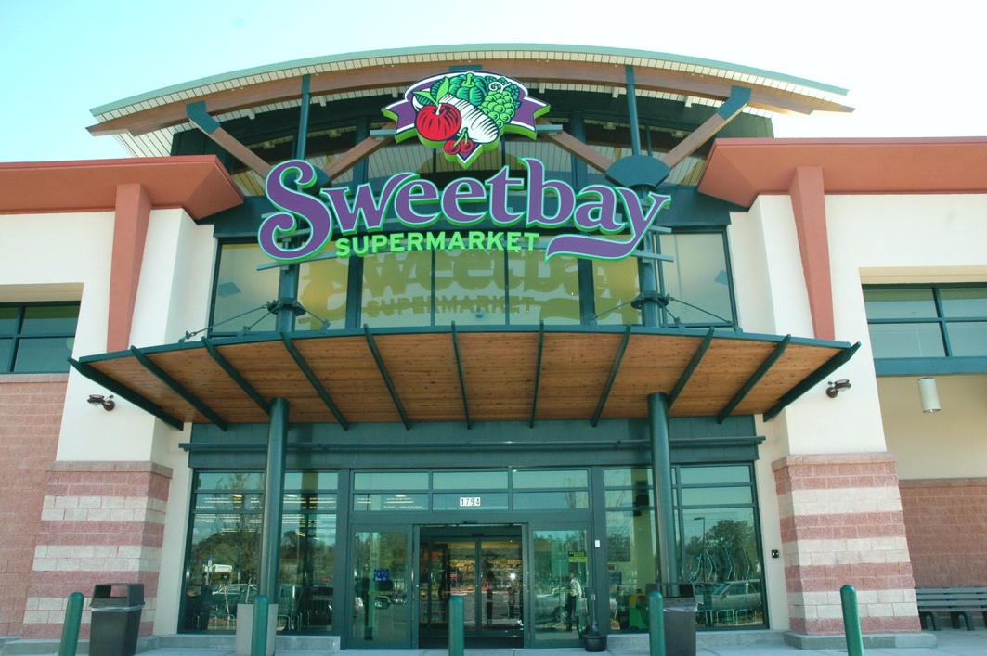
Tangerine Plaza/Sweetbay
Tangerine Plaza is a 48,000 square foot strip shopping center, anchored by a Sweetbay Supermarket with 39,000 square feet, with 9,000 square feet leasable to 6 additional, preferably local tenants.

Slide 10
Sources of Funds
Financial Institution Type Financing Amount
(millions)
BB&T First Mortgage $3.2
NLP Second Mortgage $2.0
BB&T/Fifth Third Third Mortgage $3.5
OCS & UDS
TOTAL $8.7
First Mortgage utilized FHLB EDGE Loan with a 3.4% int rate for 7 years
Second mortgage partially funded by City of St. Pete with a 2.4% interest rate for 7 years
Third Mortgage funded by BB&T and Fifth Third Bank through sale of tax credits,
OCS through a grant and UDS through part of its Developer’s Fee.

Slide 11
Uses of Funds
Activity Amount
(millions)
Pay off of Construction Loan $6.7
Working Capital $0.5
Community Outreach $0.2
Tenant Assistant $0.5
Developer’s Fee $0.2
Transaction Costs $0.6
TOTAL $8.7
The way we are providing tenant assistance is ground breaking. We are providing funds for working capital, rent buy down, as well as build out assistance.

