Slide 1


IDA Annual Conference & Tradeshow
Breakout Session:
What Retailers Want
Retail Recruitment from the Retailer’s Perspective
September 24, 2011

Slide 2
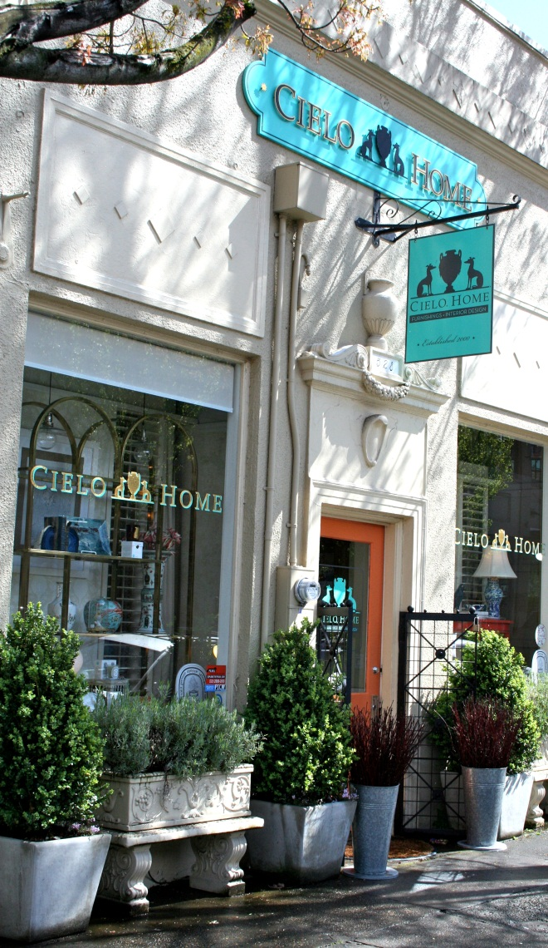
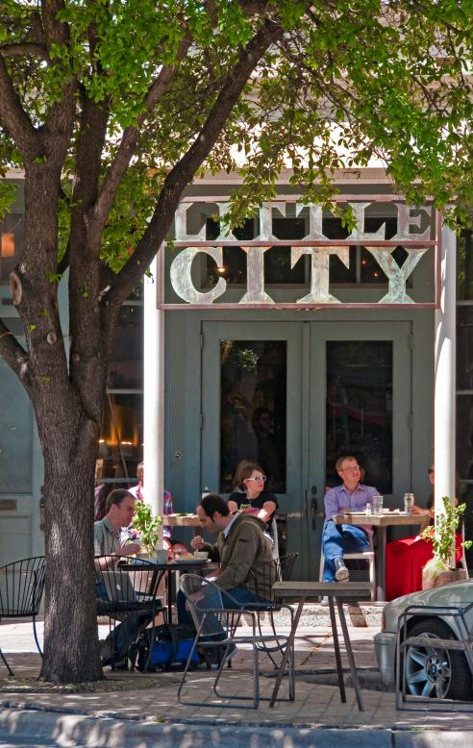
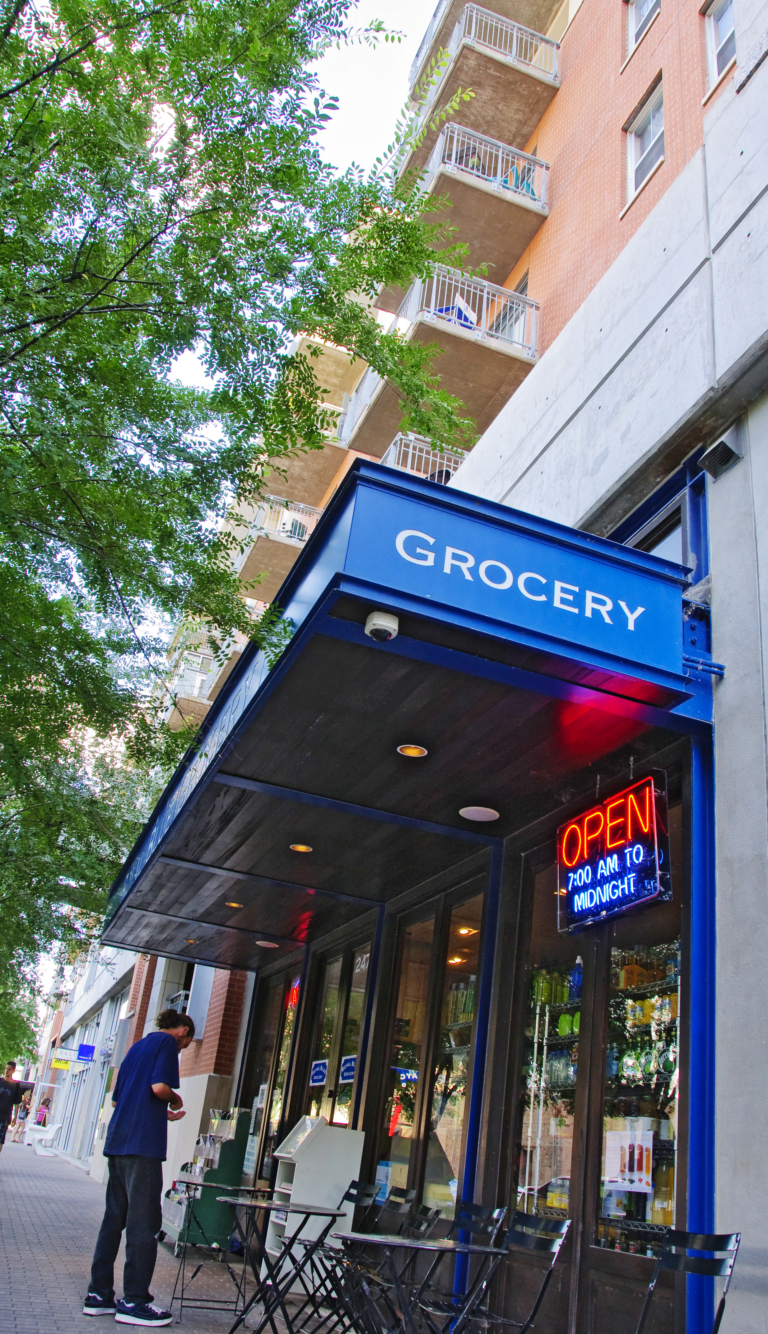
Establishing What You Are

Slide 3
Demographics
Psychographics
1-3-5 mile radius
Population, income

Slide 4
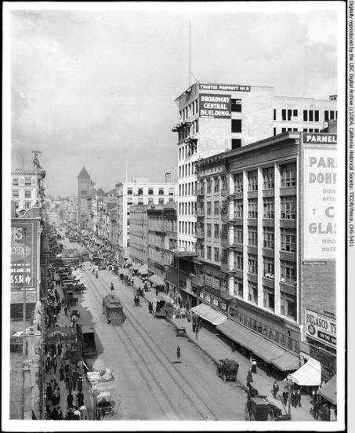
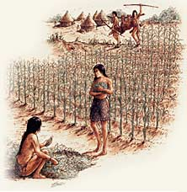
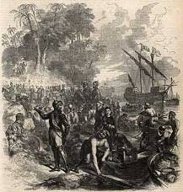
Evolution of Retail
Apalachee (500BC to 1600s) to Governor’s Square Mall
  Downtown city core – the Central Business District in a geographical, commercial, and community sense

Slide 5
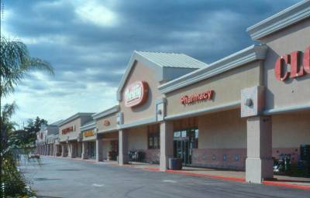
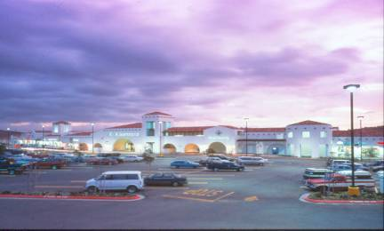
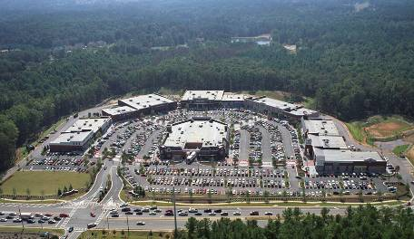
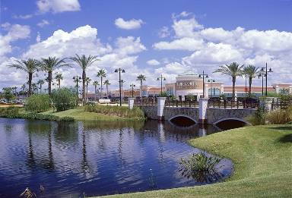
Types of Open Air Centers
Neighborhood Center
Community Center
Power Center
Lifestyle Center

Slide 6
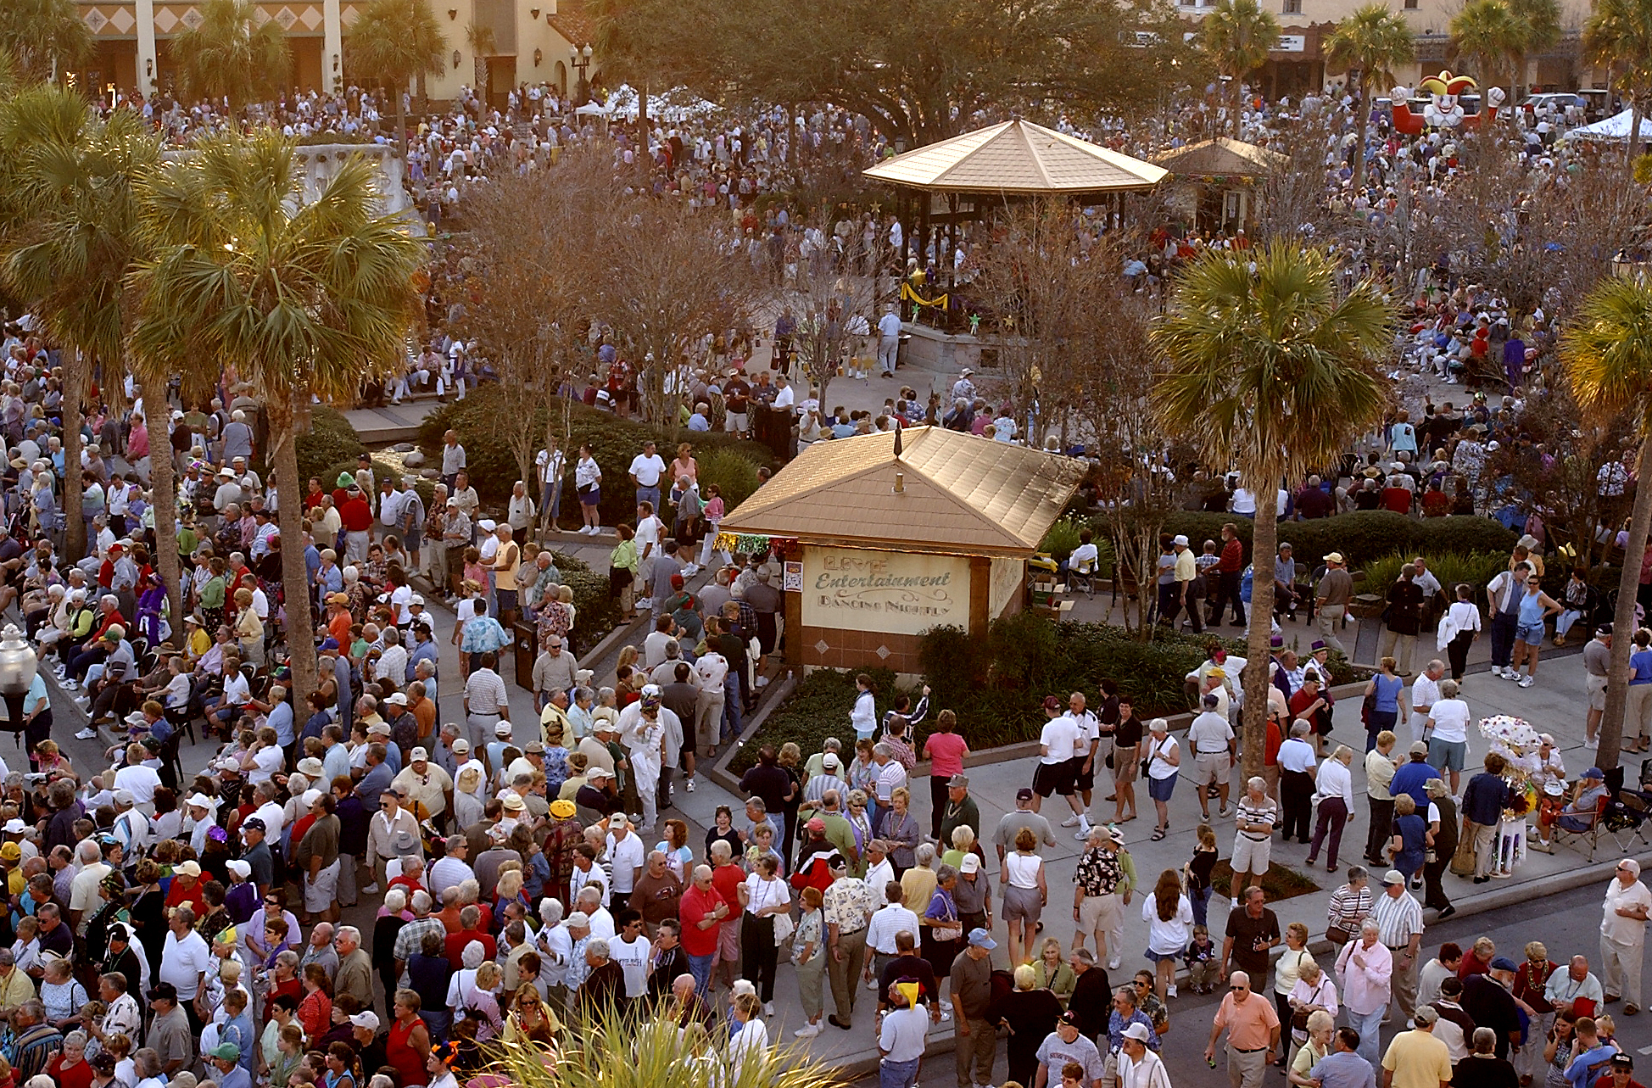
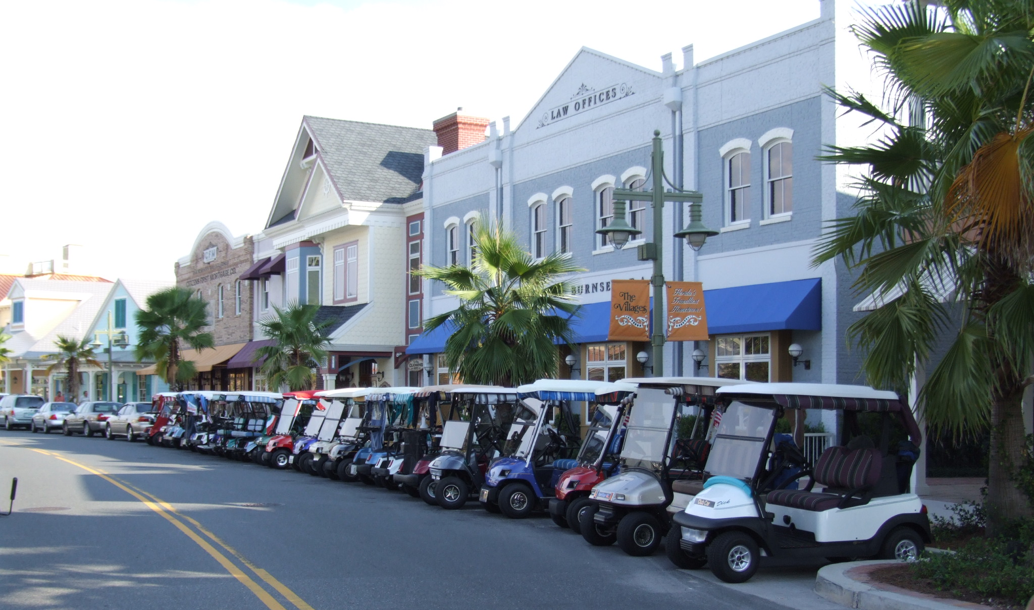
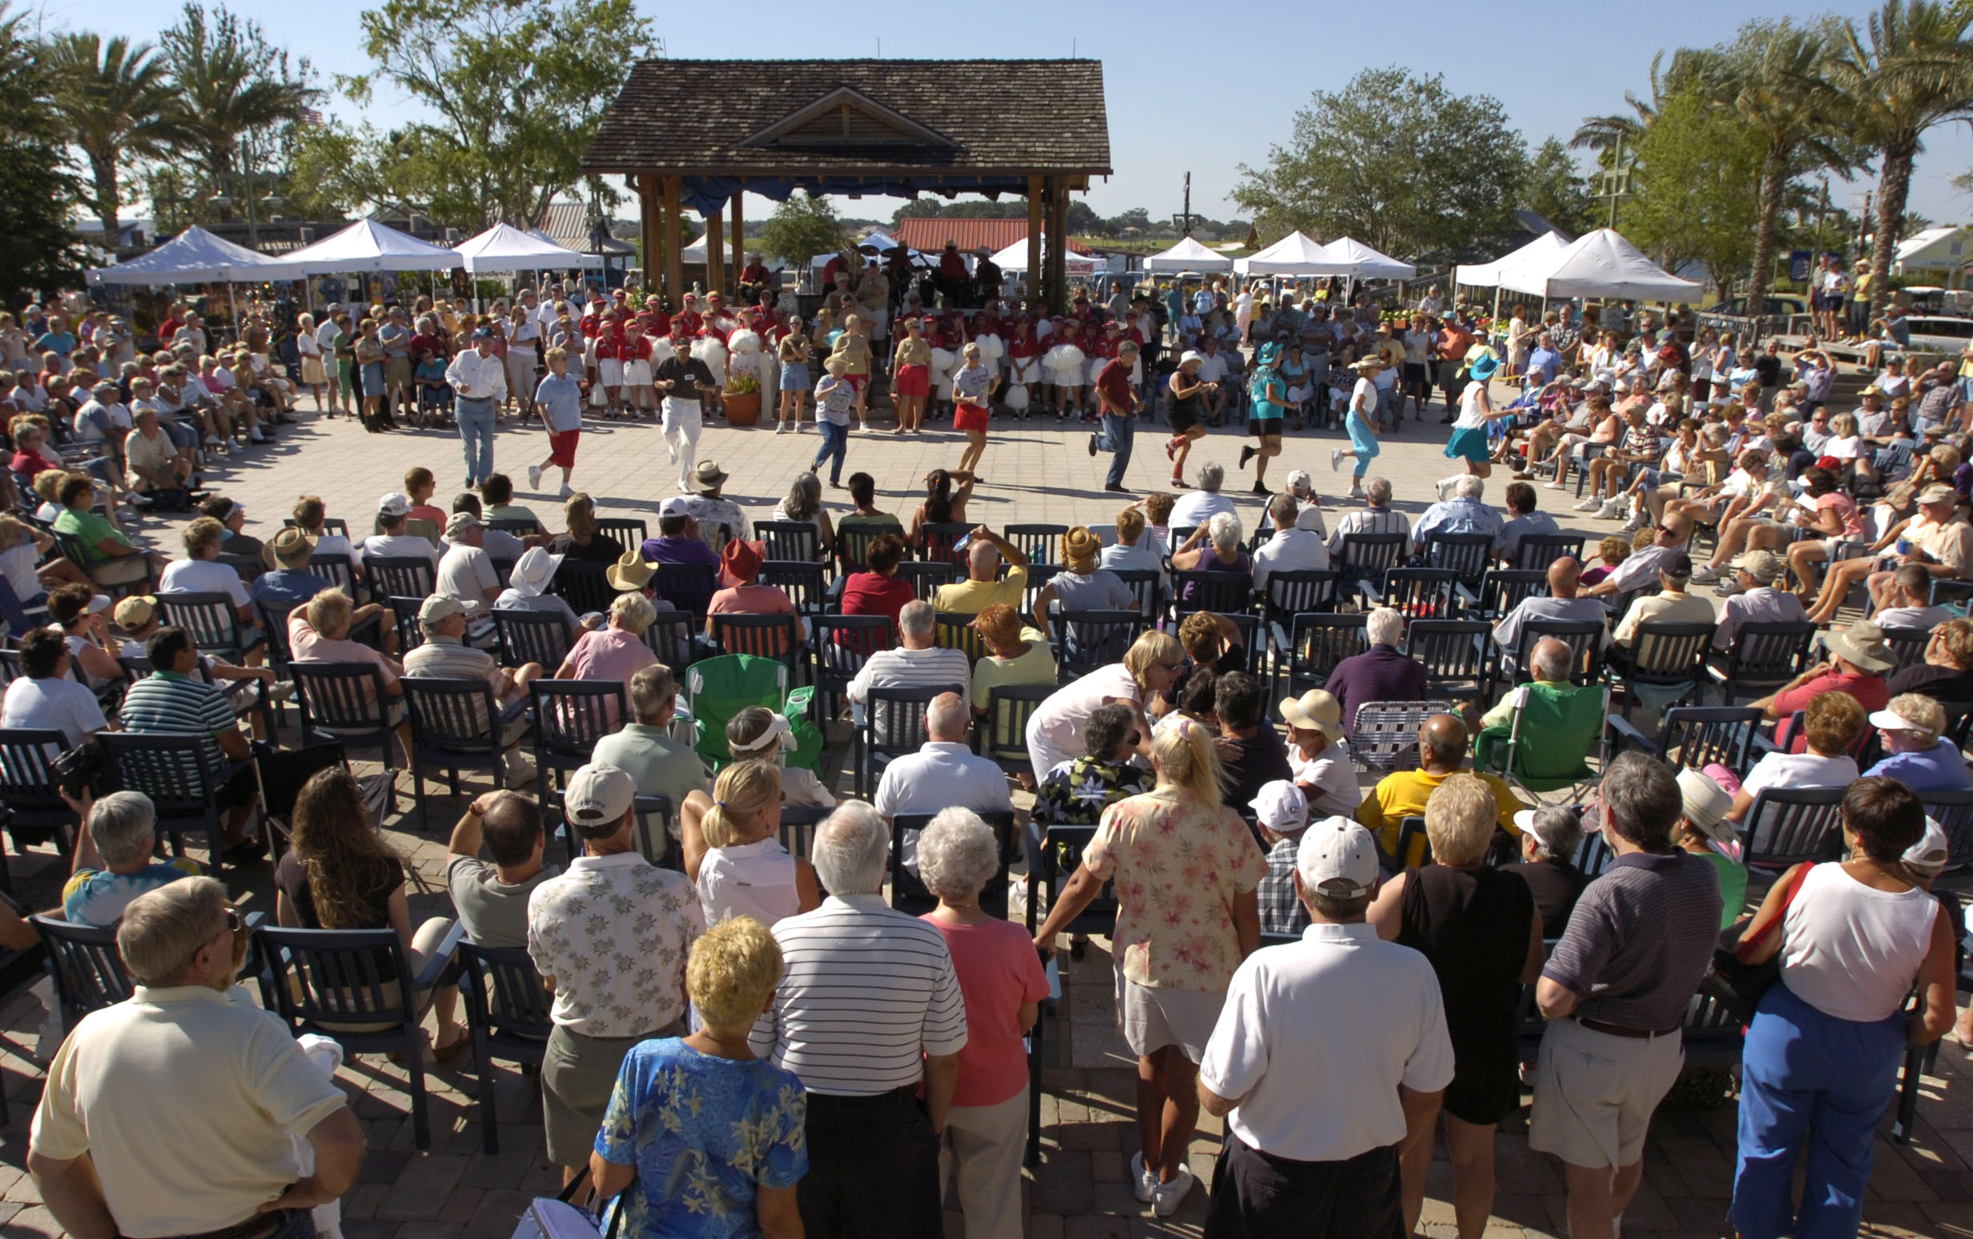
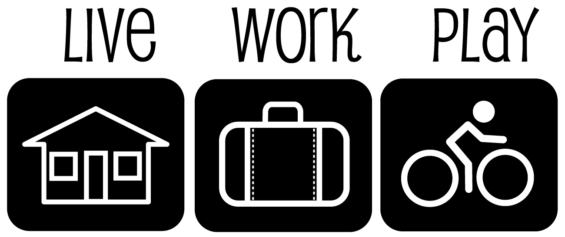
Example of Town Center: The Villages

Slide 7

















Attracting the Retailers

Slide 8
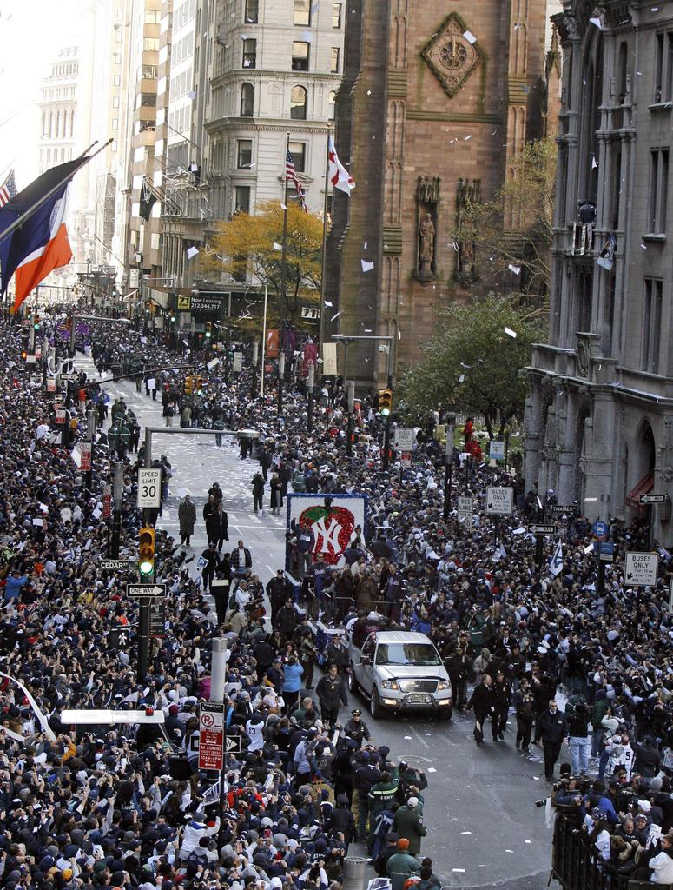

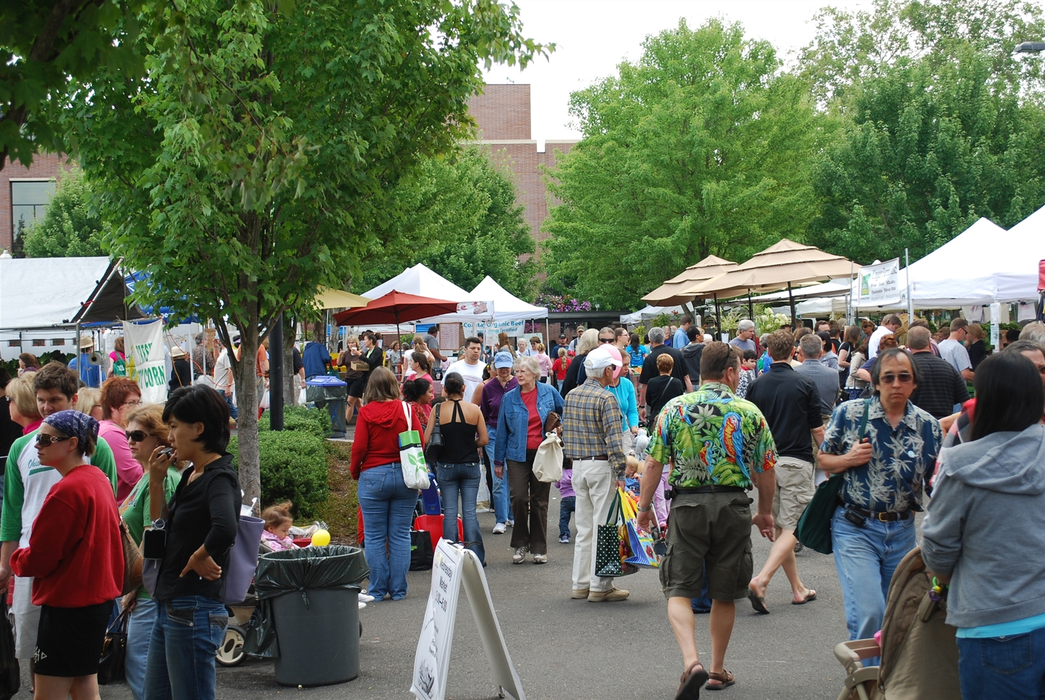
How do Downtowns ensure retail success?
Healthy sales
Customer loyalty
Traffic Drivers

Slide 9
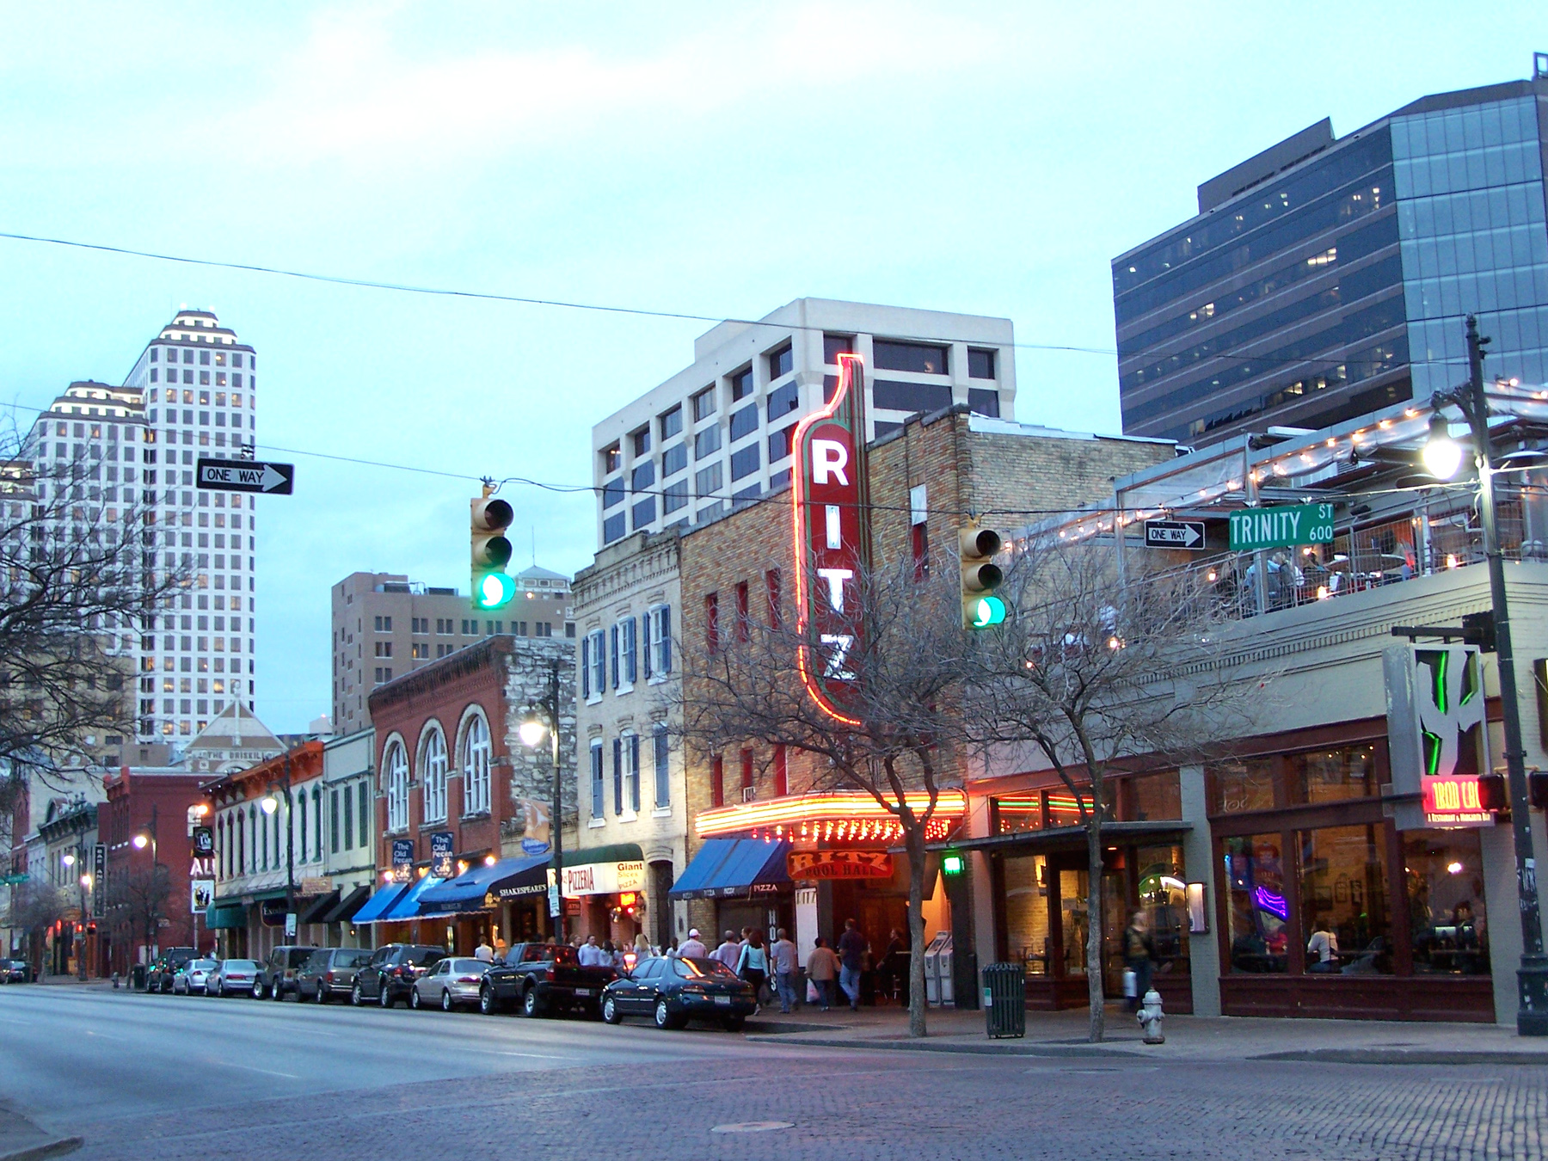
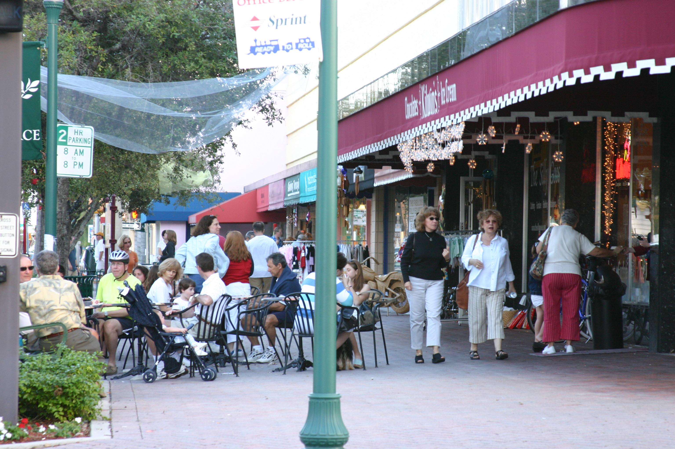
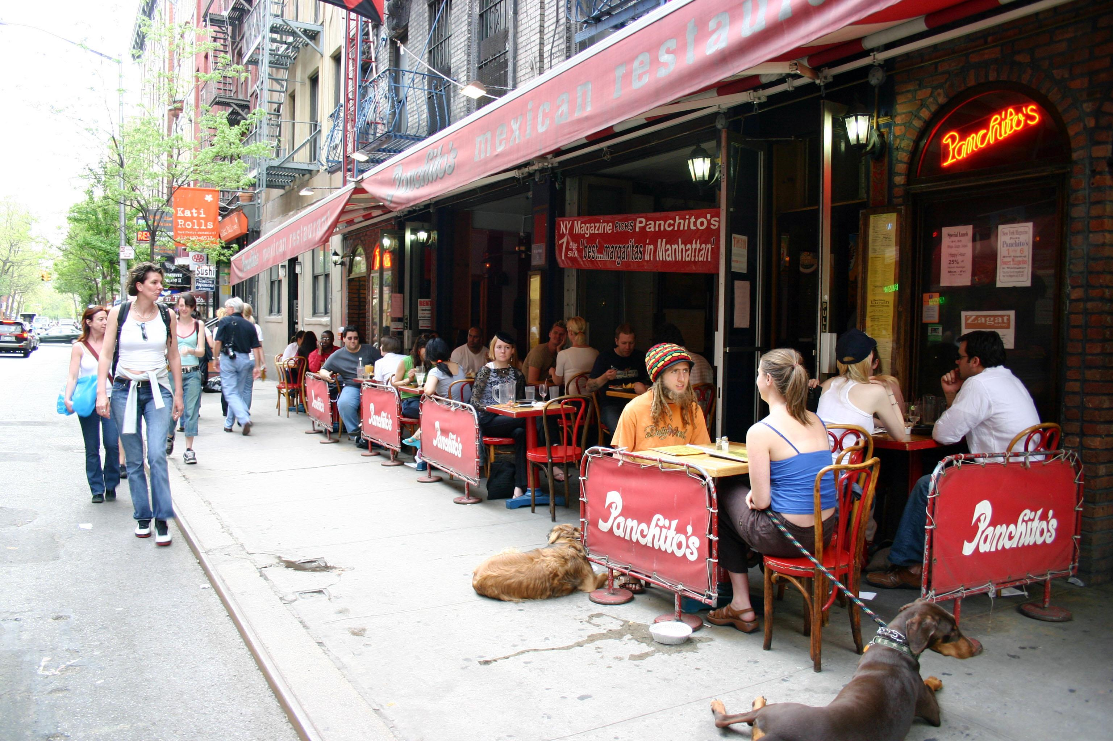

Slide 10

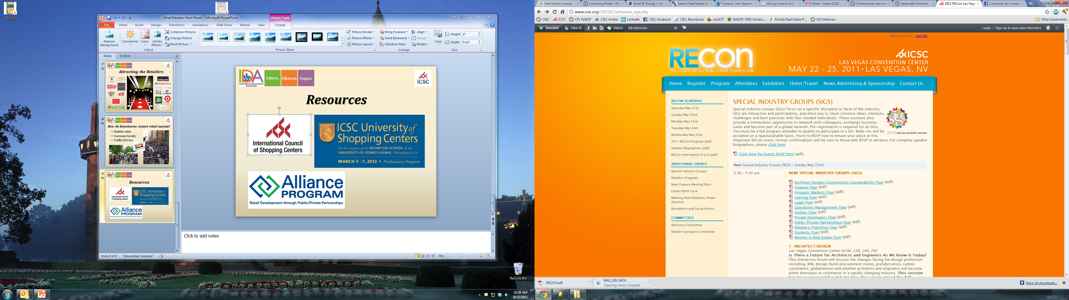

Resources

