Slide 1
Public Market Characteristics
Daily Year-Round Indoor Variety of Owner Operated Businesses
Features Fresh, Value Added and Prepared Foods
Outdoor Farmers Market Component
Focus on Locally Owned and Operated Businesses
Venue for Social Interaction
Showcases Best of Local Foods, Arts, Crafts and Heritage
Permanent Facility for Local Farm Product Sales
Tourist Attraction- Prefer to Shop Where Locals Shop
Business Incubator- Low Start-up Cost, Short Term Leases
Proven Economic Development Engine

Slide 2
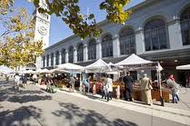
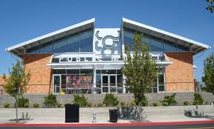
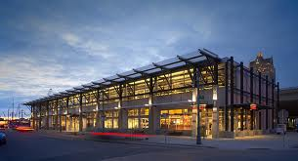
Public Market Exteriors
Ferry Building, San Francisco
Milwaukee Public Market
Oxbow Market, Napa, CA.

Slide 3
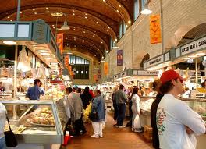
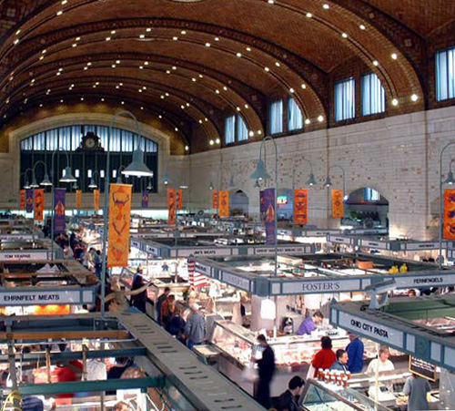
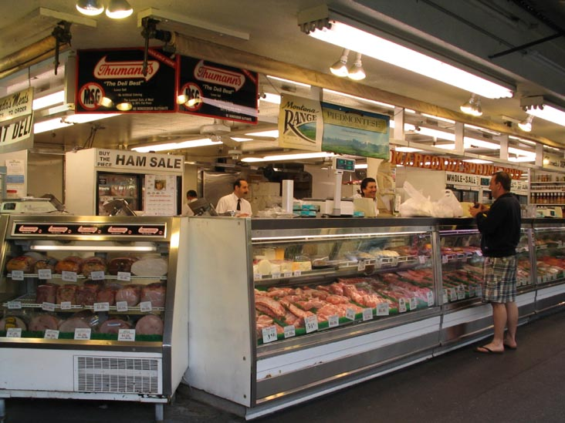
Public Market Interiors

Slide 4
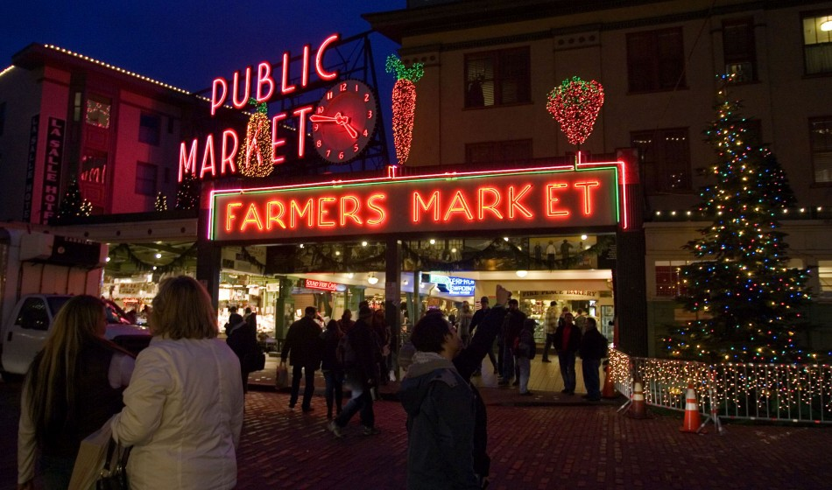
Public Market Components
Market Hall
Indoor/Outdoor Market
Seasonal Outdoor Market
Market District- All Components

Slide 5
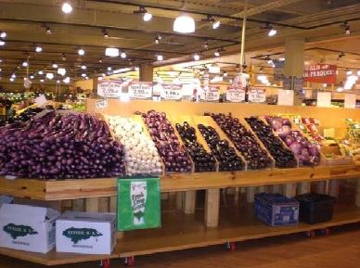
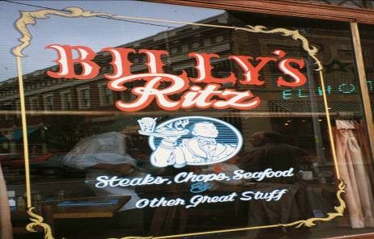
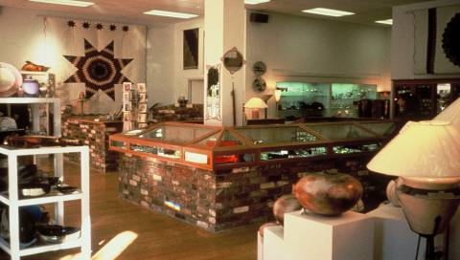
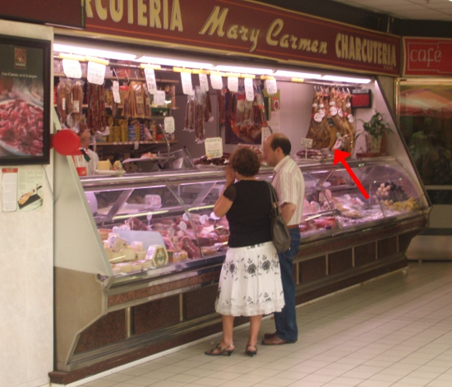
Public Market Business Types
Fresh Foods
Restaurants
Arts and Crafts
Neighborhood Shops

Slide 6
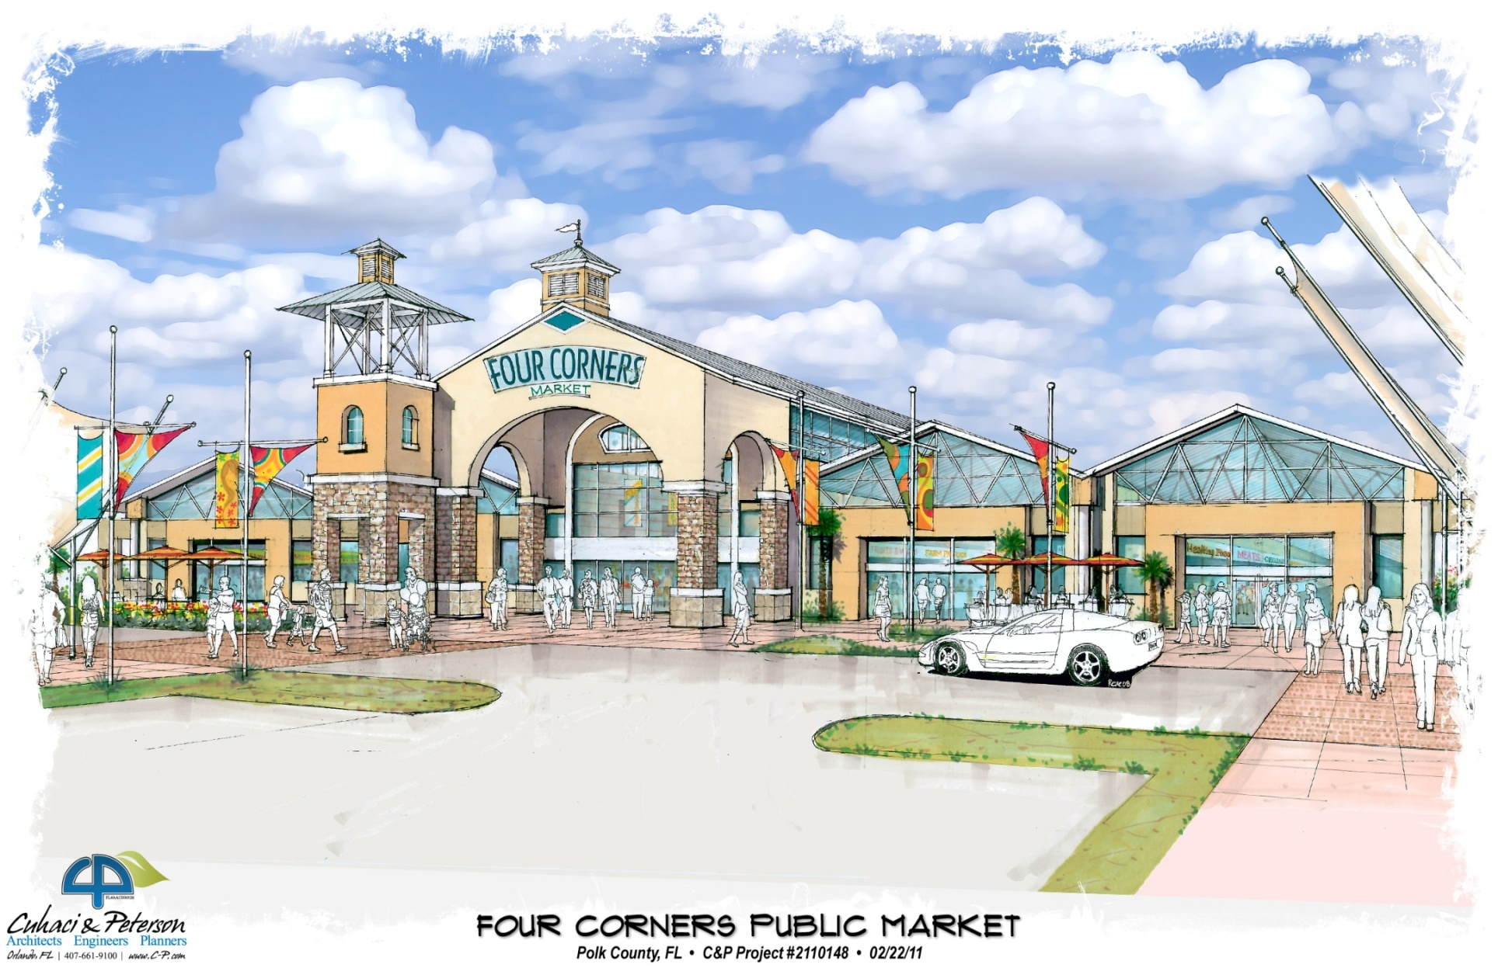
_{Exterior Rendering}

Slide 7
FLORIDA FOOD SAFETY
SMALL FARM EXEMPTION
KILLED IN COMMITTEE
NO SMALL BATCH LAW
SMALL FARMER
HELD TO SAME STANDARDS
AS LARGEST PRODUCER
COMMERCIAL KITCHEN REQUIRED

Slide 8
FEDERAL FOOD SAFETY MODERNIZATION ACT – DECEMBER 2010
TESTER HAGEN ADMENDMENT
IF FARM
1. GROSSES LESS THAN $500,000 A YEAR OVER THREE YEARS
2. SELLS MAJORITY OF PRODUCTS DIRECTLY TO CONSUMERS,
RESTAURANTS OR GROCERY STORES IN SAME STATE OR
WITHIN 275 MILES
THEN:
EXEMPT FROM DEVELOPING A FOOD SAFETY PLAN,
EXTENSIVE RECORD KEEPING AND COMPLYING WITH NEW FDA RULES

