Slide 1
Florida City CRA Acquisition and Demolition Program

Slide 2
Acquisition Plans
The CRA has adopted four area specific acquisition plans, one for the Snake Pit, one for the NW 9th Place Area, one for NW 8th Avenue, and one for the NW 6th Avenue Area.
The CRA has also acquired several other scattered site parcels when it made sense to do so.

Slide 3
Acquisition Plans
The area plans detail appraisal standards and what properties would be acquired.
All acquisition plans as well as acquisitions have been approved by the CRA Board.

Slide 4
Acquisition Plans
All four area acquisition plans call for assembling a reasonable size plot that can later be used for redevelopment. No properties are being acquired for the purpose of land banking.

Slide 5
Demolition
All structures that are demolished are either owned by the CRA or they have been taken through the County Unsafe Structures Board process. Before demolition, all are inspected for the presence of asbestos.

Slide 6
Demolition
Thru September 30, 2011, the CRA has demolished eleven structures through the County Unsafe Structures Board process and has demolished fourteen structures after first acquiring them.

Slide 7
Relocation
To date, it has not been necessary to pay displacement or relocation expenses. A few structures had squatters in them, but none had legal tenants or owners.

Slide 8
Unsafe Structure Board Process
1514 NW 7th Avenue

Slide 9
Unsafe Structure Board Process
1520 NW 7th Avenue

Slide 10
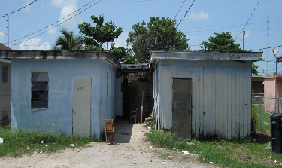
CRA Acquisition and Demolition Process
530-532 NW 15th Street

Slide 11
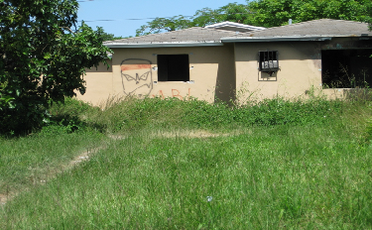
CRA Acquisition and Demolition Process
1434 NW 7th Ct

Slide 12
CRA Acquisition and Demolition Process
1505 NW 7th Avenue

Slide 13
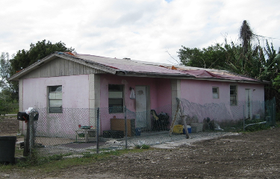
CRA Acquisition and Demolition Process
1506 NW 7th Avenue

Slide 14
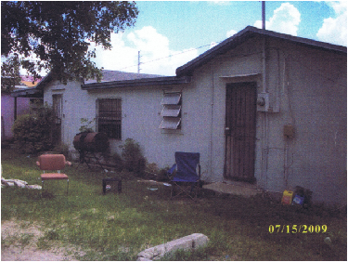
CRA Acquisition and Demolition Process
1502 NW 7th Avenue

Slide 15
CRA Acquisition and Demolition Process
1508 NW 7th Avenue

Slide 16
CRA Acquisition and Demolition Process
639 Lucy Street

Slide 17
CRA Acquisition and Demolition Process
717 Lucy Street

Slide 18
CRA Acquisition and Demolition Process
1509 NW 7th Ct

Slide 19
Demolition
The CRA just completed a contract for the demolition of 11 structures on 9 parcels. The demolitions were bid out and the winning bidder was US Wrecking and Clearance, Inc. Three of the structures are owned by the CRA and 8 of the structures are being demolished based on an order from the County Unsafe Structures Board.

Slide 20
Unsafe Structure Board Process
1226 NW 6th Avenue

Slide 21
Unsafe Structure Board Process
1332 NW 6th Avenue

Slide 22
Unsafe Structure Board Process
925 NW 15th St

Slide 23
Unsafe Structure Board Process
943 NW 15th St

Slide 24
Unsafe Structure Board Process
873 NW 9th Ave

Slide 25
Unsafe Structure Board Process
1332 NW 9th Place

Slide 26
CRA Acquisition and Demolition Process
1511 NW 7th Avenue

Slide 27
CRA Acquisition and Demolition Process
1511 NW 7th Court

Slide 28
CRA Acquisition and Demolition Process
1507 NW 7 Court

Slide 29
CRA Acquisition and Demolition Process
875 NW 12th Street

Slide 30
Demolition
The CRA is preparing to take additional structures to the County Unsafe Structures Board in before the end of 2011.

Slide 31
Unsafe Structure Board Process
998 NW 12th St

Slide 32
Unsafe Structure Board Process
Rear of 1226 NW 6th Ave

Slide 33
Unsafe Structure Board Process
Rear of 1332 NW 6th Ave

Slide 34
Unsafe Structure Board Process
1515 NW 7th Ct

Slide 35
Demolition
There are other structures in the CR Area that also need to be demolished. They will be taken to the County Unsafe Structures Board over the next 12 months.

Slide 36
Unsafe Structure Board Process

Slide 37
Unsafe Structure Board Process

Slide 38
Unsafe Structure Board Process

Slide 39
Unsafe Structure Board Process

Slide 40
Unsafe Structure Board Process

Slide 41
Unsafe Structure Board Process

Slide 42
Unsafe Structure Board Process

Slide 43
Unsafe Structure Board Process

Slide 44
Unsafe Structure Board Process

Slide 45
Unsafe Structure Board Process

Slide 46
Unsafe Structure Board Process

Slide 47
NW 9th Street Clearance Project
The NW 9th Street area was the worst drug infested, blighted part of the City in 2007. The City stepped up Code Enforcement action against the slum lords, and they finally yelled “UNCLE.”

Slide 48
The City approved a greater density allowance of 20 units per acre and a developer bought out the slum lord owners and demolished all the structures. The City abandoned the NW 9th Street right-of-way to the Developer.

Slide 61
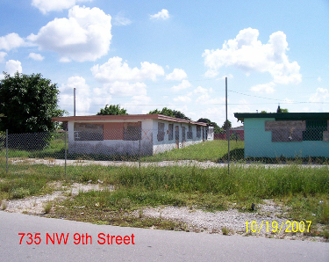

Slide 62
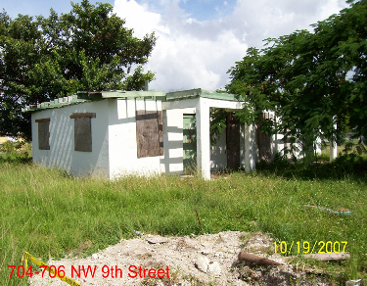

Slide 63
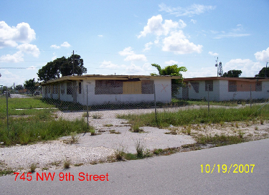

Slide 64
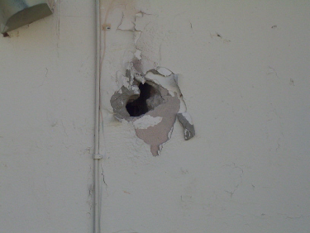

Slide 65
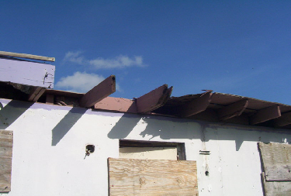

Slide 66
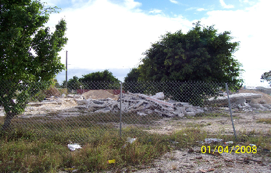
All Gone

Slide 67
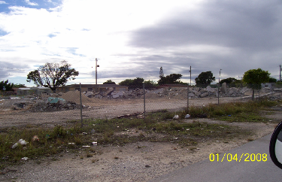
All Gone

Slide 68
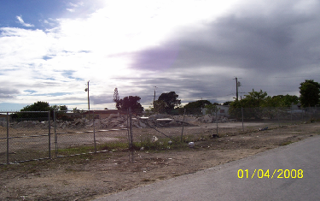
All Gone

Slide 69
And what replaced the dilapidated slum housing on NW 9th Street?
Pinnacle Housing Group just completed a tax credit 80 unit multi-family project there named “Orchid Grove”.

Slide 70
The New Orchid Grove

